Slide 1
REC ISSues group
13 July 2023

Slide 2
1. Introduction and agreement of agenda
Shelley rouse

Slide 3
Agenda For today
 | TITLE | TIME | LEAD
1 | Introductions and Agreement of Agenda | 10.00 | Chair
2 | Data Cleanse Update | 10.05 | REC Performance Assurance Team
3 | Data Issue RIG Issues Update – Issue 18 We submit ONJOB and ONPUD files monthly through the portal to Performance Assurance and as an IGT constituency we hoped this information could be used in some way to assist with the number of meter details not being accepted from the supplier. | 10.20 | Lead Analyst
4 | Update on P1 Switching incident | 10.40 | REC Performance Assurance Team
5 | REC Switching Service Management schedule review - | 11.00 | REC Performance Assurance Team
6 | Guidance on REC Requirements for Annulments and Objections | 11.10 | REC Performance Assurance Team
7 | Change Plan and Change Improvements Project | 11.40 | REC Change Team
8 | RIG Issues Update – Issue 17 New Connections - delays identified between agreeing supply contact with consumers in new builds and connection of these to the network | 12.00 | Lead Analyst
9 | AOB | 12.05 | All
 | Gas Supply Disconnection Process
 | Domestic Premise Indicator View In The Electricity Enquiry Service Portal

Slide 4
2. Data cleanse update
REC performance assurance team

Slide 5
Report AR3F
The following update was provided in the REC Weekly Bulletin issued on the 7 July:
Please note that Report AR3F will not be produced this month following an issue being identified with the Population of the Domestic Premise Indicator (DPI) within the source data used to produce the report, as discussed at prior REC Issues Group (RIG) meetings. Publication of the report will recommence following resolution.
If you do not receive the Weekly Bulletin, please sign up by contacting the REC Service Desk or by using the live chat.

Slide 6
Smart Meter Type/MTC Mismatch report
The issue of MTC mismatch for smart meters was first raised in February 2020 through the MRA IREG.
It was then brought through into the DWG in March 2020, and the production of this report was agreed as industry believed it posed issues for switching.
The requirement for smart meters to be set with a credit MTC was originally stated within the MRA DTC Annex C document. This document was moved under the REC and can now be found on EMAR as the ‘Legacy DTC Annex C’.
On transition, it was agreed the report would continue to be produced under the REC Code Manager arrangements.
Feedback has been received from Parties in recent months as to whether this issue still poses any negative impact.
We are seeking the views of RIG members on this matter.

Slide 7
NO METER MTC Report
Feedback has been received on the ‘MSN’ version of the No Meter MTC report – flagging instances where an MSN is present, but the MTC is 800.
A Party questioned whether this was still a requirement, and whether it resulted in any negative outcome for Parties or Consumers.
Again, on transition, it was agreed the report would continue to be produced under the REC Code Manager arrangements.
It was later requested that the No Meter MTC report was split into the two versions in place today.
We are seeking the views of RIG members on this matter.

Slide 8
Data Cleanse ReSULTS UPDATE
LEWIS WILLIAMS & Andrew Waghorn

Slide 9
3. DATA ISSUE
IssuE 18
MOnthly ONJOB and ONPUD submissions and meter details
LEWIS WILLIAMS

Slide 10
Issue 18
'We submit ONJOB and ONPUD files monthly through the portal to Performance Assurance and as an IGT constituency we hoped this information could be used in some way to assist with the number of meter details not being accepted from the supplier'

Slide 11
4. P1 switching incident
Anton moden

Slide 12
5. REC Switching service management schedule review – stakeholder engagement
Anton moden

Slide 13
6. Guidance on REC Requirements for Annulments and Objections
Amy Crowe-Lamont and Vaishnavi Sharma

Slide 14
Performance Assurance Risk Monitoring
REC Schedule 23 lists requirements for Suppliers in relation to the Annulments and Objections processes.
The Code Manager monitors the rate of use of Annulments and Objections as a part of the Performance Assurance risk monitoring and reporting to the Performance Assurance Board (PAB).
Earlier in the year, the Code Manager noted an increase in the volume of Objections despite the volume of switching remaining low. We also noted some Parties had high use of Annulments while they were not using Objections at all.
The Code Manager has also received allegations where some Parties may not be meeting their REC obligations for these processes.
To understand the cause for the spike, and to ensure Objections and Annulments were being in line with the Code, the Code Manager issued Request for Clarification (RFC) PATs.
This made it clear that Parties did not consistently understand which process to use when. To help Parties understand the Code we are providing guidance to clarify when to appropriately use Objections and Annulments within the Code and have also raised a Code change to make the Code much clearer .
This has really validated our RFC approach – where we are open to understanding the underlying cause, and do not assume the issue is caused by the Party.
We would like to test this guidance with RIG before circulating it to all Parties.

Slide 15
REC requirements for Annulments
When is it appropriate to use Annulments?
REC Schedule 23, 10.1: ‘A Losing Supplier must only submit an Annulment Request in respect of a Registration where the Losing Supplier is permitted to do so in accordance with its Energy Supply Licence.’
Standard Licence Conditions for Electricity and Gas Suppliers, Condition 14.2(d) & 14.4 (c) allows the use of Annulments where: ‘the Customer informs the licensee that they have not entered into a Contract with the proposed new Electricity/Gas Supplier and asks the licensee to prevent the Proposed Supplier Transfer from taking place.’
In summary: Annulments can only be used when a customer tells their existing supplier that they have not signed a new contract with a different supplier.

Slide 16
REC requirements for Annulments
Evidence retention requirements:
REC Schedule 23, 10.2: ‘A Losing Supplier which submits an Annulment Request must retain (for at least 1 year) evidence of the reason for the Annulment Request.
Standard Licence Conditions for Electricity and Gas Suppliers, Condition 14.10 requires: ‘If sub-paragraph 14.2(d) or 14.4(c) applies and the licensee has agreed to prevent a Proposed Supplier Transfer at the Domestic Customer’s or Non Domestic Customer’s request, the licensee must keep evidence of that request and of the reasons for it for at least 12 months after the request is made.’
Please note that the Code Manager may request this evidence to validate the appropriateness of the Annulment.

Slide 17
REC requirements for Objections
When is it appropriate to use Objections?
REC Schedule 23, 6.1: ‘A Losing Supplier may only raise an Objection where it is permitted to do so in accordance with its Energy Supply Licence.’
Standard Licence Conditions for Electricity and Gas Suppliers, Condition 14.2(a) allows the use of Objections where for a Non-Domestic Customer: ‘the licensee’s Contract with that customer for the supply of Electricity/Gas to the premises includes a term which allows the licensee to prevent the Proposed Supplier Transfer; and may be relied upon in the circumstances arising at that time’
In summary: Objections can only be used when:
the Losing Supplier has a contract with a customer, the terms of which allows them to object; or
the customer has outstanding charges that do not relate to a dispute or a failure of Losing Supplier to take appropriate action, and cannot be transferred to the Gaining Supplier under the Debt Assignment Protocol.
Standard Licence Conditions for Electricity and Gas Suppliers, Condition 14.4 (a) allows the use of Objections where for a Domestic Customers: ‘subject to paragraphs 14.5 and 14.7, if at the time the request is made Outstanding Charges are due to the licensee from that Domestic Customer’

Slide 18
REC requirements for OBjections
Evidence retention requirements:
REC Schedule 23, 6.3: ‘Where a Losing Supplier raises an Objection to a Pending Registration which has been identified by the Gaining Supplier as relating to a Change of Occupier, the Losing Supplier shall keep (for at least 1 year) a record of the evidence relied upon by the Losing Supplier to justify that it has raised the Objection in accordance with its Energy Supply Licence.’
Please note that the Code Manager may request this evidence to validate the appropriateness of the Objection.

Slide 19
7. Change Plan and change improvement project
REC change team

Slide 20
REC Changes
Change Plan:
  Progress current change proposals
  Task Force established and changes reviewed
  Hold Special RIG’s dates:
    Changes to Legal text 24/7
    SDEP 18/8
Change Improvements Project: end to end review
  Change and Release simple, efficient, engaged and valued process
  Use of the right experts and engagement for the Issues, want parties to be more engaged and be more effective as a group
  Upcoming Stakeholder engagement sessions

Slide 21
8. RIG ISSUE NO.17
New connections – delays identified between agreeing supply contact with consumers and new builds and connection to network
REC lead analyst

Slide 22
aob

Slide 23
Gas Supply Disconnection process
Tom Stuart Wales and West Utilities

Slide 24
Domestic Premise Indicator view in the Electricity Enquiry Service portal
Sarah Mower – EES Service Provider

Slide 25
REC Changes

Slide 26
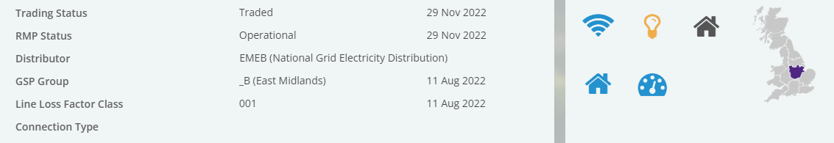
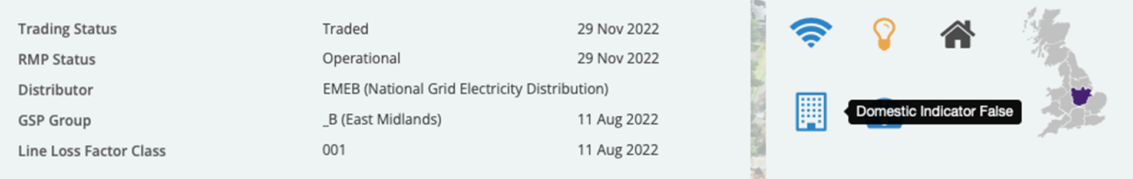
Domestic Premise Indicator view in the Electricity Enquiry Service portal
The EES sources the status of a property through the CSS DPI indicator. Where a CSS DPI has not been received, the status of the property is derived from the Profile Class and Measurement Class combination.
Currently under the Data Access Matrix, DNO’s are not permitted to view the CSS DPI indicator. Therefore, a DNO will not see a change on screen when the CSS DPI has updated the status as shown in this example:
Supplier view showing the house icon (domestic)
DNO View showing the factory icon (non-domestic)
If DNO’s were permitted to see the CSS DPI value via a change to the DAM, they would automatically see the latest DPI in the EES, helping to ensure suppliers and DNOs are seeing the same data at the same time.

Slide 27
Next meeting:
11 August 2023
Thanks for attending

