Slide 1
Consumer Consent Solution
Spotlight on UX
Solution Group
12/03/26

Slide 2
Agenda
Item | Lead | Approx Timing
Welcome & Intro | Mike Walsh | 5 mins
Recap from CCS Engagement Day | Matt White | 10 mins
Spotlight on UX | Liana Bakar | 45 mins
Forward Plan & Close | Mike Walsh | 5 mins

Slide 3
CCS Engagement Day recap

Slide 4
Spotlight on UX

Slide 5
Overview
What this session is
3 things we want
to leave you with
A chance to understand what's been consulted on and to shape what comes next
Shared understanding of the UX scope
Your questions surfaced and addressed
Your inputs captured before 25th March
What this session isn't
A detailed design review

Slide 6
What we’ll cover today
1 | Session overview
2 | What we’ve heard so far
3 | What we’ve submitted
4 | Where we are with consumer research
5 | Your turn: participatory input

Slide 7
What we’ve heard so far
Recap of key UX themes from CCS Engagement Day
1
2
3
4
5
Value exchange
Consent lifecycle
ID&V
Non-digital/assisted journeys
CEGs
What’s in it for consumers?
Revoking consent
Consent migration when an ATP/EDP is acquired or disbanded
Consent duration
Changing circumstances (moving house / switching supplier)
Realistic vs aspirational consumer behaviours
Types & fallbacks
What will the process be for those with Power of Attorney?
How will the digitally excluded be supported?
How prescriptive will these be?

Slide 8
What we've submitted

Slide 9
The approach to define the UX solution for CCS
Currently here
UX framework
User research
User journeys
CEGS
Purpose
Sets the foundation for
how consent should be experienced across the CCS
Ground UX standards in real consumer behaviour and risk, in collaboration with industry
Translate principles and research into concrete consent interactions
Enable consistent, trustworthy implementation across ATPs
Key outputs
CCS UX Framework
Design Principles applied to consent interactions
Defined scope of CCS UX application
Consumer needs and pain points
Validated design assumptions
Identified trust, comprehension and inclusion risks
Core consent lifecycle stages (Grant, Renew, Review, Revoke)
Expected consumer outcomes per stage
Consideration of guest and full account access models
Consumer Experience Guidelines
Minimum UX requirements and guardrails for CCS touchpoints
Key outcomes
Shared baseline for “good” consent experience
Reduced risk of fragmented or inconsistent journeys
Evidence-based UX standards
Proportionate expectations aligned to real consumer behaviour
Shared understanding of how CCS consent should work
Clear bridge from principles to implementation
Recognisable and consistent consent experiences
Greater consumer trust and reduced implementation ambiguity

Slide 10
Behavioural Archetypes
Behavioural patterns shaping how people engage with energy data and consent that will help us design for real behaviours
Overview
What they are
What they are not
The behavioural archetypes were developed using a combination of existing TGI* data and early qualitative research.
TGI (Target Group Index) data was used to identify broad, recurring patterns in consumer attitudes and behaviours related to energy use and data sharing, while the early research added contextual insight into how these behaviours play out in real consent and decision-making journeys.
Patterns of thinking, feeling, and decision-making
Shared motivations, barriers, and levels of confidence
Different ways people relate to energy data, control, and trust
Not demographic personas
Not fixed categories people permanently belong to
Not a prediction of individual behaviour
Their role in this project
Highlight potential usability and trust risks
Ensure CCS journeys work for a realistic range of behaviours
Help inform who we should be conducting research with to ensure a representation of needs
*TGI (Target Group Index), Kantar UK consumer attitudes and behaviour dataset

Slide 11
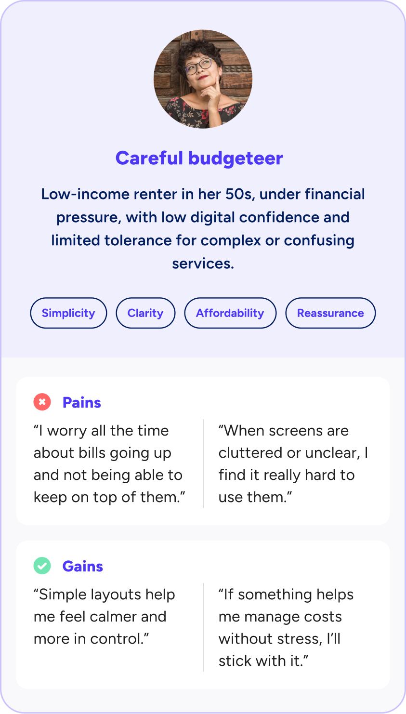
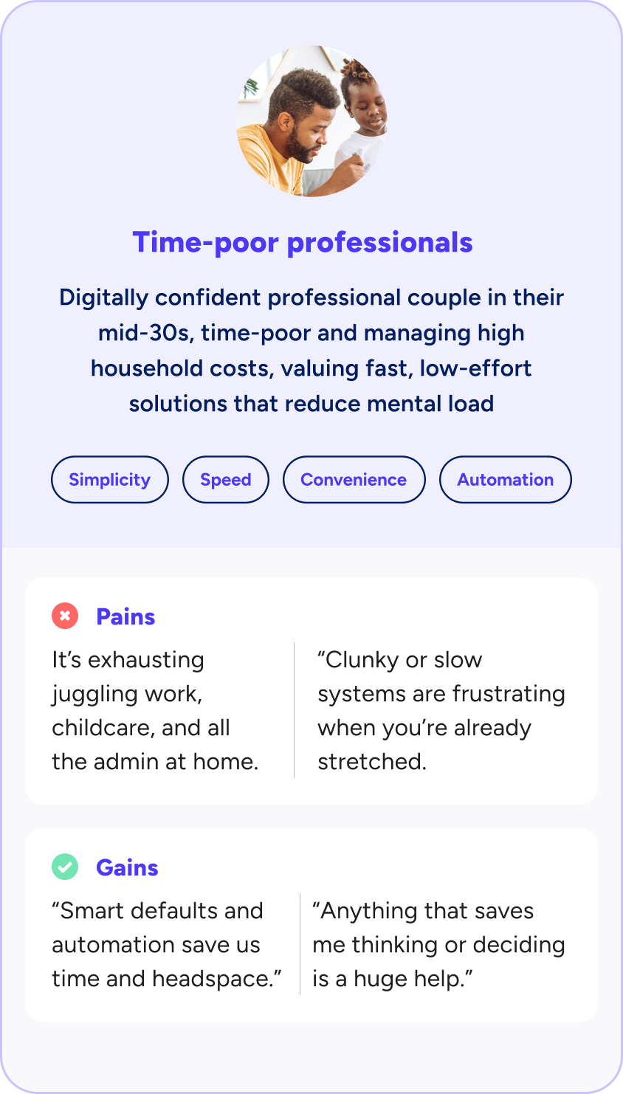
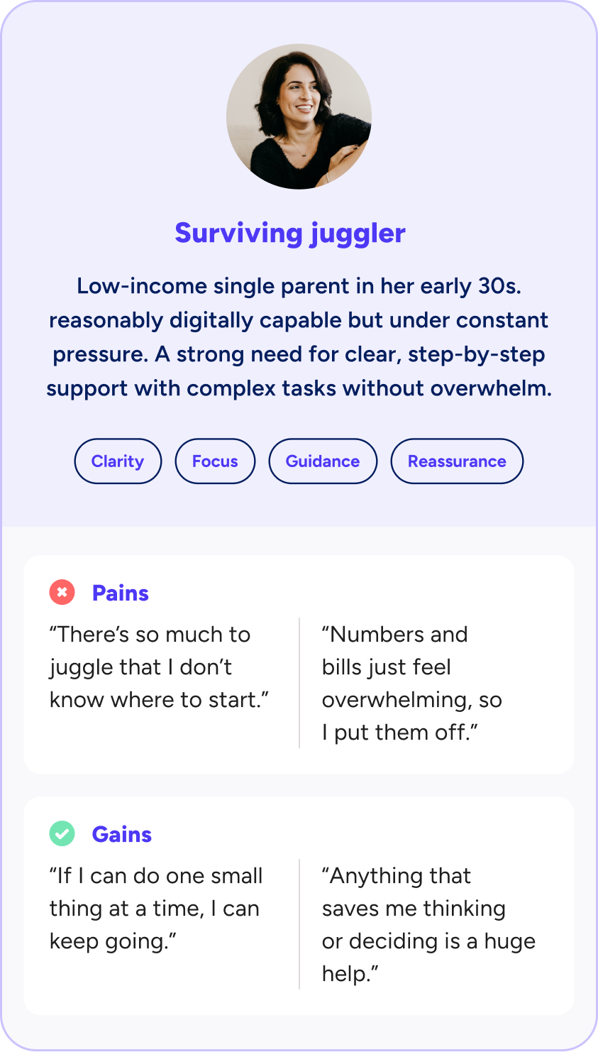
Behavioural archetypes
Identifying consumer needs

Slide 12
Identifying consumer needs
Behavioural archetypes (cont'd)
Archetype | Primary need | Risk if unmet | CEG implication
Comfortable data enthusiast | Speed and minimal friction; access to detailed data if desired | Frustration with over-simplified interfaces; journey abandonment | Progressive disclosure: essential information by default, with "show more" options for detail. No unnecessary confirmation steps for experienced users.
Careful budgeteer | Reassurance, clarity, and explicit confirmation that consent is safe | Anxiety-driven abandonment; distrust of the system | Clear trust signals (Ofgem branding, accreditation badges). Plain language throughout. Explicit "what happens next" confirmation screens.
Surviving juggler | Guided, step-by-step journeys; ability to pause and return | Errors in consent; unintended data sharing; disengagement from energy market benefits | "One thing per page" pattern. Mandatory save-and-return functionality. Extended session timeouts. Review screen before final submission.
Time-poor professionals | Speed; smart defaults; automation where possible | Abandonment if journey takes too long; resentment of unnecessary steps | Pre-populated fields where data is known. Clear indication of journey length. Option to batch-manage multiple consents.

Slide 13
Accessibility considerations apply to all archetypes
Rather than creating separate archetypes for specific accessibility needs, the research approach treats accessibility as a set of cross-cutting considerations that may apply to any behavioural archetype.
This approach reflects the reality that accessibility needs are often situational and overlapping.

Slide 14
Types of disabilities
Mental health
conditions
Physical disabilities: limitations in mobility, dexterity, or stamina
Sensory disabilities
e.g. sight, hearing,
or speech loss
Cognitive disabilities memory and/or processing conditions, e.g. dyscalculia
Functional impact
Example
Proposed design response
Anxiety triggers abandonment of consent journey.
Pop-up notifications about data sharing trigger an anxiety response, causing them to close the browser entirely.
Avoid overwhelming interfaces, reduce pop-ups, provide ability to save progress, offer offline alternatives.
Inability to complete time-limited actions; difficulty with precise touch/click targets; fatigues prevents completion in single session
A consumer with arthritis struggles to tap small checkboxes on a mobile device. Session timeouts expire while they rest their hands, forcing them to restart the consent process.
Larger user interface components and text, voice input options, reduced reliance on fine motor control
Exclusion from verification methods; inability to access visual or audio content; reliance on assistive technologies that may not be supported
A consumer with a visual disability cannot complete identity verification process by taking a photograph of their passport
Alternatives to telephone-based verification/Interactive Voice Response (IVR)
Forgetting where they are in a process; difficulty understanding complex consent language or comprehending numbers.
A consumer cannot retain information long enough to make an informed decision on the next screen. They “agree” without understanding what they have consented to.
Simplified navigation, contrast adjustments, ability to pause without losing progress.
Source: https://www.w3.org/WAI/fundamentals/accessibility-intro/

Slide 15
CCS
Journey
map overview
Notes:
"The full consent lifecycle — Grant, Renew, Review, Revoke
Most of you will have seen this live last week or during a conversation with us, but you can find it in the consultation if you want to go through it
We are going through your feedback and also starting research next week, where we will present this to consumers while continuing our benchmarking research. This will lead to further iterations of the journey.

Slide 16


Customer Experience Guidelines (CEGs)
What they are
What they are not
Why they are important
Guardrails and compliance-ready checklists to translate UX intent into consistent implementation across the CCS ecosystem
Do not dictate ATP channel strategies, service models or branding
Ensure that consumers encounter a clear, accessible and recognisable consent experience that protects their data, while simplifying ATP compliance and interoperability

Slide 17
CEG direction:
minimum UX expectations
Informed consent
Identity verification
Consent interactions
Consent must be straightforward: clear who is asking, what they want, and why
Plain English throughout; concise by default, with more detail available on request
Proportionate friction: enough to support informed decision-making without overwhelming
ID&V is required at key points: consumers must understand why and how it protects them
Clear guidance on when re-verification is needed vs. when existing verification applies
Guest journeys must be equally simple and predictable, with the same level of identity assurance
Clear narrative at each stage: purpose of the action, consequences of proceeding or not, and any relevant timeframes
Avoid lists of data fields, legal terms, or technical descriptions unless strictly necessary
Aim: genuine comprehension and consumer confidence at every stage

Slide 18
Consumer research update

Slide 19
Where we are with consumer research
FEBRUARY
MARCH
APRIL
MAY
RECRUITMENT
WAVE 1
NEEDS-BASED TESTING
WAVE 2
NEEDS-BASED
& USABILITY TESTING
WAVE 3
USABILITY TESTING
Purpose: Establish baseline needs, attitudes and risks
Purpose: Test emerging journeys informed by tech solution, address risks identified in Wave 1
Purpose: Build confidence that the solution works for users incl. access needs
Plan:
16 needs-based interviews
Accessibility needs: cognitive, mental health, neurodiversity
Plan:
12 interviews, half needs-based, half usability
Accessibility needs: sensory (visual, hearing)
Plan:
12 interviews, half needs-based, half usability
Accessibility needs: sensory (visual, hearing)
Evidence will replace assumptions — the archetypes, CEG direction,
and journey design will evolve as the waves complete
Notes:
Split into 3 waves
Foundational: needs, attitudes, motivations
Usability: to test whether people are able to use the solution and understand it
Will use a behavioural science lens (COM-B)
Accessibility throughout – starting with cognitive, then visual, hearing once we have a built prototype that works with screen readers
We will be sharing key findings with this group once the research is complete

Slide 20
Your turn

Slide 21
We want to hear from you
3 mins silent writing, 5-10mins to share
Something you’d
like clarified
Something you think we've got right
Something you'd push back on

Slide 22
Forward Plan

Slide 23
Forward Plan
CCS Central Working/Webinar Groups:
Date | Agenda
15th January 2026 ✅ | Quarterly Review & Plan – key headlines Preparation for CCS consultation, including roadmap focus and design principles position update
16th April 2026 | Quarterly Review & Plan – key headlines Technical partner procurement update REC Change Proposal update
CCS Topic Specific Solution Groups:
Date | Agenda
29th January 2026 ✅ | Issue and Error resolution, consumer journey clarifications
12th February 2026 ✅ | CCS Design Consultation – Spotlight on governance
26th February 2026 ✅ | CCS Design Consultation – Spotlight on technology
12th March 2026 ✅ | CCS Design Consultation – Spotlight on user experience
26th March 2026 ✅ | Generalised update - inc. emerging themes from consultation
9th April 2026 | Focus topic- to be confirmed
23rd April 2026 | Focus topic- to be confirmed
From late April | Sessions to continue a fortnightly basis, with focus topics to be confirmed

Slide 24
Consumer Consent Solution Engagement Day
Join us in London on 4 March 2026
We’re hosting an in-person Consumer Consent Solution Engagement Day, bringing together industry, policy, technical, and consumer voices during the CCS Solution Design Consultation.
What you’ll get from the day
You’ll leave with:
A clear understanding of the Consumer Consent Solution design proposals
The confidence to engage with the Design Consultation (and respond efficiently)
A stronger footing to collaborate with RECCo on a robust, consumer-centric solution
Who should attend
This is a working session, not a presentation-only event. It’s for anyone with an interest in consumer consent, data sharing, flexibility, or retail market design, including suppliers, service providers, consumer organisations, technology providers, and policy stakeholders.
There’s built-in time to meet peers across the market, with breakfast, lunch, and refreshments included, and networking drinks after the event.
Register for your complimentary place

Slide 25
Appendix

Slide 26
Consumer Consent Project Team
Pete Davies
Executive Sponsor
Tracy Hardy
SRO
Project SME's
Ray Newton
Commercial
Michael Walsh
Project Manager
Vicky Brown
PMO
Matt White
Product Owner
Alison Nickson
InfoSec & Data Protection
Teresa Thompson​
Stakeholder
Engagement Mgr
Nathan Gould​​
Enterprise Architect​​
George Roberts
Technical Architect
Hemant Mistry
UX Lead
Sarah Jones
Regulatory Compliance
Eva Von-Schaxmann
Business Analyst
Ann Perry
Market Design Lead
CoCo
Commercial Lead
📩 Reach us at: consumerconsent@retailenergycode.co.uk
N.B: Names & roles provided for transparency; not all roles are assigned 100% to CCS

Slide 27
Audience responses from "Something you'd like clarified" (1/3)
Number | Question | Response
1 | What is your approach to ensuring that consent is appropriately terminated where necessary (with the understanding that consumers won’t necessarily know to revoke it at the time necessary)? | MW: ATPs, once they become aware that the consent is no longer valid, will be required to inform consumer consent through the technical mechanisms. The centralised element of the CCS will give the ability for a consumer to update the record should they choose to. And we'll also have the requirement, well, the assumed position at the moment is that AT, sorry, EDPs, energy data providers, will introspect the token each time that they look to share data. Therefore, as soon as the token is revoked, the token will be updated and therefore the next time it's introspected, it will be no longer valid. Therefore, energy data holders should stop showing the data. And also there will be principled notifications when the tokens update as well. We'll be looking over time to improve that, to look at bringing in event triggers around when we know that some of this happens, change of tendency is often one that's discussed. So we'll be looking to kind of augment that. over time in future to make it even more accurate. Obviously, consumers updating their ATPs when they are no longer needing the services because they've moved address is probably going to be the primary route to start with. But yeah, there'll be, we'll need to obviously increase the accuracy of that over time and through iterations of the service to bring in new and more kind of data-driven aspects to help manage that over time.
2 | [I'd like to get] a sense of when a consumer opens this portal, what data are they seeing and indeed what data is missing or not being shown to them about various consents or indeed just other data access because it's not just conservative data access, it's same data access. | MW: That's probably the next level of detail that we'll be working to over the coming weeks and months. There's obviously going to need to be a specification of the type of data and what is going to be visible and viewable to the consumer. As we get more clarity on that, we'll make sure to bring it back to the working group.
3 | Will you have any requirements for how ATPs communicate data use purposes to users? Consent to provide a service directly to me is very different to consent for my data to be shared onwards for example | N/A
4 | Am I right in understanding that RECCo will be assessing all GDPR/UX aspects of the consent journey but that this will be completely customisable by users | MW: GDPR and UX will be assessed through our assurance model, which will be proportionate to the data being accessed and the organisation. More information on our assurance approach is in the consultation, under the Governance section. CCS users will have control over their own journeys. However, the CCS stage will be managed in accordance with the CEGs.

Slide 28
Audience responses from "Something you'd like clarified" (2/3)
Number | Question | Response
5 | The Consent Lifecycle doesn’t appear to provide an end-to-end solution, particularly in respect of Article 7 of UK GDPR. Do CCS envisage the ATP/EDP filling the gap? | MW: We are currently in the procurement of our technology and are assessing GDPR compliance. We will update the working group in due time. However, we are confident that our end-to-end solution will address Art. 7 of UK GDPR
6 | How long does each customer consent remain valid once it has been provided? | MW: Our interpretation of how long is based on based on GDPR, and what the protection legislation says we will have essentially two different durations of consent. One will be one off, essentially, so the data is accessed and utilised in a singular transaction. The other one will be time-bound, and will need to be somewhat flexible. There is no principle under GDPR where consent can be given on an unlimited basis: it has to have an element of a time-bound nature.
7 | What about journeys for people with low English literacy? or the need for languages other than English/Welsh? I am assuming the CCS would be available in English and Welsh? What about other languages? | AB: For consumers with low English literacy, this is something that we will be testing for in research: what can help consumers with low English literacy; what do they currently do if they have low English literacy for other solutions; what helps them? MW: In terms of the CCS being available in different languages, [RECCo] want to make sure we understand what capabilities the underpinning technology has the capabilities to do, and how that can be leveraged to support multiple languages. For MMP, [we] make the assumption it will be English-only.
8 | Are we providing multiple ways for ID&V? Are we including options like users needing to enter a code sent via email or SMS? | MW: Yes, the intention is to attempt to try to provide multiple ways for ID&V. This will be very much dependent on the tech solution and [its] capabilities. And we'll build that up over time. We are looking at multi-factor authentication as well as to whether that's appropriate, is it appropriate for all journeys, some journeys, new journeys.
9 | How will this be communicated to customers? | MW: Our approach to MMP will be customer communications through the ATP based on consumers choosing to take on ATP services. We will continue to review with stakeholders what any future consumer awareness plan or strategy would look like.

Slide 29
Audience responses from "Something you'd like clarified" (3/3)
Number | Question | Response
10 | How do we get transfer of consent for data subject whose first interaction is with a TPI eg at UNI... is there a graduate process | MW: We’re unclear as to what this question is referring to. If you asked this, please get in touch and we can have a conversation.
11 | Have you considered data sharing for / with TPIs | N/A
12 | Are we viewing disability from the point of view of permanent vs temporary vs situational disability? Users should be able to easily switch back and forth between options as per their current needs. | AB: Indeed, we are viewing disability as something that can change throughout somebody's life. DM: We want the implementation to be designed for one and extended for many – that is, designed to remove as many potential barriers as possible. We'd rather design a solution that works with consumers and their technologies than requires all manner of toggles and options.
13 | Are we adopting a “widgets” model so the tool can be hosted in numerous places but always have one version of the truth? | MW: If you mean for the central portal, we will be looking at this following technical procurement, and will come back to working groups with our approach to solution design
14 | The DCC have said it is straightforward to provide the data of who is accessing smart meter data through them - will this be the first step? If not when will it be added. Seems an obvious bare minimum | MW: We’ll take this away and have a discussion with DCC

Slide 30
Audience responses from "Something you'd push back on" (1/4)
Number | Question | Response
1 | How we will make sure that the bill payer will not use the household data to keep track of family members, and potententially leading to scenarios of control and abuse | MW: The reference to bill payer [refers to the] consumer: most of the time they are going to be bill payer as well. I think the important thing here is ATPs are utilising data to offer services. It's a good thing for us to take away and consider in relation to whether that data should be directly given to the consumer or whether there's any controls that we need to put in place. I'm not aware of anything within the energy sector that does that, but particularly at the moment. And obviously there are methods that people can, if they wanted to get access to that data, is their data at the end of the day, get access to that data today, so before CCS comes in. So I think as an industry, it's probably one that we need to think about.
2 | Has there been consideration of ensuring vulnerable users are not exploited by the CSS. | MW: Within CCS, there will be the ability if you live in the property and somebody is accessing that data. you'll be able to raise disputes against the data being accessed through any form of centralised portal. That's covered more by our governance team rather than UX, but UX will need to define the experience. Once somebody has identified themselves as data subject a bit behind the MPXN, then they will be able to see that there is data sharing going on, not to the nth degree and obviously granularity of information is going to need to be thought through as to what they actually can see in entirety. But they will be able to see that somebody else behind that MPxN has got access to the data.
3 | More discussion of what people want/need/expect from this tool starting from first principles rather than “this is what we plan on building what do you think? | N/A
4 | There is a danger of too much focus on encouraging consumer uptake of the tool. A successful solution would be one that engenders confidence in the data sharing eco-system without requiring the majority of consumers to interact with it - most consumers will not want to do so on a regular basis | MW: If you mean for the central portal, we will be looking at this following technical procurement, and will come back to working groups with our approach to solution design
5 | CEGs could be a significant barrier to adoption by ATPs and a significant cost to monitor | MW: We’ll take this away and have a discussion with DCC
6 | No consideration of digital excluded | AB: We are including this in the research to understand the needs of the digitally excluded. On the timeline, yes, unfortunately it is: it will be post MMP. What we're doing now, we want to prepare ourselves as much as we can and through both the research, understanding people's needs, and making sure that we design the journey with those needs in mind so that when we do have to look at non-digital journeys, we already have those needs in mind. And when specifically we design the digital journey, we also have those needs in mind to make sure that the solution is not too rigid to change anything. MW: We are doing the work through the next phases to understand what that really needs to look like. And it is within our roadmap to make sure that those journeys are catered for where appropriate and where possible. We are talking about digital data at the end of the day. The digital first approach to CCS kind of has to be the result in relation to what we bring to fruition first, because the data exists digitally, right? We're not talking about access to paper records, as an example, we're talking about access to digital data. We have a clear directive from Ofgem that the CCS needs to be as inclusive as possible for society as a whole, and we will certainly be looking - as part of our design principles - to be inclusive by design. MMP is not once and done. We will continue to iterate the CCS over a period of time beyond MMP and a decent period of time at that because we will be bringing on different features and functions that are not inclusion driven as well.
7 | Journeys of Digitally excluded people have been left out for the end. This should have been considered from the start. At the end, the solution would be too rigid to change anything to accommodate this group.

Slide 31
Audience responses from "Something you'd push back on" (2/4)
Number | Question | Response
8 | 12 interviews isn’t sufficient. Over a million consumers have completed the SEC align journeys (it provided by SEC OU). Maybe that’s a starting point rather than from scratch | AB: It's not just 12 interviews: it will be 40 hours of one-to-one interviews altogether. We decided to go for this approach as opposed to sending out a survey, because at this point we really need to understand people's situations, people's motivations and people's needs. That is very difficult to do through a quantitative approach at this point in time. It's split into three waves so that we can learn after each wave: an iterative approach to research. LB: We are building on top of what has come before us in various aspects: smart meter data and its rollout. We're using the primary research to get into the depths, assumptions, hypotheses that are still lingering. We need to strike a balance as well: how do we progress research, get good enough data to help us move forward.
9 | CCS should not aim to overregulate how ATPs engage with Consumers to manage consent. Consent is part of the building trust in the engagment with Consumers. | N/A
10 | Guest journey where consumers cant review data entered at a later time. How does this allow removal of consent and right to be forgotten | MW: Removal of consent will still exist through the ATP. There's been a lot of conversation about the guest account and how it will work in practice. It came from a previous working group that the guest account is certainly in principle one of the things that consumers like. Obviously here that when we're talking about CCS and the fact that it won't be a true guest account: it can't be a true guest account because you can't be anonymous … It's in the consultation for people to feedback on. These sorts of questions are things that we are wrangling with as well. We are also looking at how we might bring guest transactions into an account later on down the line if a consumer chooses to create an account later so they can get access to stuff that they've done previously through a guest journey. That needs a lot more technical assessment and also it has to be highly accurate and very secure in relation to making sure that we're matching the right guest journeys to the right account holder later on.

Slide 32
Audience responses from "Something you'd push back on" (3/4)
Number | Question | Response
11 | CCS should sit behind the scenes of the consumer interaction with the ATP. Only direct connection between Consumers and CCS should be triggered by the consumer wanting to access the central consent repository | MW: The way that I see this is I'm going to use buying online and shopping online as another example, bad use case based on what we've just found on the guest account, but go with it for a second. So as you're going through an online payment journey or you're buying something online, at the point that the platform then interacts with your bank for you to authorise your payment, whether that be a quick authorization because the merchant's already known to your bank or whether that be something where you have to authenticate through a PIN that's sent to your phone or you go onto a different app – whatever you have set up as a consumer. to do, that's the sort of point that CCS crops up. When you are going through your bank payment, that's coming up as your bank or MasterCard or something that is operating the transaction: that's essentially the way that I'd picture as to what CCS looks like within a journey. So it's just that little spot in the journey where CCS will appear, but it still sits in the wrapper of Amazon or John Lewis or whatever merchant it is that the consumer is operating through. So it very much is underpinning the consent element only and it is not looking to interfere in the wider journey, but it does enable that wider journey to happen because obviously the service that's been requested from the consumer needs the data that the consent enables access to. There will be nuances in the design of exactly how that works as we go through the next stages, but hopefully that brings a visualisation as it does appear in the journey, but it's for the very specific purposes of consent.
12 | CEGs could be a significant barrier to adoption by ATPs and a significant cost to monitor | N/A

Slide 33
Audience responses from "Something you'd push back on" (4/4)
Number | Question | Response
13 | CCS should sit behind the scenes of the consumer interaction with the ATP. Only direct connection between Consumers and CCS should be triggered by the consumer wanting to access the central consent repository | MW: The way that I see this is I'm going to use buying online and shopping online as another example, bad use case based on what we've just found on the guest account, but go with it for a second. So as you're going through an online payment journey or you're buying something online, at the point that the platform then interacts with your bank for you to authorise your payment, whether that be a quick authorization because the merchant's already known to your bank or whether that be something where you have to authenticate through a PIN that's sent to your phone or you go onto a different app – whatever you have set up as a consumer. to do, that's the sort of point that CCS crops up. When you are going through your bank payment, that's coming up as your bank or MasterCard or something that is operating the transaction: that's essentially the way that I'd picture as to what CCS looks like within a journey. So it's just that little spot in the journey where CCS will appear, but it still sits in the wrapper of Amazon or John Lewis or whatever merchant it is that the consumer is operating through. So it very much is underpinning the consent element only and it is not looking to interfere in the wider journey, but it does enable that wider journey to happen because obviously the service that's been requested from the consumer needs the data that the consent enables access to. There will be nuances in the design of exactly how that works as we go through the next stages, but hopefully that brings a visualisation as it does appear in the journey, but it's for the very specific purposes of consent.
14 | CEGs could be a significant barrier to adoption by ATPs and a significant cost to monitor | N/A

Slide 34
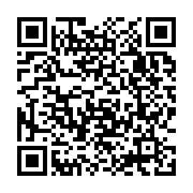
Retail Energy
Code Company
Building a Retail Energy Market fit for the future
Involved in consumer data and consent in the energy sector?
Let’s connect.
Get Involved in Developing Consumer Consent (MMP)
Help shape a practical, consumer-centred approach to consent
The Consumer Consent Project is live, and we want to hear from you. Whether you have a question or concern or want to stay in the loop, our team is here to collaborate.
📩 Reach us at: consumerconsent@retailenergycode.co.uk
Your feedback plays a key role in shaping a secure, consumer-centric solution.
Scan me!

