Slide 1
Consumer Consent Solution
Solution Group
17/06/26

Slide 2

Agenda
Item | Lead | Approx Timing
Welcome & Intro | Michael Walsh | 5 mins
Updates following last Solution Group | George Roberts | 10 mins
Policy Position Update: CCS outages | Matt White | 20 mins
CCS User Platform Demo | Christian Eloysio | ~45 mins
Forward Plan & Close | Michael Walsh | 5 mins

Slide 3
CCS Iteration & Working Group Engagement
We are continuing to iterate on the CCS, and with developments moving quickly alongside our technology partners, there may be occasions when we are waiting on key updates or decisions needed to support the working groups. When this happens, it may not always be possible to share the slides ahead of the session.
Where this is the case, we will ensure clear communication in advance about the areas being discussed and the types of SMEs whose attendance would add the most value, helping to ensure the right people are involved to support discussions and decisions.

Slide 4

Housekeeping
Please ensure that microphones remain switched off during the speaker sessions.
Raise your Hand in Teams if you have any questions
As a polite reminder, please keep all questions relevant to
the session and avoid referencing other organisations
The copy of the slides & minutes will be circulated following the session.

Slide 5
Updates following last Solution Group – 4 June

Slide 6
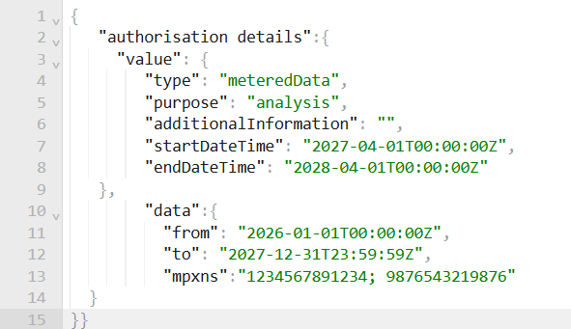
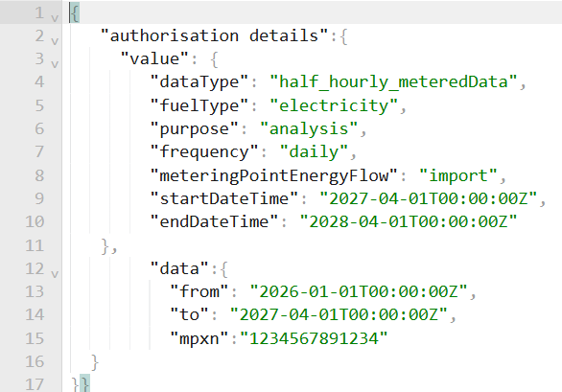
Technical Update
Consent Record Schema
Thanks for the thorough attention and engagement last week and the great technical input.
Discussions ongoing on how best to incorporate the items contributed by yourselves to ensure system efficiency.
For example, for the requirement to display the Data Controller to the consumer at the point of consent, we can surface the Client Name (human-readable name linked to a unique Client ID) in the header of the API rather than the schema itself.
4th June Working Group

Slide 7
Configuration Options
Slides presented on 4th June 2026 and shared. Feedback requested and sharing with technical teams encouraged.
Topic | Recommendation | Justification | Status
01 Client Authentication Methods | private_key_jwt | This concerns how the ATP cryptographically proves its identity to the CCS. FAPI provides an option ot tls_client_auth and private_key_jwt. We recommend the latter as it decouples ATP identity from the transport certificate, meaning ATPs can rotate their transport certificates without breaking their ability to authenticate, and provides another layer of protection against TPS cert compromise. |  | Confirmed
02 Sender-Constrained Access Tokens | mTLS | This concerns how an access_token is bound to its sender. FAPI 2.0 offers two options, mTLS (RFS 8705) and DPoP – as outlined in the consultation we recommend adoption of mTLS. We would require mTLS for transport security and so enaction of DPoP for sender-constrained tokens would add burden and complexity. We are also aligned with NESO for the DSI in the usage of mTLS. |  | Confirmed
03 Access Token Lifetime | 10 minutes | This concerns the default lifetime of access tokens before a refresh is required (a consent record can last for as long as necessary, but access tokens should have a short lifetime to protect consumer data). We propose 10 minutes to minimise the window a compromised token would be usable for. The mechanism for ATP receiving a new access token with a refresh token is extremely lightweight and proven in existing data sharing ecosystems. |  | Detailed technical discussions happening next week on revaluating token lifetime & mandatory introspection requirements.
04 JWS Signing Algorithms | PS256 | This concerns the signature algorithm for JWT signing across the ecosystem – FAPI 2.0 offers 3 option but for simplicity we propose the use of PS256. |  | Confirmed
05 Authorization Mechanism | RAR (required) | This concerns the mechanism to enforce consent details throughout the ecosystem. We believe the use of RAR is essential to reflect granularity and flexibility of consent records. |  | Confirmed
06 Message Tracing | x-fapi-* headers (required) | This concerns regulatory traceability across interactions, which will help with supporting both CCS Users and consumers. FAPI 2.0 doesn’t dictate a requirement of message tracing headers, but we recommend use of x-FAPI headers (generation of UUID in the header of all API interactions). |  | Confirmed
07 Client Key Set Management | JWKS URI (required) | This concerns where the ATP’s public keys are published – naturally these need rotation, but the keys are essential for interaction within the ecosystem. JWKS URI enables live key rotation for ATPs without re-registration – the are hosted on the Directory and retrieved and cached for a time-bound window. |  | Confirmed
08 Authorization Non-Repudiation | Signed Request Object (required) | This concerns how an ATP cryptographically signs a request to produce a provable record of what was asked for. FAPI 20 doesn’t dictate this, but it is essential for auditing and will benefit cross-sector interoperability. |  | Confirmed

Slide 8
Policy Position Update: CCS outages

Slide 9
CCS outage arrangements
No change - supported
Original RECCo position
RECCo proposed that, during a temporary CCS outage, participants could continue to rely on previously validated consent for a limited period (current proposal up to 12 hours), subject to appropriate controls and audit requirements. New consents would not be created during an outage.
Options considered | Rationale / Commentary
Option 1 – No new consents. Existing to continue relying on previously validated consent for a limited period (up to 12 hrs) | Maintains continuity of service during short outages while preserving consumer protections through controls and audit requirements.
Option 2 - Suspend all data sharing during outages | Provides maximum assurance but could unnecessarily disrupt services where valid consent already exists.
Option 3 - Permit both existing and new consent journeys during outages | Maximises service continuity but creates significant risks around consent validation, recording and auditability.
ICO / legal feedback
ICO did not raise concerns with the proposed approach and recognised that a proportionate and risk-based outage process may be appropriate, especially considering a highly available solution. ICO also noted similarities with resilience arrangements used in other sectors, such as Open Banking.
Legal did not identify any material concerns with the proposed outage arrangements, provided reliance on existing consent remains controlled, proportionate and auditable.
Recommended RECCo position:
Maintain the proposed outage arrangements and allow limited reliance on previously validated consent during short-duration outages. New consents should not be created while CCS is unavailable. Outage limit proposed as maximum of 12 hours.
Supported by ICO.
Maintains service continuity while protecting consumers.
Ensures data sharing remains controlled and auditable.
Represents a proportionate and pragmatic approach.

Slide 10
CCS User Platform Demo

Slide 11
Forward Plan

Slide 12
Forward Plan
CCS Webinar:
Date | Agenda
16th April 2026 ✅ | Quarterly Review & Plan – key headlines
28th May ✅ | Design Consultation Responses Webinar
22nd July 2026 (provisional) | Quarterly Review & Plan – key headlines
CCS Topic Specific Solution Groups:
Date | Agenda
22nd April 2026 ✅ | Tariff Interoperability & CCS alignment
7th May 2026 ✅ | UX – CCS Wave 1 Research Findings & Accessibility
21st May 2026 ✅ | Trust Framework Partner update following announcement
4th June 2026✅ | Tech focused - Consent Record Schema (more topics to be added and notified by email)
17th June 2026 | Policy position updates, CCS User platform R&R, RBAC, Auth Roles- Data Share Access
1st July 2026 | SEC & REC alignment, Legal Access Agreement, CCS User requirements, CCS Definition
15th July 2026 | IDV Photo- define service driven IDV/ Federated capabilities
29th July 2026 | topics to be added and notified by email

Slide 13

Retail Energy
Code Company
Building a Retail Energy Market fit for the future
Involved in consumer data and consent in the energy sector?
Let’s connect.
Get Involved in Developing Consumer Consent (MMP)
Help shape a practical, consumer-centred approach to consent
The Consumer Consent Project is live, and we want to hear from you. Whether you have a question or concern or want to stay in the loop, our team is here to collaborate.
📩 Reach us at: consumerconsent@retailenergycode.co.uk
Your feedback plays a key role in shaping a secure, consumer-centric solution.
Scan me!

Slide 14
Appendix

Slide 15
Consumer Consent Project Team
Pete Davies
Executive Sponsor
Matt White
Product Owner & SRO
Project SME's
Ray Newton
Commercial
Michael Walsh
Project Manager
Vicky Brown
PMO
Eva Von-Schaxmann
Business Analyst
Alison Nickson
InfoSec & Data Protection
Teresa Thompson​
Stakeholder
Engagement Mgr
Nathan Gould​​
Enterprise Architect​​
George Roberts
Technical Architect
Hemant Mistry
UX Lead
Sarah Jones
Regulatory Compliance Lead
Harriet Truss
Change Lead
Ann Perry
Market Design Lead
CoCo
Commercial Lead
📩 Reach us at: consumerconsent@retailenergycode.co.uk
N.B: Names & roles provided for transparency; not all roles are assigned 100% to CCS

