Slide 1
Consumer Consent Solution
Solution Group
01/07/26

Slide 2

Agenda
Item | Lead | Approx Timing
Welcome & Intro | Teresa Thompson | 5 mins
CCS Governance | Sarah Jones | tbc
REC Access Agreement | Brian O’Shea | tbc
Forward Plan & Close | Teresa Thompson | 5 mins

Slide 3

Housekeeping
Please ensure that microphones remain switched off during the speaker sessions.
Raise your Hand in Teams if you have any questions
Please keep all questions relevant to
the session and avoid referencing other organisations
The slides & minutes will be circulated following the session.

Slide 4
CCS Governance

Slide 5
CCS Governance Framework
Governance Framework
Change Control
Includes amendments to the CCS itself and individual Data Products
Qualification
Includes verification of CCS users and qualification to enable data access
Issue and Error Resolution
Mechanism for managing consumer and user issues
Funding
Enduring cost recovery for management of CCS and assurance / access arrangements
Assurance
Approach to ongoing monitoring and reporting and managing non-compliance
Change Control
Utilising the existing REC Change Management process.
Funding
Update on funding arrangements and qualification costs.
User Qualification
Update on proposed stages of CCS User Qualification.
Issue and Error Resolution
Ongoing work to define query management process
Assurance
Utilising REC performance assurance, to deliver ongoing assurance monitoring, with escalation to PAB for breach.
Notes:
Remove redress based on advice from Steerco

Slide 6
Consumer Consent Programme – Governance
CCS Drafting Approach
CAT 1 - Schedule
CAT 2 - Service Definition
CAT 2 - Data Specification
Consumer Consent Arrangements Schedule
CCS Service Definition
API Technical Specification
Sets out obligations on Authorised Third Parties, Energy Data Providers and RECCo
Contents:
Purpose of the CCS
Who can access the CCS
Mechanism for organisations wishing to become CCS User e.g. qualification
Mechanism for identity verification and address / MPxN matching
Mechanism for granting, reviewing and revoking consent
Mechanism for adding new Data Products to the CCS
RECCo role to deliver CCS and any associated monitoring
Obligations on Authorised Third Parties and Energy Data Providers to provide monitoring information
Explains in detail the services RECCo will provide via the CCS.
Contents:
Provision of Consumer Consent functional components
Details of CCS users and associated access requirements
Details of Non-Functional Requirements
Service management expectations e.g. service desk SLAs
Provision of any service monitoring tooling, to support assurance of the CCS.
Technical definition of Consumer Consent API to enable Authorised Third Parties and Energy Data Providers to build their solution.
Contents:
Mechanism for interacting with the CCS, including security standards and data schemas
API schema for REC governed data sharing arrangements
CAT 2 - Data Specification
Energy Market Data Specification
CAT 2 - Data Specification
Standardised definition of:
New Data Items (where required)
New Market Messages for sharing data
Customer Experience Guidelines
Defines the UX principles to be applied by Authorised Third Parties when engaging with consumers.
In addition, new definitions will be included in Schedule 1: Schedule 1 Interpretations and Definitions, details of the funding arrangements will be included in the Charging Methodology Schedule 10 Charging Methodology, details of the accreditation will be included in Schedule 9: Schedule 9 Qualification and Maintenance and reporting requirements will be defined in the Performance Assurance Reporting Catalogue: Reporting Catalogue

Slide 7
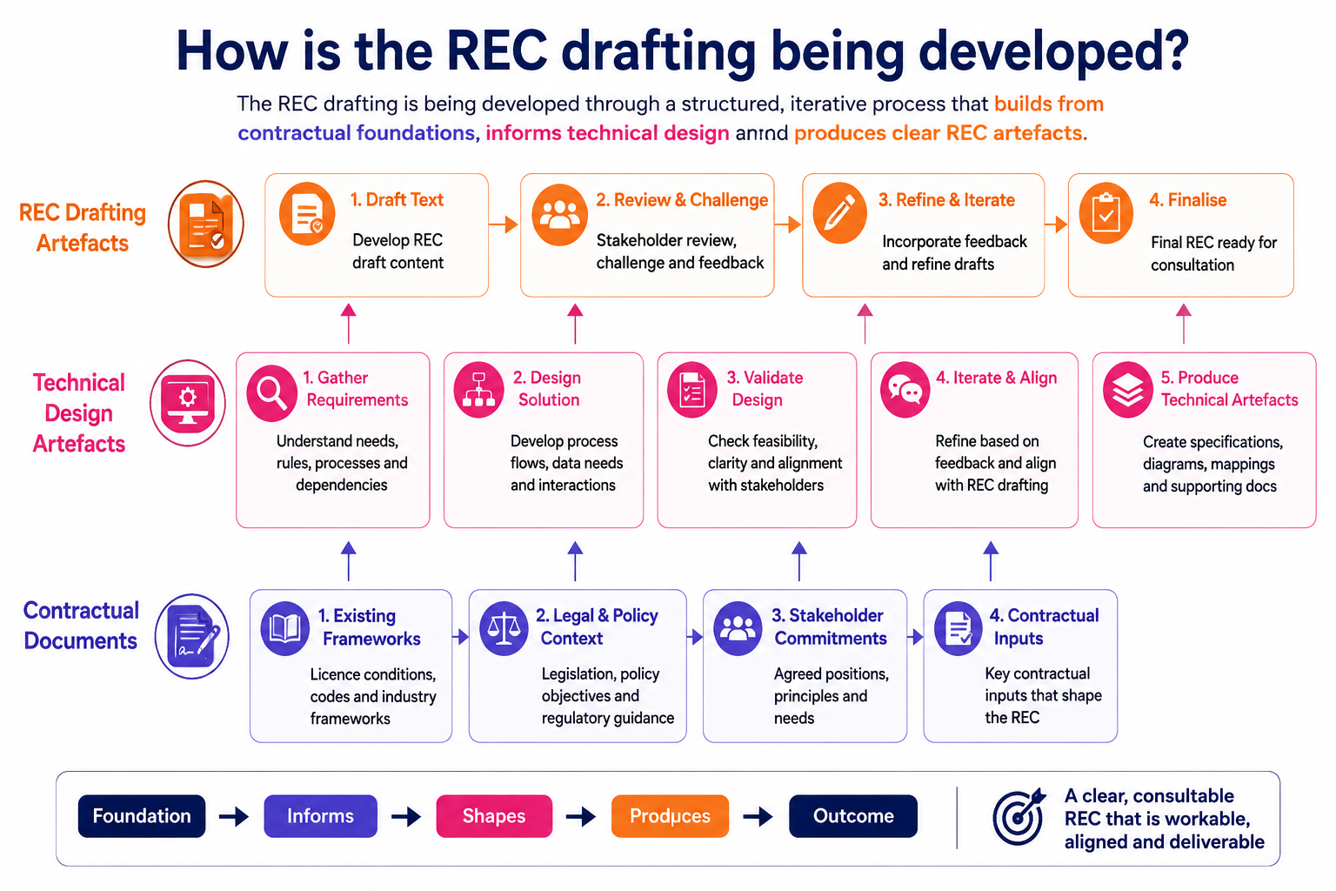

Slide 8
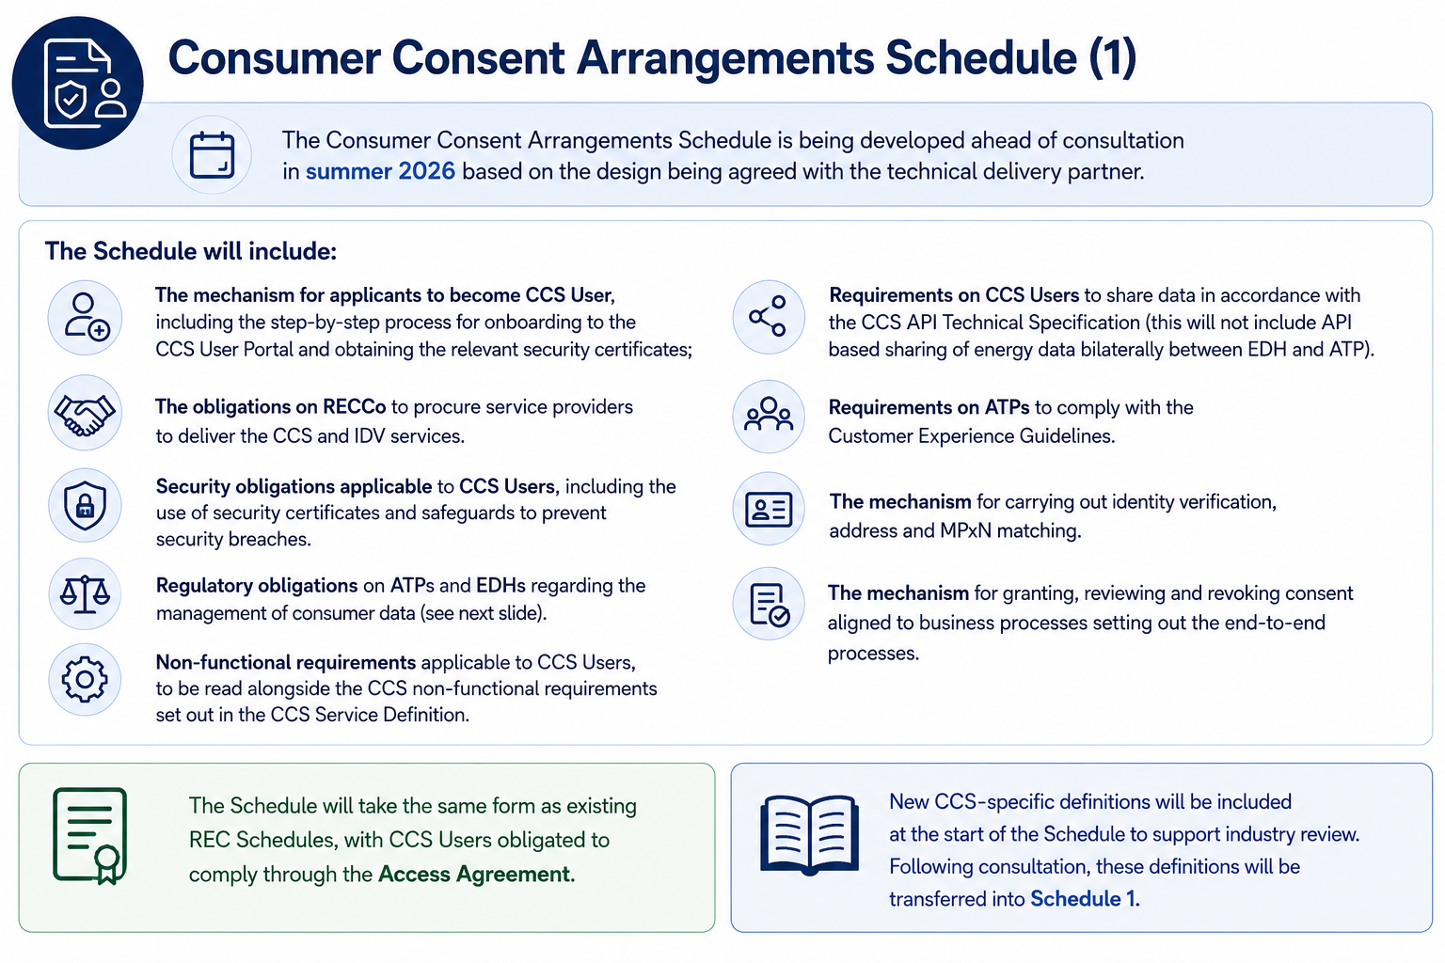

Slide 9
Consumer Consent Arrangements Schedule (2)
ATP Responsibilities
RECCo Responsibilities
EDH Responsibilities
ATPs are responsible for determining the relevant Lawful Basis by which it can access energy data under Data Protection Legislation.
ATPs shall also comply with any relevant energy regulations regarding the use of the CCS.
ATPs are responsible for ensuring that use of data is compliant with the purpose agreed by the consumer as part of the consent granting process.
RECCo is responsible for the provision of the Consumer Consent Service, consistent with the description set out in the CCS Service Definition and Consumer Consent Arrangements Schedule.
RECCo is responsible for identity verification, address and MPxN matching and ensuring consent granted through the CCS is reflected in access tokens and revocation notifications are issued where required.
EDHs are responsible for determining whether Permission via the CCS is required under any Energy Code or Energy Licence before they release energy data to an ATP.
EDHs are responsible for validating that requests for access to energy data are received from a qualified CCS User, and that consent is still active before sharing data

Slide 10
Qualification and Maintenance – Schedule 9
Consultation respondents supported applying existing REC Service User qualification arrangements to the CCS.
Some concerns were raised about potential duplication between REC and SEC accreditation activities, which are addressed on the following slides.
The REC Qualification process, set out in the Qualification and Maintenance Schedule for REC Parties and Non-Party REC Service Users, will also apply to CCS Users. At a high level, this includes:
Submission of an initial application
Completion of an ISDP Assessment
Completion of external testing
Execution of an Access Agreement
The existing schedule will be extended to include:
Inclusion of the Consumer Consent Service (CCS) as a REC Service within scope
Addition of CCS Testing to the list of external testing types (further details to be provided at a future meeting)
Inclusion of CCS access provisions within the Access Agreement template
Qualification of CCS Users for TI Energy Suppliers under the Tariff Interoperability Arrangements Schedule
Information on the existing qualification approach is available on the REC Portal: Entry Assessment Information Pack
Organisation Verification
Data Protection
Testing
Information Security
Access Agreement

Slide 11
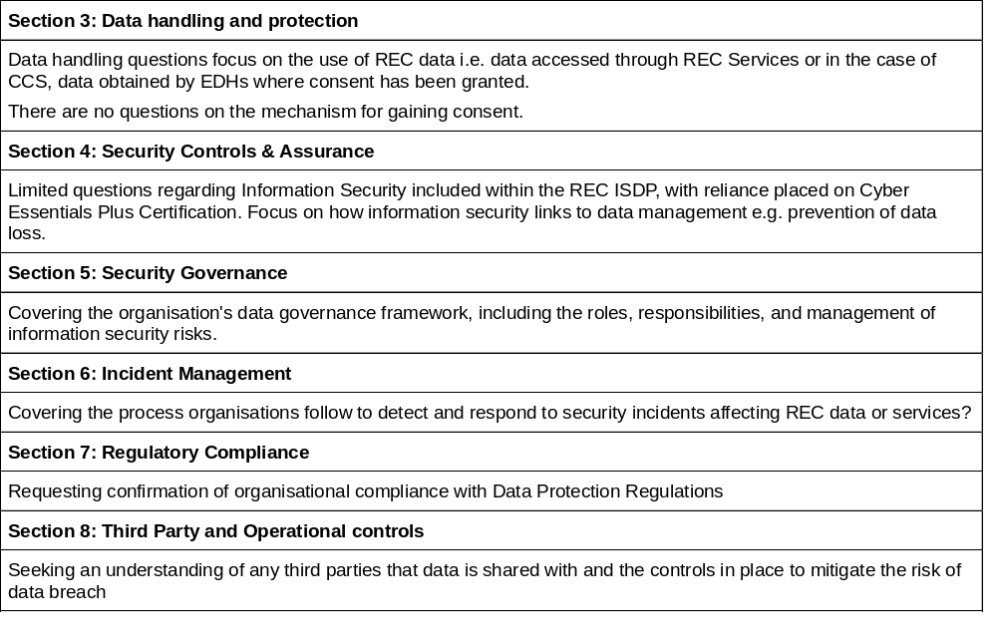
REC ISDP Question Categories
We have considered the risk profile associated with unauthorised access to half-hourly metered data and believe this requires enhanced DP questions.
Changes are also required to recognise the reliance on CE+ certification.

Slide 12
Assessment of Risk Levels
All CCS applicants required to undertake an ISDP assessment will be expected to respond to each question. However, the level of evidence required will depend on RECCo's assessment of the applicant’s individual risk profile.
Applicants will be classified as low, medium or high.
The following factors will be considered when determining the level of applicant risk:
The type of user and the purpose for which they are seeking to access data.
Whether the applicant is a new or established organisation
Whether the applicant is accessing data for its own purposes or is expecting to pass consumer data to other downstream organisations.
The number of data access requests that the applicant is expecting to make, or is making, on an annual basis when considering ongoing maintenance of qualification assessments.
The extent of reliance on third-party processors, subcontractors or other service providers.
Any relevant history of information security incidents, personal data breaches or regulatory enforcement activity.

Slide 13
REC ISDP Costs
Development of the ISDP scope is ongoing; however, RECCo has established estimated costs for Non-Party CCS User ISDP Assessments.
These estimates are based on the CCS Minimum Market Product (MMP), which provides access to half-hourly metered data.
Registered Tariff Interoperability Users accessing CCS solely for tariff data will not be required to complete an ISDP.
 | Cost Per Assessment | Rationale
Onboarding and assessing a new CCS User | High risk - up to 15k Medium risk - 8-10k Low risk - approx. 5k | Level of work is likely to vary by complexity and the level of follow ups.
Assessing an existing REC Enquiry Service User seeking access to CCS | High risk – up to 10k Medium risk - 6-8k Low risk – approx. 1k | Based on the incremental work needed over and above Enquiry Service Qualification.
Ongoing CCS Maintenance of Qualification and reassessment activities Completed either annually, bi-annually or every three years depending on risk level | For external assessments High risk - up to 15k Medium risk: 8-10k Low risk – approx. 5k | Level of work is likely to vary based on the nature of the risk level, and whether an external assessment is needed.

Slide 14
SEC/REC Interactions
RECCo is working with SECCo to develop a complementary assurance framework that recognises existing SEC assurance, avoiding duplication while maintaining appropriate oversight.
Metered Data flow
User System
Meter
DCC
User
Backend Systems
Focus of the SEC Assessments
Focus of the CCS assessments
SEC Security and Privacy Assessments focus on evaluating the security of organisations accessing smart metering data via DCC and confirming the approach used to obtain consumer consent.
This covers:
Data in transit: the secure transmission and reception of messages to and from the smart meter.
User System Boundary: The assessment's focus largely concludes once data leaves the User System
Use of a mechanism for obtaining consent aligned to the Privacy Controls Framework
REC ISDPs focus on ensuring organisations have adequate controls to prevent data leakage or misuse. This covers:
Standards to support access to data including data handling, data governance and operational controls.
Non-SEC routes where the organisation accesses data through alternative routes (e.g., BSC or REC).
By setting CE+ as a minimum-security requirement, RECCo will rely on this third-party assessment and focus the ISDP on areas not covered by CE+

Slide 15
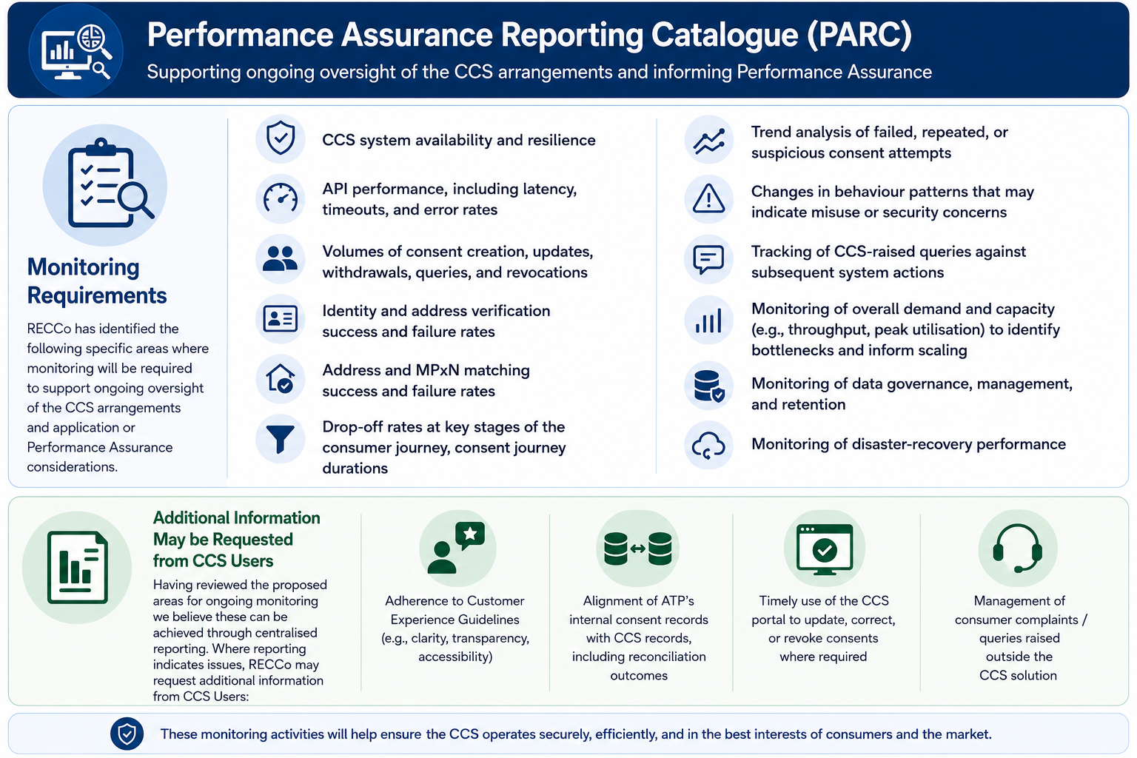

Slide 16
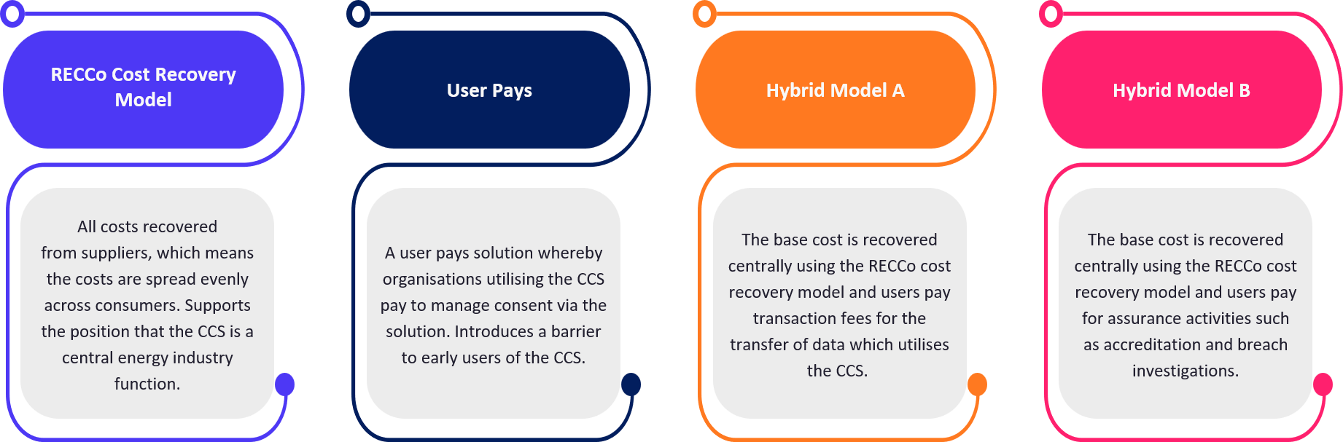
Charging Methodology – Schedule 10
Development and delivery of CCS will be funded using the RECCo Cost Recovery Model up until and including the delivery of MMP.
The February Design Consultation presented four options for ongoing funding and recommended adopting Hybrid Model B.
Conclusion
Hybrid Model B to be adopted:
RECCo recognises concerns raised regarding mutualization across the market; however, recovery of core CCS costs through the RECCo cost recovery model remains appropriate during the initial implementation period.
This approach will support voluntary uptake of CCS, avoid placing disproportionate costs on early adopters and reflects the role of CCS as a core cross-market enabling service.
The detailed approach will be defined in the REC Charging Methodology and kept under review alongside other smart data initiatives.
Qualification and any bespoke assurance costs will be recovered directly from the relevant CCS User.

Slide 17
REC Access Agreement

Slide 18
Access Agreement key principles
The Access Agreement is the legal mechanism that allows Non-REC Parties to use REC Services
It provides access on an Equivalent Basis to selected REC provisions so that Non-Party REC Service Users operate to the same standard and controls as REC Parties, without duplicating the REC itself
REC alignment by design
Access to CCS
Change control tracks the REC
REC definitions and obligations are incorporated on an Equivalent Basis, ensuring consistency as the REC evolves
The agreement will allow CCS Users to access the CCS and bind them to key existing REC clauses for IPR, Confidentiality and Data Protection
Any changes impacting the CCS Arrangements or the Access Agreement would go through the REC Change Process. Central to that is comprehensive stakeholder engagement.
Enabling organisations wishing to access multiple REC Services to sign a single access agreement
Existing REC Service Users will require an additional schedule to be added to their current agreement
Delivering low-friction participation, a consistent standard, and a future-proof path that evolves with the REC.

Slide 19
Access Agreement Rationale
The Retail Energy Code (REC) is a rulebook that makes sure the retail energy market in Great Britain runs smoothly. Licensed energy suppliers (and others) must sign up to it and follow its rules.
1. Existing legal pathways
2. Consumer Consent Arrangements
Legal pathways already exist to allow a broad range of other organisations to access REC Services without becoming fully signed up to the Code.
We are using these proven pathways to enable the Consumer Consent Arrangements.
From the CCS MMP go-live date, the Consumer Consent Arrangements will be part of the REC.
3. CCS Users must
4. Who uses the Access Agreement pathway?
Have a clear legal right to use the CCS
Fully comply with the scheme rules
Risk losing access if they break those rules
REC Parties (i.e licensed energy suppliers) won’t need to sign an Access Agreement as they are already REC Parties
Non- Party REC Service Users will access the Consumer Consent Arrangements through the proven Access Agreement pathway
CCS Users: Authorised Third Parties (ATPs) and Energy Data Holders (EDHs)
The Access Agreement legal pathway allows the parts of the REC applicable to the Consumer Consent Arrangements to apply. It is targeted and proportional approach

Slide 20
What is the Access Agreement
What is the Access Agreement, and why does it need to be robust
Access
Compliance
Protection
Assurance
Accountability
The Access Agreement is the mechanism that provides the legal pathway to allow Non-REC Parties to use the CCS
If Non-REC Parties want to utilise the CCS, they will need to comply with the Consumer Consent Arrangements.
Each will need assurance that there are consequences of non-compliance and that the consequences provide an adequate deterrent.
Consumers require confidence that a robust legal framework exists which protects the use of their data.
All participants require confidence that their obligations can be discharged, their IP protected, and their confidential data protected.

Slide 21
Access Agreement Provisions
Limitation of Liability: Standard contractual clause outlining consequences of breach. Confidentiality breaches carry unlimited liability, but under the REC, recovery is limited to direct losses only (excluding consequential losses such as loss of profit). This exposure is generally insurable.
The Consumer Consent Arrangements Schedule: This document will say what RECCo, EDHs and ATPs must do, must not do, and how they need to do it.
  Confidentiality & Data Protection: The drafting in the REC is what we would reasonably expect to see in a contract. This clause is necessary to protect CCS Users who will be sharing confidential data (personal or otherwise)
  Charging: RECCo is required under the REC to develop a Charging Methodology, and the Access Agreement refers to that. Initially, CCS costs will be recovered from Energy Suppliers with the ability for RECCo to recover the costs for qualification and investigation of suspected breaches.
  Intellectual Property Rights (IPR): The REC drafting includes standard contractual provisions to protect existing and newly created IPR arising from the Consumer Consent Arrangements, including the API Technical Specification.
  Other Clauses: The Access Agreement contains references to other legal obligations and all are standard and required for legal completeness.

Slide 22
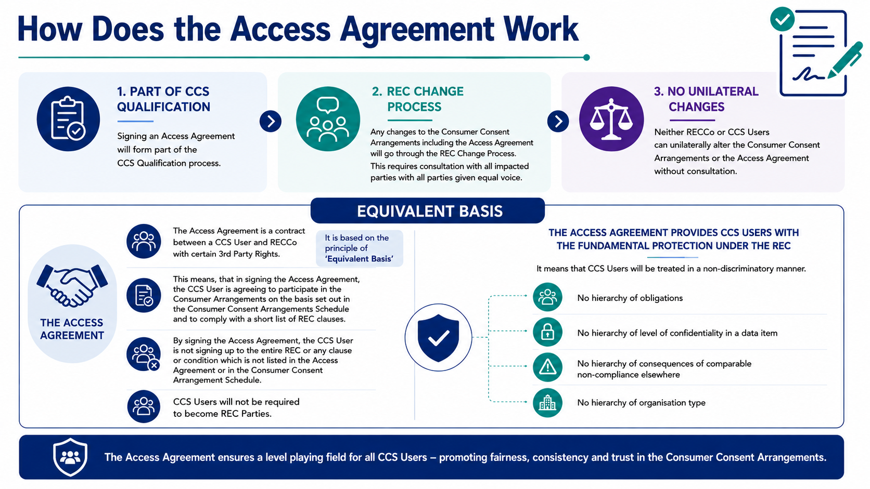

Slide 23
Questions?

Slide 24
Forward Plan

Slide 25
Forward Plan
CCS Webinar:
Date | Agenda
16th April 2026 ✅ | Quarterly Review & Plan – key headlines
28th May ✅ | Design Consultation Responses Webinar
22nd July 2026 (provisional) | Quarterly Review & Plan – key headlines
CCS Topic Specific Solution Groups:
Date | Agenda
22nd April 2026 ✅ | Tariff Interoperability & CCS alignment
7th May 2026 ✅ | UX – CCS Wave 1 Research Findings & Accessibility
21st May 2026 ✅ | Trust Framework Partner update following announcement
4th June 2026✅ | Tech focused - Consent Record Schema (more topics to be added and notified by email)
17th June 2026✅ | Policy position updates, CCS User platform R&R, RBAC, Auth Roles- Data Share Access
1st July 2026 | SEC & REC alignment, Legal Access Agreement, CCS User requirements, CCS Definition
15th July 2026 | IDV Photo- define service driven IDV/ Federated capabilities
29th July 2026 | topics to be added and notified by email

Slide 26

Retail Energy
Code Company
Building a Retail Energy Market fit for the future
Involved in consumer data and consent in the energy sector?
Let’s connect.
Get Involved in Developing Consumer Consent (MMP)
Help shape a practical, consumer-centred approach to consent
The Consumer Consent Project is live, and we want to hear from you. Whether you have a question or concern or want to stay in the loop, our team is here to collaborate.
📩 Reach us at: consumerconsent@retailenergycode.co.uk
Your feedback plays a key role in shaping a secure, consumer-centric solution.
Scan me!

Slide 27
Appendix

Slide 28
Consumer Consent Project Team
Pete Davies
Executive Sponsor
Matt White
Product Owner & SRO
Project SME's
Ray Newton
Commercial
Michael Walsh
Project Manager
Vicky Brown
PMO
Eva Von-Schaxmann
Business Analyst
Alison Nickson
InfoSec & Data Protection
Teresa Thompson​
Stakeholder
Engagement Mgr
Nathan Gould​​
Enterprise Architect​​
George Roberts
Technical Architect
Hemant Mistry
UX Lead
Sarah Jones
Regulatory Compliance Lead
Harriet Truss
Change Lead
Ann Perry
Market Design Lead
CoCo
Commercial Lead
📩 Reach us at: consumerconsent@retailenergycode.co.uk
N.B: Names & roles provided for transparency; not all roles are assigned 100% to CCS

