Slide 1
Consumer Consent Solution
Solution Group
04/06/26

Slide 2
Agenda
Item | Lead | Approx Timing
Welcome & Intro | Teresa Thompson | 5 mins
Consent Record Schema Technical structure (scopes vs RAR, field names) Impacts on Data Sharing | George Roberts | 55 - 70 mins
Security Profile- Profile configuration & considerations | George Roberts | 10 mins
Forward Plan & Close | Teresa Thompson | 5 mins

Slide 3

CCS Iteration & Working Group Engagement
We are continuing to iterate on the CCS, and with developments moving quickly alongside our technology partners, there may be occasions when we are waiting on key updates or decisions needed to support the working groups. When this happens, it may not always be possible to share the slides ahead of the session.
Where this is the case, we will ensure clear communication in advance about the areas being discussed and the types of SMEs whose attendance would add the most value, helping to ensure the right people are involved to support discussions and decisions.

Slide 4
Housekeeping
Please ensure that microphones remain switched off during the speaker sessions.
Raise your Hand in Teams if you have any questions
As a polite reminder, please keep all questions relevant to
the session and avoid referencing other organisations
The copy of the slides & minutes will be circulated following the session.

Slide 5
Consent Record Schema

Slide 6
Our objectives for CCS Consent Record Schema
Consent Record Schema =
Dictates how we define what a consumer is consenting to, and how this is structured, interpreted and replicated throughout the Trust Framework by CCS Users to enable consent-based data sharing.
Key Priorities:
Accurately reflect what a consumer is signing up for. The structure and contents of the Consent Record Schema will be shown directly to a consumer for every new consent.
Enable sufficient controls to enforce data safety and GDPR/DUAA requirements. The Consent Record Schema will need to protect consumer interests and ensure adherence to:
  Art. 5(1)(a) transparency – the schema will be displayed to consumers at the point of consenting
  Art. 5(1)(c) data minimisation – needs to be able to be specific enough to ensure minimum data is shared
  Art. 7 informed consent
Ensure long-term flexibility to enable future use-cases with minimal change required
Enforce sufficient granularity to enable nuanced

Slide 7
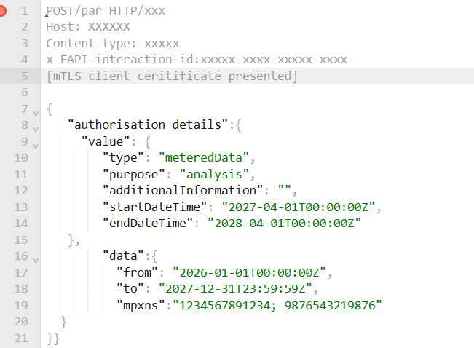
Our focus is the Consent Record Schema (JSON/YAML), not API Specifications
We are discussing the detail of the Consent Record Schema itself today.
The authorisation_details expressed in a Scopes or a Rich Authorisation Request are the foundation of how consent is tracked and managed across the ecosystem. We understand that the object expressed by the Consent Record Schema sit alongside a range of other API details which we will share with you in due course.
For this Working Group, we are not discussing the rest of the API Specifications that will sit around the Consent Record Schema. These will be brought to you as soon as possible, hopefully the next Working Group.
Out of scope for today
Consent Record Schema/authorisation_details JSON/YAML
In scope for today

Slide 8
Our decision to use Rich Authorisation Requests
Rich Authorisation Requests (RAR)
We are intending to use Rich Authorisation Requests as our model for consent record schemas. Our reasoning is:
RARs offer granularity
  - using RAR we can express Consent Duration, Purpose, Resource Identifiers (e.g. MPxN) and even conditionality. Unlike Scopes which are static, RARs can benefit from the flexibility of JSON structures
RARs offer flexibility
  – we want to design a flexible structure that can adapt to new services and datasets and enable binding of multi-requests, as well as facilitate intra and inter-sector interoperability.
Scopes, unlike RARs, only offer determination of levels of access to data, with no built-in flexibility for specifying duration of access or enabling fine-tuned resource control. RARs enable expression of WHAT, WHO, HOW LONG and WHY.
How do they work?
RARs build on Scopes which define access controls to recourses via OAuth2 tokens by adding a new parameter,r “Authorisation_details”, that will allow us to express more granularity around a consent request.
Are you happy with our proposed approach to use Rich Authorisation Requests as the model for our Consent Record Schema?
RFC 9396: OAuth 2.0 Rich Authorization Requests

Slide 9
Contextualising the Consent Record Schema
-- Simplified FAPI 2.0 Flow POV
Request
Response
Consumer
1
1. Request service
Authorised Third Party
(ATP)
12
12. API Call with access token
Energy Data Holder
(EDH)
7
9
Access_token
5
6
Redirect to CCS
Request_uri
15. Data returned
15
Request_uri
PAR with initial RAR
Consent details (drawn from RAR) reviewed
Auth_code
Access_token
Access_token
8
13. Token introspection
8. Consent approved
4
9
10
11
6
4. Submit Push Authorisation Request (PAR), with an encoded Request Object (incomplete).
5. Response with a request_uri to trigger consumer authentication.
2
13
6. Redirected to CCS with request_uri & authenticates / verifies occupancy
9. Auth_code provided, now that consent record created
10. Auth_code returned over mTLS
11. Certificate-bound access token. Tied to CCS Consent Record
2. Request metadata
14
14. Introspection response inc. Consent scope return
7. Enriched RAR with consumer details
5
3
3. Metadata returned (endpoints, certifications etc.)
7
CONSUMER CONSENT SOLUTION
Auth_code
Directory / Registry (Trust Framework)
Authorisation Server
RAR completed with MPxNs
Consent Record Completed & Stored
Initial RAR
Access token, bound to client_id
Consent Record
Type / Purpose Catalogue
Endpoints/ certificates / metadata

Slide 10
Contextualising Consent Record Schema
-- Consent Schema POV
Consent Schema
Determined by Consent Schema
Links to Consent Schema
Links to Consent Schema
-
1. Request service
3c
Consumer
Authorised Third Party
(ATP)
-
12. API Call with access token
Energy Data Holder
(EDH)
7
-
9
Access_token
Service provided
15. Data returned
-
5
1b
Redirect to CCS
-
Request_uri
PAR with initial RAR
Request_uri
Consent details (drawn from RAR) reviewed
Auth_code
Access_token
Access_token
1
-
13. Token introspection
-
3a
-
2a
8. Consent approved
3a
3b
1c
-
3d
4. Submit Push Authorisation Request (PAR), with an encoded Request Object (incomplete RAR at this stage).
5. Response with a request_uri to trigger consumer authentication.
-
-
9. Auth_code provided, now that consent record created
10. Auth_code returned over mTLS
11. Certificate-bound access token. Tied to CCS Consent Record
2. Request metadata
4
14. Introspection response inc. Consent scope return
6. Redirected to CCS with request_uri & authenticates / verifies occupancy
7. Enriched RAR with consumer details
-
3. Metadata returned (endpoints, certifications etc.)
3
CONSUMER CONSENT SOLUTION
2
1a
Directory / Registry (Trust Framework)
RAR enriched with MPxNs
Auth_code
Authorisation Server
Consent Record Completed & Store
Initial RAR
Access token, bound to client_id & consent record
Consent Record
Type / Purpose Catalogue
Endpoints/ certificates / metadata

Slide 11
Contextualising Rich Authorisation Requests
-- Consent Schema POV
Consent Schema
Determined by Consent Schema
Links to Consent Schema
Links to Consent Schema
No. | What happens
1 | ATP submits a secure PAR (Push Authorisation Request – secure mechanism to send an authorisation_request requiring an mTLS connection). The authorisation details (in RAR format) will sit underneath this request, but it will be incomplete (lacking mpxns and consumer identification info).
1a | The CCS receives the request, creates a unique request_uri to track all interactions for this request and shares it with the ATP.
1b | Consumer is redirected to CCS to authenticate.
1c | Consumer authenticates (IDV or login) to verify their occupancy – as such providing MPxN data for the RAR.
2 | CCS enriches the original RAR received in Step 1 with MPxN data, creating the full RAR we will discuss today.
2a | This RAR is then directly displayed to the consumer at the time of consent.
3 | Consumer consents, creating a Consent Record in the CCS.
3a | Tied to the Consent Record, the CCS sends an auth_code to the ATP inviting it to collect an access_token
3b | After establishment of an mTLS connection, ATP collects the access_token which is tied to the consent record and their own client_id.
3c | After establishment of an mTLS connection, ATP requests data from the EDH with the access token.
3d | EDH introspects the access_token centrally with the CCS introspection endpoint (during an mTLS connection).
4 | EDH, during introspection, receives the full RAR details specifying MPxNs and other critical consent record data. This informs what data they need to send.

Slide 12
Simplified Consent Record Schema Flow
Consumer authenticates and provides / confirms MPxN scope
Enriched RAR is shown to consumer at time of consent
Consumer
Create PAR based on service request (inc. basic RAR)
Access_token is used for the data request but doesn’t contain the RAR
ATP
Initial RAR created from Push Authorisation Request by ATP
RAR gets enriched post consumer authentication, adding MPxNs
Consent record created and tied to access_token
Consent record introspected
CCS
Access_token introspection, including RAR details to determine data in scope
EDH

Slide 13
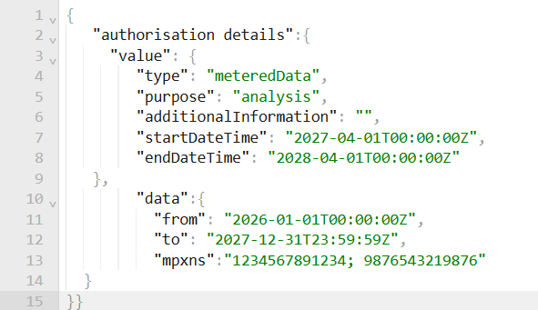
Our draft Consent Record Schema
Proposed Schema with examples
Data Item |  | Type / Format | Description
value
type |  | String / Enum | RECCo with industry to define acceptable data type catalogue for type.
purpose |  |  | RECCo with industry to define acceptable data purpose catalogue. Possibility for ATPs to state ‘Other’ triggering ‘additional Information’.
Additional Information |  | Free Text | Free text with character limit. Mandatory field if purpose = ‘Other’
Start Date Time |  | String / Date-time (ISO 8601, UTC) | Inclusive lower bound of the consent’s active window. If absent, the CCS uses the moment of consent grant as the start
End Date Time |  |  | Inclusive upper bound of the consent’s active window. Question on default limit next slide.
 | data
 | from | String / Date-time (ISO 8601, UTC) | Lower bound of the data window - earliest date for which historical readings are requested. If blank, default to start Date Time.
 | to |  | Upper bound of the data window - earliest date for which historical readings are requested.
 | mpxns | Array (min. 1) Unique items | List of MPxNs in scope of this consent. Included after a consumer authenticates and prove occupancy – meaning CCS Auth_server enriches the RAR post consumer authentication.
This is a draft and we are welcoming co-developing it further with you.
We have questions on the right and more prompts on the next slides to discuss potential additions.

Slide 14
Key Questions:
Our draft Consent Record Schema
Does type and purpose give us enough flexibility for data sharing arrangements? Will this also work for cross-sector?
Data Item |  | Type / Format | Description
value
type |  | String / Enum | RECCo with industry to define acceptable data type catalogue for type.
purpose |  |  | RECCo with industry to define acceptable data purpose catalogue. Possibility for ATPs to state ‘Other’ triggering ‘additional Information’.
additionalInformation |  | Free Text | Free text with character limit. Mandatory field if purpose = ‘Other’
Start Date Time |  | String / Date-time (ISO 8601, UTC) | Inclusive lower bound of the consent’s active window. If absent, the CCS uses the moment of consent grant as the start
End Date Time |  |  | Inclusive upper bound of the consent’s active window. Question on default limit next slide.
 | data
 | from | String / Date-time (ISO 8601, UTC) | Lower bound of the data window - earliest date for which historical readings are requested. If blank, default to Start Date Time.
 | to |  | Upper bound of the data window - earliest date for which historical readings are requested.
 | MPxNs | Array (min. 1) Unique items | List of MPxNs in scope of this consent. Included after a consumer authenticates and prove occupancy – meaning CCS Auth_server enriches the RAR post consumer authentication.
What are your thoughts on not specifying:
Data subject
Data controller
Legal basis
Our proposal is this adds additional weight and logic requirements to APIs; CCS will minimise data and ensure proper authority to consent, and mandatory introspection ensures each token is checked, reducing the need for complex record schemas.
What controls do we need to put in place for ‘Other’ e.g. character limit, monitoring for usage etc.
Is separating the mechanism for identifying which EDH has the data correct, or should we also cater for that in the schema​?
What should we suggest as the automatic upper bound of the token lifetime?
What is the best way to reconcile enduring services vs the natural security requirement to necessitate a reconsent?
If “to” is blank, do we assume enduring consent? Without specifying ‘one-off’ vs ‘enduring’ this seems a logical approach.
What do we need to consider for MPxNs (MPAN, MPRN)? Do we need to specify a fuel type?
Should MPxN be superseded by duration or vice versa?
To make Consent Records lightweight, we are proposing using Start Date Time and End Date Time to be used to configure one-off consents. Should we have a separate data item for this?
Should we specify Import/Export as a separate field, or would it be better to reflect it as a more granular type?

Slide 15
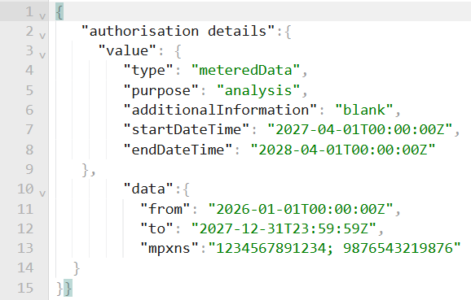
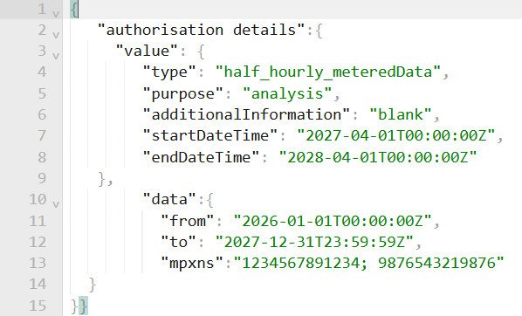
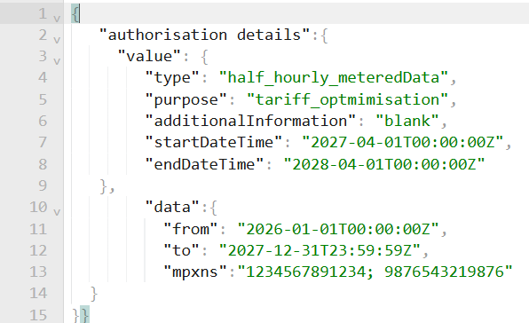
Downstream impacts to consider for our Consent Record Schema
Purpose granularity:
We need to consider the granularity we need to assign to the purpose.
As CCS will not determine all datasets, though we are proposing the potential to use the EMDS to for many-to-many, EDHs will always need (particularly for certain data requests) to ensure their own schemas enforce DUAA and GDPR.
For example, simply having Metered Data might force more work for EDHs to assess the purpose provided by the ATP, and adjust their systems before sharing the data (e.g. half-hourly metered data vs daily).
  More granular purpose would reduce risks of contravening data minimisation (e.g. sharing HH instead of daily), but may have administrative impacts as well
At the time of sharing data, the EDH knows that…
Metered Data is required for analysis. Does this mean import, export, does it mean daily/monthly or half hourly etc.?
Is carbon or cost information required for this analysis?
At the time of sharing data, the EDH knows that...
Half-hourly metered data is required for 'historical' analysis.
Does this require any additional information, or does any information need to be excluded? For example, would billing information also be useful
At time of sharing data, the EDH knows that...
EDH has an understanding of the granularity of type of data requested, as well as the purpose which provides details of the specific use case which can help inform the schema to be returned.

Slide 16
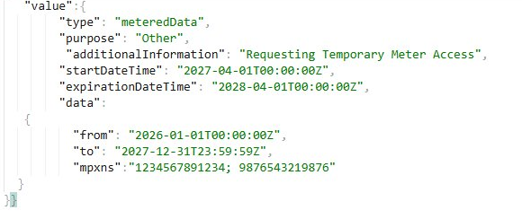
Downstream impacts to consider for our Consent Record Schema
Enabling an ‘Other’ option for purpose:
RECCo will work to continuously support the industry by ensuring a suitable and updated catalogue of purpose types. However, we are keen to make sure RECCo and the CCS do not create an administrative bottleneck, and so we are proposing to include a ‘Other’ field for the purpose.
What will be the impacts of enabling free access to use 'Other'? What guardrails should we use to minimise overuse?
Is it necessary, or should we focus on improving the efficiency of how we manage and update the Purpose catalogue?
When entering additional Information for Other, this information is provided directly to the consumer. What do we need to consider?
Does this introduce risk of overuse, or is this sufficiently limited by GDPR/DUAA obligations for ATPs?
What character limit should we include?

Slide 17
Downstream impacts to consider for our Consent Record Schema
Importance for clear consent communication:
Consent Record Schema is an essential component for displaying to consumers what they are consenting to.
Are we confident that the below will provide the consumer with enough information to make fully informed consent?
Is the combination of type, purpose, consent lifetime, and specific of data retrieval and MPxNs sufficient for the presentation to the consumer at the time of consent?
What CEGs should we consider here?
Should we have any concerns for consumers with enabling an ‘Other’ option for purpose?
Are there additional monitoring requirements we should ensure are implemented to manage the use of an ‘Other’ entry.

Slide 18
Downstream impacts to consider for our Consent Record Schema
Configuration of datasets at EDH level:
Given specific data schemas will not be in scope for standardisation, EDHs will be free to apply whatever schemas they have however they will need to manage this with their own GDPR obligations for data minimisation. How do we make this easy and enforce data minimisation?
How can CCS describe consent accurately if it can’t enforce data minimisation but requires EDHs to do so.
EDHs may wish to configure their systems independently; ATPs may wish to be at liberty to request additional data. How do we make this work efficiently?
    Will be their responsibility to redact data at their servers to not share additional unconsented data
      Having a ‘type’ and a ‘purpose’ will help specify practically what is needed, but it does not stop the requirement of EDHs to ensure their own datasets are established.
Despite clear information on the type and purpose of the request, there is no standardised dataset for EDHs to return the data.
So, even with knowledge of:
Half-hourly metered data
Historical analysis use-case
PV Estimate
… Does the EDH share existing billing costs to help the estimate? Should the EDH provide additional important information, such as additional smart assets in the house?
Should the EDH redact any information based on the specific requirements?
Do the EDH need to update their schemas to better reflect the request moving forward, etc.?

Slide 19
Downstream impacts to consider for our Consent Record Schema
  Configuration of one-off, long-lived and enduring consents
The use of Rich Authorisation Requests enables us to incorporate multiple ways to differentiate the lifetime of consent.
Our current position is that we can enforce consent token lifetime through Start Date Time and End Date Time – e.g. a one-off consent simply has a short lifetime. This, however, could mean multiple requests could occur within this time period.
We also need to consider impacts of default token lifetime for one-off consents with regards to potential failures across the system; we do not want ATPs to have to force consumers to reconsent if there are sudden and unforeseen system issues (beyond, and including, the CCS platform itself).
For one-off consents, would 1 day be a good default for token lifetime – remember ATPs will use a refresh token to get a new access token every 10 mins? We need to make sure we create enough contingency for one-off services so that, if there is failure somewhere in the system, the consumer is not forced to reconsent.
To ensure one-off, could we include a single-use flag? Would that help or increase effort for logic implementation?

Slide 20
Downstream impacts to consider for our Consent Record Schema
  Frequency:
We are aware of the criticality of creating a consent mechanism that meets the varying requirements of consumer energy data services.
We expect there to be a variety of frequencies with which services require energy data.
Will adding a frequency field help or hinder CCS?
What CEG impacts of this are there – do we need to clearly communicate this to consumers at the time of consent?

Slide 21
Downstream impacts to consider for our Consent Record Schema
  Sharing consumer information:
We have an opportunity to align industry records, should we wish.
A key objective of CCS is to verify a consumer’s right to consent to energy data for their relevant MPxNs, and in doing so we will need to create a unique identifier for each consumer who uses the platform. There may be a benefit for aligning this across the industry – CCS could share distinct and proven consumer records for ATPs to ensure updated and verified records.
Would CCS providing verified consumer details back to ATPs to align records benefit industry?
What details would be beneficial to share, if so?

Slide 22
Security Profile

Slide 23
FAPI 2.0 – Security Profile Configuration
We were glad to see universal support for Open Standards, particularly FAPI 2.0. Leveraging FAPI 2.0 will offer CCS considerable benefits, particularly with regard to providing a trusted, proven security profile that protects energy consumers and inherently enforces GDPR/DUAA obligations.
Whilst it is comprehensive for our requirements, FAPI 2.0 still requires some minor configuration. We have some recommended approaches for this low-level configuration, which we are seeking your views on.
Please respond offline – we will recap on your feedback at the start of the next Working Group.
What is a Security Profile?
A Security Profile defines, for an entire ecosystem, the cryptographic and protocol rules that every participant must follow. It locks down how down how participants prove their identity to each other, how a Consumer's authorisation is captured and bound to a token, and how data is protected
data is protected in transit.

Slide 24
Configuration Options
We welcome your thoughts on the below recommendations for our configuration of the CCS FAPI 2.0 implementation.
Topic | Recommendation | Justification
01 Client Authentication Methods | private_key_jwt | This concerns how the ATP cryptographically proves its identity to the CCS. FAPI provides an option ot tls_client_auth and private_key_jwt. We recommend the latter as it decouples ATP identity from the transport certificate, meaning ATPs can rotate their transport certificates without breaking their ability to authenticate, and provides another layer of protection against TPS cert compromise.
02 Sender-Constrained Access Tokens | mTLS | This concerns how an access_token is bound to its sender. FAPI 2.0 offers two options, mTLS (RFS 8705) and DPoP – as outlined in the consultation we recommend adoption of mTLS. We would require mTLS for transport security and so enaction of DPoP for sender-constrained tokens would add burden and complexity. We are also aligned with NESO for the DSI in the usage of mTLS.
03 Access Token Lifetime | 10 minutes | This concerns the default lifetime of access tokens before a refresh is required (a consent record can last for as long as necessary, but access tokens should have a short lifetime to protect consumer data). We propose 10 minutes to minimise the window a compromised token would be usable for. The mechanism for ATP receiving a new access token with a refresh token is extremely lightweight and proven in existing data sharing ecosystems.
04 JWS Signing Algorithms | PS256 | This concerns the signature algorithm for JWT signing across the ecosystem – FAPI 2.0 offers 3 options but for simplicity we propose the use of PS256.
05 Authorization Mechanism | RAR (required) | This concerns the mechanism to enforce consent details throughout the ecosystem. We believe the use of RAR is essential to reflect granularity and flexibility of consent records.
06 Message Tracing | x-fapi-* headers (required) | This concerns regulatory traceability across interactions, which will help with supporting both CCS Users and consumers. FAPI 2.0 doesn’t dictate a requirement of message tracing headers, but we recommend use of x-FAPI headers (generation of UUID in the header of all API interactions).
07 Client Key Set Management | JWKS URI (required) | This concerns where the ATP’s public keys are published – naturally these need rotation, but the keys are essential for interaction within the ecosystem. JWKS URI enables live key rotation for ATPs without re-registration – the are hosted on the Directory and retrieved and cached for a time-bound window.
08 Authorization Non-Repudiation | Signed Request Object (required) | This concerns how an ATP cryptographically signs a request to produce a provable record of what was asked for. FAPI 2.0 doesn’t dictate this, but it is essential for auditing and will benefit cross-sector interoperability.

Slide 25
Forward Plan

Slide 26
Forward Plan
CCS Webinar:
Date | Agenda
16th April 2026 ✅ | Quarterly Review & Plan – key headlines
28th May ✅ | Design Consultation Responses Webinar
16th July 2026 (provisional) | Quarterly Review & Plan – key headlines
CCS Topic Specific Solution Groups:
Date | Agenda
22nd April 2026 ✅ | Tariff Interoperability & CCS alignment
7th May 2026 ✅ | UX – CCS Wave 1 Research Findings & Accessibility
21st May 2026 ✅ | Trust Framework Partner update following announcement
4th June 2026 | Tech focused - Consent Record Schema (more topics to be added and notified by email)
18th June 2026 | Policy position updates, Mandatory Introspection, CCS User platform R&R, RBAC, Auth Roles- Data Share Access
2nd July 2026 | SEC & REC alignment, Legal Access Agreement, CCS User requirements, CCS Definition
16th July 2026 | IDV Photo- define service driven IDV/ Federated capabilities
30th July 2026 | topics to be added and notified by email

Slide 27
Retail Energy
Code Company
Building a Retail Energy Market fit for the future
Involved in consumer data and consent in the energy sector?
Let’s connect.
Get Involved in Developing Consumer Consent (MMP)
Help shape a practical, consumer-centred approach to consent
The Consumer Consent Project is live, and we want to hear from you. Whether you have a question or concern or want to stay in the loop, our team is here to collaborate.
📩 Reach us at: consumerconsent@retailenergycode.co.uk
Your feedback plays a key role in shaping a secure, consumer-centric solution.
Scan me!

Slide 28
Appendix

Slide 29
Consumer Consent Project Team
Pete Davies
Executive Sponsor
Matt White
Product Owner & SRO
Project SME's
Ray Newton
Commercial
Michael Walsh
Project Manager
Vicky Brown
PMO
Eva Von-Schaxmann
Business Analyst
Alison Nickson
InfoSec & Data Protection
Teresa Thompson​
Stakeholder
Engagement Mgr
Nathan Gould​​
Enterprise Architect​​
George Roberts
Technical Architect
Hemant Mistry
UX Lead
Sarah Jones
Regulatory Compliance Lead
Harriet Truss
Change Lead
Ann Perry
Market Design Lead
CoCo
Commercial Lead
📩 Reach us at: consumerconsent@retailenergycode.co.uk
N.B: Names & roles provided for transparency; not all roles are assigned 100% to CCS

