Slide 1
Agenda For today
 | TITLE | TIME | LEAD
1 | Welcome, Introduction & Scope | 14:00 | Chair
2 | Audit Update | 14:10 | Eric Dodd
3 | IGEM Update | 14:25 | Dave Harper
4 | I0274 – Gas Pressure and Capacity Information Transparency | 14:40 | Talia Lattimore
5 | Industry Issues and Change Tracker | 14:55 | Code Manager
6 | REC Metering Hub Update | 15:05 | Chair
7 | National Energy System Operator – Energy Insights | 15:15 | Chair
8 | DESNZ Smart Meter Statistics in Great Britian | 15:20 | Chair
9 | 2026 Meeting Dates | 15:25 | Secretary
10 | AOB | 15:30 | All

Slide 2
2. Audit update
Eric dodd

Slide 3
3. IGEM Update
Dave harper

Slide 4
Igem update
There is still a vacancy for a Young Persons Network GMC member.
The committee discussed the status of Metering standards and those of most interest to the metering industry.
GM/8 review is (still) almost complete, all parts have been out for comment and the last of these are being reviewed. GMC have asked if a summary of changes could be published alongside new standards.
G/1, Edition 3 has been published and is available as a free download, it covers definitions for the end of the network, meter installation and consumer installation pipework. Ther are clarifications on how consumer systems may be defined as networks and fall under the Gas Safety (Management) Regulations. It’s a free download.
Smart Metering
Information was shared regarding, changes at DCC, the end of 2G services, extension of 4G services to the northern (Arqiva) region and use of consumer broadband in poor signal areas.
CEN & MID
Hans Arp has been appointed to chair WG 8 of CEN/TC 237. Vic Tuffen will chair the review of BS 746.
The MID update has been delayed, now expected January 2026.

Slide 5
Igem update
The latest sample of meters all passed the Inservice Testing, the sample size has been reduced for future testing. There was a reminder to check that Smart meters submitted for testing have to be properly decommissioned and it is prudent to send additional meters to allow for some that can’t be tested.
OFMAT results, 95% of meters tested were accurate, 2% were fast and 3% slow, this was from a sample size of 300.
OPSS are going to investigate the dispute charges made to customers to make sure they were not excessive.
ISO 17089-1 2019 Measurement of fluid flow in closed conduits- Ultrasonic meters for gas, a rewrite has been started, expected to be published in 2028
Meter De-appointments
Report from David McRoy from National Gas Metering. Presentation to increase awareness of the subject. The de-appointment process is not fully completed and Networks believe NGM are the MAM on site when they are not.
Typically for twin stream replacements the Legacy installation has not been updated to include an ECV during the asset exchange which has led to confusion on who is responsible for the remaining assets and therefore, who can repair them.
The impact of this is that there is CoMCoP and IGEM standards non-compliance and there are stranded assets upstream of a newly designated ECV that is not under GT ownership. The incoming service has not been updated to the required standard arrangements (IGEM/G/1), and the previous MAM’s asset remains in situ downstream of the first above-ground flange. The end customer impact seen is that a gas escape downstream of the demarcation point before the new metering installation, where no clear ownership exists for completing the necessary repair.

Slide 6
Igem update
This doesn’t necessarily reflect badly on National Gas Metering specifically but does reflect badly on the gas industry as a whole. Images of installations were shared of the sorts of situations being described and discussion took place.
Jon Rand spoke of a working group, which has been set up by the GMF looking at installations, mainly in Scotland, and is going to include David McRoy as this is relevant.
Pictures also shared of residential installations where stranded assets are not maintained by the incoming MAM or the Gas Transporter. Following discussion, it was determined that the incoming MAM is the organisation responsible for these issues.
Examples will be provided to the Gas Operational Metering Form (GOMF) at one of the first two meeting in 2026.
New CoMCoP version 3.1,section 11 goes through equipment transfer and transfer of asset, what should be sent back and what shouldn’t .
Standards Summary - Separate document

Slide 7
4. i0274 – gas pressure and capacity information transparency
Talia lattimore

Slide 8
I0274 – overview
Issue
For some Energy Suppliers, Meter Asset Managers (MAMs) and consumers, retrieving pressure and capacity information via the Gas Transporter 1 (GT1) process can be time consuming (e.g. when it is required as part of the new connections process).
The Proposer is seeking to make pressure and capacity information available on the Gas Enquiry Service (GES) to allow for the data to be obtained more efficiently.
Solution

Slide 9
I0274– Impact
IMPACT
Fuel: Gas
Service Providers
REC Parties
MAMs
Suppliers
GES Provider (Xoserve)
Consumers
Gas Transporters
Cross Code
IGT UNC
UNC

Slide 10
I0274 – G-OMF Feedback request
The Code Manager wants to better understand the breadth of the issues faced by Energy Suppliers and MAMs and is therefore seeking feedback and views:
What are your views on the problem statement generally?
What difficulties have you faced when obtaining pressure and capacity information at Registrable Measurement Points (RMP) level via the GT1 process?
Under what circumstances would you use the GT1 process to obtain pressure and capacity information at RMP level?
Are you currently able to obtain pressure and capacity information via other means? (i.e. not the GT1 process)?

Slide 11
I0274– Next Steps
Solution development
CHIG
Jan/Feb
Cross Code Engagement

Slide 12
I0274– Forum Actions
Note issue background
Feedback on problem statement / issues faced obtaining gas pressure and capacity information

Slide 13
5. Industry issues and change tracker
Rec code manager

Slide 14
Change proposal tracker
CP | Title | Lead | Update
I0266 | REC Data Specification Clarifications | Caroline Freimuller | The impact assessment has closed, the Code Manager is reviewing responses and expects to proceed to consultation by February 2026.

Slide 15
6. Rec metering hub update
chair

Slide 16
7. National energy system operator – energy insights
chair

Slide 17
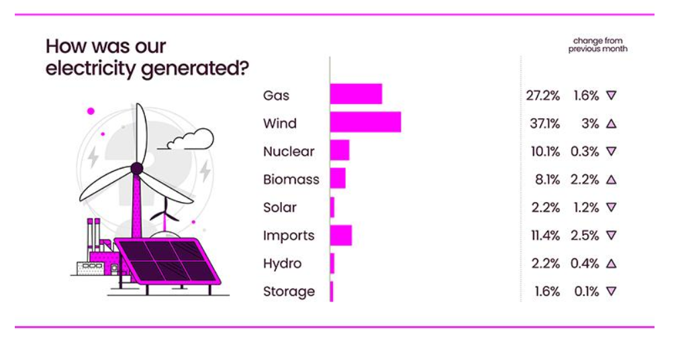
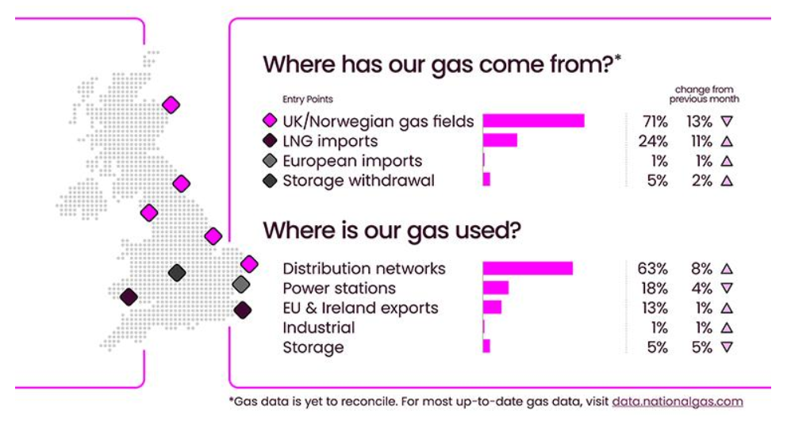
Source: National Energy System Operator – November 2025

Slide 18
8. Desnz smart meter statistics in great Britain
chair

Slide 19
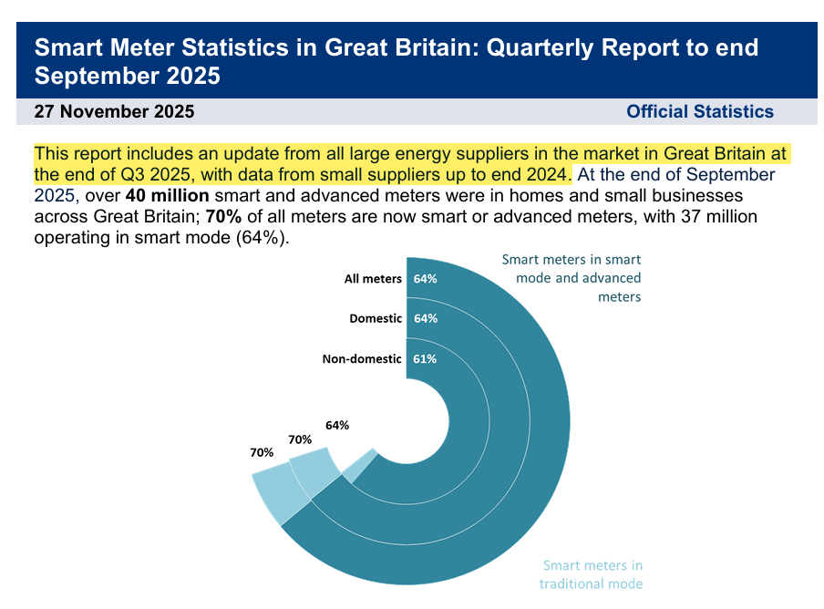
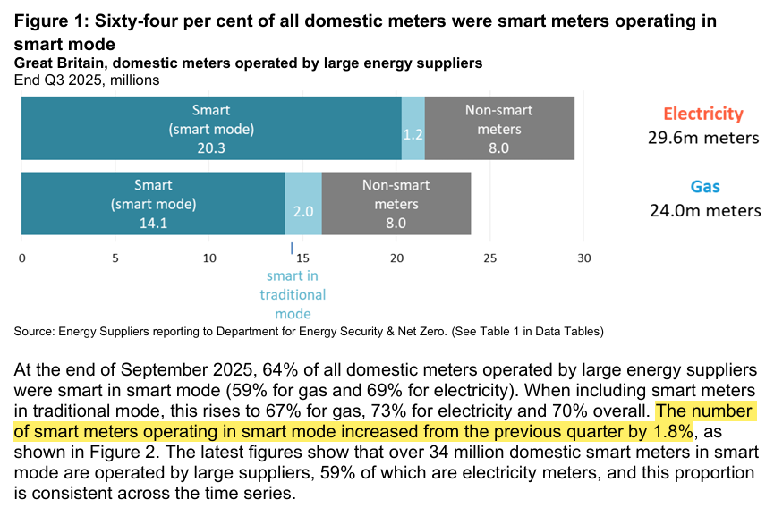
Source: DESNZ – GOV UK - Quarterly Report to end of September 2025

Slide 20
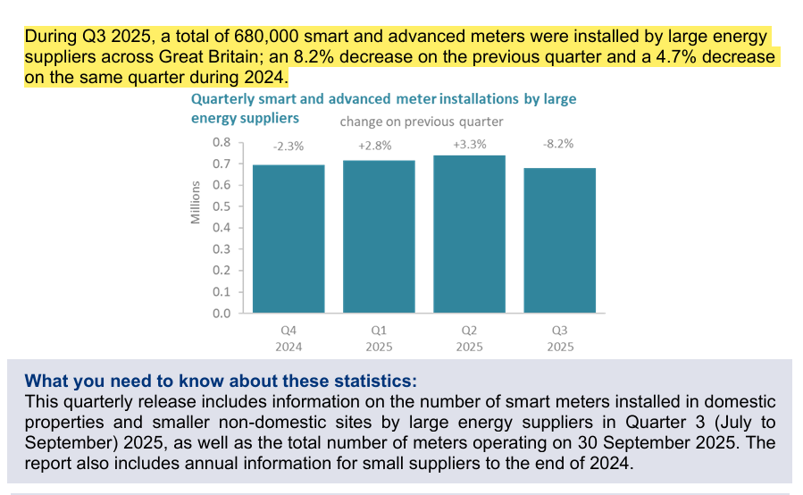
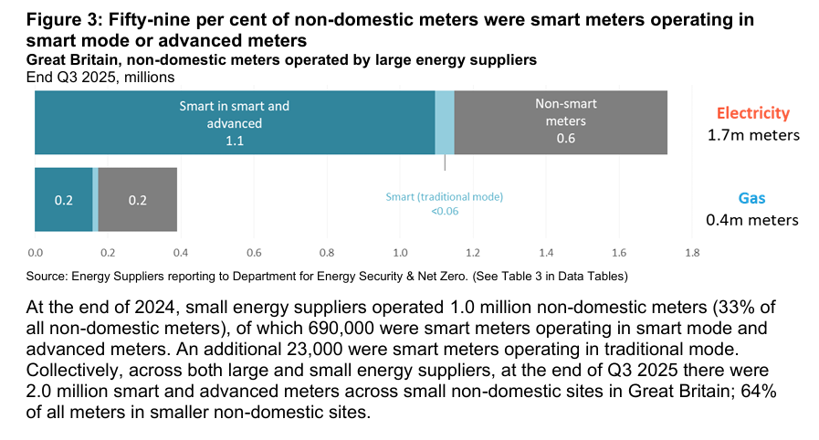
Source: DESNZ – GOV UK - Quarterly Report to end of September 2025

Slide 21
9. 2026 meeting dates
Secretary

Slide 22
2026 Meeting Dates
Meeting | Date | Time
Electricity OMF | 11 February 2026 | 14:00
Gas OMF | 11 March 2026 | 14:00
Electricity OMF | 13 May 2026 | 14:00
Gas OMF | 10 June 2026 | 14:00
Electricity OMF | 12 August 2026 | 14:00
Gas OMF | 09 September 2026 | 14:00
Electricity OMF | 11 November 2026 | 14:00
Gas OMF | 09 December 2026 | 14:00
Calendar invitations will be sent out from committees@recmanager.co.uk later this week to all those who have previously expressed an interest in receiving OMF updates. If you wish to receive the invitations and have not expressed interest previously, contact committees@recmanager.co.uk.

Slide 23
10. aob
all

Slide 24



Do not edit
How to change the design
Your Feedback about G-OMF
The Slido app must be installed on every computer you’re presenting from

