Slide 1
Wilcock Consultants Ltd
Electric Operational Metering Forum
Audit Review January 2026 - July 2026
Teams Meeting
12/08/2026

Slide 2
Overall Audit Numbers & Non-Conformances
Jan – Jul 2026 Gas and Electric
Audit Type | Number of Audits | Number of Non-Conformances
Registration | 76
CoMCoP Rev 3 | 62 | 476
I&C Gas Meter Tech Audit | 7 | 2
REC Gas Meter Site Tech Audit Rev 1 | 9 | 3
V3 Compliance Site Gas Meter Tech Audit | 19 | 2
REC Electric Meter Site Audit Rev 2 | 18 | 7
Total | 191 | 490
These numbers have been collated for 2026 only (to end July).
You will note the overall CoMCoP report is Rev 3 only as the Rev 2 finished in 2025.
The number of Gas Site options will reduce as the year progresses due to reporting changes, until “REC Gas Meter Site Tech Audit Rev 1” will be the only option.

Slide 3
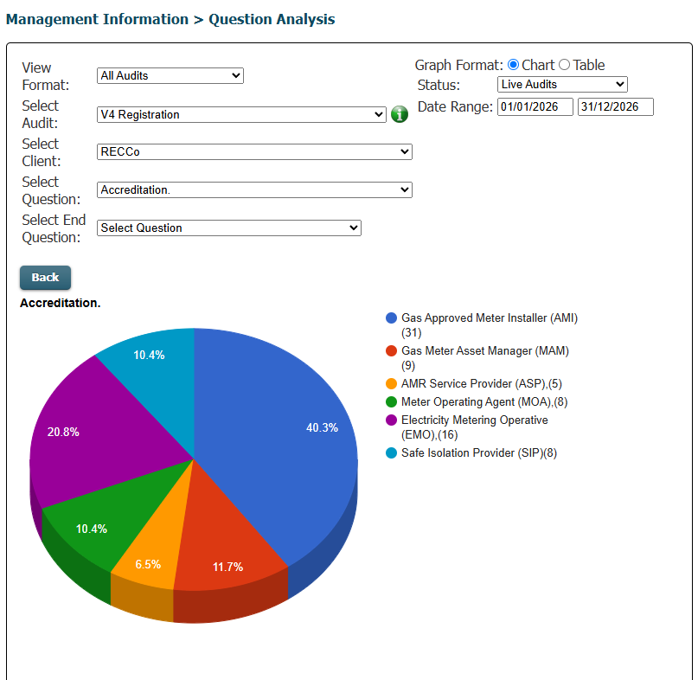
Registration Audits
These are only used to advise, where a company has completed requirements and is to be added to, or maintained on, the database as “Live” for registration purposes. The numbers do not always correlate as they are waiting for site audits in some cases.

Slide 4
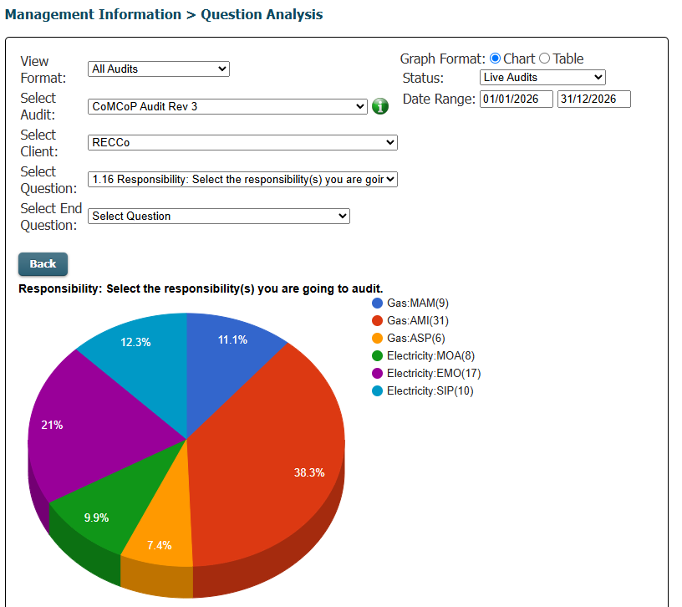
CoMCoP Rev3
These are the audit requirements from January 2026 as a result of the updates..
Part of the large numbers of Non-Conformances relate to the change in emphasis and requirements, mainly electrical. There were still issues in getting requested information in a timely manner.
Technical Audits
These are Electric site audits.
expanded in audit section below.

Slide 5
Electric Specific Audit Numbers & Non-Conformances
Audit Type | Number of Audits | Number of Defects
CoMCoP Rev 3 – Electric Only MOA | 8 | 462
CoMCoP Rev 3 – Electric Only EMO | 17
CoMCoP Rev 3 – Electric Only SiP | 10
REC Electric Meter Site Audit Rev 2 | 18 | 7

Slide 6
CoMCoP – Rev 3 Electric Audits only
Of the 35 audits carried out, 18 have Non-Conformances recorded against them and all defects are shown below.
Ref | Number of Defects |  | Ref | Number of Defects
173602 | 34 |  | 174892 | 1
173816 | 19 |  | 174893 | 12
173983 | 9 |  | 174999 | 6
174010 | 66 |  | 175041 | 60
174031 | 79 |  | 175223 | 1
174159 | 27 |  | 175252 | 3
174190 | 2 |  | 175274 | 9
174491 | 56 |  | 175277 | 4
174679 | 13
174686 | 61
As you can see from the above, 5 audits have the majority of the Non-Conformances. These tend to suggest a lack of understanding of requirements and information needed to show compliance.

Slide 7
The following table shows the number of occurrences above 8 for the above. Full table available in XL document “CoMCoP rev3 actions”
number of occurrences | Question No. | Question
12 | 24.1 | Has the company demonstrated compliance with CoMCoP?
9 | 16.8.7 & 16.8.11 | Provide evidence the company ensures that its Meter Installers have access to a current version of the Guidance for Service Termination Issue Reporting document while on Site and evidence of its use
9 | 6.2.11 | Provide evidence the company reviews the competency of its staff and sub-contractors on a periodic basis in accordance with a documented procedureProvide evidence the review of the competency is led by an appropriately qualified and experienced Engineer or Manager (e.g. Gas min EngTech)
8 | 6.2.12 | Is the review of the competency led by an appropriately qualified and experienced Engineer or Manager (e.g. gas min EngTech)
7 | 6.1.1 | Provide evidence that your company has suitable processes in place for the vetting of Employees and Contractors with demonstration of use
7 | 6.1.3 | Provide evidence that you are aware of the relevant DNO procedures and documentation when working on or in the vicinity of DNO Equipment carried out by DNO employees or agents. Such work is governed by the Distribution Safety Rules of the respective DNO.
7 | 6.2.1 | Provide evidence the company has processes in place to confirm and maintain the Competency of Employees and Contractors and the allocation of work to the correct Operative
7 | 6.3.4 | Provide evidence that the company ensures that Installers engaged for testing meter work are competent
7 | 8.2.3 | Provide evidence consumers able to check the validity of the identity card with the relevant Energy Supplier
6 | 10.2.6 | Provide evidence the company has processes in place to ensure that where instruments are used for voltage measurement they shall be equipped with fused leads
6 | 16.8.9 | Provide evidence of how the company ensure that Meter Installers report incidents/accidents and dangerous occurrences to the relevant reporting authority.
6 | 17.7.10 | Provide evidence that the Meter Operative implements procedures developed by the EMO business as requiredNote obligations also refer to MOA for section e) DNO for sections f) G) & H) of this clause
6 | 2.4 | Provide evidence that all Supplier obligations understood and acted upon as required
6 | 5.1.3 | Provide a policy/procedure and any available records of implementation that detail and confirm that accidents and dangerous occurrences are reported to the Health and Safety Executive
6 | 5.1.6 | Provide evidence that in the case of quarries and mines all work is carried out in accordance with any special regulations and safety requirements
6 | 5.2.2 | Provide evidence of relevant technical qualifications for this type of work
6 | 6.1.2 | Provide evidence of your authorisation from the DNO under its Distribution Safety Rules to operate DNO Equipment and/or enter DNO controlled substations
6 | 6.2.2 | Provide evidence that individual Meter Installers working directly on Site comply with relevant documented requirements imposed on the MAM/EMO
On further review, sufficient information has been supplied to comply with the requirements or limited scopes have been identified to resolve.

Slide 8
Electric Site Audits
Audit Type “Site” (Technical) | Number of Audits | Number of Non-Conformances
REC Electric Meter Site Audit Rev 2 | 18 | 7
Of the 18 audits carried out, 3 had Non-Conformances recorded against them and all defects are shown below.
Ref | Number of Defects |  | Number of Occurrences | Question No. | Question
14137 | 2 |  | 3 | 3.2. | Does the operative hold valid Distribution Business authorisation certificate for the required categories of work?
14187 | 2 |  | 2 | 3.3. | Does the operative hold a valid competency certificate issued by the MEM for the categories of the work being undertaken?
174450 | 3 |  | 1 | 3.4. | Does the operative have access to the current version of the Guidance for Service Termination issue Reporting?
 |  |  | 1 | 1.9. | Does meter worker have proof of qualification

Slide 9
The information that follows shows the year from April 26 to current and is generated from the reporting process

Slide 10
Electric Audit Performance: FY 2026/27
Performance information as shown is now available for you to access.
The information is generated from the table that follows.

Slide 11
Electric Audit Performance: Details
FY 2026/27 |  | Q1 |  |  | Q2 |  |  | Q3 |  |  | Q4
 | Audit Type | Apr-26 | May-26 | Jun-26 | Jul-26 | Aug-26 | Sep-26 | Oct-26 | Nov-26 | Dec-26 | Jan-27 | Feb-27 | Mar-27
 | Total Elec Office Audits | 4 | 3 | 2 | 5 | 0 | 0 | 0 | 0 | 0 | 0 | 0 | 0
 | Total Elec Site Audits | 4 | 4 | 5 | 0 | 0 | 0 | 0 | 0 | 0 | 0 | 0 | 0
 | Electric MOA Office Audits | 1 | 1 | 1 | 1 | 0 | 0 | 0 | 0 | 0 | 0 | 0 | 0
 | Electric MOA Site Audits | 1 | 2 | 2 | 0 | 0 | 0 | 0 | 0 | 0 | 0 | 0 | 0
 | Electric EMO Office Audits | 3 | 2 | 1 | 4 | 0 | 0 | 0 | 0 | 0 | 0 | 0 | 0
 | Electric EMO Site Audits | 3 | 2 | 3 | 0 | 0 | 0 | 0 | 0 | 0 | 0 | 0 | 0
 | SMART ES Office Audits | 0 | 0 | 0 | 0 | 0 | 0 | 0 | 0 | 0 | 0 | 0 | 0
C | Electricity Audits Due | #REF! | #REF! | #REF! | #REF! | #REF! | #REF! | #REF! | #REF! | #REF! | #REF! | #REF! | #REF!
C | Electricity Audits Completed | 8 | 7 | 7 | 5 | 0 | 0 | 0 | 0 | 0 | 0 | 0 | 0
 | Electricity Audits In-Tolerance | 8 | 4 | 7 | 4 | 0 | 0 | 0 | 0 | 0 | 0 | 0 | 0
 | Electricity Audits with 1 or more Non-Compliance | 1 | 2 | 0 | 5 | 0 | 0 | 0 | 0 | 0 | 0 | 0 | 0
C | Electric - % Completed On Time (PCM) | 100.0% | 57% | 100.0% | 80.0% | #DIV/0! | #DIV/0! | #DIV/0! | #DIV/0! | #DIV/0! | #DIV/0! | #DIV/0! | #DIV/0!
 | Electric - % Completed On Time (YTD) | 100.0% | 80.0% | 86.4% | 85.2% | 85.2% | 85.2% | 85.2% | 85.2% | 85.2% | 85.2% | 85.2% | 85.2%
 | Electric - % with 1 or more Non-compliances (PCM) | 12.5% | 28.6% | 0.0% | 100.0% | #DIV/0! | #DIV/0! | #DIV/0! | #DIV/0! | #DIV/0! | #DIV/0! | #DIV/0! | #DIV/0!
 | Electric - % with 1 or more Non-compliances (YTD) | 12.5% | 20.0% | 13.6% | 29.6% | 29.6% | 29.6% | 29.6% | 29.6% | 29.6% | 29.6% | 29.6% | 29.6%
C | Electric - % passed first time (PCM) | 87.5% | 71.4% | 100.0% | 0.0% | #DIV/0! | #DIV/0! | #DIV/0! | #DIV/0! | #DIV/0! | #DIV/0! | #DIV/0! | #DIV/0!
 | Electric - % passed first time (YTD) | 87.5% | 80.0% | 86.4% | 70.4% | 70.4% | 70.4% | 70.4% | 70.4% | 70.4% | 70.4% | 70.4% | 70.4%
For Electric this shows the number of audits planned against completed
Indicates whether passed 1st time and if not passed the number of defects.

Slide 12
Items for discussion / information
There are still a large number of non-conformances where “New Applications” and personnel changes affect responses.
Please remember you will need proof that you are following YOUR procedures.
Where new people have become involved the generality of the audit creates some issues, it is not just technical information it also includes company wide requirements.
  Eg company insurances, other accreditations and information may not be automatically available to technical personnel.
  Similarly, compliance personnel may not have enough understanding of technical requirements.
It may be advantageous to have a team approach rather than one person trying to navigate your company processes.

