Slide 1
Electricity operational metering forum - Meeting
13 May 2026

Slide 2
agenda
AGENDA ITEMS | PRESENTER
Welcome and Introduction | Chair
Audit Update | Eric Dodd
Reformed Connection Process | Avi Aithal
National Energy System Operator – Energy Insights | Chair
Safety and Technical Bulletins on the REC Metering Hub | Chair
Change Tracker Update | REC Change Team
Any Other Business | Rebecca Griffiths
Notes:
*Eric share screen

Slide 3
Welcome – introduction and scope
chair

Slide 4
Audit update
Eric dodd

Slide 5
Reformed Connection Process
Avi AitHal

Slide 6
National energy system operator – Energy insights
chair

Slide 7
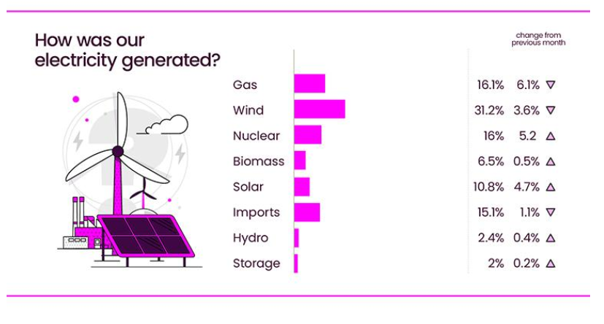
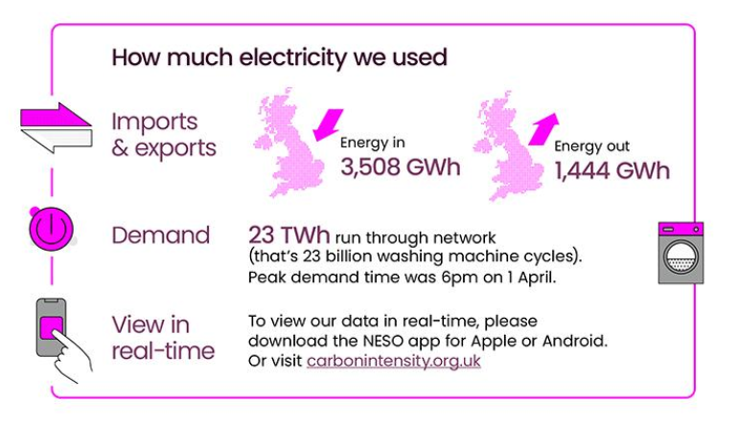
Source: National Energy System Operator – April 2026
On 22 April, between 3:30-4:00pm, zero-carbon sources supplied a record 98.8% of Great Britain’s electricity. Two new solar generation records were also set in April: a peak of 14.8 GW at 12pm on 22 April, followed by solar surpassing 15 GW between 12:30 and 1:00pm on 23 April.
These milestones highlight the capability of Great Britain’s electricity system to operate safely and securely with a significant amount of domestically produced renewables.

Slide 8
Safety and technical bulletins on the rec metering hub
chair

Slide 9
Change tracker update
Rec change team

Slide 10
Change proposal tracker
CP | Title | Lead | Update
I0278 | Establishing the Safe Isolation Provider (SIP) as a Standalone REC Metering Party​ | Francine Peyroux-Sissoko​ | Following engagement with industry Parties, a first closed working group session took place on 11 May 2026 where members started to consider the solutions needed to establish a strong governance framework for standalone SIPs. Post-meeting Papers will be published by 18 May 2026. A second Working Group session will take place on 29 June 2026.
I0312 | Review of export meter work arrangements | Bela Ashworth | On 21 April 2026, REC Change Panel approved the Change Report (Proposal Plan), including the Metering Expert Panel as the Responsible Sub-Committee for this Issue. An I0312 Working Group has been set up to gather input from Industry Parties on the review of Import/Export meters works arrangements in the REC. The first session took place on 06 May 2026. Minutes of this meeting will be uploaded onto the REC Portal by 13 May 2026.

Slide 11
Any other business

Slide 12


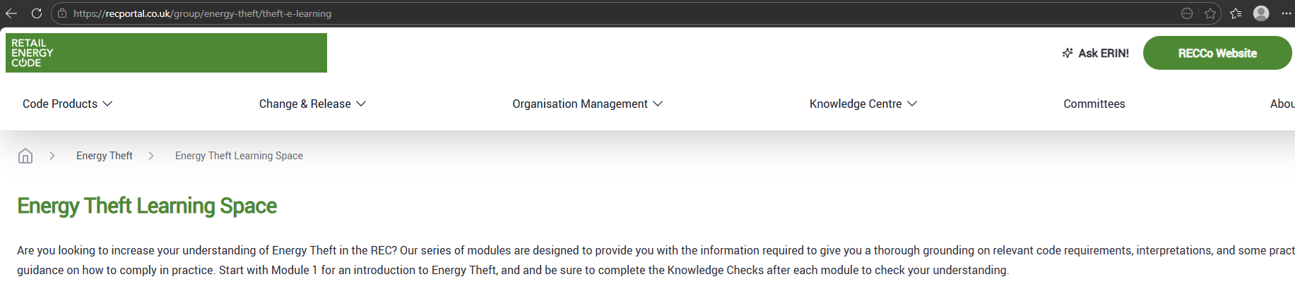
Energy Theft Learning Space
8 Learning Modules covering the end-to-end theft investigation lifecycle:
Energy Theft Overview
Energy Theft Leads
Desktop Investigation and Data Gathering
Site Visit Considerations and Safety
Warrants
Assessment of Unrecorded Energy and Loss Recovery
Reporting, Theft Detection Incentive Scheme and Settlements
Post-Investigation, Evidence and Criminal Proceedings
Access via the Theft Reduction Hub on the REC Portal
For those without a REC Portal log-in, request via the REC Service Desk

Slide 13
Any questions
Contact us:
committees@recmanager.co.uk

