Slide 1
Electricity operational metering forum - Meeting
11 February 2026

Slide 2
agenda
AGENDA ITEMS | PRESENTER
Welcome and Introduction | Chair
Audit Update | Eric Dodd
Metering Agent Annual Rating Consultation | Aleksandra Maczka
National Energy System Operator – Energy Insights | Chair
Safety and Technical Bulletins on the REC Metering Hub | Chair
Marketwide Half-Hourly Settlement (MHHS) Programme Update | Harriet Truss
I0278 – Establishing the Safe Isolation Provider (SIP) as a Standalone REC Metering Party Update | Francine Peyroux-Sissoko
Change Tracker Update | REC Change Team
Any Other Business | Rebecca Griffiths
Notes:
*Eric share screen

Slide 3
Welcome – introduction and scope
chair

Slide 4
Audit update
Eric dodd

Slide 5
Metering agent annual rating consultation
Aleksandra maczka

Slide 6
National energy system operator – Energy insights
chair

Slide 7
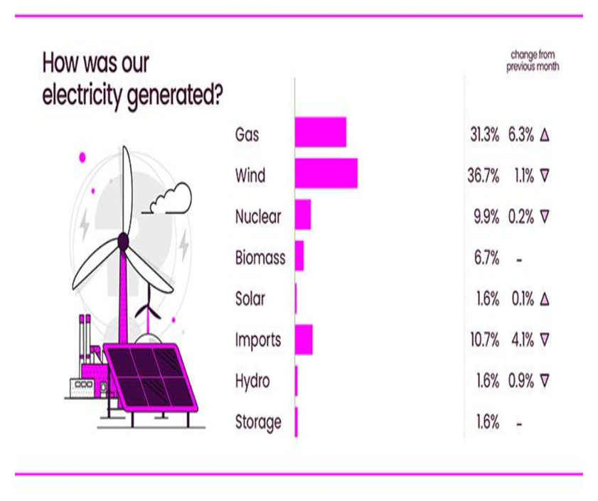
National energy system operator – energy insights
Great Britain’s Energy Explained
In January, wind was Great Britain’s largest source of electricity generation, providing 36.7% Gas followed closely behind at 31.3%.
The highest electricity demand was recorded at 47,319 MW on January at 5pm and 29TWh ran through the network, that’s enough to run 29 billion washing machine cycles.
The largest share of our gas came from UK and Norwegian gas fields at 60% with Liquefied Natural Gas (LNG) imports providing 31% and storage withdrawal provided the remaining 8%.
Distribution networks transported 70% of our gas to homes, offices, hospitals etc and power stations received 8%.

Slide 8
Safety and technical bulletins on the rec metering hub
chair

Slide 9
Marketwide half-hourly settlement (mhhs) – Migration update
Harriet truss, Robert Langdon, Stephen Lovell

Slide 10
Presenters
Harriet Truss
REC Code Manager
Robert Langdon
SMS Energy Metering Services
Stephen Lovell
EON.Next Metering Services

Slide 11
Mhhs Migration update
Migration
Early Life Support
Phase 1
Phase 2
Phase 3
What has worked well
Metering related issues and
‘lessons learnt’

Slide 12
mHhs migration so far
Migration started 22/10/2025 with 5 in-day migrations completed on the first day.
Migration process is working.
Meeting targets, systems handling volumes as required.
Migration pause in early January (1 week) affecting 250k migrations.
On track to recover.
Early Life Support Exit – expected 12/02/2026

Slide 13
Programme early life support
The Purpose of Early Life Support
To assure that the new systems and processes are working as expected across the TOM,
To assure that the central systems are performing as expected
To ramp-up the number of Migrations in a controlled manner,
To share overall performance with industry and to provide a means for industry to provide feedback and discuss performance across the TOM,
To make informed decisions based on performance against defined measures
Operation of ELS
ELS operated through the Transition & Operational Readiness Working Group (TORWG)
TORWG weekly meetings, weekly reporting
REC weekly meeting for internal monitoring, reporting into TORWG by exception
TORWG recommendations on ELS Phase exits; Migration & Cutover Advisory Group approve
Progression of Issues
Actions taken in TORWG to progress resolution under appropriate code or programme governance
- Issues or Change Proposals raised; Guidance created
- Elexon’s MHHS Expert Group; REC Change Issues Group

Slide 14
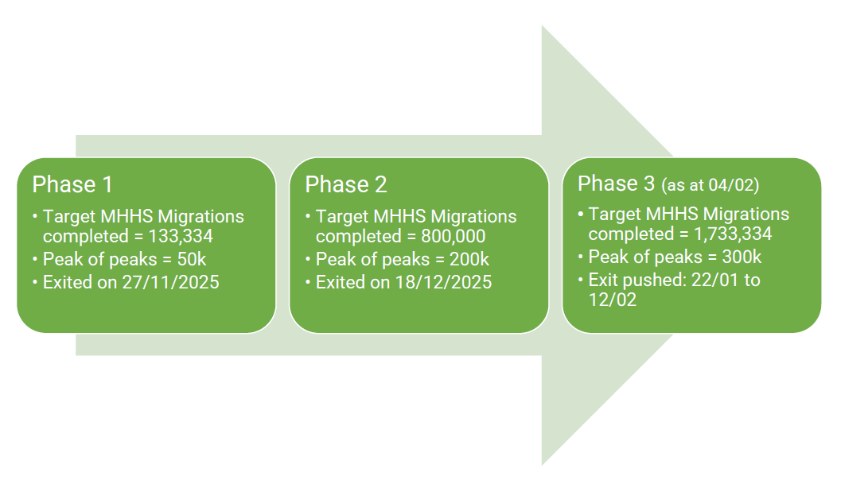
Early life support (ELS) Phases

Slide 15
Metering services experience

Slide 16


Slide 17
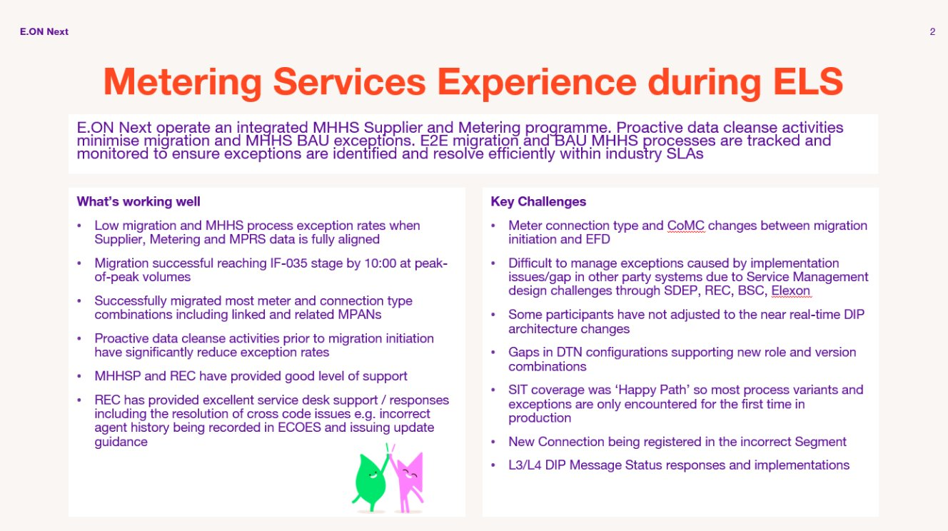

Slide 18


MHHS MIGRATION UPDATE
SMS Experience During ELS

Slide 19
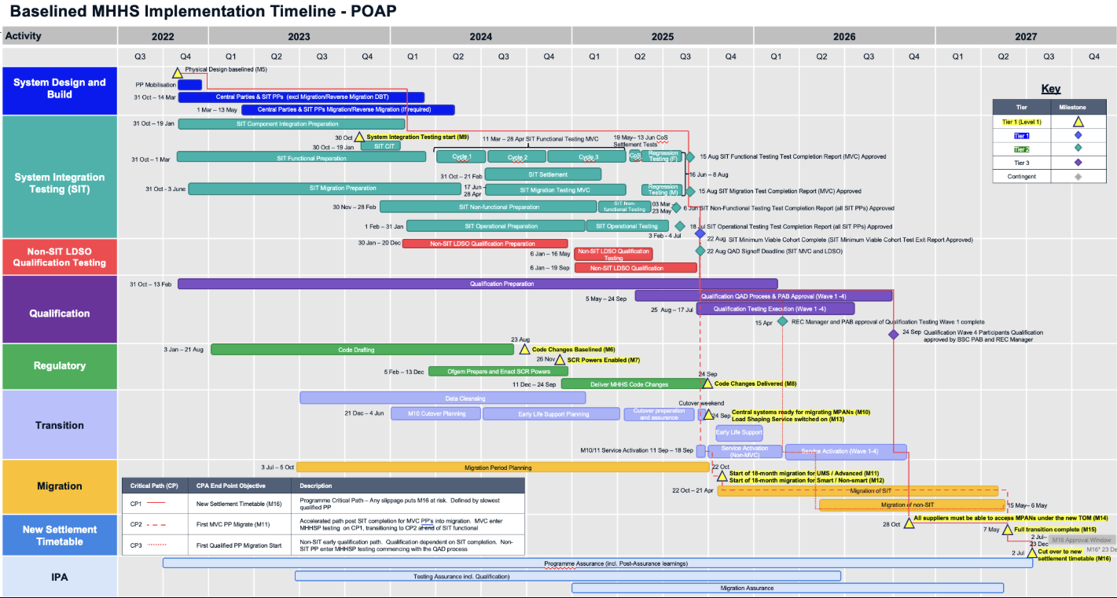
SMS are an independent provider of metering and data services.
Qualifying in all roles (MSS, MSA, SDS and ADS) through SIT and as a partner of E.On Next
What’s worked well?
  Over 1M migrations complete – Peak-of-Peak proving 300k migrations in one day
  Early Life Support providing balanced view of migration success
  TOG (Transitional Operations Group) – now open to all participants
  High levels of automations supporting high volume of successful migrations
  Code drafting delivered by REC and Elexon

Slide 20
What’s being improved?
Elexon Service Desk - Performance & Quality
  Incidents being appropriately prioritised
  Quality and relevance of initial response
  SLA and Incident resolution timescales
  Communication and updates against incidents
  Co-ordination and joined up responses
Communication
What has been challenging
  To get a complete view of issues and updates; participant are having to subscribe to multiple notifications
  Even when subscribed to notifications/following process, some participants don’t receive the messages
  Different/outdated lists being used for distribution
  Transparency and timing of update and issues has been inconsistent
What improvements are being made
  Webpage updates including improved circular sign-up experience
  Updates to Service Status Page to include DIP and Helix systems
  MHHS Run book (future improvement) to be added to website
  Survey on Comms – Published and closes on 15th February
  DIP Manager Communication Feedback Survey

Slide 21
ELS issues being progressed in rec
Issues and lessons learnt in ELS are being progressed through additional guidance being provided or where further work required issues and changes being raised.
Updated and new guidance can be found on the REC Portal, MHHS-related REC guidance Homepage, including:
D0150 Guidance for MHHS Reverse Migrations
MTDS for NHH Metering Points, Reverse Migration from Advanced
Data Alignment of Meter Information Through MHHS Migration
Meter Install EFD earlier than Meter Point Creation Date
REC Issues/Change Proposals | Status
10296 – Registration ID Required for MHHS Appointments | Non-system solution being progressed to support faster resolution
10297 – Meter Manufacturers Make and Type not populated in SMRS | Information Request open
R0300 – Amendments to D0312 to align with BSC CP1622 | Joint REC/BSC industry engagement in progress to resolve challenges with proposed solution

Slide 22
Communications/service channels
REC
REC Service Desk; enquiries@recmanager.co.uk
MHHS processes and obligations governed by the REC
Industry Contacts – REC Portal – Make sure your contact details are up to date (Party Register, Operational Contacts, DNO and MEM Operational Contact List)
Elexon
Elexon Support Homepage – Elexon Support
Elexon Service Status Dashboard
Subscribe to Elexon Newsletter and Circulars
- Includes Industry Standing Data and Integration Platform communications

Slide 23
I0278 – Establishing the Safe Isolation Provider (SIP) as a Standalone REC Metering Party
Francine Peyroux-Sissoko, Glenn Sheern

Slide 24
I0278 – overview
Issue
This Issue seeks to establish SIP as Standalone REC Metering Party to:
The current SIP framework poses several risks:
Create a standalone SIP Party category within the REC with these features:
Proposed Solution
Impact
streamlined Accreditation; and
clear governance and oversight.
Direct accession pathway;
enable easier access to certified SIPs; and
align with Ofgem's Strategic Direction Statement;
resolve risks and safety issues that the current framework poses.
Consumers, MEMs and unaccredited practitioners’ safety;
inequity with a two-tier system;
low competitive market; and
decarbonisation delays.

Slide 25
I0278 – Engagement with Parties
Establishing a clear governance framework for SIPs involves amending numerous legal texts including the Consolidated Metering Code of Practice (CoMCoP) and the Service Termination Issue Reporting Guidance (STIRG) document. This is due to the complexity of establishing a standalone REC Metering Party that is already existent and intertwined with other existing Parties as SIP is currently an additional role layered onto existing MEM’s accreditations.
Currently, there is no methodology agreed between Parties of what should be allowed in this new framework. The Code Manager has therefore started to engage with industry stakeholders to consider all impacts SIPs as a standalone Party would have on other industry Parties.
Following this engagement, the Code Manager is planning to organise working groups from March 2026 to refine the requirements needed for the solution.
The Code Manager would like to ensure all relevant Parties and organisations have been considered.

Slide 26
I0278 – Engagement with Parties
Engaged with
Planned engagement
Energy Networks Association (ENA)
Association of Meter Operators (AMO)
UKRPA
Future Energy Networks (FEN)
Independent Networks Association (INA)
Electrical Safety First
Health Safety Executive (HSE)
Cornwall Energy
DCUSA
Energy & Utility Skills Register (EUSR)
Institute of Electrical Technology (IET)
National Association of Professional Inspectors and Testers (NAPIT)
National Inspection Council for Electrical Installation Contracting (NICEIC)
National Skills Academy for Power (NSAP)
Suppliers
Smart Meter Operation Group (SMOG)
Voltari

Slide 27
I0278 – Engagement with Parties
Please feel free to reach out to:
change.management@recmanager.co.uk

Slide 28
Change tracker update
Rec change team

Slide 29
Change proposal tracker
CP | Title | Lead | Update
R0096 | CSS Message Regeneration Functionality | Bela Ashworth | The Code Manager is preparing the Change Report (Final Recommendation) for publication. This Change will be presented to the TEP on 25 February 2026 for final vote.
I0282 | Return of Legacy Meters | Francine Peyroux-Sissoko | On 03 February 2026, the Change Panel approved the MEP as the Responsible Committee for this Issue. The Code Manager is engaging with Trade Associations to gather industry views.
I0284 | Updates to Schedule 14 Measurement Transformers Commissioning Timescales | Caroline Freimuller | Party impact assessment is open, responses must be received by 23:59 06 March 2026.
I0306 | REC Change to Align with DCP467 Asset Condition Reporting | Caroline Freimuller | Party impact assessment is open, responses must be received by 23:59 27 February 2026.

Slide 30
Any other business

Slide 31
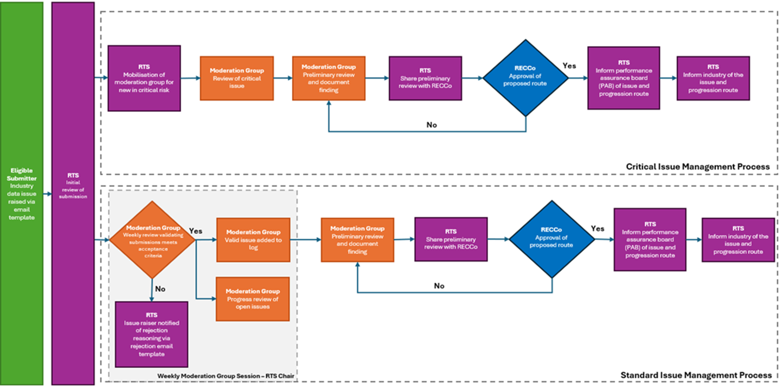
Data error resolution management process
The Performance Assurance Board identified a gap in how data issues were being logged, resolved, and tracked under the REC.
To address this, the Data Error Management process and the Central Data Error Resolution Log have been established to provide a clear, consistent, and transparent mechanism for recording and managing data issues.
The log acts as a single source of truth, improving visibility and strengthening confidence in data quality across stakeholders and consumers. It consolidates all portal submissions, both newly raised issues that require assessment and existing issues shared for visibility, ensuring comprehensive oversight of data-related concerns.
For additional information including acceptance criteria, the submission and review process please visit the designated wiki article - Data Error Management - Party Management - REC Portal
Data error submissions are to be made directly via the portal, located under Organisation Management - Data Error Resolution

Slide 32
Any questions
Contact us:
committees@recmanager.co.uk

