Slide 1

Energy Theft Reduction Programme Scope
Workstream | Project / Activity | Overview / aims
Industry Collaboration | End to End Process Mapping | Mapping of the overall industry processes relating to Energy Theft – including the inputs and outputs, code and licence condition obligations. The identification of gaps, areas of weakness, pain points or risks within the current processes and monitoring of Energy Theft – and recommendations to address these.
Awareness | ETTOS Marketing Review | Competitive procurement of the Marketing Services that are required to support the Energy Theft Tip Off Service (ETTOS) and Stay Energy Safe platform, to ensure the services are best value for money and to drive improvements. Although the Marketing Services are BAU, the procurement activity is being tracked through as part of the programme.
 | Theft Awareness and Action Strategy | Development of a detailed strategy for how awareness and action can best be raised across both industry and consumers. This will highlight how the effectiveness of existing tools and initiatives can be improved and identify new / alternative means of increasing awareness. This will result in the identification of recommended projects and initiatives to increase awareness and action.
Data | Smart Meter Alert Data | Work is underway to explore the feasibility of using Smart Meter data to improve the assumptions and data contained within the Theft Estimation Model (TEM). The intention is to complete testing (known as backtesting) on already reported thefts, to determine which, if any, Smart Meter alerts are correlated to instances of Energy Theft and could be used to better predict and detect energy theft in the future.
 | Energy Theft Data Portal | The development of a dedicated portal to improve industry-wide data sharing. This could provide heat-mapping, trend analysis and threat assessments to be used by a variety of stakeholders to help develop their Energy Theft associated processes, policies and strategies.
Incentive Schemes | Improvements to the Theft Detection Incentive Scheme (2024/2025 scheme) | As the cost of undetected Energy Theft is currently socialised, it can be a commercial advantage to individual suppliers to not detect and investigate it; the Theft Target Methodology (TTM) will be reviewed and revised to ensure those best placed to manage risk are incentivised to detect and investigate Energy Theft.
Enforcement | Social Media Monitoring | A trial of a threat Intelligence and social media monitoring service that will identify emerging trends, that can be used by RECCo and other interested/impacted stakeholder in the development of their processes, policies and strategies.
 | Police Engagement and Partnership Feasibility | Development of proposals for a REC funded dedicated Police energy theft / fraud reduction unit; to enable a nationally cross-party consistent, robust and proportionate police and prosecutorial response to Energy Theft.
 | Amnesty | The exploration of potential models for an Energy Theft amnesty, so that consumers receive help to correct and make safe their metering installation without fear of costs and criminal consequences whilst receiving support and information to prevent further reoccurrences of Energy Theft.

Slide 2
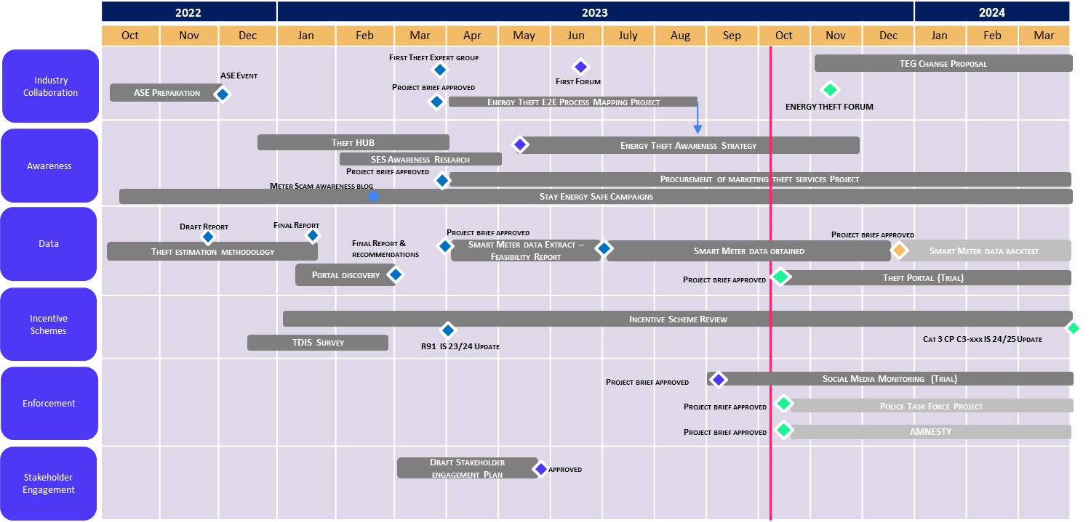
Programme POAP
Green = On Track, Amber = At Risk or Late, Red = Late Critical Path / Missed, Blue = Complete

Slide 3
Programme Status - as at week ending 13 October 2023
Overall Programme RAG Status​
Previous​ | Current​ | Forecast​
Workstream | Project | Stage | Previous RAG | Current RAG | Forecast RAG | Key activity / Update
Industry Collaboration | End Process Mapping | Delivery |  |  |  | Findings and recommendations report is being finalised, ahead of publication on the Energy Theft Reduction Hub on the REC Portal, by the end of October. Comms will target industry theft operational stakeholders. RECCo’s response to the recommendations to be presented at the Theft Forum in November.
Awareness | ETTOS Marketing Review | Delivery |  |  |  | Market engagement event held on 13th October; four marketing agencies attended. Tender requirements and specification in draft. Tender is on track to be issued on 03 November.
 | Theft Awareness and Action Strategy | Planning |  |  |  | 1st stage consumer/end user and industry research interviews have been completed; remaining interviews are being scheduled. Insights playback sessions held; ideation and prioritisation in progress.
Data | Smart Meter Alert Data | Delivery |  |  |  | Status is now amber, reflecting the delays in REC Party confirmation regarding the provision of data, and the risk that Suppliers may not be able to provide control group alert data alongside the TDIS submission alert data – potentially impacting the ability to complete the proof-of-concept testing. Discussions are still ongoing with Electralink and Correla/Xoserve to obtain data flows to support the testing.
 | Energy Theft Data Portal | Pre-project | n/a | n/a |  | RECCo Project Brief to be approved, to enable formal project kick off and the progression of agreements with the identified Portal provider. Initial data sources are being identified and additional sources are being explored.
Incentive Schemes | Improvements to TDIS (2024/2025 scheme) | Planning |  |  |  | Options paper developed by the Code Manager’s Performance Assurance team. This has been issued for consultation. Post consultation, a walkthrough will be held with RECCo and the Code Manager to assess the impact of the proposed changes on the TDIS scheme outcomes.
Enforcement | Social Media Monitoring | Delivery |  |  |  | Six reports have been produced. Reports shared with ETREG members any feedback will be incorporated in future versions. Gemserv to present an overview of the reporting at the next ETREG on 25th October.
 | Police Engagement and Partnership Feasibility | Pre-Project | n/a | n/a |  | Project brief to be developed and presented to the RECCo Portfolio Board, ahead of a proposal being developed and shared with the City of London Police.
 | Amnesty | Pre-Project | n/a | n/a |  | Activity and plan to be progressed – activity not yet due

