Slide 1
Introduction to Future Energy Networks
March 2025

Slide 2
What is FEN?
The organisation
A new membership organisation which represents those in the energy industry seeking to understand and enact the changes needed to deliver the energy networks of the future.
The membership
Current membership consists of the five GB gas networks – Cadent, National Gas, Northern Gas Networks, SGN and Wales & West Utilities. But this could evolve over time.
The
history
Formed from the gas networks’ exit from the Energy Networks Association (ENA)
“
We believe in an equitable and affordable transition to Net Zero for all, with the energy networks playing a fundamental role in enabling this to happen. FEN is leading this change through bringing together the expertise of stakeholders across the energy industry to build the evidence base in support of decision-making, while our member companies invest in the infrastructure required to transport low carbon energy from producers to consumers.
”

Slide 3
FEN’s purpose, mission and vision
Purpose
Mission
Vision
To bring our members together as a collective and to act as a convener with other key sector institutions, while at the same time leading our members to enhance their evidence and engagement in the sector on the future of the gas network
To create an organisation which is influential with key energy sector decision-makers, is established as a trusted authority on the future of the gas networks and is a powerful advocate for their key policy and regulatory issues
To see an energy sector and government which understands and values the role of gases, both in the current and future energy mix, and recognises the enduring need for a gas network as part of a whole energy system to meet Net Zero

Slide 4
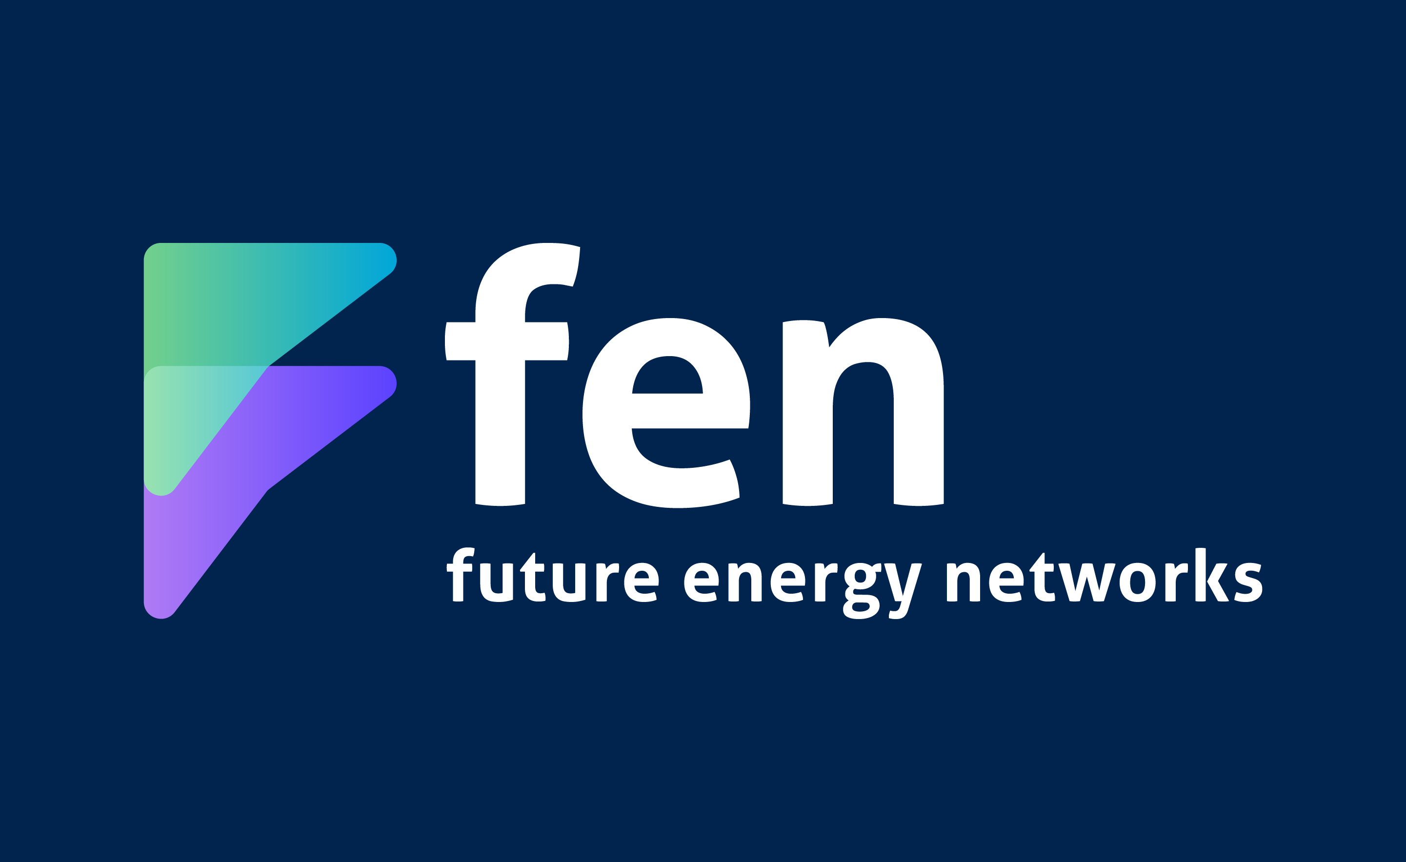
The role of FEN – our key coverage areas
Strategy
Leading our members to consider their strategic approach in response to political, policy and market change
Delivery of joint pieces of research/analysis in support of this strategy
Positioning the gas networks as key enablers of Net Zero
Policy
Engaging with key policy-related stakeholders – DESNZ, NESO, CCC etc.
Shaping policy outcomes from the new government through consultation responses and targeted engagement efforts
Developing clear collective policy positions, and the evidence behind them
Innovation
Management of collective innovation activities, as required by Ofgem
Management of collective innovation project work, either with or on behalf of our members
Running a new online portal for accessing gas network innovation project data
Regulatory
Supporting our members through the RIIO-3 business planning process
Coordination of our members’ collective regulatory and finance activities, including engagement with Ofgem and commissioning joint work
Running the ‘National Gas Incident Reporting Site’ – a key reg requirement
Technical
Running joint working groups to maintain the safe and efficient running of the networks
Coordinating cross-industry efforts to enable growth of biomethane injection into the network
Managing governance process around updates to industry standards
Comms (crisis and other)
Coordinating industry crisis comms process in the event of a national gas emergency
Act as an advocate on behalf of our members, working with member companies and any appointed agencies on comms

Slide 5
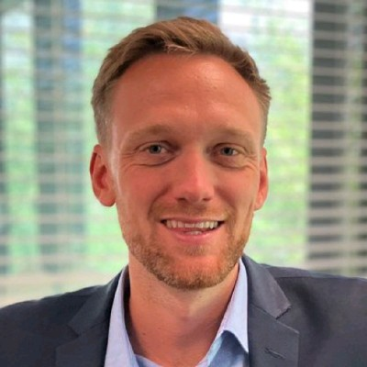
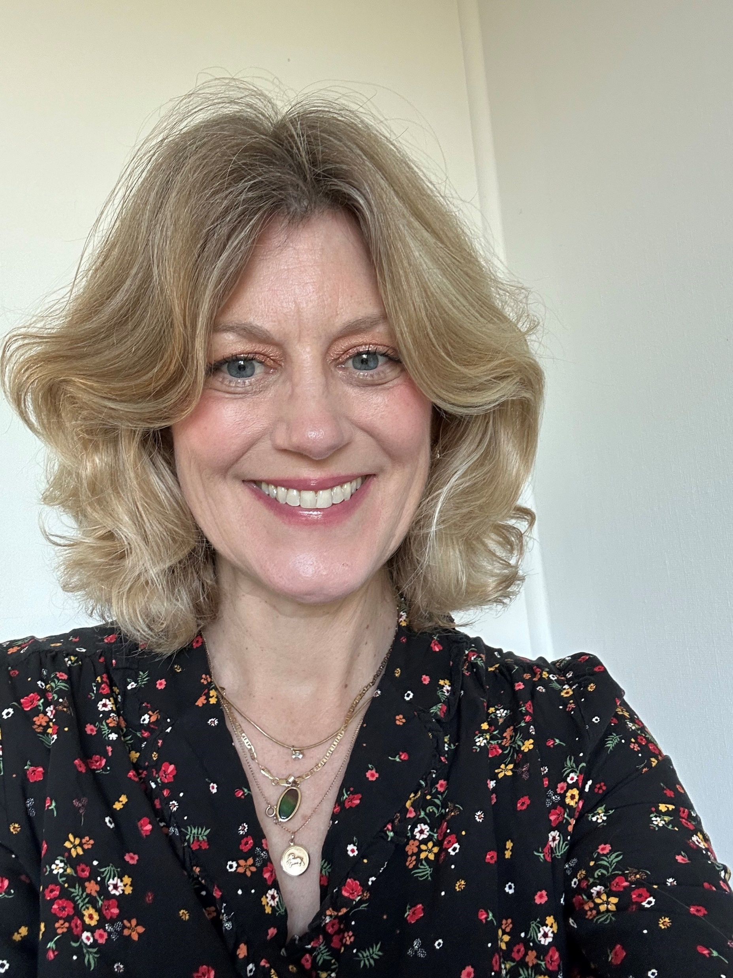
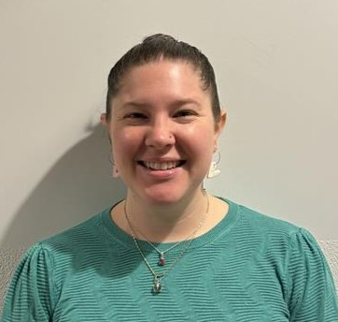
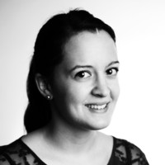
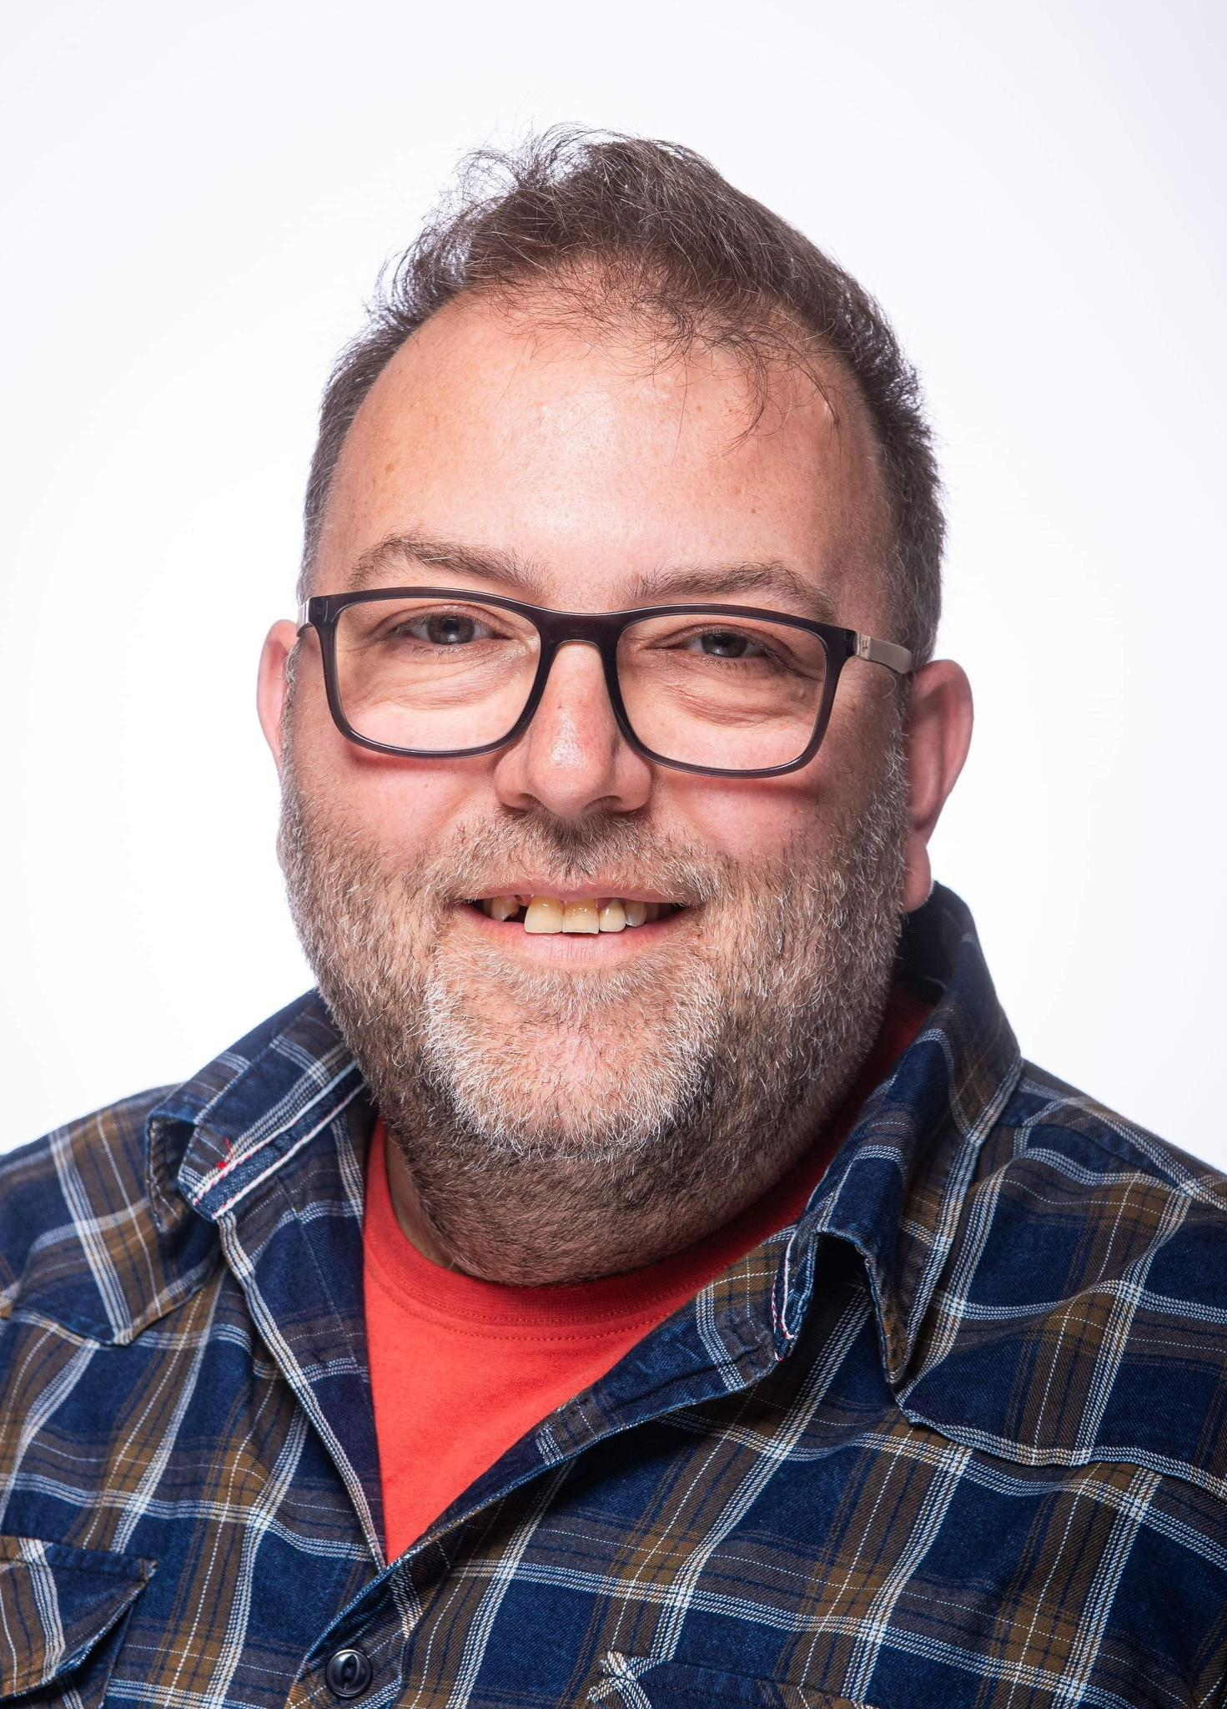
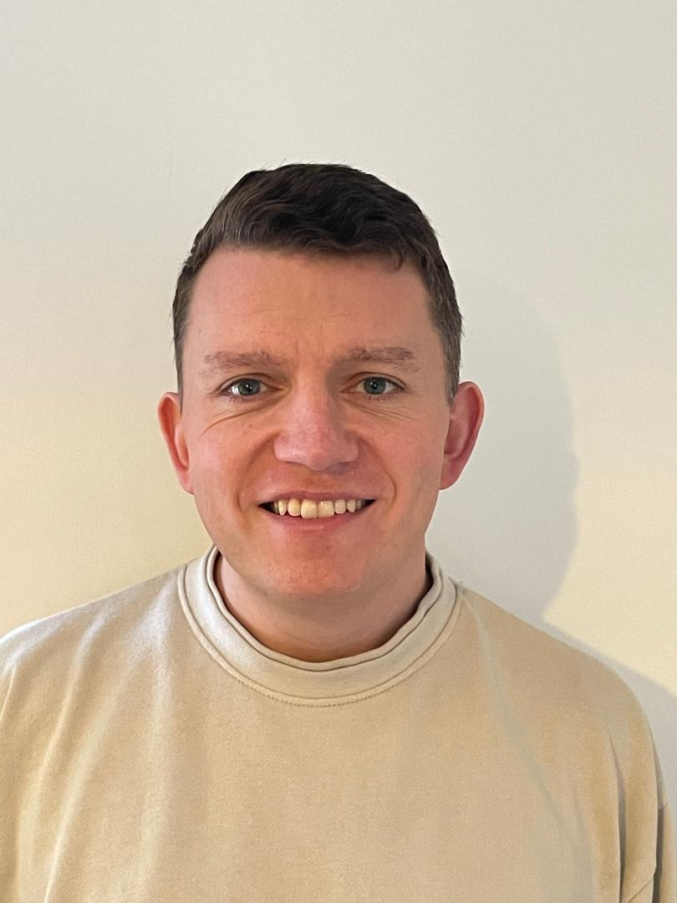
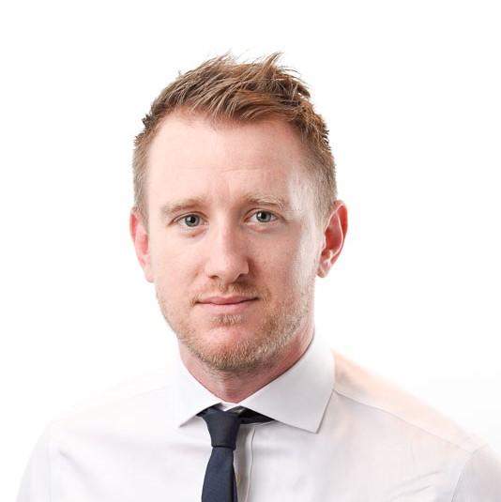
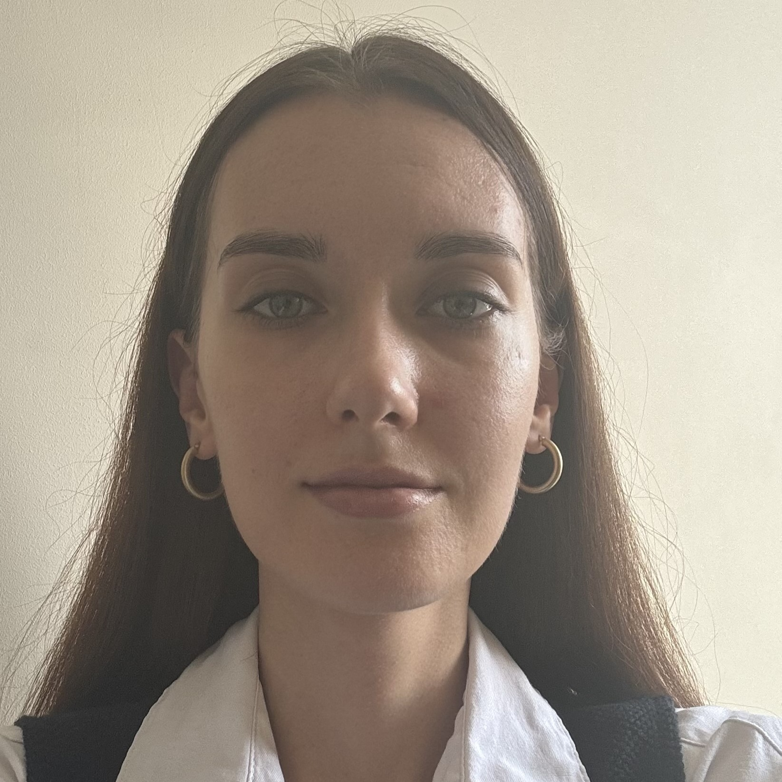
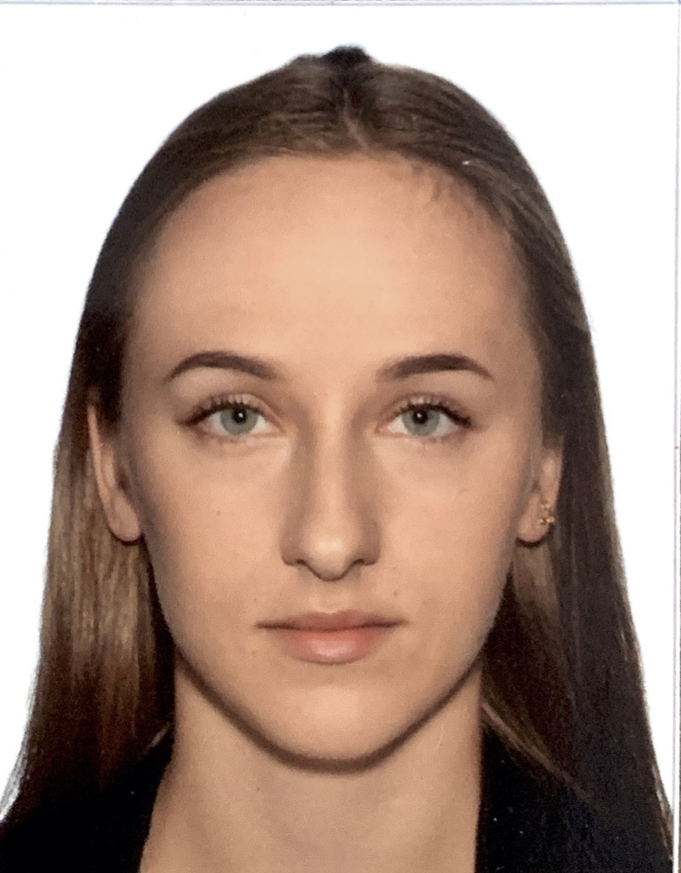
The FEN team
James Earl
CEO
Sarah Long
Erica Brown
Silvia Simon*
Head of Comms
Head of Policy
Head of Research and Innovation
Nolan Robertson
Toby Williams
James Pleass
Julia Komar
Weronika Wilkowiecka
Senior Manager
Comms Manager
Project Manager
Senior Analyst
Project Coordinator
*On maternity leave until April 2025

