Slide 1
Gas operational metering forum - Meeting
10 June 2026

Slide 2
agenda
AGENDA ITEMS | PRESENTER
Welcome and Introduction | Chair
Audit Update | Eric Dodd
Changes to ACS Training | Richard Harper
Legacy medium pressure supply sites | Perry Duhig
Schedule 14 SLAs | Harriet Truss
REC Metering Hub and Bulletins Update | Chair
IGEM Update | Dave Harper
National Energy System Operator – May 2026 Insights | Chair
Any Other Business | All
Notes:
*Eric share screen

Slide 3
Welcome and introduction
chair

Slide 4
Audit update
Eric dodd

Slide 5
Changes to ACS Training
Richard harper

Slide 6
Legacy Medium Pressure Supply Sites
Perry Duhig

Slide 7
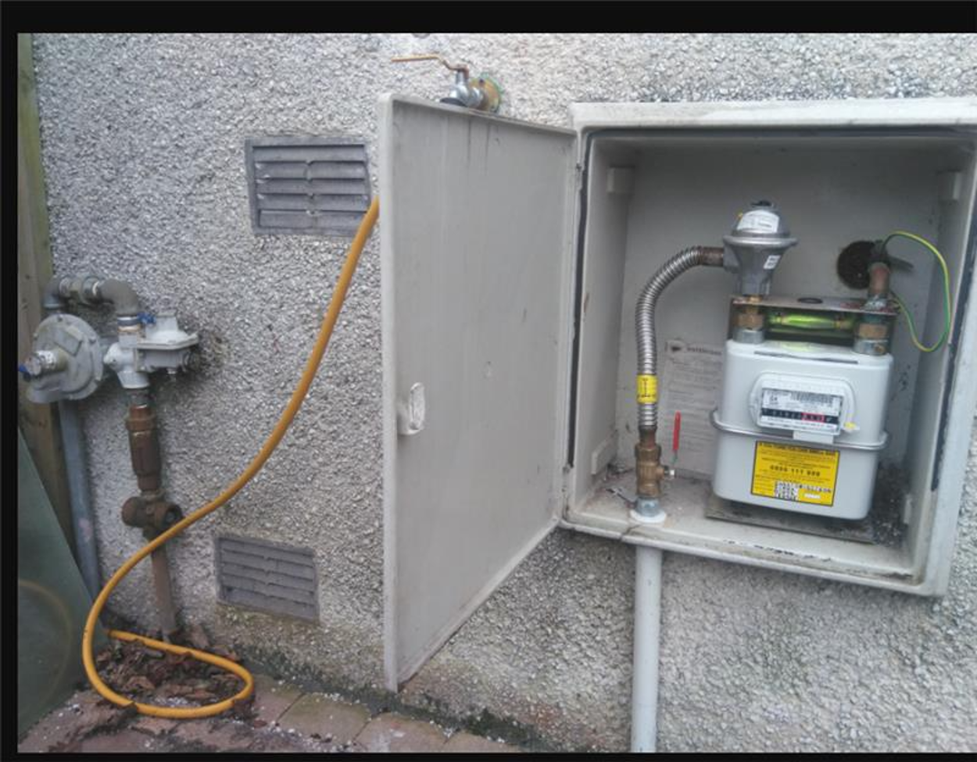
The Scenario for discussion:
Above ground Medium Pressure Regulator feeding (via above ground or buried pipework) ECV andLow-Pressure Meter Installation.
In some cases, the Low- pressure installation components are situation inside the property.
Is the Medium Pressure regulator part of the meter installation?

Slide 8
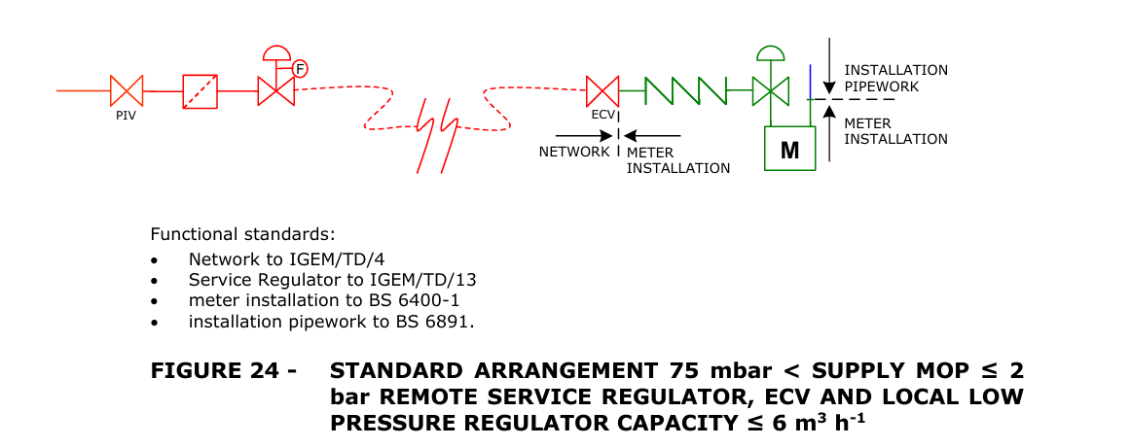
IGEM G1 States:
“An emergency control is a valve intended for use by a consumer for turning off the gas supply in an emergency. An emergency control will always be found at the end of a service pipe but additional controls may be found in premises, for example, if the primary meter is moved to assist a disabled person.”
Figure below indicates that the Medium Pressure Regulator is Network equipment (but may not apply to Legacy set ups).

Slide 9
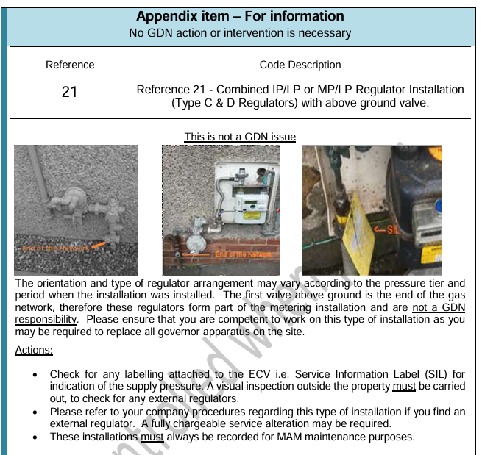
Network Operator Guidance document GER1 advises first above ground valve is the end of gas network.
These valves do not meet the criteria of an ECV
Therefore:
Medium Pressure Regulator forms part of the Meter Installation
But as situated upstream of the ecv, a Safety Case submission to HSE is required to work on replace or maintain.

Slide 10
Issues that arise:
Many MAM/AMI organisations do not have required competency to work on this configuration.
Customers have limited or no option for Smart Installation.
Customers known to move from Supplier to Supplier to facilitate Smart Installation.
Individual operatives may miss identify and exchange only Low Pressure components.
Subsequent change of agent leaving the MP regulator un-maintained.
MAMs probably being assigned to sites without knowledge of the current configuration and possibly without competence to maintain.
May cause subsequent problems when attending meter or supply failure issues where assigned MAM/AMI cannot resolve.

Slide 11
Schedule 14 SLAs
Harriet Truss

Slide 12
Metering Operations Service Level Agreements- 2WD and 48H
Schedule 14 captures SLAs for gas metering operations activities throughout
There are instances of ‘48 hours’ and ‘2 Working Days’
During REC drafting for MHHS, there was a request to review whether these should all be one or the other

Slide 13
Instances of each SLA
48H
All other steps have SLAs, where required, of 2WD (or a small number with 6WD)
2WD
Metering Asset Install (6.4.5, 6.4.9 and 6.4.10)
Metering Asset Removal (7.4.5, 7.4.9 and 7.4.10)
Metering Asset Exchange/Reposition (8.5.5, 8.5.9 and 8.5.10)
Change of MAM with Metering Asset Exchange (12.5.7, 12.5.11 and 8.5.12)
- 48H prior for pre-notifications MAM to Supplier
- Within 48H for notification MAM to Supplier
- Within 48H for notification MAM to CDSP

Slide 14
Questions
Are attendees happy that the two distinct SLAs, 2WD and 48H, are valid and should remain as is?
OR
Does this need exploring further under a REC Issue?

Slide 15
Rec metering hub and bulletins update
chair

Slide 16
Igem update
Dave harper

Slide 17
National energy system operator – May 2026 insights
chair

Slide 18
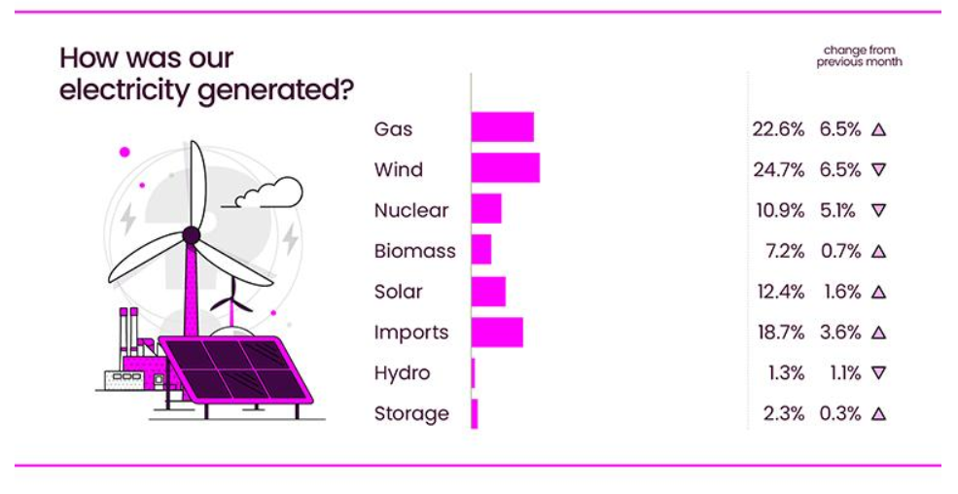
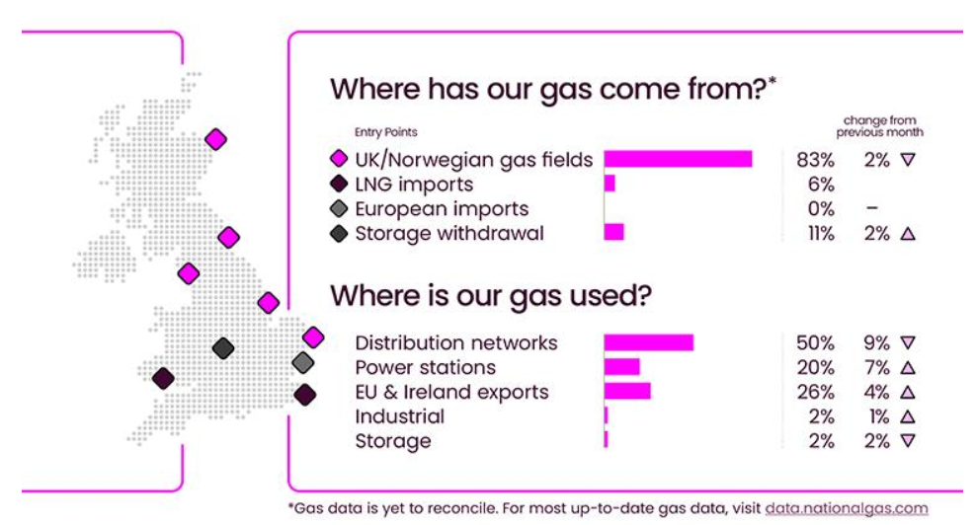
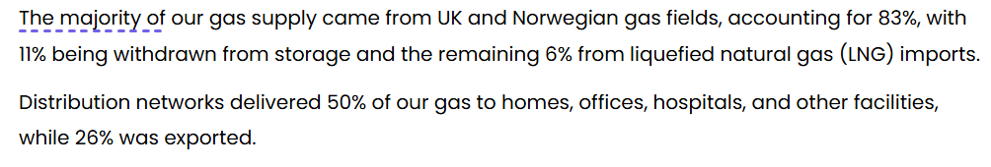
Source: National Energy System Operator – May 2026

Slide 19
Any other business

Slide 20
Any Questions
Contact us: Committees@recmanager.co.uk

