Slide 1
I0200 WORKING GROUP
Meeting 2
17 July 2026

Slide 2
Agenda
Agenda Item | Presenter
Welcome and Introduction | Chair
Review Minutes and Actions | Chair
REL Address Data Quality and Incident Management | Victoria Crossan (DCC)
Signposting / Quick Wins | Chair
DCC Validation Rules | Victoria Crossan (DCC)
Defining Unmatchable Addresses | Chair
Review Topics List and Agenda Items for Next Meeting | All
Any Other Business | All
Date and Time of Next Meeting | Chair

Slide 3
Review Minutes and Actions
cHAIR

Slide 4
I0200 – Meeting 1 – Review Minutes and Actions
MINUTES
No comments or amendments made.
ACTIONS
ITEM | RESPONSIBLE | STATUS
Develop initial guidance materials, including examples of appropriate and inappropriate address content, and draft a user guide outlining best practice for address data entry, including examples of good and poor data. | Lorna Mallon and Vic Crossan | In progress – see I0200 Working Group 2 20260717 - Address Guidance Document v0.1
DCC to clarify DCC Validation rules, prepare materials on DCC matching constraints and include default postcode usage within the standardisation activities and considerations. | Vic Crossan | In progress – To be discussed today
DCC to prepare Incident Management Guidance on incident driven address updates and when and why DCC requests changes outside standard processes. | Vic Crossan | In progress – To be discussed today

Slide 5
I0200 – Meeting 1 – Review Minutes and Actions
ACTIONS
ITEM | RESPONSIBLE | STATUS
DCC to progress agreement on definition of unmatchable addresses and the standard identification and treatment of these records. | Vic Crossan | In progress – To be discussed today
All working group participants are to share with the Code Manager any existing document, standards, or naming conventions they hold with regards to address management and submit any additional topics for the scope and agenda of the I0200 working group. | All Working Group Members | Outstanding

Slide 6
REL Address Data Quality and Incident
Management
Victoria Crossan (DCC)

Slide 7

Systemic Matching Process- Overview
‘Unmatched’ REL Address
’local’ UPRN (999..)
MPL address displayed in Enquiry Service
Confidence score <90
Initial Registration
No
Gold Standard Match?
ONLY candidate address AND
‘stands clear’ of other address
with a confidence score close to the threshold
MPL Match Against OS ABP
Matched REL Address
OS ABP UPRN allocated
18 Attempts to match using different elements of the address (Search Blazes)
The different combinations of address fields are intended to negate spurious data preventing a match.
Yes

Slide 8
Matchable vs Unmatchable
Unmatched and we could match to OS ABP if the MPL address was improved
Unmatched and we could match if the MPL address was improved but the address is not one a consumer would Switch via a Price Comparison Website or TPI
Unmatched and we will never match because it is correct that the MPL isn’t matched
Unmatched and we will never match to OS ABP because the premise type is not found
Unmatchable
Matchable
Matchable
Unmatchable
Unmatchable
Prioritised on impact to consumer
E.g. Invalid Postcodes
Challenging & complex addresses
Consumer likely to know MPXN
Infrastructure related e.g. EVCP (>13 variants identified)
Potentially possible to identify by a stop word
Flats or Landlord Supplies where no parent/appropriate UPRN to match the service to
Risk of erroneous switches
Not identified by a stop word
Identified by a stop word e.g grass verge or temporary building supply
Only applies against the Unmatched volume
Regex expression
Risk of false positives
Is Non-PAF unmatchable?

Slide 9
Stop Words
“Only MPLs which relate to property types which are expected to be recorded within OS ABP will be deemed in scope. Locations (of meters) such as ‘Mast in North Field near Holly Farm’ are deemed ‘Out of Scope’ since they are neither a postal address nor do they carry a distinct, identifiable location which will ever be expected to appear in OS ABP. These locations are not included within the REL Guidance document or counted within the match rate calculations. The very nature of meters located at sites such as those in ‘proximity’ to a building, telecoms cabinets, bus stops, advertisement hoardings or masts in fields are all allocated an addressSource of ‘MPL’”
REL Guidance Document v1.0 - Section 2.2 – Out of Scope of REL Guidance Document & Match Calculations
Stop words is a query that is only run against the unmatched REL volume- if the address has matched then a Gold Standard match has been found against OS ABP
We review new matches where potential false positives could be created e.g. ‘exchange’ & revert these matches
We don’t currently use Non PAF or Non-Postal as a stop word. Should we?
Should Electric Vehicle Charging Points be included, charger/charging is should it be extended?
Examples of current descriptors identified as ‘EVC, EVC Point, EVC Point Side Of, EVC Pont, EVC Junction With, EVCP, EVCP Car Charge Point, EVCP Car Charge Pont, EVCP Charging Point, EVCP Outside, EVCP Supply, EVCP Underground Garage Supply”
TBS –abbreviation of temporary building supply
Substations
Unmatchable
Unmatchable
Matchable

Slide 10
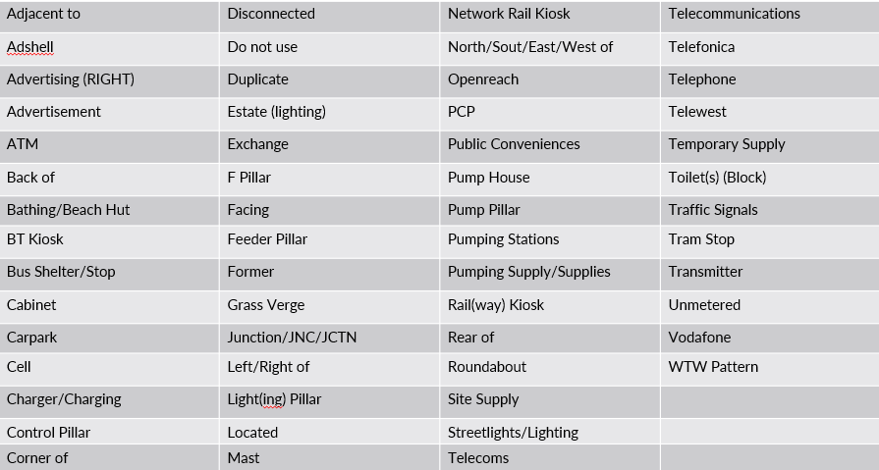
Stop Words
Unmatchable
Unmatchable
Matchable

Slide 11
Hidden Characters
The address appears valid/perfectly formed in both the Enquiry Services & in CSS
We have identified multiple types of hidden characters but so far only the Non-Breaking Space Command (NBSP) appears to cause a problem
Impact is felt downstream in the Smart Metering systems as the NBSP is being translated as a ? in the middle of the thoroughfare line of the address
Supplier is unable to install & commission a meter, significant impact on consumer, GSOP payments and multiple touches across multiple parties to resolve
Does not form part of the address and is accidentally included
Requires an RMP update, updating the MPL to ‘cleanse’ the address & update CSS
Known Issues Knowledge Article created
We have proactively identified impacted records and contacted parties to try and get data cleansed before issue manifests itself.
We will continue to run queries to identify any new issues
When identified how would parties prefer to be notified? We want to maintain visibility & audit trail
Unmatchable
Unmatchable

Slide 12
Incident Management
Schedule 29- Address Management
Paragraph 2.2 states that we should “ investigate and resolve the inaccuracies and anomalies in the REL Addresses in each case by determining the most accurate address to be used as the REL Address (such investigation and resolution to be progressed as a Switching Incident/Switching Service Request in accordance with the process and timescales required by the Switching Service Management Schedule)
Previous AQP’s note that industry agreed to not use INC to track and resolve due to the potential volume of cases and impact of the short SLA
We would, in certain circumstances, like to start using the INC process again but recognise the impact this will have on Parties
DCC is working with RECCo proposing a REC change to create a P5 incident to respective ERDA & GRDA with a longer SLA
Unmatchable
Unmatchable

Slide 13
Address Field Mapping
MPL Address Field | Address Base Premium Field
deliveryPointAlias subBuildingNameOrNumber | secondaryName
buildingName buildingNumber | primaryName
thoroughfare | street1
dependentThoroughfare | street2
dependentLocality | locality1
doubleDependentLocality | locality2
postTown | Town
postcode | postcode

Slide 14
Signposting / Quick Wins
Lorna Mallon
Notes:
Get guidance doc up

Slide 15
Defining Unmatchable Addresses
Lorna Mallon

Slide 16
I0200 - topics
Signposting from the REC / improved understanding | Standardisation | DCC Understanding | New connections | Quick wins / hand over to APM | Data Item and Reporting Changes | Legal text only
DF – flats, particularly Scottish G - PAF formatting and validation G – CMS processes DF – what cannot be included in the address e.g. security codes, what 3 words, names DF – Supplier’s role within the process | DF – agree what is non-addressable DF – agree formats for common address types e.g. landlord suppliers E – agree formats for common address types e.g. EV chargers E – What Metering Point Address Line 1 can include E – Export MPANs – should they say export? DF – should phrases be used to flag as non-addressable | DF - stop words – what are there DF – agree stop words and create published list DF – hidden and invalid characters – what are they DF - agree hidden and invalid characters and create published list DF – REL manual updates and challenging a REL DF – DCC knowledge articles DF – document and publish DCC matching sets | DF – should a default postcode be used DF – who knows what address when? DF - When is it a crossed meter and when is it an address correction? | E – lessons from D0381 assurance DF – user guides – what does good and bad look like E – D0381 user guide – what does good and bad look like DF – APM – spell checks on parts of the address e.g. town or county DF – incident flagged by DCC – how should they be raised (i.e. data issues outside of APM)? | DF – address EFD – changes each time address is updated in CDSP / MPRS and ERDS. Available on Enquiry Systems DF - Performance Assurance Reporting – including cross code | DF – Xoserve / DNOs to share UPRN if they have it and if requested by DCC DF – put into code the process for DCC flagging incidents (i.e. data issues outside of APM) DF - What should be in the Schedule (CP process), what should be in the Address Population Rules (CP process), REL guidance document, new documents. DF – What change process should any new documentation follow
DF = dual fuel, G = expected to be gas only, E = expected to be electricity only

Slide 17
Review agenda items for next meeting
Actions
Standardisation
  Dual fuel – Agree formats for common address types (e.g., landlord suppliers)
  Electricity – Agree formats for common address types (e.g., EV chargers)
  Dual-fuel – Phrases flagged as non-addressable
  Electricity – Export MPANs
Signposting
  Supplier’s role in the process

Slide 18
Any Other Business
All

Slide 19
Date and time of next meeting:
03 September, 14:00-16:00

