Slide 1
I0312 – review of Export meters works arrangements
WORKING GROUP 3
14 July 2026

Slide 2
Agenda
 | TITLE | PAPER | TIME | LEAD
1 | Welcome and Introduction | Verbal | 11:00 | Chair
2 | Review minutes and actions of previous meeting | I0312_WG_0306_Draft Minutes v0.1 | 11:05 | All
3 | Recap Position | Verbal | 11:10 | Chair
3 | Change of Energisation Status | Verbal | 11:35 | Chair
4 | Change of Feeder Status | Verbal | 12:00 | Chair
5 | Change of Market Segment | Verbal | 12:30 | Chair
6 | Any Other Business | Verbal | 12:55 | All
7 | Next Steps, Date and Time of Next Meeting | Verbal | 13:00 | Chair

Slide 3
Housekeeping Rules
Meetings will be recorded to provide meeting notes.
Use the chat or the hands-up function to help flow of discussions.
Please stay on mute if not speaking.

Slide 4
Review minutes and actions of previous meeting

Slide 5
Working group – Actions
MINUTES
No comments or amendments made.
ACTIONS
I0312WG_0605_A01 | The Code Manager to draft Impact Assessment.

Slide 6
RECAP Position

Slide 7
Recap Position
Meter Removal / De-energisation
The majority view was that the Export Supplier should not be able to physically remove the meter and de-energise the Import Supply.
There was recognition that logical meter removal and de-energisation on the Export supply may be required (e.g. if generation equipment is permanently removed) and this is a separate activity.
Where emergency de-energisation is required by the Meter Operator while on-site, to make the site safe, this will still be required. The Meter Operator would need to notify both Suppliers of the de-energisation.
PROPOSAL
Permanent meter removal and de-energisation is restricted to the Import Supplier for import/export supplies.
Does not prohibit Meter Operator from making the site safe where required.
Does not prohibit ‘logical’ changes to Meter Technical Details and energisation status.
Does not apply to Export-only sites.
Notes:
To be added in later versions

Slide 8
Recap Position
Meter Installation / Exchange
The working group acknowledged scenarios where an Export Supplier may wish to exchange an import/export meter.
Many of these scenarios may be driven by the consumer/generator directly.
It was agreed that an Export Supplier should be able to request a meter exchange, where it holds a valid contract with the MOA.
The Working Group considered that both Import and Export Suppliers should be required to notify each other of planned works, prior to the planned date, with a mechanism to object/query the work. SDEP was considered as an option.
PROPOSAL
Allow Export Suppliers to request meter exchanges/upgrades for Import/Export Supply, subject to a valid contract with the MOA.
Requirement for both Import and Export Suppliers to notify each other of planned works for shared Import/Export meters.
Introduce objection/query mechanism if one Supplier has concerns about the work.
Notes:
To be added in later versions

Slide 9
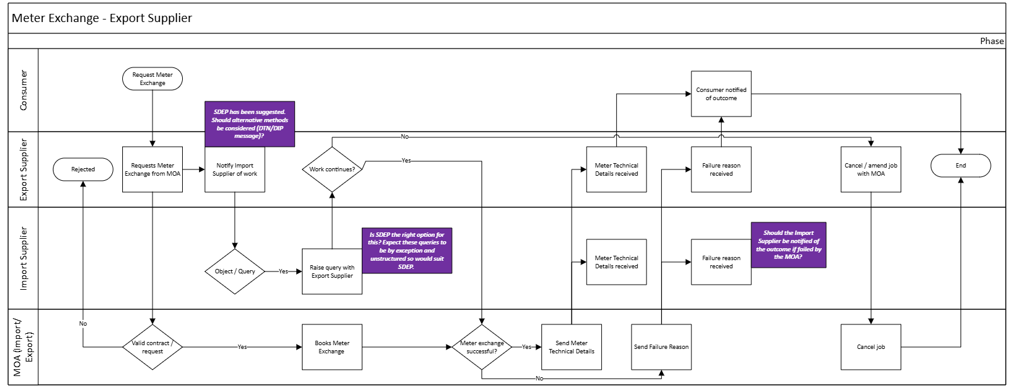
Meter Installation / Exchange

Slide 10

Meter Installation / Exchange

Slide 11
Recap Position
Fault Resolution
The working group acknowledged that both the Import and Export Supplier would have an interest in a meter fault investigation being initiated by the other Supplier or Data Service.
Where an Export Supplier holds a valid contract with the MOA, it may wish to initiate an investigation. Where an Export Supplier does not hold a valid contract with the MOA, it would need to notify the Import Supplier of the suspected fault.
PROPOSAL
Allow Export Suppliers to request fault investigations for import/export supply’s, subject to a valid contract with the MOA.
Requirement for both Import and Export Suppliers to notify each other of fault investigations; or the Data Service to notify both Suppliers (would require consequential change to BSC).
Introduce query mechanism for Supplier’s to request additional information about the fault investigation.
Both Suppliers to be notified of outcome of fault investigation.

Slide 12
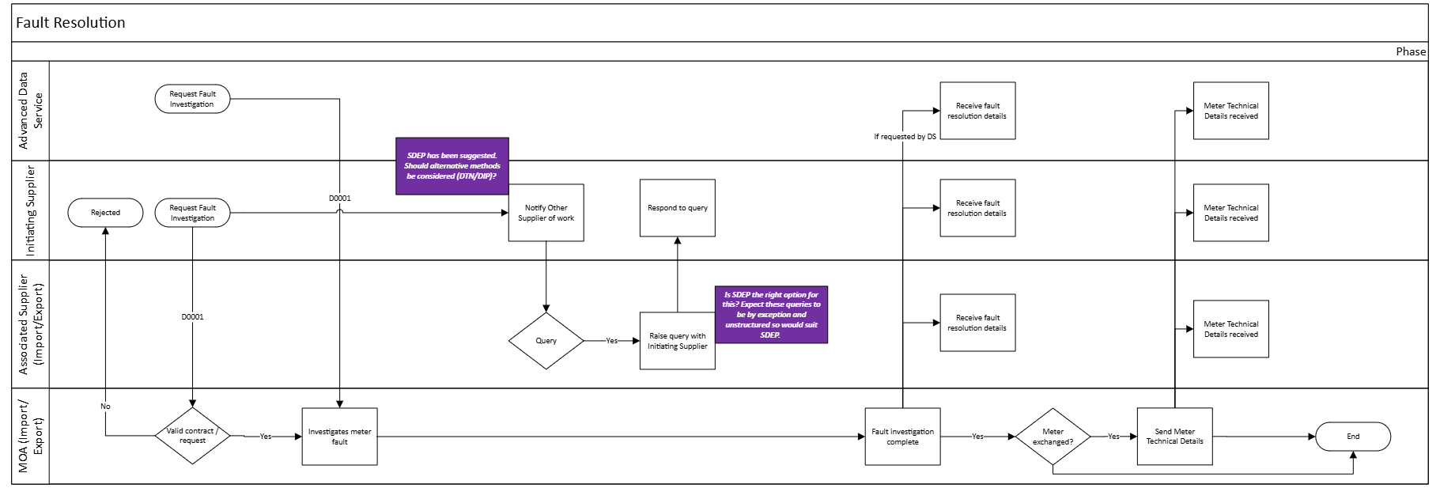
Fault Resolution

Slide 13
Change of Energisation Status
For Discussion

Slide 14
Change of energisation status
Default Position (No direct contract between Export Supplier + MOA)
Only the Import Supplier can request energisation/de-energisation.
MOA must notify Export Supplier of change in Energisation Status.
Export Supplier contracts with MOA for additional services
Non-emergency – should an Export Supplier be allowed to de-energise an Import/Export Supply. This would leave the Consumer off-supply for their Import supply.
Emergency – if the site needs to be de-energised for safety reasons (“made safe”), would permissions to complete this work be covered in the Import Suppliers contract?
Other scenarios?

Slide 15
Change of Feeder Status
For Discussion

Slide 16
Change of Feeder Status
The REC Metering Operations Schedule describes the process required for multi-feeder sites, where the Energisation status is changed for a feeder.
The feeder status is maintained for all Advanced Metering Assets by the MOA in the D0268.
Where a change is notified by the Electricity Supplier, the MOA shall update the feeder status and (if the feeder is being de-energized) confirm collection of the meter readings with the ADS.
Considerations for Import/Export Metering Assets:
Updated Meter Technical Details should be sent to both Import and Export Suppliers – requirement in Schedule 14 – Metering Operations refers to Paragraph 20, which is included in the scope of Basic Associated Export MOA Services, should R0207 be approved.
Responsibility for requesting update to feeder status. There is no explicit reference in R0207 requiring the MOA for this being included in the Associated Export MOA Services. This then assumes the Import Supplier would be responsible for requesting updates from the MOA.
Should requests to update the Feeder Status be the responsibility of the Import Supplier?

Slide 17
Change of Market SEgment
For Discussion

Slide 18
Change of Market Segment
Where an Electricity Supplier requests a meter exchange which would result in in a change of market segment, the Supplier is required to appoint a new Metering Service in advance of the works taking place.
The SMRA will hold the appointment request until updated Meter Technical Details and Connection Type details are received, in which case it will retrospectively appoint the new agent.
Where updated Meter Technical Details or connection type do not align with the existing market segment, the SMRA will notify the current Supplier to update the agent.
For Import/Export metered sites, with associated Import and Export Metering Points, the Import Supplier is responsible for appointing the appropriate agents.
As referenced in earlier slides, it is proposed that any request to exchange the metering asset by the Export Supplier is notified to the Import Supplier.
Is an explicit requirement on the Import Supplier to appoint new agents on receipt of this notification required?
What information is required by the Import Supplier in this notification to enable this?

Slide 19
AOB

Slide 20
next STEPs, Date and Time of Next meeting

Slide 21
next steps
The Code Manager will bring these thoughts together ready for the next workshop where we will start looking at possible changes to Code and/or Guidance.
Date of Next Meeting: September 2026.
Meeting Invites will be issued no later than 28 August. Pre-meeting papers will be published on 5 working days before the next meeting.
Contact us:
enquiries@recmanager.co.uk
Change.management@recmanager.co.uk
Glenn.sheern@recmanager.co.uk
Annabel.ashworth@recmanager.co.uk

