Slide 1
I0312 – review of Export meters works arrangements
WORKING GROUP 4
17 September 2026

Slide 2
Agenda
 | TITLE | PAPER | TIME | LEAD
1 | Welcome and Introduction | Verbal |  | Chair
2 | Review minutes and actions of previous meeting | I0312_WG_1407_Draft Minutes v0.1 |  | All
3 | Process Maps | Verbal |  | Chair
4 | Proving Tests | Verbal |  | Chair
5 | Safe Isolation Providers / Crowded Meter Room MOAs | Verbal |  | Chair
6 | Draft Party Impact Assessment | Verbal |  | Chair
7 | Any Other Business | Verbal |  | All
8 | Next Steps | Verbal |  | Chair

Slide 3
Housekeeping Rules
Meetings will be recorded to provide meeting notes.
Use the chat or the hands-up function to help flow of discussions.
Please stay on mute if not speaking.

Slide 4
Review minutes and actions of previous meeting

Slide 5
Working group – Actions
MINUTES
No comments or amendments made.
ACTIONS
I0312WG_1707_A01 | The Code Manager to draft Impact Assessment.

Slide 6
Process maps

Slide 7
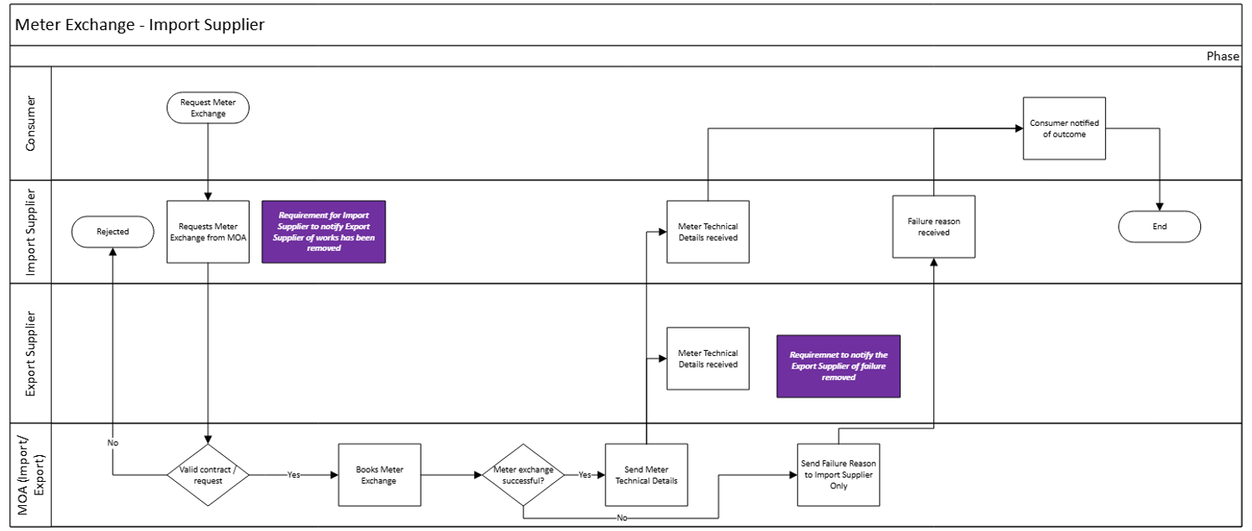
Meter Installation / Exchange

Slide 8
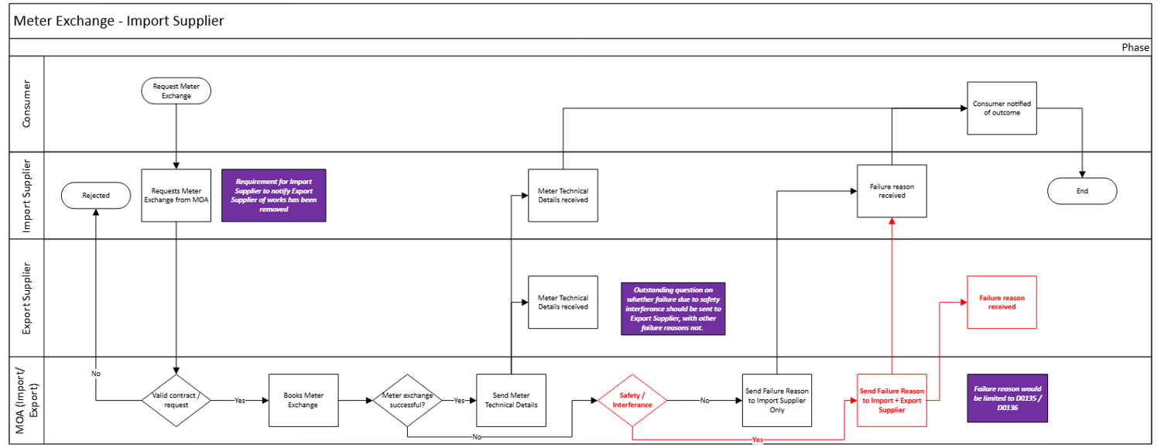
Meter Installation / Exchange

Slide 9
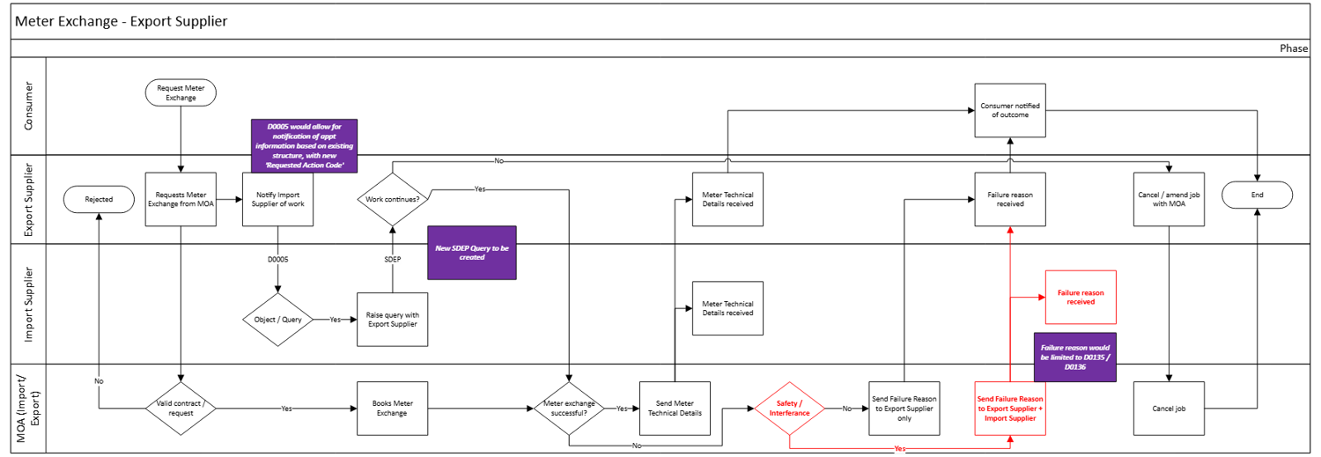
Meter Installation / Exchange

Slide 10
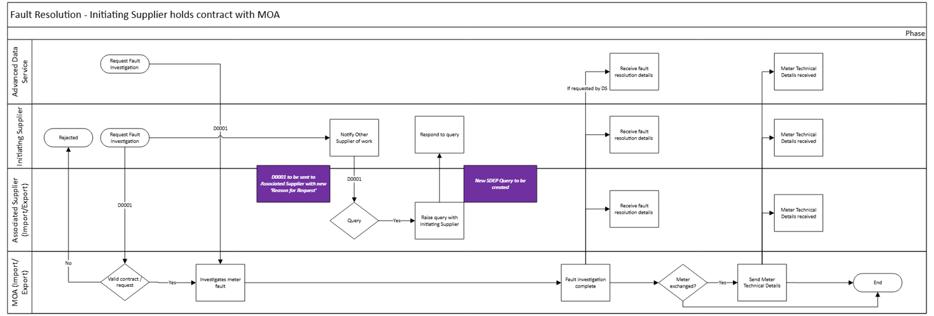
Fault Resolution

Slide 11
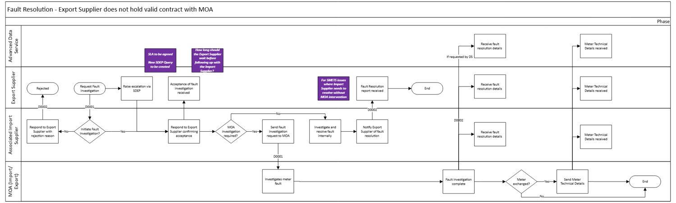
Fault Resolution

Slide 12
Proving tests

Slide 13
Proving Tests
Proving Tests are carried out to for certain Advanced Metering Assets by the MOA and Advanced Data Service (ADS), where the Metering Asset:
  is for a Complex Site;
  has a separate outstation; or
  has an integral outstation which can have a pulse multiplier than 1.
This is carried out in the following circumstances:
  New connections or transfers from CMRS to SMRS;
  A change of ADS or MOA, where MTDs have been manually intervened;
  A Metering Asset is reconfigured / replaced;
  There is a key field change;
  A feeder is Energised for the first time; or
  A Complex Site is created, modified or removed.
The MOA shall decide which of four methods to use for the Proving Test, in conjunction with the ADS, in accordance with timescales set out in the REC.
The MOA will send results of the Proving Test to relevant parties, including the Electricity Supplier.
Notes:
To be added in later versions

Slide 14
Proving Tests
Initiating Proving Tests
The majority of circumstances in which a Proving Test would be initiated would expect to be initiated by the Import Supplier, where there is a shared import/export meter using the Import Supplier’s MOA.
Where a Proving Test is required as a result of metering works initiated by the Export Supplier, is it assumed the Export Supplier will be required to request the Proving Test from the MOA? Examples include:
  Reconfiguration or replacement required by the Associated Export Supplier
  Key field change requested by the Associated Export Supplier
Issuing Results of Proving Tests
Where a MOA issues the results of a Proving Test (D0214) to the Electricity Supplier, should this be issued to both the Import and Export Suppliers?
  BSC CoP4 requires testing for both import and export directions, so the Proving Test would usually be relevant to both.
Are there any other aspects of Proving Tests that should be considered?
Notes:
To be added in later versions

Slide 15
Safe Isolation Providers / Crowded Meter Room MOAs

Slide 16
Safe Isolation Providers / Crowded Meter Room MOAs
SIPs and Crowded Meter Room MOAs are required to notify the Electricity Supplier where:
  The site is not De-energised and re-energised on the same day (D0139 for both events); and
  Where damage to Metering Equipment is identified (D0136 or telephone).
SIPs only are also required to notify the Electricity Supplier where:
  Works have been completed, as expected, on the day (D0396);
  If additional needs information is identified (D0396); and
  If pre-existing levels of smart comms can’t be re-established (D0002).
The REC does not distinguish between Import and Export Metering Points. It requires the SIP to notify the ‘Registered Supplier’. This would include both Import and Export Suppliers by default, as both are registered to the Metering Point for that address.
Should the SIP/Crowded Meter Room MOA be required to notify both Import and Export Suppliers in these events?
  If so, should this be made explicit?
  How would they know to look for multiple Suppliers to notify?
  Could this be a barrier to entry?
Notes:
To be added in later versions

Slide 17
Draft Party Impact Assessment

Slide 18
Draft Legal Text – REC Schedule 14 – Metering Operations
New requirements introduced:
  Where it has entered into a valid contract with the Appointed MOA, the Export Supplier should be able to request a meter exchange and upgrades for the Associated Export and Import Metering Point.
  Both the Import and Export Suppliers should be required to notify each other of planned meter works, prior to the planned date.
  An objection/query mechanism if one Supplier has concerns about the meter work.
  Permanent meter removal and de-energisation is restricted to the Import Supplier for both Import/Export Supplies.
    The Meter Operator is not prohibited from removals/de-energisation to make the site safe where required.
    The Meter Operator may still make changes to the Meter Technical Details (MTDs) and energisation status where required.
    Does not apply to Export-only sites.
  Where it has entered into a valid contract with the Appointed MOA, Export Suppliers should be able to request fault investigations for both Import/Export Supply’s.
  Both Import and Export Suppliers are required to notify each other of fault investigations; or the Data Service to notify both Suppliers (consequential BSC change needed).
  Introduce query mechanism for Supplier’s to request additional information about the fault investigation.
  The MOA shall notify both associated Suppliers of the outcome of a fault investigation.
  Similarly to de-energisation, energisation is restricted to the Import Supplier.
  Where the meter work is driven by the Export Supplier and can lead to a change of Market Segment, the Import Supplier should be notified.

Slide 19
Draft Legal Text and Guidance
REC Schedule 1 – Interpretation and Definitions Schedule
Import Supplier | means the Registered Supplier for an Import Metering Point.
At our WG3 session, a member proposed additional guidance for Export Suppliers on communicating delays to customers who have requested meter works.
  Delays due to the fact that the Export Supplier is unable to carry out the request and needs to notify the Import Supplier.

Slide 20
Party Impact Assessment
The Code Manager will integrate the outcome of today’s discussions into the legal text drafting.
Subject to feedback in this meeting, the next steps will involve:
  Change Report (Update to Plan) to extend the milestone timetable;
  Issue the draft legal text for legal review;
  Issue the Party impact assessment.
The Party impact assessment will seek to:
  Validate the assumptions made by the I0312 Working Group regarding impacts to industry and Consumers/generators;
  Validate the notification mechanisms – if industry confirm that SDEP should be used, a Service Provider Impact Assessment will need to be issued.
Any confidential information shared would not be detailed in the Change Report but may be collectively summarised.

Slide 21
Party Impact Assessment – Draft Questions
No. | Question
1 | Do you have any comments on the proposed solution?
2 | Do you agree the proposed solution addresses the problem statement? Are there any alternate solutions that would better address the problem statement?
3 | Consider the process maps provided for the meter installation and fault resolution processes for both Import and Export Suppliers. Do you think we have identified and considered all processes and scenarios that may be impacted through the implementation of the proposed change?
4 | The I0312 Working Group indicated a preference for the use of SDEP as a mechanism for the Export Supplier to notify the Import Supplier of meter exchange requests, prior to the planned date. Do you agree with the use of SDEP for this process? Do you consider another mechanism to be more appropriate?
5 | The I0312 Working Group indicated a preference for the creation of a new SDEP query to be sent from the Supplier initiating a meter fault investigation to the associated Import/Export Supplier. Do you agree with the use of SDEP for this process? Do you consider another mechanism to be more appropriate?
6 | The I0312 Working Group indicated a preference for the use of the following data flows: D0001 Request Metering System Investigation - can be raised by the ADS or the initiating Supplier that holds a contract with the Associated MOA to trigger a meter fault investigation. The D0001 can also be sent to the Associated Supplier with new 'Reason for Request' D0002 Fault Resolution Report or Request for Decision on Further Action - can be raised by the associated Import Supplier to respond to the Export Supplier with a rejection reason or to notify the Export Supplier of a fault resolution D0005 Instruction on Action to allow for notification of appointment information based on existing structure, with new 'Requested Action Code' D0135 Asset Condition Report/D0136 Report to Supplier of Possible Irregularity for the Associated MOA to send failure reasons to both the Export and Import Supplier
7 | In addition to the proposed legal text changes to the REC, the I0312 Working Group indicated a preference for an additional guidance document around Import/Export Supplier communications with Consumers. Do you agree with this proposal? Are there any scenarios that should also be considered for guidance that have not yet been identified?
8 | Do you have any comments on the draft legal text?

Slide 22
Party Impact Assessment – Draft Questions
No. | Question
9 | Would implementing the proposed solution incur any costs to your business? If so, please provide details breaking down design/build/test costs and on-going costs. If preferable, please indicate which of the below ranges your costs may fall: A) Nil; B) Up to £9,999; C) Between £10,000 and £49,999; D) Between £50,000 and £99,999; or E) more than £100,000.
10 | Do you identify any positive or negative Consumer outcomes through the implementation of the proposed solution?
11 | Do you identify any benefits to your business or the energy market through the implementation of the proposed solution?
12 | Taking into consideration both the costs and the benefits seen, do you consider this change should be made?
13 | What lead time would be required by your business to implement the proposed solution? Please provide justification.
14 | Do you have any other comments relating to this Change Proposal?

