Slide 1
Agenda For today
 | TITLE | TIME | LEAD
1 | Welcome and Introductions | 14:00 | Chair
2 | Audit Update | 14:05 | Eric Dodd
3 | Fife College – Hydrogen Transition Training | 14:20 | Pete Jones
4 | REC Metering Hub Update | 14:35 | Rebecca Griffiths
5 | Industry Issues and Change Tracker | 14:50 | Code Manager
6 | IGEM Update | 15:05 | Dave Harper
7 | National Energy System Operator – Energy Insights | 15:20 | Chair
8 | DESNZ Smart Meter Statistics in Great Britain | 15:35 | Chair
9 | AOB | 15:50 | All

Slide 2
2. Audit update
Eric dodd

Slide 3
3. Fife college – hydrogen transition training
Pete jones

Slide 4

Hydrogen Transition Training
Pete Jones
Gas Lecturer

Slide 5

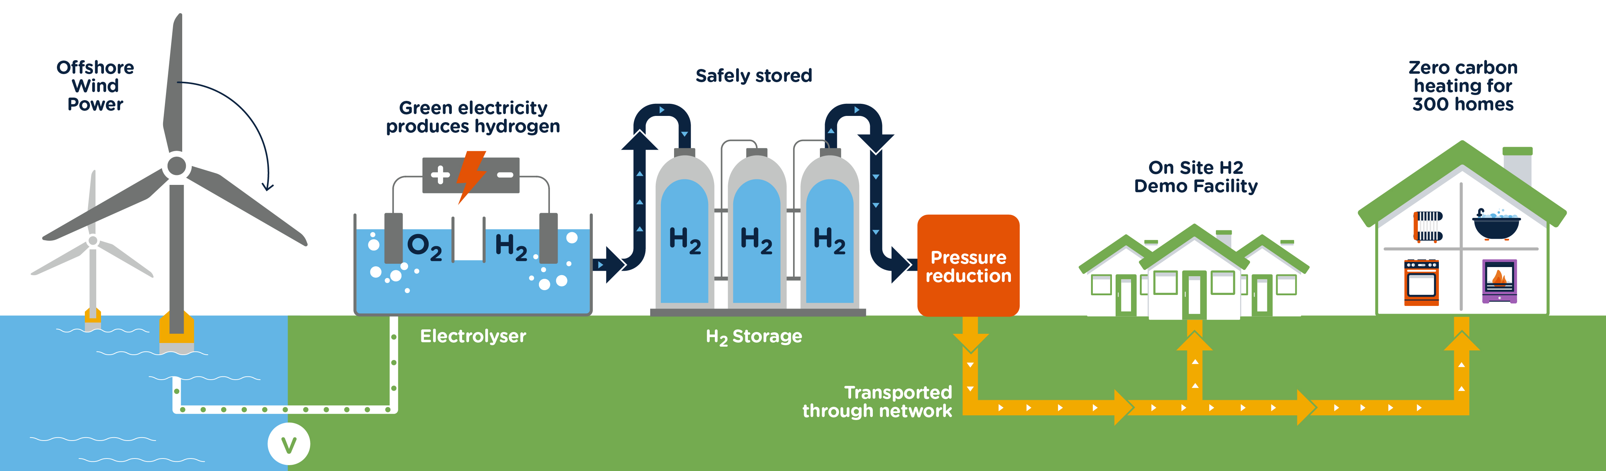
H100 Fife – End to End Summary
https://www.youtube.com/watch?v=MDS6NFBrGX4

Slide 6
So Why do we need to develop training and why Fife college?
World 1st
^{In Scotland}
In Fife
We are an accredited gas training centre with more than 30 years training experience in the area

Slide 7
So Why do we need to develop training and why Fife college?
In order for anyone to work on domestic Hydrogen installations they must receive specific training and undergo a formal assessment following this training to be deemed competent. Proof of competence will be sent to The Gas Safe Register and this will be added to the engineer approved work category.
In order to meet this legal requirement. Fife College was contracted by SGN to produce the necessary training material .

Slide 8
Who needs to be trained
Natural Gas > Hydrogen ACoP CoNGHY1
Training & Assessment for these ACS Categories.
CCN1
CENWAT
CKR1
HTR1
CESP1
CMA1
Domestic GSR Engineers
Engineers to install Boilers and cookers
Emergency Service Provider Engineers (SGN Employees)
Specialist Smart Meter Installers
First Call Operatives
Domestic Meter Installers

Slide 9

What is needed?
Completely new and bespoke course for engineers who may work on the H100 trial.
  Training must be designed around a framework approved by DESNeZ
  Produced by EU skills

Slide 10
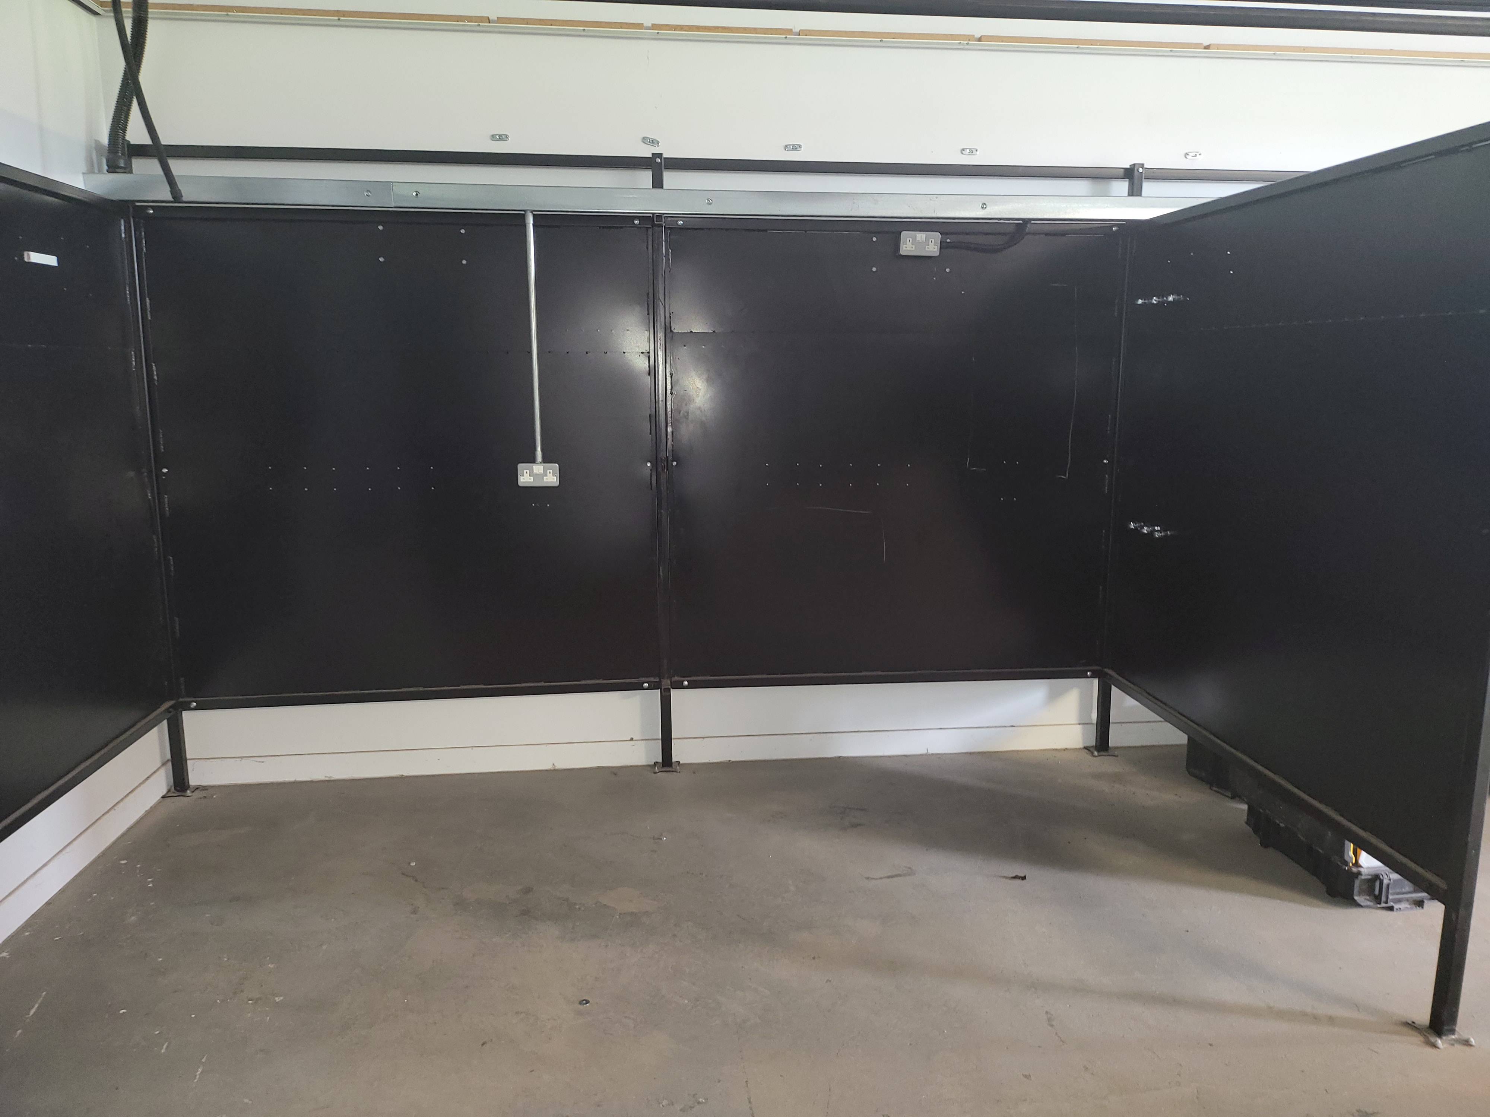
Hydrogen Training Centre to carry out the training
8 Fab and welding bays at Fife College Levenmouth campus to be re-purposed as 4 Hydrogen training and assessment bays after a design is finalised

Slide 11
Training Design
Regulations and standards
Existing
  Gas Safety Installation & Use Regulations. Hydrogen does not exist within these regulations at present but will in the future. Therfore Hydrogen Training and processes needed to be written to follow the general guidance within this document which is legally binding and is owned by HSE
  Other documents
  IGEM Standard for testing gas pipework
  BS6891 Installation of Gas Pipework
Both standards used for general guidance to be incorporated into New Standards

Slide 12
New Standards (In Draft & not final versions)
H1 Reference Standard for low pressure hydrogen utilisation
H2 HYDROGEN ENABLING STANDARD - DOMESTIC
PAS 4443 Requirements for ancillary valves, devices and components used in hydrogen gas installations –Specification
PAS 4442 2023 - Material requirements for pipework and fittings used in hydrogen gas installation – Specification
Therefore a fair amount of the training material would need to be based upon ongoing research commissioned specifically for the H100 trial

Slide 13
Key Points of training
Changing behaviours due to the different properties of Hydrogen.
  Lightest of all gasses 14 times lighter than air
    Bbehaves differently to NG
    Has much less friction
    Moves faster
    Diffuses to atmosphere quicker
  Burns 8 times faster than NG
  Heat value only 1/3 of Natural Gas so we need 3 x more Hydrogen
  Flammability range 4-76% compared to NG which is 5-15% GIA
  Burns Orange not Blue

Slide 14
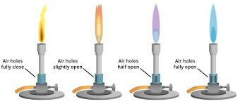
Key Points of training
Processes used for Natural Gas will not work with Hydrogen
Burner Designs different
  Cookers / Fires Burners are not pre aerated
Post aerated NG Bunsen burner Pre aerated NG Bunsen burner

Slide 15
Key Points of training
Processes used for Natural Gas will not work with Hydrogen
  Testing to ensure no leaks (process different)
  Purging (Air-Gas & Gas-Air)
  New gas detection equipment (for above)
Larger Pipes are Required
Specific Hydrogen meters are required

Slide 16
Validation of training
Theory training web based (College Moodle System)
Ensures everyone gets exactly the same
Training split into about 30 different lessons
Knowledge check after each lesson with 100% pass mark required before progressing to next lesson.
Advantages
  Consistent
  Auditable for each candidate
Final training package has to be validated by
  EU Skills (Industry Standards Setting Body)
  IGEM (Institute of Gas Engineers & Managers Who write practical standards for the Gas Industry)
  BPEC Certification body for the Qualification
  GasSafe Register (Maintain Register of all competent Gas engineers by work category)
  HSE (Health and Safety Executive)

Slide 17
Evolution of Hydrogen Training Centre
8 Fab and welding bays at Fife College Levenmouth campus to re-purpose as 4 Hydrogen training and assessment bays after a design is finalised

Slide 18
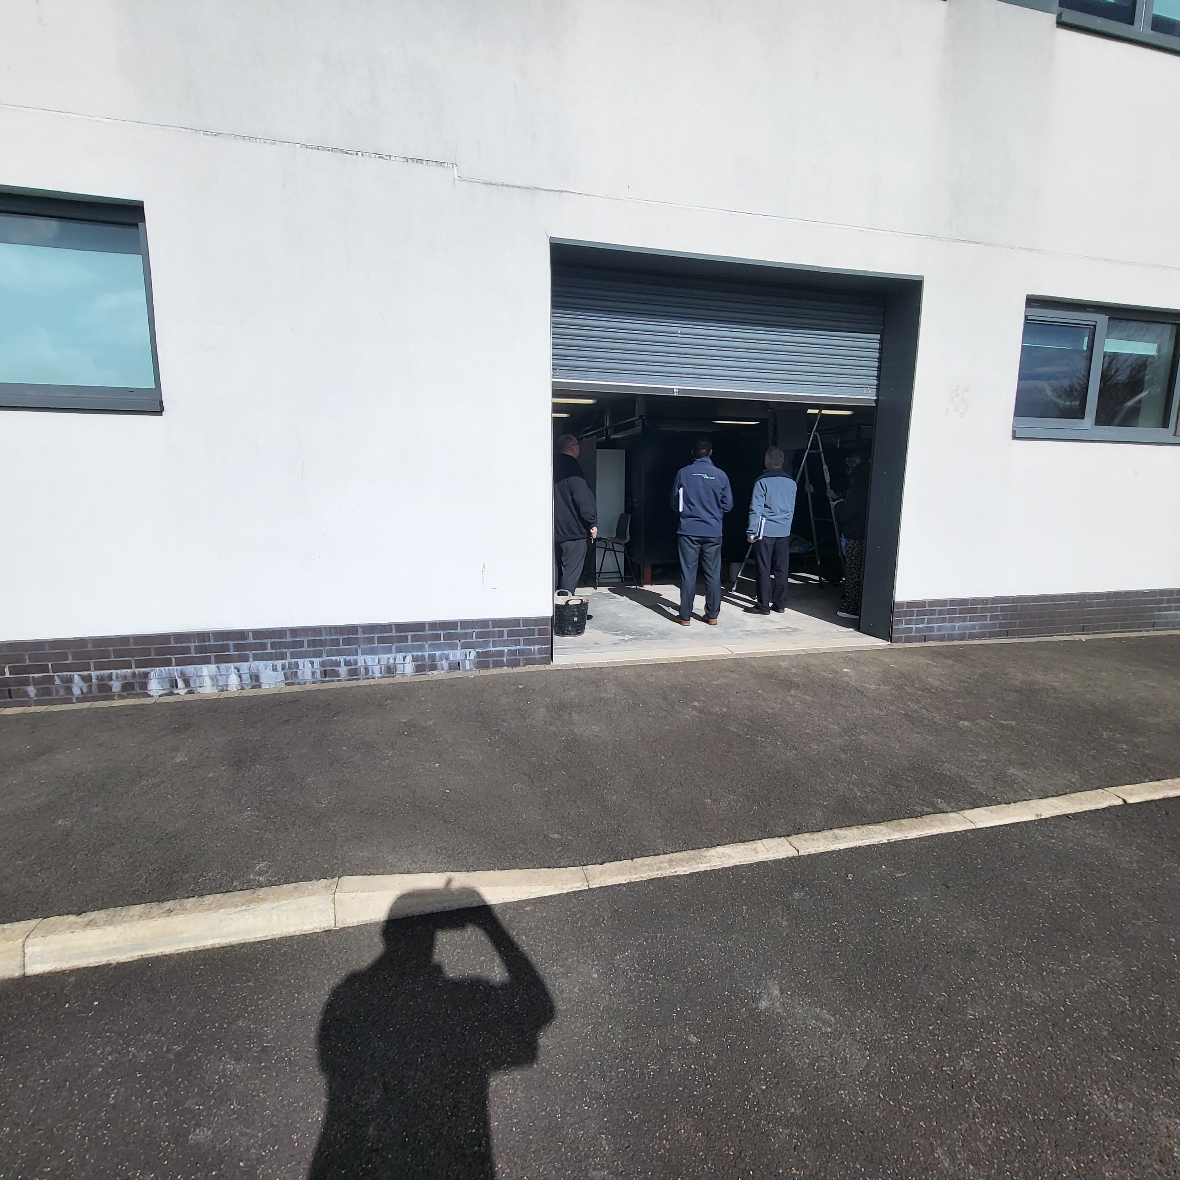
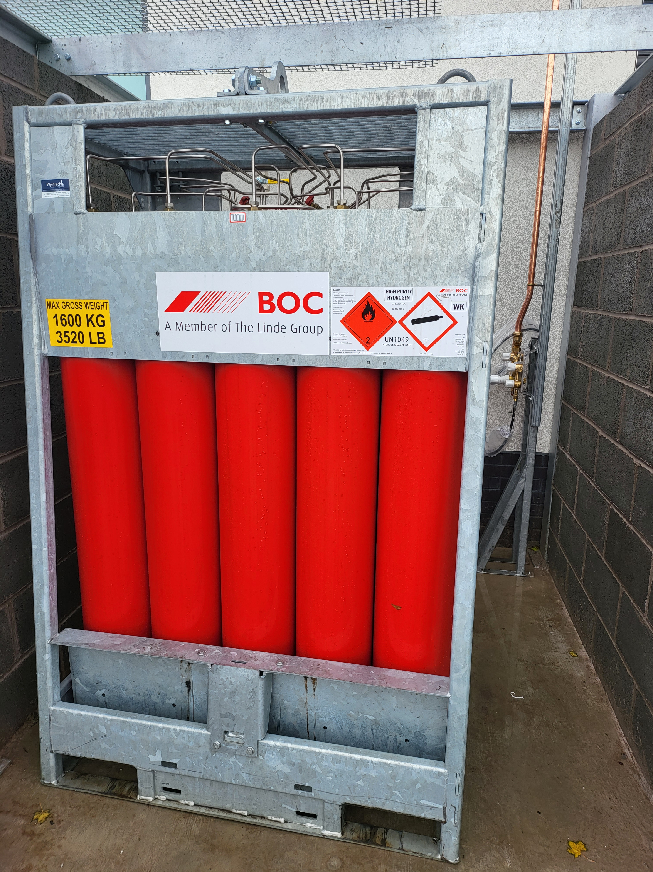
Evolution of Hydrogen Training Centre
Outside From this To this

Slide 19
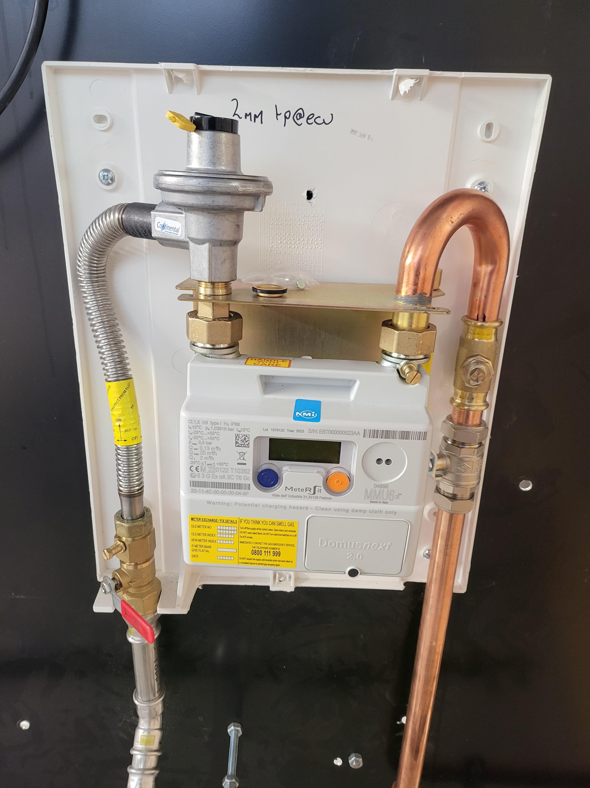
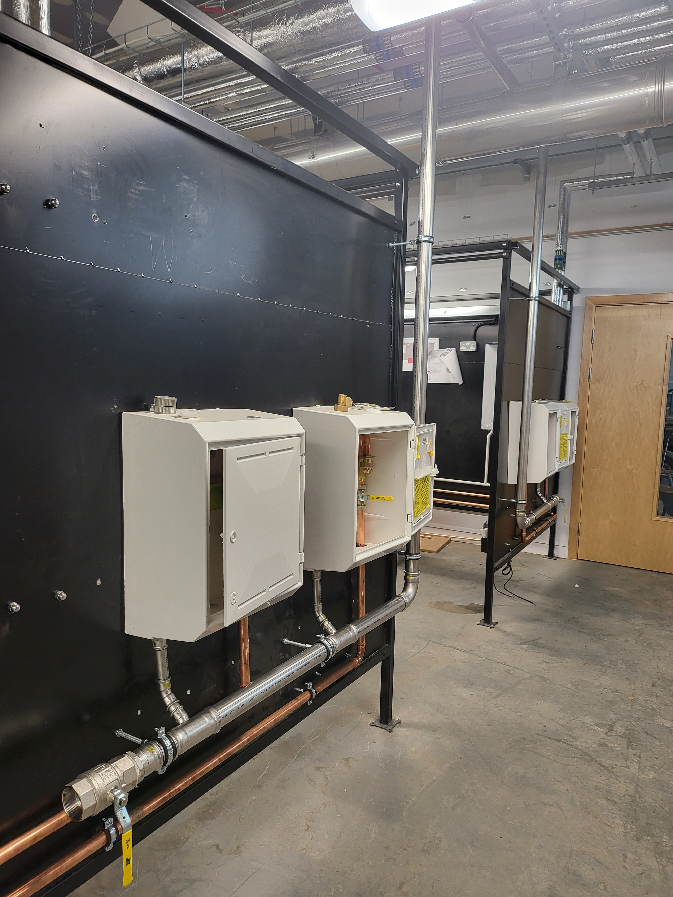
Evolution of Hydrogen Training Centre
Internal Metered Gas Supplies x 4

Slide 20
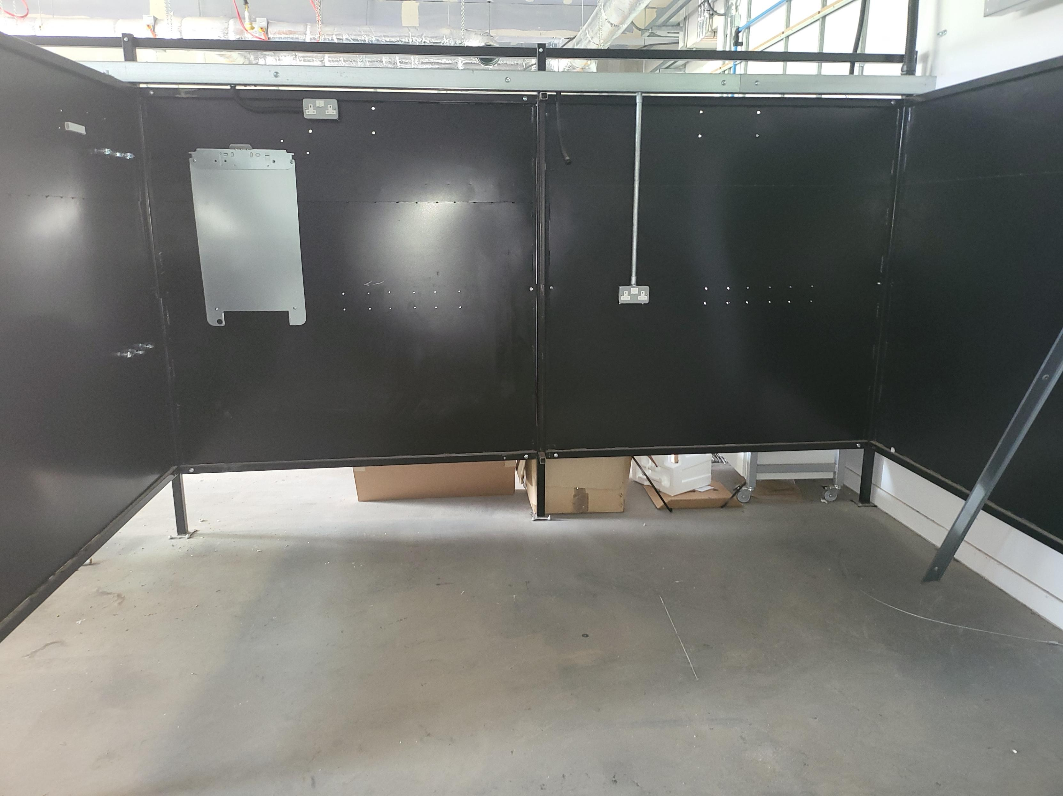
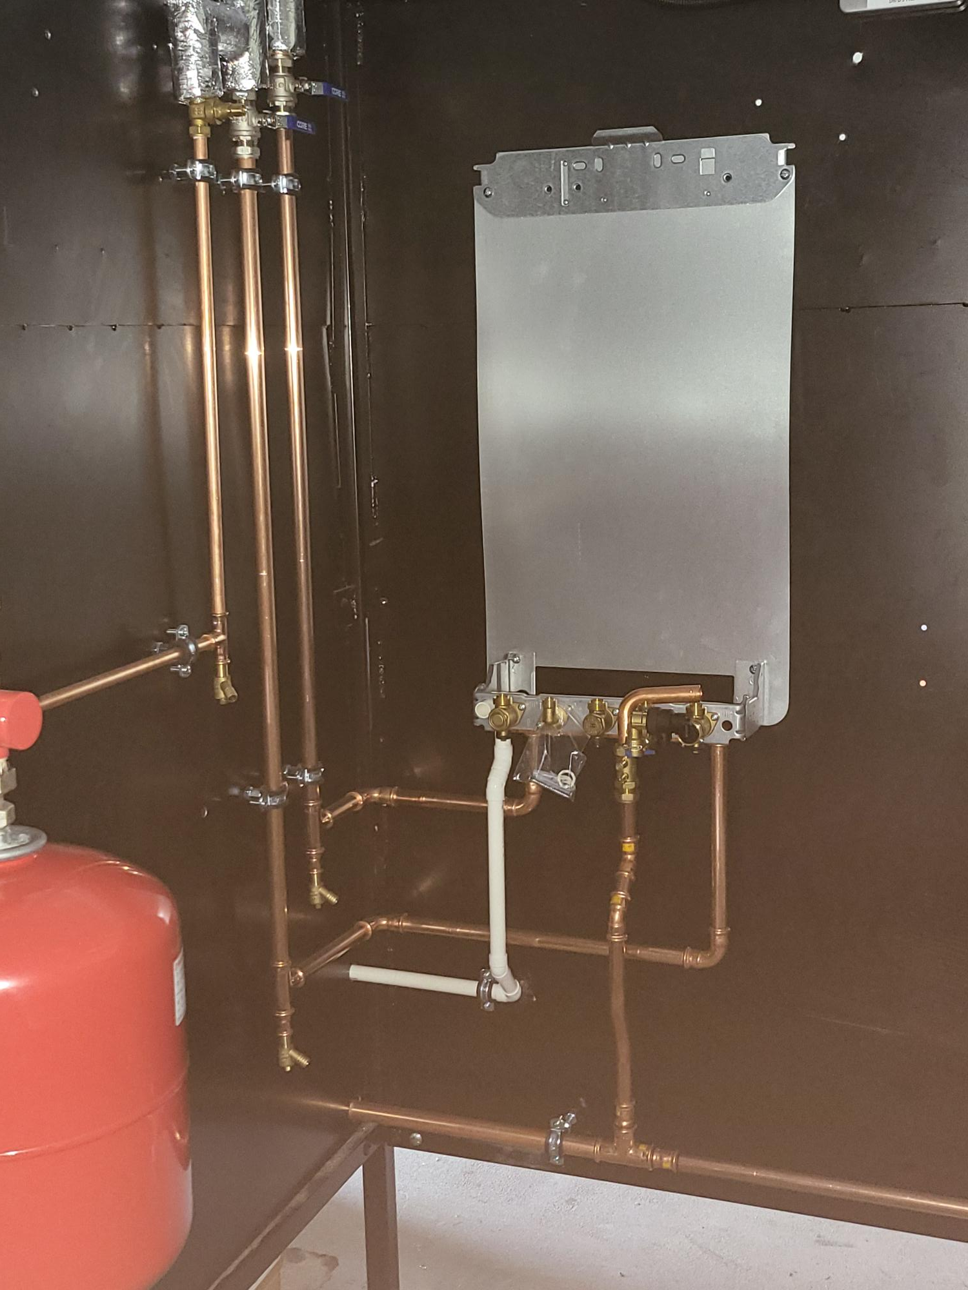
Evolution of Hydrogen Training Centre
Boiler Wall Template pipework added

Slide 21
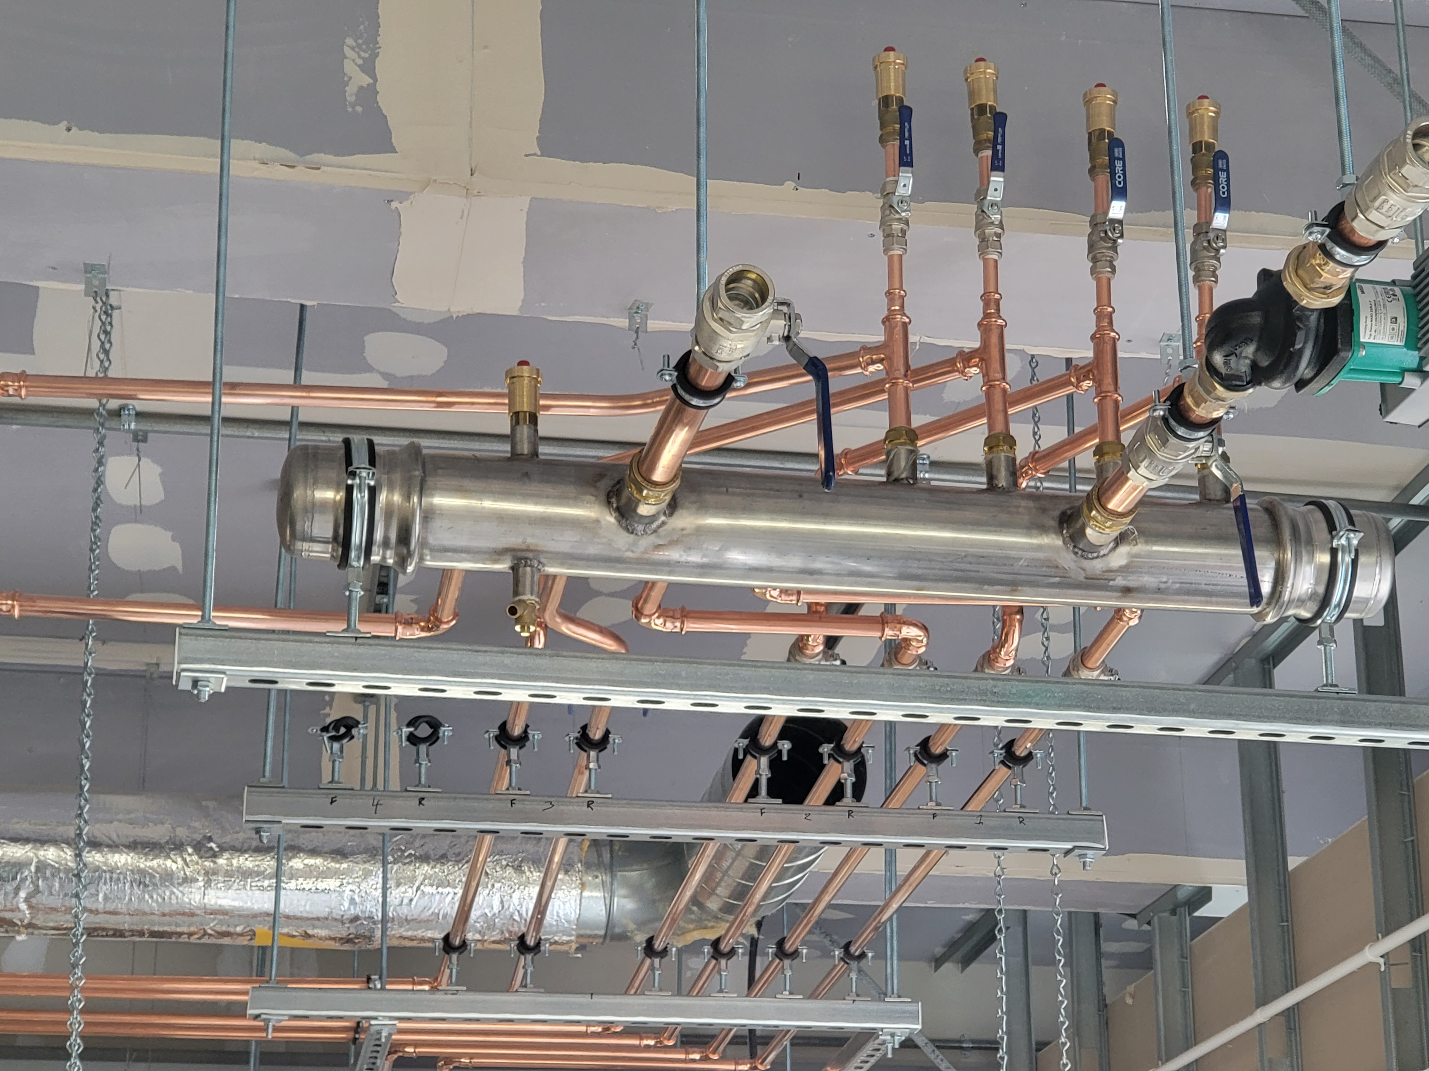
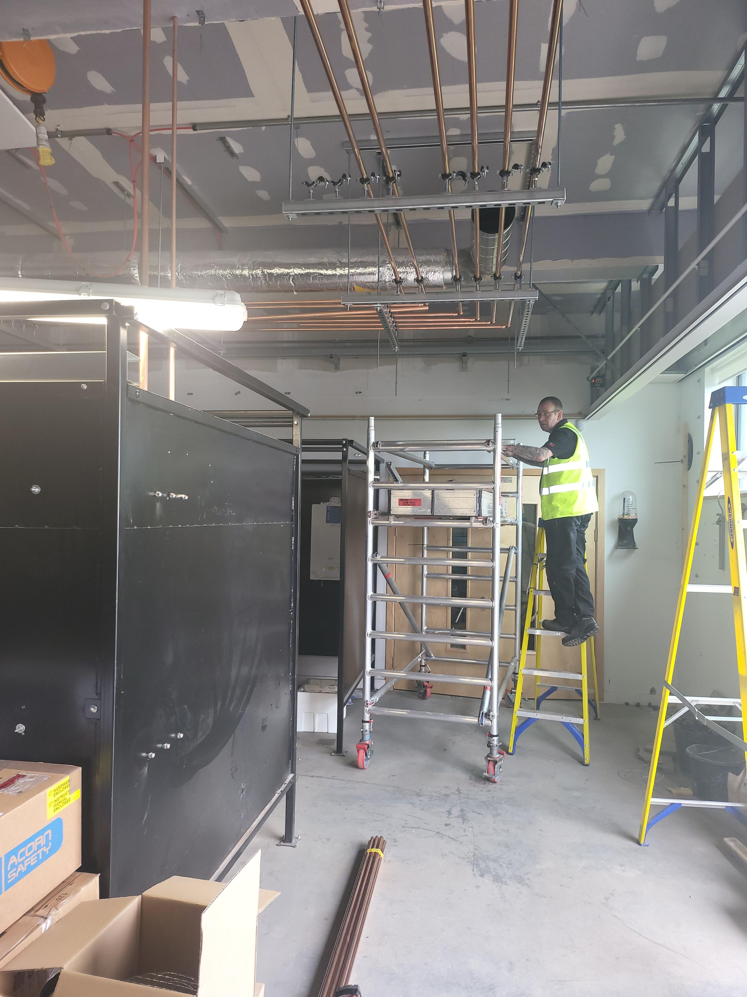
Evolution of Hydrogen Training Centre
System pipework joining all 4 boiler systems together

Slide 22
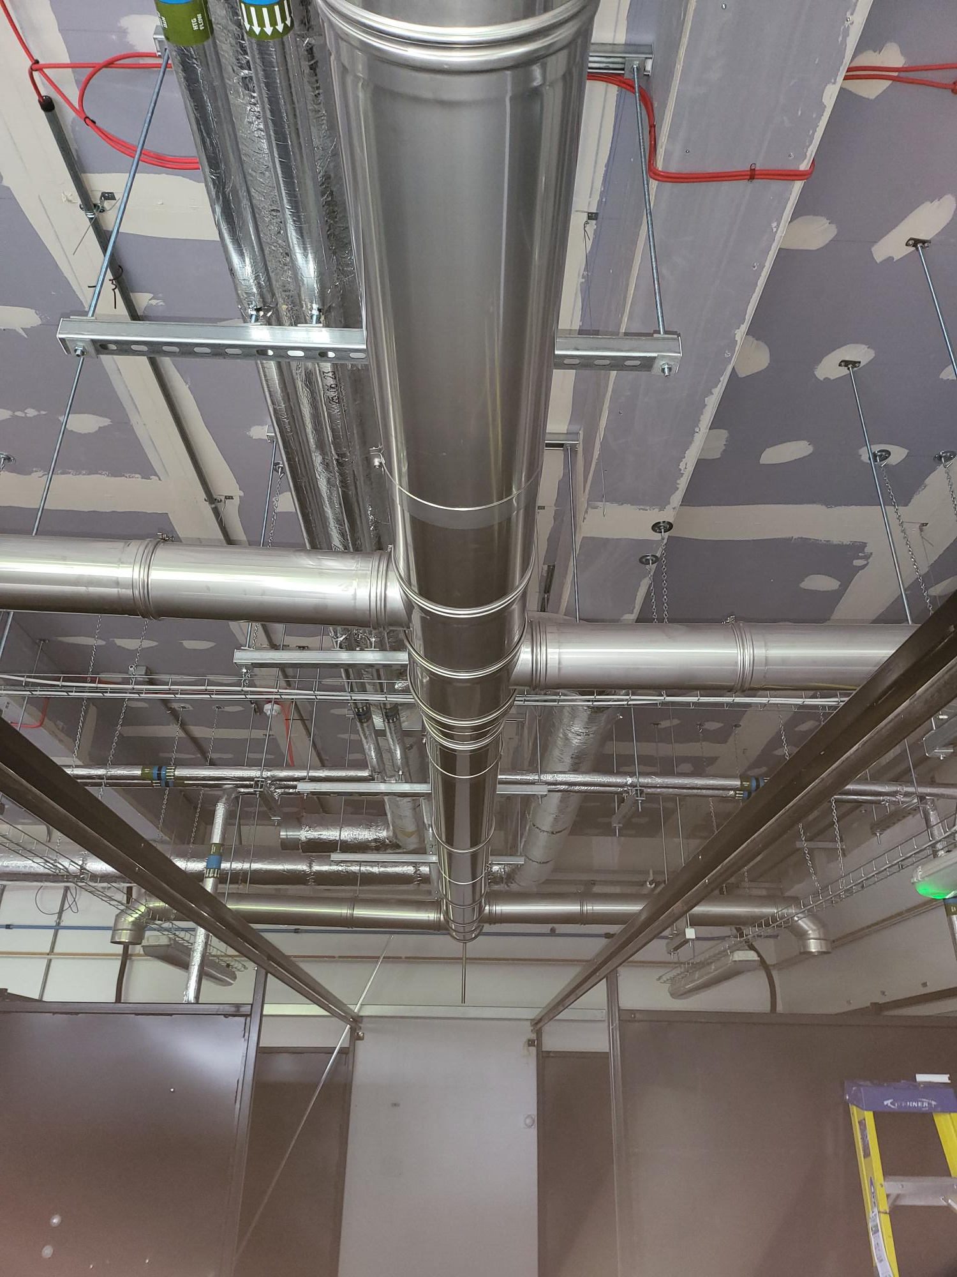
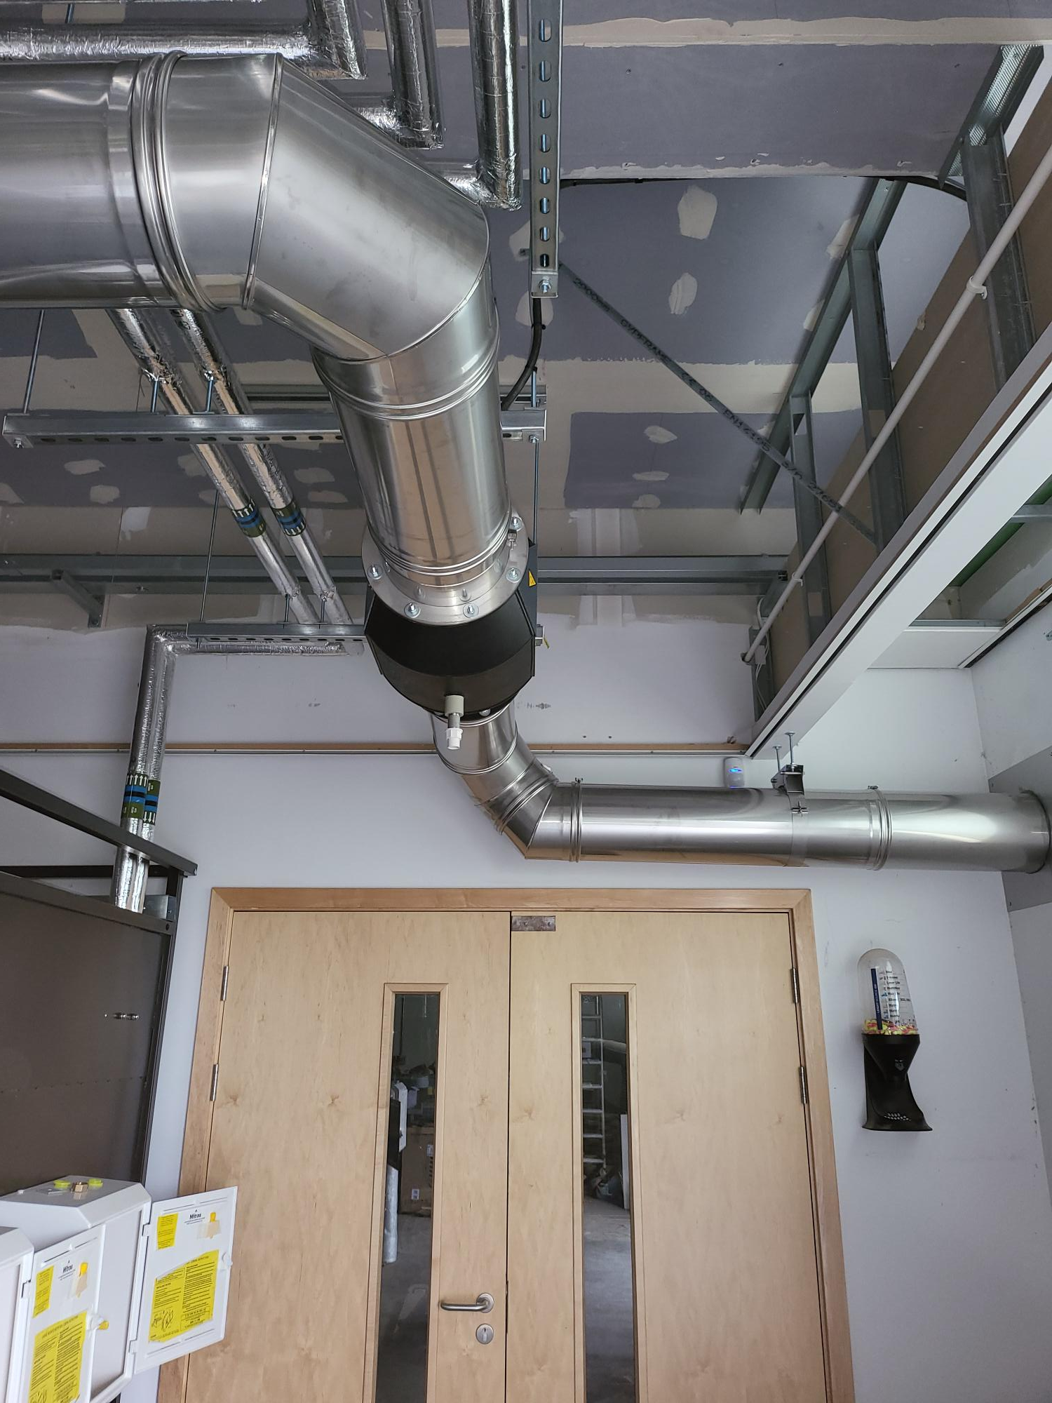
Evolution of Hydrogen Training Centre
Extract System to remove Products of Combustion from Boilers / Fires (Water Vapour)

Slide 23
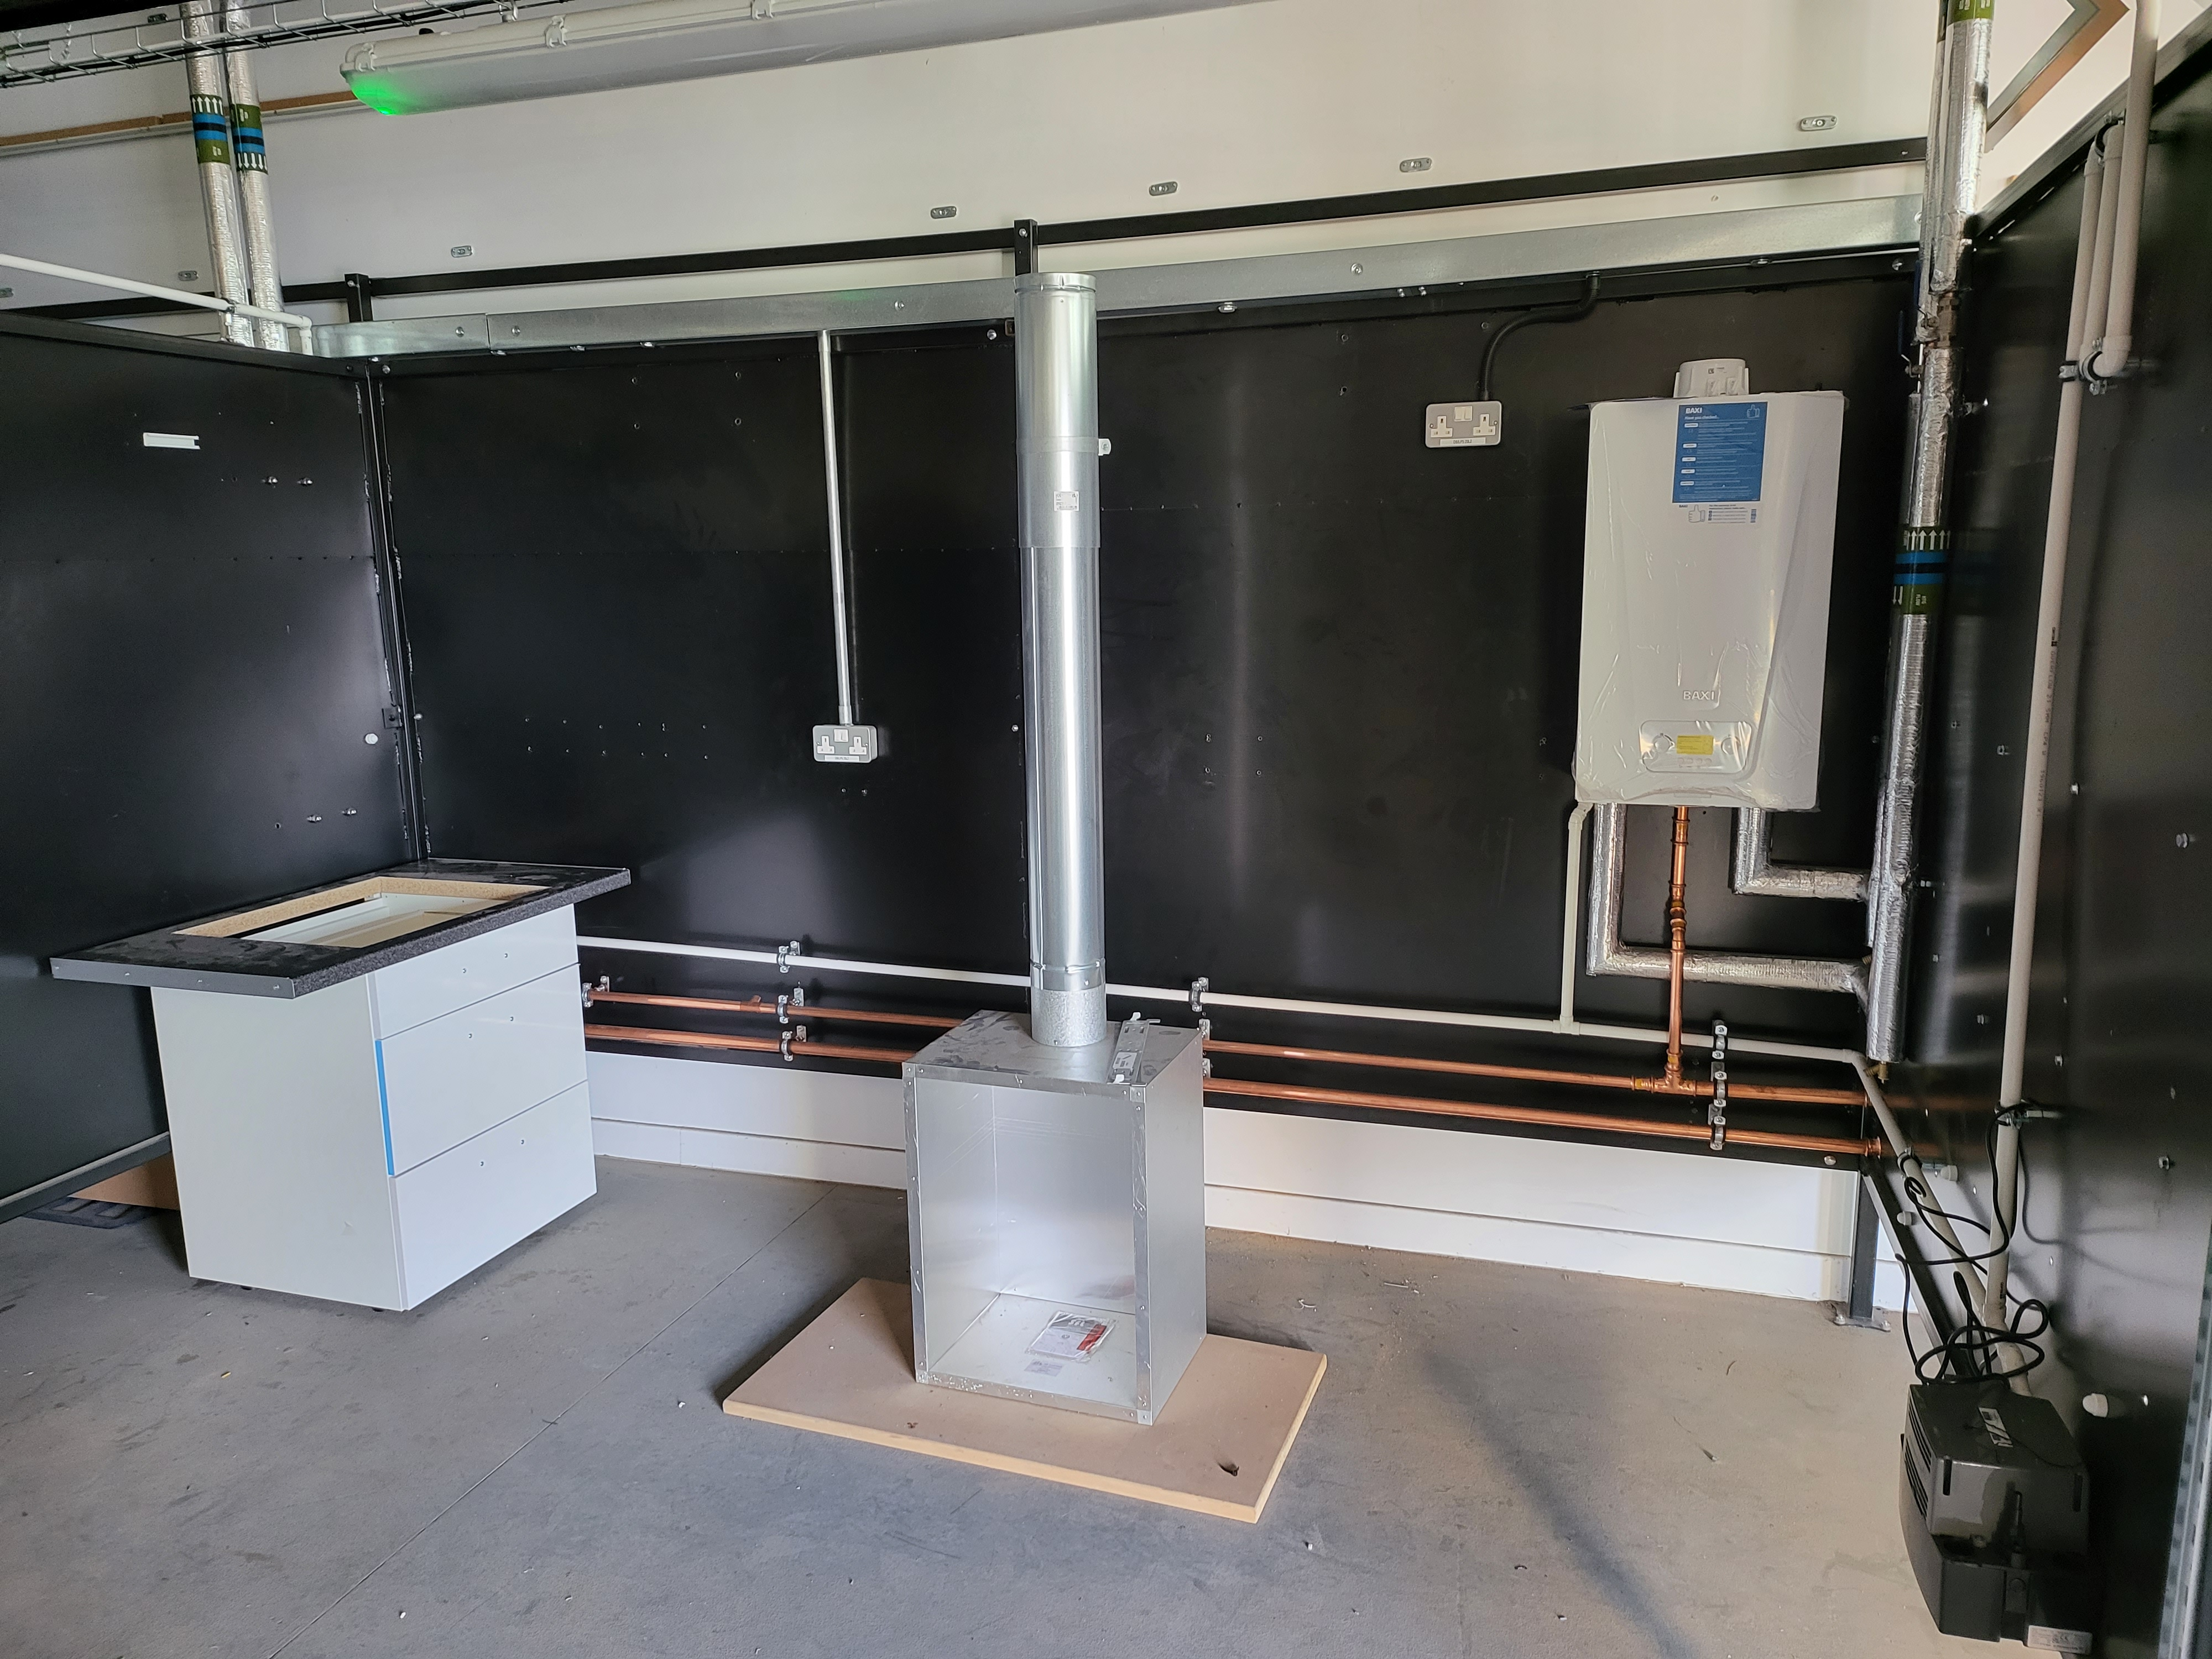
Evolution of Hydrogen Training Centre
Adding units for fires and cookers

Slide 24
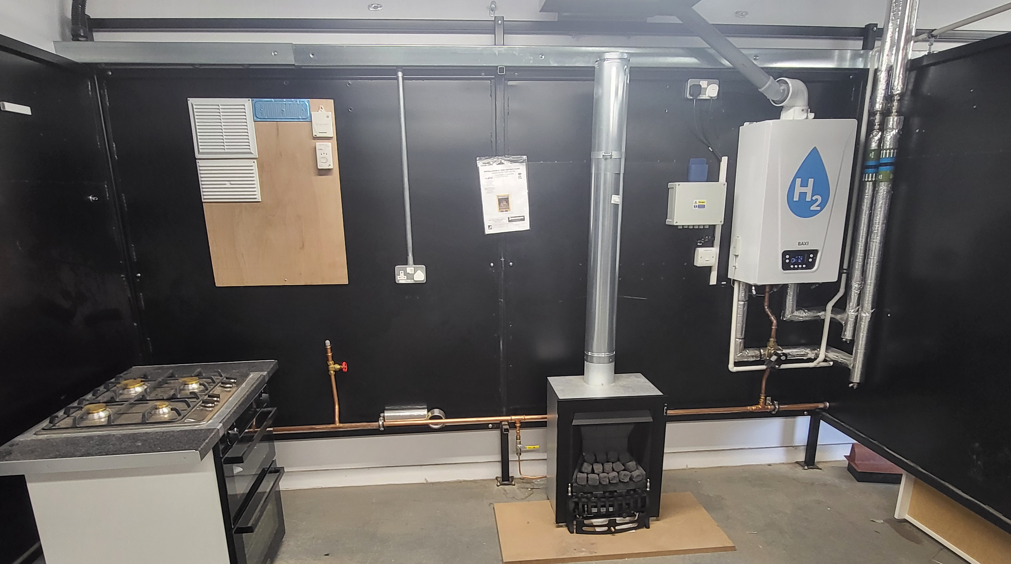
Evolution of Hydrogen Training Centre
Current Set up. Cooker is visual aid only.

Slide 25
Evolution of Hydrogen Training Centre
END
Questions?

Slide 26
4. Rec metering hub update
recco

Slide 27
5. Industry issues and change tracker
Rec code manager

Slide 28
Change proposal tracker
CP | Title | Lead | Update
I0197 | Introducing a Process to Provide Updates During Fault Resolutions | James Hardy | The first solution development Working Group for I0197 will take place on 18 June 2025, 14:00 – 15:30. If you would like to attend the working group, please email change.management@recmanager.co.uk.
R0207 | Import / Export MOA Charging Clarification | Caroline Freimuller | On 30 May 2025, the Authority made the decision to send back R0207. The letter detailing the reasons for the send back can be found here Decision to send back Retail Energy Code modification R0207: Import and Export MOA Clarification | Ofgem The Code Manager is reviewing this internally and working out the next steps.
R0241 | MHHS Incremental Changes for Go Live | Harriet Truss | Ofgem direction has now been received, following Cross Code Advisory Group endorsement, to progress to Change Proposal. Change Report (Consultation) was published on 05 June 2025 and will be considered by Change Panel on 17 June 2025.

Slide 29
6. Igem update
Dave harper

Slide 30
7. National energy system operator – energy insights
chair

Slide 31
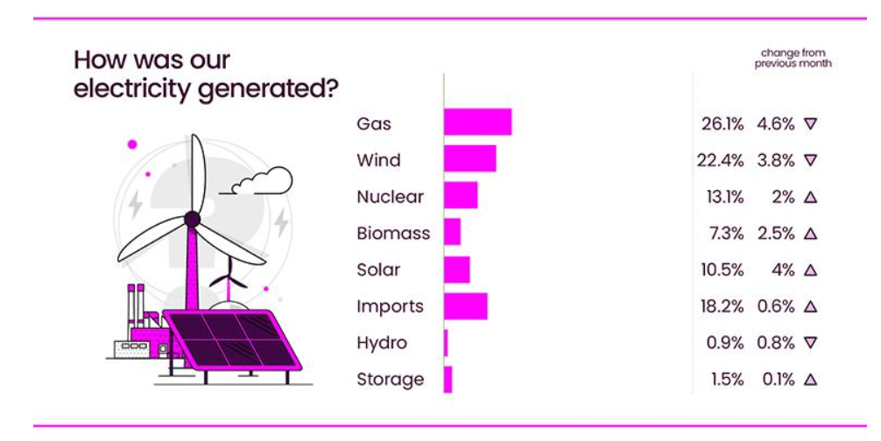
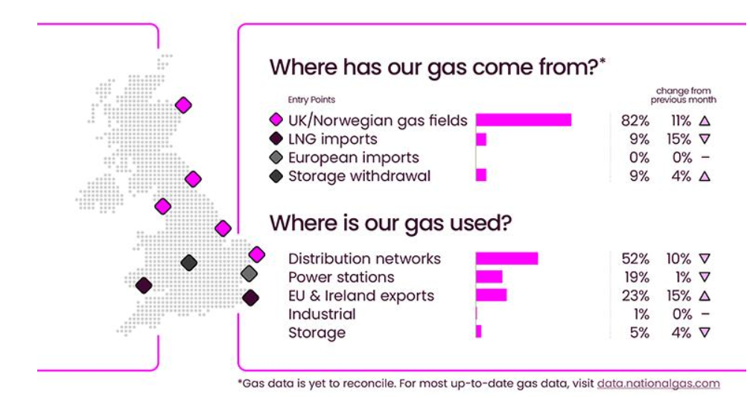
Source: National Energy System Operator – April 2025

Slide 32
8. Desnz smart meter statistics in great Britain
chair

Slide 33
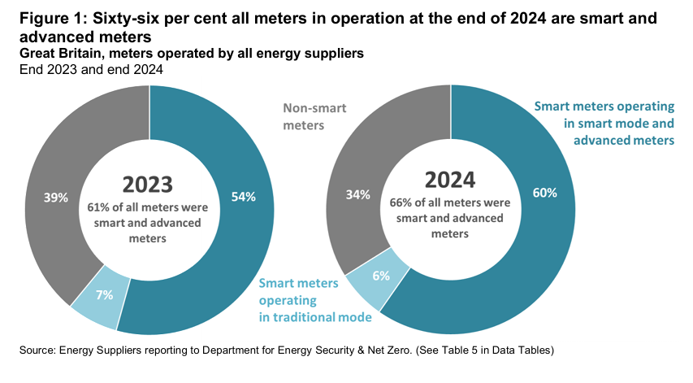
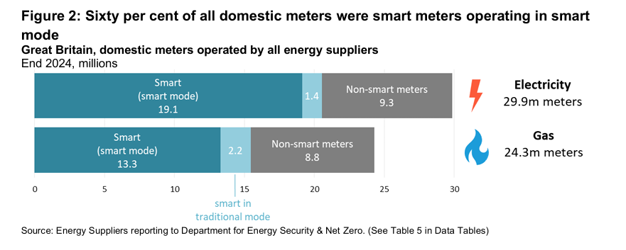
Source: DESNZ – GOV UK - Quarterly Report to end of December 2024

Slide 34
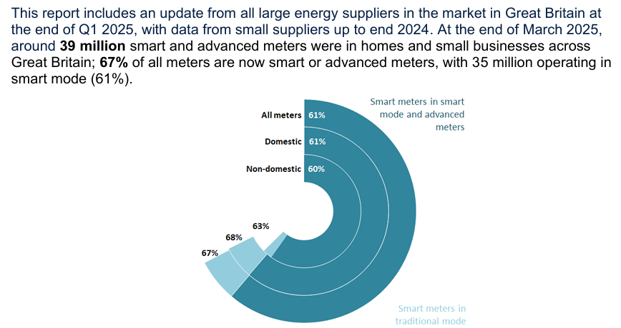
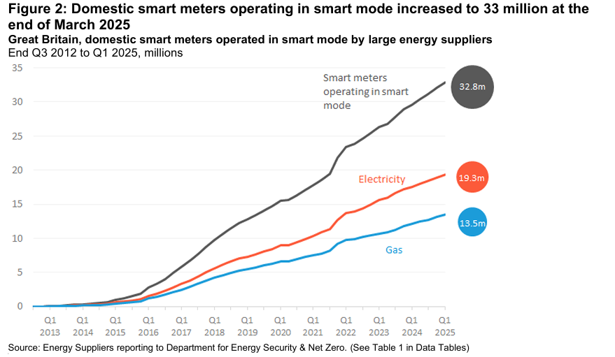
Source: DESNZ – GOV UK - Quarterly Report to end of March 2025

