Slide 1
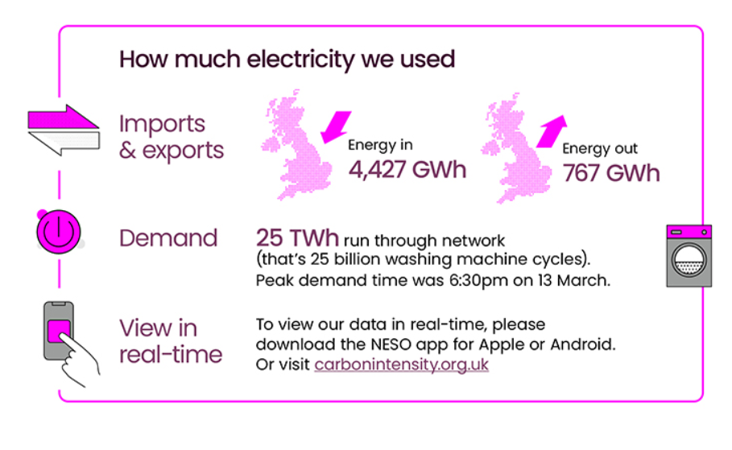
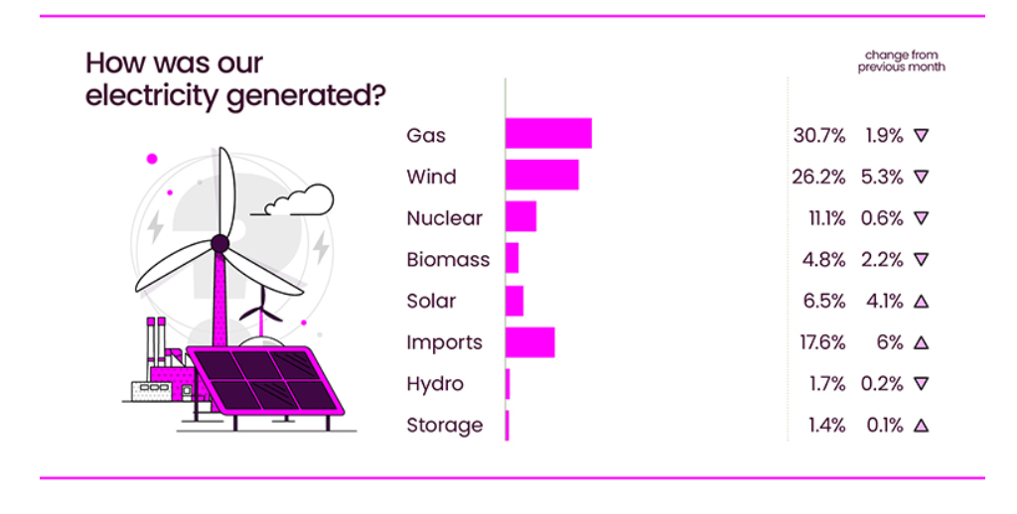
March 2024 Data
Source: National Energy System Operator

Slide 2
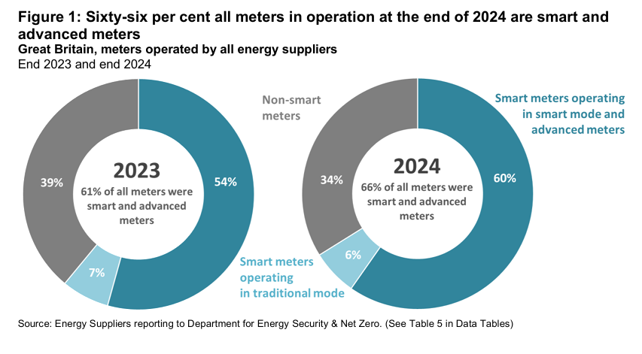
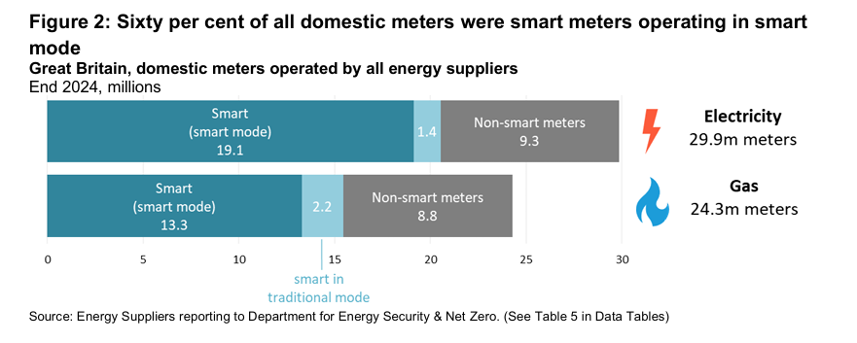
Quarterly Report to end of December 2024
Source: DESNZ – GOV.UK

