Slide 1
Fuse Upgrades on DNO cut-outs to facilitate LCT Connections
Over the past quarter, efforts have been focused on refining key elements of the project scope.
Two primary areas are currently being addressed:
Authorisation process for the installer to perform the fuse upgrade
Audit trail mechanism between installers and the DNOs
In parallel, we are developing internally a comprehensive report outlining the end-to-end solution. This document will provide a detailed view of the proposed approach and will be shared with the DNO teams for review.
The purpose is to ensure alignment and confidence across all DNOs. We anticipate the report will be ready for review in early June.
Once the report has been reviewed and endorsed, we plan to re-engage with DCUSA to initiate the formation of a working group. This group will be responsible for progressing the implementation of the required code changes.

Slide 2
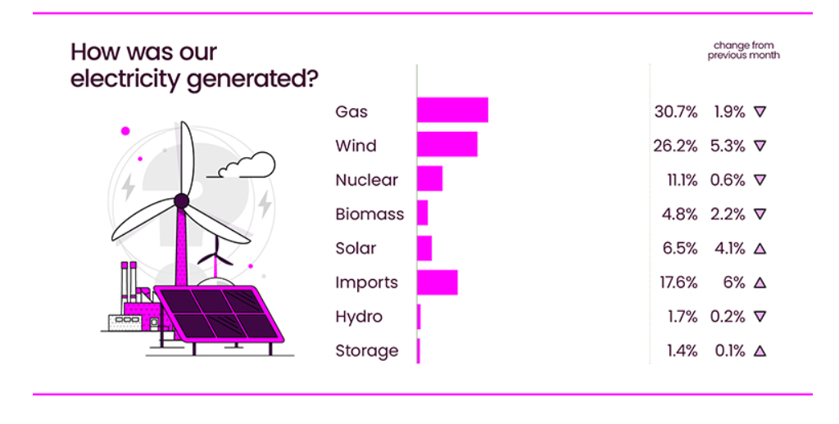
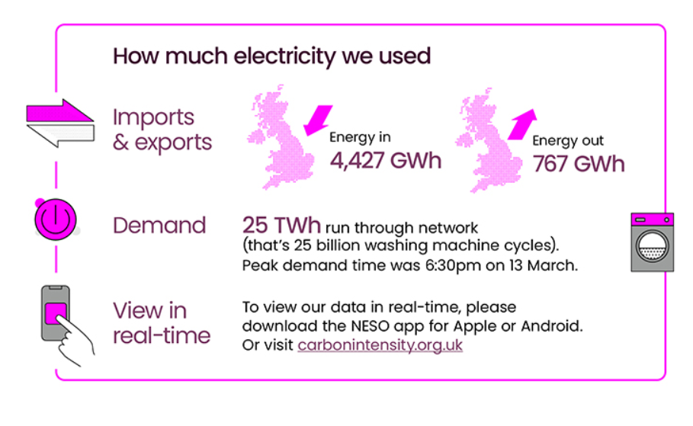
Source: National Energy System Operator – March 2025

Slide 3
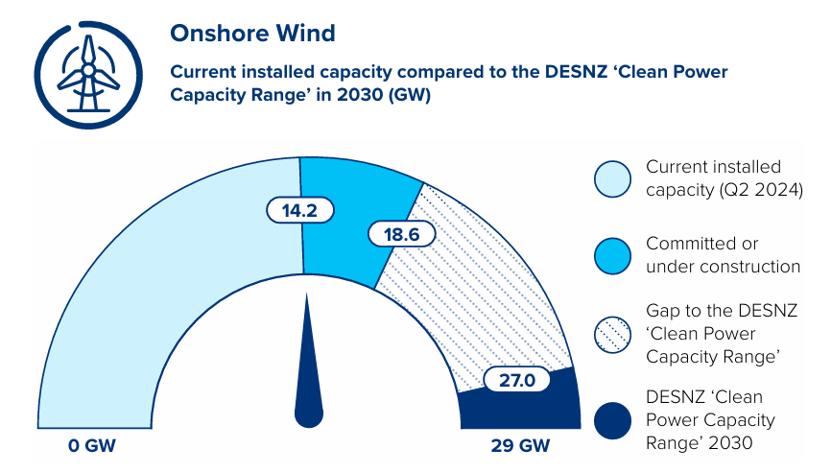
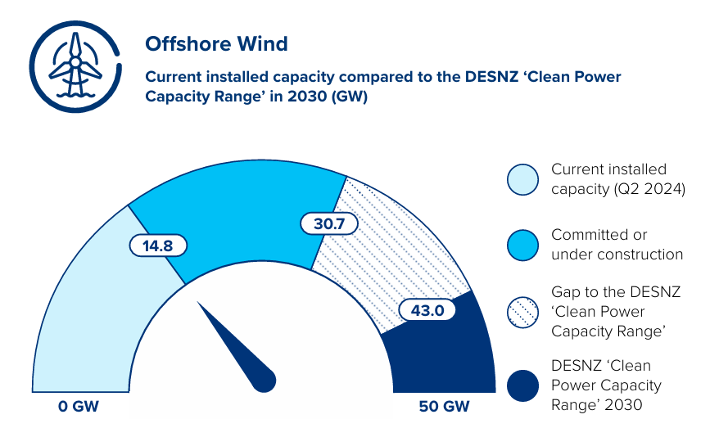
Source: Clean Power Action Plan 2030 UK GOV – Dec 2024

Slide 4
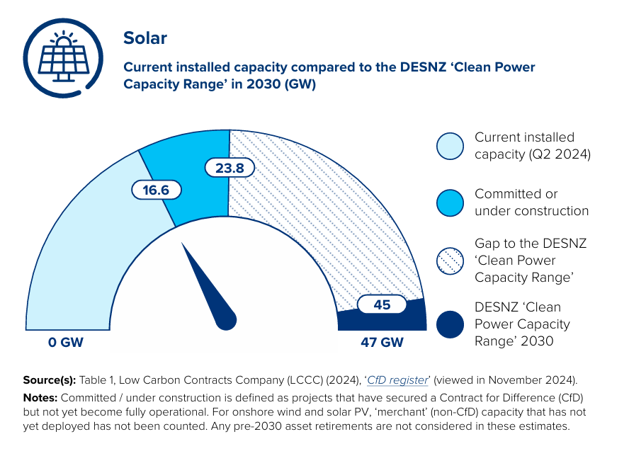
Source: Clean Power Action Plan 2030 UK GOV – Dec 2024

Slide 5
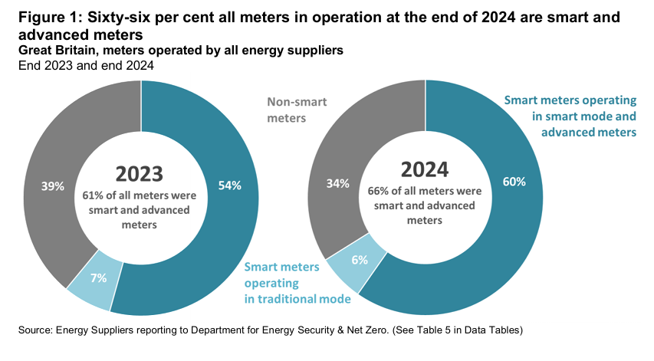
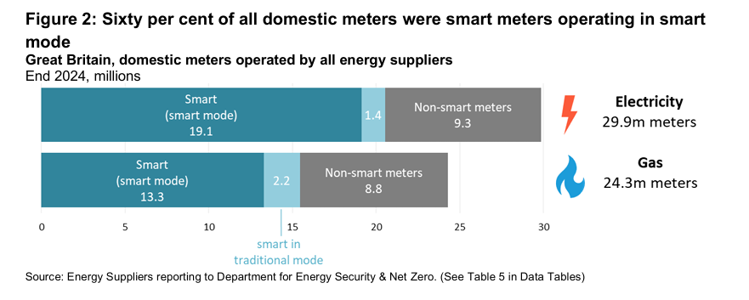
Source: DESNZ – GOV UK - Quarterly Report to end of December 2024

Slide 6
Change proposal tracker
CP | Title | Lead | Update
R0152 | Revision to the Consolidated Metering Code of Practice (CoMCoP) | Caroline Freimuller | This Change Proposal is due to be presented at June MEP for final decision.
I0197 | Introducing a process to provide updates during fault resolutions | James Hardy | The Change Report (Proposal Plan) is to be presented to the REC Change Panel on 03 June 2025. The Code Manager is continuing to explore the scope of the Issue and has engaged with the REC Metering Expert Panel and will engage with the REC Change Issues Group to discuss possible options on how to proceed with this Issue. Due to the expected large scope of, and interest in, this Issue, the Code Manager intends to set up a specific I0197 working group to begin in June.
R0201 | Creation of a Tool to Manually Correct ERDS / CSS Discrepancies | Ben Giblin | The corresponding BSC Change has been raised, however the REC Code Manager is working with the BSC to determine the timeline and implementation approach for this change proposal. This is because REC Party responses to the Impact Assessment requested sight of the BSC consultation responses before going to vote.
R0202 | Performance Assurance Report Catalogue Updates (MHHS) | Harriet Truss | The Final Recommendation was approved by REC Performance Assurance Board on 29 April 2025. This change requires MEMs to provide a new monthly report on Meter Asset Data. The implementation approach is for the first report to be submitted 3 months after the CP approval. The notice of implementation communication confirmed the date of the first report as 07 August 2025, for data as at the end of July.

Slide 7
Change proposal tracker
CP | Title | Lead | Update
R0207 | Import / Export MOA Charging Clarification | Caroline Freimuller | Awaiting Authority Decision – the Authority has not provided a date by which they expect to be able to make a decision.
I0216 | REC Changes to tie in with DCP419 | Caroline Freimuller | The Cross Code Steering Group confirmed REC as the lead code for this joint REC / DCUSA change. The Code Manager has had conversations with DCUSA, Ofgem and the Proposer of the DCUSA Change (Scottish and Southern Energy Networks, plus the Energy Networks Association), and is now conducting the business case and preparing the Change Report (For Consultation).
R0235 | Missing Scenario Variants in D0179 | Caroline Freimuller | Following discussions at the Change Issues Group and responses received at Party impact assessment, the Code Manager has raised an alternate change (R0235A) so Parties can consult on both solution options. These are: R0235 – the addition of the missing D0179 Scenario Variants to the Data Specification R0235A – the removal of the D0179 from Schedule 14 Metering Operations, and instead requiring the D0139 to be sent for all Meter types. The Change Report (For Consultation) has been published, and will be reviewed by REC Change Panel on 20 May 2025.
R0235A | Missing Scenario Variants in D0179 Alternate Solution | Caroline Freimuller | As above.

Slide 8
Change proposal tracker
CP | Title | Lead | Update
R0238 | Performance Assurance Reporting Catalogue - Annual Review | James Hardy | Change Report (Final Recommendation) has been published and will be presented to the REC Performance Assurance board on 27 May 2025. Should this Change Proposal gain approval from the PAB, R0238 will be implemented on 27 June 2025.
R0244 | C21 to be introduced into STIRG Document | Caroline Freimuller | This Issue has progressed to a Change Proposal and is currently out for consultation. The only change made to the legal text/data item after impact assessment is that connection arrangement is no longer capitalised.

