Slide 1
Wilcock Consultants Ltd
Gas Operational Metering Forum
Audit Review January 2026 – July 2026
Teams Meeting
09/09/2026

Slide 2
Overall Audit Numbers & Non-Conformances
Jan – Jul 2026 Gas and Electric
Audit Type | Number of Audits | Number of Non-Conformances
Registration | 76
CoMCoP Rev 3 | 62 | 476
I&C Gas Meter Tech Audit | 7 | 2
REC Gas Meter Site Tech Audit Rev 1 | 9 | 3
V3 Compliance Site Gas Meter Tech Audit | 19 | 2
REC Electric Meter Site Audit Rev 2 | 18 | 7
Total | 191 | 490
These numbers have been collated for 2026 only (to end July).
You will note the overall CoMCoP report is Rev 3 only as the Rev 2 finished in 2025.
The number of Gas Site options will reduce as the year progresses due to reporting changes, until “REC Gas Meter Site Tech Audit Rev 1” will be the only option.

Slide 3
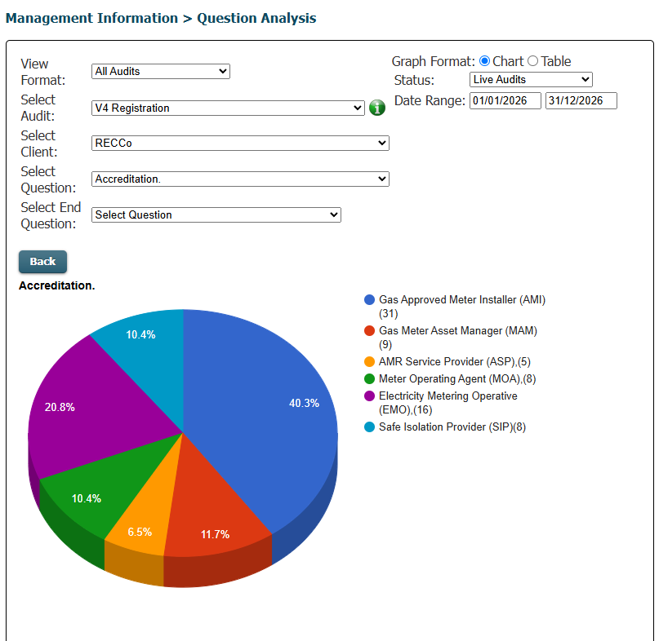
Registration Audits
These are only used to advise, where a company has completed requirements and is to be added to, or maintained on, the database as “Live” for registration purposes. The numbers do not always correlate as they are waiting for site audits in some cases.

Slide 4
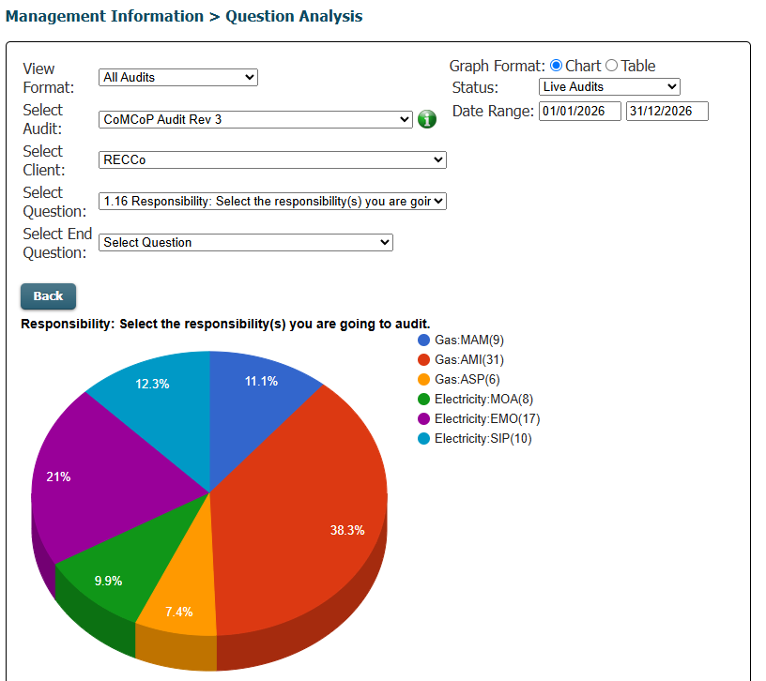
CoMCoP Rev3
These are the audit requirements from January 2026 as a result of the updates.
Part of the large numbers of Non-Conformances relate to the change in emphasis and requirements, mainly electrical. There were still issues in getting requested information in a timely manner.
Technical Audits
These are Gas site audits.
expanded in audit section below.

Slide 5
Gas Specific Audit Numbers & Non-Conformances
Audit Type “Office” | Number of Audits | Number of defects
CoMCoP Rev 3 – Gas Only | (46) | (14)
MAM | 9
AMI | 31
ASP | 6
I&C Gas Meter Tech Audit | 7 | 2
REC Gas Meter Site Tech Audit Rev 1 | 9 | 3
V3 Compliance Site Gas Meter Tech Audit | 19 | 2
Total | 81 | 21

Slide 6
CoMCoP – Rev 3 Gas Audits only
Of the 46 audits carried out, 3 have Non-Conformances recorded against them and all defects are shown below.
Ref | Number of Defects |  | Ref | Number of Defects
174611 | 7 |  | 175191 | 5
174951 | 2
As you can see from the information below, the number of defects is minimal, 1 occurrence only for each question

Slide 7
The following table shows the number of occurrences above 1 for the above. Full table available in XL document “CoMCoP rev3 actions”
Number of Occurrences | Question No. | Question
1 | 13.1.11 | Provide evidence there is a nominated competent person in place to identify and coordinate with relevant parties
1 | 16.1.1 & 16.1.4 | Provide evidence there is a process in place to ensure the company has an understanding of Rights of Entry and it is being used correctly
1 | 16.1.3 | Provide evidence the company has procedures to ensure that the opportunity to enter premises and homes is not abused
1 | 16.6.3 | Provide evidence there are procedures in place to ensure that equipment installed in a Hazardous Area is suitable and installed in accordance with relevant standards e.g. BS EN 60079 IGEM/GM/7 or IGEM/SR/25
1 | 16.7.1 | Provide evidence there is a process in place that details and confirms Inspections requested by the Gas Act Owner or DNO are carried out on the Meter Installation for all the categories required
1 | 16.8.2 | Provide evidence the company have procedures in place such that any person carrying out installation work covered by this CoMCoP who becomes aware of an unsafe or dangerous installation or gas leak during the course of that work has a duty to inform a Responsible Persone.g. HSE
1 | 16.8.4 | Provide evidence there is a process for the correct use of Unsafe situations processes
1 | 16.8.5 | Provide evidence that the correct repositioning processes are being used where required
1 | 22.2.1 & 22.2.5 - 22.2.7 | Provide evidence there is a process that where tampering or interference occurs the correct procedures are followed
1 | 22.2.2 | Provide evidence there are procedures to record tampering / theft or meter status incidents relating to the Meter Installation
1 | 23.1.1 - 6 | Provide evidence of processes and maintenance of records in relation to audits for all parties on installations technical competence and any remedial actions The Company must permit and co-operate with 3rd parties to any requests for information which the Registration Body Auditor makes for the purpose of carrying out routine surveillance audits and reassessments by the Registration Body Auditor
1 | 6.2.15 | Where applicable provide evidence that the competency of the supporting person / consultant relates specifically to the categories of accreditation(name and qualifications)
1 | 6.2.4 | Provide evidence that the company has processes in place to confirm and maintain the Competency of personnel undertaking non-standard Works and show their applicationi.e. Welding electronics or electrical installers.
1 | 6.3.5 | Provide evidence the company maintains a register of competent persons authorised by it.
There is a bit of a theme in that Provide Evidence has been included in most questions.

Slide 8
Gas Technical Audits
Audit Type “Site” (Technical) | Number of Audits | Number of Non-Conformances
I&C Gas Meter Tech Audit | 7 | 2
REC Gas Meter Site Tech Audit Rev 1 | 9 | 3
V3 Compliance Site Gas Meter Tech Audit | 19 | 2
I&C Gas Meter Tech Audit
Of the 7 audits carried out, 1 had Non-Conformances recorded against it and all defects are shown below.
Ref | Number of Defects |  | Number of Occurrences | Question No. | Question
174167 | 2 |  | 1 | 33. | Inlet outlet pipe work secure
 |  |  | 1 | 37. | Outlet pipework sleaved and sealed
All of these relate to operational requirements and were resolved on review.

Slide 9
REC Gas Meter Site Tech Audit Rev 1
Of the 9 audits carried out, 2 had Non-Conformances recorded against them and all defects are shown below.
Ref | Number of Defects |  | Number of Occurrences | Question No. | Question
174675 | 2 |  | 2 | 4.8. | Ventilation to meter area to adequate
175241 | 1 |  | 1 | 6.1. | Service installed correctly
V3 Compliance Site Gas Meter Tech Audit
Of the 19 audits carried out, 2 had Non-Conformances recorded against them and all defects are shown below.
Ref | Number of Defects |  | Number of Occurrences | Question No. | Question
175070 | 1 |  | 1 | AuditForm Error | This audit is for the following categories.
175213 | 1 |  | 1 | 36. | All necessary labels attached?
In transferring operating systems an error was identified and resolved, the non-compliance stays recorded for that audit, but the error has not reoccurred
All of these relate to operational requirements and were resolved on review.

Slide 10
The information that follows shows the year from April 26 to current and is generated from the reporting process

Slide 11
Gas Audit Performance: FY 2025/26
Performance information as shown is now available for you to access on the portal.
The information is generated from the table that follows.

Slide 12
Gas Audit Performance: Details
For Gas this shows the number of audits planned against completed
AMI
MAM
ASPCoP
Note:
The rows provide information on the number passed 1st time and the number with one or more non-compliance, the number of defects is reviewed elsewhere and individually with the client.
 | FY 2026/27 |  | Q1 |  |  | Q2 |  |  | Q3 |  |  | Q4
 |  | Audit Type | Apr-26 | May-26 | Jun-26 | Jul-26 | Aug-26 | Sep-26 | Oct-26 | Nov-26 | Dec-26 | Jan-27 | Feb-27 | Mar-27
 |  | Total Gas Office Audits | 9 | 7 | 4 | 5 | 0 | 0 | 0 | 0 | 0 | 0 | 0 | 0
 |  | Total Gas Site Audits | 10 | 5 | 5 | 6 | 0 | 0 | 0 | 0 | 0 | 0 | 0 | 0
 |  | AMI Office | 6 | 4 | 3 | 3 | 0 | 0 | 0 | 0 | 0 | 0 | 0 | 0
 |  | AMI Site | 6 | 2 | 4 | 4 | 0 | 0 | 0 | 0 | 0 | 0 | 0 | 0
 |  | Gas MEM Office Audits Completed | 2 | 1 | 1 | 0 | 0 | 0 | 0 | 0 | 0 | 0 | 0 | 0
 |  | Gas MEM Site Audits Completed | 3 | 0 | 1 | 1 | 0 | 0 | 0 | 0 | 0 | 0 | 0 | 0
 |  | ASPCoP Office Audits | 1 | 2 | 0 | 2 | 0 | 0 | 0 | 0 | 0 | 0 | 0 | 0
 |  | ASPCop Site Audits | 1 | 3 | 0 | 1 | 0 | 0 | 0 | 0 | 0 | 0 | 0 | 0
 | C | Gas Audits Due | #REF! | #REF! | #REF! | #REF! | #REF! | #REF! | #REF! | #REF! | #REF! | #REF! | #REF! | #REF!
 | C | Gas Audits Completed | 19 | 12 | 9 | 11 | 0 | 0 | 0 | 0 | 0 | 0 | 0 | 0
 |  | Gas Audits In-Tolerance | 16 | 11 | 9 | 11 | 0 | 0 | 0 | 0 | 0 | 0 | 0 | 0
 |  | Gas Audits with 1 or more Non-Compliance | 1 | 0 | 0 | 0 | 0 | 0 | 0 | 0 | 0 | 0 | 0 | 0
 | C | Gas - % Completed On Time (PCM) | 84.2% | 92% | 100% | 100% | #DIV/0! | #DIV/0! | #DIV/0! | #DIV/0! | #DIV/0! | #DIV/0! | #DIV/0! | #DIV/0!
 |  | Gas - % Completed On Time (YTD) | 84.2% | 87.1% | 90.0% | 92.2% | 92.2% | 92.2% | 92.2% | 92.2% | 92.2% | 92.2% | 92.2% | 92.2%
 |  | Gas - % with 1 or more Non-compliances (PCM) | 5.3% | 0.0% | 0.0% | 0.0% | #DIV/0! | #DIV/0! | #DIV/0! | #DIV/0! | #DIV/0! | #DIV/0! | #DIV/0! | #DIV/0!
 |  | Gas - % with 1 or more Non-compliances (YTD) | 5.3% | 3.2% | 2.5% | 2.0% | 2.0% | 2.0% | 2.0% | 2.0% | 2.0% | 2.0% | 2.0% | 2.0%
 | C | Gas - % passed first time (PCM) | 94.7% | 100.0% | 100.0% | 100.0% | #DIV/0! | #DIV/0! | #DIV/0! | #DIV/0! | #DIV/0! | #DIV/0! | #DIV/0! | #DIV/0!
 |  | Gas - % passed first time (YTD) | 94.7% | 96.8% | 97.5% | 98.0% | 98.0% | 98.0% | 98.0% | 98.0% | 98.0% | 98.0% | 98.0% | 98.0%

Slide 13
Items for discussion / information
While there are fewer “gas” issues personnel changes can create issues please note
Where new people have become involved the generality of the audit creates some issues, it is not just technical information it also includes company wide requirements.
  Eg company insurances, other accreditations and information may not be automatically available to technical personnel.
  Similarly, compliance personnel may not have enough understanding of technical requirements.
It may be advantageous to have a team approach rather than one person trying to navigate your company processes.

