Slide 1
Switching Change Proposal:
Final SLAs & Exclusions
R0092 – DCC Proposals
We believe in making Britain more connected,
so we can all lead smarter, greener lives.

Slide 2
Overview on the new evolved R92 proposals
Following the successful go-live of the Switching Service, and subsequent understanding of user and system behaviour, DCC initiated a REC Change Proposal (R0092 ‘Service Level Agreements for the Switching Incentive Regime’) to align the Switching SLAs (originally defined early in the design process) with this real-world behaviour.
DCC has used the feedback gained through the R0092 Working Group with RECCo and industry to create an updated proposal covering the areas discussed to date.
This was considered as part of the PIA process and the initial thoughts of RECCo and industry were fed back to DCC on 29 November 2023, along with some compromise suggestions.
The current CSS solution delivers a cost-effective service to DCC’s customers, and this has been considered in our response to the compromises. This deck is DCC’s response to those discussions.
Category | Metric | Service Definition Ref.
CSS Message Targets | Synchronous Messages | CSS 6.1
 | Asynchronous Messages | CSS 6.2
 | Gate Closure | CSS 6.3
Incident Management Targets | SO (DCC) and CSS (Landmark) Incidents | SO/CSS 5.2
 | Service Requests | SO/CSS 5.4
Summary for discussion | Call W/C 18th Dec and Jan Working Group
Notes:
Example Note

Slide 3
REC Objectives, headlines and switches to date
facilitate effective competition in the energy retail markets;
facilitate the efficient entry and participation of Energy Suppliers and other relevant parties in the energy retail markets;
facilitate the efficient operation of the energy retail markets;
protect the interests of Consumers in relation to the energy retail markets;
facilitate the development and implementation of innovative products and services in the energy retail markets;
facilitate the development and implementation of new technologies in the energy retail markets.
Recent headlines
“Switching rise continues with large suppliers in favour. The number of domestic customers switching supplier hit a two-year high in November.” Utility Week
Switches to date
Attempted: 20,729,822
Successful: 20,728,156
Switch request success rate: 99.99%
Failed: 1,666
Fail rate: 0.01%
Notes:
Example Note

Slide 4
6.1 Synchronous Response and peak volume boundaries
REC Proposals
Peak Volume Boundaries
  RECCo appreciated the science behind the new figure and the fact that DCC have amended their proposal from 260k to 1.088m. However, RECCo felt this could be low and therefore have asked if DCC could add 5% on top of its calculations as contingency.
Synchronous Response measurement
  RECCo response was to support this proposal.
  However, RECCo has suggested that DCC considers introducing a maximum process time of 10 seconds.
DCC Response
Peak Volume Boundaries
  An extended dataset (6 months instead of 3 months) suggests that the data is consistent. Therefore, DCC is willing to add the 5% in the spirit of collaboration – Important to note MHHS impact has not been considered in these threshold estimates.
Synchronous Response measurement
  DCC welcomes RECCo’s support on the proposed changes and believe this will give a fit for purpose, challenging yet achievable incentive measure that will deliver the customer service our customers deserve.
  If industry requires further assurance, DCC would welcome reintroducing an appropriate target for the daily 90th percentile.
Actions
  DCC to amend the peak volume boundary (following approval of R92).
  DCC to discuss, with its Service Provider, the possibility to run the system at a higher minimum capacity to avoid the need to scale-up for all but the highest periods of demand.
    We spoke in the working groups about how DCC run the system at 4 instances as a minimum and allow auto-scaling to ramp up as and when needed. This gives the best cost-effective solution but doesn’t lend itself to the best customer service. Now we have the confirmation that the REC definition was incorrect on reporting performance on ALL relevant messages, DCC will now report on all messages going forward.
  DCC considers that this revised proposal will better facilitate REC Objective (c) as increasing the number of minimum instances will enhance CSS operation.

Slide 5
6.2 Asynchronous Response
REC Proposals
  RECCo response was to remain at hourly with either a maximum response time of 60 seconds or the retention of the 90th percentile targets. Many respondents were concerned that if at critical times, a message is being processed and then was held and sent the next day could create rejections. The Maximum Demand Volume would then need to be calculated based on hourly.
DCC Response
  DCC appreciates the support for daily measures as we shared analysis in the working groups that measuring hourly does not give an accurate measure of customer service and weakens the incentive altogether as it makes it unachievable.
  DCC understands that assurance is still required on processing the outliers – therefore we would be supportive of retaining an appropriate target for the daily 90th percentile.
  DCC seeks clarification from the working group on ‘critical times’ i.e. when this occurs and whether this requires a separate SLA.
Actions
  DCC to discuss, with its Service Provider, the possibility to run the system at a higher minimum capacity to avoid the need to scale-up for all but the highest periods of demand.
    We spoke in the working groups about how DCC run the system at 4 instances as a minimum and allow auto-scaling to ramp up as and when needed. This gives the best cost-effective solution but doesn’t lend itself to the best customer service. Now we have the confirmation that the REC definition was incorrect on reporting performance on ALL relevant messages, DCC will now report on all messages going forward.
  DCC to report on all messages going forward – to reflect the confirmation of the REC definition.
  DCC to introduce an enhanced exceptions process (including the recruitment of resources) to ensure we remove every instance of failure outside of our control. DCC welcomes the support from RECCo in supporting these exceptions into PAB.
  DCC considers that this revised proposal will better facilitate REC Objective (c) as increasing the number of minimum instances will enhance CSS operation as well as increasing performance visibility by reporting on all message types.

Slide 6
6.3 Gate Closure
REC Proposals
  RECCo’s response is that gate closure is to remain the responsibility of the DCC for the end-to-end processing with the utilisation of the exceptions process available from the PAB. This was seen as a big risk area for industry and therefore there is no appetite for compromise.
DCC Response
  DCC shared and discussed data at the last working group process that clearly showed DCC is being measured on aspects of the system completely out of DCC’s control - this was acknowledged by the REC Code Manager. DCC is also being held to account for third parties that DCC do not have a contractual relationship with which was accepted by the working group. We agree that we have a responsibility to help PAB manage their responsibility to ensure non-compliance is addressed across the infrastructure.
  Ofgem has been clear on the principle that economic incentive regimes should only apply to areas within DCC’s control. This decision has been made since the submission of the PIA and therefore, DCC would ask that the REC take this into consideration.
    In March 2022 Ofgem wrote to DCC, “We will take wider evidence into account when deciding whether DCC should lose margin under the OPR associated to SRV8.11. For example, we will consider what options DCC explored with its Fundamental Service Providers (FSPs) and customers to improve performance, or whether the targets were not met due to circumstances outside of DCC’s control.” This confirms Ofgem's position that where performance is outside of DCC's control, DCC should not lose margin. In October 2023, Ofgem published it’s minded-to position to zero weight SRV8.11 because it was outside of DCC’s control.
  DCC is happy to continue to measure and report on end-to-end performance as a KPI – this provides visibility for PAB so that it may address issues that are impacting performance as well as transparency on how DCC has fulfilled its obligations to manage issues across the process.
  DCC understands that this is a big risk area for industry. An option to address this would be to create SLA response times for the end user points – which could ensure timey responses and in turn limit the CSS performance impact.
Actions
  DCC to pre-set an increased minimum number of instances for two hours around gate closure time to minimise the processing time (but this does not resolve the issue of the measure being outside of DCC’s control).
    We spoke in the working groups about how DCC can increase the minimum number of instances when required – this is the only option available to DCC to somewhat maximise its chances of meeting this SLA. This would have an additional estimated cost of £10k per annum..
  DCC to introduce an enhanced exceptions process (including the recruitment of resources) to ensure we remove every instance of failure outside of our control. DCC welcomes the support from RECCo in supporting these exceptions into PAB.
  DCC considers that this revised proposal will better facilitate REC Objective (c) as increasing the number of minimum instances will enhance CSS operation.

Slide 7
5 (SO) Service Levels: Switching Incidents Measurement
REC Proposals
  RECCo has no support for this change; however, a compromise could be considered by Incorporating a maximum resolution time for Switching Incidents with the suggestion of 5WD for P3 and 15WD for P4. Alternatively, no more than an additional 100% of the current response time of 6WD for P3 and 20WD for P4.
  DCC Response
  Delivering 100% across P3 and P4 measures is impossible to deliver, and hasn’t been delivered to date, for the complex incidents we see in CSS. DCC accepts that industry need assurance that incidents will not be left and will be processed in line with their priority status but for example, a 90% target for Category 3 incidents would literally affect 1 incident per month. Since the Working Group, DCC took on the challenge to improve Category 3 performance from 51% and are now delivering above 90% through service improvement processes. The current regime penalises, not incentivises this improvement.
Actions
  DCC to increase resources within the suppliers' teams to ensure resources are available to process incidents 100% of the time.
    If DCC is to hold their CSS supplier to 100% delivery of all incidents, then we will need to increase resources as above. This will increase the cost of CSS and will not guarantee 100% SLAs but is a recognition of the importance of delivery to industry.
  DCC to introduce an enhanced exceptions process (including the recruitment of resources) to ensure we remove every instance of failure outside of our control. DCC welcomes the support from RECCo in supporting these exceptions into PAB.
  DCC considers that this revised proposal will better facilitate REC Objective (a) as providing greater transparency of failures outside of DCC’s control to the PAB will facilitate effective competition in the energy retail markets.

Slide 8
SO (DCC) Switching Standard Service Requests - SO 5.4
REC Proposals
  RECCo stated there is no support to change the SLAs; however, Incorporating a maximum 100% response time for Service Requests of 15WD could be a compromise.
DCC Response
  Delivering 100% across all Service Requests gives no room for manoeuvre, and everything is treated as a priority. To keep costs of CSS down, current supplier contracts do not have Service Request contracted SLAs in CSS and are delivered as a best endeavours basis. Failures of the 100% performance measure in the year have led to failed incentive regime measures and therefore penalty charges to DCC. DCC will now need to formalise this service with the CSS suppliers, and this will result in additional costs to CSS.
Actions
  DCC to raise CRs into Capgemini, Landmark, Capita and Entrust.
    DCC believes the CSS Suppliers would not agree to a 100% contract change without a considerable investment in resources and this will be investigated through the CRs.
  DCC to introduce an enhanced exceptions process (including the recruitment of resources) to ensure we remove every instance of failure outside of our control. DCC welcomes the support from RECCo in supporting these exceptions into PAB.
  DCC considers that this revised proposal will better facilitate REC Objective (a) as providing greater transparency of failures outside of DCC’s control to the PAB will facilitate effective competition in the energy retail markets.

Slide 9
Summary
Any good measure of performance over a month, where there are millions of events during the month, should not be determined by a single bad event especially when the vast majority of events are within target. DCC considers that the current measurement regime misrepresents the overall performance of the Central Switching Service.
Asks of RECCo and Industry
  Consider the Ofgem precedent with the decision to remove any measures from incentive regimes that DCC cannot control and apply the same principle to Gate Closure.
  Consider the cost benefit of additional resource implications on DCC/CSS/REC Parties to correct inappropriate measures.
  Support DCC increasing the minimum instance counts for Asynchronous messages and Gate Closure.
  Work with DCC on a joint process for exception reporting to PAB.
What can DCC do to compromise?
  Add the 5% contingency to the Peak Volume boundaries.
  Introduction of infrastructure changes to increase minimum instances for Asynchronous messages and Gate Closure operations.
  Retain an appropriate daily target on synchronous and asynchronous messages for the 90th percentile.
  Gate closure - In the case of failures, provide supporting data reporting for the end-to-end process to enable PAB to address non-compliance.
  DCC to introduce an enhanced exceptions process and resource to ensure we remove every instance of failure outside of our control.
  Service Requests will need to be formally backed off in CSS supplier contracts. This will be an additional cost to DCC.
Additional actions for DCC
  Detailed exceptions process introduction:
    Hybrid - Manual/Automated tooling – DCC to explore, via a CR into Capgemini, the development of an auto tooling solution to identify and remove agreed exceptions in line with audit processes.
  DCC and its Service Providers will need additional resources to be available to process incidents and Service Requests 100% of the time and therefore we will need to change the current operating model.

Slide 10
Appendix & Previous slides
Previously presented supporting slides

Slide 11
Overview on the new evolved proposals
Following the successful go-live of the Switching Service, and subsequent understanding of user and system behaviour, DCC initiated a REC Change Proposal (R0092) to align the Switching SLAs (originally defined early in the design process) with this real-world behaviour.
DCC has used the feedback gained through the R0092 working group with REC and Industry to create an updated proposal covering the areas discussed to date. This slide pack outlines our best suggestions of how these SLAs could be changed to enable an accurate and tangible measurement of the performance levels in these areas.
Category | Metric | Service Definition Ref.
CSS Message Targets | Synchronous Messages | CSS 6.1
 | Asynchronous Messages | CSS 6.2
 | Gate Closure | CSS 6.3
Incident Management Targets | SO (DCC) and CSS (Landmark) Incidents | SO/CSS 5.2
 | ERDS/GRDS Incidents | ERDS/GRDS 6.2
 | Service Requests
Performance Measurement Exclusions | Relevant to all areas
Working Group Next Steps
Notes:
Example Note

Slide 12
6.1 Synchronous Response
Following receipt of Market Messages from CSS Users, the CSS Provider shall carry out synchronous validation and provide a response within the following times:
Current Definition
Proposal
Performance Parameter | Performance Level
Average daily volume | mean time of two seconds or less
Average daily volume | 90th percentile time of four seconds or less
Peak daily volume | mean time of three seconds or less
Peak daily volume | 90th percentile time of six seconds or less
Performance Parameter | Performance Level
Average and Peak daily volume | mean time of two seconds or less
Definition | Mean Daily Response = 100 x Nr days where mean response time for all messages ≤2s Count of days in the month
Target | 100% of days in month meeting mean daily response of 2 seconds or less
Boundary | Target applies where daily volume of all messages received <= 1.088m
Key Outcomes
Applying the two-second performance level to both Average and Peak category days simplifies the measure and reduces the overall target time
The 90th percentile measure does not bring any additional Performance Assurance benefits; removing it negates the need for a CR and saves costs
As daily volumes are sufficiently high to avoid single anomalies causing a failure for the month, a 100% SLA is challenging yet achievable within existing service design. However, increasing peak numbers from 281k to 1.088m will need to be flagged to DCC Service Design for review as part of a CR off the back of this REC Change Proposal, which may incur a cost
All message types are included as per Service Definition (removal of ambiguity)
Daily measurement maintained as per Service Definition
Proposal

Slide 13
6.2 Asynchronous Response
The CSS Provider shall process Market Messages (from the point of receipt by CSS to the point where CSS sends out the response of either "Validated" or "Rejected") as follows:
Current Definition
Proposal
Performance Parameter | Performance Level
Average hourly volume | mean time of three seconds or less
Average hourly volume | 90th percentile time of six seconds or less
Peak hourly volume | mean time of five seconds or less
Peak hourly volume | 90th percentile time of eight seconds or less
Performance Parameter | Performance Level
Average and Peak daily volume | mean time of three seconds or less
Definition | Mean Daily Response = 100 x Nr days where mean response time for all messages ≤3s Count of days in the month
Target | 100% of days in month meeting mean daily response of 3 seconds or less
Boundary | Target applies where daily volume of all messages received <= 1.088m
Key Outcomes
Applying the three-second performance level to both Average and Peak category days simplifies the measure and reduces the overall target time
In moving to daily volumes, the message counts are sufficiently high to avoid single anomalies causing a failure for the month, therefore a 100% SLA is challenging yet achievable within the current service design
The 90th percentile measure does not bring any additional Performance Assurance benefits; removing it negates the need for a CR and saves costs
All message types are included to align with measure 6.1 and ensure that all critical messages are tracked
Measure simplified and ambiguity removed
However, increasing peak numbers from 281k to 1.088m will need to be flagged to DCC Service Design for review as part of a CR off the back of this REC Change Proposal, which may incur a cost
Proposal

Slide 14
6.3 Gate Closure
The CSS Provider shall process the securing of Switches up to the point where all messages are queued for delivery to each relevant Market Participant (from the time of Gate Closure to CSS Processing Complete) as follows:
Current Definition
Proposal
Performance Parameter | Performance Level
Average daily volume | mean response time of 20 minutes or less
Average daily volume | 90th percentile response time of 25 minutes or less
Peak daily volume | mean response time of 35 minutes or less
Peak daily volume | 90th percentile response time of 40 minutes or less
Performance Parameter | Performance Level
Average and Peak daily volume | mean time of 35 minutes or less
Average and Peak daily volume | 90th percentile response time of 40 minutes or less
Definitions | Mean Processing Complete Time = 100 x Nr days where Processing Complete reached in ≤35 mins Count of days in the month
 | If 90th percentile value of time to reach Processing Complete over month range ≤40 mins = Pass
Targets | Mean: 100% of days in month meeting SLA 90th: Value of 40 minutes or less
Boundaries | Targets apply where daily volume of all active switches & initial registrations <= 281.6k (current Peak limit)
Key Outcomes –
Discussions through the workshops have highlighted the fact that measuring the
SLAs outside of DCC control is unfair. Proposal is we measure 6.3 Gate Closure as the
CSS process within DCC's/CSS control and that forms the measure in the incentive
regime. No change to the measure itself but we propose to only measure the part of
the process within DCC's control. In addition, we propose to introduce a new KPI measure under the Switching Operator that tracks DCC's management of issues that impact end-to-end Gate Closure, including that which is outside of CSS control. The latter is not an SLA and therefore not part of the incentive regime.
The use of the Processing Complete point in time means that DCC’s SLA will be completely within DCC’s control
End-to-end system design will still target 35-minute mean Gate Closure time, but SLA will be against elements within DCC control
Applying the same performance levels to both Average and Peak category days simplifies the measures and removes ambiguity
DCC will continue to report the end-to-end gate closure time as supporting evidence, highlighting any slow user end points to the PAB
Proposal

Slide 15
6.3 Gate Closure cont....
Example – On the 12th September 2023 one of the largest energy suppliers submitted a large amount of internal Switches. This led to one million Switch messages at Gate Closure which DCC processed in 19 minutes 56 seconds. However, the end-to-end processing time for this was 43 minutes 12 seconds including the DCC processing time.
This additional time taken to progress Gate Closure is completely outside of DCC's control. DCC needs to provide a service to our customers to get these messages out as quick as we can. This example shows how DCC performed well against our REC Obligations. Using the two measures going forward is a better way to measure DCC performance and still capture slow end point performance that DCC can share with the REC Manager as part of its Switching Operator obligations.
DCC are not proposing to change anything in the Gate Closure process, only the way we measure DCC's performance within it.

Slide 16
5 (SO) Service Levels: Switching Incidents
Current Definition
Proposal
Priority | Target Response Time | Target Resolution Time
Priority 1 | 30 minutes | 4 hours
Priority 2 | 1 hour | 24 hours
Priority 3 | 3 working hours | 3 working days
Priority 4 | 1 working day | 10 working days
No change to response and resolution target times for major incident
Exclusions to be defined and applied
Response targets are only applicable to incidents raised by Market Participants via the Switching Portal
Incident response and resolution for ERDS and GRDS are not part of DCC’s targets
Currently implied 100% target changed to the following:
Priority | Response Target | Resolution Target
Priority 1 | 100% | 100%
Priority 2 | 100% | 100%
Priority 3 | 99% | 90%
Priority 4 | 99% | 95%
Key Outcomes
DCC is only responsible for incidents that are within its control as SO and CSS Provider. Anything
outside of DCC control will be removed from the measure.
Focus is maintained on high priority incidents
Ambiguity on target levels is removed
Applying a 90% resolution target on lower priority 3 incidents and 95% for priority 4s will enable
detailed investigation of P3/P4s, and no change to the policy of P1 & P2s to be prioritised.
It also allows for service infancy and the associated new issues experienced. Volumes are extremely low so the impact of a miss is huge on percentage. At present Service is 51% so we would suggest 90% as an interim target to incentivise DCC to improve service and review once we hit that measure.
Value for Money – There would be a commercial impact to reach 100%
Service Improvement plans are now in place for Priority 3 and 4 incident lifecycle process.
Proposal

Slide 17
5 (SO) Service Levels: Switching Incidents
Priority 3 – Can we implement an interim measure of 90% rather than the unachievable 100%.
Data – We are averaging nine Priority 3 incidents per month based on 2023 data. By nature Priority 3 incidents are more complicated and therefore additional time is usually taken to resolve. Should volumes increase in line with more switching activity across the industry, a target of 90% (currently 51% performance) would give DCC a real incentive to improve performance. At the workshop it was stated that it would not be acceptable for 10% of incidents to fail this SLA but as we can see that would be one incident at most, per month, based on current volumes.
Priority 4 – Can we implement an interim measure of 95% rather than the unachievable 100%.
Data – We are averaging 454 Priority 4 incidents per month based on 2023 data. So, a 95% success measure on these low priority incidents would give DCC some leeway of 22 incidents per month. Currently 88% performance so a target of 95% would be an incremental and achievable incentive for DCC to improve performance.
DCC is investing time and resources to develop Service improvement plans for Priority 3 & 4 SLA measures.
Examples of the types of incidents that would be a Priority 3 and 4 are on the following slide.

Slide 18
Examples of P3 and P4 incident types
Data below is since Jan 1 2023
Examples of P3 incident types/issues raised: 40% of 54 incidents relate to “Security” (11) or “Submission Error” (11), 16% relate to “Application” (9)
Submission error in this instance was used for incidents raised relating to missed messages, potential duplicates or were raised on the back of a service request where a party is trying to update their ARO/SRO
Most of the security categorised incidents were raised by DCC Security around data received from the Azure cosmos data base where they noticed an anomaly – of those then resolved, statement of no impact was confirmed post alert being raised
The majority of incidents in the Application category relate to certificate issues
Examples of P4 incident types/issues raised: 70% of 12,833 incidents relate to “Submission Error” (10,691), 7.5% relate to “Application” (986)
83% of submission error categorised incidents were Error API incidents raised by Landmark to parties
In the category Application, 99% relate to failed registrations/status updates needed in external systems

Slide 19
Performance Measurement Exclusions: Context
DCC has been providing REC Manager with additional reporting, taking into account events that are outside of DCC’s control, helping to provide clarity around core system performance and incident resolution. These events form an exclusions list, which is a living document that is updated in response to ongoing events and User behaviour. DCC is seeking to formalise this exclusions list and integrate it into the SLA reporting.
Exclusions are required to remove events that do not fall within the criteria for the metric calculation or are erroneous due to incorrect data entered.
There are different types of exclusions that fall into two classifications: Data Cleanse and Business Exception
Data Cleanse - The Event is in scope for the Measure but is removed from the Service Level calculation because the attributes of the Event have been identified as erroneous by DCC
Business Exception - The Event is in scope for the Measure but is removed from the Service Level calculation on agreement by DCC
National Outage impacting the Internet
Impact:
  Target Response times failing SLA
PMEL:
  Events failing Target Response times during the outage removed from the calculation as part of Business Exception Rule
System reported SLA status does not reflect the true SLA due to Incident State Change to Resolved after Service Restoration
Impact:
SLA reported inaccurately
PMEL:
  Evidence analysed and SLA Status updated to reflect true SLA as part of Business Exception Rule
Incident Assigned to Landmark incorrectly
Impact:
  The Provider, Switching Operator Service Centre and Switching Operator are all measured against Incident Resolution although the provider had no intervention on support of the issue
PMEL:
  Removed from Landmark Resolution Calculation only as part of Data Cleanse Rule
Issues
It was felt that the REC definitions provide the process to include exceptions via the PAB process on a monthly basis. DCC acknowledged this and will continue to use the current exclusions process which DCC will have to invest time and resource into. In addition to this DCC will need to invest time and effort into appealing the decision to penalise DCC through the incentive regime.

Slide 20
SO (DCC) Switching Standard Service Requests
SO 5.4
Current Definition
Proposal
Priority | Target Fulfilment Time
Priority 1 | 1 working day
Priority 2 | 2 working days
Priority 3 | 3 working days
Priority 4 | 10 working days
No change to fulfilment times for any request
Exclusions to be defined and applied (see later slides)
Currently implied 100% target changed to the following:
Priority | Fulfilment Target
Priority 1 | 100%
Priority 2 | 100%
Priority 3 | 98%
Priority 4 | 98%
Key Outcomes
Focus is maintained on high priority standard service requests
Ambiguity on target levels is removed
Applying a 98% fulfilment target on lower priority requests will enable detailed responses of P3/P4s, and will allow P1 & P2s to be prioritised.
Value for Money – There would be a commercial impact to reach a 100% target
In 2023 we have seen on average 45 Priority 3 standard service requests per month and 104 Priority 4s. Re-aligning the fulfilment target to 98% from 100% would give DCC a little leeway of 3 Priority 3 requests per month and 5 priority 4s which would make all the difference in the Switching Incentive Regime.
Service improvement plan underway to achieve 98% performance and beyond consistently
Proposal

Slide 21
Working Group Next Steps
Following the really positive interactive workshops:
  DCC has evolved its original set of proposals
  We believe these measures are an accurate way of measuring the customer experience; they are stretching but are also realistic
The Final DCC proposal will now be issued for a minimum 20 Working Day Impact Assessment
  As a workgroup we should then do a final review / tidy up of all of the PAB measures to ensure we have set the legacy for success in the future across CSS.

Slide 22
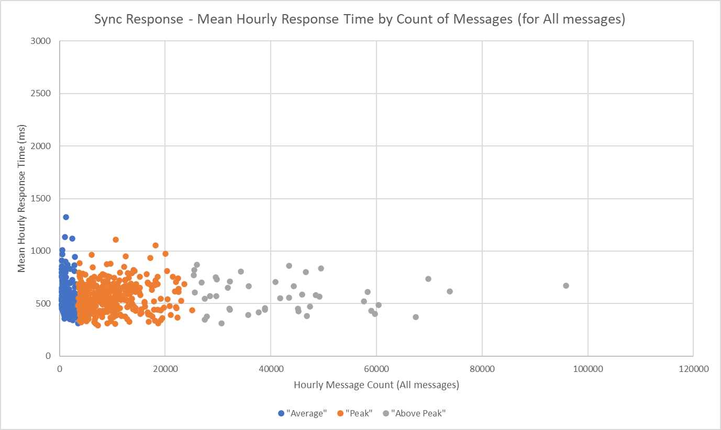
1506_02 - Synchronous Response – Mean Hourly Response for ALL messages
Action 1506_02: The DCC to confirm the required timescales to process synchronous and asynchronous responses during peak demand volumes.
The data below shows the Mean hourly response for ALL message types in May 2023. It shows that there is no obvious correlation between mean response time and the volume of messages processed in any hourly period.
3-second Target for Peak Hours
2-second Target for Average Hours
Each dot represents an hour.
The position of the dot on the y-axis (time) does not depend on the message volume in that hour (x-axis)
Average hour = 0 - 3,500 messages; Peak = 3,501 - 25,300; Above Peak = 25,301+

Slide 23
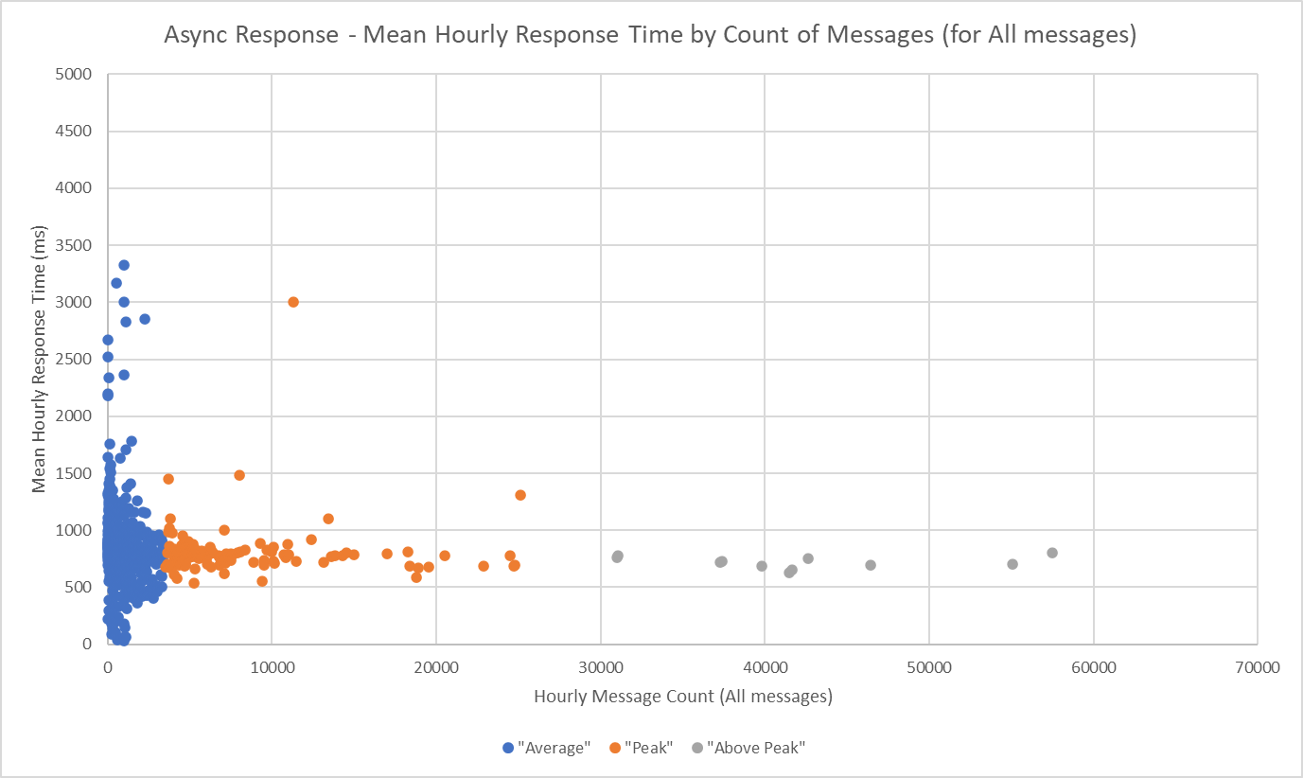
1506_02 - Asynchronous Response – Mean Hourly Response for ALL messages
Action 1506_02: The DCC to confirm the required timescales to process synchronous and asynchronous responses during peak demand volumes.
The data below shows the Mean hourly response for ALL message types in May 2023. It shows that there is no obvious correlation between response time and the volume of messages processed in any hourly period.
5-second Target for Peak Hours
3-second Target for Average Hours
Each dot represents an hour.
The position of the dot on the y-axis (time) does not depend on the message volume in that hour (x-axis)
Average hour = 0 - 3,500 messages; Peak = 3,501 - 25,300; Above Peak = 25,301+

Slide 24
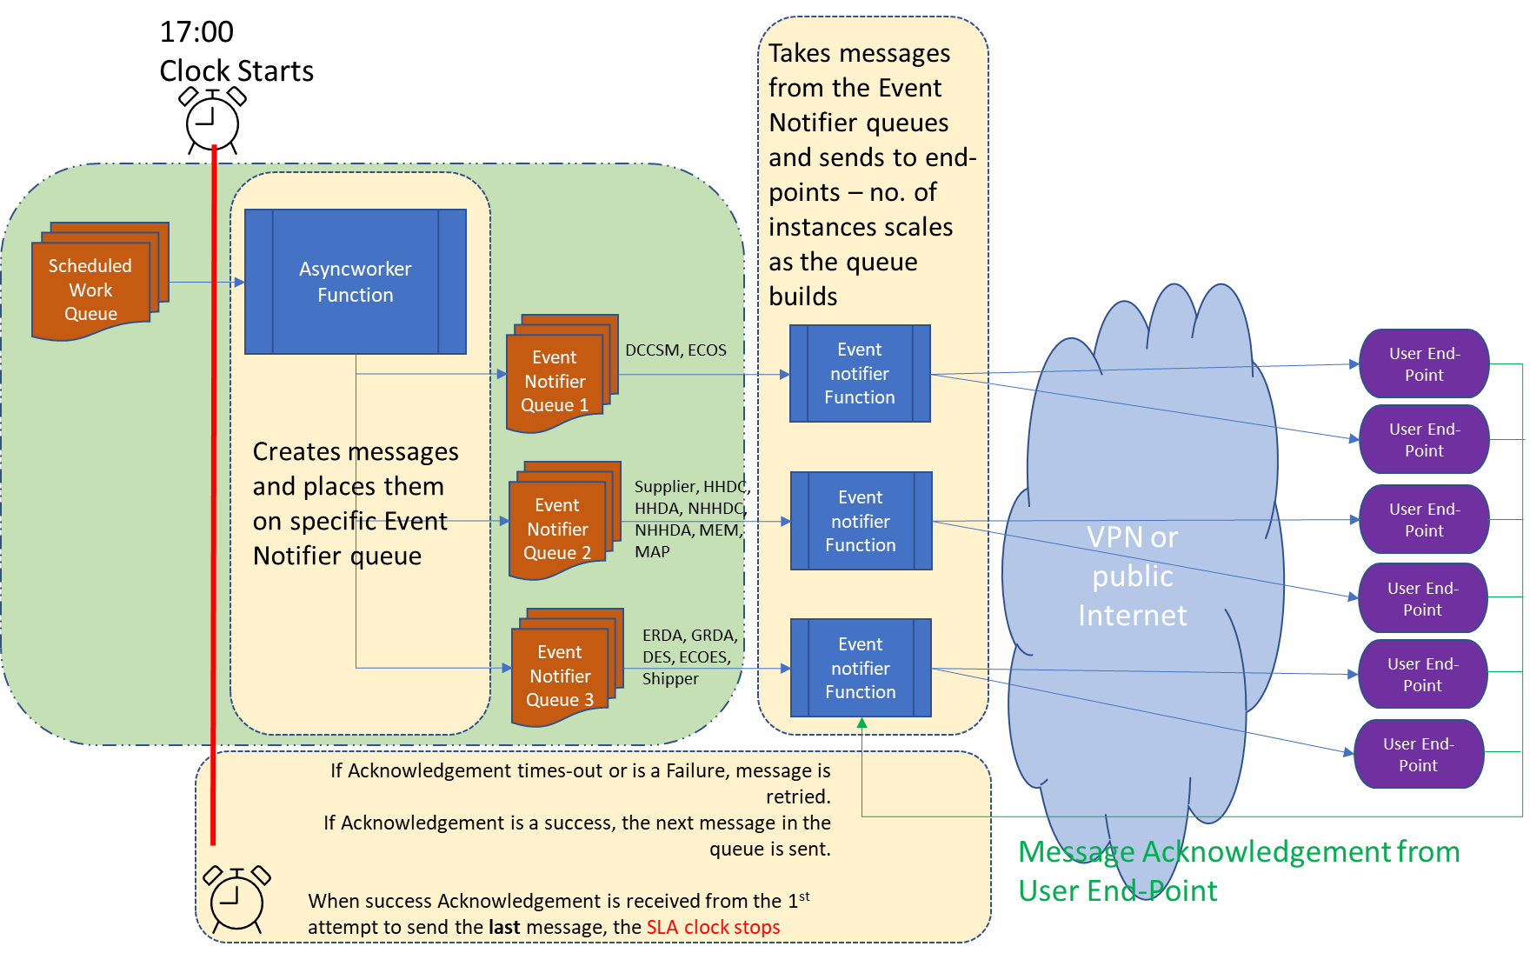
1506_04 – Gate Closure Diagram
Action 1506_04 DCC to produce a slide demonstrating the dependencies on user response vs dependencies on the DCC to complete processes regarding gate closure
Boundary of DCC’s exclusive control

Slide 25
1506_03 – Time for CSS Instances to Scale-Up
Action 1506_03: The DCC to confirm how long in-hour scaling processes takes to account for unexpected peak volumes.
Microsoft (Azure) do not provide scaling timescales for new function instances, nor do they publish the scaling algorithms.
CSS can specify the minimum number of function instances. This is currently set at 4 per data centre (8 in total).
Microsoft keep an equivalent number of function instances in the background ready to add – effectively on hot standby. Adding these in is a matter of seconds (exact timing is not known).
We can therefore scales from 4 to 8 instances per site quickly (but still in the same order as a 2-second SLA).
Scaling beyond the number of instances on hot standby takes longer. Again, MS do not specify and we can only sample at minute intervals. We see it scales-up within a minute but exact timing is not known. Increases in demand of this type will not achieve the SLA.

Slide 26
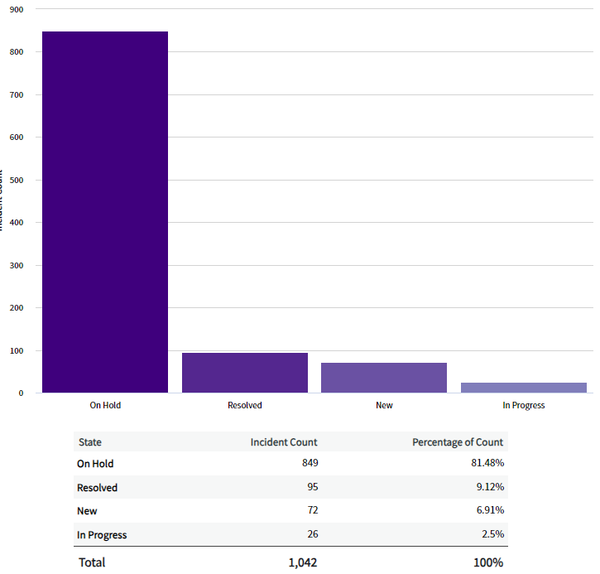
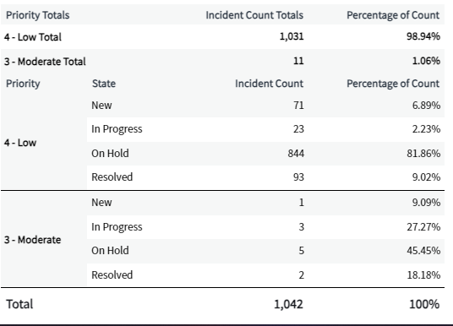
Snapshot view of the open Incidents by state and priority as of 22/06
Summary
As of 22/06 there are 1042 incidents in an open state which includes “Resolved” as incidents stay in this state for 3 days to allow users to reject the resolution provided. Within this stage 849 are on hold with a market participant, New and In progress states are used for DNO’s and other licensed parties. Out of the 1042, 98.94% of these are P4 incidents, 1.06% are P3 and we have no current major incidents open.

Slide 27
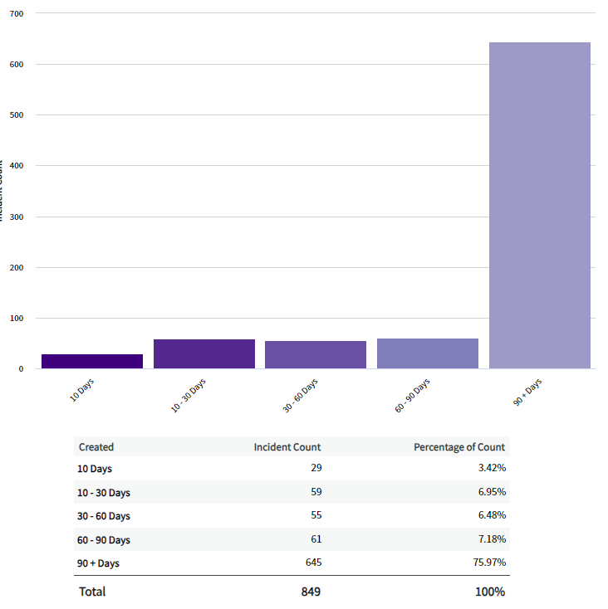
A view of trending of new incidents coming into the desk and age of current on hold incidents
Commentary
Between the 12th June and 18th of June we have received 150 Incidents 101 were related to Error API. 15 were related to Failed Registration. 11 were related to One or more CSS business validation errors With the remainder being across several areas. To the left the graph is showing the age of incidents which are currently on hold awaiting a market participant response.

Slide 28
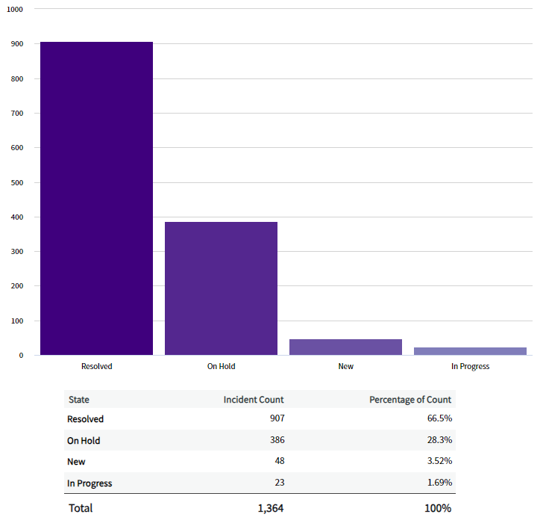
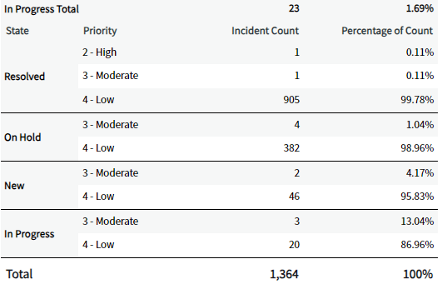
Snapshot view of the open Incidents by state and priority as of 28/06
Summary
As of 28/06 there are 1364 incidents in an open state which includes “Resolved” as incidents stay in this state for 3 days to allow users to reject the resolution provided. Within this stage 386 are on hold with a market participant, New and In progress states are used for DNO’s and other licensed parties. Out of the 1364, 98.98% of these are P4 incidents, 1.02% are P3 and we have one current major incident open.

Slide 29
Performance Measurement Exclusions: Approach
All service areas
Ref | Method Title | Service Level Calculation Methodology | Applies To
PMEL1 | Auto Identified Exclusions/Exceptions | Events that can be auto identified based on rules will have the PMEL Classification applied where applicable and will be removed from any Performance Measure Calculations Not included in count of Total Events regardless Event SLA Status | ALL
PMEL2 | Manually Identified Exclusions/Exceptions | Events that have breached their SLA will be examined to ascertain if they meet the PMEL definition, PMEL classification applied where applicable and will be removed from any Performance Measure Calculations Missed Events analysed only | ALL
PMEL3 | Manually Reviewed SLA Metric Change | Events that have breached their SLA will be examined to ascertain if the system reported SLA status reflects the true SLA - Evidence based Missed Events analysed only | ALL
PMEL4 | Switching Operator Specific Exception | Incident records that have a ERDS/GRDS SLA attached Not included in count of Total Events regardless Event SLA Status | SO
PMEL5 | Service Catalogue Requests | Service Catalogue Requests will be manually examined to ascertain if they should be classified as an exclusion, if applicable a PMEL Classification will be applied and will be removed from any Performance Measure Calculation Not included in count of Total Events regardless Event SLA Status | ALL
Issues
ISSUE
IMPACT
SOLUTION

Slide 30
Proposed Performance Measurement Exclusions
Service Catalogue-Related
 | Title | Use Case/Justification | Related Service Definition Criteria | Identification Process | Governance | Exclusion Type | PMEL Approach
Service Catalogue | Non Standard Service Request | Non-standard Service Requests have no defined SLAs | SO 5.4.1 – 5.4.4 | Automatic and Manual – Data Analysis | DS&A | Data Cleanse | PMEL5
 | Cancelled Service Request | Service Request has been cancelled | SO 5.4.1 – 5.4.4, 6.2 CSS 6.5 | Automatic and Manual – Data Analysis | DS&A | Data Cleanse | PMEL5
 | Duplicate Service Request | Duplicate Service Request created | SO 5.4.1 – 5.4.4, 6.2 CSS 6.5 | Automatic and Manual – Data Analysis | DS&A | Data Cleanse | PMEL5
 | Service Request Raised In Error | Service Request raised in error | SO 5.4.1 – 5.4.4, 6.2 CSS 6.5 | Automatic and Manual – Data Analysis | DS&A | Data Cleanse | PMEL5
 | Mandatory Information Not Supplied/Inaccurate | Information to support fulfilment not provided or inaccurate | SO 5.4.1 – 5.4.4, 6.2 CSS 6.5 | Automatic and Manual – Data Analysis | DS&A | Data Cleanse | PMEL5
 | Service Request Related to Pre Prod/Dev | Non CSS Service Impacting | SO 5.4.1 – 5.4.4, 6.2 | Automatic and Manual – Data Analysis | DS&A | Data Cleanse | PMEL5

Slide 31
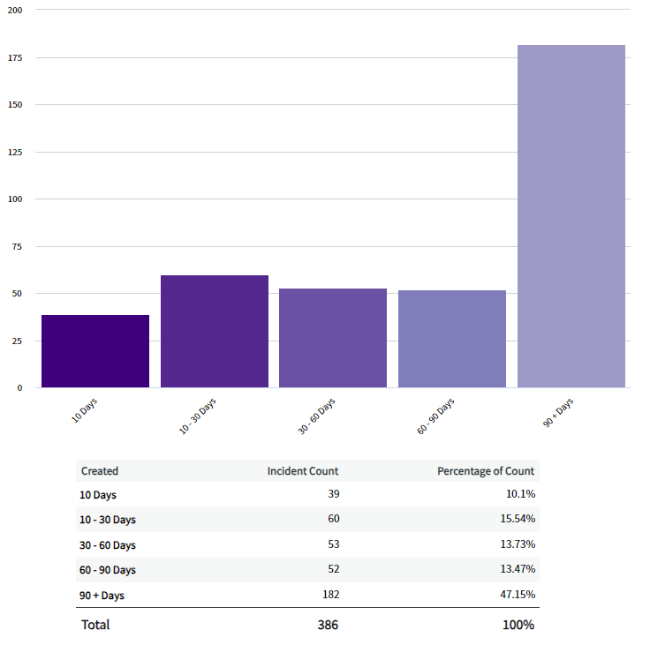
A view of trending of new incidents coming into the desk and age of current on hold incidents
Commentary
Between the 19th June and 25th of June we have received 144 Incidents 75 were related to Error API. 14 were related to Failed Registration. 29 were related to One or more CSS business validation errors With the remainder being across several areas. To the left the graph is showing the age of incidents which are currently on hold awaiting a market participant response. The largest contributing party to the on-hold queue (500 incidents) confirmed closure this week.

Slide 32
Proposed Performance Measurement Exclusions
Incident-Related
 | Title | Use Case/Justification | Related Service Definition Criteria | Identification Process | Governance Process | Exclusion Type | Approach Type
Incident | ERDS and GRDS – Attached SLA | RECCo Managed, not under DCC Control | SO 5.2.1 to 5.2.8 | Automatic | DS&A | Data Cleanse | PMEL4
 | Cancelled State | Cancelled | SO 5.2.1 to 5.2.8 | Automatic | DS&A | Data Cleanse | PMEL1
 | Duplicate Incident | Duplicate incident created | SO 5.2.1 to 5.2.8 | Automatic | DS&A | Data Cleanse | PMEL1
 | Raised In Error | Incident raised in error – manually or system generated | SO 5.2.1 to 5.2.8 | Manual – Data Analysis | DS&A | Data Cleanse | PMEL2
 | Non CSS Impacting | Issue not impacting CSS or Switches | SO 5.2.1 to 5.2.8 | Manual – Data Analysis | DS&A, DCC Service Owner, ILSM | Business Exception | PMEL2
 | Not SO Or Provider Responsibility | Incident raised due to message unable to be delivered - this could be due to an endpoint being down, capacity issues/scaling or a business rule failure (failed to deliver) | SO 5.2.1 to 5.2.8 | Manual – Data Analysis | DS&A, DCC Service Owner, ILSM | Business Exception | PMEL2
 | Catalogue Request/Service Request | Request erroneously raised in Incident module | SO 5.2.1 to 5.2.8 | Manual – Data Analysis | DS&A | Data Cleanse | PMEL2

Slide 33
Proposed Performance Measurement Exclusions
Incident-Related
 | Title | Use Case/Justification | Related Service Definition Criteria | Identification Process | Governance | Exclusion Type | PMEL Approach
Incident | Planned Maintenance | Incident raised due to unavailability during Planned Maintenance Window | SO 5.2.1 to 5.2.8 | Manual – Data Analysis | DS&A, DCC Service Owner, ILSM | Data Cleanse | PMEL2
 | Event Monitoring | Alert/Alarm for Information only | SO 5.2.1 to 5.2.8 | Manual – Data Analysis | DS&A | Data Cleanse | PMEL2
 | Testing/Production Proving | Incident raised for testing purposes only | SO 5.2.1 to 5.2.8 | Manual – Data Analysis | DS&A | Data Cleanse | PMEL2
 | Known Defects | We have an open Problem Record | SO 5.2.1 to 5.2.8 | Manual – Data Analysis | DS&A, DCC Service Owner, ILSM | Data Cleanse | PMEL2
 | Tooling Defect/Issue | ServiceNow Configuration/Workflow Issues – This could be where an SLA has incorrectly attached, integration has failed | SO 5.2.1 to 5.2.8 | Manual – Data Analysis | DS&A | Data Cleanse | PMEL2
 | SLA Metric Correction | Where the System generated SLA status based on Service Restoration or Incident Response is different to actual – this could be due to incorrect tool usage | SO 5.2.1 to 5.2.8 | Manual – Data Analysis | DS&A, DCC Service Owner, ILSM | Business Exception | PMEL3

Slide 34
Proposed Performance Measurement Exclusions
Availability, Transaction Times
 | Title | Use Case/Justification | Related Service Definition Criteria | Identification Process | Governance | Exclusion Type | PMEL Approach
Availability | Planned Maintenance | Planned Maintenance excluded from Availability Measure |  | Manual – Data Analysis | DS&A, DCC Service Owner, ILSM | Data Cleanse | PMEL3
Transaction Times | Planned Maintenance
Transaction Times | Volumes above agreed thresholds | Message volumes beyond the agreed system capacity thresholds E.g. instances where the volume of hourly messages is over 25,300 or daily switches is over 281,600 | CSS 6.1, 6.2 & 6.3 Response times | Automatic | DS&A, DCC Service Owner, ILSM | Data Cleanse | PMEL3

Slide 35
Proposed Performance Measurement Exclusions
Miscellaneous
 | Title | Use Case/Justification | Related Service Definition Criteria | Identification Process | Governance | Exclusion Type | PMEL Approach
Miscellaneous | Event Outside of Service Provider Control | Any 'event'/non-standard behaviour by Market Participants that negatively/positively impacts the performance metrics E.g. where user end-points are responding slowly (or not at all) | ALL | Manual – Data Analysis | DS&A, DCC Service Owner, ILSM | Business Exception | PMEL3
 | Erroneous User Service Levels that indicates User issue |  | ALL | Manual – Data Analysis | DS&A, DCC Service Owner, ILSM | Business Exception | PMEL3
 | Exceptional Industry Incidents that impact DCC Service |  | ALL | Manual – Data Analysis | DS&A, DCC Service Owner, ILSM | Business Exception | PMEL3
 | Force Majeure |  | ALL | Manual – Data Analysis | DS&A, DCC Service Owner, ILSM | Business Exception | PMEL3
 | Incorrect Tool Usage by Market Participants |  | CSS 6.1, 6.2, 6.3 & 6.5 SO 5.2.1 to 5.2.8, 5.4.1 – 5.4.4, 6.2 | Manual – Data Analysis | DS&A, DCC Service Owner, ILSM | Data Cleanse | PMEL3

