Slide 1
R0207 – Revised Approach
Revised approach to R0207 – Import / Export MOA Charging Clarification

Slide 2
R0207 – Revised Approach
Update to Problem Statement
“Where the same electricity Metering Asset is being used for the measurement of Import and Export for more than one Metering Point, the Export MOA must be the same as the Import MOA. This may result in difficulty agreeing a contract with, or uncompetitive charging by, the MOA as the Export Supplier has no choice in their appointment. It is impractical for all Electricity Suppliers to agree contracts bi-laterally with all MOAs for this purpose. This leaves the Export Supplier at risk of not fulfilling its obligations under the REC and BSC.”
Problem | Considerations
Export Supplier has no choice in their appointment | The Export Supplier cannot choose another MOA or refuse to appoint them if they cannot agree contractual terms. The Export Supplier’s only options is non-compliance with the REC, and by extension its license.
Risk of uncompetitive charging by the MOA to the Export Supplier | The Export MOA can currently apply uncompetitive / non-cost reflective charges to Export Suppliers with no recourse or alternative options available to the Export Supplier.
Not addressed in problem statement
Difficulty/complexity in Export Supplier’s agreeing contracts with all Export MOA’s | Not specifically addressed in the problem statement but a key part of the issue. Many Suppliers simply don’t have contractual relationships with the Export MOA and many MOA’s don’t want to enter into these arrangements (some may be in-house MOA’s with no commercial interest in other Suppliers).

Slide 3
R0207 – Revised Approach
Alternatives to original solution
The original proposed solution required that the MOA shall “so far as reasonably practicable, treat all Suppliers in the same manner as regards costs charged by it when providing the same type of service”.
For this to be monitored or enforced under the REC, the Supplier and/or the REC PAB / Code Manager would require knowledge of the different rates each MOA charges both Import and Export Suppliers.
Also, as the legal text refers to “Suppliers” it is not clear if this extends to Import charging arrangements as well as Export charging arrangements.
For these reasons, the previously proposed solution would not be feasible under the REC, and an alternative solution must be considered to address the problem statement. The revised solution must:
  Address the risk of unfair / uncompetitive charging arrangements for linked export supplies;
  Allow MEMs to recover its reasonable costs of delivering its services;
  Promote competition in the supply of metering services;
  Protect the interests of consumers; and
  If required, be measurable and enforceable under the Retail Energy Code

Slide 4
R0207 – Revised Approach
Issues to be addressed from send back letter
Issue | Response / Options to address
Comparison between DNO’s charging MOA’s on a non-discriminatory as part of the COMCoP to support this modification. | Acknowledgment that this should not have been used as a comparison for this modification, as DNOs operating as monopolies under regulated price control cannot be compared to MOA’s acting in an unregulated, competitive market.
PAB ability to oversee disputes relating to commercial agreements and conflict with COMCoP requirement that the PAB is not responsible for the arbitration of commercial disputes. | The PAB can only oversee disputes relating to provisions set out in the REC. Requiring parties to disclose commercially sensitive and confidential information from negotiated contracts would not be appropriate, particularly considering the constitution of the PAB including competitor organisation’s.
Risk that Export Suppliers who have negotiated lower rates with MOAs than Import Suppliers or other Export Suppliers could see charges increased, and an obligation requiring all Suppliers to be treated in the same manner could reduce competition, which is already limited as the Export Supplier must chose the Import Suppliers MOA. | It is unlikely that a solution that requires monitoring / knowledge of the charges a MOA applies to different suppliers will be feasible in the REC. Any solution taken forward will need to address this.
As far as reasonably practicable, any solution must promote competition and ensure the interest of consumers, particularly with pass through charges, is protected. | Any revised solution will need to be assessed against these principles as part of its impact assessment and consultation.

Slide 5
R0207 – Revised Approach
MHHS Context
The MHHS Target Operating Model will implement auto-appointments for Associated Import/Export Metering Points, where only the Import Supplier will be responsible for appointing a MOA for the Import MPAN.
Where the appointment is accepted, the relevant SMRA will appoint the same MOA to any Associated Export Metering Points and / or any Secondary Related Metering Points.
Where there are any changes to Meter Technical Details, or other information where the MOA is the data master, the MOA must synchronise the data automatically for both the Import and Export Suppliers.
This is a fundamental requirement that all MOA’s qualifying under MHHS must have designed, built and tested as part of its MHHS Qualification (or future Qualification if entering the market post-MHHS).
The MOA will be required to do this, as part of its MHHS solution, regardless of whether it has entered into a contract with the Export MOA for the provision of these services. This is a requirement of both the REC and the BSC, supported by automated processes performed by the SMRA and Data Integration Platform (DIP).
Therefore, MHHS will already introduce an environment where it is not necessary for an Export Supplier to enter into a contract with the Export MOA to receive these basic services, as they should be delivered by the MOA in any case.

Slide 6
R0207 – Revised Approach
Additional Services
The basic requirement of being appointed/de-appointed as MOA, and synchronising changes to metering information, for an Associated Export MPAN will need to be met by the Export MOA regardless of whether a contract is in place with the Export Supplier.
However, there may be additional/optional services that a MOA does not have an obligation to deliver in the absence of a contract with a Supplier, such as:
  New meter installations / meter changes;
  Fault resolution;
  General site visits / meter inspections; or
  Provision of bespoke products or services offered by that MOA on a competitive basis (digital tools, contact centre solutions, etc).
The REC does not currently distinguish these activities for Import and Export Suppliers in the Metering Operations Schedule. However, a MOA would be within its right to reject a request for work where it does not have a valid contract in place to recover its reasonable costs.
There is a broader question as to whether the REC should clarify how certain requirements in the Metering Operations Schedule should apply to scenarios where there is an Associated Export MPAN (e.g. faults).

Slide 7
R0207 – Revised Approach
Exceptions
There are also where the appointment of an Export MEM will not be linked to the Import Supplier, such as Metering Points with stand-alone export meters.
In these cases, the Export Supplier will be free to select their preferred MOA (or the customers appointed MOA) and not be required to select the Import Supplier’s MOA.
It is already possible for Supplier’s to propose to the LDSO that an Import/Export association is removed where it is no longer appropriate for same MOA to be appointed to both Metering Points by sending an IF-019 DIP message (as set out in BSCP705).
These cases would need to be acknowledged as part of any solution.

Slide 8
R0207 – Revised Approach
Potential solution - Strawman
The REC could set out that in the case of an Associated Export Metering Point, the MOA shall be required to provide the “Associated Export MOA Services” to the Export Supplier. These services would be defined to relate specifically to the services required under the REC Metering Operations Schedule and BSCP706 (auto-appointments, updates to meter information, etc.).
The MOA would be required to provide these services under the REC, without requiring a separate contract with the Export Supplier or direct payment for the provision of these services.
The requirement would clarify that this only applied to Associated Export Metering Points where the same electricity Metering Asset is being used for the measurement of Import and Export through multiple Metering Points.
The requirement would also clarify that the provision of “Associated Export MOA Services” does not include “Optional Associated Export MOA Services”, which would be subject to a contract being agreed between the Export Supplier and MOA. This would enable MOA’s that wished to provide additional services to these Suppliers to do so.

Slide 9
R0207 – Revised Approach
Impact to competition
An MHHS Qualified MOA must provide the minimum services referenced (auto-appointment/de-appointment, updates to meter information) as part of its services provided to an Import Supplier. This is required regardless of whether a contract is in place with the Export Supplier.
Each MOA providing this service must therefore already consider the cost of these services when determining charges to the Import Supplier, as there is no guarantee it will be able to recover costs from the Export Supplier.
It is therefore reasonable to assume that a MOA may consider these costs in its charges to the Import Supplier. In this scenario, the Import Supplier is still able to benefit from competition, as it would be down to the MOA to determine if and how these costs would need to be recovered.
Some MOA’s could factor in an explicit charge to the Import Supplier, some may factor this in their margins, some may implement operational efficiencies meaning this does not require additional cost recovery, etc.. The MOA’s overall approach to charging would influence the outcome of any competitive process employed by the Supplier seeking to procure its services, ensuring a fair, competitive process would still apply.
Where an Export Supplier sought to procure additional/optional services from that MOA, the MOA and Supplier would be able to negotiate to agree a mutually acceptable arrangement (or not) without either risking non-compliance with the REC.

Slide 10
R0207 – Revised Approach
Consumer impact
Where the Export MOA’s costs of providing “Associated Export MOA Services” would need to be factored into the charges it applies to the Import Supplier, there is a perceived risk that this charge could be passed on to the consumer of the Import Metering Point.
While in many cases the same Consumer will be responsible for the Import and Export Metering Points, this is not always the case and there will be cases where there are different Consumers responsible for the Import and Export Metering Points.
This could lead to a perception where a Consumer is paying higher charges to offset the costs for another Consumer. In this case there is a greater risk of vulnerability and increased likelihood for the Import Consumer to experience detriment compared to the Export Consumer. This is because the Import Consumer must make payment to the Import Supplier whereas the Export Consumer will receive payment from the Export Supplier.
The requirement to pass through additional charges to the Import Consumer would only be the case where the costs of providing the limited definition of “Associated Export MOA Services” was significant enough that it exceeded existing allowances the Import Supplier has for the cost of Metering Services.

Slide 11
R0207 – Revised Approach
Consumer impact (Cont’d)
As already set out, the current market arrangements and requirements of MHHS mean that in the absence of this proposal, MOA’s will be required to make similar assumptions relating to the provision of these services.
Therefore, it is not expected that any costs a MOA may choose to recover in its charges to Import Suppliers would be material beyond those charges currently agreed. In the event that individual MOA’s choose to introduce significant cost uplifts, the benefits of competition would still be available to the Import Supplier to validate and benchmark costs in the market.
These assumptions would need to be validated as part of the impact assessment of this proposal.

Slide 12
R0207 – Revised Approach
Draft legal text (pre-WG and Legal Review)
Metering Operations Schedule (MHHS version):
New paragraph 2.7B
  “Where the MOA accepts an Appointment for an Associated Import Metering Point and is therefore also Appointed as MOA for the Associated Export Metering Point, the MOA shall provide the Associated Export MOA Services to the Export Supplier. The Associated Export MOA Services shall be provided to the Export Supplier without requiring direct payment or a contract to exist between the Export Supplier and the MOA. The provision of Associated Export MOA Services shall not require the MOA to provide Optional Associated Export MOA Services to the Export Supplier and shall not preclude an Export Supplier and MOA entering into a contract for the provision of these services.”

Slide 13
R0207 – Revised Approach
Draft legal text (pre-WG and Legal Review)
Interpretations Schedule
New Interpretations
  “Associated Export MOA Services”
    means the processes associated with the Appointment of the Meter Operator Agent, maintenance and synchronisation of accurate Meter Technical Details, and sending and processing of relevant Market Messages in accordance with the Metering Operations Schedule.
  “Export Supplier”
    means the Electricity Supplier of an Export Metering Point.
  “Optional Associated Export MOA Services”
    means the provision of additional services other than Associated Export MOA Services which may be agreed bi-laterally between an Export Supplier and Meter Operator Agent.

Slide 14
R0207 – Revised Approach
Consequential Review of Metering Operations Schedule
The Metering Operations has limited distinction between the activities for import and export metering.
These provisions were not specifically developed to support a market with high volumes of small-scale microgeneration with shared metering assets for import and export.
Due to this, there is no recognition of how certain activities should be managed where there is a shared metering asset with separate import and export Suppliers. E.g. whether there are specific services that should only be requested by one of these Suppliers.
Are there any provisions in the REC Metering Operations Schedule that should be reviewed to consider how these should apply to Associated Export Metering Points?
This may be more appropriate to be progressed as part of a separate Change Proposal, which will be reviewed following the discussion.

Slide 15
R0207 – Revised Approach
Revised approach to R0207 – Import / Export MOA Charging Clarification

Slide 16
R0207 – Revised Approach
Recap from previous meeting
Agreed amendment to Problem Statement
Agreed previous proposed solution would not be feasible
Agreed principles to address the revised Problem Statement
Initial review of proposed solution – focused on MHHS Metering Points only
Initial review of Consumer Impacts and Competition Impacts – to be validated in Impact Assessment
Agreed further review of the applicability of the Metering Operations Schedule to Associated Import/Export Metering Points is necessary – potentially as a separate Change Proposal.

Slide 17
R0207 – Revised Approach
Notes from Legal Review
Proposed solution is legally viable through the REC.
Definition of Basic Associated Export MOA Services should specifically refer to relevant sections of the Metering Operations Schedule to prevent ambiguity.
Implementation timescales should consider if a lead time is required to accommodate a period of contractual negotiation / amendment. This can be validated in impact assessment.
Metering contracts may already have clauses relating to regulation / code requirements that allow for a review of the agreement. This may be applicable where existing contracts have assumed a commercial relationship would exist between the Import Supplier’s MOA and a separate Export Supplier.

Slide 18
R0207 – Revised Approach
Updated Legal Text - Definitions
Basic Associated Export MOA Services | means the services which an MOA is required to provide under the following provisions of the Metering Operations Schedule: (a) paragraph 20 (Sharing Information following Electricity Meter Works); (b) paragraph 21 (Change of Energisation Status); (c) paragraph 22 (Electricity MOA Appointment); (c) paragraph 24 (Change of Advanced / Smart Data Service Agent); and (d) paragraph 25 (Change of Meter Asset Provider).
Export Supplier | means the Registered Supplier for an Export Metering Point.
Definition of ‘Basic Associated Export MOA Services’ refers to relevant sections of the Metering Operations Schedule specifically.
This removes the requirement for a separate definition for Additional Services. Additional drafting in the Metering Operations Schedule clarifies additional services can still be agreed bi-laterally.
Referenced paragraphs are contained to ‘Part D’ of Schedule, to limit the application of the services to MHHS Metering Points. Equivalent requirements for non-MHHS Metering Points are set out in ‘Part E’, under different paragraph references.

Slide 19
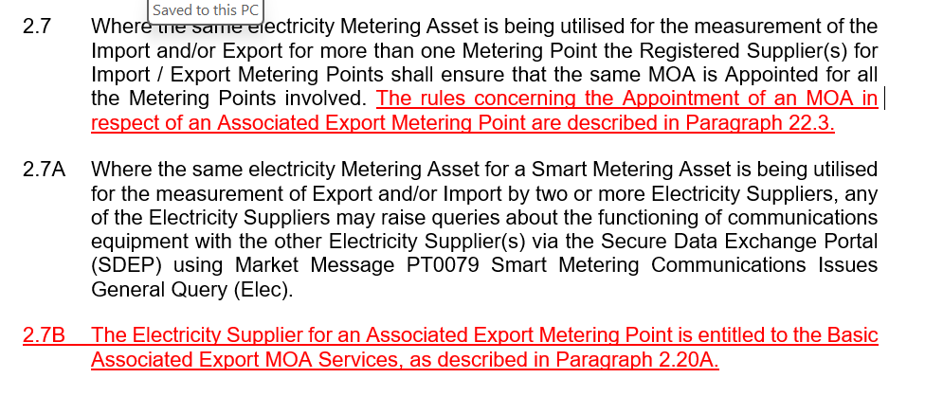
R0207 – Revised Approach
Updated Legal Text – Paragraph 2

Slide 20
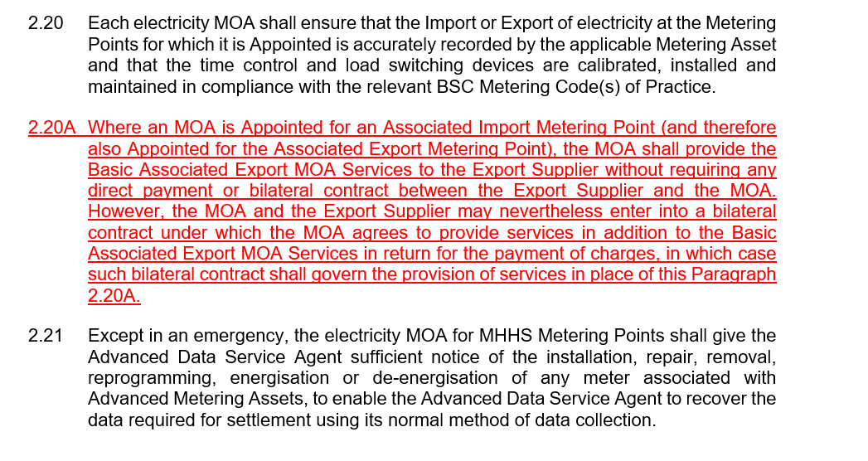
R0207 – Revised Approach
Updated Legal Text – Paragraph 2

Slide 21
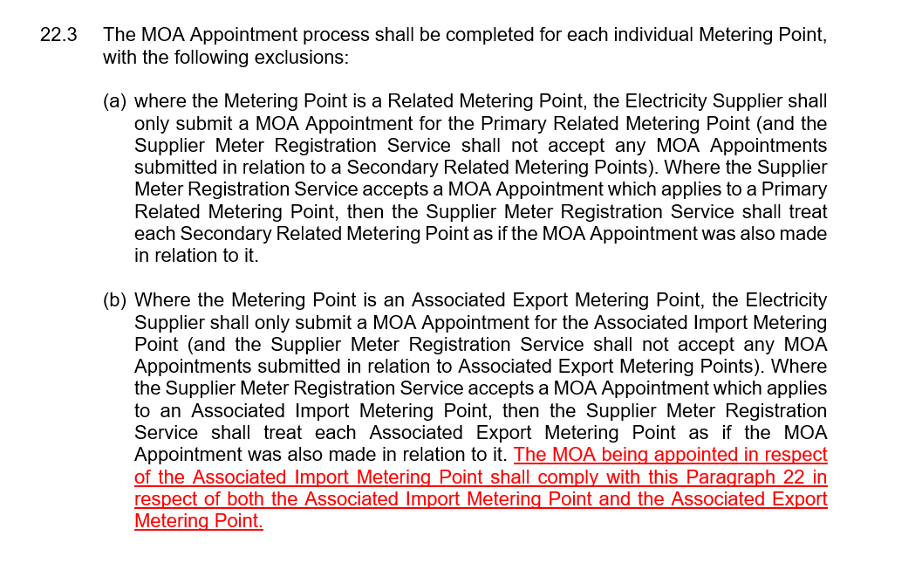
R0207 – Revised Approach
Updated Legal Text – Paragraph 22

Slide 22
R0207 – Revised Approach
Updated Legal Text – Energisation Status
All Paragraphs referenced in the definition of Basic Associated Export MOA Services relate to essential data synchronization required by the MOA. It is not intended to infer that an Export Supplier would be entitled to onsite services.
This includes changes to the Energisation Status, either where requested by the Import Supplier or updated by the DNO.
The current drafting in Paragraphs 21.5.2-3 allows a Supplier to request the MOA attend site to energise / de-energise the site on a particular date. It is not intended that the Export Supplier would be entitled to this from the MOA through the Basic Associated Export MOA Services. The rest of Paragraph 21 should still apply.
Should the proposal specifically confirm that these requirements are out of scope?
  This could be achieved through updating the text in 21.5.2 to clarify that this is not included as part of the Basic Associated Export MOA Services.
Are there any other references in the referenced Paragraphs that should be reviewed?

Slide 23
R0207 – Revised Approach
Approach to Impact Assessment
Subject to feedback in this meeting, next steps will involve issuing the proposal for impact assessment.
The impact assessment will need to seek feedback on the proposal itself, as well as the assumptions regarding impacts to competition and consumers.
This may involve seeking input on commercial impacts to MOAs and Suppliers, which may need to be shared confidentially.
Any confidential information shared would not be detailed in the Change Report but may be collectively summarised (e.g. “some MOAs highlighted that…”, “some Suppliers suggested…”) and shared with Ofgem to support its decision.
Do you agree that it is appropriate to specifically seek input on the commercial impacts of this Change Proposal?

Slide 24
R0207 – Revised Approach
Impact Assessment Questions
Do you have any comments on the proposed solution?
Do you agree the proposed solution addresses the problem statement?
Are there any alternate solutions that would better address the problem statement?
Would you incur additional costs, in addition to those incurred today, in providing the ‘Basic Associated Export MOA Services’ to Export Suppliers? Please provide details, including a rough order of magnitude. (MOAs only – confidential).
Do you consider it is reasonable to assume a MOA would have already had to consider the cost of providing the ‘Basic Associated Export MOA Services’ as part of its MHHS qualification and service offering?
Would you incur any additional costs as a result of implementing this Change Proposal that would result in additional pass-through costs to Consumers? Please provide details, including a rough order of magnitude. (Suppliers only – confidential).
Do you agree that any additional costs incurred from the implementation of this Change Proposal are unlikely to result in a direct, material impact to Consumers?
Do you have any comments on the draft legal text?
Do you consider changes to your commercial agreements with Import Suppliers / MOAs will be required if this Change Proposal is implemented?
What lead time would be required by your business to implement the proposed solution? Please provide justification.
Do you identify any benefits to your business through the implementation of the proposed solution?

Slide 25
R0207 – Revised Approach
Review of Metering Operations Schedule – Export Metering Points
It was suggested that a review of the Metering Operations Schedule should consider whether the requirements for Export Metering Points are appropriately considered, including the prevalence of small-scale generation assets with smart or advanced meters.
Part | Impacted
Part A – General Provisions | Potentially impacted – some general obligations relate to export metering points
Part B – Metering Equipment Managers | Not impacted – limited to Qualification and Accreditation of MEMs.
Part C – Operational Processes Gas | Not impacted – gas only
Part D – Operational Processes Electricity for MHHS Metering Points | Impacted – sets out operational processes relevant to this review
Part E – Operational Processes Electricity for Non-MHHS Metering Points | Potentially impacted – to be confirmed if the review should consider non-MHHS Metering Points (only relevant until MHHS M15 milestone) or focus solely on future MHHS arrangements

Slide 26
R0207 – Revised Approach
Review of Metering Operations Schedule – Export Metering Points
Section | Initial considerations
Metering Asset Installation | Should the Associated Export Supplier be able to request the installation, exchange or removal of a Metering Asset or should this be limited to the Import Supplier? Are there exceptions where the Export is the primary supply? Assume no change for Export Only Metering Points?
Metering Asset Removal
Metering Asset Exchange / Reconfiguration
Change of Feeder Status | Should the Associated Export Supplier be able to request a change to Feeder Status or should this be limited to the Import Supplier?
Fault Resolution | Should the Associated Export Supplier be able to request a fault investigation or should this be limited to the Import Supplier? Should there be a mechanism for an Associated Export Supplier to report faults to the Import Supplier, and for the Import Supplier to update the Export Supplier?
Change of Energisation Status | Should the Associated Export Supplier be able to request a change of energization status or should this be limited to the Import Supplier?
Change of Market Segment | Is it assumed that the Associated Import Supplier is responsible for resolving discrepancies in the Market Segment or should there also be a requirement on the Associated Export Supplier.
Proving Tests | Are Proving Tests required for both the Import and Export MPAN where a shared metering asset is in use?
Safe Isolation Providers / Crowded Meter Room MOAs | Should reports of danger, damage or interference be reported and investigated by both Import/Export Suppliers or a lead Supplier?

Slide 27
R0207 – Revised Approach
Revised approach to R0207 – Import / Export MOA Charging Clarification
Working Group 3

Slide 28
R0207 – Revised Approach
Impact Assessment Responses
Following discussions at the previous working group, a Party Impact Assessment was issued which closed on 5th December 2025.
A total of 7 responses were received from:
5 Energy Suppliers; and
2 Confidential responses.
We have set out a summary of responses to each question and initial thinking on how to address concerns/suggestions that have been raised.

Slide 29
R0207 – Revised Approach
Q1. Do you have any comments on the proposed solution?
4 respondents supported the proposed solution. 2 respondents had no comments, and 1 respondent did not agree with the proposed solution.
2 respondents that supported the solution raised concerns regarding the consumer impact where metering works are required, highlighting that this solution does not address the operational impacts of coordinating metering works between import/export Suppliers/MOAs and the importance of protecting consumer interests in this space.
1 respondent that did not support the proposed solution did not believe the solution addresses the core problem and could create further complexity for industry parties. They raised concerns about how the solution would work with Export only supplies and the lack of competition associated with the Import MOA being automatically appointed as the Export MOA.
Code Manager comments
We recognise the need to review the arrangements for metering works between import and export supplies. The potential scope of this was initially discussed in Working Group 2 and we are considering the most appropriate way to take this forward.
The proposed solution does not extend to Export only supplies and the Export Supplier would still need to agree a contract with its chosen MOA and appoint the MOA for these sites. Paragraph 2.20A of the draft legal text clarifies that the requirement to provide the Basic Associated Export MOA Services only applies where is appointed for an “Associated Import Metering Point (and therefore also Appointed for the Associated Export Metering Point”.
The requirement for the Import MOA to be appointed as the Export MOA for Associated Import/Export Metering Points is an existing requirement introduced through Market-wide Half-Hourly Settlement (MHHS). The auto-appointment of the Export MOA for MHHS Metering Points will remain in place unless an alternative arrangement is agreed and implemented.

Slide 30
R0207 – Revised Approach
Q2. Do you agree the proposed solution addresses the problem statement?
6 respondents agreed the proposed solution addressed the problem statement.
  1 of these respondents suggested that the provision of Basic Associated Export MOA Services would fully resolve the issue, as a full contract between either the Supplier or Customer and the Export MOA would be required to obtain full support for Export metering. They also highlighted that this solution would not prevent an Export MOA from offering uncompetitive charges for additional export metering services.
  Another respondent wanted to highlight that the majority of metering works for these supplies would typically be initiated by the Import Supplier.
1 respondent did not agree that the proposed solution addresses the problem statement. They considered that the solution can only be enforced for MHHS migrated MPANs and having different arrangements during MHHS migration would cause confusion and complexity. They were also concerned that the expectation of MOAs providing a free service to Export Suppliers could prevent Export Suppliers attempting to enter into Export Metering contracts and impact competition.
Code Manager comments
It is correct that the intention of this proposal is not to set requirements/parameters for the agreement of bi-lateral contracts. This will be for the Export Supplier and Export MOA to negotiate and agree. This proposal is seeking to address the commercial challenge associated with the solution introduced through MHHS, where an Export MOA is auto-appointed with no contract in place. The requirement for the Import MOA to be appointed as the Export MOA for Associated Import/Export Metering Points is an existing requirement introduced through Market-wide Half-Hourly Settlement (MHHS).
The intention of this proposal is that it will only apply to MHHS MPANs. The draft legal text only references requirements in Part D of the Metering Operations Schedule, which only applies to MHHS Metering Points. The equivalent requirements for non-MHHS Metering Points are set out in Part E, which is not included.

Slide 31
R0207 – Revised Approach
Q3. Are there any alternate solutions that would better address the problem statement?
2 respondents suggested that industry should work together to explore a longer-term solution that allows Suppliers to appoint its own Export MOA. .
  1 of these respondents supported this proposal as a short-term solution, as the proposal mitigates the immediate impact while a longer-term solution can be explored.
  1 respondent suggested that the introduction of message routing through the Data Integration Platform (DIP) could offer a future solution for the synchronization of Meter Technical Details between import and export MOAs.
1 respondent recommended establishing a Working Group comprising Suppliers and MOAs to review responsibilities for metering works for export supplies.
Code Manager comments
We recognise the need to review the arrangements for metering works between import and export supplies. The potential scope of this was initially discussed in Working Group 2 and we are considering the most appropriate way to take this forward.
We would like to understand wider views of the Working Group on exploring a longer-term solution to allow Export Suppliers to appoint their own MOA. We expect this would not be possible to take forward until MHHS migration is complete.

Slide 32
R0207 – Revised Approach
Q4. Would you incur additional costs, in addition to those incurred today, in providing the ‘Basic Associated Export MOA Services’ to Export Suppliers? Please provide details, including a rough order of magnitude. (MOAs only – confidential).
This question was marked as confidential to all respondents.
Respondents highlighted that there would be some additional costs associated with changes to billing systems, and potential support costs to manage additional queries coming from uncontracted Export Suppliers.

Slide 33
R0207 – Revised Approach
Q5. Do you consider it is reasonable to assume a MOA would have already had to consider the cost of providing the ‘Basic Associated Export MOA Services’ as part of its MHHS qualification and service offering?
5 respondents agreed with this statement, with some noting this requirement has been known through MHHS for some time. .
1 respondent disagreed with this statement, noting that costs of providing services go beyond sending data flows and the MHHS design did not consider the impact of consequential changes such as changes to billing systems and contract referencing. The MHHS solution does not offer a solution for MOAs to know to accept certain requests from one Supplier and reject this request from another.
1 respondent highlighted that the MHHS design does not address contractual arrangements, and some MOAs that are appointed by the Import MOA today may have existing arrangements for contracting with the Export Supplier.

Slide 34
R0207 – Revised Approach
Q6. Would you incur any additional costs as a result of implementing this Change Proposal that would result in additional pass-through costs to Consumers? Please provide details, including a rough order of magnitude. (Suppliers only – confidential).
This question was marked as confidential to all respondents.
The majority of respondents either did not anticipate additional costs or expected these to be material.
Some respondents highlighted that the arrangements for metering works could impact this, if the Import Supplier was expected to arrange or fund site visits at the Export Supplier’s request.
1 respondent highlighted that if costs were bourn by Export Suppliers, these would still be passed on to consumers.
Code Manager comments
The arrangements for metering works between import and export supplies will be explored separately.
The current proposal would not require the Import Supplier to complete works at the request of the Export Supplier. If the Export Supplier wished the MOA to complete a site visit on its behalf, it would need to agree additional services bi-laterally with the MOA.

Slide 35
R0207 – Revised Approach
Q7. Do you agree that any additional costs incurred from the implementation of this Change Proposal are unlikely to result in a direct, material impact to Consumers?
1 respondent agreed with this statement.
4 respondents neither agreed or disagreed.
2 respondents disagreed, with one believing there is a concern that additional costs passed on to Import Suppliers would not be covered by existing charges and could result in different pricing for import only vs import + export metering. The other respondent noted that this change would result in a shift of costs onto the Import Supplier, which would ultimately be bourn by the import consumer.
Code Manager comments
The arrangements for metering works between import and export supplies will be explored separately.
The current proposal would not require the Import Supplier to complete works at the request of the Export Supplier. If the Export Supplier wished the MOA to complete a site visit on its behalf, it would need to agree additional services bi-laterally with the MOA.

Slide 36
R0207 – Revised Approach
Q8. Do you have any comments on the draft legal text?
5 respondents had no comments on the draft legal text.
1 respondent suggested it would be helpful to include clear timescales on expectations for a MOA providing the basic services to the Export Supplier.
1 respondent raised concerns about the existing code requirement in Paragraph 22.3(b) of the Metering Operations Schedule which mandates that the Supplier Meter Registration Service (SMRS) shall not accept a MOA Appointment for an Associated Export Metering Point as this removes choice for the Export Supplier and MOA. They further raised concerns with the principle of defining commercial scope within industry governance arrangements.
Code Manager comments
The proposal points to existing requirements in the code for providing the Basic Associated Export MOA Services, which includes required timescales. The Export MOA would be required to meet the standard timescales set out in the Code.
The requirement for a DNO’s SMRS to auto-appoint the Import MOA as the Export MOA for an Associated Export Metering Point is an existing requirement from the MHHS design, and is not being introduced by this proposal.

Slide 37
R0207 – Revised Approach
Q9. Do you consider changes to your commercial agreements with Import Suppliers / MOAs will be required if this Change Proposal is implemented?
There was a mixed response from respondents.
  2 respondents were not able to comment at this time.
  2 respondents did not believe changes would be required to its contracts.
  2 respondents noted it is a possibility, dependent on further review and how industry parties respond to this change (if implemented).
  1 respondent expects to require conversations with all metering agents on the impact of charging.

Slide 38
R0207 – Revised Approach
Q10. What lead time would be required by your business to implement the proposed solution? Please provide justification?
3 respondents suggested a minimal lead time is required, with 1 advocating for the earliest possible implementation.
2 respondents suggested a minimum of 3 months lead time would be required to allow for contract discussions/negotiations and changes to billing systems/processes.
1 respondent suggested a 6-month lead time to allow for contract discussions/negotiations.
1 respondent could not advise on the required lead-time, but highlighted the need to update billing systems/processes and potentially requiring additional recruitment to manage additional operational engagement.

Slide 39
R0207 – Revised Approach
Q11. Do you identify any benefits to your business through the implementation of the proposed solution?
Several respondents highlighted benefits to their business as a result of this proposal, including;
  Mitigating the risk of unfair and/or uncompetitive charging from Export MOAs where there is no choice in the appointment.
  More consistently and accurately receiving Meter Technical Details and other basic MOA support services where a contract is not in place, reducing negative impacts on Supplier settlement performance.
  Operational efficiency from simplifying arrangements for managing Associated Export Metering Points.
  Removing barriers will help to foster more innovative export tariffs being brought to market, benefiting renewable generators.
One respondent that does not service Smart Export Guarantee (SEG) generators highlighted there would be no direct benefits to its organisation, as the majority of its customers would have a direct contact with a MOA for its export supply.
On respondent highlighted that there would be a cost saving benefit to Export Suppliers, but these costs will be shifted to Import Suppliers who would not benefit in the same way.
Code Manager comments
The proposal would not extend to Export-only sites or sites without shared import/export metering. Where a customer has directly contracted with its own Export MOA, and that MOA is separate to the Import MOA, the Supplier would need to request the Import/Export Association in SMRS is removed by the DNO. This will allow separate appointments to be managed in this type of edge-case.

Slide 40
R0207 – Revised Approach
Next steps
Subject to discussions at the working group discussions, responses to the impact assessment have not currently identified required changes to the proposed solution or legal text.
  The responses did highlight a lack of clarity that these arrangements would not extend to Export-only sites, and other edge-cases. Should we consider additional clarification in the legal text to provide additional clarity?
Responses to the impact assessment offered further support for reviewing the export metering arrangements more generally, including responsibility for meter works in import/export metering scenarios. Is there support for this being taken forward through a separate working group?
Some responses also suggested a longer-term review of the MHHS solution, requiring the same MOA to be appointed for Import and Export Metering Points. It is expected this couldn’t be considered before the completion of MHHS migration. Is there support for re-visiting these arrangements in the future, to identify if a solution can be identified that allows Supplier/Customer choice of Export MOA?

