Slide 1
REC Change Issues group
05 June 2025

Slide 2
1. Welcome and introduction
Paul witton-dauris

Slide 3
Agenda For today
 | TITLE | TIME | LEAD
1 | Welcome and Introduction | 10:00 | Chair
2 | Confirmation of Agenda | 10:00 | Chair
3 | Approval of Previous Minutes | 10:05 | Harry Firth
4 | R0122 - SDEP Review Improvements (2) - Usability | 10:10 | Keisha Patel
5 | I0172 - End-to-End New Connections Process Review | 10:30 | James Hardy and Lorna Mallon
6 | I0197 – Introducing a Process to Provide Updates During Fault Resolutions | 11:00 | James Hardy
7 | I0205 - Provision of Half-Hourly Consumption Data for Advanced Meter Erroneous Switches | 11:10 | James Hardy
8 | I0240 – Data Alignment of Meter Information through MHHS Migration | 11:30 | Harriet Truss
9 | Code Manager Tracker Update | 11:50 | James Hardy
10 | Any Other Business | 12:10 | All

Slide 4
3. approval of previous minutes
Harry firth

Slide 5
4. R0122 - SDEP Review Improvements (2) - Usability
Keisha patel

Slide 6
R0122 – SDEP Review improvements - usability
Overview on the Change
The current SDEP system has usability limitations that hinder users from efficiently filtering workflows and queries, and from receiving timely and effective notifications. This change proposal of proposed functionality improvements aims to address these issues by enhancing the user experience and overall system effectiveness.
This change proposal focuses on streamlining user interactions, reducing the time required to navigate the system, and improving the accuracy and speed of responses, through improved filtering and more effective notification capabilities.
Following a comprehensive review of the SDEP system, the Code Manager has identified a number of functionality improvements with the SDEP system. This change represents the second batch, following the implementation of R0121.
This change seeks to allow users to better manage queries in SDEP through:
Additional status options for open communications
Additional filters to improve visibility of communications to work on
Enhanced email notifications to provide a more useful alert for action required
Enhanced reporting to allow improved management of full communication set
This change was initially explored under the SDEP Review from 2022, during which multiple workshops were held to gather input and define requirements. However, it was placed on hold due to the MHHS code freeze.
The change is now being revisited, with a focus on validating and updating the requirements to ensure they continue to align with user needs.

Slide 7
R0122– proposed statuses
Status | New / Existing | Requirement Description
Unread | Existing / New | Can be returned to unread manually
Read | Existing | New communication and/or message
Solved | New | Party believes/agrees query fully resolved. One status at a time for each party Can change back to Unsolved if subsequently realised issue not resolved
Unsolved | New | Party believes query unresolved
In progress | New | Communication being worked Status visible to both parties
Response sent | New | Message sent in SDEP or outside, reply or next action expected Status visible to both parties
Archived | Existing | Query resolved or lapsed Query archived automatically for both parties when both have assigned to “Solved” If message needs to be sent in Archived, then will move to Unsolved, then will have to be marked at Solved to move back into Archive.
Deleted | Existing | Query resolved or redundant Once query marked as “Solved” and in archive, it will automatically get deleted after 30 days
Escalated to Code Manager | New | Query detail submitted to Code Manager via Portal form
Raised incorrectly | New | If the receiving Party believes invalid PT used , then can set this status Status visible to both parties
Filters | New | Each of the proposed statuses above can be filtered on the Secure Communication Screen
Blue = New

Slide 8
OVERVIEW OF REQUIREMENTS
Topic | Description
Emails | Assign owners will receive email notifications when status has been changed Based on frequency selected
Emails | Unique SDEP case number and Process Type (PT) reference for the relevant communication to be included
Escalation PTs | View time left to respond to escalation process types displayed in the Communications List View
Audit | Assignment of the status or a change of a communication's status to be recorded in the audit log
Assignment of Users | Automatic assignment of the raiser as the owner of any Communication raise but this can be switched off manually, with the option to amend or remove the named owner during raising of the call or at a later date
MPID | When raising a new query, ability to search immediately by MPID rather than through Company Group
MPXN | Enter and/or view the number of MPXNs related to a single Communication
CMGQ | Link a Contract Manager General Query with another SDEP communication that is be related to it, so that the history of the query can be easily views and resolved quicker
Raw Data | Extract a raw data file containing all information (except attachments) about all communications that are returned after setting some basic parameters
Reporting | Access to additional standard reports at three levels of granularity; High level, Detail level & Message level
Allocate permissions | Assign users to MPIDs and Process Types within Company Group early as possible, so that updates are efficiently completed

Slide 9
Next steps
Code Manager has issued the Preliminary Impact Assessment to the Service Provider
To confirm requirements, we are inviting interested parties and users to submit comments
Detailed requirements & response form to be shared at the end and will close 26th June
Any queries contact: enquiries@recmanager.co.uk

Slide 10
5. I0172 - End-to-End New Connections Process Review
James hardy and lorna mallon

Slide 11
I0172 - End-to-End New Connections Process Review
This Issue seeks to explore where problems arise during the entire new connections process, from supply point creation, to the Change of Occupier, to the end Consumer, including the Crossed Meter processes. The Code Manager is conducting a cross-code analysis to explore where these problems occur, and then how to resolve them.
To assist with the progression of the solution analysis for I0172, the Code Manager has made the decision to separate the gas and electricity meter installations process. The process for each fuel type will now be reviewed individually – starting with the electricity process, today.
This will cover electricity metering installations from the point the Consumer requests the meter installation to the update of the Energy Supplier, their agents, and all Central Systems. The aim at the is to review this as the current process, and as per the MHHS process, wherever possible.
The Code Manager will walk through each step of the process, highlighting any existing gaps or areas that could be open to misinterpretation.

Slide 12
I0172 - End-to-End New Connections Process Review
To assist the Code Manager during this walkthrough, we encourage Change Issues Group attendees to consider their current involvement in the process, including, but not limited to:
  How do Energy Suppliers determine the required metering configuration?
  Rescheduled appointments
  Failed appointments
  Interactions with the SEC process(es)
  D0312 validation

Slide 13
6. I0197 – Introducing a Process to Provide Updates During Fault Resolutions
James hardy

Slide 14
I0197 – Introducing a process to provide updates during fault resolutions
I0197 has been raised by REC Performance Assurance alongside I0195, I0196, and I0198.
Originally, the proposed scope sought to introduce a maximum timeframe Fault Resolution deadline to resolve issues around faulty meters. Following wider Code Manager discussions and assessment, this proposal was deemed unworkable, and the scope was amended to focus on introducing a new process to provide updates amongst impacted Market Participants during fault resolutions.
To further determine the scope for this Issue, an industry Information Request was issued by the Code Manager to gain understanding of existing gaps and problems occurring during fault resolutions. The information request received 16 responses from across gas and electricity Parties.
REC Performance Assurance reviewed the responses and have requested that this Issue focuses on a consideration to establish clearer SLAs to cover both fuels and all meter types/market segments.
To do this, it is possible that a Working Group could be formed, with a new Issue being raised so that the gas and electricity processes are separate.

Slide 15
I0197 – Introducing a process to provide updates during fault resolutions
Electricity Processes Key Gaps Identified: Processes built to meet Code compliance, not fix faults. Lack of clarity around ownership/responsibility. Lack of clarity around categorisation and prioritisation. Lack of agreed data workarounds for low materiality faults. Lack of accurate and prompt site contact details. Insufficient resourcing at Suppliers to support fault resolution. D0005 Updates are not currently sent to Supplier, also only HH. Issues with Data Flows: D0001: Often lacks sufficient information for efficient investigation. D0002: Used to request further information, but suppliers often overlook these requests. D0005: Should be used to maintain an audit trail and allocate action owners. D0302: Essential for scheduling site visits, but fields are not mandatory and can be incorrectly populated. Initial Meter Configuration: Poor communication, manual processes, and access issues can prevent successful controls. | Gas Processes Key Gaps Identified: No Code defined process for Gas meter faults. No Code defined process for Logger faults. No auditable industry flows relating to faults. Poor information sharing between participants. Appointment processes not followed. Fault Types: Transco Faulty Meter (TFM): Emergency linked, usually raised by consumers. Faulty Equipment Query (FEQ): Non-urgent, related to billing or register read issues. Logger Faults: Identified internally, scheduled for site visit within 30 days. Address Management: Inconsistent address data can lead to errors and inefficient fault resolution. Appointment Process: Rarely followed, creating ambiguity over responsibility and accountability.

Slide 16
I0197 – Introducing a process to provide updates during fault resolutions
A I0197 Working Group would likely begin by addressing these immediate considerations:
Define the term “Metering Fault”
What is the current process that Parties are following? What issues are they faced with?
Short term vs long term – how do we redesign the process? What can we currently not resolve?
What does a good solution look like? What is the most appropriate way to address the gas process vs the electricity process?
The Code Manager will hold the first session of the I0197 Working Group on 18 June 2025
Proposed Time, 14:00-15:30. If you wish to attend, please email enquiries@recmanager.co.uk.

Slide 17
7. I0205 - Provision of Half-Hourly Consumption Data for Advanced Meter Erroneous Switches
James hardy

Slide 18

I0205 - Provision of Half-Hourly Consumption Data for Advanced Meter Erroneous Switches
To be able to accurately bill an Advanced Meter site, following repatriation of that Consumer to their correct supplier after an ES has been raised / agreed, the supplier needs to have access to Half-Hourly consumption data for the ES period when they were not the registered supplier. With ES’s potentially taking up to two years to be identified and resolved, the only place that the supplier could reliably source that Half-Hourly consumption data would be from the other, Losing Supplier.
An approval of this Issue/Change Proposal would see an obligation placed upon the Losing Supplier, following a successful Erroneous Switch repatriation, to provide the Gaining Supplier with the Half-Hourly consumption data for the period in which they were erroneously supplying the meter. Half-Hourly consumption data would be providing to the Gaining Supplier, from the Losing Supplier, via SDEP using an Excel template within 5 Working Days of the Erroneous Switch repatriation switch date. The Gaining Supplier would be required to provide 48 Half-Hourly consumption intervals for each day that the Consumer was supplied by the erroneously Gaining Supplier.
The Code Manager intends to issue I0205 for Party impact assessment on 20 June 2025. To assist,
Change Issue Attendees are invited to discuss the legal drafting and reporting templates in today’s
meeting.

Slide 19
I0205 – Legal Drafting
Addition to Schedule 30 - Resolution of Consumer Facing Switching and Billing Issues:
6.8B For Advanced Electricity Meters, once the Losing Supplier has re-registered the RMP, the Gaining Supplier must provide the Losing Supplier with the Half-Hourly consumption data held (actual or estimated) for the period they were the Registered Supplier. This must be provided using Market Message PT0047 Erroneous Transfers General Query (Elec) within SDEP using the template provided by the Code Manager in Appendix XX.

Slide 20
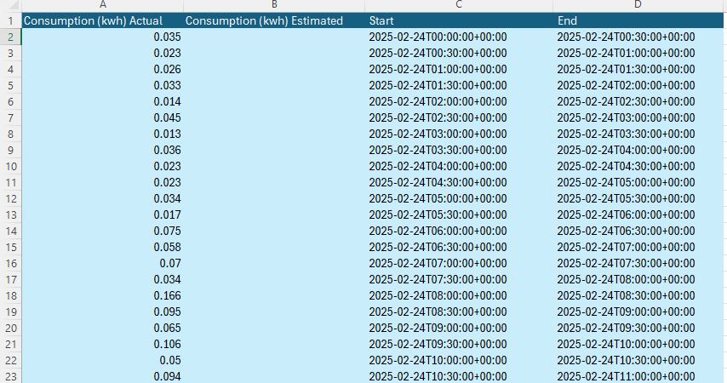
I0205 – Reporting Strawman - Option 1

Slide 21
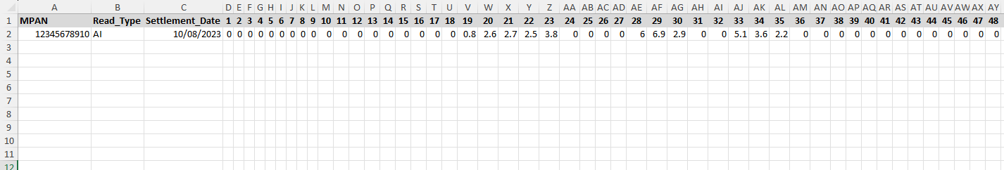
I0205 – Reporting Strawman – Option 2

Slide 22
I0205 – Next steps
Legal Review
02 June – 20 June
Change Report (Impact Assessment) and Update to Proposal Plan presented to REC Change Panel
17 June
20 June – 11 July
July - August
Party Impact Assessment
Solution Refinement and Consultation

Slide 23
8. I0240 – Data Alignment of Meter Information through MHHS Migration
Harriet truss

Slide 24
Scope of I0240
Submission
To address where meter updates are made whilst a migration is underway and the Registration Service will not receive updates
Impacts Forward and Reverse migrations
Additional
The same issue could arise in relation to energisation status

Slide 25
Problem Statement
During Transition, Meter Technical Details held between Parties may not align with those held by the Registration Service (ERDS/SMRS) due to meter updates occurring during the migration of Metering Point
This in turn could result in out of date MTDs being received via the PUB-036, requiring intervention to correct the discrepancy
  PUB-036 - SMRS formal Confirmation of Appointment & provision of MPAN Supporting Data and MTDs
  IF-005 - MTD Updates to SMRS
  D0312 - Notification of Meter Information to MPAS

Slide 26
Meter Updates – Forward migration
Migration Schedule:
2.7.15 (MHHS Migration with Switch), 2.8.15 (MHHS Migration with no Switch):
Where the MTDs change before the Gaining MOA effective from date, the Losing MOA shall send revised MTDs.
Forward Migration initiated
Losing MOA operating Metering Point in non-MHHS arrangements
No provision for the Registration Service to be updated during a migration – D0312 will be rejected for in flight migrations
Meter updates after MTDs shared as part of migration
Losing MOA required to share MTD updates until Gaining MOA EFD
Sent via D0149/150 or D0268
Gap – No provision in design or code for Registration Service to be updated.
Proposed solution
  Agreed process for Gaining MOA to be able (data and know to send it) to update MTDs once migration completed via IF005.
  Avoid, where possible, booking any non-emergency jobs on a pending migration or don’t pick sites for migration that have jobs.
What should the mechanism be for informing the Gaining MOA to make update post migration?

Slide 27
Meter Updates – reverse migration
Migration Schedule:
3.8.7 (Reverse Migration with Switch):
Where the MTDs change before the Gaining MOA effective from date, the Losing MOA shall send revised MTDs.
Reverse Migration initiated
Losing MOA operating Metering Point in MHHS arrangements
Losing MOA required to share MTD updates until Gaining MOA EFD
Sent via D0149/150 or D0268
Meter updates after MTDs shared as part of migration
No provision for the Registration Service to be updated during a migration – IF005 will be rejected for in flight migrations
Gap – No provision in design or code for Registration Service to be updated
Proposed solution
  Agreed process for Gaining MOA to be able (data and know to send it) to update MTDs once migration completed via D0312
  Avoid, where possible, booking any non-emergency jobs on a pending migration or don’t pick sites for migration that have jobs.
What should the mechanism be for informing the Gaining MOA to action the update post migration?

Slide 28
energisation status
During a migration the energisation status is provided to MPRS via the D0205
  the D0205 will be rejected (via the D0203) during a migration
Gap – no provision for updating the Registration Service
Code Manager intention to bring this additional issue into scope of I0240
  D0203 - Rejection of Changes to Metering Point Details
  D0205 - Update Registration Details

Slide 29
9. Code manager tracker update
James hardy

Slide 30
Change ISSUE tracker
CP | Title | Lead | Update
R0162 | Access to SDES for Gas Networks | Caroline Freimuller | Service Provider impact assessment with the SDEP Provider is expected to run until the end of August 2025
R0179 | Proposal for Limiting Queries in EES API Calls (Single Query per API Call | Holly Law | Issue has progressed to a CP, the Chage Report for consultation will be taken to Change Panel on the 17 June for publication on the on the 20 June.
I0189 | Voice of the Consumer | Caroline Freimuller | Working Group 5 is being held at 10am 12 June 2025. The slides have been published in the Change Issues Group space on the REC Portal (under Work Groups). If anyone wants to attend who does not have an invite, please email change.management@recmanager.co.uk
I0200 | Improving Address Management Targets | James Hardy | The Code Manager has continued to complete analysis of unmatched addresses supplied by I/DNOs and has been engaging with RECCo to discuss their CRS plans that also covers address management. Following these discussions, improvements to address management will be led through RECCo's CRS work. This work will continue analysis of the unmatched address pot, further understand the impacts of unmatched addresses, include a review of the end-to-end process, and begin consideration for industry engagement and a possible sprint to fix identified issues. RECCo have informed the Code Manager they expect this to take place between June and September 2025. This will include engagement between RECCo and the DCC and a potential sandbox at a later date. Whilst this takes place, I0200 will pause, but the Issue will remain to allow a route for further industry engagement and communication. Once RECCo have progressed with their CRS improvement work, the Code Manager will reassess the next steps of the change process, if required, for I0200.

Slide 31
Change ISSUE tracker
CP | Title | Lead | Update
I0213 | Creation of a Mechanism to Report Objection Activity | James Hardy | Party impact assessment to close on 09 June 2025. Change Issue group attendees are invited to respond to this Party impact assessment.
I0216 | REC Changes to tie in with DCP419 | Caroline Freimuller | The Code Manager and REC legal advisors are working on the legal text, and expect to complete this in line with the current Change Proposal Plan (by July 2025).
I0223 | Reconciliation of Unallocatable Transactions Review | James Hardy | Party impact assessment to be issued on 06 June 2025 and will be open for responses until 27 June 2025.
R0235/A | Missing Scenario Variants in D0179 and alternate solution | Caroline Freimuller | Consultation is open, this closes 23:59 16 June 2025.
R0241 | MHHS Incremental Changes for Go Live | Harriet Truss | Ofgem direction has now been received, following Cross Code Advisory Group endorsement, to progress to Change Proposal. Change Report targeting publication on 05 June 2025 (today).
I0254 | Non-Domestic Change of Occupier Reporting (R0155 Solution) | James Hardy | Party impact assessment to be issued on 06 June 2025 and will be open for responses until 27 June 2025.
I0257 | Change to REC for Data processing outside of EEA | Flo Monea | Proposal Plan has been approved by the REC Change Panel. The legal review is currently in progress.

Slide 32
10. Any other business

Slide 33
Next meeting:
03 July 2025
Thanks for attending

