Slide 1
REC Change Issues group
03 July 2025

Slide 2
1. Welcome and introduction
Paul witton-dauris

Slide 3
Agenda For today
 | TITLE | TIME | LEAD
1 | Welcome and Introduction | 10:00 | Chair
2 | Confirmation of Agenda | 10:00 | Chair
3 | Approval of Previous Minutes | 10:05 | Harry Firth
4 | I0196 – Review of Metering Asset Data Transferred from MAMs to the CDSP | 10:10 | Lydia Bentley
5 | Meter Point Request Tool for MHHS | 10:40 | Jonny Moore
6 | Issue Tracker Update | 10:50 | Lydia Bentley
7 | Change Issues Group Agenda Order | 11:00 | Harry Firth
8 | Any Other Business | 11:10 | All

Slide 4
3. approval of previous minutes
Harry firth

Slide 5
4. I0196 – Review of Metering Asset Data Transferred from MAMs to the CDSP
Lydia bentley

Slide 6
I0196 – overview
Issue
There are mismatches between Data Items held by the CDSP, Supplier/Shipper & MAM.
Our research has suggested that unworked RGMA Rejections contribute towards mismatches.
Proposed Solution
Impact
These relate to gas Market Messages – Specifically RGMA flows.
Lower quality of gas Data.
Impact on Consumer-facing Metering processes.
Impact on Switching.
We propose a strengthening of obligations relating to resolving RGMA Rejections.

Slide 7
I0196 – Journey So Far
Initial Research
REC Performance Assurance team identified wide-spread gas Data Item mismatches
Information Request
Code Manager published an Information Request to understand industry perception of mismatches.
Follow Up
Code Manager picked up on themes identified in Information Request response with individual respondents to gain deeper understanding.

Slide 8
I0196 – RGMA Flows & Responses
RGMA Flows
Response
MM40020
ORDET
ONDET
ONUPD
Response Code
DI40152
ONAGE
Meter Details
Job Requests
ONJOB
ORJOB

Slide 9
I0196 – Current RGMA Rejection Obligations
Schedule 14 – Appendix 1 – RGMA Responses & Exceptions
Exception Handling
Response Requirements
1.2(c): “Wherever possible the record with the error will be returned as the erroneous record and any number of reasons associated to it.”
1.2(c): “It is for the systems to determine how far the error processing goes”
1.4: File Level Exceptions Vs Technical Exceptions
1.2(b): file rejection based on an “optional number of errors limit, over which they will reject the file”

Slide 10
I0196 – Questions for CHIG
Do you support changes to strengthen requirements to respond to RGMA Rejections?
How do you currently engage with the RGMA Rejections process?
Would you like a dedicated I0196 workgroup to develop an enhanced RGMA Rejection process ?

Slide 11
I0196– Next Steps
CHIG:
Iterate Solution
CHIG:
Finish Solution
Impact Assessment

Slide 12
5. meter point request tool for mhhs
Jonny moore

Slide 13
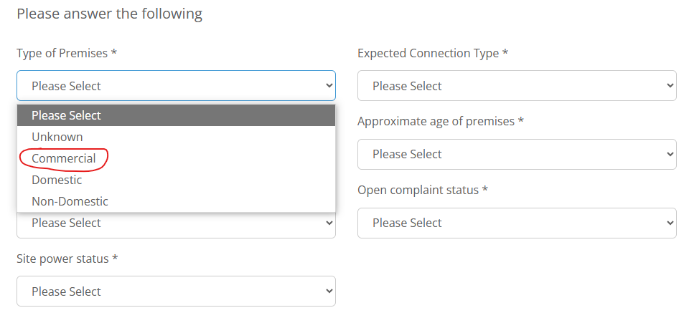
New Metering Point Request – UPDATE TOOL
‘REC Consequential Change – Additional Metering Points’ confirmed updates required for M10 to the Secure Data Exchange Service (SDES) New Metering Point Request tool as follows:
Remove the following data items
Expected Profile Class
Expected Measurement Class
Add the following data items as mandatory
Expected Connection Type
Expected Market Segment
During testing of the changes to the MPAN Request process Supplier questions, it has been noted that the ‘Type of Premises’ question currently aligns to the 'MPAN Designation' and includes a 'Commercial' enumeration
As the MPAN designation is being removed and replaced with the Domestic Premise Indicator for MHHS, the 'Commercial' enumeration is no longer applicable
Solution = remove 'Commercial' from the drop down leaving ‘Unknown’, ‘Domestic’ and ‘Non-Domestic’.

Slide 14
New Metering Point Request UPDATE – IMPACT & aPPROACH
Impact = limited
For DNO info only. DPI will be set by Supplier on registration as normal
No impact on EES solution going through testing, New Metering Point Request tool is a standalone module in SDES
Approach:
Direct Change Request (CR) from RECCo to EES Provider - covered in the MHHS cutover CR, currently under IA
Implemented alongside previously agreed updates to the tool
Ask of Change Issues Group:
SDES requirements for this request are not codified in the REC, no code change required
REC Parties to take the opportunity to review and comment on intended approach for progression directly with the SDES Provider

Slide 15
6. Issue tracker update
Lydia bentley

Slide 16
ISSUE tracker update
CP | Title | Lead | Update
R0179 | Proposal for Limiting Queries in EES API Calls (Single Query per API Call) | Holly Law | 15 WD Consultation has been published. The deadline for responses is 23:59 on 11 July 2025
I0189 | Voice of the Consumer | Caroline Freimuller | The last (and expected to be final) Work Group is being held on 28 July 2025 12.30pm. Please contact change.management@recmanager.co.uk if you wish to receive the invite.
I0197 | Introducing a Process to Provide Updates During Fault Resolutions | James Hardy | The Second Meeting of the I0197 Working Group will be split across two sessions. An electricity specific session will be held on 09 July (14:00 – 15:00), with a gas specific session on 16 July (10:00-11:00). Working Group attendees are invited to join one, or both, of these sessions depending on their organisation type and organisation’s interests. If you would like to join the I0197 Working Group, please contact us at change.management@recmanager.co.uk.
R0191 | Introduction of SLA for Supplier De-Registration on Disconnected Meters | Caroline Freimuller | Open for Consultation, responses must be submitted by 23:59 11 July 2025.
I0205 | Provision of Half Hourly Data for Advanced Meter Erroneous Switches | James Hardy | Party impact assessment open for responses until 23:59 on 11 July 2025. Draft legal text and reporting templates are available on the REC Portal.
R0216 | REC Changes to tie in with DCP419 | Caroline Freimuller | Change Report (for Consultation) published on 02 July 2025. This will be reviewed by the Metering Expert Panel at their meeting on 09 July 2025 before proceeding to consultation.

Slide 17
ISSUE tracker update
CP | Title | Lead | Update
R0244 | C21 to be introduced into STIRG Document | Caroline Freimuller | The Change Report (Final Recommendation) has been published, and will be voted on at the July Metering Expert Panel.
R0248 | REC Changes to tie in with DCP451 - Suspending Registrations | Caroline Freimuller | Open for Consultation, responses must be submitted by 23:59 11 July 2025.
I0256 | MM00023 /D0135 - Asset Condition Report clarification of intent on R0021/R0101 | Caroline Freimuller | Change Report (Proposal Plan) has been approved by Change Panel. This will proceed to Party impact assessment shortly.

Slide 18
7. Change issues group agenda order
Harry firth

Slide 19
Change issues group agenda order
The Code Manager are asking attendees for their preferred order of agenda items, to maximise engagement on each Issue:
Numerical order (which is currently used)
By theme (technical, metering, MHHS, supplier operations etc.)
By priority (low, medium, high, critical) as per the prioritisation matrix
By planned release date
Other
Please answer the poll issued in the meeting chat and let us know if you have a preferred alternate order.

Slide 20
8. Any other business

Slide 21
Next meeting:
07 august 2025
Thanks for attending

