Slide 1
R0169 – Introduction of End of Gate Closure Notifications
R0178- Improvements to CSS Business Logic
Rec technical services

Slide 2
CSS Changes – overview
The Code Manager has recently completed Impact Assessments with the CSS Provider for two technical changes:
  R0169 - Introduction of End of Gate Closure notifications
  R0178 - Improvements to CSS Business Process Logic
The results of the impact assessment do not give us a clear business case to move forward with the changes and as such we would like to invite feedback on the progression of both changes.

Slide 3
R0169 – Introduction of End of Gate Closure notifications
Rec technical services

Slide 4



R0169 – overview
  CSS Users currently do not receive notifications when the End-of-Gate Closure (EoGC) event is completed.
  As a result, they must assume when the gate closure has occurred to begin their downstream processing.
  It risks delays or errors in time-sensitive downstream processes such as RMP registrations and agent appointments (SMDRs), especially under the tight timelines required by market obligations and the MHHS programme.
  Implement a new functionality that enables CSS to send EoGC notifications to CSS users, allowing them to trigger downstream processes promptly and accurately, and improve overall efficiency, compliance, and performance monitoring.
Issue
Impact
Proposed Solution

Slide 5
R0169 – Proposed Solution
  Creation of a dedicated End-of-Gate-Closure (EoGC) message for two use case as follows:
1. A Party Specific Notification
2. A Generic Broadcast Notification
EoGC (PS) Notification
ERDA
2. EoGC (B) Notification
CSS
GRDA
CSS
Any CSS User
DSP
(If subscribed)
  Both the EoGC (PS) and EoGC (B) messages will enter the standard retry protocol if delivery fails (short retry and, if still unsuccessful, long retry).
  EoGC messages do NOT redefine Gate Closure as per current REC drafting.

Slide 6




R0169 – Business Case
Need for the change
Benefits
No formal End-of-Gate Closure (EoGC) notification
CSS Users must infer gate closure completion.
Reconciliation processes are required to confirm message receipt before triggering downstream processes.
Helps identify potential message gaps earlier.
EoGC message adds clarity and resilience.
Supports timely and accurate downstream processing.
Key Consideration: Cost
Additional Points
Following the completion of the PIA, the total ROM cost of the change is £513,016.49 - £636,159.33.
Concerns have been raised regarding existing reporting metrics that place obligations on other central parties to perform activities within a defined period from the start of gate closure.
Should the proposal for an EoGC notification be removed, these metrics may need to be revisited.

Slide 7

R0169 – Questions for CHIG
To what extent would receiving a formal End-of-Gate Closure (EoGC) notification improve your operational efficiency or reduce risk?
Are you aware of any consumer detriment with this issue?
Given the cost, do you believe the benefits of R0169 justify the investment?

Slide 8
R0178 - Improvements to CSS Business Process Logic
Rec technical services

Slide 9
R0178 – overview
This change proposal is aimed towards rectifying a collection of issues that were identified with the CSS Business Process Logic.
These have been identified as follows:
1. Deactivation of an active reg. whilst in-flight switch in progress
2. Deactivation of a prior cancelled registration .
3. OFAF switch containing multiple MPxN.
Instances of the incumbent supplier withdrawing before the 'Supply Effective from Date' cause accepted switches to fail at Gate Closure (17:00hrs). This leaves no losing supplier, stalling the switch process.
This scenario occurs when the registered supplier of an MPxN is the same supplier that cancelled a previous switch for the same MPxN. The supplier might accidentally deactivate the active registration using the cancelled registration identifier. CSS currently accepts this request, erroneously changing the cancelled registration state to inactive and sending out securedInactive messages.
This is the instance where the end user sends through a One Fail All Fail (OFAF) switch with the same MPxN contained within the payload 2 or more times.
Multiple registration IDs are created for the same MPxN, and the registration is left in an incorrect state given a lack of appropriate BDVRs.

Slide 10
R0178 - solution
1. Deactivation of an active reg. whilst in-flight switch in progress | There are instances where the incumbent supplier is withdrawing prior to the ‘Supply Effective from Date’, causing the accepted switch to fail at Gate Closure which occurs at 17:00hrs. Number of Occurrences since go-live: 156
Proposed Solution
The desired outcomes for each meter state have been listed in the table below. The intention is to provide as little intervention as possible and recognise the following:
Dormant: The meter is inactive. Note that this is a temporary state and therefore the meter could be put back into service.
Terminated: The meter has reached end of life and cannot be reinstated. Note that this is a permanent state.
Initial RMP Status | RMP Status changed to: | Registration Status (from) | Registration Status (to) | Desired Outcome
Operational | Dormant | Inactive | Active | Switch should continue
 |  | Inactive | Cancelled
Dormant | Terminated | Inactive | Cancelled | Switch should not continue (this is believed to be as per current functionality)
The aim is for an effective solution to be developed which would ensure that the consumer is switched with the original effective date being used and that CSS systems could cater for such registration events whilst following the normal Gate Closure processes.

Slide 11
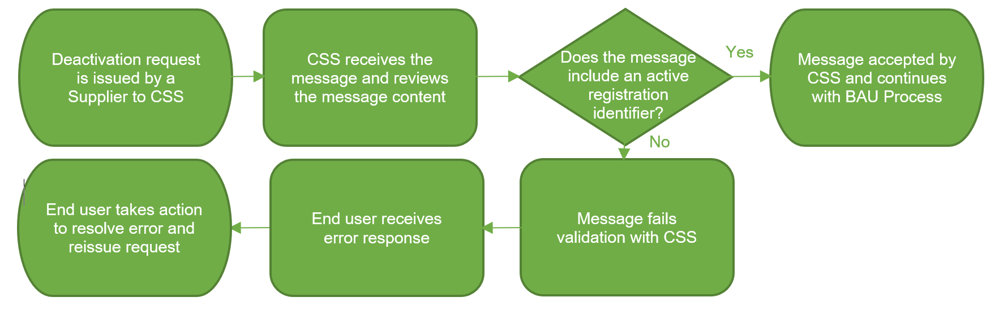
R0178 - solution
2. Deactivation of a prior cancelled registration | This scenario occurs when the registered supplier of an MPxN is the same supplier that cancelled a previous switch for the same MPxN. The supplier might accidentally deactivate the active registration using the cancelled registration identifier. CSS currently accepts this request, erroneously changing the cancelled registration state to inactive and sending out securedInactive messages. Number of Occurrences since go-live: 10
Proposed Solution

Slide 12
R0178 - solution
3. OFAF switch containing multiple MPxN. | This is the instance where the end user sends through a One Fail All Fail (OFAF) switch with the same MPxN contained within the payload 2 or more times. Multiple registration IDs are created for the same MPxN, and the registration is left in an incorrect state given a lack of appropriate BDVRs. Number of Occurrences since go-live: 19
Proposed Solution

Slide 13


R0178 – Business Case
Need for the change
Industry Position
Consumer switches can be impacted by the issues (true for issue 1).
Extra work for suppliers
Potential for system misalignments (e.g CSS and UKL)
Issue needs resolution despite low volume.
Cost alone shouldn't justify inaction.
DCC/CSS should explore alternative solutions.
Key Consideration
Additional Points
Following the completion of the DIA, the total cost of the change is £368,420.91.
The numbers of for each issue is low (156, 10 ,19).
An alternative solution could be the following:
  CSS identifies incumbent supplier deactivation.
  Notifies incoming supplier.
  Incumbent cancels and resubmits as Initial Registration
  Preserves original registration effective date

Slide 14
R0178 – Questions for CHIG
To what extent would this change improve your operational efficiency or reduce risk?
Are you aware of any consumer detriment with this issue?
Given the cost, do you believe the benefits of R0178 justify the investment?

