Slide 1
REC Change Issues group
02 october 2025

Slide 2
1. Welcome and introduction
Paul witton-dauris

Slide 3
Agenda For today
 | TITLE | TIME | LEAD
1 | Welcome and Introduction | 10:00 | Chair
2 | Confirmation of Agenda | 10:00 | Chair
3 | Approval of Previous Minutes | 10:00 | Harry Firth
4 | How NESO influence Regulatory Change | 10:05 | Michelle Niits
5 | I0275 - MHHS Metering Points across Market Segments | 10:30 | Francine Peyroux-Sissoko and Jonny Moore
6 | I0240 - Data alignment of meter information through MHHS Migration | 10:50 | James Hardy
7 | MHHS Update | 11:00 | Harriet Truss
8 | Issue Tracker Update | 11:05 | James Hardy
9 | Any Other Business | 11:15 | Chair

Slide 4
3. approval of previous minutes
Harry firth

Slide 5
4. How NESO influence Regulatory Change
Michelle niits

Slide 6
National Energy System Operator (NESO)
Market Frameworks
October 2025

Slide 7



The National Energy System Operator
The National Energy System Operator, NESO, is an independent, public corporation at the centre of the energy system taking a whole system view to create a world where everyone has access to reliable, clean and affordable energy.
Our work will be the catalyst for change across the global community, forging the path to a sustainable future for everyone.
The challenge
Tackling climate change is truly the challenge of our generation; addressing energy security, sustainability and affordability for everyone is at the forefront of the global agenda and drive to meet net zero.
It is our job to transform the whole energy system to meet these challenges and transition to a low-carbon future, embracing new technologies and cleaner generation sources, always with the cost to the consumer in mind.
Your Energy Your Future Our Purpose

Slide 8
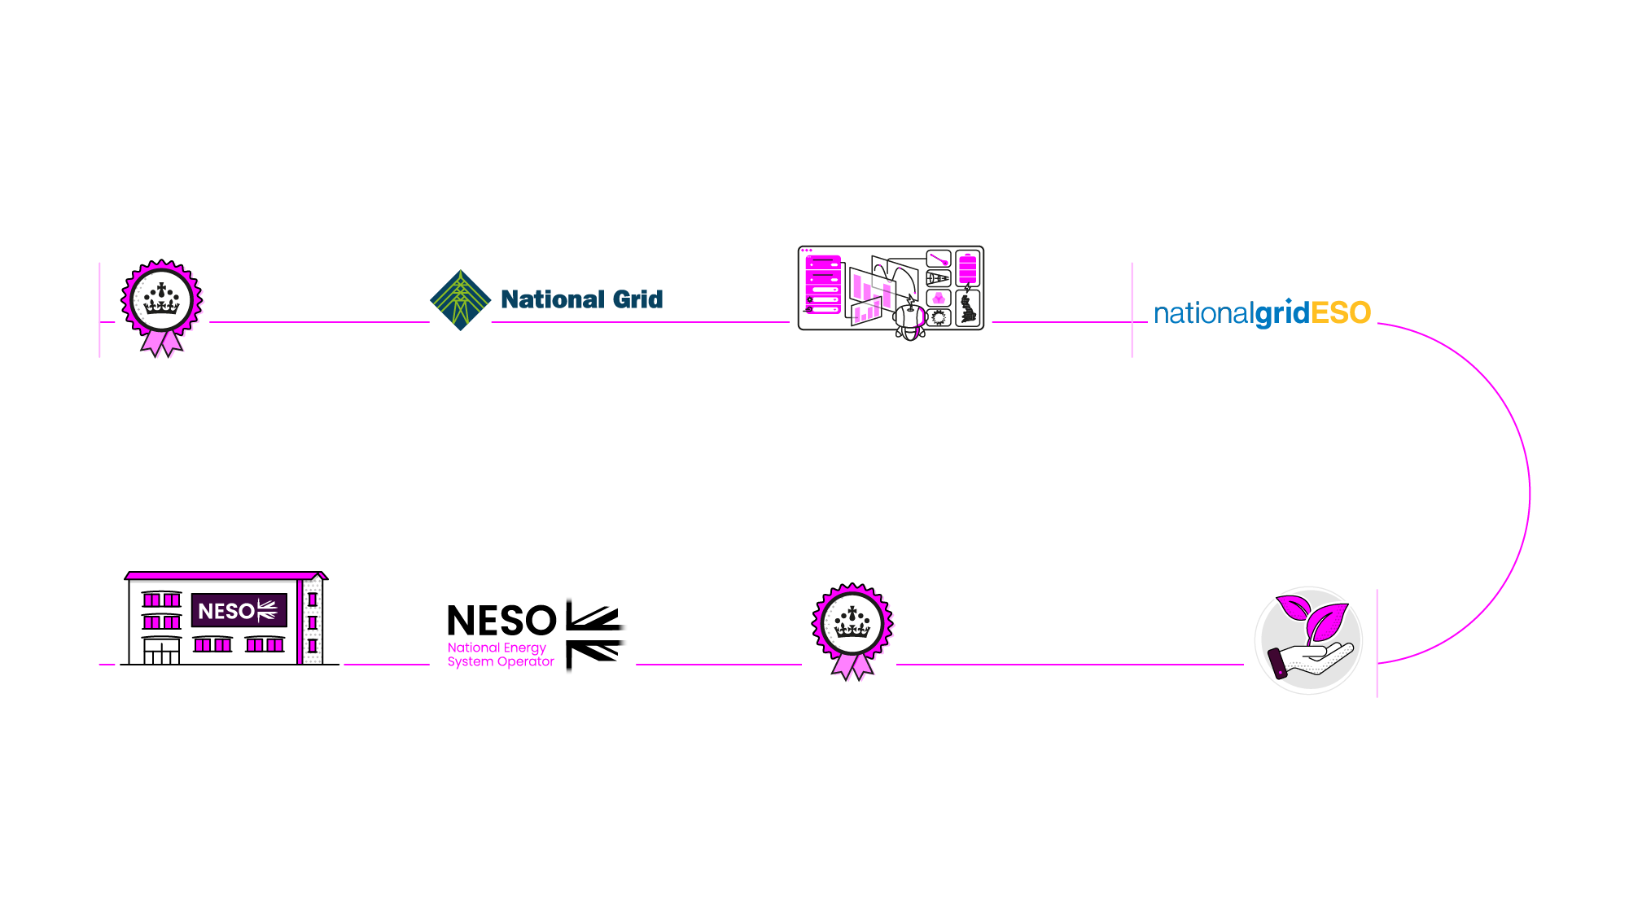
NESO Timeline
History of the System Operator:
Legal Separation of the Electricity System Operator:
1989
The Electricity Act was approved by parliament, which paved the way for privatisation of the electricity industry.
1990
National Grid was established, creating one regulated company for England and Wales to provide transmission infrastructure and a marketplace; not to buy or sell energy itself.
1996
Our control room, the Electricity National Control Centre (ENCC) was established, in Wokingham.
April 2019
National Grid Electricity System Operator (ESO), became a legally separate business within the National Grid PLC Group.
The Formation of the
National Energy System Operator:
October 2024
NESO is established.
January 2024
The ESO announced the new name for this entity as the National Energy System Operator, or NESO.
October 2023
The Energy Act 2023 was passed with cross-party support, legislating for a Future System Operator to be created.
April 2022
Following industry consultation, the UK government decided that the Future System Operator would be a public corporation free from commercial interests and operationally independent.

Slide 9

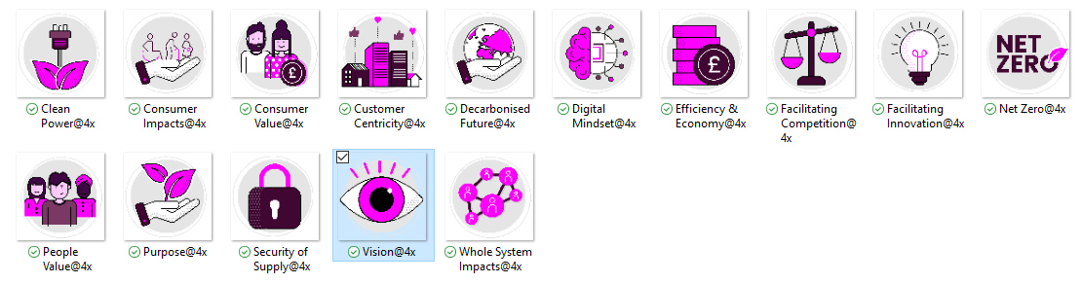


Who we are
Markets Directorate
Our directorate ensures competitive, coordinated and coherent whole energy markets that result in the most cost-efficient energy system and give us the tools and services to operate in a low-carbon energy landscape.
Market Frameworks
Market Frameworks manage, on behalf of NESO, the Industry Codes and Frameworks which govern the energy Industry. We represent the viewpoints of NESO regarding Codes and are the administrator of 4 codes.
We liaise regularly with Ofgem and DESNZ on the direction of travel on regulatory change
October 2025

Slide 10
Market Frameworks Codes​
These are the codes where NESO has a defined role;
Industry code​ | Code outline​ | Our Involvement​
Balancing & Settlement Code (BSC)​ | The BSC contains the rules and governance arrangements for electricity balancing and settlement in GB​ | Panel Member​
Connection and Use of System Code (CUSC)​ | The CUSC is the contractual framework for connection to and using the National Electricity Transmission System (NETS), and paying TNUoS and BSUoS​ | Code Administrator​
Grid Code (GC)​ | The GC details the technical requirements for connection to and using the NETS. Compliance with GC is a requirement of the CUSC​ | Code Administrator​
System Operator Transmission Owner Code (STC)​ | The STC defines the relationship between the transmission system owners and the system operator​ | Code Administrator​
Security and Quality of Supply Standard (SQSS)​ | The SQSS sets out the criteria and methodology for planning and operating the NETS​ | Code Administrator​
Uniform Network Code (UNC) ​ | A legal and contractual framework for the transportation and supply of gas in the competitive gas industry. ​ | Panel Member​
October 2025

Slide 11
Market Frameworks Codes​
Even though we do not have a defined role we also interact with the following codes;
Industry code​
Carbon Capture & Storage (CCS) | Distribution Code of Licensed Distribution Network Operators in GB (DCODE)​
Distribution Connection and Use of System Agreement (DCUSA)​ | IGT Uniform Network Code (IGTUNC)
Retail Energy Code (REC) | Smart Energy Code (SEC)
October 2025

Slide 12
Market Framework Teams
Code Governance
Code Governance
administers four of the Industry codes. They are the CUSC, Grid Code, STC and SQSS. Our team manages the governance process required, should a party wish to make a change to any of these codes. Each code has a Panel that oversees the process
Commercial Codes
The Commercial Codes team deal with the commercially impactful codes (CUSC, BSC) and represent the views of NESO in Industry Workgroups, Code Panels and Task Forces.
The regulation around Use of System Charges (CUSC Section 14), TNUoS and BSUoS, and associated changes sit within this team
Technical Codes
The Technical Codes team deal with the technically impactful codes (Grid Code, STC, SQSS) and represent the views of NESO in Industry Workgroups, Code Panels and Task Forces.
The regulation around connecting to the system and the technical parameters required sit with this team
European Frameworks
The European Frameworks team deal with the Electricity European Codes and Frameworks.
The team deal with interconnector arrangements, retained EU Law, and feed into broader European initiatives which impact the NESO and the GB Market
Whole System
The Whole System Market Frameworks team applies a holistic view of the intricate interaction between the entire electricity network to address key challenges within the electricity market. Through systematic assessments of current and future key challenges, the team makes overarching recommendations to industry codes (Grid Code, CUSC, BSC) and wider frameworks, supporting the NESO in Industry Workgroups, Code Panels and Task Forces.
Gas Markets
The Gas Markets Change team deals with the gas industry codes It represents the views of NESO in industry workgroups and has a NESO representative on the UNC Panel. It also represents NESO in longer-term strategic change programmes to facilitate the net zero transition, including workstreams on hydrogen blending, gas quality, decommissioning and biomethane capacity.
October 2025

Slide 13
Where to find more information?
Codes | National Energy System Operator

Slide 14
Thank you

Slide 15
5. I0275 - MHHS Metering Points across Market Segments
Francine Peyroux-Sissoko and jonny moore

Slide 16
I0275 – MHHS Metering Points across Market Segments
Within the Market-wide Half Hourly Settlement (MHHS) design it is assumed that all Metering Points across a Relationship are in the same Market Segment (either Advanced or Smart). In line with this, agent appointments for Related MPANs will be automatically aligned to the Primary MPAN. Meaning that a single MOA (either Smart or Advanced) and single Data Service (either Smart or Advanced) will be appointed across a Relationship.
In addition, the recently implemented MHHS changes to the REC now classify Related MPANs as being within either a ‘Smart’ or ‘Advanced’ relationships. With these categories replacing the existing NHH and HH classifications.
However, the MHHS Data Cleanse Working Group (DCWG) has identified around 3,000 MPAN Relationships where Metering Points would span multiple Market Segments. This is either where the Relationship spans multiple Connection Types or Meter Types, with the most common being a mixture of Traditional and Advanced meters.
Whilst the majority of these are valid set-ups in legacy arrangements, they are not supported by the MHHS design and are unable to migrate into MHHS arrangements. The main issue being that agent appointments cannot be aligned where a relationship covers multiple Market Segments.

Slide 17
I0275 – engagement with chig
A solution needs to be found to avoid a risk to the MHHS Migration due to Related Metering Points not being able to migrate when they would be assigned different Market Segments.
Should the issue not be resolved these Metering Points would not be able to fully migrate, putting the MHHS Milestone 15 (Migration Complete) at risk.
During this meeting, we intend to provide a few solution options to the group to resolve this Issue and are seeking to gather suggestions as well as your feedback to ensure we can progress with the right solution.

Slide 18
I0275 – solution options
A number of options have been identified to resolve the issue:
MHHS Design Updates
This would involve allowing Relationships to span Market Segments. Updates would be required to the REC to account for this and an SMRS Change would be required to allow different agents to be appointed across the relationship. This option would resolve the issue but would involve central system change and a key amendment to the MHHS design.
Supplier Physically Resolve the Issue
Parties could ensure that the meters installed across a Relationship were compatible with a single Market Segment. This would not require any Code or system change but Suppliers would need to resolve 100% of issues prior to M15.
De-link Impacted Relationships
By removing the relationship Suppliers could ensure that the impacted Metering Points can migrate to MHHS arrangements. However, this would leave Metering Points that should be Related being able to be separated during a switch.

Slide 19
I0275 – Next steps
Change Issues Group attendees are invited to:
  Provide any feedback and suggestions on the options suggested;
  Provide alternative options if any; and
  Consider next steps including which solution to take forward.
The I0275 Change Report (Proposal Plan) will go to Change Panel on 21 October before engaging with the Metering Expert Panel on 12 November.

Slide 20
6. I0240 - Data alignment of meter information through MHHS Migration
James hardy

Slide 21
I0240 – Feedback Overview
Thank you to all stakeholders who took the time to review and provide feedback on the draft guidance document.
Summary of feedback:
  Worked examples: Request to include examples for each scenario to aid interpretation.
  Request for further clarity: Suggestion to include quoting flow details to improve understanding and for Meter installation/replacement.
  Read submission timing: Need clarification on when reads should be sent during the processes.
  Review of flowcharts: Ensuring the flowchart diagrams are an accurate reflection of the scenario.

Slide 22
I0240 – Next steps
The Code Manager will:
  Review all feedback receive and update the draft guidance document.
  Engage with the Metering Expert Panel, in their role as a critical friend, to review feedback and any amendments to the document.
  Engage with the REC MHHS Programme team to review feedback and any amendments to the document.
  Provide a run through of the final guidance document with the Change Issues Group at the November meeting.
  Determine the appropriate spot on the REC Portal for the document to be held and publish this in line with the November REC Release on 07 November 2025.

Slide 23
7. Mhhs update
Harriet truss

Slide 24


MHHS UPdate
MHHS Release – M8 ‘Code changes delivered’
M10 ‘Central systems ready for migration’
Programme Early Life Support
Cross Code Horizon Scanning

Slide 25
MHHS Release – M8 ‘Code changes delivered’, 22/09/2025
Theme | CHANGE
MHHS SCR CPs | R0209 | Implementation of Market-wide Half Hourly Settlement (MHHS) Arrangements
 | R0241 | MHHS Incremental Changes for go live
Other MHHS | R0044 | MHHS Programme Changes required to Central Switching Service
 | R0083 | Changes to Supply Number Format for MHHS
 | R0097 | Consequential Change for CSS Smart Meter Data Retriever Appointments
Other | R0173 | Improvements to the Theft Detection Incentive Scheme (TDIS)
 | R0222 | ESME ID Update Rejections
 | R0223 | Reconciliation of Unallocatable Transactions Review
 | R0264 | Data Specification Housekeeping
5 Cat3 CPs | EES Data Access Matrix, EES User Guides, Meter Configuration Tables, Metering Guidance, Electricity Metering Point Guidance
MHHS
12 Schedules updated
1 new Schedule
4 Operational & Technical Documents updated
Data Specification
4 new Category 3 Documents
New data tables
8 Updated Category 3 documents
+
2 further Schedules updated
PARC updated

Slide 26
Extraordinary DTC release, 22/10/2025
For information
22 October 2025 - Required before migration starts (M11)
No REC-owned changes
  DCUSA change for missing scenario variants (EMDS & DTC) – DCUSA Urgent CP
  BSC missing scenario variants (DTC only)

Slide 27
Migration & Early Life Support
Migration
Will start on 22 October 2025, subject to Programme Steering Group go ahead on the same date.
Will complete May 2027
Programme Early Life Support
For controlled, monitored ramp up of migration volumes
Operated through the Transition & Operational Readiness Working Group (TORWG)
Meeting weekly; reporting weekly
REC representation
Issue Resolution Group
Established and written into Programme Governance Framework
To resolve high impacting cross service, cross code issues
Potential source of urgent change, where proposed solution agreed under programme

Slide 28
Cross Code Horizon Scanning
Cross Code Advisory Group (CCAG) last meeting on 24/09
MHHS Programme continues post M8/M10
Focus on transition, qualification and migration
Monthly horizon scanning to continue
Ensure Qualification and Migration are not impacted
Monthly ‘code forum’ will replace CCAG
Code Bodies, Ofgem, MHHS Programme
Where potential impacts, may see programme representation in Change Issues Group and other Definition activities

Slide 29
8. Issue tracker update
James Hardy

Slide 30
Issues tracker
Issue/ CP | Title | Lead | Update
R0179 | Proposal for Limiting Queries in EES API Calls (Single Query per API Call) | Holly Law | A Consultation has been issues on a date for implementation. The consultation will close on the 10 October 2025.
I0189 | Voice of the Consumer | Caroline Freimuller | This Issue is at Service Provider impact assessment with REC Performance Assurance and with the likely new Service Provider for the proposed surveys. This is expected to run through until December, with Party impact assessment opening in early 2026.
I0190 | Related Meter Point RMP status rules | Caroline Freimuller | This Issue is at Party impact assessment, closing on 10 October 2025.
I0196 | Review of Metering Asset data transferred from MAMs to the CDSP | Lydia Bentley | The next meeting of the Solution Development Working Group will convene on 29 October 25. If you would like to attend this working group, please contact us at change.management@recmanager.co.uk.
I0197 | Introducing a Process to Provide Updates During Fault Resolutions | James Hardy | The next working group meeting for I0197 will be held on 22 October 2025, 14:00 – 15:30. Invites will be sent out via email later today. This will be a joint gas and electricity session. If you would like to attend this working group, please contact us at change.management@recmanager.co.uk.

Slide 31
Issues tracker
Issue/ CP | Title | Lead | Update
I0200 | Improving Address Management Targets | James Hardy | The Code Manager is currently reassessing I0200 as the scope of the Issue has been fundamentally impacted by the new REC Change Proposal R0283 – Annual Address Management Plan Updates. I0200 is expected to become a process Issue, now that the governance part will be managed by R0283. As such, I0200 requires a new problem statement and title to align it to the Address Data Quality workstream of the CRS Improvement Plan. The Code Manager is working with RECCo and the DCC to refine the problem statement for I0200 in accordance with the outputs from the CRS Improvements.
R0201 | Creation of a Tool to Manually Correct ERDS / CSS Discrepancies | Holly Law | The Final Recommendation will be taken to Change Panel on 07 October 2025.
R0207 | Import / Export MOA Charging Clarification | Holly Law | The second working group will be help on the 20 October 2025, 14:00-15:30. To sign up please email change.management@recmanager.co.uk.
I0218 | Proposal to Enable Broader Use of Retail Energy Location (REL) Data for Non-Switching Applications | James Hardy | This Issue will now require a technical solution. As such, a further set of Service Provider impact assessments will be required from the EES and GES providers. On 16 September 2025, the Change Panel approved an update to plan to allow the Code Manager to engage with the providers to determine the scope and prioritisation of these impact assessments. Further updates will be provided in November.

Slide 32
Issues tracker
Issue/ CP | Title | Lead | Update
R0254 | Non-Domestic Change of Occupier Reporting (R0155 Solution) | James Hardy | This Change Proposal was approved by the REC Performance Assurance Board on 30 September 2025. Subject to no appeals being raised, R0254 will be implemented on 07 November 2025.
I0265 | Theft Assessment Calculator Usage and Suitability Assessment | Francine Peyroux-Sissoko | The Code Manager has published an Information Request targeted at Energy Suppliers. This Information Request is open for responses until 24 October 2025 and can be accessed via the Information Request Register on the REC Portal.
R0276 | SFIC to CMRM - missing Scenario Variant in D0126 / MM00016 | Caroline Freimuller | This Change Proposal is at Party impact assessment, closing on 10 October 2025.

Slide 33
9. Any other business

Slide 34
Next meeting:
06 november 2025
Thanks for attending

