Slide 1
REC Change Issues group
06 November 2025

Slide 2
1. Welcome and introduction
Paul witton-dauris

Slide 3
Agenda For today
 | TITLE | TIME | LEAD
1 | Welcome and Introduction | 09:30 | Chair
2 | Confirmation of Agenda | 09:30 | Chair
3 | Approval of Previous Minutes | 09:35 | Harry Firth
4 | R0096 - CSS Message Regeneration Functionality | 09:35 | Bela Ashworth and Maxime Van Eyseren
5 | R0178 - Improvements to CSS Business Process Logic | 09:50 | James Hardy and Maxime Van Eyseren
6 | I0172 - End-to-End New Connections Process Review | 10:05 | James Hardy and Tim Newton
7 | I0262 - Additional Registration Data (Gas) under Smart Energy Code | 10:15 | Lydia Bentley
8 | I0275 - MHHS Related Metering Points across Market Segments | 10:30 | Francine Peyroux-Sissoko and Jonny Moore
9 | Issue Tracker Update | 10:45 | James Hardy
10 | RECCo Annual Stakeholder Satisfaction Survey | 10:50 | Chair
11 | Any Other Business | 10:55

Slide 4
3. approval of previous minutes
Harry firth

Slide 5
CSS Changes:
R0096- CSS Message Regeneration Functionality
R0178 – Improvements to CSS Business Logic
Rec technical services

Slide 6
CSS Changes – overview
The Code Manager has recently completed Impact Assessments with the CSS Provider for two technical changes:
  R0096 - CSS Message Regeneration Functionality
  R0178 - Improvements to CSS Business Process Logic
Subsequent iterations to Changes R0096 and R0178 have made it necessary to provide Change Issues Group with an update on their progress.

Slide 7
4. R0096 – CSS Message Regeneration Functionality
Rec technical services

Slide 8



R0096 – overview
  Since CSS Go-Live, there have been incidents where CSS has failed to generate messages and therefore intended recipients do not receive them.
  As a result, the Switching process fails.
  CSS currently cannot generate messages that were not originally created.
  There are significant complications for the intended recipient, who is required to manually intervene to re-synchronise messages
  During development of this Change Proposal, the CSS incurred a P1 Incident, which resulted in secured active and inactive messages not being generated.
The design of this solution was completed in June 2025, shortly after which the DIA was completed on 22 August 2025.
The solution and costs associated have changed from the PIA to the DIA.
Despite the changing landscape of the REC, this solution still stands to be the best option.
Issue
Impact
Solution Process

Slide 9


R0096 – Proposed Solution
  Adoption of an approach with revised priorities and newly added features:
What is R0096 trying to achieve?
The solution consists of the following additions:
• Exploring the introduction of message regeneration functionality.
• Recognising the importance of re-triggering workflow operations that have encountered challenges.
• Regenerate notifications - CSS must be capable of identifying workflows that have not reached the desired state and instigate automated recovery, with manual intervention as a last resort.
• Workflow Tracking Ledger – Provide information of the current workflow state.
• Workflow Regeneration Function – Compare current workflow state against desired workflow state and, if there is a mismatch, will initiate the ‘Regenerate Workflow’ which acts as a self-healing system.
• A ‘Failing to Resolve Ledger’ has also been incorporated into the solution with the aim to provide live insight into the Workflow Ledger.

Slide 10




R0096 – Status Update
Changes since last PIA in September 2023
New Cost
Since PIA (Sep 2023), multiple REC changes and releases (e.g., R044, R0067, R0080) have extended the CSS architecture.
DIA reflects 2 years of system evolution and anticipates future updates, with the system now far more complex.
Design cost (approved): £98,734.24
Build and Test cost: £986,230.01
Total: £1,084,964.25
Original PIA ROM cost: £401,477.24 - £534.477.24
New Features
Benefits of this Solution
Recovery Point System (RPSys): Introduces durable checkpoints via Cosmos DB, orchestrator, and Service Bus migration.
Resilience Upgrades: Moves from Azure Storage Queues to Service Bus Premium; enables multi-region writes in Cosmos DB.
Built-In Testing: Incorporates Chaos Studio fault injection, K6 load testing, and dual-region failover simulations.
Design Evolution: Learns from R0080 and moves beyond PIA’s recovery concept to a robust, future-proof architecture.
Near-Zero Data Loss: RPO < 2 mins.
Reduced Market Disruption: Automatic recovery of stalled workflows.
Cost Avoidance: Minimised manual reprocessing.
Improved Transparency: Real-time dashboards and recovery logs.
Future Proofing: Resilient design to mitigate future incidents.

Slide 11

R0096 – Questions for change issues group
Does this latest iteration of the solution provide greater confidence in the solution’s viability?
Do you think that the new features in the solution enhance its ability to address the issue?
Would you like to respond to a Party impact assessment or are you happy for the change to go straight to consultation?

Slide 12
5. R0178 - Improvements to CSS Business Process Logic
Rec technical services

Slide 13


R0178 – Business Case
What has happened so far?
Options now
This change went to Change Issues Group but was placed on hold previously.
The Code Manager in the meantime has explored alternative options .
Either pursue the technical change option or adopt a non-technical change.
The decision to be made is either to have the three key problem areas addressed at a cost by pursuing a technical change or to pursue a non-technical change and have REC Performance Assurance (RPA) report against it.

Slide 14
R0178 – overview
This Change Proposal is aimed towards rectifying a collection of issues that were identified with the CSS Business Process Logic.
These have been identified as follows:
1. Deactivation of an active reg. whilst in-flight switch in progress
2. Deactivation of a prior cancelled registration .
3. OFAF switch containing multiple MPxN.
Instances of the incumbent supplier withdrawing before the 'Supply Effective from Date' cause accepted switches to fail at Gate Closure (17:00hrs). This leaves no losing supplier, stalling the switch process.
This scenario occurs when the registered supplier of an MPxN is the same supplier that cancelled a previous switch for the same MPxN. The supplier might accidentally deactivate the active registration using the cancelled registration identifier. CSS currently accepts this request, erroneously changing the cancelled registration state to inactive and sending out securedInactive messages.
This is the instance where the end user sends through a One Fail All Fail (OFAF) switch with the same MPxN contained within the payload 2 or more times.
Multiple registration IDs are created for the same MPxN, and the registration is left in an incorrect state given a lack of appropriate BDVRs.

Slide 15
R0178 - solution
1. Deactivation of an active reg. whilst in-flight switch in progress | There are instances where the incumbent supplier is withdrawing prior to the ‘Supply Effective from Date’, causing the accepted switch to fail at Gate Closure which occurs at 17:00hrs. Number of Occurrences since go-live: 156
Proposed Solution
The desired outcomes for each meter state have been listed in the table below. The intention is to provide as little intervention as possible and recognise the following:
Dormant: The meter is inactive. Note that this is a temporary state and therefore the meter could be put back into service.
Terminated: The meter has reached end of life and cannot be reinstated. Note that this is a permanent state.
Initial RMP Status | RMP Status changed to: | Registration Status (from) | Registration Status (to) | Desired Outcome
Operational | Dormant | Inactive | Active | Switch should continue
 |  | Inactive | Cancelled
Dormant | Terminated | Inactive | Cancelled | Switch should not continue (this is believed to be as per current functionality)
The aim is for an effective solution to be developed which would ensure that the consumer is switched with the original effective date being used and that CSS systems could cater for such registration events whilst following the normal Gate Closure processes.

Slide 16
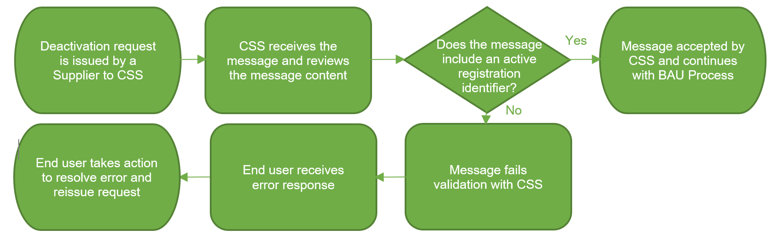
R0178 - solution
2. Deactivation of a prior cancelled registration | This scenario occurs when the registered supplier of an MPxN is the same supplier that cancelled a previous switch for the same MPxN. The supplier might accidentally deactivate the active registration using the cancelled registration identifier. CSS currently accepts this request, erroneously changing the cancelled registration state to inactive and sending out securedInactive messages. Number of Occurrences since go-live: 10
Proposed Solution

Slide 17
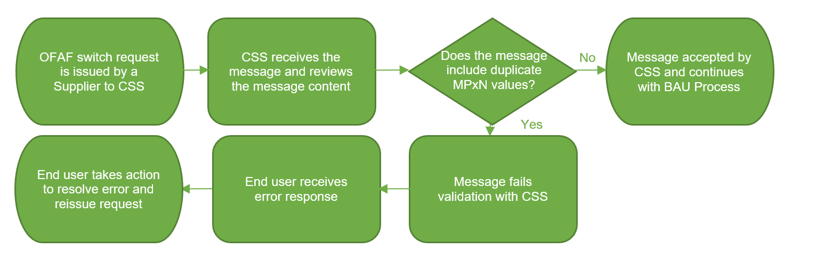
R0178 - solution
3. OFAF switch containing multiple MPxN. | This is the instance where the end user sends through a One Fail All Fail (OFAF) switch with the same MPxN contained within the payload 2 or more times. Multiple registration IDs are created for the same MPxN, and the registration is left in an incorrect state given a lack of appropriate BDVRs. Number of Occurrences since go-live: 19
Proposed Solution

Slide 18

R0178 – Non-Technical solution
Proposed Solution
1. Deactivation of an active reg. whilst in-flight switch in progress:
Clarification in the REC legal text that Parties should not withdraw before the ‘Supply Effective from Date’
Generate a new report which will allow RPA to track and monitor party compliance, via the solution to R0224.
2 & 3. Deactivation of a prior cancelled registration, OFAF switch containing multiple MPxN:
Issue guidance documents which will outline correct practices for parties

Slide 19
R0178 – Questions for Change Issues Group
Do we see more value in a technically engineered fix or in a simpler, non-technical resolution?

Slide 20
6. I0172 - End-to-End New Connections Process Review
James hardy and tim newton

Slide 21
I0172 - End-to-End New Connections Process Review
Domestic New Supply Connections (Gas) – Independent Gas Transporters:
1. Developer Appoints Parties
4. iGT (MAM) installs meter - iGT informs Supplier/Shipper
3. Shipper Responds to iGT PSA (PSB)
2. iGT sends PSA to Supplier/Shipper

Slide 22
I0172 – Issues Arising for IGT (Domestic)
No. | Trigger | Impact
1 | The developer may change Energy Supplier before the Consumer moves into the premise. | The developer may inform the incoming Consumer, but industry parties may be unaware.
2 | The plot and postal address details may change before the meter is installed but premise is not yet occupied. | Developer may not inform industry parties
3 | The plot and postal address may change after the premise is occupied. | Developer may not inform industry parties. It will be left to the Consumer to resolve.
4 | The installed meter may be moved to another plot or address before the premise is occupied due to a priority for the developer. | Developer may have a genuine requirement to fulfil, but industry parties may not be informed.

Slide 23
I0172 - End-to-End New Connections Process Review
Non-Domestic New Supply Connections (Gas) – Independent Gas Transporters:
1. Developer Appoints Parties
4. iGT (MAM) installs meter - iGT informs Supplier/Shipper
3. Shipper Responds to iGT PSA (PSB)
2. iGT sends PSA to Supplier/Shipper
The Non-Domestic process varies from Domestic in step 2 as a result of specific information relating to the plots within a non-domestic or industrial development and a need to ensure the PSA must not contain details of any Domestic premises:

Slide 24
I0172 – Issues Arising for IGT (Non-Domestic)
No. | Trigger | Impact
1 | The developer may change Energy Supplier before the Consumer/tenant moves into the premise. | The developer may inform the incoming tenant/landlord but not inform industry parties.
2 | The plot and postal address details may change before the meter is installed. | Developer may not inform industry parties
3 | The plot and postal address may change after the meter is installed and the premise is occupied. | Developer may not inform industry parties. It will be left to the tenant or landlord to resolve.

Slide 25
I0172 –Rejection Codes
REJ01 (No Contract) REJ02 (Missing Data)
REJ03 (Configuration Mismatch)
REJ04 (Duplicate PSR)
REJ05 (Issue number out of sequence)
REJ06 (Issue number been superseded)
REJ07 (MAM ID Incorrect)
REJ08 (Meter Mechanism)
REJ09 (Other, use the free text field and populate with the reason)

Slide 26
7. I0262 - Additional Registration Data (Gas) under Smart Energy Code
Lydia bentley

Slide 27
I0262 – overview
Issue
Solution
SEC Section E – ‘Registration Data’ obligates Gas Network Parties to submit Additional Registration Data to the DCC on a monthly basis.
The Proposer has asked SECAS to explore how the obligation to submit Additional Registration Data may be transferred from the SEC to the REC.
This is the only explicit obligation on Gas Network Parties in the Smart Energy Code.
The Proposer, a Gas Network Party, has suggested that the regulatory and operational impacts of assession to the SEC are disproportionate to their level of obligation within the Code.
This would allow Gas Network Parties to consider applying for a derogation against their licence requirement to accede to the SEC.

Slide 28
I0262 – Solution Options (1/2)
REC Drafting Options:
The REC Code Manager is currently exploring options for where the legal drafting containing the “transplanted” SEC obligation may be placed within the REC. The following areas are being considered:
Schedule 23 – Registration Services
Schedule 24 – Switching Data Management > Code Manager Minded-To Position
Schedule 25 - Central Switching Service
The Code Manager is also considering placing the obligation in the Gas Retail Data Service Definition, pending advice from the CDSP. The current drafting enables the Gas Transporter or the CDSP (on behalf of the Gas Transporter) to send the data. The Code Manager is considering whether placing the obligation in the Gas Retail Data Service Definition would preclude Gas Transporters sending the data themselves.
Decision:
The Code Manager is interested in industry feedback on the above. This will be considered alongside feedback from legal counsel.

Slide 29
I0262 – Solution Options (2/2)
Data Transfer Mechanism:
Additional Registration Data is currently sent to the DCC from Gas Transporters via the Registration Data Provider (RDP) – Xoserve.
  The RDP utilises secure File Transfer Protocols detailed in SEC Appendix X ‘Registration Data Interface Specification’:
The REC Code Manager is exploring the means by which this data transfer might be replicated in the REC.
  In addition to conversations with the DCC, Gas Transporters and the CDSP, the Code Manger would welcome a view from the REC Change Issues Group.
The current options being considered are:
  A recreation of the FTP arrangements found within the SEC;
  The Secure Data Exchange Platform (SDEP); or
  An undefined mechanism to give Gas Transporters the freedom to devise their own arrangements.

Slide 30
I0262 – Questions for Change Issues Group
Do you have any views on the drafting options presented?
Do you have any views on the data transfer mechanism options presented?
Do you have any other views or comments about this Issue?

Slide 31
I0262– Next Steps
Resolve outstanding solution questions
Impact Assessment
Consultation

Slide 32
8. I0275 - MHHS Related Metering Points across Market Segments
Francine Peyroux-Sissoko and Jonny Moore

Slide 33
I0275 - Update
Background
In October’s Change Issue Group, we discussed I0275 - MHHS Related Metering Points across Market Segments and agreed to explore REC and associated BSC change to allow these metering points to migrate to MHHS arrangements.
During this exploration it became apparent that this situation is already catered for within BCSCP706: Supplier Meter Registration Service for MHHS Metering Systems with the SMRS rules detailing that Relationships covering multiple Market Segments should be defaulted to the Advanced Market Segment.
This would allow the MOA to be appointed, and no REC change is now thought to be required, however validation rules also contained in BSCP706 and pointing to ISD would prevent the Data Service appointment.
There is still a potential issue around the transfer of Meter Technical Details (MTDs). With Advanced Segment MTDs being communicated via the D0268 ‘Advanced Meter Technical Details’ which doesn’t include meter register mapping.

Slide 34
I0275 - Update
Proposed Next Steps
Elexon (BSCCo) took an action at the recent BSC MHHS Expert Group to progress BSC change to resolve the Data Service appointment issue. The MHHS Programme’s expectation is that this is implemented by June 2026.
REC guidance will be provided for Parties in advance of MHHS Migration to allow Parties to review and remove Metering Point Relationships that are no longer required. Following the REC Guidance, this issue will be marked as resolved.
The issue around communicating MTDs for Traditional Meters via a D0268 will be picked up as part of I0273 – Sharing of SSC and TPR Information for MHHS Smart and Advanced Meters.

Slide 35
9. Issue tracker update
James hardy

Slide 36
Issues tracker
Issue/ CP | Title | Lead | Update
R0155/R0232 | Non-Domestic Change of Occupier | James Hardy | R0232 will be implemented on 07 November 2025. This will introduce the newly dedicated SDEP Screens for the Non-Domestic Occupier process. These should be used for all queries raised after 07 November. As a result of this implementation, the Code Manager has also updated the R0155 Guidance Document with further details on the new SDEP screens.
I0231/ I0261 | D0303 flow following MHHS design changes / Addition of Export flag in D0303 flows | Caroline Freimuller | An Information Request has been opened for feedback on multiple solution options. Responses must be received by 23:59 05 December 2025. The Code Manager will be holding a webinar for any questions on the solution options (more details to follow in the Change Bulletin).
I0240 | Data Alignment of Meter Information Through MHHS Migration | James Hardy | On 05 November 2025, the Code Manager published the I0240 – Scenario Guidance Document on the REC Portal. This can be found on the I0240 Portal Page or on the MHHS Hub. As a result of this publication, I0240 is now classed as Resolved.
I0266 | REC Data Specification Clarifications | Caroline Freimuller | Party impact assessment is open; responses must be received by 23:59 28 November 2025. This is an extended impact assessment open for a total of 8 weeks due to the volume of changes proposed.
R0268 | Consequential Cross-Code Change for BSC P441 - Complex Site Classes Creation | Caroline Freimuller | Consultation is open, responses must be received by 23:59 14 November 2025. The consultations for BSC P441 and DCUSA DCP424 close on the same day.
R0276 | SFIC to CMRM - missing Scenario Variant in D0126 / MM00016 | Caroline Freimuller | Consultation is open, responses must be received by 23:59 14 November 2025.

Slide 37
Issues tracker
Issue/ CP | Title | Lead | Update
I0278 | Establishing the Safe Isolation Provider (SIP) as a Standalone REC Metering Party | Francine Peyroux-Sissoko | The Code Manager is currently reviewing eight REC legal texts and the Service Termination Issue Reporting Guidance (STIRG) document to establish a clear governance framework for individuals or organisations to accede to the REC as SIPs without requiring MEM status.
R0280 | CSS Certificate Authority audit clarification | Bela Ashworth | Consultation is open, responses are due 23:59, 14 November 2025. This will go to PAB for final vote in December.
I0282 | Return of Legacy Meters | Francine Peyroux-Sissoko | The Code Manager will discuss this topic with CHIG on 06 December 2025 to gather views and feedback from Distribution Network Operators (DNOs) and suppliers on this issue, having engaged with the Community of Meter Asset Providers (CMAP) in October to assess whether this was an issue experienced by current MAPs.
R0283 | Annual Address Management Plan Updates | Bela Ashworth | Consultation is open, responses are due 23:59, 14 November 2025. This will go to Change Panel for final vote in December.

Slide 38

*Deadline extended to 18 November *
Have your say: our Annual Stakeholder
Satisfaction Survey is Live
Your voice matters. Our Annual Stakeholder Satisfaction Survey is now open, allowing you to share direct feedback on how we’re managing the Retail Energy Code (REC) Services.
Why participate?
This is your chance to tell us what’s working well in how the Change Issues Group operates, and where we need to improve.
Your feedback will directly shape our priorities for 2026–27.
Our main Annual Satisfaction Survey has also been launched. Please look out for an email from Researchcraft in your mailbox (researchcraft@qrs-research.net).
All responses are completely confidential, and results will be shared in early 2026.
https://online1.snapsurveys.com/l9blyt?Q1a=CHIG

Slide 39
11. Any other business

Slide 40
Next meeting:
04 December 2025
Thanks for attending

