Slide 1
REC Change Issues group
04 december 2025

Slide 2
1. Welcome and introduction
Holly law

Slide 3
Housekeeping
Cameras off, hands up for questions
Meeting is recorded
Free discussion of ideas
Any other Business?

Slide 4
Agenda For today
 | TITLE | TIME | LEAD
1 | Welcome and Introduction | 10:00 | Chair
2 | Confirmation of Agenda | 10:00 | Chair
3 | Approval of Previous Minutes | 10:00 | Harry Firth
4 | I0282 – Return of Legacy Meters | 10:05 | Francine Peyroux-Sissoko
5 | R0287 and R0287A - Clarification and Amendments to Annulment Definition in Schedule 23 – Alignment with SLC Obligations | 10:20 | Bela Ashworth
6 | Issue Tracker Update | 10:35 | Harriet Truss
7 | 2026 Meeting Dates | 10:45 | Harry Firth
8 | Any Other Business | 10:50 | All

Slide 5
3. approval of previous minutes
Harry firth

Slide 6
4. I0282 – Return of Legacy Meters
Francine Peyroux-sissoko

Slide 7
I0282 – return of legacy meters
The Code Manager would like to:
Gather views and feedback from DNOs and Energy Suppliers on whether there is a wider experience of issues with the return of non-smart electric meters
Establish whether there is a better way to proceed should there be industry wide challenges

Slide 8




I0282 – return of legacy meters
    SP Electricity North West, DNO and legacy MAP, is experiencing challenges with the return of legacy meters:
      Contacted by approximately six different storage providers every week;
      Asked to establish ownership of > 30,000 assets (gas and electricity).
    Time and effort spent:
      check serial numbers to establish whether they own the asset;
      notify the storage provider of the outcome;
      where appropriate take delivery of those assets; and
      arrange for disposal of the assets.
    Over the years, company names have changed, adding difficulty for storage providers to identify the original owner of the asset.
    Approximately 2/3 of legacy meters have been replaced with smart meters which are operated by the DCC.

Slide 9
I0282 – return of legacy meters
The Code Manager would like to assess whether:
this is an isolated case; or
an issue that is being experienced by other industry Parties.

Slide 10
I0282 – return of legacy meters
The Code manager engaged with the Community of Meter Asset Providers (CMAP) on 16 October to assess whether this was an issue experienced by current MAPs.
Not an issue for them as there is a longstanding industry process in place and an obligation for meters to be returned to the asset owner.
The problem could originate from storage providers not receiving the relevant details regarding the assets or not accessing this information themselves.
Process described in CoMCoP and facilitated by the UKMF Meter Returns Document.

Slide 11
I0282 – return of legacy meters
CHIG Members are invited to:
NOTE the contents of this presentation;
CONSIDER whether this is an isolated case or an issue shared by other Parties;
REVIEW any issues that may arise in this process; and
REFLECT on possible solutions.

Slide 12
5. R0287 and R0287A - Clarification and Amendments to Annulment Definition in Schedule 23 – Alignment with SLC Obligations
Bela ashworth

Slide 13
R0287/A – overview
Issue
The current wording of the Annulment definition in Schedule 23 does not sufficiently align with the obligations set out in SLC 14.2(d), 14.4(c) and 14.10.
Inconsistent interpretations of the usage of the Annulment process.
Misalignment between the Code and the SLCs.
Schedule 23, paragraph 10 outlines the annulment process.
This issue is seeking further amendments and clearer guidance to ensure the definition fully aligns with the SLCs.
Impact
Customer confusion, as the lack of clarity sends mixed signals about Switching protections and processes.

Slide 14
R0287 - Proposed Solution – Design & Intent
What is changing?
How will this help?
REC Schedule 1: The definition of Annulment Request will be amended to clarify that the Request is to be used by a Losing Supplier where the Consumer has informed the Losing Supplier that the Consumer has not entered into an Energy Contract with the proposed Gaining Supplier and asks the Losing Supplier to prevent the Switch from taking place.
Wording will be taken directly from the relevant SLCs to avoid any misinterpretation over the definition of Annulment and the Annulment process. This will also ensure full alignment of the REC with the SLCs.
REC Schedule 23: updated to include reference to SLC 14 and that the Consumer has informed the Losing Supplier that they have not entered into an Energy Contract with the proposed Gaining Supplier and asked the Losing Supplier to prevent the Switch from taking place.
Improves operational efficiency through clearer legal drafting, reducing ambiguity in the obligations of REC Parties and aligning processes across the industry.

Slide 15
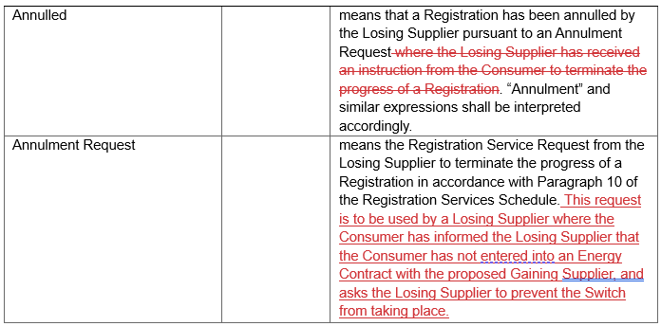
R0287 - Proposed Solution – REC SCHEDULE 1

Slide 16
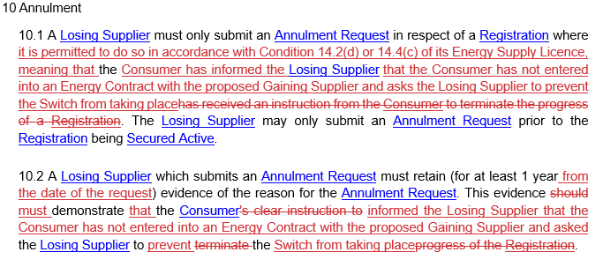
R0287 - Proposed Solution – REC SCHEDULE 23

Slide 17
R0287A - Proposed Solution – Design & Intent
What is changing?
REC Schedule 1: The definition of Annulment will be amended to clarify that the Annulment Request can be made in response to two scenarios outlined in REC Schedule 23.
This proposed solution introduces new wording to the REC that would not result in alignment of the Code with SLC 14. However, this will widen the scope of the Annulment process to allow the Losing Supplier to prevent a Switch from progressing if the Consumer notifies them that they have changed their mind and do not wish the Switch to progress.
REC Schedule 23: updated to include two scenarios that would allow for an Annulment Request to be raised:
How will this help?
1) Where the Consumer has not entered into a contract with the Gaining Supplier and asks the Losing Supplier to prevent the Proposed Supplier Transfer from taking place; or
2) the Consumer does not wish the Supplier Transfer to take place and requests that the Losing Supplier informs the Gaining Supplier on their behalf.

Slide 18
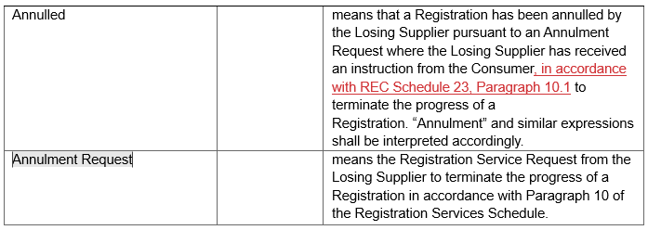
R0287A - Proposed Solution – REC Schedule 1

Slide 19
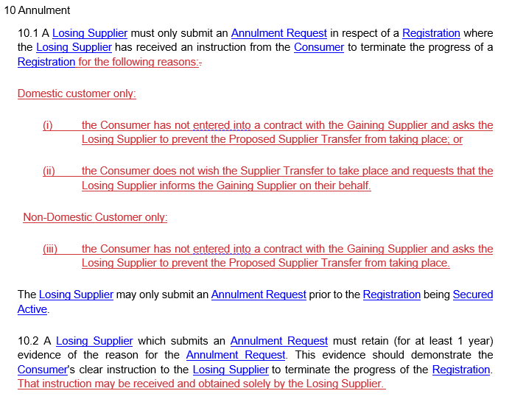
R0287A - Proposed Solution – REC Schedule 23

Slide 20
R0287/A - Clarification and Amendments to Annulment Definition in Schedule 23
CHIG Members are invited to:
NOTE the contents of this presentation;
CONSIDER the proposed solutions of R0287 and R0287A;
RAISE any questions or comments ahead of consultation.

Slide 21
6. Issue tracker update
Harriet Truss

Slide 22
Issues tracker
Issue/ CP | Title | Lead | Update
R0272 | Enabling transparency of the CRS Provider’s REC service level performance | Francine Peyroux-Sissoko | This Issue has been progressed to a Change Proposal on 01 December 2025. The draft legal text is available on the REC Portal. The Code Manager will be issuing a Consultation, open from 05 December 2025 to 02 January 2026. This will go to PAB for final vote in January.
I0289 | Rationalisation of reports produced by CSS - CRS improvements project | Bela Ashworth | The Code Manager will be issuing an Information Request for Energy Suppliers, open from 05 December 2025 to 05 January 2026. We are asking Suppliers to review a list of reports currently available from the DCC via ServiceNow, provide feedback on their utilisation and whether reports could potential be removed, reduced or cadence changed.

Slide 23
New submissions
CP | Title | Lead | Update
R0294 | Implementation of IF-051 Data Refresh in EES for BSC CP1607 | Harriet Truss | The Code Manager accepted in this Change Proposal on 27 November 2025.
I0295 | MHHS D0300 Issue | TBD | The Code Manager accepted in this Issue on 27 November 2025.
I0296 | Registration Id Required for MHHS Appointments | TBD | The Code Manager accepted in this Issue on 03 December 2025. This issue has been raised out of MHHS Early Life Support lessons learnt and options will be brought to January Change Issues Group for discussion.
I0297 | Meter Manufacturers Make and Type not Populated in SMRS | TBD | The Code Manager accepted in this Issue on 03 December 2025. This issue has been raised out of MHHS Early Life Support lessons learnt and will be brought to January Change Issues Group for discussion. .

Slide 24
R0294 - Implementation of IF-051 Data Refresh in EES
R0294 - Implementation of IF-051 Data Refresh in EES for BSC CP1607,
raised 27 November 2025
The IF-051 has been approved for implementation on 26 March 2026 under BSC CP 1607
Targeting 16 December 2025 Change Panel for Change Report (Proposal Plan)
IF-051 trigger could be updates by MPAS Super Users
Urgent Change Proposal to implement new DIP Market Message, IF-051 ’Data Refresh’, to EES
Need to understand associated scenarios and volumes
Information Request to be sent to DNOs in December
DIP = Data Integration Platform
EES = Electricity Enquiry Service
DNO = Distribution Network Operators

Slide 25
2026 Meeting dates
The invitations for the 2026 Change Issues Group meetings will be reissued shortly to everyone who has signed up to the Change Issues Group Distribution List.
If you want to receive the invitations for the 2026 Change Issues Group meetings, please email enquiries@recmanager.co.uk or committees@recmanager.co.uk to be added to the Distribution List.
The proposed date for the next Change Issues Group meeting is 15 January 2026. The remaining 2026 Change Issues Group meetings are listed on the next slide:

Slide 26
2026 meeting dates
Month | Paper Day | Meeting Date
January | 08 January 2026 | 15 January 2026
February | 29 January 2026 | 05 February 2026
March | 26 February 2026 | 05 March 2026
April | 26 March 2026 | 02 April 2026
May | 31 April 2026 | 07 May 2026
June | 28 May 2026 | 04 June 2026
July | 25 June 2026 | 02 July 2026
August | 30 July 2026 | 06 August 2026
September | 27 August 2026 | 03 September 2026
October | 24 September 2026 | 01 October 2026
November | 29 October 2026 | 05 November 2026
December | 26 November 2026 | 03 December 2026

Slide 27
8. Any other business

Slide 28
Next meeting:
15 January 2026
Thanks for attending

