Slide 1
REC Change Issues group
05 March 2026

Slide 2
1. Welcome and introduction
Paul witton-dauris

Slide 3
Housekeeping
Cameras off, hands up for questions
Meeting is recorded
Free discussion of ideas
Any other Business?

Slide 4
2. confirmation of agenda
Paul witton-dauris

Slide 5
Agenda For today
 | TITLE | TIME | LEAD
1 | Welcome and Introduction | 10:00 | Chair
2 | Confirmation of Agenda | 10:00 | Chair
3 | Approval of Previous Minutes | 10:00 | Harry Firth
4 | I0273 - Sharing of SSC and TPR Information for MHHS Smart and Advanced Meters and I0303 - Potential Consumer detriment for Smart Economy 7 | 10:05 | Bela Ashworth
5 | R0316 - Clarification to Data Items within the Payment Method Levelisation Supplier Data Reporting Specification | 10:15 | Bela Ashworth
6 | I0318 – Introduction of Consumer Consent Solution | 10:30 | Harriet Truss
7 | Issue Tracker Update | 10:45 | Bela Ashworth
8 | Any Other Business | 10:55 | All

Slide 6
3. approval of previous minutes
Harry firth

Slide 7
4. I0273 - Sharing of SSC and TPR Information for MHHS Smart and Advanced Meters and I0303 - Potential Consumer detriment for Smart Economy 7
Bela ashworth

Slide 8
5. R0316 - Clarification to Data Items within the Payment Method Levelisation Supplier Data Reporting Specification
bela ashworth

Slide 9
R0316 - Proposed Solution – Design & Intent
What is changing?
Why is it changing?
How will this help?
REC Schedule 31 – Payment Method Levelisation Reconciliation, Appendix 1 will be amended to correctly label the data items.
To ensure that all Suppliers have clear and consistent guidance when preparing and submitting portfolio data, thereby supporting accurate and aligned reporting across the PML scheme.
Improves operational efficiency through clearer legal drafting and reducing ambiguity in the obligations of REC Parties in the PML scheme.
For the purposes of Appendix 1, an Eligible Meter Points means:
Gas: a Supply Meter Point for a Domestic Premises;
Electricity: an Unrelated Metering Point or a Primary Relating Metering Point for (in each case) a Domestic Premises. This includes any domestic Metering Points that are related under a single customer account, but not related as per REC Schedule 28.
REC Schedule 1 – Interpretations and Definitions will be amended to add Unrelated Metering Point, meaning a Metering Point that does not have any relationship with a Related Metering Point.
Clarifies the PML scheme’s submission process and data calculations, removing ambiguity for current and future recipients.

Slide 10
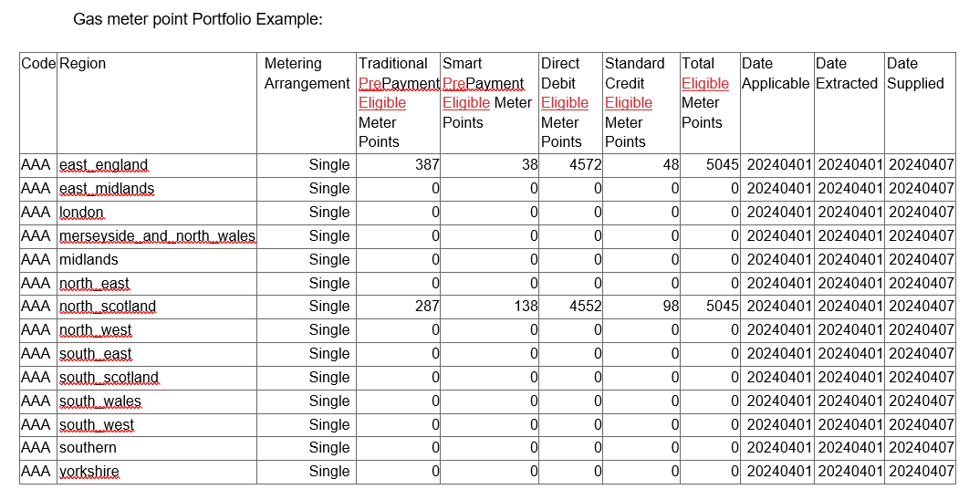
r0316 - Proposed Solution – Legal Text
Example of legal text changes to REC Schedule 31 – Payment Method Levelisation Reconciliation, Appendix 1:

Slide 11
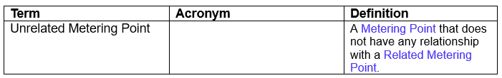
r0316 - Proposed Solution – Legal Text
REC Schedule 1 – Interpretations and Definitions:

Slide 12
R0316 – Next Steps
Consultation:
04/03/26 – 25/03/26
Change Panel Final Vote:
07/04/26
Implementation: 17/04/26

Slide 13
6. I0318 – Introduction of Consumer Consent Solution
Harriet truss

Slide 14
Consumer Consent Solution (CCS)
New, secure digital solution.
Empowers energy consumers to control who can access their energy data.
Enables people to easily grant, manage, review, and revoke consent.
Supports transparency, consumer choice, and data protection across the retail energy market.
Service being developed in line with Ofgem’s published Design Principles .
Will underpin a supplier licence obligation for recording consent consistently across the sector.

Slide 15
RECCO Project key contacts
Tracy Hardy – Senior Responsible Owner
Matt White – CCS Product Owner
Sarah Jones – Regulation & Governance Lead
Ann Perry – Market Design Lead

Slide 16
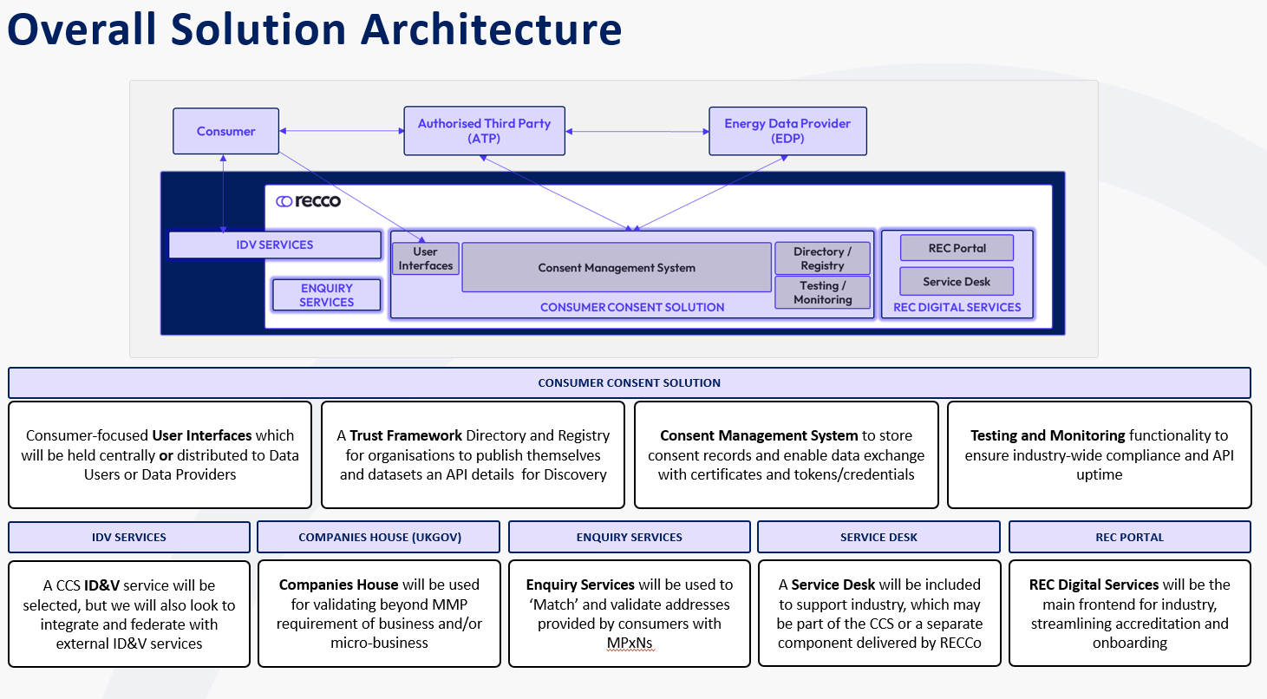

Slide 17
Consumer Consent SOlution - Background
Ofgem
2022-24: Development leading to mandate & Consent Solution paper
RECCo Project
Deliver technical solution
Current status
Design consultation open until 25 March 2026
Apr-May 2025: Appointed RECCo to deliver Consumer Consent Solution
CCS Arrangements to be governed under the REC
Jun-Dec 2025: Industry engagement transitioned to RECCo
Deliver governance arrangements
Engagement with industry
Topic Specific Groups
Webinars
In Person Engagement Days
Technology procurement in progress
REC Issue raised – I0318
Governance framework in development

Slide 18
R0318 – Introduction of CCS
RECCo project
Responsible for the delivery of the Consumer Consent Solution.
Including development of solution, governance, assurance and legal drafting.
REC Issue
Ensures visibility amongst REC change stakeholders.
Supports engagement before approval and implementation through REC change governance.
RECCo consultation on legal drafting in Q3 2026
Primary opportunity to input into legal text.
REC Change Proposal
Will progress following refinements resulting from the legal drafting consultation.

Slide 19
Overview of REC Impacts
REC Main Body
New Schedule for CSS Arrangements
New Service Definition (new Service Provider)
New API Technical Specification (Data Spec)
Customer Experience Guidelines (Data Spec)
Schedule 9 - Qualification & Maintenance + Access Agreement
Schedule 10 - Charging Methodology
Schedule 29 - Address Management
Schedule 1 - Interpretations & Definitions
Performance Assurance documents

Slide 20
I0318 what’s next
Regular updates at Change Issues Group
Signposting to engagement opportunities
Direct link to RECCo project legal drafting
Move to Change Proposal expected in Q4 2026

Slide 21
Get involved
Consumer Consent Solution Design Consultation
Consulting on the proposed design of the Consumer Consent Solution and the Minimum Marketable Product
  To respond, download the Consumer Consent Solution Design Consultation Pack from RECCo | Consumer Consent Programme page
  Complete Annex A: Consultation Response Form, and email your completed response to consumerconsent@retailenergycode.co.uk by 17:00 on 25 March 2026.
Further information
REC Portal - Consumer Consent Hub

Slide 22


Slide 23
7. Issue tracker update
Bela ashworth

Slide 24
Issues tracker
Issue/ CP | Title | Lead | Update
R0096 | CSS Message Regeneration Functionality | Bela Ashworth | On 25 February 2026, the Technical Expert Panel voted in line with the Code Manager recommendation to approve R0096 for implementation. Subject to no appeals, this Change will be implemented in the standard REC release in November 2027.
I0265 | Theft Calculator Usage and Suitability Assessment | Francine Peyroux-Sissoko | The next Working Group will take place on 25 March 2026 and will focus on Industrial and Commercial cases.
I0278 | Establishing the Safe Isolation Provider (SIP) as a Standalone REC Metering Party | Francine Peyroux-Sissoko | An information request to gather views from industry is open and will close on 13 March 2026.
I0284 | Updates to Schedule 14 Measurement Transformers Commissioning Timescales | Caroline Freimuller | Party impact assessment is open, closing on 06 March 2026.
R0286 | Clarification on Detailed Impact Assessment Activities | Francine Peyroux-Sissoko | The consultation is open and will close on 13 March 2026.
R0300 | Amendments to D0312 to align with BSC CP1622 | Caroline Freimuller | Party impact assessment is open, closing on 13 March 2026.

Slide 25
8. Any other business

Slide 26
Next meeting:
02 April 2026
Thanks for attending

