Slide 1
REC Change Issues group
03 September 2026

Slide 2
1. Welcome and introduction
Lydia bentley

Slide 3
Housekeeping
Cameras off, hands up for questions
Meeting is recorded
Free discussion of ideas
Any other Business?

Slide 4
2. confirmation of agenda
Lydia bentley

Slide 5
Agenda For today
Title | Time | Lead
Welcome and introduction | 10:00 | Chair
Confirmation of agenda | 10:00 | Chair
Approval of previous minutes | 10:00 | Harry Firth
I0318 – Introduction of Consumer Consent Solution | 10:05 | Harriet Truss
R0321 - DNOs Create Export MPANs after approving G98/99 commissioning documents | 10:15 | Caroline Freimuller
I0325 - Post-MHHS Full Transition Complete (M15) REC update | 10:25 | Harriet Truss
I0331 - Regulatory Alliance Creation Rejections | 10:45 | Caroline Freimuller
R0336 - Legal text to support REC Change R0180 | 10:55 | Caroline Freimuller
Any Other Business | 11:05 | All
R0322 – Erroneous Switch Review I0237 Clarifications |  | Lorna Mallon
Priority Service Register Process |  | Lorna Mallon

Slide 6
3. approval of previous minutes
Harry firth

Slide 7
4. I0318 – Introduction of Consumer Consent Solution
Harriet Truss

Slide 8
5. R0321 - DNOs Create Export MPANs after approving G98/99 commissioning documents
Caroline Freimuller

Slide 9
R0321 – DNOs Create Export MPANs after approving G98/99 commissioning documents
Changes post Party impact assessment
Change renamed to “DNOs Create Export MPANs after approving G98/99 commissioning documents”
Safety concerns raised by DNOs around creating Export MPANs before commissioning has been completed
Solution heavily workshopped with 2 DNOs who responded to the Party IA

Slide 10
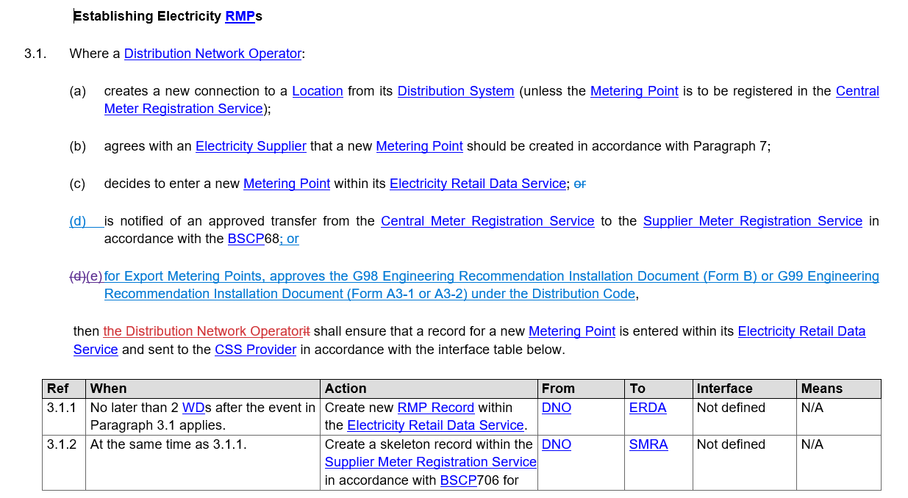
R0321 – DNOs Create Export MPANs after approving G98/99 commissioning documents
New proposed solution – Schedule 27 RMP Lifecycle, section 3

Slide 11
R0321 – DNOs Create Export MPANs after approving G98/99 commissioning documents
Next steps
At consultation 21 August to 14 September 2026
  Consultation question for DNOs: do you know what percentage of G98/99 Engineering Recommendation Installation Documents you have approved within the past 12 months where the Premise did not require an Export Metering Point to be created?
15 September 2026 to 12 October 2026 – Code Manager to review consultation responses and determine if this solution is appropriate for implementation
Final recommendation to be published by 13 October 2026, for review at REC Change Panel on 20 October 2026

Slide 12
6. I0325 - Post-MHHS Full Transition Complete (M15) REC update
Harriet truss

Slide 13
I0325 – Progress to DATe
Code Manager has reviewed 13 Schedules, and 4 Category 2 products.
Examples of updates required in these products:
In progress: Code Manager review of Data Specification’s Market Message and Data Item Catalogues
Impact assessment requested: EES Service Provider on technical changes and product changes to EES to remove redundant data items from the portal and API
Remove references to non-MHHS and MHHS Metering Points, moving to ‘Metering Points’ only as the split will be redundant
Removal of references to redundant market participants (e.g. Data Collector, Data Aggregator)
Complete removal of legacy only and transition processes (Migration processes, non-MHHS metering processes)

Slide 14
I0325 – Scope list – Progress
I0325 Schedules CHIG 03092026 – available to view on CP page
Category 1 Products | Status
REC Main Body | In Progress
Schedule 1 - Interpretations and Definitions | In Progress
Schedule 9 - Qualification and Maintenance | Available for CHIG review
Schedule 12 - Data Access | Available for CHIG review
Schedule 13 - Transfer of Consumer Data | No changes required
Schedule 14 - Metering Operations | Available for CHIG review
Schedule 23 - Registration Services | Available for CHIG review
Schedule 24 - Switching Data Management | In Progress
Schedule 25 - Central Switching Service | In Progress
Schedule 27 - RMP Lifecycle | Internal review
Schedule 28 - Related Metering Points | Available for CHIG attendee review
Schedule 29 - Address Management | Internal review
Schedule 30 - Resolution of Consumer Facing Switching and Billing Issues | In Progress
Schedule 34 - MHHS Migration | To be removed from REC

Slide 15
I0325 – Scope list – Progress
Category 2 Products | Status
Consolidated Metering Code of Practice | In Progress
CSS Service Definition | In Progress
EES Service Definition | In Progress
ERDS Service Definition | In Progress
Market Message and Data Item Catalogues | In Progress
EES API Spec (and EES related products) | IA triggered with EES Provider

Slide 16
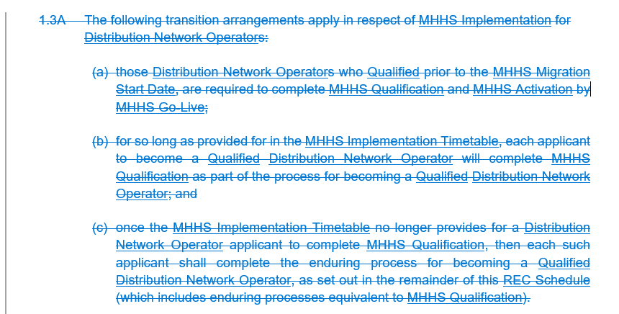


I0325 – schedule 9 Qualification & Maintenance
Updates
4 impacted paragraphs
  Removing transition arrangements
  Removing references to MHHS Qualification

Slide 17
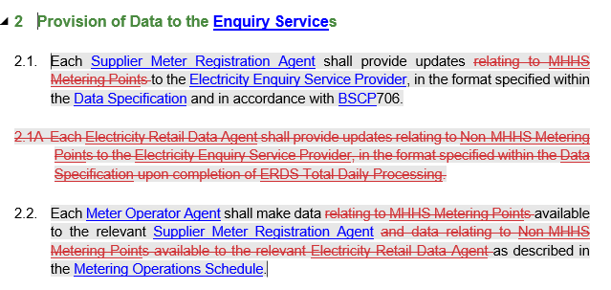
I0325 – schedule 12 Data Access
Updates
3 impacted paragraphs
  Removing non-MHHS process/obligations
  Removing MHHS references which no longer need to be specified

Slide 18
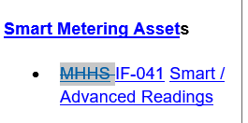
I0325 – schedule 14 Metering Operations
Updates
Removal of Part E - Operational Processes Electricity for non-MHHS Metering Points and all references to it
Removal of non-MHHS Metering Point specific paragraph, 2.21A, (not in Part E)
Removal of ‘MHHS Metering Points’ references, as all will be in MHHS arrangements so no distinction to make
Removal of ‘MHHS’ from in front of all IF-0xx (Data Integration Platform Market Messages) references, ‘MHHS’ surplus to requirements and not part of the data specification naming
Amendment required to R0207 legal text to be implemented in November 2026
Remove ‘MHHS Migration’ reference in para 2.14 relating to Communications Equipment obligation

Slide 19
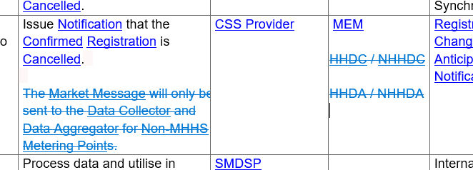
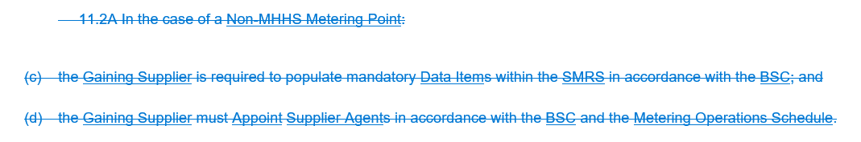
I0325 – schedule 23 Registration Services
Updates
7 impacted paragraphs
  Removing non-MHHS process/obligations, including redundant market participants
  Removal of ‘MHHS’ reference, as all will be in MHHS arrangements so no distinction to make

Slide 20
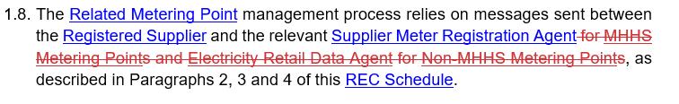
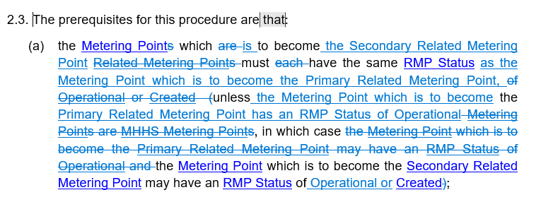
I0325 – schedule 28 Related Metering Points
Updates
11 impacted paragraphs
  Removing non-MHHS process/obligations
  Removal of ‘MHHS Metering Points’ references, as all will be in MHHS arrangements so no distinction to make
  Removal of ‘MHHS’ from in front of all IF-0xx (Data Integration Platform Market Messages) references, ‘MHHS’ surplus to requirements and not part of the data specification naming
  Update pre-requisites for creating relationships to address that the MHHS Metering Point scenario captured is enduring

Slide 21
I0325 – Post-MHHS Full Transition Complete (M15) REC updates
CHIG Consideration
Do you agree with the amendments made so far?
Do you have any further thoughts about amendments that need to be made?
Future CHIG meetings will be used to review detailed proposals, including details on EES and Data Specs changes.
Are there any other scope areas that CHIG members would like to discuss?
Solution development target is end of October 2026.

Slide 22
7. I0331 - Regulatory Alliance Creation Rejections
Caroline Freimuller

Slide 23
I0331 - Regulatory Alliance Creation Rejections
An incident where Network Parties did not submit Regulatory Alliances on time to the Central Switching Service (CSS) Provider, or did submit the Regulatory Alliances but did not action rejections from the CSS Provider in a timely manner, led to over 200 Consumers being delayed in Switching to their chosen Energy Supplier.
This Issue looks to review the section of the process of creating Regulatory Alliances that sits within REC Schedule 24 – Switching Data Management
It looks to introduce SLAs on Network Parties to submit Regulatory Alliances, and to work any rejections they receive from the CSS
This is being closely monitored by the Cross Code Steering Group (CCSG) to ensure the Issue keeps the scope solely to the part of the Regulatory Alliance process owned by the REC and has no impacts to DCUSA or UNC

Slide 24
I0331 - Regulatory Alliance Creation Rejections
Proposed solution – full legal text available on the portal here
GT/DNO informs GRDA/ERDA within 2 Working Days of creating a new Regulatory Alliance with an Energy Supplier
GRDA/ERDA submits Market Participant Role Alliance (MM90003) to CSS within 1 Working Day
If GRDA/ERDA receives a rejection from CSS via the Standard Response Body (MM90071), they must investigate the reason for error within 1 Working Day
Within 1 further 1 Working Day, they must either resubmit the Market Participant Role Alliance (MM90003) or inform the Energy Supplier why they cannot resubmit and if required, raise a ticket to the CSS
The above process/timescales is also applicable for DNOs re-establishing a Regulatory Alliance

Slide 25
I0331 - Regulatory Alliance Creation Rejections
Performance Assurance
There are no routine performance assurance requirements being proposed under this Issue
  Regular reporting from CSS is costly, and likely could not be impact assessed for costs until after the outcome of R0224 is known (and potentially implemented)
  Do not believe this is high enough risk to request regular self-reports from Network Parties via the PARC
Instead, the Code Manager plans for an “incident based” assurance approach
  Performance Assurance to issue a guidance note to Network Parties if I0331 is approved, so all Parties aware of new process
  If Performance Assurance are made aware of any Network Party not meeting requirements, they will reach out to that Party directly
  This approach will be reviewed if the number of incidents increases
While Regulatory Alliances not being set up in time can impact Consumers Switching, there have not been a large number of known incidents of this failing and the most recent time it happened impacted a small number of Consumers (~200). As such, the Code Manager has deemed this a low enough risk to not require regular performance assurance monitoring

Slide 26
I0331 - Regulatory Alliance Creation Rejections
Next steps
04 to 25 September – Party impact assessment open for responses
End September to mid October – Code Manager to review Party IA responses, conduct business case assessment and refine the solution as required
No later than end of October – Code Manager to submit an Update to Plan to REC Change Panel with proposed next steps and timescales

Slide 27
8. R0336 - Legal text to support REC Change R0180
Caroline Freimuller

Slide 28
R0336 - Legal text to support REC Change R0180
R0180 Clarity on use of on hold for switching issues, including the obligations of CSS Users
  Technical change introducing functionality for automated closure of tickets in the CSS Service Desk where no response is received after a set period of time
  Approved for implementation on 06 November 2026 by the Technical Expert Panel in March 2026
It has since been identified there are changes to Schedule 26 Switching Service Management and the Switching Operator Service Definition to codify when the Switching Operator is allowed to close tickets due to no response and which tickets are in/out of scope of being closed due to no response

Slide 29
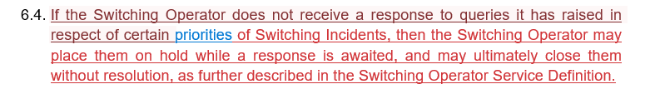
R0336 - Legal text to support REC Change R0180
Solution – Schedule 26 Switching Service Management

Slide 30
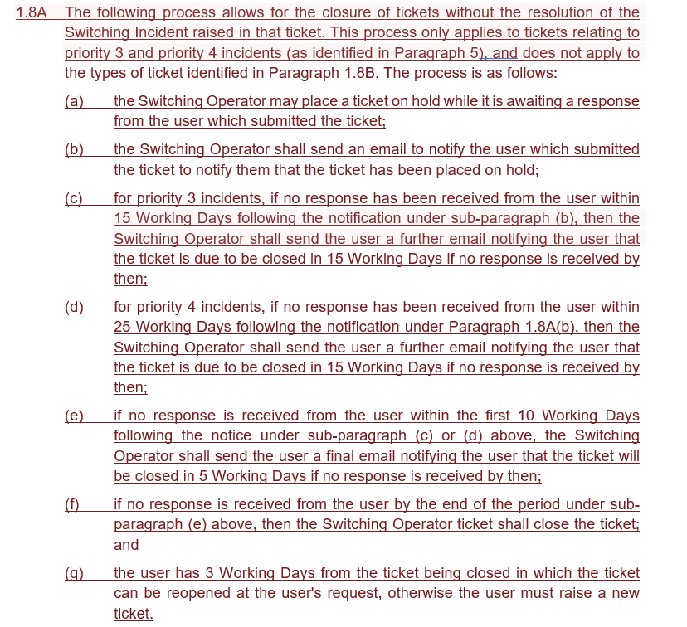
R0336 - Legal text to support REC Change R0180
Solution – Switching Operator Service Definition

Slide 31
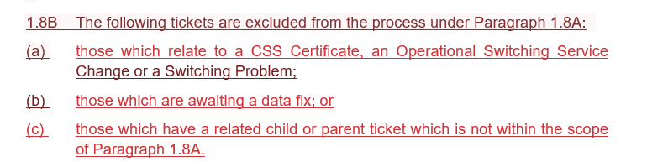
R0336 - Legal text to support REC Change R0180
Solution – Switching Operator Service Definition

Slide 32
R0336 - Legal text to support REC Change R0180
Out for consultation 21 August to 14 September 2026
Final recommendation will be presented to the Technical Expert Panel in either their September or October meeting, for implementation on 06 November 2026 alongside R0180
  The Code Manager is aiming for a September vote, so the appeal window closes before the Change Proposal is implemented
There will also be changes required to Category 3 documents owned by the Switching Operator to support the implementation of this Change Proposal, which are currently being drafted by the Switching Operator

Slide 33
9. Any other business

Slide 34
R0322 – Erroneous Switch Review I0237 Clarifications​
Lorna mallon

Slide 35
R0322 – Solution updates
Location | Party Impact Assessment | Updated Solution
Schedule 30 | Paragraph 5.3 removing mention of deletion of data collected during Erroneous Switch period | Proposal updated to clarify requirement to delete data not needed for Settlements or other Regulatory obligations.
 | Paragraph 4.4 terminology updates ‘Customer’ to ‘Consumer’ | Proposal stay the same, no amendments.
 | Addition of 4.10 (Reason for Return table)
D0301 | Data Items title: terminology updates ‘Customer’ to ‘Consumer’, ‘Transfer’ to Switch’ | Proposal will keep terminology of ‘Customer’ to ensure consistency within Market Messages. The amendment from ‘Transfer’ to ‘Switch’ will be kept.
 | Data Items Enumeration Values: amended descriptions to improve clarity | Proposal stay the same, no amendments.
 | N/A | DI50998 (Status of Erroneous Switch) Enumeration Values description have been amended with current REC terminology to allow consistency between Electricity and Gas Data Items.
Erroneous Switch flag | Clarity around the use of the flag (final step) | Proposal stay the same, no amendments.
 | Physical length: 1 | Physical length: 5
 | N/A | Logical Length: 5
 | Data Item Note: clarity on when to be used | NO AMENDMENT
 | Enumeration values: t / f | Enumeration values: true / false

Slide 36
R0322 – Solution updates
Location | Party Impact Assessment | Updated Solution
RET Flow | Terminology updates: ‘Customer’ to ‘Consumer’, ‘Transfer’ to Switch’ | Proposal will keep terminology of ‘Customer’ to ensure consistency within Market Messages. The amendment from ‘Transfer’ to ‘Switch’ will be kept.
 | DI40209 Enumeration Value: ‘N’ (to correct typo from ‘NA’) | Proposal stay the same, no amendments.
 | Various Data Items: replace ‘Customer’ to ‘Consumer’ | Proposal will keep terminology of ‘Customer’ to ensure consistency within Market Messages.
 | DI40212 (Reason for the Erroneous Switch) Enumeration Values descriptions amended to provide clarity | Proposal stay the same, no amendments.
 | DI40213 Enumeration Value descriptions amended to remove outdated terminology: ‘current’ / ‘original’ Supplier to ‘New’ / ‘Old’ Supplier | DI40213 Enumeration Values description have been amended with current REC terminology to allow consistency.
 | DI40213 Enumeration Value T: correct a typo: ‘4 months’ to ‘24 months’ | Proposal stay the same, no amendments.
Implementation Date | November 2026 release | February 2027 release as consultation has been delayed

Slide 37
Priority services register process​
Lorna mallon

Slide 38
Issue tracker updATE
CHANGE TEAM

Slide 39
Issues tracker
Issue/ CP | Title | Lead | Update
I0200 | Review of the REC’s Address Management Service | Bela Ashworth | The third working group session took place on Thursday, 03 September 2026. The post-meeting papers will be issued by Thursday, 10 September 2026. Members were encouraged to provide examples of good practice, bad practice and address examples that can be added to the draft Address Guidance Document.

Slide 40
Next meeting: 01 October 2026
Thanks for attending

