Slide 1
REC Change Issues group
01 October 2026

Slide 2
1. Welcome and introduction
Florentina monea

Slide 3
Housekeeping
Cameras off, hands up for questions
Meeting is recorded
Free discussion of ideas
Any other Business?

Slide 4
2. confirmation of agenda
Florentina monea

Slide 5
Agenda For today
Title | Time | Lead
Welcome and introduction | 10:00 | Chair
Confirmation of agenda | 10:00 | Chair
Approval of previous minutes | 10:00 | Harry Firth
I0325 - Post-MHHS Full Transition Complete (M15) REC update | 10:05 | Francine Peyroux-Sissoko
R0095 - Changes to allow DNOs to reinstate disconnected MPANs | 10:25 | Finn Deacon
I0335 - Introduction of Defined Electricity Metering Work Categories for Metering Accreditation | 10:45 | Poppy Mullins
I0341 - Improved Validation for DI51599 - Electricity Smart Meter Equipment (ESME ID) | 10:55 | Harry Firth
Issue Tracker Update | 11:05 | Change Team
RECCo Annual Stakeholder Satisfaction Survey | 11:15 | Harry Firth
Any Other Business | 11:20 | All

Slide 6
3. approval of previous minutes
Harry firth

Slide 7
4. I0325 - Post-MHHS Full Transition Complete (M15) REC update
Francine Peyroux-sissoko

Slide 8
I0325 – Post-MHHS Full Transition Complete (M15) REC updates REMINDER
Background
The REC was updated to add requirements that support the transition to, and enduring operation of the MHHS arrangements.
As part of the MHHS transition, each impacted Metering Point will be migrated using processes defined in Codes, including the REC.
Once this migration activity is complete, the legacy and transitional arrangements will become redundant and should be removed from the REC to support its efficient operation.
MHHS
This Issue has been noted by the programme who will be seeking confidence that there are no unintended impacts to MHHS Implementation, particularly regarding the timing of the changes to be made.
Cross-Code Impacts
It is expected that the BSC and DCUSA will also look to identify what legacy, and transitional arrangements should be removed from their governed documents.
Cross-code coordination may be required for consultation on, or implementation of parts of the solution to I0325 where there are dependencies between the Codes.
This however does not impact the development of the REC solution itself.

Slide 9
I0325 – Post-MHHS Full Transition Complete (M15) REC updates REMINDER
Solution approach
Review the identified legal drafting changes within the main REC governed products provided in the submission.
Review the legal drafting for further Category 2 and 3 products which are potentially impacted.
Identify amendments required to the Electricity Enquiry Service (EES), in respect of a number of redundant data items.
Identify amendments required to the Data Specification’s Market Message and Data Item Catalogues.
Confirm implementation timing and approach for all scoped areas (EES technical delivery and Data Specs may be different from the other products) with the expectation that no changes will be made until after the MHHS Programme Milestone M15, currently planned for 07 May 2027.
Any impacts on other industry Codes and on the provision of REC Services will be considered.
Any consequential impacts on REC guidance will also be identified.

Slide 10
I0325 – Scope list – Progress
I0325 Schedules CHIG 01102026 – available to view on CP page
Category 1 Products | Status
REC Main Body | In Progress
Schedule 1 - Interpretations and Definitions | In Progress
Schedule 9 - Qualification and Maintenance | Reviewed at September CHIG
Schedule 12 - Data Access | Reviewed at September CHIG
Schedule 13 - Transfer of Consumer Data | No changes required
Schedule 14 - Metering Operations | Reviewed at September CHIG
Schedule 18 - Green Deal Arrangements | Available for CHIG review
Schedule 23 - Registration Services | Reviewed at September CHIG
Schedule 24 - Switching Data Management | Available for CHIG review
Schedule 25 - Central Switching Service | Available for CHIG review
Schedule 27 - RMP Lifecycle | Available for CHIG review
Schedule 28 - Related Metering Points | Reviewed at September CHIG
Schedule 29 - Address Management | Available for CHIG review
Schedule 30 - Resolution of Consumer Facing Switching and Billing Issues | Available for CHIG review
Schedule 34 - MHHS Migration | Reviewed at September CHIG

Slide 11
I0325 – Scope list – Progress
Category 2 Products | Status
Consolidated Metering Code of Practice | Available for CHIG review
CSS Service Definition | Available for CHIG review
EES Service Definition | Available for CHIG review
ERDS Service Definition | Available for CHIG review
PARC | In Progress
Rules for the Completion of Electricity Market Messages | (New with R0266) In Progress
Market Message and Data Item Catalogues | In Progress
EES API Spec (and EES related products) | IA triggered with EES Provider

Slide 12
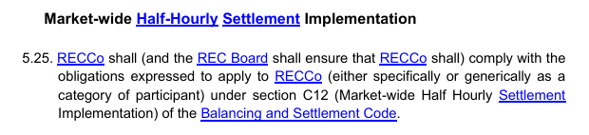
I0325 – REC Main Body
Updates
1 impacted paragraph
  Removing references to MHHS Implementation
5.25 relates to wider than M15 and the Code Manager proposal is that it should only be removed when section C12 is removed from the BSC. Therefore, this will not be taken forward within R0325.

Slide 13
I0325 – Schedule 1 - Interpretations and Definitions
Updates / Final checks in progress
28 definitions removal for I0325.
6 impacted definitions that need amending for I0325.
3 definitions identified for removal post M16.

Slide 14
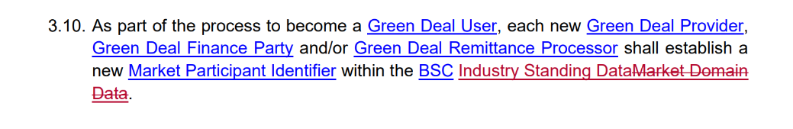
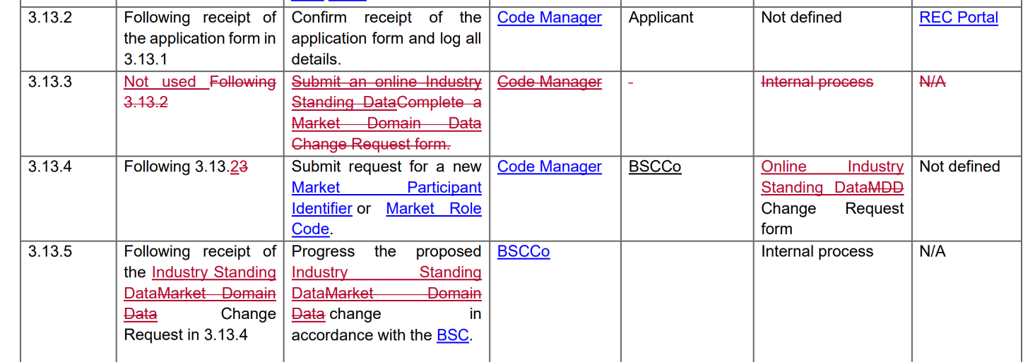
I0325 – Schedule 18 - Green Deal Arrangements
Updates
4 impacted paragraphs and 8 subparagraphs within interface tables
  Removing references to Market Domain Data and replacing them with Industry Standing Data
  Updating reference to change request form

Slide 15
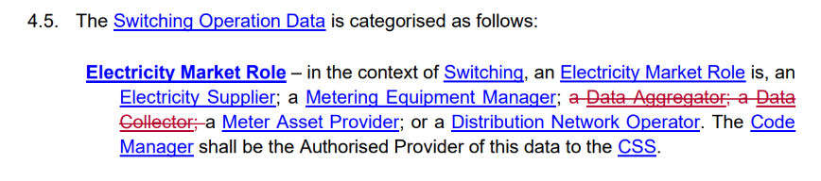
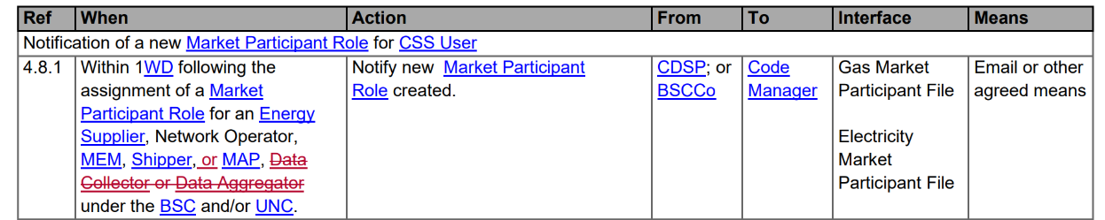
I0325 – Schedule 24 - Switching Data Management
Updates
1 impacted paragraph and 1subparagraph within an interface table
  Removing the reference to Data Collector and Data Aggregator (Data Services not added in MHHS drafting as they are not CSS Users)

Slide 16

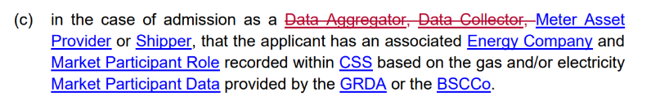
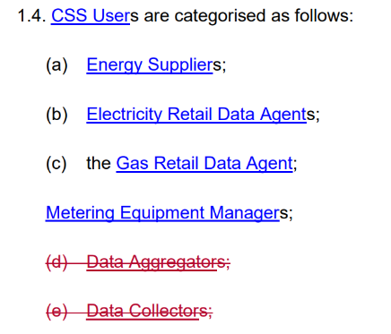
I0325 – Schedule 25 - Central Switching Service
Updates
3 impacted paragraphs
  Removing the reference to Data Collector and Data Aggregator (Data Services not added in MHHS drafting as they are not CSS Users)

Slide 17
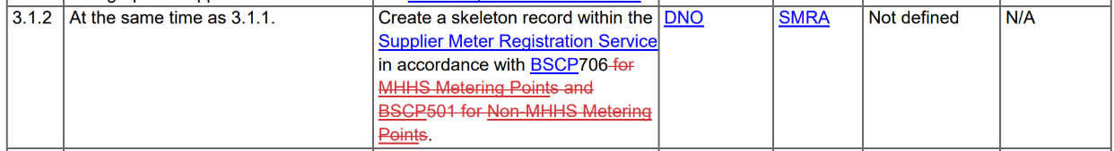
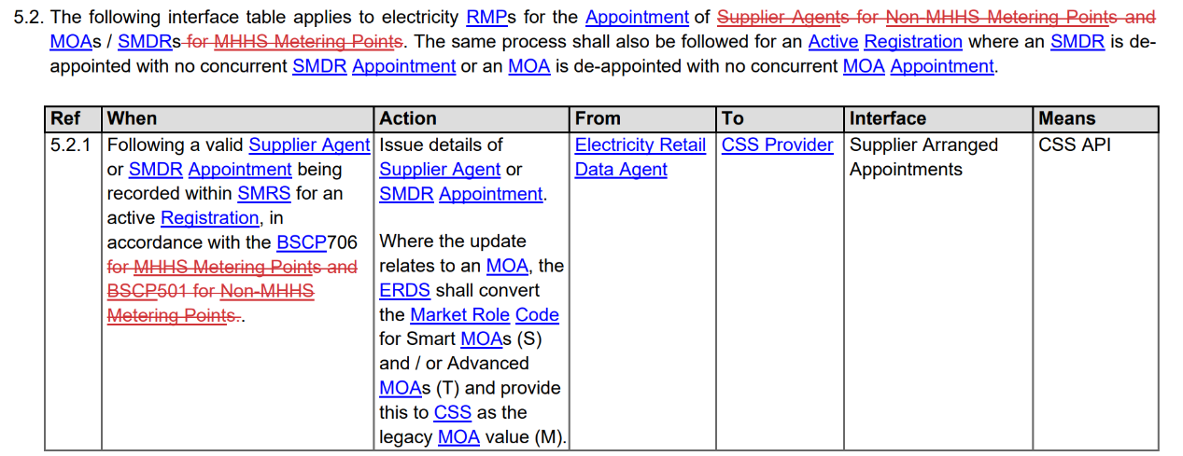
I0325 – Schedule 27 - RMP Lifecycle
Updates
1 impacted paragraph and 13 subparagraphs within interface tables
  Removing ‘non-MHHS Metering Points’ and ‘MHHS Metering Points’ references, as all will be in MHHS arrangements so no distinction to make

Slide 18
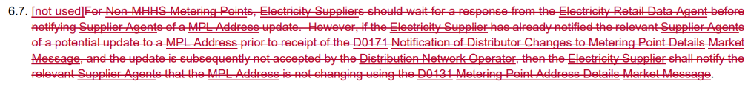
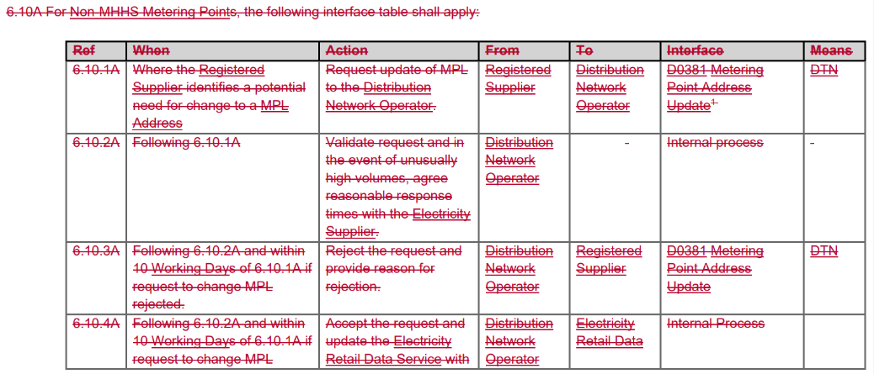
I0325 – Schedule 29 - Address Management
Updates
3 impacted paragraphs, 1 interface table impact
  Removing ‘non-MHHS Metering Points’ and ‘MHHS Metering Points’ references
Notes:
Updates: 6.11 is actually a paragraph restructure: the text was taken out of 6.10 and moved to a new paragraph 6.11.

Slide 19
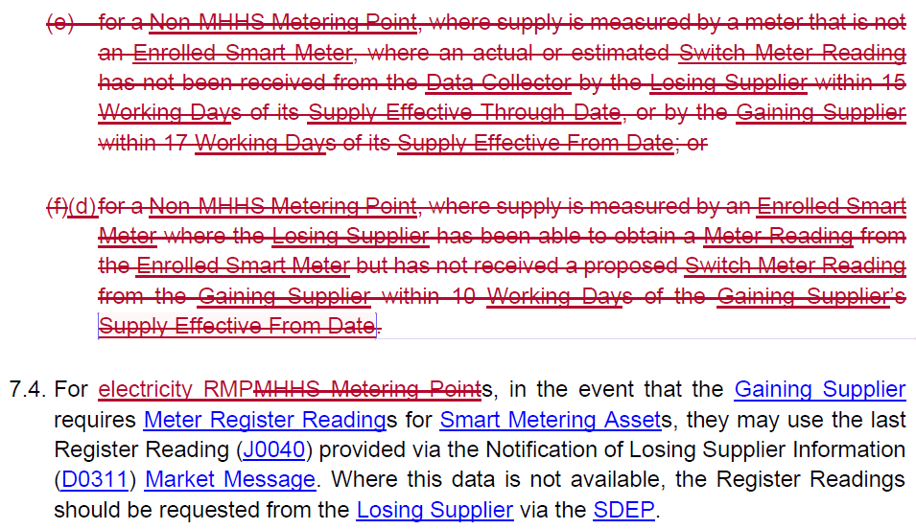
I0325 – Schedule 30 - Resolution of Consumer Facing Switching and Billing Issues
Updates
13 impacted paragraphs
  Switching ‘MHHS Metering Points’ to ‘electricity RMPs’
  Removing ‘Data Collector’ references
  Removing ‘non-MHHS Metering Points’ references

Slide 20
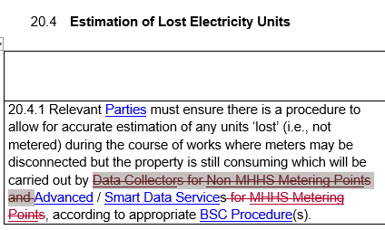
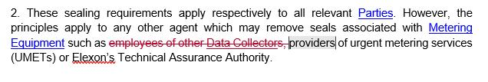
I0325 – ComCOP
Updates
2 impacted paragraphs
  Removing ‘non-MHHS Metering Points’ and ‘MHHS Metering Points’ references
  Removing the reference to Data Collector
  Would attendees prefer that “employees of Data Services” is specified in this example list, as a known valid example? Or should it be removed as redlined here?
Notes:
Ask attendees: Would attendees prefer that “employees of Data Services” is specified in this example list, as a known valid example? Or should it be removed as redlined here?

Slide 21
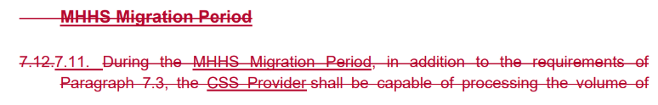
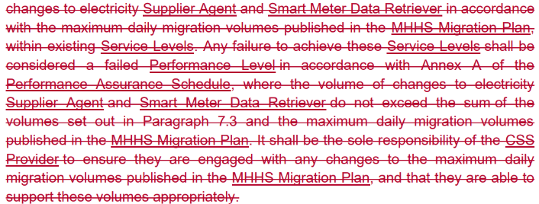
I0325 – CSS Service Definition
Updates
1 impacted paragraph
  Removing reference to the MHHS Migration Period

Slide 22
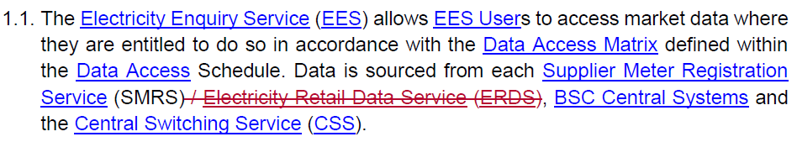

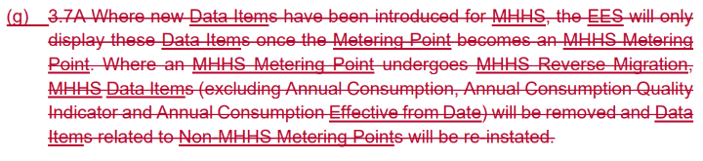
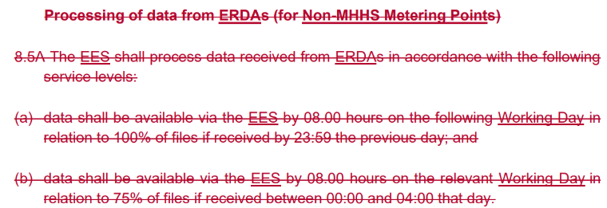
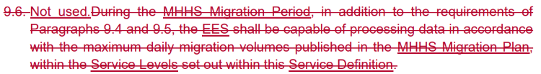
I0325 – EES Service Definition
Updates
14 impacted paragraphs
  Removing references to the ERDS and the ERDA
  Removing reference to the MHHS Migration Period
Subparagraph 3.7 (g) will not be removed. MHHS indication will remain until technical updates are made to EES
Notes:
Paragraph 2.3 for number (e)

Slide 23
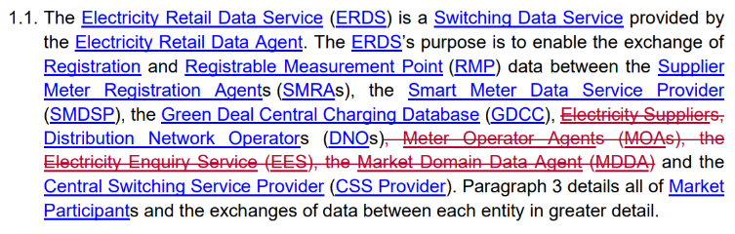
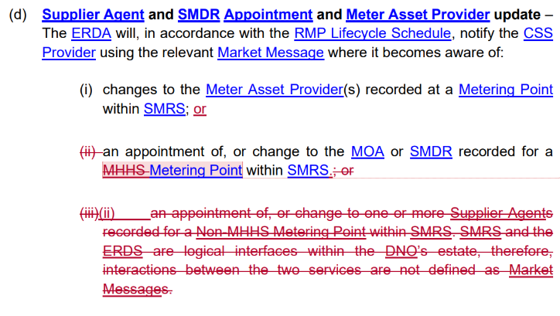
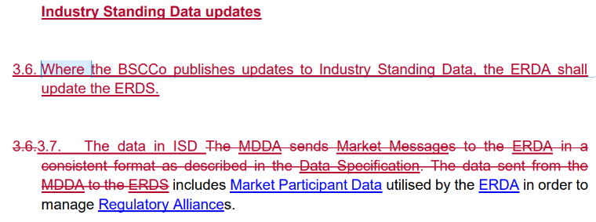
I0325 – ERDS Service Definition
Updates
12 impacted paragraphs
  Removing Electricity Suppliers EES, MOAs and MDDA from the list of ERDS Users as Related Metering Point interactions move to the SMRS via the DIP
  Removing ‘non-MHHS Metering Points’ and ‘MHHS Metering Points’ references
  Removing references to Market Domain Data and replacing them with Industry Standing Data

Slide 24
I0325 – Post-MHHS Full Transition Complete (M15) REC updates
CHIG Consideration
Do you agree with the amendments made so far?
Do you have any further thoughts about amendments that need to be made?
Next steps
Solution development target is now likely to be mid-November 2026 where this Issue will
move to a Modification.
Clear view of R0325 scope.
Out of scope sets will progress separately.
Consultation to be progressed in license Code Manager arrangements.

Slide 25
5. R0095 - Changes to allow DNOs to reinstate disconnected MPANs
Finn deacon

Slide 26
Reminder of what r0095 addressed in 2023 pre MHHS
Post CSS go-live, reinstatements cannot be made where the Supplier has submitted a Registration Deactivation to CSS. MPANs that are erroneously disconnected post CSS go-live now rely on the Supplier not setting the status to ‘inactive’ following DNO disconnection of the MPAN.
However, there have already been cases where Suppliers have already submitted a deactivation of the registration of the MPAN. This means that the DNO is required to create a new MPAN, and the Customer has to register the new MPAN with a Supplier.
Problem statement
In Scope
A mechanism whereby erroneously disconnected MPANs can be reinstated without any loss in supply continuity for either the Registered Supplier, the DNO/iDNO, and the Consumer
Progress limited due to MHHS Change Freeze
Now assessing 2026 suitability + business case

Slide 27
R0095’s place in 2026 in the world of MHHS
MHHS has made disconnection a 2-stage process
1
2
LDSO Disconnection which notifies SMRS
SMRS publishes IF/PUB-009 to relevant parties
CSS Registration Deactivation
After successful deactivation, SMRS sends de-appointment / de registration
There is now an explicit MPANReconnection event before Registration Deactivation, with a Supplier obligation to receive and maintain it.
This means that the problem that existed in 2023 is heavily reduced.

Slide 28
Issue still to be resolved
What happens when the error is discovered only after Registration Deactivation has completed?
There is a key gap still here that R0095 could be the solution for

Slide 29
Ask of Chig
Do Erroneous disconnections still reach completed CSS Registration Deactivation before the error is detected?
How often and to what detriment?
Does the current option to use MPANReconnection before disconnection currently work for parties?
Is there any current REC/BSC/CSS mechanism that restores the original registration after deactivation which we haven’t identified?
Does CHIG think that R0095 should be re-scoped to post-deactivation reinstatement? Is there enough of a problem to justify pursuing a solution? Think about business case here.

Slide 30
6. I0335 - Introduction of Defined Electricity Metering Work Categories for Metering Accreditation
Poppy mullins

Slide 31
I0335 – Introduction of Defined Electricity Metering Work Categories for Metering Accreditation
Background
The Consolidated Metering Code of Practice (CoMCoP) does not currently include defined work categories for electricity metering accreditation but does set specific work categories for gas metering
This Issue seeks to introduce defined electricity metering work categories within CoMCoP for electricity metering and related activities to ensure the scope of activities, and any changes to, are recorded for Meter Operator Agents (MOAs) and Electricity Metering Operatives (EMOs).

Slide 32
I0335 – Introduction of Defined Electricity Metering Work Categories for Metering Accreditation
Solution approach
Use established electricity metering classifications to input into defining the new electricity metering work categories
Assign the electricity work categories to the relevant metering activities in CoMCoP

Slide 33
I0335 – Introduction of Defined Electricity Metering Work Categories for Metering Accreditation
Work Category | Installation Details | Scope
Category A | Whole Current Single Phase | Metering works on a whole current 230v nominal supply and maximum fuse rating of 100amps
Category B | Whole Current Single Phase off Polyphase | Metering works on a single phase whole current meter connected to a polyphase supply
Category C | Whole Current Polyphase | Metering works on a whole current 400v nominal supply and maximum fuse ratings of 100amps
Category D | Safe Isolation Provider (SIP) | SIP Specific Activity Only - Withdrawing and reinserting cut-out fuses on Whole Current Supplies with fuse ratings not exceeding 100amp
Category E | Low Voltage (LV) Current Transformer (CT)/Voltage Transformer (VT) Metering Installations | Metering works on Current Transformer metering arrangements not exceeding 1000v
Category F | High Voltage (HV) CT/VT Metering Installations | Metering works on Current Transformer metering arrangements exceeding 1000v

Slide 34
I0335 – Introduction of Defined Electricity Metering Work Categories for Metering Accreditation
CHIG Consideration
Do you have any objection to reinstating and clearly defining the existing electricity metering classifications?
Do you have any objection on the proposed electricity metering work categories?
Do you have any objection on the proposed labelling approach for the electricity work categories?
Do you consider the proposed categories to be complete? If not, please identify any additional categories that should be considered for inclusion and provide the rationale for your response.
Do you have any other comments you would like to add?

Slide 35
7. I0341 - Improved Validation for DI51599 - Electricity Smart Meter Equipment (ESME ID)
Harry firth

Slide 36
I0341 – overview
Issue
This REC Issue looks at the Electricity Smart Meter Equipment (ESME) ID data stored in the Metering Point Registration System (MPRS).
This is preventing Metering Services from accepting IF-033 appointment requests due to an invalid ESME ID.
The Code Manager believes that a solution will require a cross-code Change to update the ESME ID validation rules. Potential solution options include updating these validation rules within the Supply & Meter Registration Service (SMRS), which falls under BSC, or the Data Integration Platform (DIP) rules.
Proposed Solution
Impact
The currently appointed Metering Service is required to correct the data via an IF-005. EES is displaying these invalid ESME IDs.
Scale of issue: 100s
There is a discrepancy from the validation of ESME IDs in DCC.

Slide 37
I0341 – Points for Discussion
CHIG Consideration
Do you think that an amendment to the ESME ID validation rules is required?
What impacts do you foresee for your organisation?
Which solution option would you prefer?
  Updates to SMRS – BSC impact
  Updates to DIP rules – DIP manager impact

Slide 38
8. Issue tracker updATE
CHANGE TEAM

Slide 39
Issues tracker
Issue/ CP | Title | Lead | Update
I0278 | Establishing the Safe Isolation Provider (SIP) as a Standalone REC Party | Francine Peyroux-Sissoko | The fourth closed working group session took place on 18 August 2026 where members focused on the theme of equipment, testing and sealing methodology. The next closed working group session will take place on 06 October 2026 where members will continue to consider the solutions needed to establish a strong governance framework for standalone SIPs.
I0297 | Meter Manufacturers Make and Type not Populated in SMRS | Flo Monea | On 30 September, the REC Technical Expert Panel approved an Update to Plan and to place I0297 on hold pending M15 completion.
I0314 | Crossed Meters Process: Clarifications and Support | Flo Monea | The Code Manager is in the process of drafting the Guidance document. An update to CHIG will be postponed until the transition to the new arrangements of Code Reform is complete.
I0318 | Introduction of Consumer Consent Solution | Harriet Truss | REC Drafting Consultation was published on 07 September, closing 9am on 19 October. Webinar held on 29 September, resources can be found on RECCo website. Updated Proposal Plan approved by Change Panel on 30 September. Updates reflect the REC drafting consultation date and the associated impact to plan as well as anticipatory planning to align to governance under the Code Manager license, which is expected later in the year.
I0273 | Sharing of SSC and TPR Information for MHHS Smart and Advanced Meters | Bela Ashworth | The Code Manager engaged with the BSC to discuss raising a consequential BSC change to facilitate the use of the SSC for non-Settlement purposes, with amendments proposed to the IF-025 and BSCP706. The BSC Issue is currently being drafted.

Slide 40
9. Any other business

Slide 41



Share your feedback with us. Your insights help us continuously improve and deliver the high-quality services you expect.
2026 Annual Committee Survey
Change Issues Group (CHIG)
https://online1.snapsurveys.com/hjh0ut?_cat=hcajaca
Scan the QR code and have your say.
on behalf of
This survey is run independently by Researchcraft. Your responses are confidential and anonymous unless you choose otherwise.

Slide 42
Next meeting: 05 November 2026
Thanks for attending

