Slide 1
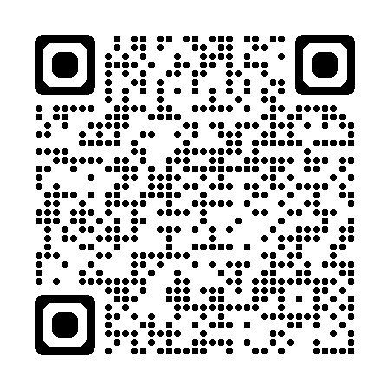
Have your say: our Annual Stakeholder
Satisfaction Survey is Live
Your voice matters. Our Annual Stakeholder Satisfaction Survey is now open, allowing you to share direct feedback on how we’re managing the Retail Energy Code (REC) Services.
Why participate?
This is your chance to tell us what’s working well in how the REC Change Panel operates, and where we need to improve.
Your feedback will directly shape our priorities for 2026–27.
Our main Annual Satisfaction Survey has also been launched. Please look out for an email from Researchcraft in your mailbox (researchcraft@qrs-research.net).
All responses are completely confidential, and results will be shared in early 2026.
https://online1.snapsurveys.com/l9blyt?Q1a=Change

