Slide 1
REC Tariff Interoperability Implementation Working Group
23rd June 2026

Slide 2
Agenda
AGENDA ITEM | PRESENTER
Welcome & Introduction | Chair
Confirmation of Agenda | Chair
Testing Approach and Plan | John Aung
Tariff Interoperability Change Log | Nizar Hamood
Tariff Interoperability Query Tracker | Chris Stock
Q&A | Chair
AOB | Chair

Slide 3
Action Log
Ref | Action | Update | Status
RECIWG_26_0326_02 | RECCo to engage with the Performance Assurance Board (PAB) to confirm the appropriate assurance approach for Phase 1a. | RECCo reviewed the approach for party operational readiness for go-live and enduring performance assurance requirements at the 02 June PAB meeting. See RECPAB_26_0602_04 and RECPAB_26_0602_04A here. There were no material comments on the approach. RECCo has now published the Phase 1a Test Approach and Plan for industry review and I0323 - Tariff Interoperability Phase 1a; Supplier Performance Assurance Requirements, which proposes changes to the REC Performance Assurance Report Catalogue, was subsequently issued for Party Impact Assessment on 04 June 2026 with a closing date of 26 June 2026. | Propose to close

Slide 4
Testing Approach and Plan

Slide 5
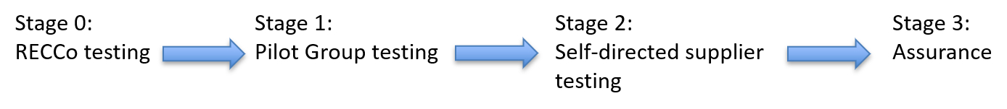
Testing Approach & Plan
Objective -
Validate End to End Testing
Ensure Supllier Readiness for Go Live ( Feb 2027)
Support testing of RECCo developed products (TI Supplier Register, TI Validation Tool and TI Monitoring)Tool)
Support TI Users testing before Go-Live
Approach -
Phased delivery to de-risk go –live
Pilot validates design before scale
Suppliers self-test standard workbook
Assurance via director assurance
Tariff Interoperability Hub - REC Portal - Link to the Test Approach and Plan

Slide 6
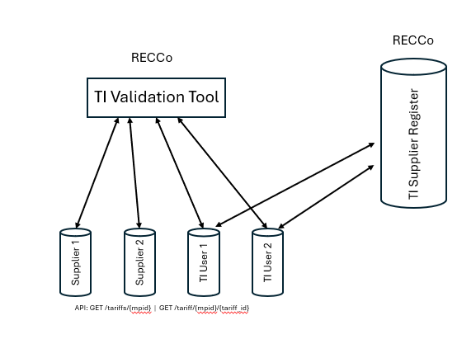
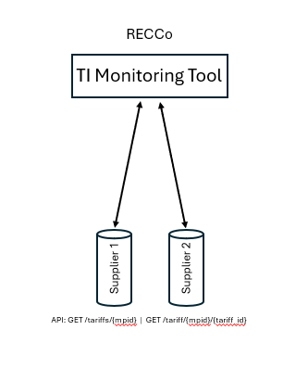
Testing Approach & Plan
Key Principles
Industry led model
Central Tooling (TI Suppler Register, TI Monitoring Tool, TI Validation Tool)
Pilot stabilises design before scale

Slide 7
Testing Approach & Plan
Assurance, Controls & Risk Management
Assurance Model
Suppliers' accountability via Direct sign-off
No Sev 1-2 defects at key gates
Evidence retained by suppliers
Controls
Pre-live endpoint validation via monitoring tool
Central defect management
Governance oversight (RECCO, DESNZ)
Risk Mitigation
Pilot reduces design risk
No Sev 1-2 defects at stage exit
Supplier standard test workbook ensures consistency
  Inclusion of TI User test workbook to be determined
Outcome
Scaleable, low botleneck model
Clear go/no-go confidence

Slide 8
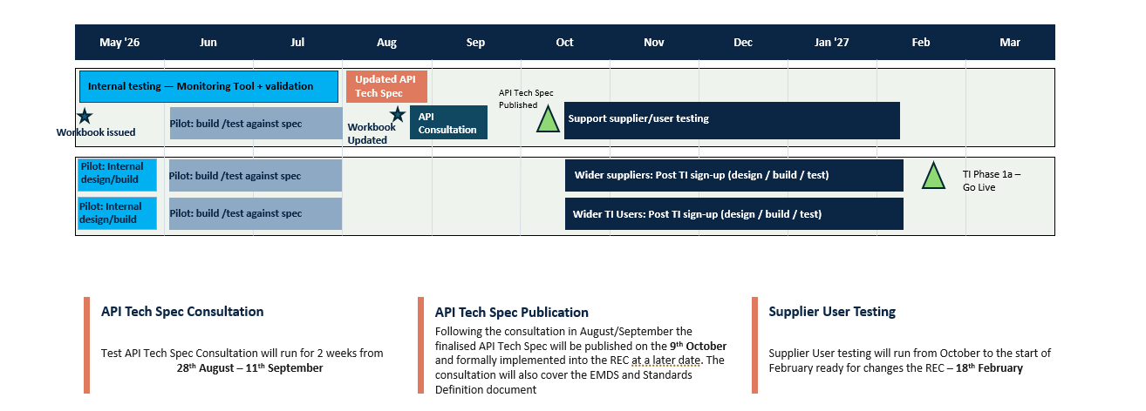
Testing Approach & Plan

Slide 9
Tariff Interoperability Change Log

Slide 10
Tariff Interoperability Change Log
API Versioning
CURRENT APPROACH
Header-based versioning. The version is carried in the HTTP header, enabling version-based routing and management of active / default versions at the gateway.
ALTERNATIVE RAISED — IWG
Path / URL-based versioning (e.g. /v1/…) has been put forward as the alternative. Both header and path support routing; they differ mainly in visibility and how the version is requested.
VIEW
Caching applies equally to either approach, so it does not favour one. Version filtering only filters the spec, not live API consumption. Header is preferred for routing and version control — the genuine choice is header vs path.
FOR IWG
Confirm header-based versioning as the standard, or is there a case for path / URL-based versioning?

Slide 11
Tariff Interoperability Change Log
LDZ Region
CURRENT RULE
LDZ Region is mandatory for all gas tariffs; GSP Group Id is reserved for electricity tariffs (conditionality applied in both the Get Tariffs and Get Tariff Details responses).
RAISED
Suppliers do not always price gas by LDZ; some use GSP Group. A blanket “if gas, populate LDZ” condition does not reflect how their tariffs actually vary.
IMPLICATION
GSP Group is not currently available to populate against a gas tariff, so the regional-identifier conditionality is too rigid to cover real pricing structures.
QUESTION
How should the conditionality flex so the correct regional identifier — LDZ Region or GSP Group — is populated based on how the tariff actually varies?
Does the approach differ between domestic and non-domestic tariffs?

Slide 12
Tariff Interoperability Change Log
Regex Validation
POSITION
Regex validation will not be mandated. Field formats follow the existing REC standards set out in the Energy Market Data Specification.
RAISED — MULTIPLE TIMES
Request to mandate regex validation of field values within the TI arrangements.
RATIONALE — PER GOVERNMENT RESPONSE
Existing REC / EMDS standards already apply, as the TI arrangements are introduced into the REC.
Mandating regex would add unnecessary processing overhead at scale and a maintenance burden on users.
Where the intent is validation, that is for suppliers and TI Users — RECCo is not required to carry it out.
Regex opens security considerations that are for suppliers and TI Users to determine for themselves.
STATUS
Rejected — consistent with the published government response. No change to the spec.

Slide 13
Tariff Interoperability Change Log
Polymorphism
CURRENT SPEC
Response fields vary by fuel type through prose and conditionality rules (e.g. LDZ for gas, GSP for electricity). The message structure itself is fixed.
RAISED — IWG
Formalise polymorphism so the returned structure varies by context — fields included or excluded depending on whether the request is gas or electricity.
IMPLICATION
May sharpen validation, but adds supplier build complexity and lands late in the delivery cycle when suppliers are already building.
QUESTION
Is structural polymorphism worth the additional supplier build effort at this stage, or is the existing conditionality sufficient?
Decision pending — view to be formed ahead of design-authority sign-off.

Slide 14
Tariff Interoperability Change Log
Economy 7 / Time-of-Use
CURRENT SPEC
Static-rate tariffs carry time_from / time_to segments within the rates array. No explicit identifier marks a tariff as Economy 7 or time-of-use.
RAISED
How should Economy 7 be represented? The suggestion was to add an API field to flag it explicitly.
IMPLICATION
Time-of-use tariffs (e.g. a separate, cheaper overnight rate) need to be unambiguously identifiable and modelled within the existing rates structure.
QUESTION
Given the current rates structure, how is Economy 7 / time-of-use best accommodated — an explicit identifier, or the existing time-segment and type-of-use fields?

Slide 15
Tariff Interoperability Query Tracker and updates on questions from previous IWG

Slide 16
Tariff Interoperability Query Tracker – June 2026
RECCo has reviewed and responded to queries raised during the session and through the project mailbox. Responses have been captured in the Query Tracker, with the majority now actioned or closed. A small number remain subject to further technical or policy clarification.
THEME | DETAIL | RESPONSE
Technical Artefacts | Questions raised regarding Government Response dependencies, Phase 1b impacts and technical change tracking. | Suppliers should continue building against the published Phase 1a API specification. No material changes are expected, with future updates limited to defect fixes or significant issues identified through testing.
Testing & Assurance | Queries around test workbooks, evidence requirements, attestation and simulation capability. | Phase 1a remains based on supplier self-testing supported by management/director attestation. Further guidance and validation capabilities will be provided through the Test Approach.
Tariff Updates & Notifications | Questions raised regarding tariff versioning, future tariffs and event notifications. | Phase 1a uses tariff identifiers and last_modified values to support change detection. Event notifications and webhook capabilities are being developed as part of Phase 1b and CCS integration.
Future Tariff Publication | Suppliers highlighted scenarios involving commercially sensitive future tariffs. | Current expectation is that tariffs should be exposed at least 60 minutes before they become available to customers. Additional guidance or change proposals may be considered if this becomes a wider industry concern.
Non-Domestic Obligations | Questions raised regarding exemptions and suppliers crossing the 100k meter threshold. | Further guidance is being developed with DESNZ. No formal grace period applies, although Ofgem has indicated it would take a proportionate approach to compliance and derogations remain available.

Slide 17
Tariff Interoperability Query Tracker – May 2026 update
Queries raised at previous IWG sessions have been reviewed and updates have been captured in the Query Tracker. Several actions have now been completed, with remaining items continuing to inform ongoing design and guidance activities.
Full responses and updates are available within the Query Tracker.
THEME | UPDATE
Testing & Assurance | Test Approach and Plan developed and due for publication. Validation and simulation capabilities incorporated into the emerging approach.
CCS Alignment | Phase 1b alignment with CCS confirmed, with joint design activities now underway.
Technical Artefacts | YAML and OpenAPI specifications published to support supplier build activities.
Payload Guidance | Clarifications incorporated into the latest technical artefacts and examples.
Outstanding Topics | Optional participation, development support and complex tariff scenarios continue to be refined through ongoing engagement.

Slide 18
Questions

Slide 19
AOB

