Slide 1


Implementation Working Group· 18 August 2026
Tariff Interoperability
Targeted Technical Consultation Overview

Slide 2
IWG | Agenda
Agenda
AGENDA ITEM | PRESENTER
Welcome & Introduction | Chair
Confirmation of Agenda | Chair
Action Log | Secretariat
How the documents evolved and Consultation Scope | Paul Crorken
Annex B: API Technical Specification | Nizar Hamood
Annex C: Energy Market Data Specification | Andrew Wallace
Annex D: Standards Definition Document | Andrew Wallace
Consultation Next Steps | Paul Crorken
Pilot Testing Update | Nizar Hamood
AOB | Chair

Slide 3
IWG | Action Log
Action Log
Ref | Action | Update | Status
RECIWG_26_0326_01 | RECCo to provide an update on indicative Phase 1b timelines following publication of the CCS consultation response. | TI Phase 1b will follow the CCS consultation and will launch at the end of October 2026 for 6 weeks. Publish Government Response to Consultation – Early March 2027. Supplier Build and Test – March 2027 – September 2027. Phase 1b Go Live – November 2027. | Propose to close.
RECIWG_26_0623_01 | Code Manager to post questions into a post-meeting email. RECIWG Members to provide feedback by 03 July 2026. | Code Manager has sent out an email and feedback has been received. | Propose to close.
RECIWG_26_0623_05 | RECCo to circulate webinar details and include links in post-meeting communications. | Code Manager attached the webinar details and link to the post-meeting communication. | Propose to close.

Slide 4
IWG | Action Log
Action Log
Ref | Action | Update | Status
RECIWG_26_0623_02 | RECCo to consider publishing a public-facing version of the API design decision log to support industry review. | Update Post IWG and published with post meeting papers. | Propose to close.
RECIWG_26_0623_03 | RECCo to engage with suppliers with a possible request for information to assess the prevalence and implications of using GSP for gas tariffs. | Engagement with suppliers and update to API Spec set out in IWG Slides. | Propose to close.
RECIWG_26_0623_04 | RECCo to gather further evidence and use cases on Economy 7 requirements and provide additional clarification. | Example payloads developed and will be issued with post meeting papers. | Propose to close.

Slide 5
IWG | Purpose, scope and how to review
How we got here
November 2025
DESNZ and RECCo consulted on Tariff Interoperability proposals covering both the public and consumer-specific routes.
May 2026
The Government Response confirmed phased implementation. A Phase 1a-only technical baseline was published, with Phase 1b content removed for separate development.
May – July 2026
Industry engagement, detailed review and pilot testing identified a small number of Phase 1a refinements.
Current Consultation
A targeted review of three principal technical changes and associated editorial or consistency updates before finalisation

Slide 6
IWG | Purpose, scope and how to review
Scope and how to review
The consultation covers the technical documents needed to operate Phase 1a. It does not reopen the May 2026 policy decision or the obligations in Electricity Supply SLC 11C and REC Schedule 35.
Letter & Annex A
Annex B
Annex C
Annex D
Purpose, scope, response route and consultation questions.
API technical specification and changes since the May 2026 baseline: Three principle API clarifications
Data items, market messages and conditionality rules and changes since the May 2026 baseline.
Standards definition changes for TI API messaging and changes since the May 2026 baseline.
What is not in scope
The policy decision, SLC 11C, REC Schedule 35, implementation phasing or Phase 1b

Slide 7
IWG | Overall purpose
Planned consultation timing
18 May 26
17 Sept 26
Aug 26
Nov 26
18 Feb 27
Elec Supply SLC 11C and
REC Schedule 35 live; Technical Baseline
IWG
Consultation Close
REC release
Phase 1a
go-live
May – July 26
27 Aug 26
29 Oct 26
8 Jan 27
Pilot Testing and Industry refinement
Consultation
planned to open
Government
Response (Decision)
Testing Attestations and
Assurance
Working assumption
If a material issue is raised during consultation
Continue build and test against the May 2026 baseline while reviewing the proposed changes.
Assessment to determine if a fix is required ahead of TI Phase 1a Go-Live

Slide 8
Annex B: API Technical Specification

Slide 9
IWG | Annex B
API: change summary
Annex B describes the physical API standard. The consultation propose three principal technical clarifications to the May 2026 baseline, with consequential changes to the EMDS and Data Standards addressed in later slides. They are incremental refinements rather than a redesign of Phase 1a.
Change
Area
Proposed update
CHG-015
Static and dynamic rates
Separates rate structures so the OpenAPI/YAML can validate the correct fields.
CHG-018
Gas regional fields
Clarifies when GSP Group ID or LDZ Region is populated for gas tariffs.
CHG-019
Block tariff bands
Clarifies that min_kWh and max_kWh apply only to block tariffs.
Review focus
do these changes create any defect, inconsistency or implementation impact affecting build, testing or interoperability?

Slide 10
IWG | Annex B
CHG-015 static and dynamic rates
The May 2026 baseline described rates as one general-purpose structure. Feedback and testing showed that static and dynamic tariffs need different rate fields.
Before
Consultation version
Effect
One rates structure, with written guidance explaining which fields should be populated.
The rates object is split into rate_static and rate_dynamic in the OpenAPI definition.
Systems can validate payloads against the specification rather than relying on prose.
Review Focus
Rate data should match either the static or dynamic structure. The returned rates object and field names do not change.

Slide 11
IWG | Annex B
CHG-018 region code conditionality
This change corrects the rule for geographic tariff variants for gas tariffs. It clarifies which existing field is populated; it does not require Suppliers to change how tariffs are priced or regionalised.
Rule described in the draft
What is unchanged
Use gsp_group_id where GSP Group ID distinguishes a gas tariff variant.
Use ldz_region where LDZ Region distinguishes a gas tariff variant.
If a gas tariff is not regionally differentiated, neither field is required.
No API field is added, removed or renamed.
The payload structure is unchanged.
Suppliers are not required to re-price or re-regionalise tariffs.
Mapped to Annex C
The same conditionality is applied to LDZ Region and GSP Group ID in MMXXXX5 and MMXXXX7.

Slide 12
IWG | Annex B
CHG-019 usage-band fields
Testing showed that usage-band fields could be populated inconsistently. This proposal makes the intended use explicit.
For block tariffs
For other tariffs
Specification effect
min_kWh and max_kWh define the usage band where the unit price changes. max_kWh can be omitted on the final block where there is no upper limit.
The usage-band fields should be omitted.
No structural API change. The rule is made clearer in field descriptions and EMDS conditionality.
Review Focus
Review test data for non-block tariffs and final blocks of block tariffs.

Slide 13
Annex C: EMDS Changes

Slide 14
IWG | Annex C
EMDS: change summary
Annex C updates the Data Item Catalogue and Market Message Catalogue. Ten updates are proposed to the May 2026 baseline. Several changes are linked to the API Changes, some are editorial/ data quality corrections.
No. | Area | Proposed update
1 | TI YAML names | Add TI-specific YAML name to 'Data Item Notes' for five existing data items where the TI API uses a different YAML name format.
2 | Sellable To | Item Description minor update to improve wording.
3 | Company Legal Name | Correct the decimal length from 200 to 0
4 | Tariff Days | Add data item enumerations. These match the API specification (All, Monday, Tuesday, Wednesday, Thursday, Friday, Saturday, Sunday).
5 | Tariff Days | Update conditionality – Suppliers populate MMXXXX7 for static tariffs only (dynamic tariffs use datetime)
6 | LDZ Region | Update conditionality - Suppliers populate in MMXXXX5/7 where used to distinguish gas tariff variants (reflects CHG-018).
7 | GSP Group ID | Update conditionality - Suppliers populate in MMXXXX5/7 where used to distinguish gas tariff variants (reflects CHG-018).
8 | Block tariff bands | 'Tariff from kWh' and 'Tariff to kWh' only populated for block tariffs, and 'Tariff to kWh' not used for final block (reflects CHG-019).
9 | API Route | Added the API route for each TI Market Message, previously marked TBC. The route specifies the URL path only.
10 | API Method | Added or updated the API method for TI market messages using 'GET' for API requests and 'N/A' for API responses.

Slide 15
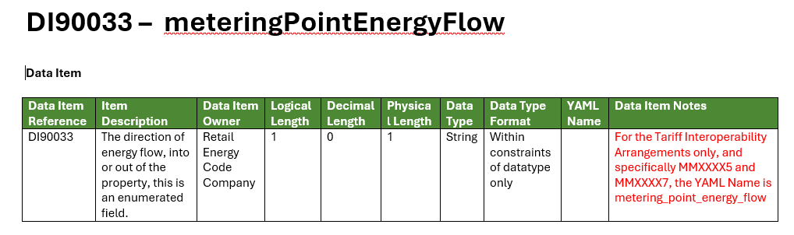
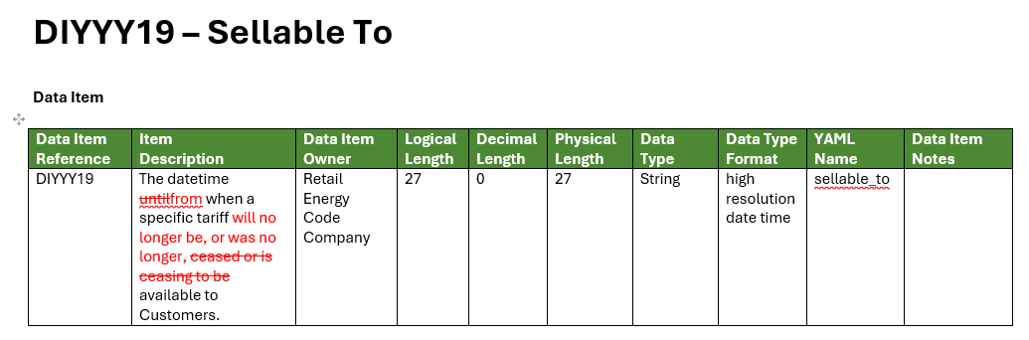
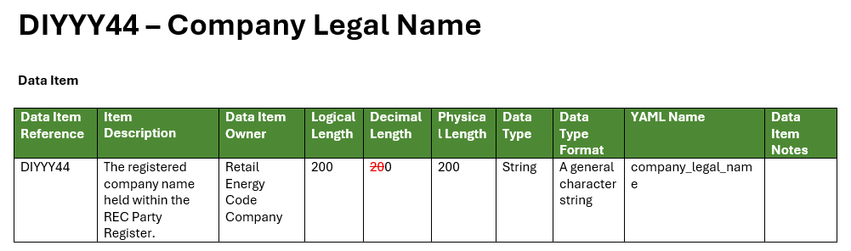
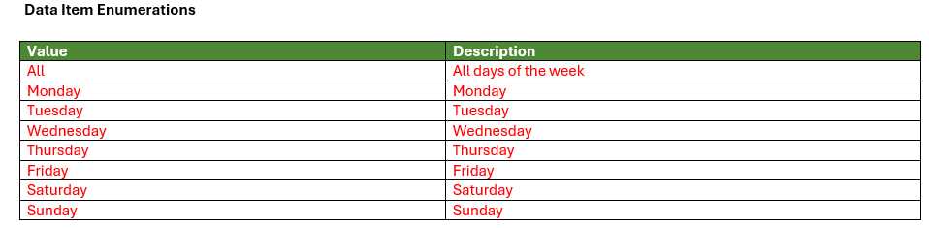
IWG | Annex C
EMDS changes #1
Change 1 – Update TI YAML notes in existing Data Items
Change 2 – Update Item Description for clarity
Change 3 – Update Decimal Length
Change 4 – Add enumerations for Tariff Days

Slide 16
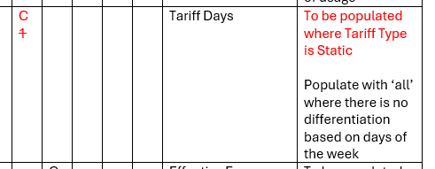
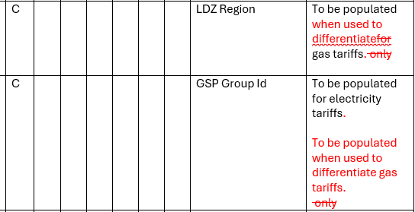
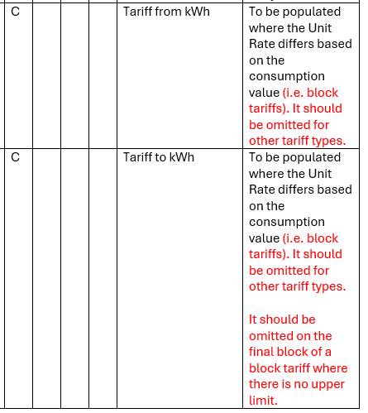
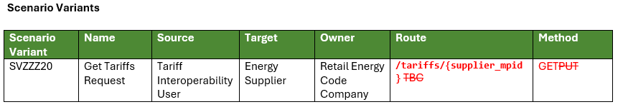
IWG | Annex C
EMDS changes #2
Change 5 – Update conditionality rules for Tariff Days
Change 6 and 7 – Update conditionality rules for gas tariffs
Change 8 – Update conditionality rules for block tariffs
Change 9 and 10 – Addition of API Route and Method in Market Messages

Slide 17
Annex D: Standards Definition Document

Slide 18
IWG | Annex D
Standards Definition Document: change summary
Annex D updates the REC Standards Definition Document so TI API messages, roles and message means are recognised in the REC data framework. Two incremental changes are proposed to the May 2026 baseline
Change
Area
Proposed update
1
Paragraph 2.6
YAML Name description no longer limited to DIP messages. It can support TI API market messages.
2
Paragraph 2.14
Correction from 'TI Register' to 'TI Supplier Register' to match the use of that term in Schedule 35 and the EMDS.

Slide 19
Consultation Next Steps

Slide 20
IWG | Consultation Question
How consultation responses should be framed
The annex questions use the same basic test. Responses should identify technical implementation issues, not restate policy positions already decided in May 2026.
Does the Phase 1a technical package and/ or proposed updates contain any defect, inconsistency or blocker that could prevent implementation?
A response should include:
1. Location
2. Evidence and Impact
3. Proposed Resolution
Affected annex, section, endpoint, field, data item or market message.
Why it is a blocker or defect, including the build or testing impact.
Suggested wording, rule, technical change or clarification.

Slide 21
IWG | Next Steps
Preparing for Consultation
The aim is to make the short consultation window manageable once the formal documents are issued.
Route the pack internally
Compare against build plans
Prepare evidence
Identify who needs to review the API, EMDS and standards changes.
Check whether the proposed changes affect development, testing or assurance activity.
Where an issue is found, capture the exact location, impact and suggested resolution.
Output from IWG
Early clarity on any areas that may need explanation before the consultation opens.

Slide 22
IWG | Wrap-Up
Key takeaways and next steps
The September consultation is a targeted technical consultation before the documents enter the REC release and go-live preparation completes. Phase 1b is outside of scope.
Stage
Next step
What changes
Now
IWG reviews the pack structure and prepares internal review routes.
API clarifications
EMDS data updates
Standards Definition changes
August 26
DESNZ issues the consultation; three-week response window.
October 26
DESNZ and RECCo assess responses and confirm final changes.
November 26
Technical documents are implemented ahead of Phase 1a go-live.
Policy scope is unchanged.
Any ambiguity that may slow review or lead to inconsistent responses?

Slide 23
Pilot Testing Update

Slide 24
IWG | Consultation Question
Pilot Testing Update
What we tested
GET Tariffs
Returns the list of available Tariff Ids with summary attributes (tariff type, fuel type, region, payment method).
GET Tariff Details
Returns full Tariff Pricing Data for a specific Tariff Id, including standing charge, unit rates and rate validity periods.
Tariffs tested
✓
Static
✓
Dynamic
✓
Gas
Time-of-day unit rates that do not change over time, validated against the static rate structure.
Unit rates that change over time, validated against the dynamic rate structure and validity windows.
Gas tariff returned with the expected regional attributes and pricing structure.

Slide 25
IWG | Consultation Question
Next Steps for TI Energy Suppliers and TI Users
What happens next
1
2
3
TI Energy Suppliers (mandatory and opt-in) should continue to prepare for TI Phase 1A go-live.
The RECCo TI Test Manager has now been appointed.
RECCo will shortly confirm the final test pack for TI Energy Suppliers, and how Suppliers / TI Users can use the TI Monitoring Tool to support their testing.
4
5
RECCo will engage with Suppliers during September / October to confirm awareness, and that plans are in place to meet go-live requirements.
TI Energy Suppliers are required to provide a director-signed attestation by 8 January confirming that all required testing has been completed.

Slide 26
Any Other Business

Slide 27
AOB | R0323 Consultation
R0323 Tariff Interoperability Phase 1a –
Supplier Performance Assurance Requirements
Update proposed to the REC Performance Assurance Report Catalogue (PARC):
  Require TI Energy Suppliers to provide a monthly report on their TI performance and ad hoc report on error messages,
  Require all Suppliers to provide ad hoc report on tariffs that cannot be accommodated by the TI API schema design, and
  Document TI Monitoring Tool information collection
I0323 issued for Impact Assessment on 05 June 2026 and three responses were received by 26 June 2026
Issued for Consultation on 13 Aug 2026 and responses requested by 07 Sept 2026
Tariff Interoperability Phase 1a; Supplier Performance Assurance Requirements
Aim is to seek REC PAB approval on 29 Sept 2026
Action
Stakeholders requested to provide consultation responses by 07 Sept 2026

