Slide 1
REC ISSues group
10 February 2023

Slide 2
1. Introduction and agreement of agenda
Paul Witton-Dauris

Slide 3
Agenda For today
 | Agenda Item | TIME | LEAD
1 | Introductions and agreement of agenda | 10:00 | Chair
2 | Data Cleanse update - Data Cleanse issues log | 10.05 | Performance assurance team
3 | April 2023 REC release and Metering Code of Practice Consolidation | 10.40 | REC Release Manager
4 | Code Road Map | 11.00 | REC
5a | RIG Issues Update – Issue 02 Theft Incentive Scheme – reintroduction of scheme lock out date | 11.50 | Lead Analyst
5b | RIG Issues Update – Issue 07 EES API Specification | 11.55 | Lead Analyst
5c | RIG Issues Update – Issue 08 Should Shipper and Suppliers have the same view in GES, specifically the data items relating to meter read history? | 12.00 | Lead Analyst
5d | RIG Issues Update – Issue 09 DNO B Code Escalations – Where B code timeframes have exceeded 41 working days is there a way to escalate to the DBO? | 12.05 | Lead Analyst
5e | RIG Issues Update – Issue 10 R0021 questions on implementation | 12.15 | Lead Analyst
6 | Close | 13.00 | Chair

Slide 4
2. Data cleanse update – issues
REC performance assurance team

Slide 5
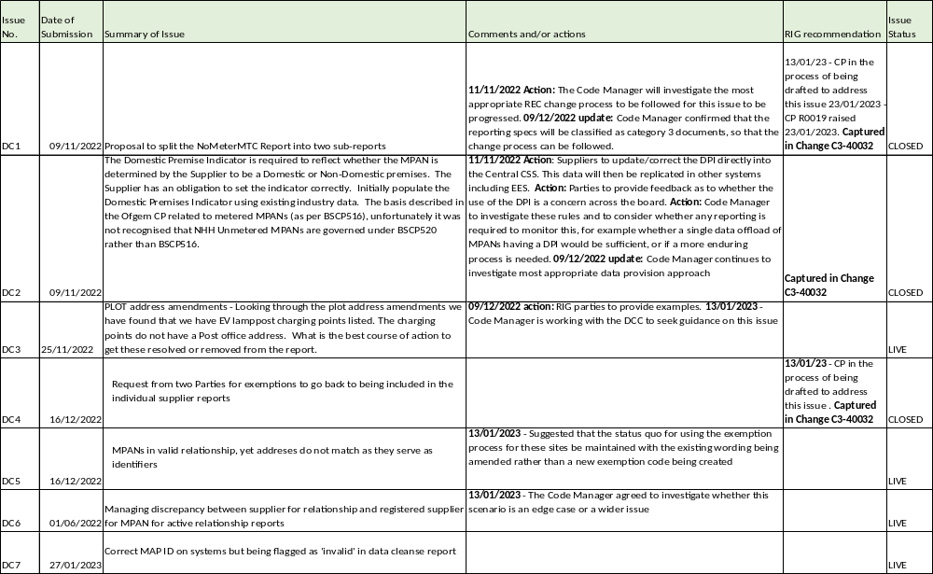
Data cleanse issues log

Slide 6
DATA CLEANSE cp UPDATE
Lewis Williams & Andrew waghorn

Slide 7
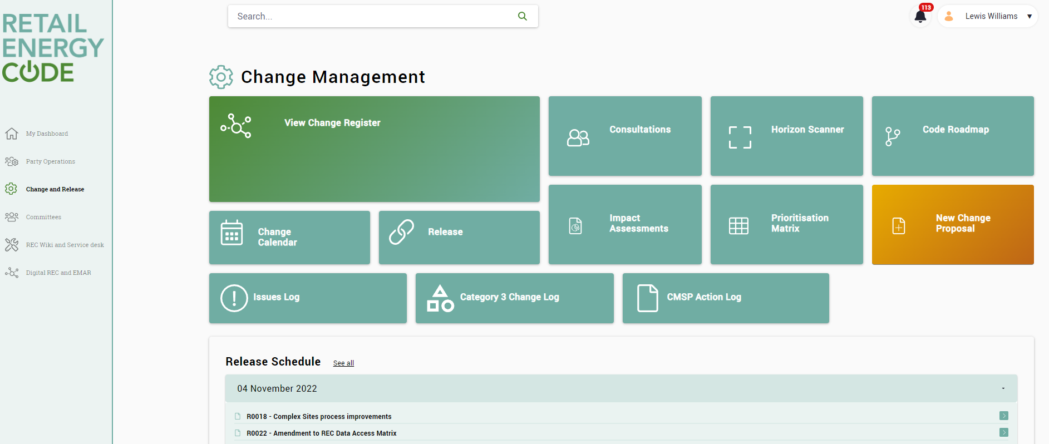
Change PROPOSAL C3-0042

Slide 8
Change PROPOSAL C3-0042
Summary
Addition of the Movement Report to the REC Performance Assurance Dashboard.
Separation of the No Meter MTC Report into two sub-reports.
Update to the process of dealing with exemptions, so that they remain included in the reporting but flagged as such instead – impacting all reports.
Update to the recipient of the Invalid Electricity MAP ID report to the Installing Supplier.
Addition of Active Relationship Domestic Premises Indicator (DPI) report (Report AR3F)
Addition of Unmetered Domestic Premises Indicator Report

Slide 9
DATA CLEANSE RESULTS UPDATE
Lewis Williams & Andrew waghorn

Slide 10
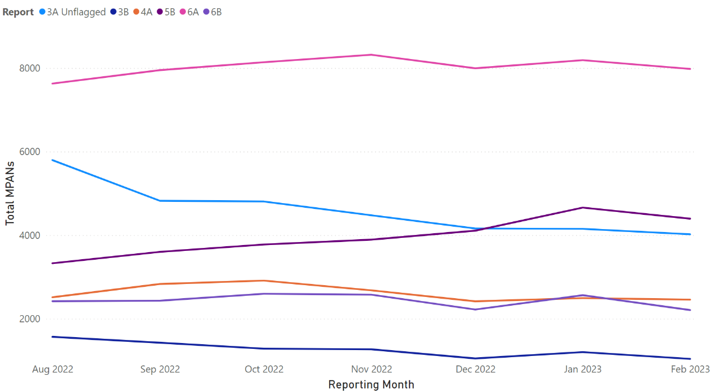
Update on MTC Reports
Summary
3A Unflagged has shown a small month-on-month decrease – 4,152 → 4,022
4A was the only report to show a month-on-month increase from January – 2,494 → 2,612
The 6-month trend for reports 5B and 6A remain as an increase - +29% and +3%, respectively

Slide 11
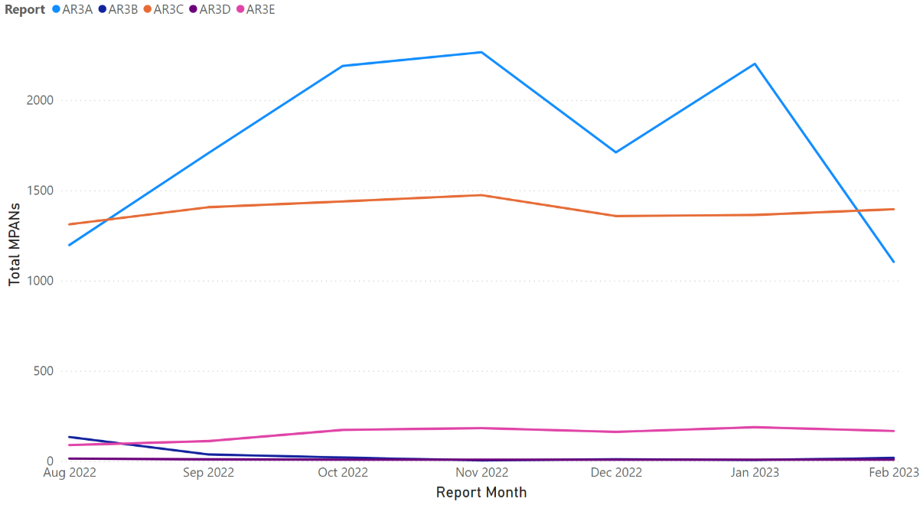
Update on ar reports
Summary
Significant month-on-month decline in AR3A, primarily driven by a high number of exemptions
AR3B increased from 6 → 18 total MPANs and 3 → 9 Primary
Primary MPANs in AR3D remain at 2
Increasing trend observed in AR3E over the past 6-months - MPAN count 111 → 188 and Primary MPAN count 42 → 71
* Graph displays total MPANs

Slide 12
Update on Non-rel Reports (1/2)
Report | Sep-22 | Oct-22 | Nov-22 | Dec-22 | Jan-23 | Feb-23 | 6-Month Trend
Meter Type Mismatch | 42,033 | 42,997 | 44,297 | 45,636 | 45,200 | 45,712 | +9%
No Meter MTC | 172,800 | 180,178 | 188,755 | 194,799 | 201,971 | 211,779 | +23%
Smart Meter Type/MTC Mismatch | 106,292 | 116,880 | 161,870 | 141,073 | 144,127 | 151,899 | +43%
Invalid MAP ID | N/A | 4,940 | 4,855 | 4,638 | 4,584 | 4,479 | -9%
Plot Address Energised (Supplier) | 20,779 | 20,194 | 20,477 | 23,848 | 24,238 | 22,066 | +6%
Plot Address De-Energised (Supplier) | 11,442 | 10,726 | 10,390 | 14,851 | 15,476 | 12,539 | +10%
Plot Address Energised (DNO) | 13,796 | 13,038 | 12,831 | 12,883 | 12,967 | 12,938 | -6%
Plot Address De-Energised (DNO) | 5,899 | 5,402 | 4,739 | 4,969 | 5,009 | 4,857 | -18%

Slide 13
Update on Non-rel Reports (2/2)
Report | Sep-22 | Oct-22 | Nov-22 | Dec-22 | Jan-23 | Feb-23 | 6-Month Trend
Disconnected MPANs/Active Relationships | 1,759 | 1,706 | 1,700 | 1,698 | 1,698 | 1,698 | -4%
Unrestricted SSC/Active Relationships Flag | 1,407 | 1,439 | 1,474 | 1,358 | 1,364 | 1,364 | -3%
Invalid Topline (Supplier) | 1,863 | 1,856 | 1,831 | 1,780 | 1,774 | 1,774 | -5%
Invalid Topline (DNO) | 32,589 | 33,046 | 36,163 | 33,860 | 34,300 | 34,300 | +5%

Slide 14
3. April 2023 REC release and Metering Code of practice consolidation
REC release manager

Slide 15
R0047 – consolidated metering code of practice & Metering Audit scheme
Communication & Engagement Plan | January 2023 |  | February 2023 | February 2023 |  |  | March 2023 | March 2023
 | W/C 23 | W/C 30 | W/C 06 | W/C 13 | W/C 20 | W/C 27 | W/C 06 | W/C 13 | W/C 20 | W/C 27
April Release
publish FAQs
Update FAQs
Registration live
Webinar
Publish video
Publish podcast
Item | Agenda
1 | Introduction
2 | Consolidated Metering Code of Practice (CoMCoP)
4 | EMAR demonstration
6 | Metering Audit Scheme
8 | MHHS Programme impacts on CoMCoP

Slide 16
4. Code road map
REC lead

Slide 17
REC code roadmap launch
10 February 2023

Slide 18
Agenda For today
Agenda Item
Introduction to the REC Code Roadmap
Overview of the roadmap contents
Feedback discussion
Next steps

Slide 19






Introduction to the rec code roadmap
Presents the priority work items that RECCo and the Code Manager are planning to progress over the next 3 years, and what should be achieved
Moves change away from disjointed individual Change Proposals to longer term more fundamental change for REC stakeholders including consumers
Provides a clearer big picture of change themes and certainty over the future direction of the REC arrangements
WHAT IS THE CODES ROADMAP?
Enables control of the pace and direction of change towards strategic priority areas
Changes can be prioritised, batched and delivered in logical, cost-effective order

Slide 20
Change topics
90 CHANGE PROPOSALS RAISED AS OF 26 Jan 2023
SOME LESS IMPACTFUL CHANGES PROGRESSED
Transitional issues
Directed change
REC party / stakeholder initiated
Code Manager / RECCo initiated
Cable colour
Processing requests for Site Technical Details
SUBSTANTIAL AREAS OF EFFORT ON CHANGE
NOTABLE GAPS
REC V3 / CSS
Metering
Prepayment
Theft
Net Zero
governance
commissioning
systems
data
SoLR
EMR
SDEP
ETs
MSC
metering
servicedesk
EES
energisation
smart
theft
MHHS
errors
CSS
housekeeping
settlement
registration
switching
V3

Slide 21

Roadmap content
Categories
Themes
Epics
RECCo’s strategy FWP items
Other areas for change
Epic statements
For – [stakeholder(s)]
Who - want …
Our – [product/service]
Is/are – [deliverable/standard]
That – [outcome]
Kanban style buckets – when work will start
0-3 mo / 3-6 mo / 6-12 mo / 12-36 mo
Done / not doing
Backlog

Slide 22
Codes Roadmap – categories and themes
Industry Processes
Consumers
REC Systems
Data & Digitalisation
Net Zero
Market Wide HH Settlement
Prepayment
Secure Data Exchange
Data principles and usage
Electric Vehicles *
Heat networks *
Next Day Switching
Priority Service Register *
CSS post go live review – known/early operation issues
Evolution of Enquiry and Database Services *
Hydrogen *
Supplier of Last Resort
CSS post go live review – discovery
Theft
REC Services Digitalisation and evolution
Third Party Intermediaries *
* RECCo FWP items

Slide 23
RECCo Forward work plan
2023/24
2024/25
2025/26
Data and Digitalisation
Theft Reduction Strategy
Market Wide Half Hourly Settlement Programme
Evolution of Enquiry and Database Services
Priority Services Register
Third Party Intermediaries
Net Zero RECCo
Code Reform
Transition to Next Day Switching
Electric Vehicles
Heat Network Governance
Hydrogen

Slide 24
INDUSTRY PROCESS
To Start
In Progress
Category
Theme
0 – 3 months
3 – 6 months
6-12 months
12 – 36 months
MHHS Settlement Procedures
That - the arrangements implemented for MHHS go live fully support live operations
MHHS Post go live review – discovery
That - improvements have been understood and solution options identified
Market Wide HH Settlement
Supplier of Last Resort
That - normal REC processes can continue as far as possible.
Industry Processes
Supplier of Last Resort
Theft - REC provisions
That - Stakeholders are clear on their obligations and understand how to comply, and theft is reduced / managed according to specified goals
Theft
Prepayment top ups
That - payments are allocated accurately and promptly.
Prepayment unallocated / misdirected
That - payments are allocated accurately and promptly.
Consumers
Prepayment
Prepayment infrastructure
That - ensures consumers are protected as the remaining population of legacy meters reduces.

Slide 25
Codes Roadmap
To Start
In Progress
Category
Themes
0 – 3 months
3 – 6 months
6-12 months
12 – 36 months
Category
Secure Data Exchange Portal Functionality Review
That - SDEP Users are supported in resolving queries.
Secure Data Exchange
CSS post go live review – known issues
CSS Post go live review - known issues
That – known/early operation issues have been understood prioritised and solutions options identified.
REC Systems
CSS post go live review - discovery
CSS Post go live review - discovery
That - improvements have been understood and solution options identified.
Access to EES and GES data
That - Stakeholders are confident access is as open as possible whilst consumer data is protected where necessary
Data principles and usage
Data & Digitalisation
Address quality
That - Stakeholders can rely on address data and understand what they need to do to preserve address quality
Digitalisation of Data Specification
That - industry information can be created, exchanged and understood/used effectively
REC Services Digitalisation and evolution
Digitalisation of Data Specification - MHHS
That - MHHS information can be created, exchanged and understood/used effectively

Slide 26

Proposals over 36 months
SDEP Review (Underway)
Prepayment
EES/GES access
CSS post go live- known issues
SoLR
Address quality
CSS post go live - discovery
0 month
3 months
6 months
12 months
36 months
Data Specification – MHHS
Streamlining the Data Specification
MHHS post go live issue discovery
Market wide Half Hourly
Theft
Change Proposals
  Releases to go ahead as planned
  Those with existing plans especially already in later stages, likely to continue as now
  New CPs will be raised and accepted in on basis of urgency / priority
RECCo FWP – Code Manager support and contribution

Slide 27








Roadmap process
Refreshed quarterly
Adjusted continuously as BAU
RECCo and the Code Manager run Epics as projects – plan and approach bespoke to the subject matter, including stakeholder engagement
Epic projects likely to have standard stages:
  Discovery
  Analysis / solution development
  Recommendations for change
CPs raised as required based on the recommendations
CP process progresses as now – with less effort required on solution development, but impact assessment and consultation carried out
‘Backlog’ maintained with items for future consideration / progression
Information available on progress of the Epics, the timeline and the backlog; committee updates; feedback methods

Slide 28

What the roadmap is not
A way to reduce the volume of change
A way to stop CPs being raised
A duplication of the change process
THE ROADMAP IS NOT
A standalone paper exercise
Set in stone for the year

Slide 29

What if I…
…have an issue or idea that fits into a theme on the roadmap?
…have an issue or idea that doesn’t fit into a theme on the roadmap?
… raised a CP that is in the early stages of the change process?
WHAT IF I…

Slide 30
engagement
Engagement plan, working towards refresh 30 March:
Committee sessions in February
  Change Panel
  PAB
  TEP
  MEP
  RIG
Open commentary
  Questionnaire

Slide 31

Roadmap feedback sought
Are main areas of focus included – anything significant missing?
Anything you’d move much further up / down the priority list?
ROADMAP
What sort of information / communication on the roadmap would be useful for you?
  E.g. releases, in-progress Change Proposals
* Reminder - RECCo FWP items are being consulted on separately

Slide 32
The epics

Slide 33
Rec systems
Category
Theme
Timescale
Description
Category
SDEP Review - Full review of SDEP functionality to broaden usage / enhance user experience.
Secure Data Exchange
0 – 3 months
Epic rationale – Broad review of the SDEP after a number of issues and ideas for improvement were raised. Recommendations due to be raised as CPs.
Time-band rationale – Project is nearing conclusion.
CSS post go live review – known issues - Review of CSS operational efficiency and identification of functional improvements to the CSS from either Switching Programme / post go-live incident monitoring.
REC Systems
0 – 3 months
Epic rationale – Switching Programme handed over a number of change requests and some observed operational incidents that require addressing. Epic signposts the issue resolution work as a priority area.
Time-band rationale – Work is already underway on tools/mechanisms to reduce impact.
CSS Operations
Future of Faster Switching – discovery - Review of CSS arrangements to prepare for delivering future stages of faster switching.
12 – 36 months
Epic rationale – Meeting net zero targets likely to be enhanced by much faster switching in the long term, so consumers can actively participate in the energy market.
Time-band rationale – in comparison to other Epics and when there has been sufficient time for CSS to bed in.

Slide 34
Consumers
Category
Theme
Timescale
Description
Category
REC objective - delivering positive consumer outcomes. RECCo is proposing to focus on the Priority Services Register and ‘tell me once’ principle in 2023/24; the Code Manager proposing focus on prepayment.
Areas for consideration under the roadmap:
Prepayment switching
Prepayment unallocated / misdirected
Prepayment top up
Prepayment infrastructure
Prepayment debt identification
Prepayment new tenant
Consumers
Prepayment
0 – 3 months
Epic rationale – Roadmap priority due to known or suspected issues with prepayment arrangements, volume is increasing and potential vulnerability of households with PPMs.
Time-band rationale – Propose all the prepayment epics are initially considered together, alongside the change items, and a view taken as to how the individual epics should progress.

Slide 35
Data and digitalisation
Category
Theme
Timescale
Description
Category
Access to EES and GES Data - Review of process for requesting / granting access to GES and EES, including open data principles, review of access need, and approval process.
Data access, principles and usage
3 – 6 months
Epic rationale – Regular new requests for access to EES and/or GES data, and CPs may not be the most appropriate approval route.
Time-band rationale – to offset effort in the change process, and align with open data work.
Address Quality - Review of address data quality and processes around address maintenance including potential inclusion of geolocation information.
6 – 12 months
Epic rationale – Address quality is key to facilitate smooth rollout of the MHHS target operating model.
Time-band rationale – in comparison with other epics, and allowing some early analysis to test the potential scale and impact of related issues / opportunities for benefit.
Data & Digitalisation
Data Specification – MHHS - Review of the Data Specification for changes required for MHHS, to identify how digitalisation could be continued to enhance user experience and data access.
REC Services Digitalisation and evolution
0 – 3 months
Epic rationale – Data Specification can have all industry interface definitions in one place for industry parties to use during the preparation for / transition to new MHHS arrangements.
Time-band rationale – Incorporation of MHHS interface definitions is planned to commence in February 2023.
Streamlining the Data Specification - Review of provision of Data Spec to identify how digitalisation could be continued to enhance user experience and data access (no intention to amend existing Market Messages or Data Items in a way that would impact party systems).
12 – 36 months
Epic rationale – Providing a clear, concise and easily accessible data specification will help facilitate smooth delivery of future data specification Change Proposals.
Time-band rationale – After MHHS arrangements live.

Slide 36
Industry processes
Category
Theme
Timescale
Description
Category
Theft - REC provisions – Considering RECCo FWP items on Theft, identify if there are improvements to the current REC theft arrangements/systems/data to support and enhance stakeholder activities and needs.
Theft
3 – 6 months
Epic rationale – Value in looking at if more could be done with the current REC theft provisions, to support RECCo’s more fundamental objectives.
Time-band rationale – To align with RECCo’s work.
Supplier of Last Resort - Review of REC provisions around SoLR events, in particular how gaining Suppliers can obtain the information required to continue provision of services to the affected customers.
Supplier of Last Resort
6 – 12 months
Epic rationale – SoLR events can cause a significant market disruption in particular for gaining Suppliers who must ensure as much continuity of service for consumers as possible.
Time-band rationale – In comparison to other epics; includes early analysis to test the potential scale and impact of related issues / opportunities for benefit.
Industry Processes
MHHS Settlement Procedures - Delivering necessary changes for implementation of MHHS, and identifying other consequential impacts on the REC, aligned with the RECCo Forward Work Plan project.
0 – 3 months
Epic rationale – observing developing detail of MHHS arrangements and impact on REC processes / systems to ensure the changes are understood, reviewed and prepared for. Epic signposts MHH as a priority.
Time-band rationale – The REC activity has already started which the Code Manager is supporting.
MHHS
MHHS Post go live review - discovery - Review of MHHS operations against the original programme objectives, to identify improvements and enhance operational effectiveness.
12 – 36 months
Epic rationale – full half hourly settlement will be substantial shift - new market roles, systems and processes. This Epic provides for proactively seeking out opportunities for improving REC operations affected by MHHS.
Time-band rationale – work couldn’t commence before MHHS live.

Slide 37
Roadmap feedback
Are main areas of focus included – anything significant missing?
Anything you’d move much further up / down the priority list?
ROADMAP
What sort of information / communication on the roadmap would be useful for you?
  E.g. releases, in-progress Change Proposals
* Reminder - RECCo FWP items are being consulted on separately

Slide 38
summary
1
Roadmap purpose is to provide clear information on change priorities and longer term direction of travel of REC arrangements
2
The ‘Epics’ are work items, that sit within themes/categories
3
Epics will likely be progressed as projects with recommendations taken forward as Change Proposals
4
Items not yet prioritised will sit on a backlog until progression is appropriate
5
Change Proposals can still be raised; inflight or approved CPs will probably not be affected by the roadmap launch
6
Roadmap will be formally refreshed quarterly
7
We are seeking feedback through February, for the launch at end of March

Slide 39
5A. RIG ISSUE NO.02
Theft incentive scheme, reintroduction of scheme lock out date
REC OAM team

Slide 40
5B. RIG ISSUE NO.07
EES API specification
REC OAM team

Slide 41
5C. RIG ISSUE NO.08 should shippers and suppliers have same view in GES?
REC lead analyst

Slide 42
5D. RIG ISSUE NO.09
DNO B Code Escalations
REC lead analyst

Slide 43
DNO Escalation Issues
An emergency found on site requiring DNO rectification - An A code is raised
A non-emergency requiring DNO rectification - A D0135 is issued from the MEM along with the relevant code (normally B).
The quality of the responding D126 from the DNO can be poor.
  Examples
    A previous MEM raised the D135. A change of Agent has occurred, and the new MEM has issued a further D135, response received from DNO – Duplicate Job, although the D135 is from a different MEM. This gives the MEM no visibility of the original response in the D126.
    What is the escalation procedure when an asset code of U is returned – Unable to resolve ?
    How do we continue dialogue with the DNO when an asset code of D is returned – Disputed ?
    How do we escalate when the D135 was sent 41 days prior but no response?
There is little support / advice on the DNOs website.

Slide 44
5E. RIG ISSUE NO.10
R0021: questions with implementation
REC lead analyst

Slide 45

Background and status of CP R0021
CP R0021 - Allowing REC accredited MEMs to de-energise and re-energise supply points independent of the Supplier has a current status: Approved – Awaiting Implementation
Latest update is that Ofgem published decision to approve change, to be implemented 30 Jun 2023
Change Summary - Currently only the Registered Supplier can instruct a Metering Equipment Manager (MEM) to work on their metering asset. This Change Proposal will introduce a new role for REC accredited MEMs that will enable them to accept instructions to undertake a limited set of activities at the request of the premise owners without the need to use the Registered Suppliers’ MEMs
1 Proposed solutions – Changes to Legal Text to include new definitions around Safe Isolation Provider (SIP) and SIP Works. Adding new text to REC Schedule 14 – Metering Operations and to REC Schedule 15 – Metering Accreditation
2 Proposed solutions – Amending Data Specifications to include changes to Market Messages; MM00013 (D002), MM00016 (D0126), MM00023 (D0135), MM00029 (D0136) and MM00036 (D0139).
3 Proposed solutions - Creating a new Market Message: MM00??? (D0???) – SIP Event Completed

Slide 46
Questions from British gas
Given implementation of the change is for 30 Jun 2023 – British Gas has identified certain questions to enable timely preparations for knowledge and systems to successfully implement this change:
Q1 – Where is the new obligation in REC for SIP to send the D0139 or the new message?
Q2 – Should the SIP send the D0139 to only the Supplier, or only the MEM or both? - If the latter two it makes the whole process simpler for suppliers as this is what currently happens
Q3 – If the SIP only sends the D0139 to the supplier how are suppliers supposed to notify the MEM as there is no existing Market Message (Dataflow) to do this?
Q4 – When does the SIP send the new Market Message (SIP Event Completed)? Is it in addition to the D0139? Only when PSR data is collected?

Slide 47
aob

Slide 48
Next meeting:
10th March 2023
Thanks for attending

