Slide 1
REC ISSues group
10 march 2023

Slide 2
1. Introduction and agreement of agenda
Shelley rouse

Slide 3
Agenda For today
 | Agenda Item | TIME | LEAD
1 | Introductions and agreement of agenda | 10:00 | Chair
2 | Data Cleanse update - Data Cleanse issues log | 10.05 | Performance Assurance Team
3 | Switch Meter Read – Guidance document | 10.35 | Performance Assurance Team
4 | April 2023 REC Release and Metering Code of Practice Consolidation | 10.50 | REC Change Team
5a | RIG Issues Update – Issue 09 DNO B Code Escalations – where B code timeframes have exceeded 41 working days is there a way to escalate to the DNO? | 10.55 | Lead Analyst
5b | RIG Issues Update – Issue 10 Registrations failing due to domestic / non-domestic indicator not matching | 11.00 | Lead Analyst
6 | AOB GROUPPOOLCODES IN DTC DATA SPEC ACCESS DATABASE | 11.15 | Lead Analyst
7 | Close | 11.30 | Chair

Slide 4
2. Data cleanse update – issues
REC performance assurance team

Slide 5
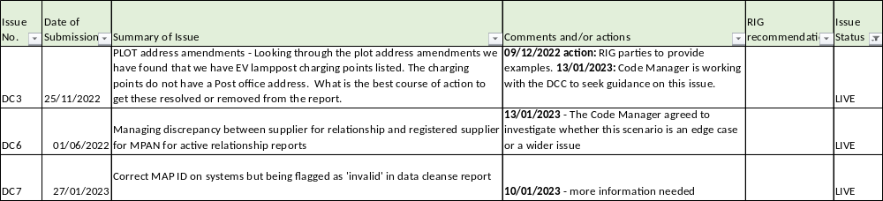
Data cleanse issues log

Slide 6
DATA CLEANSE RESULTS UPDATE
Lewis Williams

Slide 7
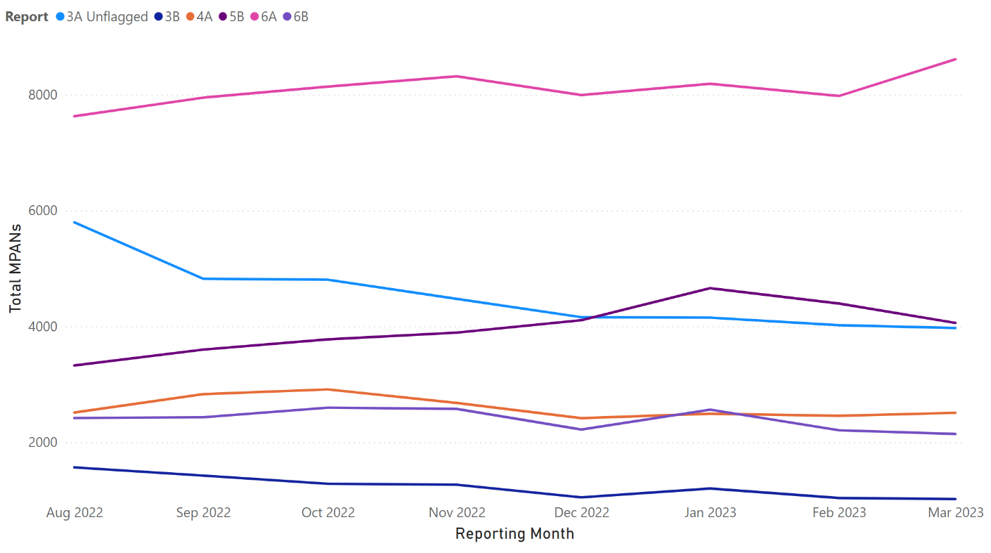
Update on MTC Reports
Summary
3A Unflagged has continued it’s decreasing trend - 4,807 → 3,973 in 6-months
Reports 3B, 4A and 6B have remained relatively stable
The 6-month trend for reports 5B and 6A remains an increase – both +6% - although a month-on-month decrease has been observed in 5B.

Slide 8
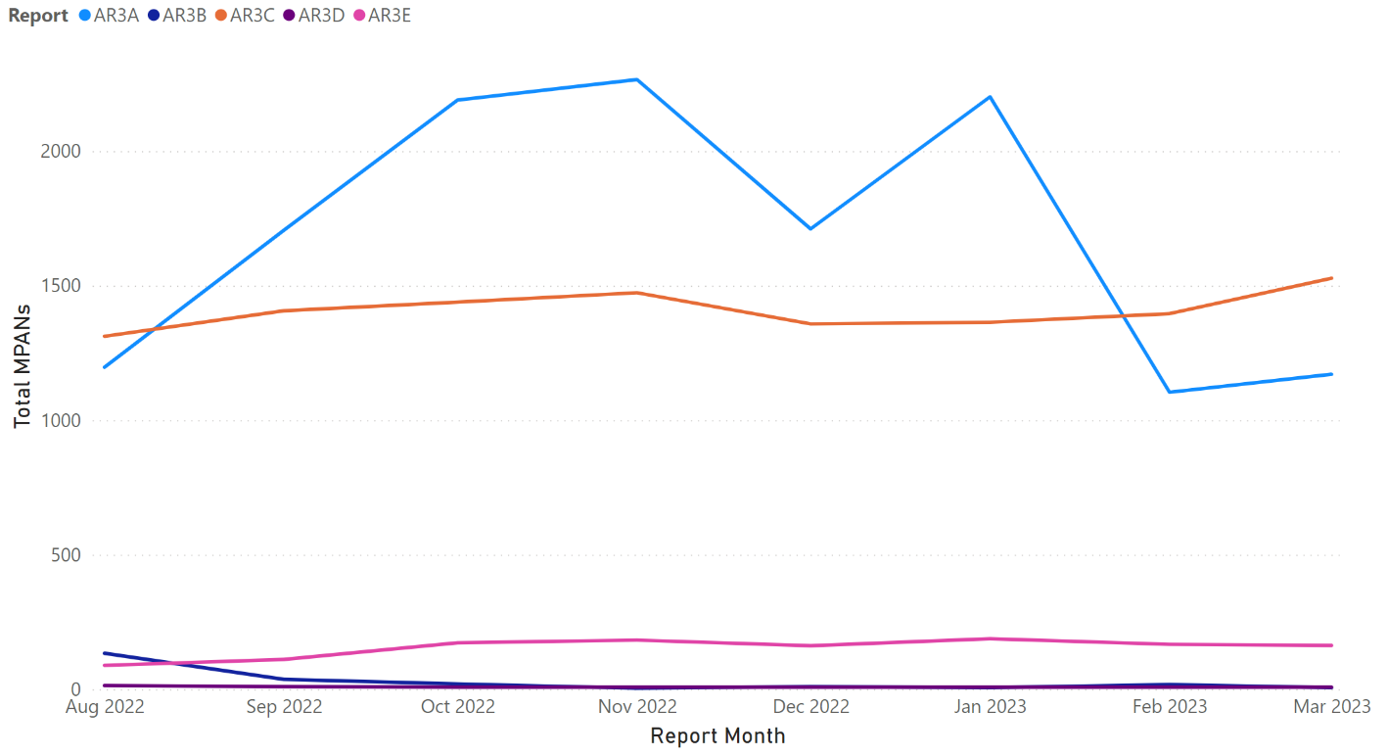
Update on ar reports
Summary
AR3A remains stable month-on-month
AR3B has dropped back down to 6 total MPANs following a spike to 18 last month
AR3C has increased up to 1,528 from a low of 1,312 in August
2 Primary MPANs remain in AR3D
AR3E has stabilised around 160 following an increase back in Sept/Oct
* Graph displays total MPANs

Slide 9
Update on Non-rel Reports (1/2)
Report | Oct-22 | Nov-22 | Dec-22 | Jan-23 | Feb-23 | Mar-23 | 6-Month Trend
Meter Type Mismatch | 42,997 | 44,297 | 45,636 | 45,200 | 45,712 | 40,929 | -5%
No Meter MTC | 180,178 | 188,755 | 194,799 | 201,971 | 211,779 | 224,390 | +25%
Smart Meter Type/MTC Mismatch | 116,880 | 161,870 | 141,073 | 144,127 | 151,899 | 159,757 | +37%
Invalid MAP ID | 4,940 | 4,855 | 4,638 | 4,584 | 4,479 | 4,119 | -17%
Plot Address Energised (Supplier) | 20,194 | 20,477 | 23,848 | 24,238 | 22,066 | 21,905 | +8%
Plot Address De-Energised (Supplier) | 10,726 | 10,390 | 14,851 | 15,476 | 12,539 | 11,659 | +9%
Plot Address Energised (DNO) | 13,038 | 12,831 | 12,883 | 12,967 | 12,938 | 12,807 | -7%
Plot Address De-Energised (DNO) | 5,402 | 4,739 | 4,969 | 5,009 | 4,857 | 4,119 | -24%

Slide 10
Update on Non-rel Reports (2/2)
Report | Oct-22 | Nov-22 | Dec-22 | Jan-23 | Feb-23 | Mar-23 | 6-Month Trend
Disconnected MPANs/Active Relationships | 1,706 | 1,700 | 1,698 | 1,698 | 1,698 | 1,698 | -1%
Unrestricted SSC/Active Relationships Flag | 1,439 | 1,474 | 1,358 | 1,364 | 1,396 | 1,528 | +6%
Invalid Topline (Supplier) | 1,856 | 1,831 | 1,780 | 1,774 | 1,770 | 1,776 | -4%
Invalid Topline (DNO) | 33,046 | 36,163 | 33,860 | 34,300 | 34,116 | 34,946 | +6%

Slide 11
3. Switch meter read – guidance document
REC performance assurance team

Slide 12
SWITCH METER READING GUIDANCE
Many market participants struggle to meet their Switch Meter Readings obligations. We think the complexity of the process may be a factor. We have produced draft guidance to help operational teams understand what they need to do.
This presents information within Schedule 30 of the REC in a simpler way, as well as hints and tips based on input from industry participants.
We want to get feedback on this before it is updated and finalised from the RIG, asking the following questions
1. Are there potential pitfalls we have missed or other issues we should cover?
2. Is this guidance pitched at the right level to be helpful to your operational teams?
Notes:
Purpose of RIG
-Demonstrate that when we see a performance issue we try to pulg the gaps
Doing this
Heres the guidance
Currently reflects the code

Slide 13
Switch meter reads guidance
Schedule 30 section C: switch meter reading problems
Notes:
Purpose of RIG
-Demonstrate that when we see a performance issue we try to pulg the gaps
Doing this
Heres the guidance
Currently reflects the code

Slide 14

This Guidance document aims to provide information on 3 key themes
1
Why might a dispute arise?
2
What is the process?
3
Top tips to drive your performance

Slide 15


Why might a dispute arise?
When should I use this process
When shouldn’t I use this process
Minimum threshold for consumer disputes:
There is no meter read available
The gaining or losing supply does not agree with the read
A consumer disputes the read and it is over the minimum threshold
Settlement reads are late
Another process, such as the Erroneous Switch is underway
A dispute has already been raised
1,200 kWh
250 kWh
What is a late settlement read?
The losing supplier hasn't got a read from CDSP / Data Collector after 15 days, or the gaining after 17.
The losing supplier has a read from the smart meter, but no proposed read from the gaining supplier after 10 days.
Agree a Switch Meter Reading where no actual or estimated Switch Meter Reading has been obtained;
Agree an alternative Switch Meter Reading where the original Switch Meter Reading is being disputed.
Where the Consumer is disputing the Switch Meter Reading, the Energy Supplier shall endeavour to reach an agreement with the Consumer without invoking this disputes process.
This area has potential for revision and to be included in guidance to provide.

Slide 16
What is the process?
9.11.13 | For gas only, following 9.11.12 if the agreed Switch Meter Reading is not accepted by the gas CDSP | Request replacement of the Meter Reading(s) that are preventing the agreed Switch Metering Reading from being accepted. | Gaining Supplier | Losing Supplier | Gas Replacement Readings | SDES
9.11.14 | For gas only, where 9.11.13 applies and within 5 WDs. | Submit the replacement Meter Reading(s). | Losing Supplier | Shipper | In accordance with the BSC and UNC / IG T UNC | N/A
Once identified this request is within 5WD
Use SAR / D300
Once both suppliers have proposed a solution, if it's not agreed it's time for a telephone call.
Switch meter read not received
Use SAR / D300 + settlement flows
Is there a read?
Agree?
Yes
Initial request – proposing an alternative read
Yes
Tell the other supplier, DC and Shipper
5WD
Switch meter read received but disputed
5WD
5WD
No
Use SAR / D300 + settlement flows
Propose solution
10 WD
No
Call the other supplier
Use SAR / D300
Ask the customer for a read / instruct agent
5WD
10 WD
Who calls varies. Where they are reads, the person raising the dispute calls. Where not it’s the gaining supplier
D flows are for electricity SAR flows for gas
4
Agree a Switch Meter Reading where no actual or estimated Switch Meter Reading has been obtained;
The Energy Supplier contacted by the Consumer shall consider the specific circumstances as detailed below:
A
B
Agree an alternative Switch Meter Reading where the original Switch Meter Reading is being disputed.
Where the difference between the Energy Supplier’s view of consumption and that derived from the initial Switch Meter Reading is 1,200 kWh or less for a gas RMP or 250 kWh or less for an electricity RMP, then the Energy Supplier shall not Resolution of Consumer Facing Switching and Billing Issues 19 Copyright 2022 Retail Energy Code Company dispute the Switch Meter Reading unless the Consumer specifically requests a new Switch Meter Reading, but shall instead attempt to resolve the dispute with an accommodation (e.g. cash allowance to the Consumer), thus retaining the initial proposed Switch Meter Reading, so that no further action is then required;.
where the Consumer is unwilling to accept an accommodation, or the difference between the Energy Supplier’s view of consumption and that derived from the Switch Meter Reading is more than 1,200 kWh for a gas RMP or more than 250 kWh for an electricity RMP, then the Energy Supplier shall initiate a dispute.
3
Where the Consumer is disputing the Switch Meter Reading, the Energy Supplier shall endeavour to reach an agreement with the Consumer without invoking this disputes process.
This area has potential for revision and to be included in guidance to provide.

Slide 17
Specific gas process following resolution
If after resolution a gas reading its possible the CDSP may not accept the reading
If so the gaining supplier requests the replacement of the read by the losing supplier on SDEP
This needs to take place within 5WD, so the losing supplier must update the shipper
Full details of the full switch meter process are included in Schedule 30 which you can get to following this link
Agree a Switch Meter Reading where no actual or estimated Switch Meter Reading has been obtained;
Agree an alternative Switch Meter Reading where the original Switch Meter Reading is being disputed.
Where the Consumer is disputing the Switch Meter Reading, the Energy Supplier shall endeavour to reach an agreement with the Consumer without invoking this disputes process.
This area has potential for revision and to be included in guidance to provide.

Slide 18
Top tips to Drive your performance

Slide 19




What can you proactively do to improve your performance?
Monitor SDEP Daily
Track number of open issues
Review your Performance Assurance Risk Dashboard via REC portal

Slide 20
Building blocks to drive performance
Problem 1
Not able to resolve Switch Meter Read problems in a timely manner
Reduce the risk by…
Process all incoming D0300s first thing in the morning every day.
Check SDEP to make sure all follow up queries are responded to at most every other day.
Upon D0300 receipt create a work item for the relevant term to work on in date order descending from oldest to newest daily.
Problem 2
Incidents that exceed timescales described within REC Schedule 30, Section C 9.11
Reduce the risk by…
Have controls in places to prevent or detect instances, some examples of this below:
Dating the work item of the incoming DO300 when opened originally.
SDEP managed daily to ensure follow ups are sent in a timely manner.
You could create automated alerts for timescales in place to monitor and detect instances/timescales, for the missing read process whereby when it reaches X day on gain and X day on loss the system triggers the missing read process.
You could have an exception management process in place whereby you can respond to requests where the system has failed.
You could create a D0300 report at the beginning of each month and follow up any D0300s that have not been responded to on SDEP.
Ensure that when reviewing responses received for D0300 process it is escalated correctly via SDEP when SLAs missed.

Slide 21
Building blocks to drive performance
Problem 4
Backlog of Switch Meter Reads due to lack of staff
Reduce the risk by…
Ensure you have a monthly update on how your recruitment activity is progressing, outlining any delays, risks or dependencies.
Ensure that any newly recruited team members have the skills and knowledge to effectively fulfil their role
Ensure you have procedures and controls in place to identify and address capability gaps within your organisation, ensuring that the teams are sufficiently staffed to achieve compliance to REC obligations.
Problem6
Not being able to communicate with Suppliers
Reduce the risk by…
Examples of communication mechanisms you can use:
  SDEP
  Voice (calls)
  Email
  Escalate to Code Manager via enquiries@recmanager.co.uk
Problem 7
Not responding to the Switch Meter Read Data Flows due to lack of information
Reduce the risk by…
Confirm if there is any mismatch of data e.g., MSN or number of registers
Check read history, if any
Customer contact
Photo evidence of meter

Slide 22
glossary

Slide 23

Switch
Initiating Supplier
means a change to the Registered Supplier for an RMP.
means the Energy Supplier which sends the Initial Request.
RMP
Dual Initiation
means a person which is either or both an Electricity Supplier and/or a Gas Supplier.
means where two or more Energy Suppliers have sent an Initial Request in relation to the same problem..
Switch Meter Readings
Enquiry Services
means the meter reading at the time of a Switch, as determined under the BSC or the UNC (as applicable)
means one of the Gas Enquiry Service (for gas) or the Electricity Enquiry Service (for electricity).
Erroneous Switch
Actual Meter Readings
means where a Consumer has been switched to an Energy Supplier which does not have an Energy Contract in place, as further described in the Resolution of Consumer-Facing Switching and Billing Problems Schedule.
Means a meter reading obtained by inspection by the Energy Supplier (or its Supplier Agent or other contractor) or via a remote meter reading (including via a Smart Meter).
Losing Supplier
Associated Supplier
means, in relation to a proposed Switch (or Switch), the Energy Supplier which will cease to be the Registered Supplier at an RMP as a result of that proposed Switch (or which has ceased to be the Registered Supplier as a result of that Switch)
means, in respect of a problem under the Resolution of Consumer-Facing Switching and Billing Problems Schedule, each of the Energy Suppliers to which the Initiating Supplier sent an Initial Request.
Consumer
Data Collector
means any person supplied (or seeking a supply) of Energy at an RMP (whether that person also exports or is seeking to export electricity at an RMP)..
means the person Appointed by an Electricity Supplier to collect and process meter readings for an RMP as further described in the Balancing and Settlement Code.
Gaining Supplier
Initial Request
means, in relation to a proposed Switch (or Switch), the Energy Supplier which is proposing to become the Registered Supplier at an RMP as a result of that proposed Switch (or which has become the Registered Supplier as a result of that Switch).
means a notification from an Energy Supplier to another Energy Supplier to raise an issue which needs to be resolved in respect of one of the problems covered by the Resolution of Consumer-Facing Switching and Billing Problems Schedule..
Energy Supplier
DCC Enrolled Meter
means a person which is either or both an Electricity Supplier and/or a Gas Supplier.
means a Smart Meter for which the communications between the Energy Supplier and the Smart Meter are managed by the DCC..

Slide 24
4. April 2023 release and metering code of practice consolidation
REC lead

Slide 25
R0047 – consolidated metering code of practice & Metering Audit scheme
Presentation slides and webinar video now available on the REC Portal
Version V2.0 of FAQS will be published on REC Portal on 10 March
March’s podcast will be on the Metering Audit Scheme and will be published on 27 March
Any requests or recommendations of amendments to the Consolidated Metering Code of Practice can be sent via a Service Desk Enquiry and tilted ‘next iteration of the CoMCoP
Link to EMAR
Link to REC Release Information
Link to REC Change Proposal R0047
Communication & Engagement Plan | March 2023 | March 2023
 | W/C 06 | W/C 13 | W/C 20 | W/C 27
April Release
Update FAQs
Publish podcast

Slide 26
R0047 – consolidated metering code of practice & Metering Audit scheme
Post Go live Support
End Users
Support Ownership
End User
Has an enquiry related to the release
Metering Auditor
Scheduling
Scope
Delivery
Audit follow up questions
Audit charges/how to invoice
1st line support
Will respond within 24 hours
2nd line support
Will respond within 3 Working Days
Step 1
Review information available via the REC Release Information page
Enquiry Management
Code Manager
Audit certificates
Accreditation queries
Query on the audit results
Step 2
Raise Service Desk Enquiry
Raise an Enquiry with Wilcock eric@wilcock.co.uk

Slide 27
5A. RIG ISSUE NO.09
DNO B Code Escalations
REC lead analyst

Slide 28
DNO Escalation Issues
An emergency found on site requiring DNO rectification - An A code is raised
A non-emergency requiring DNO rectification - A D0135 is issued from the MEM along with the relevant code (normally B).
The quality of the responding D126 from the DNO can be poor.
  Examples
    A previous MEM raised the D135. A change of Agent has occurred, and the new MEM has issued a further D135, response received from DNO – Duplicate Job, although the D135 is from a different MEM. This gives the MEM no visibility of the original response in the D126.
    What is the escalation procedure when an asset code of U is returned – Unable to resolve ?
    How do we continue dialogue with the DNO when an asset code of D is returned – Disputed ?
    How do we escalate when the D135 was sent 41 days prior but no response?
There is little support / advice on the DNOs website.

Slide 29
5B. RIG ISSUE NO.11
Registrations failing due to domestic/non-domestic indicator not matching
REC lead analyst

Slide 30

Switching incidents between domestic suppliers and non-domestic suppliers
ISSUE SUMMARY
Since the launch of Faster Switching (Central Switching Services - CSS), Non-Domestic suppliers have seen an increase in Switching incidents where Domestic suppliers try to register Profile Class meters 1 & 2 from their supply (Non-Domestic supply points).
From Faster Switching go-live, the domestic premise indicator is based on MPID level for Non-Domestic suppliers.
Therefore, all Domestic Indicators show as ‘False’ for Non-Domestic suppliers.
This ‘False’ designation (or Non-Domestic Indicator) is also reflected on Electricity Enquiries Service (EES).
However, whilst attempting to initiate the Switch for these Non-Domestic supply points, Domestic suppliers mark the Domestic Indicator as ‘True’.
Resulting in the Switch Request failing CSS validation checks.

Slide 31
Switching incidents between domestic suppliers and non-domestic suppliers
Questions for REC Issues Group (RIG)
Due to multiple communications between Issue raiser and Domestic suppliers, we would like to gauge how many other Group members have experienced similar challenges?
Where would be the best forum for this issue to be addressed, is it Central Switching Services (CSS) or the REC Manager?
This issue is impacting customers, due to switching delays, how long would it take to find a sustainable and consistent approach to minimise this issue?

Slide 32
aob

Slide 33
GroupPoolCodes in DTC Data spec Access Database
Issue:
A Change Proposal has been submitted, requesting an update to the DTC Data Specification Access database
The submission is requesting the DataGroup tables within the database to be updated to include GroupPoolCodes - GroupPoolCodes are used to lookup the structure of the flow.
In the example provided below, the GroupPoolCodes have never been included in any version of the DTC database since the flows entered the database.
No other issues have been reported related to the missing GroupPoolCodes.
  Example:
  An example is the D0311s 05D group.
  In the DataFlowGroup table searching for entries with a FlowCounter equaling 311, the first result is the 05D group with a GroupCounter of 1305.
  In the DataGroup table searching for entries with GroupCounter of 1305 the GroupPoolCode is null. This should be populated with 05D.
  In the example provided, the GroupPoolCodes have never been included in any version of the DTC database since the flows entered the database.
Ask of RIG: To provide views on whether your organisation is experiencing any issues relating to the missing GroupPoolCode – this will help the Code Manager determine whether a change is required.

Slide 34
Next meeting:
14th april 2023
Thanks for attending

