Slide 1
REC ISSues group
14 April 2023

Slide 2
1. Introduction and agreement of agenda
Shelley rouse

Slide 3
Agenda For today
 | Agenda Item | TIME | LEAD
1 | Introductions and agreement of agenda | 10:00 | Chair
2 | Data Cleanse update - Data Cleanse issues log | 10.05 | Performance Assurance Team
3 | Code Road Map Update | 10.35 | REC Technical Services Team
4a | RIG Issues Update – Issue 12 Erroneous switching process – incorrect use of annulment process | 11.00 | Lead Analyst
4b | RIG Issues Update – Issue 10 SDEP queries – increased instances of queries raised against incorrect MPIDs | 11.15 | Lead Analyst
5 | AOB | 11.30 | All
6 | Close | 12.00 | Chair

Slide 4
2. Data cleanse update – issues
REC performance assurance team

Slide 5
Data cleanse issues log
No Open issues
Issue No. | Date of Submission | Summary of Issue | Date of RIG at which initially reviewed | Comments and/or actions | RIG recommendation | Issue Status
DC1 | 11/9/2022 | Proposal to split the NoMeterMTC Report into two sub-reports | 11/11/2022 | 11/11/2022 Action: The Code Manager will investigate the most appropriate REC change process to be followed for this issue to be progressed. 09/12/2022 update: Code Manager confirmed that the reporting specs will be classified as category 3 documents, so that the change process can be followed. | 13/01/23 - CP in the process of being drafted to address this issue 23/01/2023 - CP R0019 raised 23/01/2023. Captured in Change C3-40032 | CLOSED
DC2 | 11/9/2022 | The Domestic Premise Indicator is required to reflect whether the MPAN is determined by the Supplier to be a Domestic or Non-Domestic premises. The Supplier has an obligation to set the indicator correctly. Initially populate the Domestic Premises Indicator using existing industry data. The basis described in the Ofgem CP related to metered MPANs (as per BSCP516), unfortunately it was not recognised that NHH Unmetered MPANs are governed under BSCP520 rather than BSCP516. | 11/11/2022 | 11/11/2022 Action: Suppliers to update/correct the DPI directly into the Central CSS. This data will then be replicated in other systems including EES. Action: Parties to provide feedback as to whether the use of the DPI is a concern across the board. Action: Code Manager to investigate these rules and to consider whether any reporting is required to monitor this, for example whether a single data offload of MPANs having a DPI would be sufficient, or if a more enduring process is needed. 09/12/2022 update: Code Manager continues to investigate most appropriate data provision approach | Captured in Change C3-40032 | CLOSED
DC3 | 25/11/2022 | PLOT address amendments - Looking through the plot address amendments we have found that we have EV lamppost charging points listed. The charging points do not have a Post office address. What is the best course of action to get these resolved or removed from the report. | 9/12/2022 | 09/12/2022 action: RIG parties to provide examples. 13/01/2023: Code Manager is working with the DCC to seek guidance on this issue. | 10/03/2023 - group agreed that issue could be closed | CLOSED
DC4 | 12/16/2022 | Request from two Parties for exemptions to go back to being included in the individual supplier reports | 1/13/2023 |  | 13/01/23 - CP in the process of being drafted to address this issue . Captured in Change C3-40032 | CLOSED
DC5 | 12/16/2022 | MPANs in valid relationship, yet addreses do not match as they serve as identifiers | 1/13/2023 | 13/01/2023 - Suggested that the status quo for using the exemption process for these sites be maintained with the existing wording being amended rather than a new exemption code being created | 10/02/2023 - RIG parties agreed that E3 is the correct exemption code to be used in this situation. Description to be amended to make it clearer. | CLOSED
DC6 | 6/1/2022 | Managing discrepancy between supplier for relationship and registered supplier for MPAN for active relationship reports | 13/01/2023 | 13/01/2023 - The Code Manager agreed to investigate whether this scenario is an edge case or a wider issue | 10/02/2023 - Code Manager confirmed that they will make a change to the Disconnected MPANs/Active Realtionshop Logic to correct the issue | CLOSED
DC7 | 1/27/2023 | Correct MAP ID on systems but being flagged as 'invalid' in data cleanse report | 2/10/2023 | 10/01/2023 - more information needed | 10/03/2023 - agreed to close and for party to raise as a Service Desk Ticket | CLOSED

Slide 6
DATA CLEANSE RESULTS UPDATE
Andrew Waghorn

Slide 7
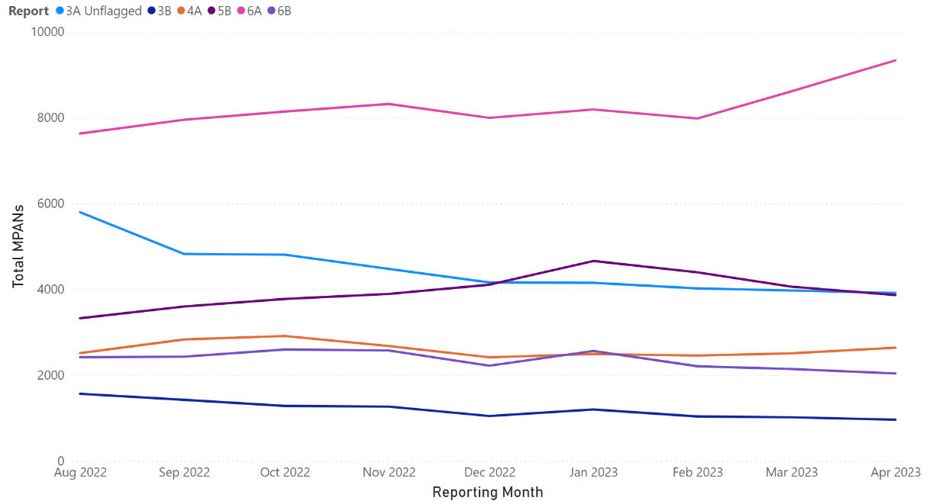
Update on MTC Reports
Summary
3A Unflagged has continued it’s decreasing trend - 4,477 → 3,915 in 6-months
Reports 3B, 4A and 6B have remained relatively stable, showing slight decreases
The 5B population is declining following a spike in January
An increasing trend is being observed for 6A, increasing by 12% since February

Slide 8
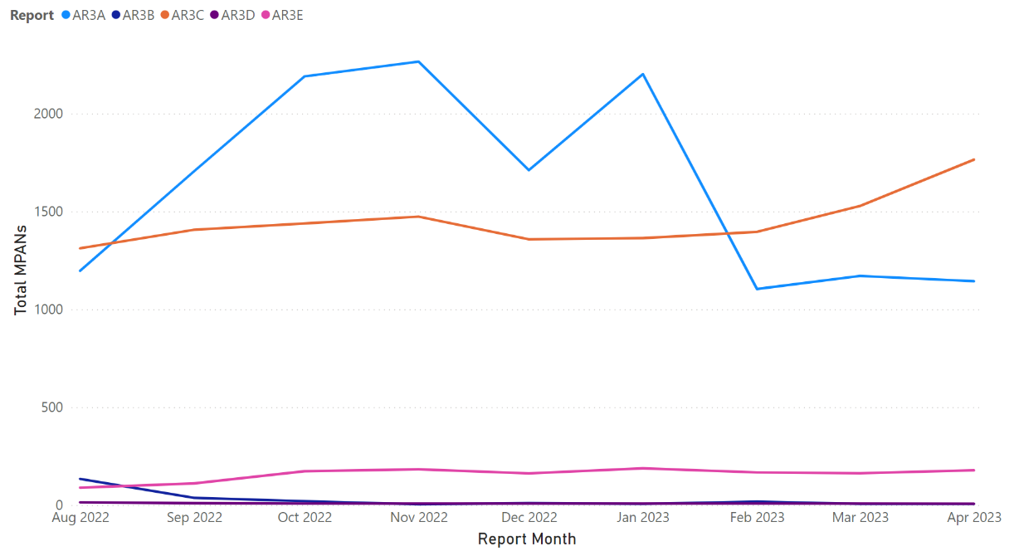
Update on ar reports
Summary
AR3A remains stable month-on-month
AR3B remains at 6 total MPANs
AR3C has increased to 1,756 from a low of 1,312 in August
2 Primary MPANs remain in AR3D
AR3E has shown a small month-on-month increase from 163 → 178
* Graph displays total MPANs

Slide 9
Update on Non-rel Reports (1/2)
Report | Nov-22 | Dec-22 | Jan-23 | Feb-23 | Mar-23 | Apr-23 | 6-Month Trend
Meter Type Mismatch | 44,297 | 45,636 | 45,200 | 45,712 | 40,929 | 39,367 | -11%
No Meter MTC | 188,755 | 194,799 | 201,971 | 211,779 | 224,390 | 221,296 | +17%
Smart Meter Type/MTC Mismatch | 161,870 | 141,073 | 144,127 | 151,899 | 159,757 | 170,906 | +6%
Invalid MAP ID | 4,855 | 4,638 | 4,584 | 4,479 | 4,119 | 4,055 | -16%
Plot Address Energised (Supplier) | 20,477 | 23,848 | 24,238 | 22,066 | 21,905 | 21,532 | +5%
Plot Address De-Energised (Supplier) | 10,390 | 14,851 | 15,476 | 12,539 | 11,659 | 10,860 | +5%
Plot Address Energised (DNO) | 12,831 | 12,883 | 12,967 | 12,938 | 12,807 | 12,556 | -2%
Plot Address De-Energised (DNO) | 4,739 | 4,969 | 5,009 | 4,857 | 4,914 | 4,678 | -2%

Slide 10
Update on Non-rel Reports (2/2)
Report | Nov-22 | Dec-22 | Jan-23 | Feb-23 | Mar-23 | Apr-23 | 6-Month Trend
Disconnected MPANs/Active Relationships | 1,700 | 1,698 | 1,698 | 1,698 | 1,698 | 1,694 | 0%
Unrestricted SSC/Active Relationships Flag | 1,474 | 1,358 | 1,364 | 1,396 | 1,528 | 1,765 | +20%
Invalid Topline (Supplier) | 1,831 | 1,780 | 1,774 | 1,770 | 1,776 | 1,266 | -30%
Invalid Topline (DNO) | 36,163 | 33,860 | 34,300 | 34,116 | 34,946 | 39,082 | +8%

Slide 11
3. Codes road map update
REC technical services team

Slide 12

Rec code roadmap
Launched 30 March
Presents ‘epics’ over 7 themes
35 epics due to start during April - June 2023
Wiki page on the background and approach
Roadmap hosted on the REC Digital Navigator
Information about epics active / in planning to be published regularly
Contact for queries – enquiries@recmanager.co.uk

Slide 13
Epics due to start April – June 2023
Theme
Sub-theme
Epic
MHHS
Central Switching Service
Analysis of CSS Management of Changes in Market Roles and Data
Data & Digitalisation
Consumer Consent
Publish Findings of ODCC Work for Consultation
Energy Enquiry Service
Analysis of the Energy Enquiry Service Data Processing Procedure
Open Data (OD)
Changes to the REC
Provide Metadata Standard for Data asset
Identify Data Sources for OD
Analyse Data Sources for OD
Solution Development for Achieving OD for REC Controlled Data
Engagement
Engagement With Stakeholders Regarding MHHS Programme
Impacts and Consequential Changes
Impact Assessment of MHHS Programme on REC Services
Data Specification – MHHS
MHHS REC Products
Energy Theft
Awareness
Raising Awareness of Energy Theft for Consumers
Raising General Awareness of Energy Theft Across Industry
Policy Initiatives
Net Zero RECCo
Progress Towards a Net-Zero Company
Other
Development of Procurement Principles
Data Driven Detection
Obtain Smart Meter Data, relevant to Energy Theft
Prepayment
Debt identification
Legacy
New Tenant
Unallocated/misdirected
Theft Forum
Re-establish Dedicated Theft Expert Group
Implement Energy Theft Stakeholder Forum
Third Party Intermediaries
Analysis for Possibility of a REC Governed Code of Conduct
Analysis to Identify Other Categories of TPIs Beyond Brokers
Publish Comms for Findings of Industry Workshops Regarding TPI Governance
Evolution of REC Services
CSS Operations
CSS early life issues rectification
Enquiry Services and Green Deal
Analysis for Evolution of Gas and Electricity Enquiry Services and GGDCC Database
Priority Services Register
PSR Improvements
Analysis of Consumer Journeys Relating to PSR Application Process
Assessment of Other Industry Activities - 'Support for All'
Publish Comms for Analysis / Solution Development for Improving PSR
Secure Data Exchange
SDEP functionality review
Solution Development for SDEP
UX-Driven Change
EMAR / Portal
EMAR Usability Improvements
Vulnerability criteria and id
Gap Analysis for Vulnerability Criteria Across Industry

Slide 14
Use of the roadmap
Epics progressed, usually akin to projects
Stakeholder input likely to be sought during solution development
Recommendations presented for approval / progression
Change implemented as Change Proposals and/or Service Provider contract changes
Change Proposals and REC Issues assessed against roadmap items for prioritisation and alignment
Quarterly refresh (end June 2023) – engagement ahead of this

Slide 15
4A. RIG ISSUE NO.12 erroneous switching process – incorrect use of annulment process
REC lead analyst

Slide 16

Using Annulment process on erroneous switches
ISSUE SUMMARY
A REC Party has raised a concern that they believe the Annulment Process is being used to resolve registration issues where an Erroneous Switch has taken place.
Annulment Process is capture in REC Schedule 23 - Registration Services. It is described as; ‘A Losing Supplier must only submit an Annulment Request in respect of a Registration where the Losing Supplier is permitted to do so in accordance with its Energy Supply Licence. The Losing Supplier may only submit an Annulment Request prior to the Registration being Secured Active.’
Erroneous Switch is captured in REC Schedule 30 – Resolution of Consumer Facing Switching and Billing Issues. It is described as, ‘An Erroneous Switch occurs where a Consumer has been switched to an Energy Supplier which does not have an Energy Contract in place. An Erroneous Switch only occurs once the Registration Status of the erroneous Energy Supplier's Registration has become Secured Active or Active.’

Slide 17
4B. RIG ISSUE NO.13
SDEP queries – increased instances of queries raised against incorrect mpids
REC lead analyst

Slide 18
Sdep queries being raised to the incorrect mpid
ISSUE SUMMARY
A REC Party has raised a concern that they have seen in increase in SDEP (Secure Data Exchange Portal) queries being raised to the incorrect MPID (Market Participant Identifier).
The SDEP and it’s functionality is captured in REC Schedule 17 – Secure Data Exchange and the Secure Data Exchange Portal (SDEP) User Guide V3.1
The SDEP User Guide informs users on Raising a new Communication in section 4.3 of the SDEP User Guide.
For users raising these communications (queries), great care needs to be taken in selecting the ‘Recipient Company Group’ and ‘Recipient Legal Entity’.
Errors in the selection of the Company group and Legal entity (MPID) can and will result in delays to queries being addressed.

Slide 19
aob

Slide 20
Next meeting:
12th may 2023
Thanks for attending

