Slide 1
REC ISSues group
12 May 2023

Slide 2
1. Introduction and agreement of agenda
Shelley rouse

Slide 3
Agenda For today
 | Agenda Item | TIME | LEAD
1 | Introductions and agreement of agenda | 10:00 | Chair
2 | Data Cleanse update DC9 – Customer wants related MPANs to be unrelated to allow switch to new supplier | 10.05 | Performance Assurance Team
2a | Data Cleanse update • Data cleanse reporting | 10.20 | Performance Assurance Team
3 | SDEP Final Change Report (issue 13) | 10.35 | REC Technical Services Team
4a | RIG Issues Update – Issue 12 Erroneous switching process – incorrect use of annulment process | 11.00 | Lead Analyst
4b | RIG Issues Update – Issue 13 • SDEP queries – increase instances of queries raised against incorrect MPIDs | 11.15 | Lead Analyst
4c | RIG Issues Update – Issue 14 • Issues identified with communicating with ‘white-label’ suppliers. Escalations are not able to be followed | 11.30 | Lead Analyst
4d | RIG Issues Update – Issue 15 • Early addition of ‘Expected Connection Type’ in to SDEP New/Additional MPAN request | 11.45 | Lead Analyst
5 | AOB | 12.00 | All
6 | Close | 12.30 | Chair

Slide 4
2A. Data cleanse update issue DC9 - Customer requests related MPANs to be unrelated to allow switch to new supplier
REC performance assurance team

Slide 5
Data cleanse issue DC09 -
Customer requests related MPANs to be unrelated to allow switch to new supplier
Example query:
Site has 2 MPANs that are currently related.
One MPAN is energised with a meter (24/7 supply), the other MPAN is de-energised with a meter (heating circuit). The de-energised MPAN has not been used for since the electric heating was removed.
The customer wants to switch supplier but the new supplier won’t offer the same tariff if they are required to take both MPANs so the customer wants them unrelated.
The customer also doesn’t not want to pay to have the second unused meter removed which would allow them to be unrelated by the Supplier.
If the Supplier unrelated these MPANs it would result in them appearing in the exception reports and is not in line with the principle of related MPANs.
If the customer then ever re-energised the second MPAN they would need to be brought back together if they were with different suppliers.
So is it acceptable for suppliers to unrelate MPANs where the off-peak circuit has been de-energised for a period of time (tba) and the customer refused to have the unused meter removed due to the cost.
They may have never used it since they moved into the property.
If it is agreed that these MPAN can be split/remain split then we need an exception code to report these against and the rules around the code that aren't onerous on the consumer.

Slide 6
2A. Data cleanse update issue DC9 - Customer requests related MPANs to be unrelated to allow switch to new supplier
REC performance assurance team

Slide 7
DATA CLEANSE RESULTS UPDATE
LEWIS WILLIAMS

Slide 8
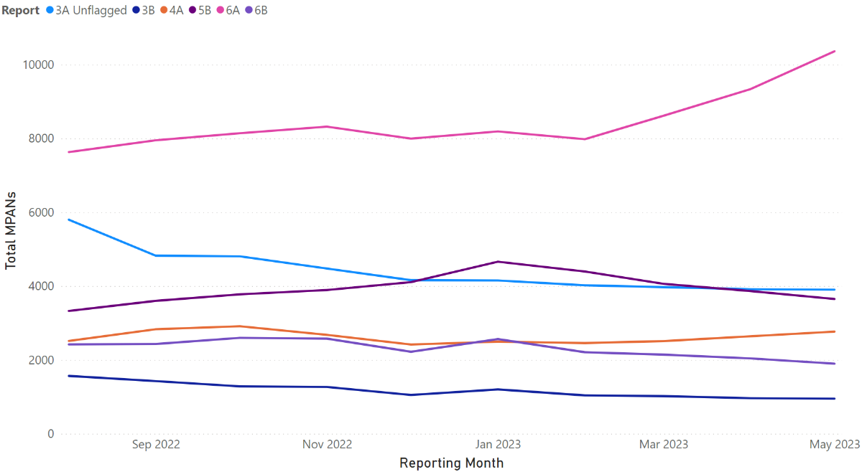
Update on MTC Reports
Summary
3A Unflagged is similar to last month at just over 3,900
Reports 3B, 5B and 6B have shown small MoM declines
Report 4A has been showing small monthly increases since February – 2,458 → 2,767
Report 6A has continued to increase from 7,980 → 10,362 since February

Slide 9
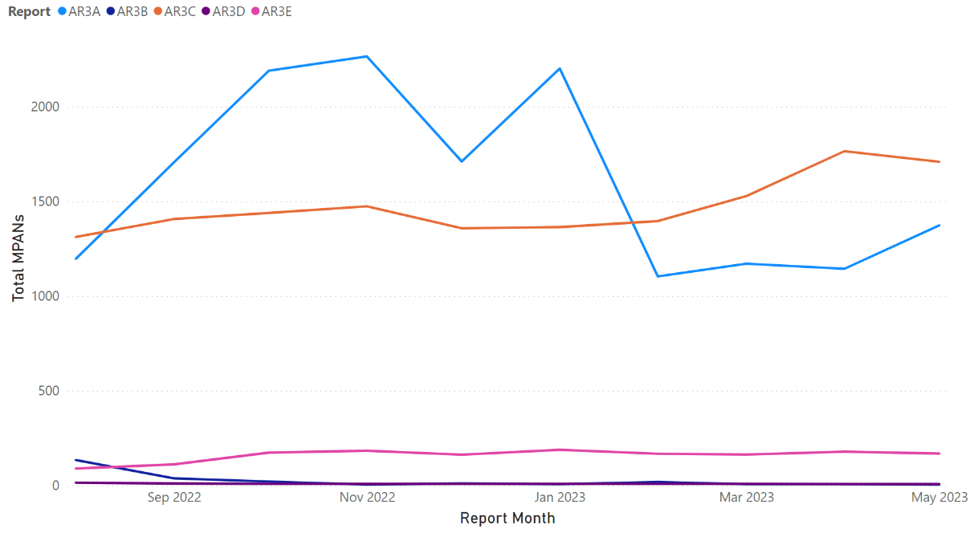
Update on ar reports
Summary
AR3A has shown a 20% MoM increase to 1,373
AR3B has reduced to 4 total MPANs
AR3C has shown a small MoM decrease to 1,709
2 Primary MPANs remain in AR3D
AR3E has shown a small MoM decrease to 168
AR3F has been produced for the first time, with 247,510 MPANs identified
* Graph displays total MPANs

Slide 10
Update on Non-rel Reports (1/2)
Report | Dec-22 | Jan-23 | Feb-23 | Mar-23 | Apr-23 | May-23 | 6-Month Trend
Meter Type Mismatch | 45,636 | 45,200 | 45,712 | 40,929 | 39,367 | 24,195 | -47%
No Meter MTC No MSN | 171,266 | 178,712 | 187,375 | 199,971 | 198,363 | 184,733 | +8%
No Meter MTC MSN | 23,533 | 23,259 | 24,404 | 24,419 | 22,933 | 16,756 | -29%
Smart Meter Type/MTC Mismatch | 141,073 | 144,127 | 151,899 | 159,757 | 170,906 | 160,342 | +14%
Invalid MAP ID | 4,638 | 4,584 | 4,479 | 4,119 | 4,055 | 4,035 | -13%
Plot Address Energised (Supplier) | 23,848 | 24,238 | 22,066 | 21,905 | 21,532 | 21,641 | -9%
Plot Address De-Energised (Supplier) | 14,851 | 15,476 | 12,539 | 11,659 | 10,860 | 10,267 | 31%
Plot Address Energised (DNO) | 12,883 | 12,967 | 12,938 | 12,807 | 12,556 | 21,641 | +68%
Plot Address De-Energised (DNO) | 4,969 | 5,009 | 4,857 | 4,914 | 4,678 | 10,267 | +107%

Slide 11
Update on Non-rel Reports (1/2)
Report | Dec-22 | Jan-23 | Feb-23 | Mar-23 | Apr-23 | May-23 | 6-Month Trend
Disconnected MPANs/Active Relationships | 1,698 | 1,698 | 1,698 | 1,698 | 1,694 | 6 | -99%
Unrestricted SSC/Active Relationships | 1,358 | 1,364 | 1,396 | 1,528 | 1,765 | 1,709 | +26%
Invalid Topline (Supplier) | 1,780 | 1,774 | 1,770 | 1,776 | 1,266 | 1,312 | -26%
Invalid Topline (DNO) | 33,860 | 34,300 | 34,116 | 34,946 | 39,082 | 33,456 | -1%
NHH Unmetered DPI | N/A | N/A | N/A | N/A | N/A | 0 | N/A

Slide 12
3. SDEP final change report
RIG issue 13
REC technical services team

Slide 13

SDEP Review overview
Worked with SDEP Users and the Service Provider to identify opportunities and ideas for improvement
Validated and developed solution ideas into 29 recommendations for change
Immediate Action – six Change Proposals will cover improvements to the current SDEP system, developed with support from users
Future Work - progressed alongside RECCo to consider medium to long-term future of REC secure communications

Slide 14
the change proposals
1
2
3
Process Type Changes
Merge General Query/Escalation
Additional Process Type - Missing Read
Additional Process Type - Multiple Supplier Report
Additional Process Type - Address Management
Additional Process Type - Theft
Useability
Solved Status
Filter for Unread / Escalatable / Age / MPID
Additional Statuses
Enhanced Notification Emails
Enhanced Query Function
Notification of Status Change
Look and Feel
Merge General Query/Escalation - User Guide
Selecting MPID over Company Group
Readability of Fields
View of time left to respond
View of Summary info/dashboard
4
5
6
Reporting
Enhanced filter and export
View of time left to respond - Report
Report selection
Reporting
Multilateral Communications
Multilateral Erroneous Switches
Training and Documentation
Clarification of SDEP Obligations
Review of SDEP User Guides

Slide 15
Examples of changed functionality
Another party needs to raise a Multiple Supplier Report query with me, they may use an inappropriate PT as there is no dedicated PT, which makes it harder to act promptly on the query
A dedicated PT for Multiple Supplier Report queries means both initiating and associated Suppliers can manage queries effectively
When I raise a query, I need to enter the Company Group of the associated party before the MPID, which can take additional time to determine, and it’s easier to make a mistake
I can select the MPID of the party I need to communicate with quickly and accurately
When I think a SDEP query is resolved, I don’t have a way to proactively confirm that I don’t think further action is required
Either party to a query can mark it as ‘solved’, allowing for better workload planning and faster resolution of issues
If a query is not solved within the SLA in the REC, I need to enter all relevant details again to raise a separate escalation query, which takes more time and does not carry over the history of the original query
If I need to escalate a query, I can do so within the same communication, saving time re-entering the details and retaining all the information from the original messages

Slide 16
Next steps
Interested parties may submit comments on the recommendations
Code Manager to prepare Change Proposals to be raised
Change Proposals to go through the standard process including full impact assessment and consultation
Long term provision of secure data exchange considered as necessary during ongoing development of REC systems and processes

Slide 17
4A. RIG ISSUE NO.12 erroneous switching process – incorrect use of annulment process
REC lead analyst

Slide 18

Using Annulment process on erroneous switches
ISSUE SUMMARY
A REC Party has raised a concern that they believe the Annulment Process is being used to resolve registration issues where an Erroneous Switch has taken place.
Annulment Process is capture in REC Schedule 23 - Registration Services. It is described as; ‘A Losing Supplier must only submit an Annulment Request in respect of a Registration where the Losing Supplier is permitted to do so in accordance with its Energy Supply Licence. The Losing Supplier may only submit an Annulment Request prior to the Registration being Secured Active.’
Erroneous Switch is captured in REC Schedule 30 – Resolution of Consumer Facing Switching and Billing Issues. It is described as, ‘An Erroneous Switch occurs where a Consumer has been switched to an Energy Supplier which does not have an Energy Contract in place. An Erroneous Switch only occurs once the Registration Status of the erroneous Energy Supplier's Registration has become Secured Active or Active.’

Slide 19
4B. RIG ISSUE NO.13
SDEP queries – increased instances of queries raised against incorrect mpids
REC lead analyst

Slide 20
4B. RIG ISSUE NO.14
Issues identified with
communicating with ‘white-Label’ suppliers. Escalations are not able to be followed
REC lead analyst

Slide 21
4B. RIG ISSUE NO.15
Early addition of ‘Expected
Connection Type’ in to SDEP
New/Additional MPAN request
REC lead analyst

Slide 22
early addition of ‘expected connection type’ into sdep new/Additional mpan request
ISSUE SUMMARY
The Connection Type data item is one of the new data items being introduced into SMRS on 30/06/23 through BSC CP1568. This and R0066 which adds the items into EES are enabling changes for MHHS.
The Connection Type provides information as to whether an MPAN is CT or Whole Current and the voltage for CT MPANs.
The REC MHHS Stakeholder Advisory Group (MSAG) agreed on 19/04/23 that the Expected Connection Type should be added to the New/Additional MPAN Request within SDEP as part of the amendments required for MHHS Go-Live. (expected March 25)
It was agreed that the Expected Connection Type would provide the DNO with useful information that would aid in setting an accurate LLFC / DUOS Tariff ID for MPAN creation.
It was further discussed whether this item would be useful in the pre-MHHS arrangements if added when the Connection Type goes live from June 23.
As pre-MHHS processes are outside the remit of MSAG an issue was raised for RIG to consider whether the ‘Expected Connection Type’ should be added to the New/Additional MPAN request prior to MHHS go-live.

Slide 23
aob

Slide 24
Data quality issues – GES/CSS
Party initially identified data quality issues with GES and a number of MPRNs being returned with no REL or UPRN
Further investigation identified that these MPRNs are not in CSS and have yet to be assigned REL IDs
  Party previously advised that all 'switchable' MPRNs should have been assigned a UPRN
  Lack of REL leading to detriment impacts to switching journeys
  Have any other REC Parties experienced similar issues relating to enquiry service data quality and lack of REL detail?

Slide 25
Updating CSS certificates
Please be aware that due to the time of year, TLS Certificates for CSS will be running out and will require renewing. If you fail to renew your TLS certificates before they run out you will not be able to connect to CSS and no traffic of messages from CSS will be received by your end point.
In order to successfully complete this activity you will need to ensure the contacts provided within Service Now are up-to-date, particularly your SRO, ARO and Technical contact as only they will receive notifications of expiry and only they can complete this.
Please log into the Switching Portal to review the date of expiry and submit the renewal before this date. Any issues please contact cssservicedesk@smartdcc.co.uk.

Slide 26
Next meeting:
9 June 2023
Thanks for attending

