Slide 1
REC ISSues group
08 September 2023

Slide 2
1. Introduction and agreement of agenda
Shelley rouse

Slide 3
Agenda For today
 | TITLE | TIME | LEAD
1 | Introductions and Agreement of Agenda | 10:00 | Chair
2 | Data Cleanse Update 2A – Theft Target Methodology Initial Analysis | 10.05 | REC Performance Assurance Team
3 | R0132 – Market Role Codes | 10.30 | REC Change Analyst
4 | R0143 – New Value for site visit check code (J0024) | 10.45 | REC Change Analyst
5 | LLFC ID – DI50078 / J0147 Discrepancy in Logical Format | 11.00 | REC Technical Services Lead Analyst
6 | R0062 – Removal of ERDA meteringPointEnergyFlow change restriction | 11.15 | REC Technical Services Lead Analyst
7 | Classification Based Access (Open Data) Change Proposal | 11.30 | REC Change Analyst
8 | SDEP change proposal update Including Change proposal merge plan | 11.45 | REC Change Analyst
8 | R0136 – Market Stabilisation Charge | 12.00 | REC Change Analyst
10 | AOB | 12.15 | ALL
 | Close | 13.00 | Chair

Slide 4
2. Data cleanse update
REC performance assurance team

Slide 5
2A. Theft target methodology initial analysis
Nirav vyas

Slide 6
Target Theft Methodology Initial Analysis
Background:
The Energy Theft Reduction Scheme (ETRS) as specified in Schedule 7 of the Retail Energy Code aims to combat Energy Theft within the Retail Energy Market and support Suppliers with their obligations in Condition 12A of the Energy Supply Licence
Following REC change R0091 responsibility for the Theft Target Methodology (TTM) – which determines the level, distribution and value of targets – moved from the RECCo Board to the Code Manager.
Code Manager administers the Theft Detection Incentive Scheme (TDIS), assigning all Suppliers in the market a Theft Target, currently split by fuel type and further by Domestic and Non-Domestic customer segments for a total of four distinct target totals or incentive pots across the industry.
Context:
The Code Manager has been responsible for the administration of the ETRS for the last two Reporting Years, covering the period from April 2021 to the present.
The TTM has not been significantly changed since REC go-live
The overall performance of the industry for the previous two completed Reporting Years has fallen short of the total targets,
  42% of the overall industry target being achieved in 2021/2022
  40% achieved in 2022/2023

Slide 7
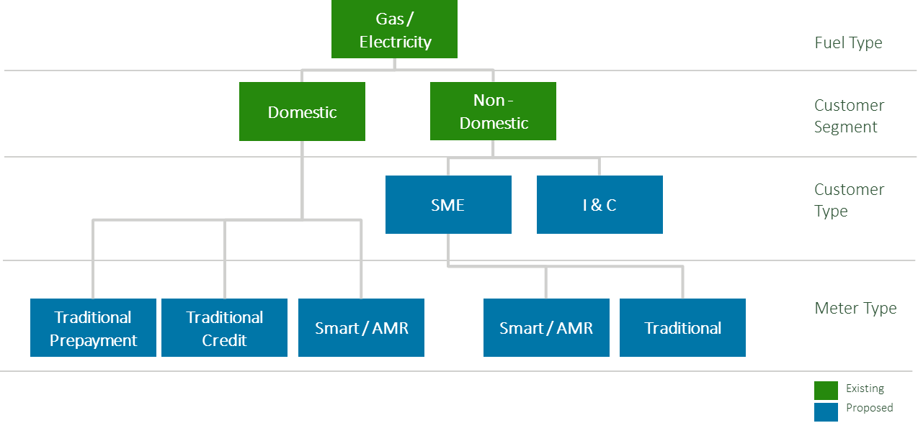
Proposed changes
Incentive pots:
The Domestic customer segment will have an additional split by meter type and include Traditional Prepayment, Traditional Credit and Smart.
Disaggregation of the Non-Domestic customer segment into SME and Industrial & Commercial (I&C).
The SME customer type is further split between Smart/AMR and Traditional meters.
Theft Detection Values:
In light of the new proposed incentive pot splits, the TDV will be revisited to determine appropriate values.
For the avoidance of doubt, no change is proposed to the underlying definition of the TDV – such as basing it on the value of theft avoided or setting it in a way designed to incentivise specific behaviours.
Theft target:
In light of the new proposed incentive pot splits, the Theft targets will be revisited to determine appropriate values.
The target for the 2023/2024 TDIS reporting year continued to be based on the number of confirmed thefts and operates at the same level as in the prior year.
The three proposed changes will require input from Suppliers so will represent a key part of the call for evidence from Suppliers.

Slide 8
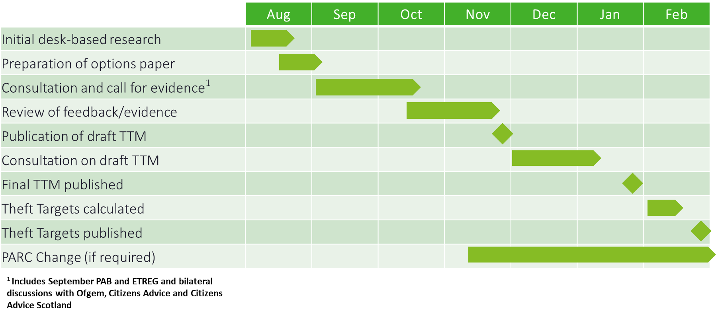
Next steps
The proposed timeline for review of the TTM is as follows:

Slide 9
3. R0132 Market Role Codes
REC change analyst

Slide 10
R0132 – OVERVIEW
Change the Logical Format of the J0001 (DI50001) ‘Market Participant Role Code’ data item to Char(2)
The REC Change Proposal, R0132, looks to make the consequential changes to REC-owned Market Messages.
The Cross Code Steering Group (CCSG) have confirmed BSC will be the lead code. There is a commitment between the codes to align change plans and for information provided to inform both processes.
There are only 36 possible Market Participant Roles, and they have all been allocated. BSCCo will not be able to allocate new Market Participant Role Codes when required.
BSC, as the data item owner, are raising a Change Proposal to change the logical format of the J0001 Market Participant Role Code. The proposed solution is to change the logical format from one character to two characters which would provide thousands of new Market Participant Role Codes. Other solutions have been considered but have discounted during the BSC’s development of the solution.
Notes:
If

Slide 11
R0132 – OVERVIEW
Proposed implementation date of June 2024
Dependencies - R0043 - Commissioning of Works by the Crowded Meter Room Coordinator (CMRC) to Resolve Issues In Crowded Meter Rooms & R0143 - New value for Site Visit Check Code (J0024)
Indicative plan
  Urgent Critical change
  Service Provider impact assessment to start w/c 11 September 2023
  IAR & CPP at Change Panel on 19 September 2023
  Party impact assessment start date 06 October 2023
  10 working day consultation period, but with consultation engagement event in advance
  Decision date early Jan 2024
What can you do?
  Respond to the Party IA in October
Notes:
If

Slide 12
4. R0143 – New value for site visit check code (J0024)
REC change analyst

Slide 13
R0143 – New Value for site visit check code (joo24)
DCUSA Change Proposal DCP 411 was raised to enable the DNO’s to apply charges to de-energised sites, where the registrant wished to retain the site’s capacity.
DCP 411 completed its development and was submitted to the Authority for a decision on 14 June 2023. We are expecting a decision from the Authority in November.
The DCUSA workgroup determined that the D0139/MM00036 was the most appropriate mechanism for the DNO to notify the Supplier of the agreement between the Supplier and the Consumer that the capacity for the site would be retained, and that charges for that capacity would be levied by the DNO to the Supplier, to be paid by the Consumer.
The DNO’s raised R0143 to give effect to the solution they designed during development of DCP411. The intention of the Change Proposal is to require the DNO to send a D0139/MM00036 to the Supplier and include a enumeration of the Site Visit Check Code (J0024) to indicate Capacity Charges will apply.

Slide 14
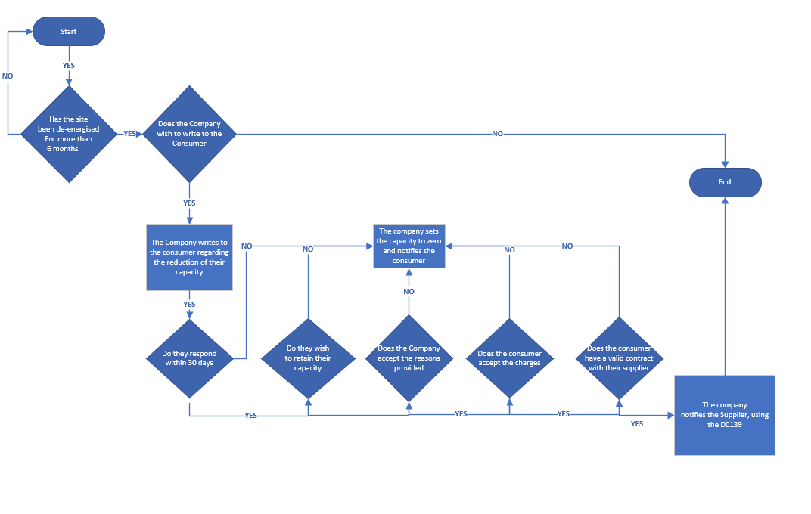
R0143 – New Value for site visit check code (joo24) – DNO Process

Slide 15
R0143 – New Value for site visit check code (joo24)
During our Impact Assessment of the Change, we have identified that the instance of the D0139 between the DNO and the Supplier will no longer exist after MHHS and so this can only be an interim solution, and post MHHS a new solution will need to be found.
The Proposer has indicated they wishes to proceed with this interim solution, which we propose to implement together with other changes to the D0139 Market Message (Change Proposal R0043) in June 2024.

Slide 16
5. LLFC ID – DI50078 / J0147 discrepancy in Logical format
Beth brown

Slide 17
LLFC id
A Party has flagged that the logical format of the DI50078 (J0147 Line Loss Factor Class Id) is inconsistent between the Data Specification and the EES (ECOES) API.
Data Specification – Up to 3 alphanumeric characters. ‘000’ and combinations starting ‘0’ and ’00’ are invalid – e.g. ‘1’ not ‘001’
System – ECOES API returns LLFCs with leading zeros
Looks like the format was updated under BSC CP1434 / MRA CR3472 in 2016, equivalent system change may not have happened

Slide 18
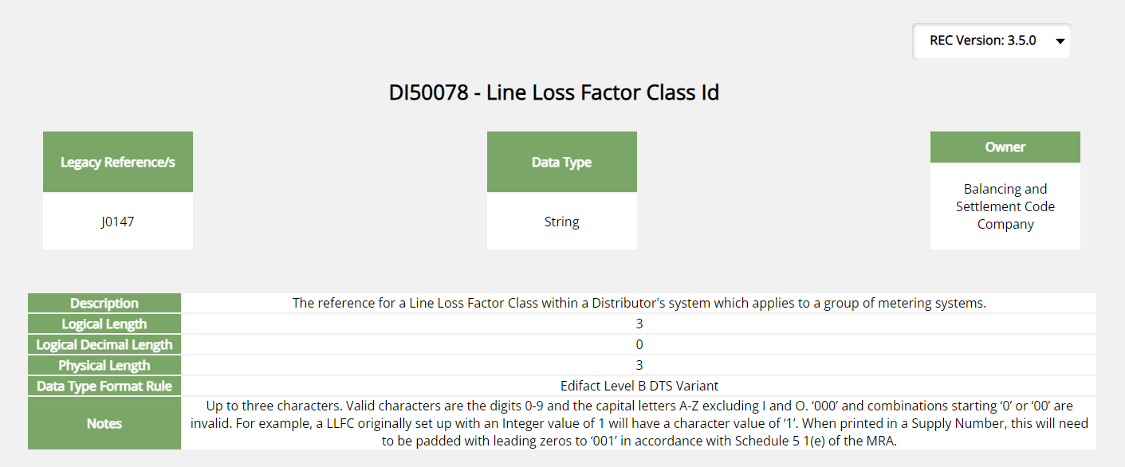
Current data specification

Slide 19
Way forward
This Data Item is due to be retired under MHHS.
Is this causing any known issues now?
Are organisations using work arounds?

Slide 20
6. R0062 Removal of ERDA meteringpointenergyflow change restriction
REC technical services Lead Analyst

Slide 21
CP summary
The Electricity Retail Data Service (ERDS) currently derives the Energy Direction (‘meteringPointEnergyFlow’ DI90033) from the MS Specific LLF Class Indicator (DI50370) which is an attribute of Line Loss Factor Class, as set by ERDAs.
As part of the Faster Switching Programme Enactment Phase, change CR-E37 implemented a restriction within ERDS, limiting a correction to DI90033 to a once only event occurrence (within the lifetime of an Registrable Measurement Point).
At present, rules under Schedule 27 - RMP Lifecycle prevent the ERDA making more than one amendment in an
RMP’s lifetime. The code states that any corrections which require more than one event change will need to be completed via termination and creation of a new RMP.
This change looks to align ERDS with CSS and only enforce the Effective From Date validation rule.
Allowing ERDAs (DNOs) to make more than one change to Energy Flow direction to improve data
accuracy without requiring a new RMP to be created in line with the MHHS Transition date.
The current solution defines this as an ‘unrestricted’ number of changes that can occur within an RMP’s lifetime.

Slide 22
dno workshop for scenario establishment
A workshop with several LDSO’s was conducted by the Code Manager on 25 July 2023. The purpose of this workshop was to review and refine the draft Proposed Solution, but also to ensure a greater understanding of what processes and scenarios may enact the need to correct the ‘energyPointMeteringFlow’ direction on more than one occasion.
The result of this workshop defined, two scenarios which may require a correction to the energyPointMeteringFlow direction:
  Corrections following a New Connection request; or additional Import/ Export Connection request; and
  Correction following a Switch
In both identified scenarios, the correction which takes place may be for both the energyPointMeteringFlow and Line Loss Factor Class data items, or solely a correction to the energyPointMeteringFlow as the LLFC assigned is correct.

Slide 23
Scenario process maps
Scenario 1: Corrections following a New Connection request; or additional Import/ Export Connection request
1st correction instance (within current rules)
Instruction to DNO to Create new/ additional Connection
Request received.
DNO Creates new RMP record within ERDS
RECM_SN_CSS01000
Message sent from ERDS to CSS
RMP Creation process completed.
energyPointMeteringFlow set within ERDS & CSS.
Supplier issues request to correct energyPointMeteringFlow
RECM_SN_CSS00700
Message sent from ERDS to CSS
Terminate RMP
Inaccurate energyPointMeteringFlow identified.
Supplier issues request to correct energyPointMeteringFlow
2nd correction instance
[restriction prevents update to CSS
Does this process map articulate an accurate reflection of activities, which enact the need to make more than one correction to the ‘energyPointMeteringFlow’ data item?
What are the reasons that a 2nd correction instance is required?

Slide 24
Scenario process maps
Scenario 2: Corrections following a Switch
1st correction instance (within current rules)
CoS Complete
Supplier identifies incorrect energyPointMeteringFlow direction.
Request DNO to amend
(how?/ method? SDES)
ERDA reviews to identify if any previous corrections have already been made for RMP?
RECM_SN_CSS00700
Message sent from ERDA to CSS
No
Yes
Terminate RMP
Inaccurate energyPointMeteringFlow identified.
Supplier issues request to correct energyPointMeteringFlow
2nd correction instance
[restriction prevents update to CSS
2nd correction instance
[restriction prevents update to CSS]
Does this process map articulate an accurate reflection of activities, which enact the need to make more than one correction to the ‘energyPointMeteringFlow’ data item?

Slide 25
Queries for parties’
Electricity Supplier’s
Are there any operational challenges that should be reviewed/ addressed as part of this change proposal which would mitigate the need to correct an Energy Flow direction?
Do Suppliers maintain any records of how many RMP’s have been terminated as a result of where a correction is requested (on more than one instance)?; or how many RMP’s require a correction, but have not had the RMP terminated to avoid consumer detriment?
Are there any further scenarios which have not been described/ documented which may enact the need to make more than 1 correction an Energy flow or LLFC direction?
All Parties
Are there any further methods to make requests to correct Energy Flow/ LLFC which have not been described and documented under the Scenario Process Maps slide?
2. Should a ‘top’ level restriction be considered? The current draft solution has this as unrestricted (technically to 99 instances), but would a more appropriate restriction be implemented? (for example, 3)

Slide 26
7. classification based access (open data) change proposal
REC change analyst

Slide 27
Open Data Project - Background
Goal of Project: To improve & simplify access to data securely & efficiently
The REC is accountable for delivery of a number of key industry data services
The REC and RECCo has an obligation to conduct a periodic assessment and review to assure itself that the code and REC services remain fit for purpose
The REC Forward Work Plan sets out a key priority area of its Data and Digitilisation Strategy which included the Open Data project
Ambition is to deliver a published asset via existing mechanisms of the data governed by the REC with a move towards classification-based access and the creation of a meta data catalogue
Global and national recognition of increased benefits from transparency and data publication
Support Industry with adoption of Ofgem's Data Best Practices work, which will be being extended to retailers next

Slide 28
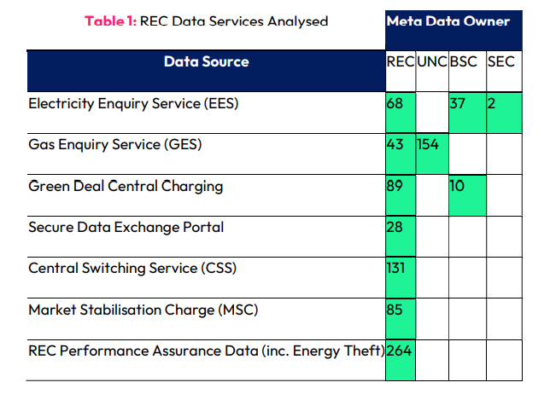
Open Data Project - Background
Achievement to date
Phase 1 – Discovery Phase
  Focussed on meta data (information about the data, rather than the actual data) for data sources within REC's control.
  Analysis of 911 data items which have been mapped back to specific items within the code (Table 1).
  Delivered:- Meta Data Catalogue; Roles and Responsibilities Model; Data Item Classification Model; Data Domain Model; Data Quality Framework and Log
Current Activities
Phase 2 – Open Data
  Update the metadata catalogue based on stakeholder feedback;
  Gain approval of metadata item classification from metadata owners as per the Energy Markets Data Specification (EMDS);
  Raise a REC Change Proposal to improve and expand data access simply and securely; and
  Develop technical solution to reflect any changes proposed

Slide 29
Classification Based Access and CP Principles
The classification-based access model seeks to grant access to data items by virtue of the data item classification as opposed to role-based access which is based on access to the data item by virtue of the role of the user.
Expect that new data item requests will be assessed against the data item classification and associated conditions.
In addition, seek to develop a solution to make always open data items easily available without the need for a data access request.
Key principles to take forward as part of the Change Proposal:
  No change will be made to current EES & GES user access;
  Minimise any additional work that may be required by EES & GES service providers in granting access;
  The move from role-based access to classification-based access will not increase the time taken to approve access requests;
  A list of available data items & classification will be made available to users;
  A list of open data items will be available to all (could be via an open data portal);
  Conditions of access will be defined & examples made available; and
  CP aligns to Ofgems Data Best Practice guidance.

Slide 30
Classification Definitions
Each data item will have one of the following classifications associated with it:
Classification | Definition
Always Open | Data item does not contain personal, commercial or security sensitive data and can be made open.
Conditionally Open | Data item in isolation is not personal, commercial or security sensitive, but when combined with other data items, may result in it becoming personal, commercial or security sensitive.
Personal | Data item contains Personally Identifiable Information (PII).
Closed | Data item contains data that is personally, commercially or security sensitive and cannot be shared unless under exceptional circumstances.

Slide 31
HOw it could work
New access request comes in
Each data item has one of four defined classifications and conditions for access associated with it
If the user meets the conditions for access to the classified data items, access can be granted
More information/assessment may be needed before access is granted
Example Request
I want access to data items 3-4 for Customers 1-5, no purpose given
Data Record ​ |  | Customer 1​ | Customer 2 | Customer 3 | Customer 4 | Customer 5​ | Additional info​
Data item 1​ | Address​ | P​ersonal | P​ersonal | P​ersonal | P​ersonal | P​ersonal | Personal because location info is GDPR​
Data item 2​ | Supplier​ | Conditionally Open​ | Conditionally Open | Conditionally Open | Conditionally Open | Conditionally Open | Conditionally Open because could be used to target marketing to change supplier​
Data item 3​ | Install date​ | Always Open​ | Always Open | Always Open | Always Open | Always Open | Always Open because it is a date ​
Data item 4​ | Annual Quantity​ | Always Open | Always Open | Always Open | Always Open | Always Open | Always Open because it is a value​
OUTCOME
WHY?
AUTOMATIC APPROVAL
Because the data items are not connected to a Conditionally Open item, and all are classified Always Open, then automatic approval is given

Slide 32
HOw it could work
New access request comes in
Each data item has one of four defined classifications and conditions for access associated with it
If the user meets the conditions for access to the classified data items, access can be granted
More information/assessment may be needed before access is granted
Example Request
I want access to data item 2, no purpose given
Data Record ​ |  | Customer 1​ | Customer 2 | Customer 3 | Customer 4 | Customer 5​ | Additional info​
Data item 1​ | Address​ | P​ersonal | P​ersonal | P​ersonal | P​ersonal | P​ersonal | Personal because location info is GDPR​
Data item 2​ | Supplier​ | Conditionally Open​ | Conditionally Open | Conditionally Open | Conditionally Open | Conditionally Open | Conditionally Open because could be used to target marketing to change supplier​
Data item 3​ | Install date​ | Always Open​ | Always Open | Always Open | Always Open | Always Open | Always Open because it is a date ​
Data item 4​ | Annual Quantity​ | Always Open | Always Open | Always Open | Always Open | Always Open | Always Open because it is a value​
OUTCOME
WHY?
Assessment Required
The data items requested, when combined together will lead to more insights of customers directly, as well as the ability to establish market share or direct marketing when viewed across all data records.

Slide 33
HOw it could work
New access request comes in
Each data item has one of four defined classifications and conditions for access associated with it
If the user meets the conditions for access to the classified data items, access can be granted
More information/assessment may be needed before access is granted
Example Request
I want access to data item 2, no purpose given
Data Record ​ |  | Customer 1​ | Customer 2 | Customer 3 | Customer 4 | Customer 5​ | Additional info​
Data item 1​ | Address​ | P​ersonal | P​ersonal | P​ersonal | P​ersonal | P​ersonal | Personal because location info is GDPR​
Data item 2​ | Supplier​ | Conditionally Open​ | Conditionally Open | Conditionally Open | Conditionally Open | Conditionally Open | Conditionally Open because could be used to target marketing to change supplier​
Data item 3​ | Install date​ | Always Open​ | Always Open | Always Open | Always Open | Always Open | Always Open because it is a date ​
Data item 4​ | Annual Quantity​ | Always Open | Always Open | Always Open | Always Open | Always Open | Always Open because it is a value​
OUTCOME
WHY?
Assessment Required
The data items requested, contain personal data and will also lead to more insights of customers directly, as well as the ability to establish market share or direct marketing when viewed across all data records.

Slide 34
DEVELOPMENT OF THE CHANGE PROPOSAL
The Code Manager is looking at a potential implementation of this Change Proposal between April – July 2024.
Stakeholders are expected to see a Party Impact Assessment being circulated in January 2024 and Consultation in February/March 2024.

Slide 35
Key Points and Questions for stakeholders
Key Points:
  No change will be made to current EES & GES user access and data items that users have access to.
  Assigning classifications to each of the items in the DAM is complete and has been through Code Body and Service Provider consultation. This information is contained in the metadata catalogue which will be a living document throughout the life of the CP to ensure any changes to the DAM are reflected.
  Next steps are to further develop use cases and the proposed solution for implementation via the Change Proposal process.
  Prior to raising the Change Proposal, we would like to understand views from stakeholders which will help to develop the Change Proposal.
Key Questions:
  Seeking to understand views on movement from role-based access to classification-based access.
  Should we run this CP in parallel to the current CP in progress to remove the backlog of data access request CPs currently in the process?
  Could we have different implementation dates for the Electricity data items vs Gas data items?

Slide 36
8. SDEP Change proposal update
Rec change analyst

Slide 37
SDEP Change Proposals Update
Special RIG held 18 August – great engagement and stakeholder feedback regarding the requirements for R0121 – Process Types and Escalations.
Some of the recommendations being put forward had conflicting views so the Code Manager will be circulating an RFI on 15 September 2023 for 10WDs. This will then provide the final steer on what to take to C&C as the Service Provider.
Work has also commenced on R0122, and this will be the umbrella CP for R0122 - Useability, R0123 - Look and Feel and R0124 - Reporting Change Proposals.
To get stakeholder feedback on the requirements for R0122, a second Special SDEP RIG will be held 20 October 2023.
R0009 – Introduction of SDEP and EES User Maintenance API had its appeal rejected by the Authority.

Slide 38
SDEP Review – Change Proposals

Slide 39
Approach to merged change proposals
R0121 – Process Types & Escalation
R0121 – Process Types & Escalation,
User Guide, Obligations
R0122 – Usability
R0122 – Usability, Look & Feel,
Reporting
R0123 – Look & Feel
R0124 – Reporting
R0125 – Multilateral Erroneous Switches
R0125 – Multilateral Erroneous Switches
Category 3 Change(s) for User Guide – aligned to CP implementation(s)
R0126 – User Guide & Obligations
R0123, R0124, R0126 will be withdrawn

Slide 40
9. R0136 – Market Stabilisation charge
REC change analyst

Slide 41
R0136 – OVERVIEW
When REC Schedule 22 – Market Stabilisation Charge was introduced, the statement Schedules were not correctly aligned to the stated period for issuing statements as set out in the business process maps that were shared during the development of the changes.
Additionally, suppliers are querying how they may raise a dispute when they believe they are not entitled to the monies stated on Credit Advice Notices as this process is not set out in the Schedule.

Slide 42
R0136 –Proposed Solution
This Change Proposal seeks to:
Correct the error in the timescales for the production of the 4- weekly statements by RECCo to reflect what was intended – issuing them at 15 Working Days instead of the 10 Working Days set out in the Schedule.
Enable Parties to dispute Credit Advice Notes – which is currently not permitted.
Amend section 7.3 (b) to enable the energy suppliers to query the amount in a statement within 10 Working Days of receipt of the supporting statement data.
The Change Proposal plan has been set out with an accelerated timeline to reflect the urgency of this Change. The Proposal has a fully formed solution and has no central system impacts, there are no requirements to conduct Service Provider or Party Impact Assessments and therefore we propose to progress straight to production of the Preliminary Change Report (PCR).

Slide 43
R0136 – Questions From rig
We would be happy to understand your thoughts on the issue and would like to open discussion:
Do you have any alternative ideas on solution options, different to the one raised by the proposer ?
Notes:
If

Slide 44
R0136 – Further comments
If you would like to contact me to discuss further, please reach me at:
Samantha.Briggs@recmanager.co.uk

Slide 45
aob

Slide 46
Next meeting:
Regular RIG: 13 October 2023
SPECIAL RIG: 20 october 2023
Thanks for attending

