Slide 1
REC ISSues group
10 November 2023

Slide 2
1. Introduction and agreement of agenda
Shelley rouse

Slide 3
Agenda For today
 | TITLE | TIME | LEAD
1 | Introductions and Agreement of Agenda | 10:00 | Chair
2 | Data Cleanse Update | 10:05 | REC Performance Assurance Team
2a | Data Cleanse Update Data Cleanse Reporting | 10.20 | REC Performance Assurance Team
3 | Metering Workshops | 10:30 | REC Performance Assurance Team
4 | R0094 – Clarify Obligations on Gas Meter Exchanges that Occur Close to CoS | 10.45 | REC Change Team
5 | R0092 – DCC Service Level Agreements for the Switching Incentive Regime | 11:00 | REC Change Team
6 | R0148 and the Metadata Catalogue | 11:15 | REC Change Team
7 | Return of MPRN from Postcode Search on GES | 11:30 | REC Change Team
8 | Schedule 30 & Risk Driver 5.8 | 11:45 | RIG Member
9 | AOB | 12:00 | REC Change Team
9a | AOB R0037 – Prepayment Credit Balance & Debt Transfer Processes | 12:00 | REC Change Team
9b | AOB Introduction to Erin | 12:15 | REC Technical Services Team
10 | Close | 12:30 | Chair

Slide 4
2. Data cleanse update
REC performance assurance team

Slide 5
2a. Data cleanse reporting
REC performance assurance team

Slide 6
3. metering workshops
REC performance assurance team

Slide 7
Schedule 14 metering operations engagement UPDATE
Background:
REC Schedule 14 sets out the obligations on Metering Equipment Managers (MEMs) and Energy Suppliers in respect of metering operations, covering management of MEM appointments and maintenance of Meter Technical Details (MTD) across Parties. These involve updating central systems in gas, namely the Central Data Service Provider (CDSP), a role performed by Xoserve primarily governed by the Joint Office of Gas Transporters. The Code Manager and PAB monitor performance in relation to these obligations to mitigate Retail Risk 7: Inaccurate meter point master data results in errors that impact consumers.
In accordance with the Central Data Service Provider (CDSP) Further Services Service Definition which sets out CDSP responsibilities under the REC, the CDSP conducts an annual comparison exercise between the gas MTD data provided directly by each gas MEM and the MTD data held within the Central Gas Register. The findings from this reconciliation activity are shared with the appointed Gas MEM, the Gas Supplier that has appointed the MEM, and the Code Manager.
We carried out further analysis on the report received from the CDSP and noted:
  2,669,208 out of 6,275,634 gas meter points (42.53%) covered by this exercise had inconsistencies between the meter data maintained by the MEM and within the Central Gas Register.
  Four gas MEMs accounted for 60.35% of inconsistencies noted across the market.

Slide 8
Problem Statement:
We are aware of performance issues in relation to MEMs from the CDSP reconciliation, MEM RFI and Metering-specific topic monitoring. We think that for this issue to be resolved the requirements defined within the Code and how operational processes are delivered by MEMs will need to change.
Current requirements do not obligate data retention for effective performance monitoring and reporting, so a more Party-focused approach will not work.
Non-domestic customers may have direct contracts with MEMs, reducing the ability of Suppliers to ensure MEMs meet standards of service through contract management.
Smaller Suppliers often have limited ability to incentivise MEM performance.

Slide 9

Schedule 14 metering operations engagement UPDATE continued…
Actionable Deliverables:
We propose a working group focused on resolving these issues for Gas customers. We are focusing on Gas first as Electricity is more mature.
This will include representatives from BSC (where appropriate), UNC and Supplier organisations (ensuring coverage of both Domestic and Non-Domestic sector, as well as organisation scale).
Workshops and Follow-up workshops with the working group to explore potential solutions and evaluate their cost-benefits.
Develop proposal for Standards of Service for MEMs
1
2
3
As-Is process and data mapping
An articulation of issues at each process points.
Recommendations on changes to systems or data required for REC Change
4
Recommendations on the appropriate assurance approaches for each requirement that does not meet required performance levels.
A summary report that is suitable for scrutiny at the Metering Expert Panel (MEP) and the Performance Assurance Board. In addition, A summary report that can be communicated to industry so that they understand the conclusions.
FIRST ASK:
Please raise your interest to be part of the workshop that will be delivered on 20 November. Invites will be sent accordingly.

Slide 10
4. R0094 – clarify obligations on gas meter exchanges that occur close to cos
REC change team

Slide 11
R0094 – OVERVIEW
Following a meter job, the Central Data Service Provider (CDSP) are updated with ONJOB and JOB Market Messages from the MEM and Shipper, respectively. It has been reported that the CDSP are not always sent updated meter details if a meter job occurs concurrent with a switch.
As a result, the CDSP retains out of date meter information, and cannot make the new details available to the gaining supplier. This results in a poor Consumer experience as the gaining MEM & Supplier do not have accurate meter information.
Whilst the obligation for the MEM and Supplier to communicate to CDSP persists beyond de-appointment during a switch, we have been told that this is not clear within Schedule 14 – Metering Operations. A mechanism should be identified to reinforce MEM/Supplier obligations.
Notes:
If

Slide 12
R0094 – Current mechanism
There are currently two mechanisms by which the CDSP receive updated information following a meter job.
Pathway 1:
MEM > CDSP (via ONJOB)
Pathway 2:
MEM > Supplier (Via ONJOB) > Shipper (via ONJOB) > CDSP (via JOB)

Slide 13
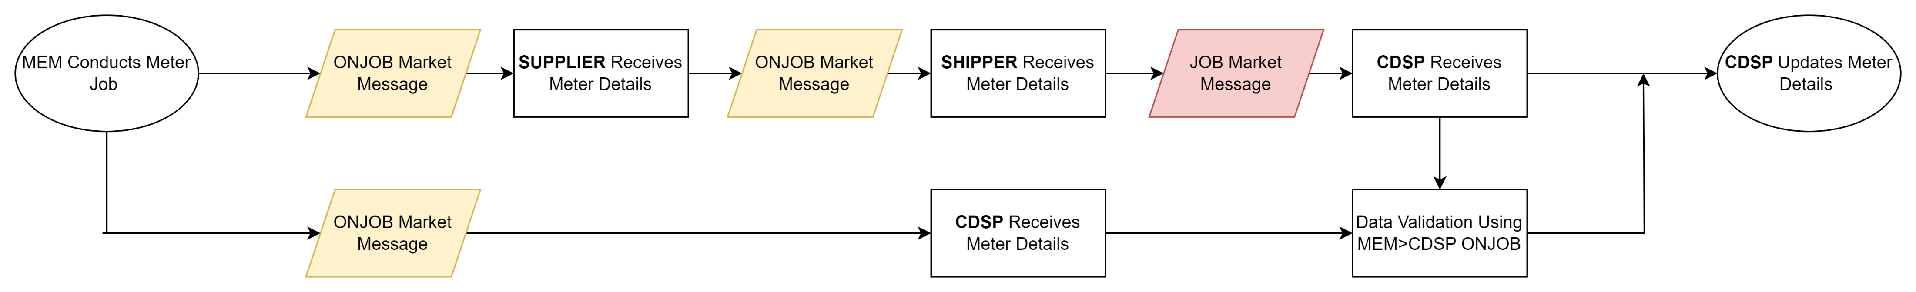
R0094 – Current mechanism

Slide 14
R0094 - Scenario Summary
We have identified 3 main scenarios causing the issues outlined in R0094:
Losing Supplier instructs a meter job prior to the switch and it is conducted in the losing Supplier’s ownership period, but the market messages are not sent prior to the switch.
Losing Supplier instructs a meter job, but the supply switches prior to the job, and the work done is done in the gaining Supplier’s ownership.
The gaining Supplier conducts a meter job in the losing Supplier’s ownership period following a request from the incoming supplier to the incoming MEM.
All 3 scenarios can result in market messages not being sent to the CDSP.

Slide 15
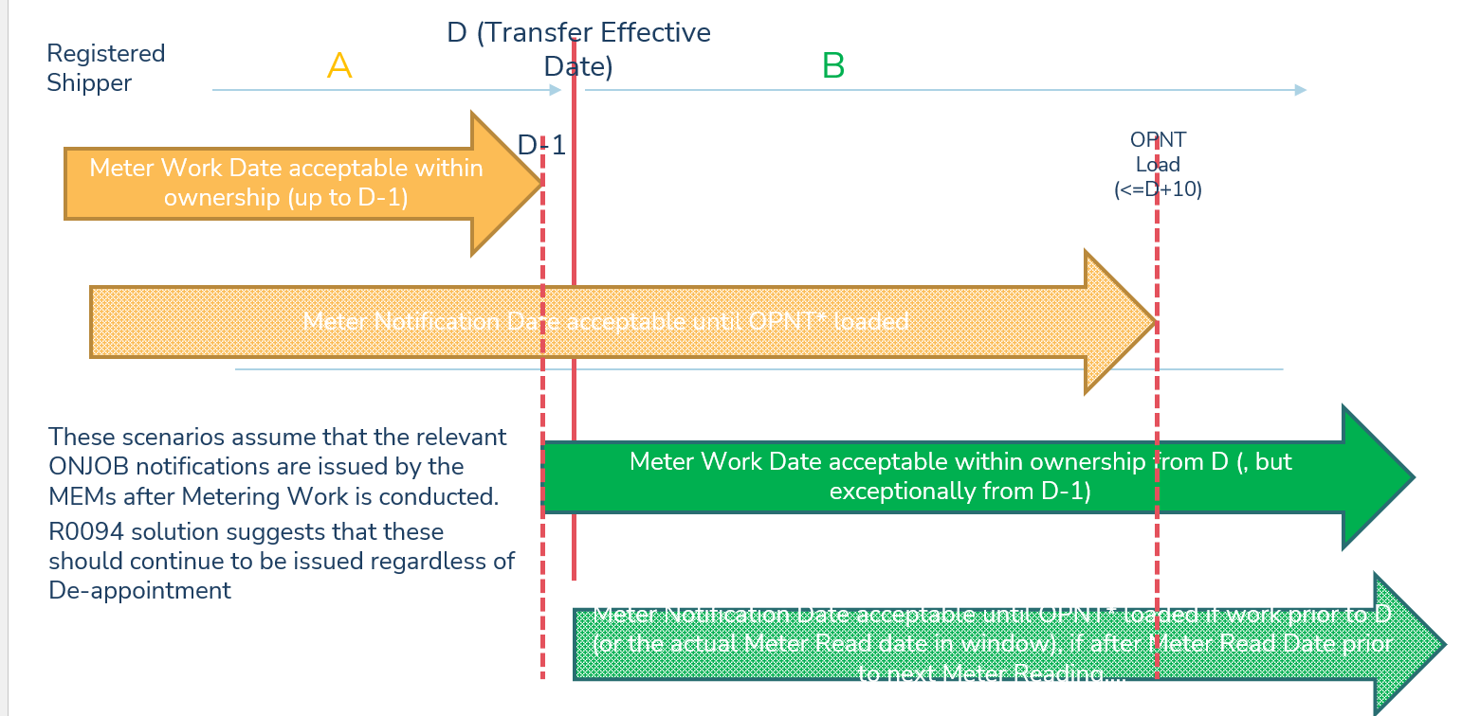
R0094 – scenarios
Graphic provided courtesy of Xoserve
Notes:
Hand over to DA to talk about this

Slide 16
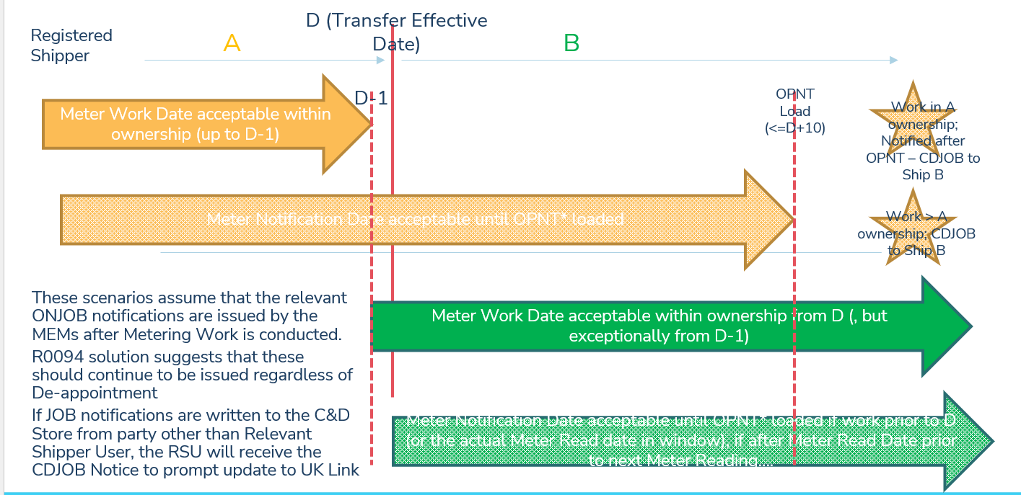
R0094 – SCENARIOS CONT.
Graphic provided courtesy of Xoserve
Notes:
Hand over to DA to talk about this

Slide 17
R0094 – Solution summary
The Code Manager and Xoserve have identified 3 solution options to remedy the 3 issue scenarios:
We believe a clarificatory legal text change would remedy scenario 1. All parties involved have a 10WD window to update CDSP with the new Meter Asset information. We propose the inclusion of a new paragraph within Schedule 14 – Metering Operations to remind parties of their obligations to update CDSP and the existence of the 10WD window.
The Code Manager may establish an obligation for the gaining supplier to respond to messaging from the C&D store that indicates action is required when the losing supplier’s messaging to the CDSP is rejected on account of being in the gaining Supplier's ownership period. We would explore using a CD JOB Market Message received by a gaining supplier as the prompt for this obligation.
As the bulk of issues occurring in scenario 3 happen due to Meter Asset jobs being conducted prior to D-1, we may introduce a requirement to prevent work being carrying out by a gaining supplier any earlier than D-1. <D-1 Market Messages would requirement amendment to be accepted by the C&D store even if they are notified >D-1, which we are not minded to allow.
Notes:
Talk through this but ask DA if he would like to provide any further clarification.

Slide 18
R0094 – Questions for rig
We would like to hear your take on this issue to understand the size and scale of the problem, and to open discussion about possible solutions:
What do you think of the proposed solution ?
Do you think the proposed solution will address the issue ?
Notes:
If

Slide 19
R0094 – Further comments
If you would like to contact me to discuss further, please reach me at:
Lydia.Bentley@recmanager.co.uk
Notes:
If

Slide 20
5. R0092 – DCC Service Level agreements for the switching incentive regime
REC Change Team

Slide 21
Background
The CRS’s Service Levels were based on assumptions made in the early phases of the Switching Programme and R0092 was raised to conduct a review to ensure these are still fit for purpose.
A work group has been operational since June and has been discussing the DCC’s proposals.
An Impact Assessment will be triggered today to gain Service Provider and Party feedback on the DCC’s proposals. This will include information on the work group discussions to provide that additional context.
There may be an alternate change proposal raised, dependent on the responses of this Impact Assessment.

Slide 22
Proposal 1 - MAXIMUM DEMAND VOLUMES
Maximum Demand Volumes are set out in the REC Service Definitions, and set out assumptions regarding the level of demand REC Services are expected to manage within the defined Service Levels in the REC. Where Service Levels are not met as a result of Maximum Demand Volumes being breached, the Service Provider would not usually be held accountable for the failure
The work group highlighted that there needs to be a better definition of how Maximum Demand Volumes are measured based on learnings from the early operation of the service. The definition should relate to the total number of messages relating to switching, rather than the switches themselves.
CSS Definition 7.3 (Switch Requests only)
Average daily volume = 42,300
Peak daily volume = 281,600
CSS Definition X.X (Total volume of messages)
Average daily volume = 455,000
Peak daily volume = 1,088,000
Industry ask
Do you agree with the proposed Maximum Demand Volume?
Do you believe this should be subject to an optimism bias?
Notes:
The work group agreed that the current Maximum Demand Volume of 281,600 was intended to relate to switching volumes, not the volume of all messages sent across the CSS network.
Create Switch
Create Registration
Intervention (Objections, Withdrawals and Annulments)
Update Registration
Update Supplier Appointed Agent.

Slide 23
Proposal 2 – synchronous responses
CURRENT
CSS Definition 6.1
6.1. Following receipt of Market Messages from CSS Users, the CSS Provider shall carry out synchronous validation and provide a response within the following times:
Performance Parameter | Performance Level
Average daily volume | Mean time of two seconds or less
Average daily volume | 90th percentile time of four seconds or less
Peak daily volume | Mean time of three seconds or less
Peak daily volume | 90th percentile time of six seconds or less
Industry ask
Do you agree with the proposal?
Do you believe there should be a maximum response time?
What do you think an appropriate maximum response time should be?
Any alternative proposals?
PROPOSED
Performance Parameter | Performance Level
Average and Peak daily volume | Mean time of two seconds or less
Notes:
The work group agreed that the current Maximum Demand Volume of 281,600 was intended to relate to switching volumes, not the volume of all messages sent across the CSS network.
Create Switch
Create Registration
Intervention (Objections, Withdrawals and Annulments)
Update Registration
Update Supplier Appointed Agent.

Slide 24
Proposal 3 – asynchronous responses
CURRENT
CSS Definition 6.2
The CSS Provider shall process a Registration Service Request (from the point of receipt by CSS to the point where CSS sends out the response of either "Validated" or "Rejected") as follows:
Performance Parameter | Performance Level
Average hourly volume | mean time of three seconds or less
Average hourly volume | 90th percentile time of six seconds or less
Peak hourly volume | mean time of five seconds or less
Peak hourly volume | 90th percentile time of eight seconds or less
Industry ask
Do you agree with the proposal?
Do you believe there should be a maximum response time?
What do you think an appropriate maximum response time should be?
Any alternative proposals?
PROPOSED
Performance Parameter | Performance Level
Average and Peak daily volume | Mean time of three seconds or less
Notes:
The work group agreed that the current Maximum Demand Volume of 281,600 was intended to relate to switching volumes, not the volume of all messages sent across the CSS network.
Create Switch
Create Registration
Intervention (Objections, Withdrawals and Annulments)
Update Registration
Update Supplier Appointed Agent.

Slide 25
Proposal 4 – gate closure
CURRENT
CSS Definition 6.3
The CSS Provider shall process the securing of Switches and send synchronisation messages of secured Switches at Gate Closure to each relevant Switching Data Service Provider (from the time of Gate Closure to the point at which CSS sends the last message) as follows:
Performance Parameter | Performance Level
Average daily volume | Mean response time of 20 minutes or less
Average daily volume | 90th percentile response time of 25 minutes or less
Peak daily volume | Mean response time of 35 minutes or less
Peak daily volume | 90th percentile response time of 40 minutes or less
Industry ask
Do you believe that the DCC should only be responsible for its control area?
Or should the end-to-end still be measured but managed by exemptions?
Do you agree with the Proposal?
Are there any other options?
Do you see changing Gate Closure SLAs as a risk?
PROPOSED
Performance Parameter | Performance Level
Average and Peak daily volume | Mean time of 35 minutes or less
Average and Peak daily volume | 90th percentile response time of 40 minutes or less
Notes:
The work group agreed that the current Maximum Demand Volume of 281,600 was intended to relate to switching volumes, not the volume of all messages sent across the CSS network.
Create Switch
Create Registration
Intervention (Objections, Withdrawals and Annulments)
Update Registration
Update Supplier Appointed Agent.

Slide 26
Proposal 5 – switching incidents
5.2 Switching Operator Service Definition
Switching Incidents will be categorised as follows:
Priority | Target Response Time | Target Resolution Time
Priority 1 | 30 minutes | 4 hours
Priority 2 | 1 hour | 24 hours
Priority 3 | 3 working hours | 3 working days
Priority 4 | 1 working day | 10 working days
Industry ask
Do you agree with the Proposal?
Do you believe that a maximum response time should be incorporated?
What should the maximum response time be?
Any other Proposals?
100% of the above met
PROPOSED
Priority | Response Target | Resolution Target
Priority 1 | 100% | 100%
Priority 2 | 100% | 100%
Priority 3 | 99% | 90%
Priority 4 | 99% | 95%
Notes:
The work group agreed that the current Maximum Demand Volume of 281,600 was intended to relate to switching volumes, not the volume of all messages sent across the CSS network.
Create Switch
Create Registration
Intervention (Objections, Withdrawals and Annulments)
Update Registration
Update Supplier Appointed Agent.

Slide 27
Proposal 6 – Service Requests
5.4 Switching Operator Service Definition
Switching Service Request will be assigned a priority based on the nature of the request. Each request is defined in the Switching Portal with the priority and service level that applies.
Priority | Definition | Targets
Priority 1 | Critical priority request | One working day
Priority 2 | High priority request | Two working days
Priority 3 | Medium priority request | Three working days
Priority 4 | Low priority request | 10 working days
Industry ask
Do you agree with the Proposal?
Any other Proposals?
PROPOSED
Priority | Fulfilment target
Priority 1 | 100%
Priority 2 | 100%
Priority 3 | 98%
Priority 4 | 98%
Notes:
The work group agreed that the current Maximum Demand Volume of 281,600 was intended to relate to switching volumes, not the volume of all messages sent across the CSS network.
Create Switch
Create Registration
Intervention (Objections, Withdrawals and Annulments)
Update Registration
Update Supplier Appointed Agent.

Slide 28
6. R0148 and the metadata catalogue
REC Change Team

Slide 29
R0148 and the metadata catalogue
R0148 involves the categorisation of data within the Enquiry Services which will help to improve, extend, and simplify access to data securely and efficiently. These will be 4 categories of Closed, Personal, Conditionally Open and Always Open.
Part of this Change Proposal will be to introduce a metadata catalogue and the draft of this was worked through with RECCo and other Code Bodies. This will need to be impact assessed by industry and can be found on the Change Proposal Page of the Portal here.
The ask
For the RIG to consider how this should be impact assessed and for how long.
Do you think an additional two columns at the end of each data item would be the best way to gain the feedback required? One to say do you agree with the categorisation and one for any additional comments?
If we triggered this Impact Assessment within the next 2 weeks, would the 12 January 2024 closure date be appropriate and give your organisation enough time to respond?

Slide 30
7. Return of mprn from postcode search on ges
REC Change Team

Slide 31
Problem Statement– Return of MPRN from Postcode Search of GES
Following a postcode search of GES, the following details are currently returned. Address id, UPRN, MPL address, REL address.
The Electricity Enquiry Service returns the MPAN for each property within a response to a postcode search.
GB Group Plc are requesting sight of the MPRN of all gas supply points in the postcode before other technical details are retrieved for a selected address because this is causing issues where the consumer cannot recognise any of the MPL addresses as their own. This issue is particularly pertinent for non – domestic premises that are predisposed to changes in occupier/ business name.

Slide 32
Impact of Issue and Suggested Solution
Consumers can have trouble in recognising and selecting an address following a postcode search of GES causing friction and frustration in the switching journey, possibly resulting in abandonment
Consumers may select an incorrect address which could result in an erroneous switch
The ‘happy path’ could allow any consumer experiencing difficulties recognising or selecting their address, to enter their MPRN to be checked by the supplier/PCW/Broker against the list of MPRNs returned from the postcode search.
The Meter Serial Number(s)associated with the MPRN would also be beneficial as the consumer would then be able to provide this to the energy supplier should they not know their MPRN.

Slide 33
Key questions
Is there a need to align the functionality of EES and GES?
Does anyone have similar concerns that consumers are experiencing difficulties in switching because of the way in which this information is presented?
If there are concerns what is the scale of the problem?
Is there an urgent industry need to resolve this issue?
Assuming that this is an issue. Are there any alternative solutions or work arounds in place?

Slide 34
8. Schedule 30 & risk driver 5.8
RIG member

Slide 35



Slide 36

Schedule 30 & Risk Driver 5.8 - background
5.8 Failure of the Initiating Supplier to respond to rejected proposed/alternate switch read on time leading to billing issues impacting consumers.
Following the receipt of an RFI relating to our performance against Risk Driver 5.8 we identified that there appeared to be disparity between our treatment of rejected D0300s and the treatment of them expected by the Code Manager. Essentially Schedule 30 obligates Suppliers to respond to rejection flows, and the Code Manager has been using this obligation to assess Party performance and assign risk scores.
We have held discussions with the code manager and agreed upon an initial action to raise this here today and then to develop a change to solve the problem.

Slide 37
Schedule 30 & Risk Driver 5.8 - Issues
The issues identified
  Schedule 30 (CFSB) does not recognise a D0300 rejection as an end status
  Because of this the Performance Assurance Code Manager is looking for a response flow
  This is causing all Suppliers to have adversely effected risk scores
  There is no read dispute/missing read process user guide

Slide 38
Schedule 30 & Risk Driver 5.8 - changes
What needs to change
  CFSB schedule needs to reflect what happens with the flows, this will provide clarity to Suppliers and to the Code Manager
  The Code Manager needs to reference additional data from their service provider (D10x/D86)
  A process guide would support Parties in understanding how to correctly use the rejection codes.
  Potentially the rejection codes need to be reviewed and updated and or removed

Slide 39
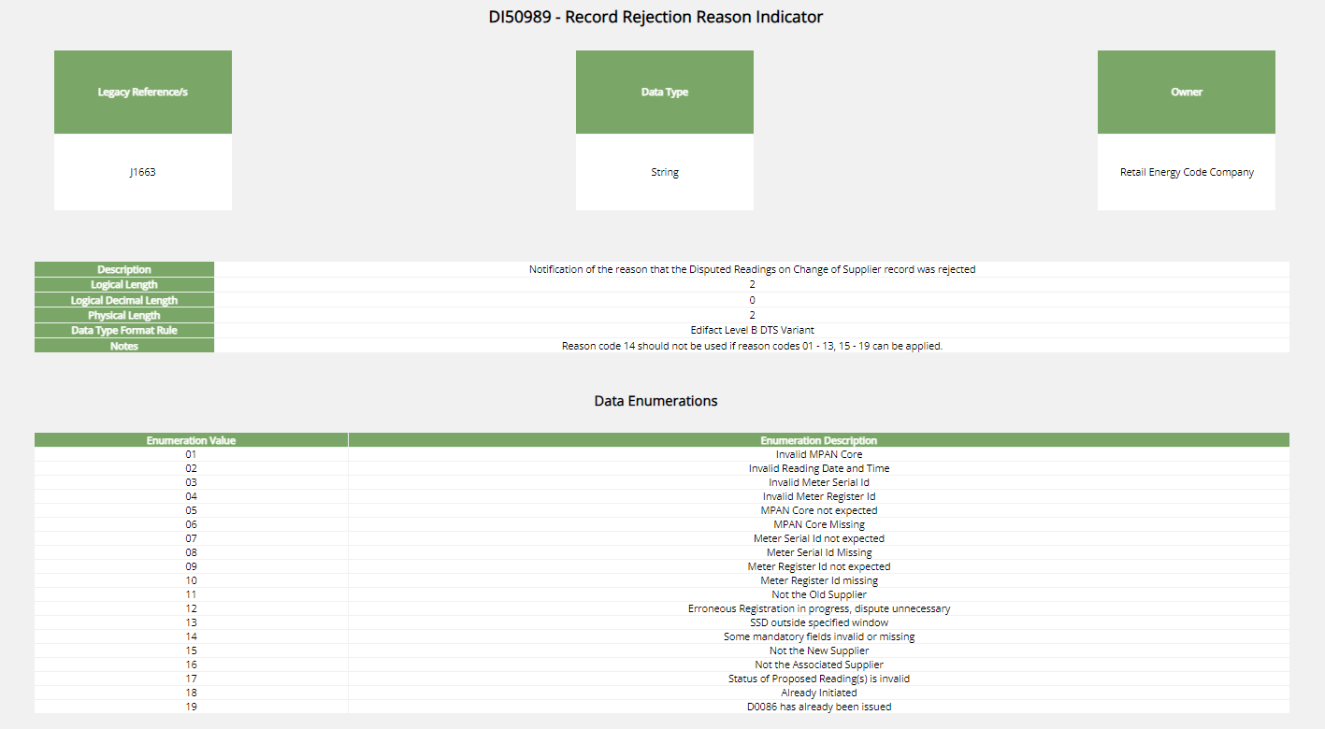

Slide 40


Slide 41
9. AOB
All

Slide 42
9a. R0037 – prepayment credit balance & debt transfer processes
REC Change Team

Slide 43
AOB – R0037 Solution development
R0037 Prepayment Credit Balance and Debt Transfer Processes – current status is with Code Manager relooking at solution development post legal review
Most recent proposed solution available Prepayment Credit Balance & Debt Transfer Processes - REC Portal
New proposed solution to be discussed at RIG 8th December – we are requesting parties come prepared with ideas and solution input
  Alternatively email them to change.management@recmanager.co.uk prior to the meeting for us to review

Slide 44
9b. introduction to erin
Rec technical services team

Slide 45

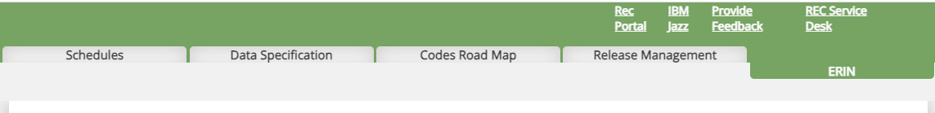
Meet erin
New artificial intelligence tool
Trained to answer questions on the REC
Available via the Digital Navigator and the REC Portal
Energy
Resource
Information
Network

Slide 46
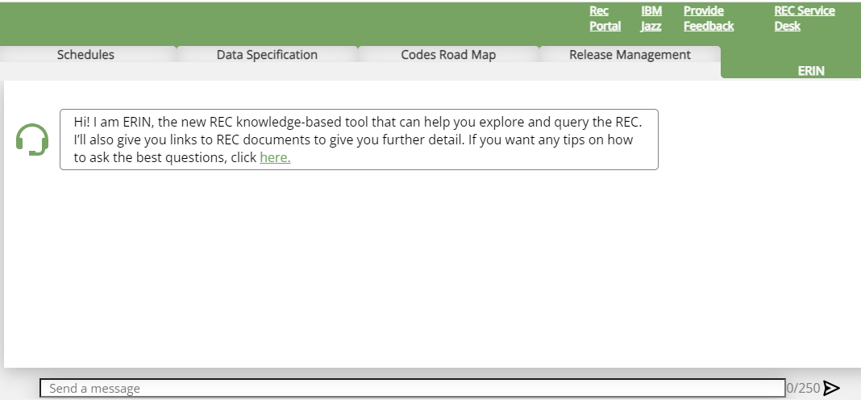
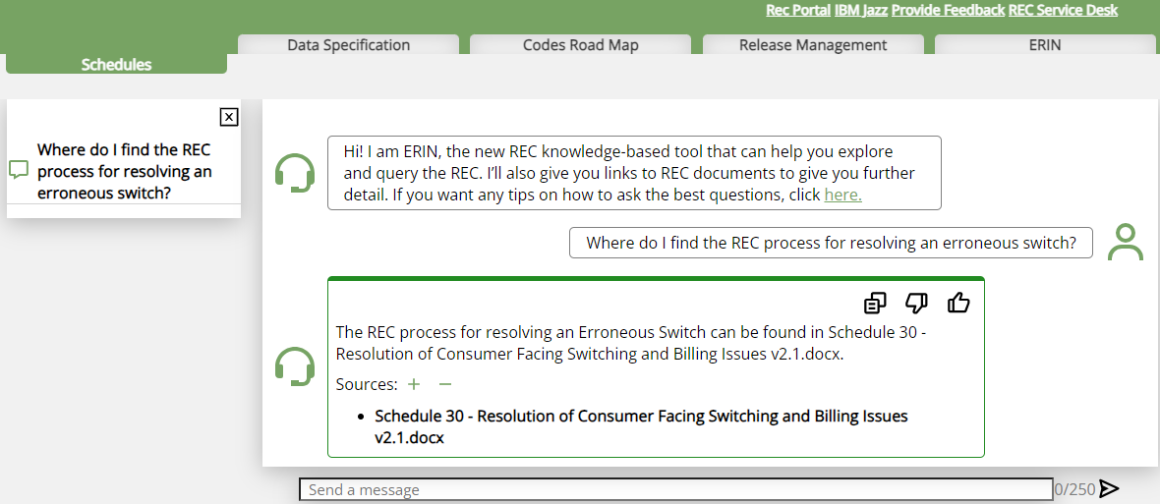
How to use erin in five simple steps
Type your question
Read the answer
Check the sources
Give a thumbs up/down
Ask another question!

Slide 47
Erin’s sources
Green
Main Body
Schedules
Operational Documents
Data Specification
Category 3 documents
Source for the answer has been verified
Amber
Answer provided but the source is not verified - answer should be treated with caution
Red
Please do read the disclaimer to understand what reliance you can place on Erin’s answers
ERIN cannot find the answer in the REC

Slide 48
Next meeting:
08 December 2023
Thanks for attending

