Slide 1
REC Issues group
11 August 2023

Slide 2
1. Introduction and agreement of agenda
Paul Witton-Dauris

Slide 3
Agenda For today
1 | Introductions and Agreement of Agenda | 10:00 | Chair
2 | Data Cleanse Update | 10.05 | REC Performance Assurance Team
3 | Data Cleanse issue DC10 Request for additional guidance on Report AR3C | 10.20 | REC Performance Assurance Team
4 | Guidance on REC Requirements for Annulments and Objections | 10.35 | REC Performance Assurance Team
5 | Update on P1 Switching incident | 10.45 | REC Performance Assurance Team
6 | Draft Information request on Customer Impact of DCC P1 issue (paper available on RIG meeting page) | 11.00 | REC Performance Assurance Team
7 | REC Change Proposal R0094 Clarify obligations on gas meter exchanges that occur close to COS | 11.30 | REC Change Analyst
8 | REC Change Change to REC Access Governance | 11.45 | REC Change Analyst
9 | REC Issue Update – Issue 19 Gas Disconnections process | 12.00 | Lead Analyst
10 | REC Change Proposal Consolidation - Legal Text changes | 12.15 | REC Change Team
 | Close | 13.00 | Chair

Slide 4
2. Data cleanse update
REC performance assurance team

Slide 5
3. Data cleanse issue DC10
Request for additional guidance on report AR3C
REC performance assurance team

Slide 6
Data Cleanse issue DC10 – Request for additional guidance on Report AR3C
Data Cleanse Report AR3C – Unrestricted Standard Settlement Configuration (SSC) / Active Relationship Flag
Description
Two or more MPANs that have unrestricted SSC where the Relationship Flag has been made active and no MPAN in the relationship has an SSC outside of the unrestricted range.
Request
Guidance requested for Data Cleanse Report AR3C, specifically:
  The related MPAN process and how the SSCs (related and unrelated) are determined.
  Actions required to resolve the MPANs identified.

Slide 7
4. Guidance on REC Requirements for Annulments and Objections
Amy Crowe-Lamont and Vaishnavi Sharma

Slide 8
Performance Assurance Risk Monitoring
REC Schedule 23 lists requirements for Suppliers in relation to the Annulments and Objections processes.
The Code Manager monitors the rate of use of Annulments and Objections as a part of the Performance Assurance risk monitoring and reporting to the Performance Assurance Board (PAB).
Earlier in the year, the Code Manager noted an increase in the volume of Objections despite the volume of switching remaining low. We also noted some Parties had high use of Annulments while they were not using Objections at all.
The Code Manager has also received allegations where some Parties may not be meeting their REC obligations for these processes.
To understand the cause for the spike, and to ensure Objections and Annulments were being in line with the Code, the Code Manager issued Request for Clarification (RFC) PATs.
This made it clear that Parties did not consistently understand which process to use when. To help Parties understand the Code we are providing guidance to clarify when to appropriately use Objections and Annulments within the Code and have also raised a Code change to make the Code much clearer .
This has really validated our RFC approach – where we are open to understanding the underlying cause, and do not assume the issue is caused by the Party.
We would like to test this guidance with RIG before circulating it to all Parties.

Slide 9
REC requirements for Annulments
When is it appropriate to use Annulments?
REC Schedule 23, 10.1: ‘A Losing Supplier must only submit an Annulment Request in respect of a Registration where the Losing Supplier is permitted to do so in accordance with its Energy Supply Licence.’
Standard Licence Conditions for Electricity and Gas Suppliers, Condition 14.2(d) & 14.4 (c) allows the use of Annulments where: ‘the Customer informs the licensee that they have not entered into a Contract with the proposed new Electricity/Gas Supplier and asks the licensee to prevent the Proposed Supplier Transfer from taking place.’
In summary: Annulments can only be used when a customer tells their existing supplier that they have not signed a new contract with a different supplier.

Slide 10
REC requirements for Annulments
Evidence retention requirements:
REC Schedule 23, 10.2: ‘A Losing Supplier which submits an Annulment Request must retain (for at least 1 year) evidence of the reason for the Annulment Request.
Standard Licence Conditions for Electricity and Gas Suppliers, Condition 14.10 requires: ‘If sub-paragraph 14.2(d) or 14.4(c) applies and the licensee has agreed to prevent a Proposed Supplier Transfer at the Domestic Customer’s or Non Domestic Customer’s request, the licensee must keep evidence of that request and of the reasons for it for at least 12 months after the request is made.’
Please note that the Code Manager may request this evidence to validate the appropriateness of the Annulment.

Slide 11
REC requirements for Objections
When is it appropriate to use Objections?
REC Schedule 23, 6.1: ‘A Losing Supplier may only raise an Objection where it is permitted to do so in accordance with its Energy Supply Licence.’
Standard Licence Conditions for Electricity and Gas Suppliers, Condition 14.2(a) allows the use of Objections where for a Non-Domestic Customer: ‘the licensee’s Contract with that customer for the supply of Electricity/Gas to the premises includes a term which allows the licensee to prevent the Proposed Supplier Transfer; and may be relied upon in the circumstances arising at that time’
In summary: Objections can only be used when:
the Losing Supplier has a contract with a customer, the terms of which allows them to object; or
the customer has outstanding charges that do not relate to a dispute or a failure of Losing Supplier to take appropriate action, and cannot be transferred to the Gaining Supplier under the Debt Assignment Protocol.
Standard Licence Conditions for Electricity and Gas Suppliers, Condition 14.4 (a) allows the use of Objections where for a Domestic Customers: ‘subject to paragraphs 14.5 and 14.7, if at the time the request is made Outstanding Charges are due to the licensee from that Domestic Customer’

Slide 12
REC requirements for Objections
Evidence retention requirements:
REC Schedule 23, 6.3: ‘Where a Losing Supplier raises an Objection to a Pending Registration which has been identified by the Gaining Supplier as relating to a Change of Occupier, the Losing Supplier shall keep (for at least 1 year) a record of the evidence relied upon by the Losing Supplier to justify that it has raised the Objection in accordance with its Energy Supply Licence.’
Please note that the Code Manager may request this evidence to validate the appropriateness of the Objection.

Slide 13
5. P1 switching incident update
Anton moden

Slide 14
6. Information request: Customer impact of DCC P1 Issue
Anton moden

Slide 15
Information request – customer impact
Is an online survey an appropriate approach?
Are there any questions that are unclear and could be improved?
Are there any questions that we have missed?
Are there any questions that would be challenging for you to respond?
We plan for this request to be issued mid August 2023. Is this an appropriate timeframe?
We plan on providing a two week timeframe for response. Is this an appropriate timeframe?

Slide 16
7. REC cp R0094
Clarify obligations on gas meter exchanges that occur close to COS
REC change analyst – Lydia bentley

Slide 17
R0094 – OVERVIEW
Following a meter job, the Central Data Service Provider (CDSP) are updated with ONJOB and JOB Market Messages from the MEM and Shipper, respectively. It has been reported that the CDSP are not always sent updated meter details if a meter job occurs concurrent with a switch.
As a result, the CDSP retains out of date meter information, and cannot make the new details available to the gaining supplier. This results in a poor Consumer experience as the gaining MEM & Supplier do not have accurate meter information.
Whilst the obligation for the MEM and Supplier to communicate to CDSP persists beyond de-appointment during a switch, we have been told that this is not clear within Schedule 14 – Metering Operations. A mechanism should be identified to reinforce MEM/Supplier obligations.
Notes:
If

Slide 18
R0094 – Current mechanism
There are currently two mechanisms by which the CDSP receive updated information following a meter job.
Pathway 1:
MEM > CDSP (via ONJOB)
Pathway 2:
MEM > Supplier (Via ONJOB) > Shipper (via ONJOB) > CDSP (via JOB)

Slide 19
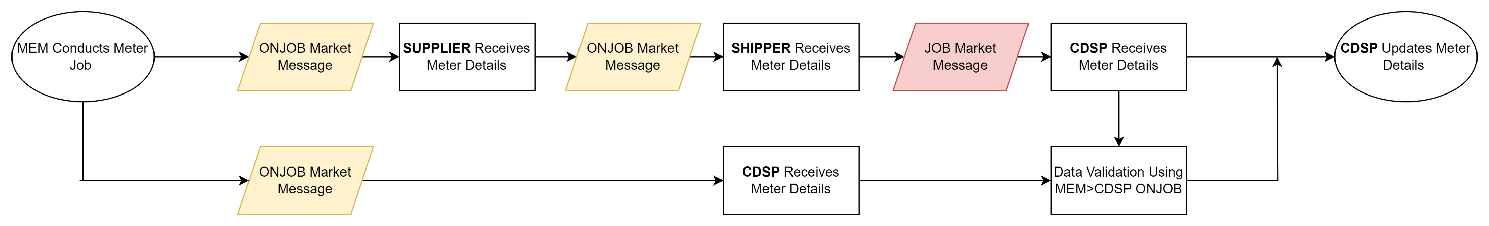
R0094 – Current mechanism

Slide 20
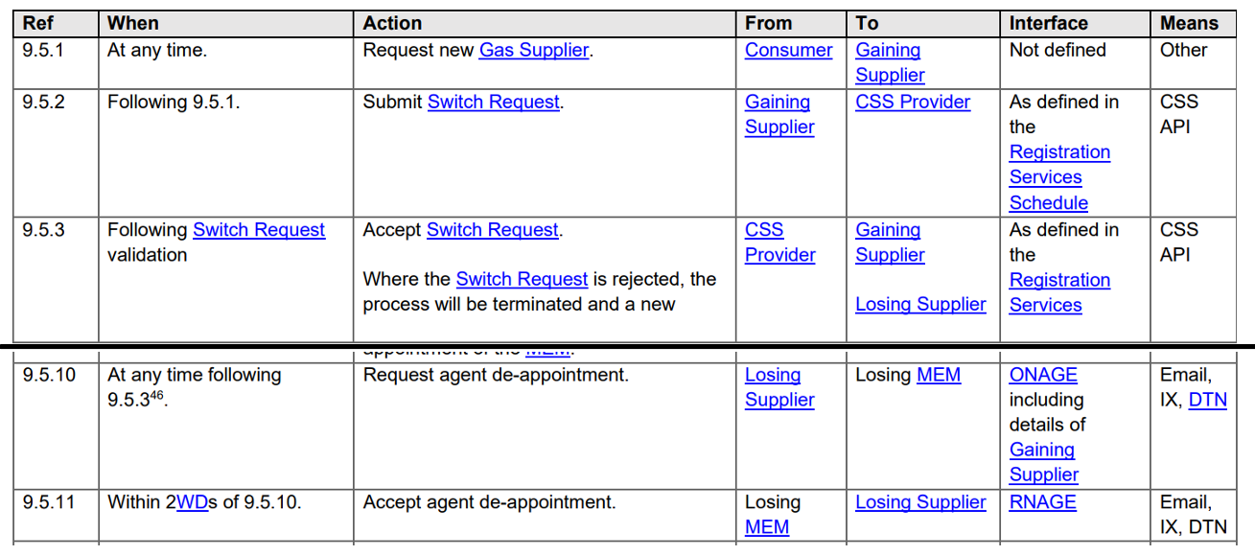
R0094 – concurrent switch
Notes:
If

Slide 21
R0094 – Core issue
The issue occurs when the MEM conducts a meter job where the job date falls within the two day window following receipt of the De-Appointment message from the Losing Supplier.
In this scenario, this problem can then occur in the following areas:
3
4
2
1

Slide 22
R0094 – proposed solution
The proposer has suggested a potential solution in 2 parts:
An amendment to the legal text of Schedule 14 – Metering Operations to re-affirm that the obligation on MEMs and Suppliers to send relevant market messages to the CDSP following a meter job persists beyond de-appointment.
Obligate the MEM/Supplier/Shipper to use CDR and UNR market message data to validate meter information upon change of supplier.
We’d been keen to hear the groups thoughts on this option.

Slide 23
R0094 – Questions for rig
We would like to hear your take on this issue to understand the size and scale of the problem, and to open discussion about possible solutions:
Gas Suppliers – Are you experiencing this issue ?
    If so, are you able to share any data about volumes ?
If you are experiencing this issue, can you identify where it is occurring in the process map ?
    We have identified 4 areas where this problem can occur – Does your experience support this ?
How would you like to see this issue addressed ? We welcome feedback on solution ideas.
    Do you have any alternative ideas on solution options, different to the one raised by the proposer ?
Notes:
If

Slide 24
R0094 – Further comments
If you would like to contact me to discuss further, please reach me at:
Lydia.Bentley@recmanager.co.uk
Notes:
If

Slide 25
8. REC change
Changes to REC access governance
REC change team

Slide 26
Background – Open Data Project
RECCo has identified an opportunity for consumers to benefit from improved product and service offerings with an Open First culture through the Open Data and Consumer Consent (ODCC) activities it has been undertaking, namely the creation of a Meta Data Catalogue and the classification of data items within the Data Access Matrices (DAM) of the REC. This work also fulfils future obligations expected to be placed on code bodies and energy retailers with regards to Ofgem Data Best Practice (DBP) standards. RECCo published its Open Data Review¹ paper in July 2023 which provides further insight of the work undertaken to date.
Alongside this ongoing Open Data activity, the Enquiry Services have been receiving a growing number of requests from users whose access use cases are valid, yet they are not listed in Schedule 12. Consequently, these users have to go through the formal change process to have their market role and access permissions included in Schedule 12 and the DAM. An exceptions process has been developed (Process 4) in the interim. However, the use of this process is becoming increasingly common. It is evident that the role-based framework imposes restrictions on data accessibility, and the existing roles are not adaptable enough to accommodate ongoing changes within the energy industry.
The portfolio of Change Proposals relating to this issue sits at approximately 17 which are at varying stages of the Change Process.
As such, there are two CPs that are to be taken forward in support of moving to Open Data and resolving the current issues regarding user access requests:
CP 1 seeking to achieve a streamlined process to resolve today's governance issues; access for those with legitimate purpose but not listed in Schedule 12; and establishing some additional user categories to help to future proof user access.
CP 2 will consult and work with industry during the CP process to enable classification-based access via the introduction of data classification into the REC (part of the REC Forward Work Plan), and to support industry with future obligations on industry from the Ofgem DBP standards.
¹ https://www.retailenergycode.co.uk/fs/wp-content/uploads/2023/07/Final-Open-Data-Review-v.1.pdf

Slide 27
Open Data Change Roadmap
Aug 2023
Raise CP1 (option A or B) to resolves today's governance
Nov 2023
Implement CP1 (option A or B)
Apr 2024
Raise CP2 for Introduction of open data classification
Implement CP2 introducing open data classifications (i.e. Always Open, Conditionally Open, Personal, Prohibited) of DAM data items in place of role based accessed

Slide 28
Background – schedule 12 and dam
Under the current Change Process, where a new user wants to access data, an amendment is required to Schedule 12 – Data Access and the relevant Data Access Matrix via a Change Proposal.
When assessing the priority of this Change Proposal, these are normally determined to be a Low Priority change.
To ensure these types of requests can be processed more efficiently and user benefits realised more quickly, we wish to make changes to the current process.
There are two options for how this can be taken forward, labelled as Option A and Option B.
Exceptions to Market Roles becoming increasingly common.
Role based framework places restrictions on the accessibility of data.
Market roles are too narrow. Does not reflect market roles which could exist in 10 years time.
Users who use case for access is valid, but are not listed on Schedule 12, must request to be added via the formal change process = lengthy.
Doesn’t support the futureproofing of the energy industry.

Slide 29
Change Proposal 1 – a vs b
Change Proposal 1A (preferred)
Remove the Enquiry Service User categories from Schedule 12 and place them within a newly created CAT 3 document.
Move the Gas and Electricity DAM from CAT 2 documents to CAT 3 documents.
Due diligence
Both DAMs will be placed under the control of the RECCo Board with delegated authority to the REC PAB.
Alter the PAB Procedures to mandate PAB consults on any changes to the DAMs or the newly created CAT 3 document via the RIG or another expert group.
Circa 10 CPs would be given their access as soon as possible following the implementation Change Proposal 1A.
Change Proposal 1B (alternate)
List of User Categories and Purposes remains in Schedule 12
DAM remains as CAT 2 document
Introduce a revised Change Management governance Process in Schedule 5 to support changes to the DAM and Schedule 12.
DAM and Schedule 12 will be excluded from the traditional obligations set out in Schedule 5.
DAM and Schedule 12 under the control of RECCo Board with delegated authority to the REC PAB.
Known use cases/purposes for access will be used to test the changes introduced.
Circa 10 CPs would be given their access as soon as possible following the implementation Change Proposal 1B.

Slide 30
Change Proposal 1A
List of documents changed (red-lined Draft Legal Text provided in zip folder)
Schedule 12 – Data Access (Category 1)
Data Access Matrices (no change, just moved from Category 2 to Category 3)
Creation of Enquiry Service User Categories Document (Category 3)
PAB Procedures (Category 3)
REC Baseline Statement (Category 3)

Slide 31
Change Proposal 1B
List of documents changed
Schedule 12 – Data Access (Category 1) – governance changes from usual process for changes to new users and purpose.
Schedule 5 – Change Management (Category 1)
PAB Procedures (Category 3)
REC Baseline Statement (Category 3)

Slide 32
Change Proposal 1B
No changes to the Categorisation of Schedule 12 or the DAM
PAB under delegated authority from the RECCo Board will decide on changes to the DAM and Schedule 12 Data Access Requests as part of a formally recognised but revised Change Management Process.
Addition of a clause to Schedule 5 which stipulates changes to the DAM and Schedule 12 will follow a Data Access Request process. A process already exists for handling Meter Product Data updates (Paragraph 28 of Schedule 5).
Notes:
OR DAM and Schedule 12 follow a bespoke process whereby case for change is set out, consulted upon and sent to PAB for approval. Process to stipulated as a process in Schedule 5 but it is streamlined.

Slide 33
Proposed future process – 50WD
 | FROM | TO
INITIAL REVIEW OF ACCESS REQUEST (1WD) | 11/08/2023 | 14/08/2023
ACCESS REQUEST REFINEMENT (10WD) | 14/08/2023 | 29/08/2023
SERVICE PROVIDER IMPACT ASSESSMENT | 30/08/2023 | 04/10/2023
SEEK FEEDBACK FROM RIG (PAPER DAY AND MEETING) CONCURRENT PROCESS WITH SPIA | 01/09/2023 | 08/09/2023
SEND SPIA AND RIG RECOMMENDATION TO PAB | 13/10/2023 | 13/10/2023
CATEGORY 3 CHANGE RAISED NOTIFICATION | 13/10/2023 | 13/10/2023
CATEGORY 3 CHANGE IMPLEMENTED NOTIFICATION | 20/10/2023 | 20/10/2023
Notes:
OR DAM and Schedule 12 follow a bespoke process whereby case for change is set out, consulted upon and sent to PAB for approval. Process to stipulated as a process in Schedule 5 but it is streamlined.

Slide 34
Current change process – 137 wdS
 | FROM | TO
IAR AND CPP PUBLISHED AND APPROVED | 25/08/2023 | 05/09/2023
SERVICE PROVIDER IMPACT ASSESSMENT | 08/09/2023 | 10/10/2023
PARTY IMPACT ASSESSMENT | 13/10/2023 | 03/11/2023
PRELIMINARY CHANGE REPORT ISSUED | 10/11/2023 | 10/11/2023
RESPONSIBLE COMMITTEE REVIEW | 21/11/2023 | 21/11/2023
CONSULTATION | 24/11/2023 | 15/12/2023
FINAL CHANGE REPORT ISSUED | 29/12/2023 | 29/12/2023
RESPONSIBLE COMMITTEE DECISION | 09/01/2024 | 09/01/2024
APPEAL WINDOW CLOSURE | 23/01/2024 | 23/01/2024
TARGETED RELEASE | 23/02/2024 | 23/02/2024
Notes:
OR DAM and Schedule 12 follow a bespoke process whereby case for change is set out, consulted upon and sent to PAB for approval. Process to stipulated as a process in Schedule 5 but it is streamlined.

Slide 35
Implementation timescales of governance cp
November 2023 Release
 | FROM | TO
CHANGE PANEL APPROVAL OF INITIAL ASSESSMENT REPORT AND CHANGE PROPOSAL PLAN | 05/09/2023 | 05/09/2023
PRELIMINARY CHANGE REPORT AND CONSULTATION ISSUED | 08/09/2023 | 08/09/2023
CONSULTATION | 08/09/2023 | 22/09/2023
FINAL CHANGE REPORT ISSUED | 06/10/2023 | 06/10/2023
RESPONSIBLE COMMITTEE DECISION | 17/10/2023 | 17/10/2023
APPEAL WINDOW CLOSURE | 31/10/2023 | 31/10/2023

Slide 36
Questions for stakeholders
Do you have any questions on either solution?
What are your perceived challenges with either approach?
Do you agree with the preferred option of CP1A?
Please note: the focus at this time is on CP1, any questions or requests for further information on CP2 or the Open Data Review please email info@retailenergycode.co.uk and see the Open Data Review¹.
¹ https://www.retailenergycode.co.uk/fs/wp-content/uploads/2023/07/Final-Open-Data-Review-v.1.pdf

Slide 37
9. REC issue 19 gas disconnection process
Tom Stuart – Wales and west utilities

Slide 38
Gas supply disconnection
Reasons that customers want to stop using gas:
Move to alternative method of heating
Customer is carrying out works that affect the DNs pipework e.g. demolition, re-development, or extension
Customers are being referred to DNs to:
‘Cap the supply prior to the meter being removed’
Disconnect the service prior to the meter removal
Why is this a problem:
Customers pay for a disconnection when it's not necessary (happy to leave capped or cut off under GSR)
Miscommunication
Frustration - customers find themselves in the middle of conflicting information by suppliers and networks
Complaints & escalation to the ombudsman
Issue of incorrect data flowing through central systems

Slide 39
Customer journey to disconnect a gas supply
Step 1: Disconnection of the internal pipework (outlet) The customer must organise this via their Gas Safe engineer
Step 2: Meter disconnection & removal. The customer should organise the removal of the meter via their gas supplier. The meter must be removed prior to the disconnection of the service pipe
If the customer is not doing any works that affect the DNs pipework, then the customer can leave the service capped at the ECV. The Gas Safety (Installation & Use) Regulations 1998 (paragraph 16(3)(b)) process will be triggered if a new meter is not fitted within 9 months from the meter removal which may lead to the service disconnection at the main.
If the customer is doing works that affect the pipe, they must contact the DN (or GIRS accredited company) to organise a service disconnection.
Step 3: Disconnection of the service. These are chargeable works. The customer must apply for a quote. The meter must be removed before the service disconnection
Step 4: Xoserve records updated. Shipper to update meter removal and DN to update the status of the MPRN to DE (Dead)
Notes:
Step 1: Disconnection of the internal pipework (outlet). The customer must organise this via their Gas Safe engineer.
Always direct people to the Gas Safe Register - The Official List of Gas Safe Registered Businesses - Gas Safe Register has replaced CORGI registration. Don't cut corners, only use a Gas Safe registered engineer.
Step 2: Meter disconnection & removal. The customer must organise the removal of the meter via their gas supplier. The meter must be removed prior to the disconnection of the service pipe.
If the customer is not doing any works that affect the DNs pipework, then the customer can leave the service capped at the ECV. The Gas Safety (Installation & Use) Regulations 1998 (paragraph 16(3)(b)) process will be triggered if a new meter is not fitted within 9 months from the meter removal.
If the customer is doing works that affect the pipe, they must contact the DN (or GIRS accredited company) to organise a service disconnection.
Step 3: Disconnection of the service. These are chargeable works. The customer must apply for a quote. The meter must be removed before the service disconnection.
Step 4: Xoserve records updated. Shipper to update meter removal and DN to update the status of the MPRN to DE (Dead).

Slide 40
Summary
The customers internal pipework must be disconnected, and the meter disconnected and removed before a DN can disconnect the service pipe
Advising the customer correctly is key
A clear and consistent approach is needed - A training package is being developed with Xoserve to support this

Slide 41
10. REC change proposal consolidation
- R0058, R0104 and R0129
REC change team

Slide 42

BACKGROUND
This change seeks to efficiently address the issues raised under the following Change Proposals.
R0058 – REC Services Procurement Clarification
R0104 – Clarifying Requirement for Continuous Billing Following an Erroneous Switch
R0129 – Clarifying Event of Default Requirements
These Change Proposals have been identified by the Code Manager as requiring non-contentious, clarificatory and non-material alterations to the REC Legal Text only.

Slide 43
R0058 - REC Services Procurement Clarification
The Data Communications Company (DCC) highlighted that the current drafting within Clause 5.3 of the REC Main Body could impact both RECCo and the DCC’s ability to protect input VAT entitlements as a recipient of the Centralised Registration Service (CRS). The suggested amendment to Clause 5.3 would clarify that all provision of REC Services to the REC Service Users (including the Centralised Registration Service is procured by, and from, the CRS Provider) and are procured from the REC Service Providers by RECCo.

Slide 44
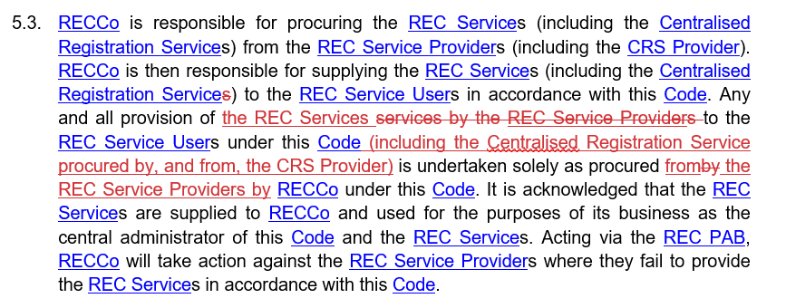
R0058 –PROPOSED LEGAL TEXT
REC Main Body

Slide 45
R0104 – CLARIFYING REQUIREMENT FOR CONTINIOUS BILLING FOLLOWING AN ERRONEOUS SWITCH
One of the required outcomes of an Erroneous Switch is that the Consumer is only billed once for the period of Erroneous Switch. R0104 seeks to make it explicitly clear within Schedule 30 - Resolution of Consumer Facing Switching and Billing Issues that in the case of an Erroneous Switch, the Supplier that erroneously gained the Supply, should not bill the Consumer.

Slide 46
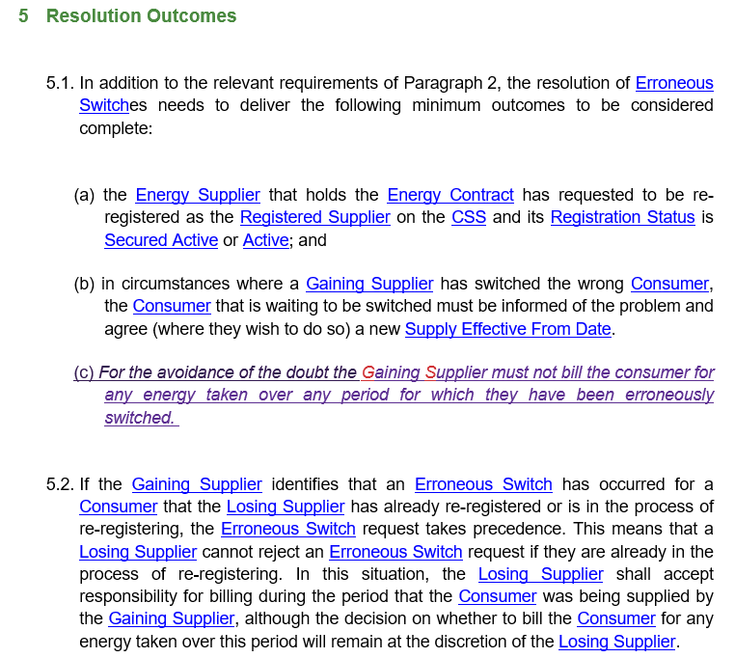
R0104 – Proposed legal text
Schedule 30 –
Resolution of Consumer Facing Switching and Billing Issues

Slide 47
R0129 – Clarifying Event of Default Requirements
Following several recent events of non-payment for services and REC defaults, it has been identified that the Event of Default provisions in the Code are unclear. This change seeks to add clarity to the REC Main Body in that persistent non-payment constitutes an Event of Default.

Slide 48
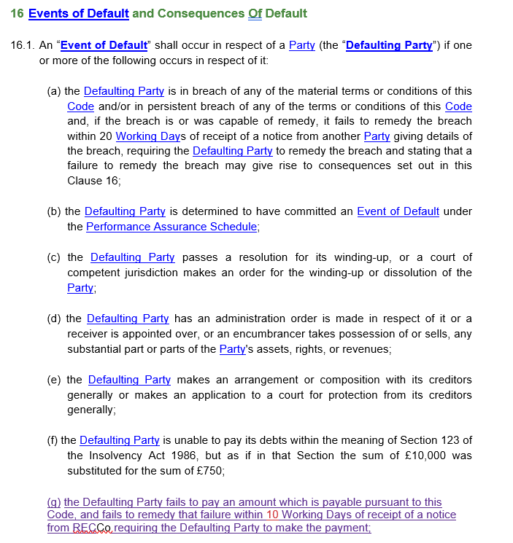
R0129 – Proposed legal text

Slide 49
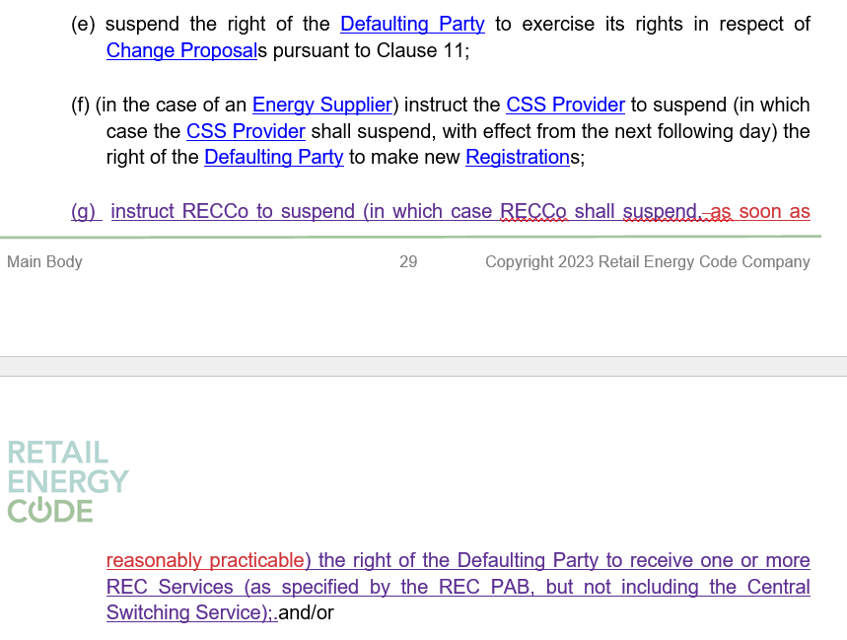
R0129 – Proposed legal text

Slide 50
aob

Slide 51
SPECIAL RIG – 18 August 2023
As part of the REC Change Proposal Consolidation work, a special RIG meeting will be held on Friday 18 August 2023.
This is session will consider the consolidation of currently live CPs relating to changes to the SDEP system
If you have not yet received an invitation to this event, or would like to add an additional attendee to the list, please contact enquiries@recmanager.co.uk

Slide 52
Next meetingS:
Special RIG: 18 August 2023
Regular RIG: 08 September 2023
Thanks for attending

