Slide 1
REC ISSues group
08 december 2023

Slide 2
1. Introduction and agreement of agenda
Shelley rouse

Slide 3
Agenda For today
 | TITLE | TIME | LEAD
1 | Introductions and Agreement of Agenda | 10:00 | Chair
2 | Data Cleanse Update | 10:05 | REC Performance Assurance Team
2a | Data Cleanse Update Data Cleanse Reporting | 10.15 | REC Performance Assurance Team
3 | Cadence of Issuing Performance Assurance Techniques | 10:30 | REC Performance Assurance Team
4 | R0037 – Prepayment Credit Balance & Debt Transfer Process | 10.40 | REC Change Team
5 | R0142 – Amendment to Multiplication Factor Enumerations to Support Hydrogen Trials | 11:10 | REC Change Team
6 | AOB | 11:40 | REC Change Team
7 | Close | 12:00 | Chair

Slide 4
2. Data cleanse update
REC performance assurance team

Slide 5
DATA CLEANSE SPRINT Update
Lewis WIlliams

Slide 6
Data Cleanse Sprint Update
Sprint 1 has now closed, as of the issuing of the December reports yesterday.
We will be conducting a full review of the sprint over December and January.
Subject to review, appropriate PATs will be applied to Parties who have not made sufficient progress in the sprint.
We are aiming to launch a second sprint in February/March 2024, to be confirmed following the review.

Slide 7
Domestic Premises Indicator
Lewis Williams

Slide 8
Domestic Premise Indicator
The version of the Domestic Premise Indicator (DPI) used in CSS is: DI90016
To update/maintain the data item:
  Use the CSS Market Message: CSS02000
  Refer to REC Schedule 23 – Registration Services, Section 16 for further guidance on the process
We’re investigating the potential issue and trying to gain access to further data to allow us to confirm the issue or not.
Subject to the investigation, we may run a specific sprint to make sure the DPI is accurate for use in the Energy Theft Target calculations and our wider risk monitoring.

Slide 9
2a. Data cleanse reporting
REC performance assurance team

Slide 10
3. Cadence of issuing performance assurance techniques
REC performance assurance team

Slide 11
Party assurance Technique Cadence update
From feedback provided we have updated the cadence of when PATs will be issued. Timeline below highlights that we will align the issuing of PATs (i.e. Queries/ RFIs etc) with SMIS reporting on a quarterly basis with the aim to improve the effectiveness of PATs.
Dec 23 | Jan 24 | Feb 24 | Mar 24 | Apr 24 | May 24 | Jun 24 | Jul 24 | Aug 24
SMIS
SMIS
SMIS
PATs
PATs
PATs
Continuous monitoring on Parties’ performance with regards to Risk Drivers will be carried out monthly and reported to PAB.
We will notify Parties to make them aware of their performance if they are above threshold. This notification will signpost them to their dashboard and highlight any guidance that is available on the REC portal.

Slide 12
4. R0037 – Prepayment Credit Balance & Debt transfer process
REC change team

Slide 13
R0037 Prepayment Credit Balance & Debt Transfer Processes
R0037 Prepayment Credit Balance and Debt Transfer Processes – current status is with Code Manager relooking at solution development post legal review
Our proposed solution is that additional data items are added into the Gains/Losses CSS flows where the Gaining Supplier confirms
  They have a smart Prepayment contract
  There has not been a COT (no change required, current data item)
  The Consumer has consented to the credit / debt transfer
Where all 3 conditions are met, the Losing Supplier does NOT reset the meter to Credit Mode allowing the credit / debt to transfer to the Gaining Supplier
When the transfer reading is received, this is then used for the Suppliers to invoice as required
This solution is only proposed for DCC enrolled smart meters

Slide 14
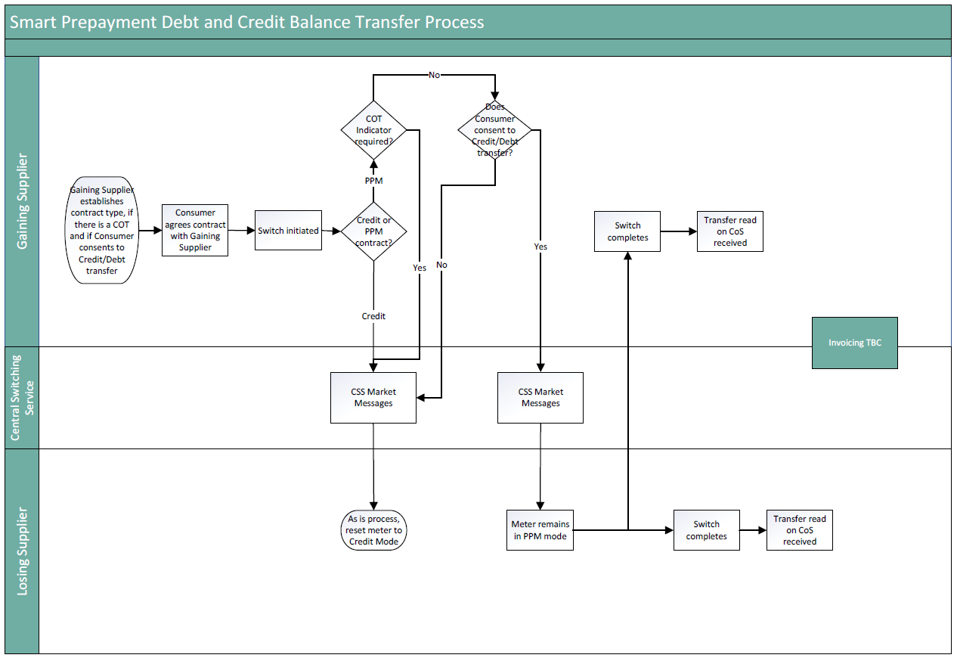
R0037 Prepayment Credit Balance & Debt Transfer Processes

Slide 15
R0037 Prepayment Credit Balance & Debt Transfer Processes
Questions for RIG
Are there any major concerns with this suggested solution or any alternatives?
Are these 2 new data items sufficient or is there any other information Suppliers feel would need to be confirmed?
Are there any suggestions on what the credit / debt levels should be capped at?
Are there any preferences regarding invoicing on either MPxN level or a monthly aggregated level?
How could an escalations process work?
Does there need to be a separate process for when a COT becomes known after the COS to return the credit / debt to the Losing Supplier?
Are there any suggestions on how this process could be treated during a SOLR?

Slide 16
5. r0142 – Amendment to multiplication factor enumerations to support hydrogen trials
REC Change Team

Slide 17
R0142 – OVERVIEW
The H100 hydrogen gas trial involves the supply of hydrogen gas to households in place of natural gas. The quantity of gas supplies needs to be billed in a way that consumers are not charged more than they would have been for the same amount of natural gas. To calculate this, we need to use hydrogen’s calorific value.
Changes to calorific values are technically challenging and are expected to result in substantial consequential changes.
A simplified temporary approach has been put forward for the trial. The proposed solution is to modify the multiplication factor by an amount that will result in a corrected kWh figure for hydrogen, based on what it would have been if it had been calculated with the correct calorific value.
To facilitate the trial, a multiplication factor enumeration value must be established within the Data Specification that can replicate hydrogen’s calorific value, therefore allowing accurate billing.
Notes:
If

Slide 18
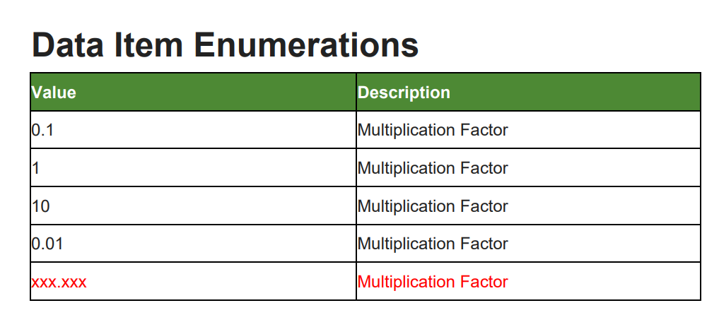
R0142 – Proposed solution
The Code Manager proposes to introduce a new enumeration value for the DI40145 – Multiplication Factor Data Item. This will take the total number of enumerations from 4 to 5. The new value will take the same logical and decimal lengths, and the same format as existing values.

Slide 19
R0094 – proposed solution
The following Market Messages contain the DI40145 – Multiplication Factor Data Item:
Market Message | Name | Users
MM40008 | ORJOB – Meter Job Request | Suppliers, MEMs
MM40009 | ONJOB – Meter Job Notification | Suppliers, MEMs, Shippers, CDSP
MM40013 | ONAGE – MAM Appointment/De-Appointment | Suppliers, MEMs
MM40014 | ONUPD – Notification of Metering Asset Details Update | Suppliers, MEMs, Shippers, MAPs, CDSP
MM40033 | ONDET – Transfer of Metering Asset Details | MEMs

Slide 20
R0142 – Questions for rig
The Code Manager has taken the decision to proceed to Party Impact Assessment without the final calculated value for the new Multiplication Factor enumeration. We took this decision on the following basis:
We anticipate that most REC Parties’ impacts will stem from the addition of a new enumeration, rather than the actual value itself.
  i.e. Billing systems may be set up to accommodate 4 values, and the impact comes from the action of introducing room for a 5th, not from the exact value itself.
The final calculated value will be available (following Ofgem approval) by the new year. Therefore, we will be able to go to Consultation with the final value. We expect that having access to the value at consultation stage will make up for not having it at Party Impact Assessment.
Do you agree with our assessment ? We welcome your thoughts and feedback.
Notes:
If

Slide 21
R0142 – Further comments
If you would like to contact me to discuss further, please reach me at:
Lydia.Bentley@recmanager.co.uk

Slide 22
6. AOB
ALL

Slide 23
Next meeting:
12 January 2024
Thanks for attending

