Slide 1
REC ISSues group
13 OCTOber 2023

Slide 2
1. Introduction and agreement of agenda
Shelley rouse

Slide 3
Agenda For today
 | TITLE | TIME | LEAD
1 | Introductions and Agreement of Agenda | 10:00 | Chair
2 | MPRS Rejecting D0205’s | 10:05 | Lead Analyst
3 | Data Cleanse Update | 10.20 | REC Performance Assurance Team
3a | Data Cleanse Update Data Cleanse Reporting | 10.35 | REC Performance Assurance Team
 | Data Cleanse AOB Related MTC reports | 10.45 | RIG Member
4 | R0092 – DCC Service Level Agreements for the Switching Incentive Regime | 10:50 | REC Change Team
5 | R0117 - Retrospective Implementation of DCP383 | 11:05 | REC Change Team
6 | Return of MPRN from Postcode Search on GES | 11:20 | REC Change Team
7 | Controlled Distribution of ‘Consolidated Report’ Extracts of Meter Point Data | 11:35 | REC Change Team
8 | R0132 - Change the Logical Format of J0001 | 11:50 | REC Change Team
9. | Erroneous Switch Resolution Timeline Change | 12:05 | RIG Member
10 | RIG Issues Update – New PSR Codes following SLC changes on PPM Installation Requirements | 12:20 | Lead Analyst
10a | RIG Issues Update – Out of Hours Distributor Bypass – Vulnerable Customers | 12:35 | Lead Analyst
11 | AOB | 12:50 | All

Slide 4
2. MPRS Rejecting D0205 flows
Lead analyst

Slide 5
Market Domain Data
Matt Cogram
Product Analyst
13 October 2023

Slide 6
Agenda
Overview of Market Domain Data
What is MDD
Key Processes and Timeline
MDD Publish
Change Requests
Raising an MDD Change Request
Timeline of MDD Releases and Publish
Common Supplier Change Requests
Change Request Examples

Slide 7
Overview of MDD

Slide 8
What is MDD?
A database containing reference data used by Suppliers, Supplier Agents, DNOs and IDNOs in the retail electricity market
It includes significant information such as Standard Settlement Configuration (SSC), Profile Classes (PC), and Grid Supply Point (GSP) Groups
Essential to the operation of SVA Trading Arrangements (and Settlement)
Primarily used for reference purposes

Slide 9
Who owns the data?
Market Participant
MDD details Market Participant information and Data in a central repository
ELEXON
ELEXON manages the changes applied to the database and validates the new data.
SVA Agent
The SVA Agent is responsible for updating the database with the latest changes.
Market Domain Data
BSCP509 Appendix 4.1 lists who can create and change each Entity

Slide 10
MDD Release Schedule
A new version is published approximately every month
Key dates (e.g. Deadlines, Publish Dates and Go-Live Dates) for each version of MDD are available on ELEXON’s website
MDD Version Number | General Change Request Deadline | Fast Track Change Request Deadline | Publish Date | Go-Live Date
339 | 09/08/2023 | 22/08/2023 | 13/09/2023 | 20/09/2023
340 | 06/09/2023 | 19/09/2023 | 11/10/2023 | 18/10/2023
341 | 11/10/2023 | 24/10/2023 | 15/11/2023 | 22/11/2023
342 | 08/11/2023 | 21/11/2023 | 13/12/2023 | 20/12/2023

Slide 11
Change Requests

Slide 12
Raising a Change Request (CR)
Change Request
BSCP509/01 Form
Entity Forms
Entity Forms
Entity Forms
Submitted via Email by Authorised Signatory
ELEXON
MDD Co-ordinator
mddc@elexon.co.uk

Slide 13
Common Supplier Change Requests
The most common changes submitted are:
Entity 1 – Market Participant
Entity 45 – Market Participant Role
Entity 61 – BM Unit for Supplier in GSP Group

Slide 14
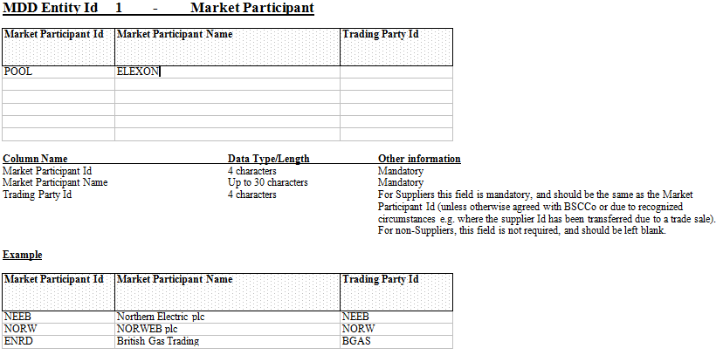
Entity 1
Entity 1 sets up the Market Participant ID against the Party Name

Slide 15
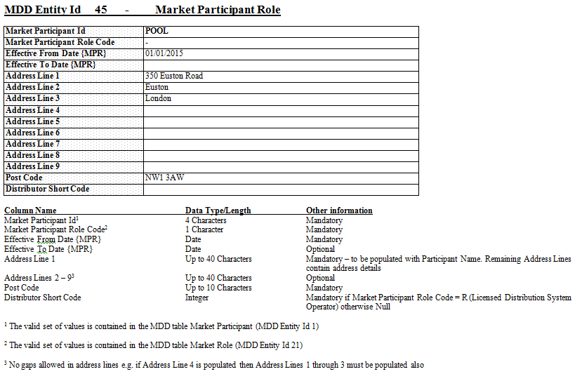
Entity 45
Entity 45 sets up the Role Code and registered address against the MPID.

Slide 16
3. Data cleanse update
REC performance assurance team

Slide 17
3a. Data cleanse reporting
REC performance assurance team

Slide 18
3. Data cleanse AOB related MTC reports
REC performance assurance team

Slide 19
Rig a.o.b. – Data cleanse – related mtc reports
Original purpose of Meter Timeswitch Code (MTC)
Providing basic knowledge of metering on site for potential new suppliers (Tariff)
Providing indication if an MPAN is Related
Proposal on Data Cleanse reports regarding MTC
Incorrect MTC doesn’t currently impact Consumer
In Central Switching Service (CSS) the Relationship Flag and Primary/Secondary MPAN’s indicate relations now
The MTC is not used by CSS
Creating new MTC’s provides no benefit, as they aren’t used by systems anymore
Shouldn’t MTC be formally removed from EES
Therefore, instead of reporting on Related MTC reports for Data Cleanse, can’t we all rather use this time to prepare for Market-wide Half Hourly Settlement (MHHS)

Slide 20
4. R0092 – DCC Service Level agreements for the switching incentive regime
REC Change Team

Slide 21
Background
The CRS’s Service Levels were based on assumptions made in the early phases of the Switching Programme and R0092 was raised to conduct a review to ensure these are still fit for purpose.
A work group has been operational since June and has been discussing the DCC’s proposals.
An Impact Assessment will be triggered today to gain Service Provider and Party feedback on the DCC’s proposals. This will include information on the work group discussions to provide that additional context.
There may be an alternate change proposal raised, dependent on the responses of this Impact Assessment.

Slide 22
Proposal 1 - MAXIMUM DEMAND VOLUMES
Maximum Demand Volumes are set out in the REC Service Definitions, and set out assumptions regarding the level of demand REC Services are expected to manage within the defined Service Levels in the REC. Where Service Levels are not met as a result of Maximum Demand Volumes being breached, the Service Provider would not usually be held accountable for the failure
The work group highlighted that there needs to be a better definition of how Maximum Demand Volumes are measured based on learnings from the early operation of the service. The definition should relate to the total number of messages relating to switching, rather than the switches themselves.
CSS Definition 7.3 (Switch Requests only)
Average daily volume = 42,300
Peak daily volume = 281,600
CSS Definition X.X (Total volume of messages)
Average daily volume = 455,000
Peak daily volume = 1,088,000
Industry ask
Do you agree with the proposed Maximum Demand Volume?
Do you believe this should be subject to an optimism bias?
Notes:
The work group agreed that the current Maximum Demand Volume of 281,600 was intended to relate to switching volumes, not the volume of all messages sent across the CSS network.
Create Switch
Create Registration
Intervention (Objections, Withdrawals and Annulments)
Update Registration
Update Supplier Appointed Agent.

Slide 23
Proposal 2 – synchronous responses
CURRENT
CSS Definition 6.1
6.1. Following receipt of Market Messages from CSS Users, the CSS Provider shall carry out synchronous validation and provide a response within the following times:
Performance Parameter | Performance Level
Average daily volume | Mean time of two seconds or less
Average daily volume | 90th percentile time of four seconds or less
Peak daily volume | Mean time of three seconds or less
Peak daily volume | 90th percentile time of six seconds or less
Industry ask
Do you agree with the proposal?
Do you believe there should be a maximum response time?
What do you think an appropriate maximum response time should be?
Any alternative proposals?
PROPOSED
Performance Parameter | Performance Level
Average and Peak daily volume | Mean time of two seconds or less
Notes:
The work group agreed that the current Maximum Demand Volume of 281,600 was intended to relate to switching volumes, not the volume of all messages sent across the CSS network.
Create Switch
Create Registration
Intervention (Objections, Withdrawals and Annulments)
Update Registration
Update Supplier Appointed Agent.

Slide 24
Proposal 3 – asynchronous responses
CURRENT
CSS Definition 6.2
The CSS Provider shall process a Registration Service Request (from the point of receipt by CSS to the point where CSS sends out the response of either "Validated" or "Rejected") as follows:
Performance Parameter | Performance Level
Average hourly volume | mean time of three seconds or less
Average hourly volume | 90th percentile time of six seconds or less
Peak hourly volume | mean time of five seconds or less
Peak hourly volume | 90th percentile time of eight seconds or less
Industry ask
Do you agree with the proposal?
Do you believe there should be a maximum response time?
What do you think an appropriate maximum response time should be?
Any alternative proposals?
PROPOSED
Performance Parameter | Performance Level
Average and Peak daily volume | Mean time of three seconds or less
Notes:
The work group agreed that the current Maximum Demand Volume of 281,600 was intended to relate to switching volumes, not the volume of all messages sent across the CSS network.
Create Switch
Create Registration
Intervention (Objections, Withdrawals and Annulments)
Update Registration
Update Supplier Appointed Agent.

Slide 25
Proposal 4 – gate closure
CURRENT
CSS Definition 6.3
The CSS Provider shall process the securing of Switches and send synchronisation messages of secured Switches at Gate Closure to each relevant Switching Data Service Provider (from the time of Gate Closure to the point at which CSS sends the last message) as follows:
Performance Parameter | Performance Level
Average daily volume | Mean response time of 20 minutes or less
Average daily volume | 90th percentile response time of 25 minutes or less
Peak daily volume | Mean response time of 35 minutes or less
Peak daily volume | 90th percentile response time of 40 minutes or less
Industry ask
Do you believe that the DCC should only be responsible for its control area?
Or should the end-to-end still be measured but managed by exemptions?
Do you agree with the Proposal?
Are there any other options?
Do you see changing Gate Closure SLAs as a risk?
PROPOSED
Performance Parameter | Performance Level
Average and Peak daily volume | Mean time of 35 minutes or less
Average and Peak daily volume | 90th percentile response time of 40 minutes or less
Notes:
The work group agreed that the current Maximum Demand Volume of 281,600 was intended to relate to switching volumes, not the volume of all messages sent across the CSS network.
Create Switch
Create Registration
Intervention (Objections, Withdrawals and Annulments)
Update Registration
Update Supplier Appointed Agent.

Slide 26
Proposal 5 – switching incidents
5.2 Switching Operator Service Definition
Switching Incidents will be categorised as follows:
Priority | Target Response Time | Target Resolution Time
Priority 1 | 30 minutes | 4 hours
Priority 2 | 1 hour | 24 hours
Priority 3 | 3 working hours | 3 working days
Priority 4 | 1 working day | 10 working days
Industry ask
Do you agree with the Proposal?
Do you believe that a maximum response time should be incorporated?
What should the maximum response time be?
Any other Proposals?
100% of the above met
PROPOSED
Priority | Response Target | Resolution Target
Priority 1 | 100% | 100%
Priority 2 | 100% | 100%
Priority 3 | 99% | 90%
Priority 4 | 99% | 95%
Notes:
The work group agreed that the current Maximum Demand Volume of 281,600 was intended to relate to switching volumes, not the volume of all messages sent across the CSS network.
Create Switch
Create Registration
Intervention (Objections, Withdrawals and Annulments)
Update Registration
Update Supplier Appointed Agent.

Slide 27
Proposal 6 – Service Requests
5.4 Switching Operator Service Definition
Switching Service Request will be assigned a priority based on the nature of the request. Each request is defined in the Switching Portal with the priority and service level that applies.
Priority | Definition | Targets
Priority 1 | Critical priority request | One working day
Priority 2 | High priority request | Two working days
Priority 3 | Medium priority request | Three working days
Priority 4 | Low priority request | 10 working days
Industry ask
Do you agree with the Proposal?
Any other Proposals?
PROPOSED
Priority | Fulfilment target
Priority 1 | 100%
Priority 2 | 100%
Priority 3 | 98%
Priority 4 | 98%
Notes:
The work group agreed that the current Maximum Demand Volume of 281,600 was intended to relate to switching volumes, not the volume of all messages sent across the CSS network.
Create Switch
Create Registration
Intervention (Objections, Withdrawals and Annulments)
Update Registration
Update Supplier Appointed Agent.

Slide 28
5. R0117 – Retrospective Implementation of DCP383
REC Change Team

Slide 29
Background
DCP383 provides a facility for licensed Distributors to move Whole Current (WC) meters as part of customer requested works to alter the service position.
This change created two new DCUSA-owned market messages, and these were implemented in February 2023.
MEMs are receiving new market messages into their system gateways, however without a corresponding REC CP, these are not being acted on as MEM systems have not been configured to accept and process them.
These market messages are
D0394 - Notification of a new, changed or cancelled customer appointment to move an electricity meter as part of a service alteration.
D0395 - Confirmation that an electricity meter has been moved during a service alteration.

Slide 30
Request for Information
No. | QUESTION
1. | How many D0394s have you sent (Distributor) or received (MEM/Supplier) since February 2023?
2. | How many D0395s have you sent (Distributor) or received (MEM/Supplier) since February 2023?
3. | Out of the D0395s that were sent or received, how many had the Meter Location Code changed?
4. | Of those that have changed, can you provide the before and after Meter Location Codes?
5. | If R0117 did result in an obligation being placed on MEMs to process the D0395, what would an achievable implementation date look like considering other priorities including MHHS?
6. | If R0117 did result in an obligation being placed on MEMs to process the D0395, what would the approximate costs be to your organisation? Any response to this information will be treated as confidential and will be used on aggregation only (if needed).
7. | Do you believe the Code Manager should consider providing additional guidance?
8. | Are there any other possible solutions that the Code Manager hasn’t identified?

Slide 31
6. Return of mprn from postcode search on ges
REC Change Team

Slide 32
Problem Statement– Return of MPRN from Postcode Search of GES
Following a postcode search of GES, the following details are currently returned. Address id, UPRN, MPL address, REL address.
The Electricity Enquiry Service returns the MPAN for each property within a response to a postcode search.
GB Group Plc are requesting sight of the MPRN of all gas supply points in the postcode before other technical details are retrieved for a selected address because this is causing issues where the consumer cannot recognise any of the MPL addresses as their own. This issue is particularly pertinent for non – domestic premises that are predisposed to changes in occupier/ business name.

Slide 33
Impact of Issue and Suggested Solution
Consumers can have trouble in recognising and selecting an address following a postcode search of GES causing friction and frustration in the switching journey, possibly resulting in abandonment
Consumers may select an incorrect address which could result in an erroneous switch
The ‘happy path’ could allow any consumer experiencing difficulties recognising or selecting their address, to enter their MPRN to be checked by the supplier/PCW/Broker against the list of MPRNs returned from the postcode search.
The Meter Serial Number(s)associated with the MPRN would also be beneficial as the consumer would then be able to provide this to the energy supplier should they not know their MPRN.

Slide 34
Key questions
Is there a need to align the functionality of EES and GES?
Does anyone have similar concerns that consumers are experiencing difficulties in switching because of the way in which this information is presented?
If there are concerns what is the scale of the problem?
Is there an urgent industry need to resolve this issue?
Assuming that this is an issue. Are there any alternative solutions or work arounds in place?

Slide 35
7. Controlled distribution of ’consolidated report’ extracts of meter point data
REC Change Team

Slide 36
Controlled Distribution of ‘Consolidated Report’ Extracts of Meter Point Data
GB Group has requested to reinstate the monthly ‘flat file’ extracts of the electricity and gas meter point data formerly known as the Consolidated Reports, that were withdrawn from circulation in July 2022 by OFGEM. Between 1996 and 2022, these data files, cleansed and matched by GBG, underpinned the legacy version of the Utilities Register that was used for the majority of UK consumer switching journeys during this period.
The flat file may be needed if there were any issues with the Enquiry Services service. Having this as a back-up may help to negate any risks to GB Group service being provided.
  The Risks could include hitting the API limit and any associated service availability of the system.
Notes:
As part of Ofgem’s Faster and More Reliable Switching Programme, a decision was taken to remove the publication of the electricity and gas address Consolidated Report extracts from July 2022.
It is understood that the main drivers for this decision related to:
a desire to ensure the most current address and meter data was made available for consumer switching journeys to support the principles of the Faster Switching Programme – a major disadvantage of the Consolidated Reports was that it was refreshed monthly, increasing the risk of erroneous or failed switches.
the classification of meter address data under GDPR as personal data, requiring a much higher standard of data protection across the market.

Slide 37
Proposed Solution
Three possible solutions are proposed to resolve the issues highlighted in the Problem Statement
  Agree set times that data can be retrieved to resolve any potential issues
  Upgrade EES and GES platforms to prevent fall-over in the event of high volumes of enquiries
  Reintroduce the Consolidated Reports
Notes:
System Upgrades
RECCo and the enquiry service providers have recognised a need to re-platform the APIs and whilst encouraging, this is likely to take circa 12-18 months to engineer, test and release to the market.
Upgrade modifications to the APIs will likely require subsequent implementation changes to Market Participants’ systems to take advantage of any enhancements, adding several months’ further delay before realisation of improved customer journeys.

Slide 38
Key questions
What problem is the information being used to solve currently?
Would it be acceptable to agree set times for access to data to improve download speeds?
As an interim solution, should the Code Manager reintroduce the provision of flat-file Consolidated Reports, and do so on a daily basis?
Is there an alternative solution?
Are there any other considerations?

Slide 39
8. R0132 – Change to the Logical Format of J0001
Change Analyst

Slide 40
UPDATES
Removal of R0043 dependency: R0043 (Crowded Meter Rooms) is no longer dependent on a Market Participant Role Code being created as part of R0132 - the BSC have identified two further role codes that are no longer in use, one of which will be available for the implementation of R0043 in June 2023.
Withdrawal of R0132: Changing the logical format of the J0001 will update all Market Messages where the J0001 appears. The BSC CP will change the logical format of the J0001 as they own the data item, the changes to Market Messages which contain the J0001 are consequential.

Slide 41
updates
The BSC will raise a Change Proposal to the BSC to update the J0001 (DI50001) and industry should engage with that change to provide their views on the proposal. The decision on the change will be made by the BSC Supplier Volume Allocation Group (SVG).
We will share all non-confidential information we have gathered so far on this change with the BSC to ensure that all impacts and feedback already captured are not lost.
An appropriate implementation date will be assessed as part of that change, as the dependency on a solution being available for R0043 for June 2024 has been removed.

Slide 42
9. Erroneous switch resolution timeline change
RIG member

Slide 43
Erroneous Switch Resolution Timeline Change
Preventing incorrect outcomes during Erroneous Switch Resolutions
Carl Dennis
REC Contract Manager
Confidentiality level: Restricted

Slide 44

Contents
Erroneous Switch Resolution Timeline Change - the issue and the benefits of a change
Case study - Nichelle
The length of time it takes for customers to respond to validate the ES
The number of double Erroneous Switches and the rate of these per 100 Erroneous Switches

Slide 45
Erroneous Switch Resolution Timeline Change - the issue and the benefits of a change
The issue identified
  Incorrect outcomes during Erroneous Switch Resolutions
  Parties are sending Erroneous Switch (ES) flows incorrectly
  Because of the 2 day response time for the losing supplier responses decisions may be rushed
  This can lead to Consumers being pushed through a switch that is not required and then having to be returned again
Benefits of longer time to respond
  Timescale more accurately reflects data processing times
  Less pressured response times leads to greater confidence in delivering the correct Consumer outcome
  More accurate responses leads to greater Consumer confidence
  Billing and Settlements have improved accuracy, less requirement for rebilling and settlement correction.

Slide 46

Case study - Nichelle
Nichelle wants to take their previous supplier at the SERL property they have moved into. Shortly after the switch SERL receives an Erroneous Switch request from the associated supplier - because we understood Nichelles desire to maintain their contract with the supplier in question we email them to confirm the validity if the request.
Nichelle is able to confirm that they do not want to return to SERL, this allows SERL to reject the request, preventing Nichelle from being forced through an unnecessary Erroneous Switch (ES).
This process takes longer than the two working days permitted under REC Schedule 30, so we have applied for a derogation against that particular obligation to allow the extra time to take this action for our Consumers.
Now we plan to submit a Change to REC to allow all Consumers to benefit from their Suppliers having longer to investigate and resolve their issues, increasing the number of correct resolutions for Consumers and leading to better Performance Assurance results for Parties, as well as improved billing and settlement accuracy.

Slide 47
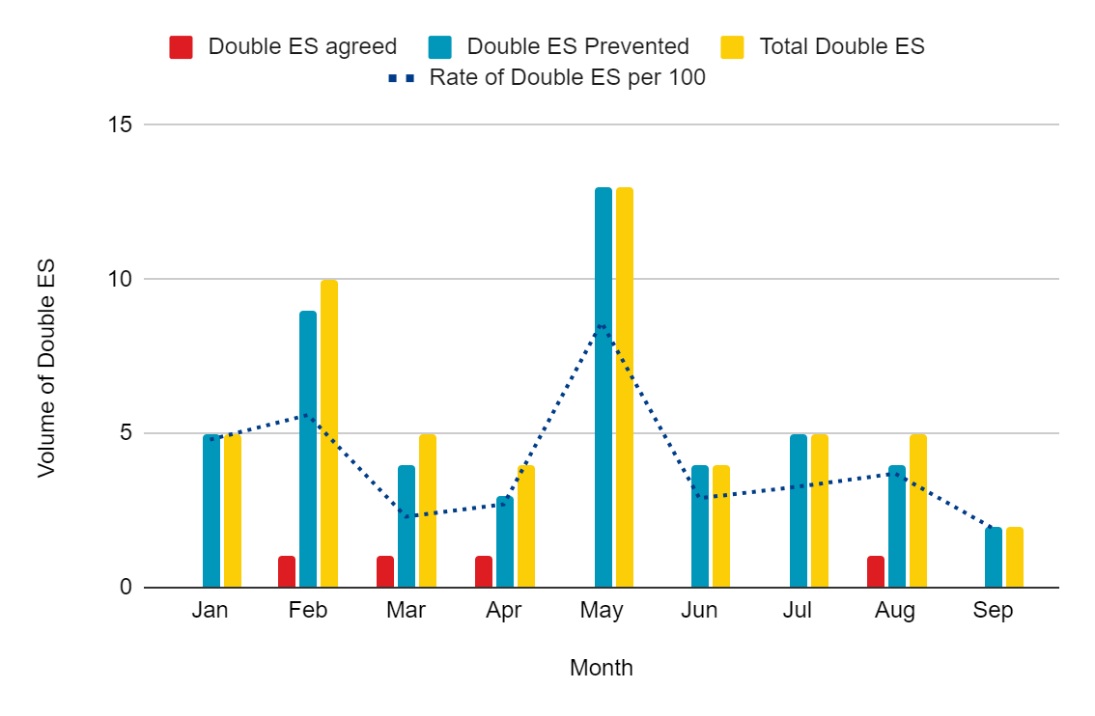
The number of double Erroneous Switches and the rate of these per 100 Erroneous
Switches.

Slide 48
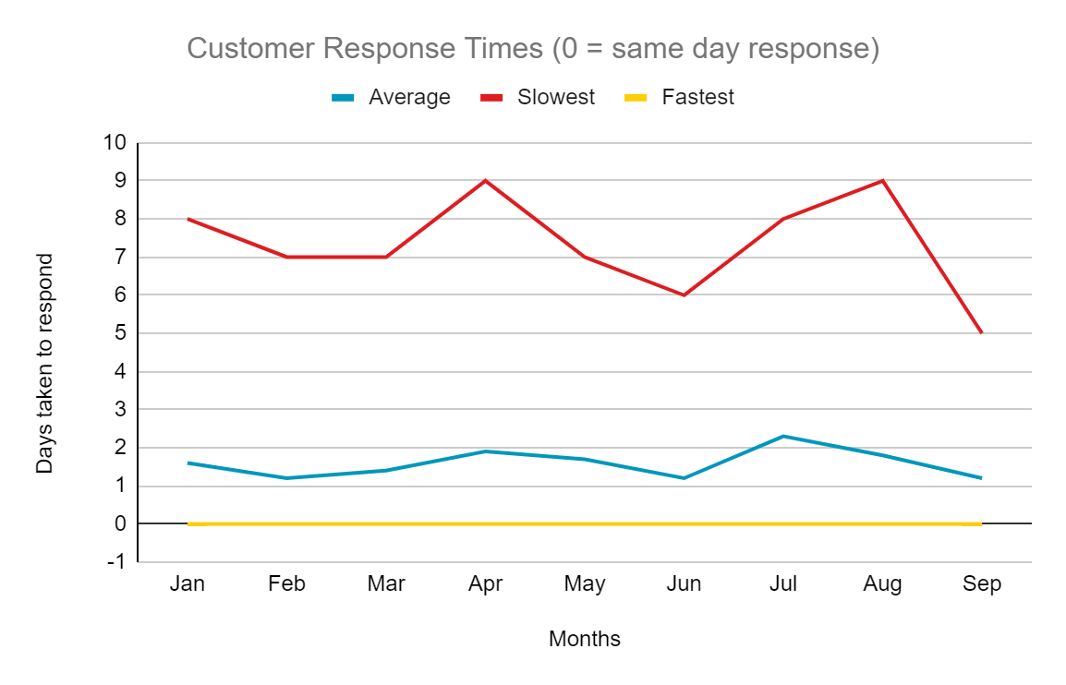
The length of time it takes for customers to respond to validate the ES
As you can see Customer response times are consistent month on month

Slide 49


Slide 50
10. RIG issue – new psr codes following slc changes on ppm installation requirements
Lead analyst

Slide 51
PSR CODES FOLLOWING SLC CHANGES ON PPM INSTALLATION REQUIREMENTS
Summary
SLC changes set out new PSRs; for example, regarding children under two or over 75s without support, which Suppliers need to log and take account of.
However, customers have the right to update their DNO or Supplier. This means that Suppliers could be missing out on valuable information if the customer talks to the DNO as the current D0225 does not have the new requirements included in the flow.
Suppliers may treat a DNO update as a full refresh and therefore overwrite the new requirements as they aren’t held within the current flow from the DNO. This is the choice of a Supplier, however, in the interim, some will need to look at their automation to avoid this from happening. Whilst each Supplier and DNO treats this differently, it was originally intended as a full refresh.
Action
RIG to agree what the new PSR codes should be and potential implementation timescales.
Links
Involuntary Prepayment Meter Decision
New rules for installing involuntary prepayment meters

Slide 52
10a. RIG issue – out of hours distributor bypass – vulnerable customers
Lead analyst

Slide 53
Out of hours dno bypass – vulnerable customers
Summary
If a Distribution Network Operator (DNO) attends a fault call out of hours, they may take the decision on grounds of vulnerability to bypass a customer's meter to prevent an off-supply scenario. At present, it is believed there is no formal process to notify a Supplier of the action taken.
Additionally, this could happen incorrectly when a customer advises they are unable to top up; however, they are on friendly non-disconnect hours, therefore not creating a detriment to the customer at that time. Suppliers can be hit with early replacement charges for smart meters, which, after investigation, show there was no fault. It has been found that a lack of engagement from customers to try and gain access to remedy the fault so the bypass can be reversed sometimes leads to increased Revenue Protection activity.
Action
RIG to agree if a formal process should be proposed to notify a Supplier of these instances when a DNO bypasses a customer’s meter, and what said process should comprise.

Slide 54
aob

Slide 55
Next meeting:
Regular RIG: 10 November 2023
SPECIAL RIG: 20 october 2023
Thanks for attending

