Slide 1
REC ISSues group
12 January 2024

Slide 2
1. Introduction and agreement of agenda
Shelley rouse

Slide 3
Agenda For today
 | TITLE | TIME | LEAD
1 | Introductions and Agreement of Agenda | 10:00 | Chair
2 | Data Cleanse Update | 10:05 | REC Performance Assurance Team
2a | Data Cleanse Update Data Cleanse Reporting | 10.15 | REC Performance Assurance Team
3 | R0037 – Prepayment Credit Balance & Debt Transfer Process | 10:25 | REC Change Team
4 | R0109 – Aligning Electricity and Gas Timescale Requirements for Sharing Meter Technical Detail Information | 10:45 | REC Change Team
5 | R0157 – Removal of a Fax as a Code Communication Method | 11:00 | REC Change Team
6 | AOB | 11:15 | All
6.1 | D0189 Flow – Data Item DI50274/J0554 Total Debt | 11:30 | RIG Member
6.2 | Access to SDEP – GT’s | 11:45 | RIG Member
6.3 | Installer Skills and Competencies for Comms Hub Only Exchange Activity | 12:00 | RIG Member
6 | Close | 12:15 | Chair

Slide 4
DATA CLEANSE SPRINT Update
Amy Crowe-Lamont & Nirav Vyas

Slide 5
2. Data cleanse update
REC performance assurance team

Slide 6
Data Cleanse Sprint 1 – Closing Actions
01
02
03
BUCKET 1
The Party has not engaged with the data cleanse exercise or made no significant improvement
BUCKET 2
The Party made more than a 50% improvement in the data cleanse exercise
BUCKET 3
The Party hit their data cleanse target and no further action required.
Next Steps
Performance Assurance team will:
Reach out via email with an action plan to understand when the remainder of the reports will be cleared.
Schedule an optional workshop for Parties to attend and provide feedback on difficulties they may have faced. This can also be communicated to OAMs or Performance Assurance mailbox if unable to attend.
Next Steps
A call will be scheduled with the Party, if not done so already, outlining that a Management Assertion will be issued shortly.
Next Steps
Party will receive an email via Performance Assurance mailbox outlining no further action required.
*expect next steps wc 22 Jan 24

Slide 7
Data Cleanse Sprint 2 – Proposal
We propose to launch a second 6-month sprint in March 2024, following PAB approval of the selected reports and targets.
We will formally communicate the reports and targets in February, at the RIG and via a direct communication to Contract Managers and Alternates.
Report | Proposed Target | Rationale
Invalid Electricity MAP ID | Reduction of pot value to zero | Sprint 1 resulted in a reduction in population of c. 50%. Progress has been linear, and we want to continue to drive down this report until it is cleared. Reported issues with being able to update meter data in CSS in cases where Meter Points were registered to an Invalid MAP ID.
No Meter MTC – MSN | Reduction of the pot value to 25% of that at sprint start. | Identified as a priority cleanse area by the MHHS programme to improve MTD accuracy ahead of migration.
No Meter MTC – No MSN | Reduction of the pot value to 25% of that at sprint start. | As above

Slide 8
2a. Data cleanse reporting
REC performance assurance team

Slide 9
3. R0037 – Prepayment credit balance & debt transfer process
REC change team

Slide 10
R0037 Prepayment Credit Balance & Debt Transfer Processes
R0037 Prepayment Credit Balance and Debt Transfer Processes – current status is with Code Manager relooking at solution development post legal review
Changes to the solution presented last month
  On receipt of message from Gaining Supplier saying customer wants their balance moving over, Losing Supplier sends a flow to the Gaining Supplier confirming if it is possible for the meter to move down this process. Potential reasons why it could not
    Meter currently in Credit Mode
    Meter not communicating
    Debt higher than threshold (would likely also lead to objection)
  If meter is moving down the process, Losing Supplier reads the balance as close to midnight as possible and sends on flow to Gaining Supplier. This is used for invoicing.
OFGEM credit limit discussion - TBC

Slide 11
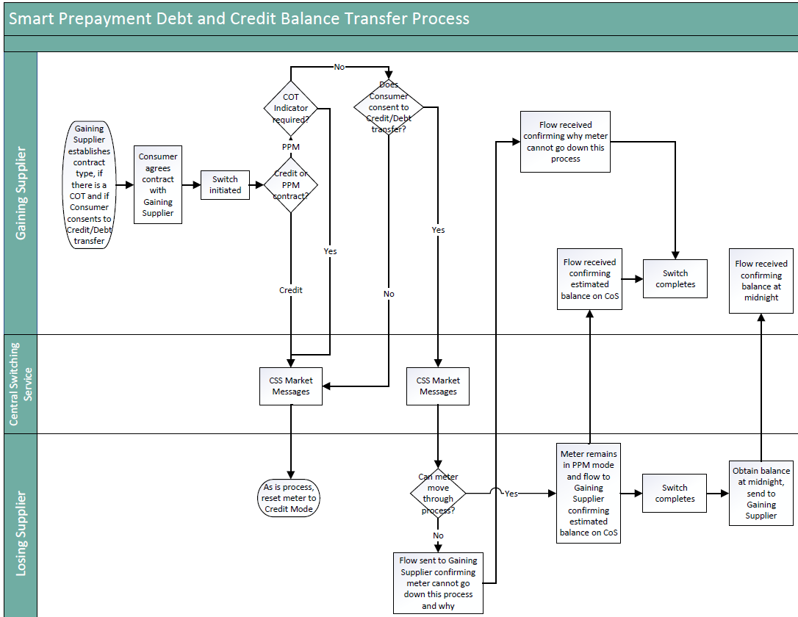

Slide 12
Pass backs
Reasons identified for a “pass back” so far
  CoT before or on CoS date identified after CoS
  Resolution of disputed balance at CoS that impacts debt/credit position
  Customer disputes debt position with Losing Supplier
We intend for the pass back to be able to be full or partial
  For CoT identified after CoS, all credit/debt would be passed back to the Losing Supplier
  For disputed balance at CoS or customer disputing the debt position, a portion of the credit/debt would be passed back to the Losing Supplier as appropriate
We have omitted Erroneous Transfers from a “pass back” on the basis that the same customer should still be in the property using the meter. The credit would not need to be passed back to the Losing Supplier as the right customer was using it, just with the wrong supplier.
  On the meter being returned to the Losing Supplier, it can re-go through this process and the credit/debt at the new CoS transferred back.

Slide 13
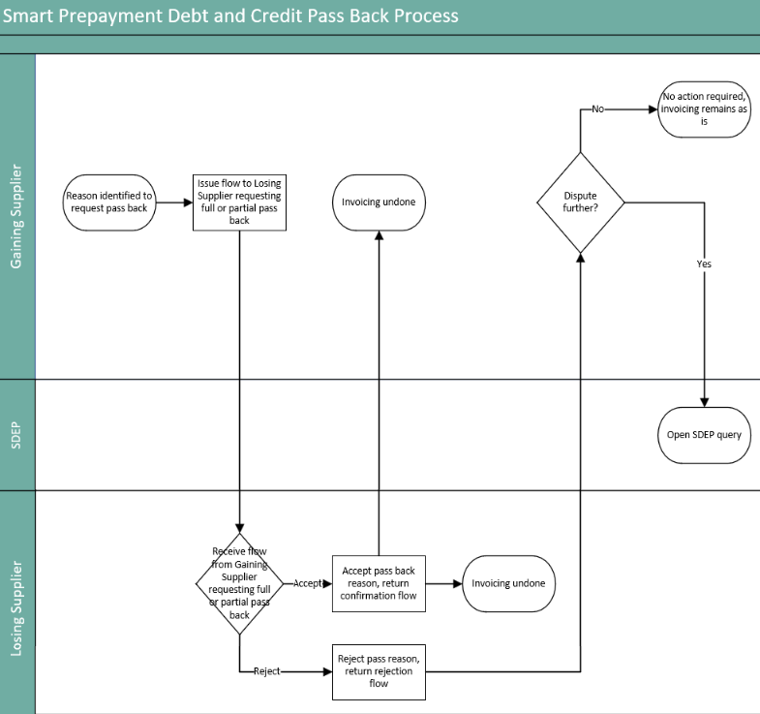
N.B the process can also be initiated by the Losing Supplier, diagram just shows one way for simplicity.

Slide 14
R0037 Prepayment Credit Balance & Debt Transfer Processes
Questions for RIG
Are there any major concerns with the additions to the process?
Are there any other reasons that would require invoicing to be passed back?
Are there any other scenarios to discuss?

Slide 15
4. r0109 – aligning electricity and gas timescale requirements for sharing meter technical detail information
REC Change Team

Slide 16
r0109 – aligning electricity and gas timescale requirements for sharing meter technical detail information
The current timescales for the MEM to send electricity Meter Technical Details to the Supplier via the D0149 and D0150 data flows are 10 Working Days, but the equivalent for gas is 2 Working Days. R0109 seeks to align the requirements to 2 working days for both fuels.
The Code Manager wishes to seek information from industry on the scale of the issue and will circulate an RFI to gain this information.
Does this difference in timings currently cause you operational problems? If yes, please explain.
Are you receiving customer complaints due to the difference in timescales in different fuels? If yes, please provide volumes.
If we were to align these requirements, would you need time to make system changes?
What costs would you incur in making changes to align the requirements?
Do you believe any change to bring the timescales in line across fuels should happen now or wait until MHHS to be implemented? Please give your reasons.
Any other comments you wish to make?
Are there other questions the Code Manger should include within this RFI?

Slide 17
5. R0157 – Removal of a fax as a code communication method
REC Change Team

Slide 18
R0157 – Removal of facsimile as a method of code communication
The Public Switched Telephone Networks (PSTN) is being switched off in December 2025 by all telecom companies and will be replaced with an Internet Protocol (IP) digital network.
UK transition from analogue to digital landlines - GOV.UK (www.gov.uk)
Existing fax machines that are incompatible with new all IP digital networks will become obsolete and no longer capable of meeting Code Communications as prescribed in the REC and all communication methods referencing fax or facsimile will need to be removed.
This change requires a simple solution that is already known. The Code Manager has found all document clause references where an amendment is required. The documents impacted are Metering Operations Schedule, Green Deal Arrangements Schedule, CoMCop and EES Service Definition.
Due to the simple solution already known, and an expectation that the alternative method(s) communication is already in place for REC parties and Market participants, the Code Manager would propose moving straight to PCR and Consultation, without the need for a Party Impact Assessment.
Do you agree with our proposal? We welcome your thoughts and feedback and any questions.

Slide 19
6. AOB
ALL

Slide 20
6.1. D0189 Flow – data item di50274/j0554 total debt
Rig member

Slide 21
What mechanism are parties using to reduce a meter’s debt?
The D0189 has data item J0554 which is the total amount of debt transferred to the customer
This data item currently has to be a positive number
If the meter’s debt is reduced, necessitating a new D0189 should J0554 be the “target” debt amount or the adjustment value?

Slide 22
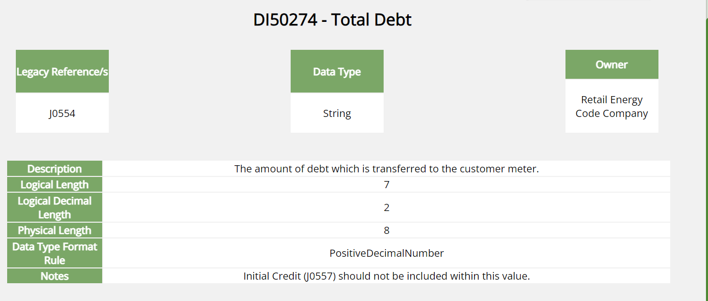
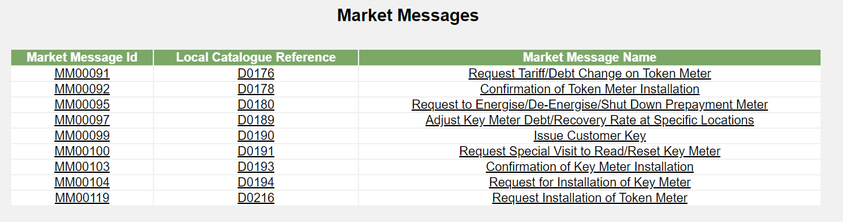

Slide 23
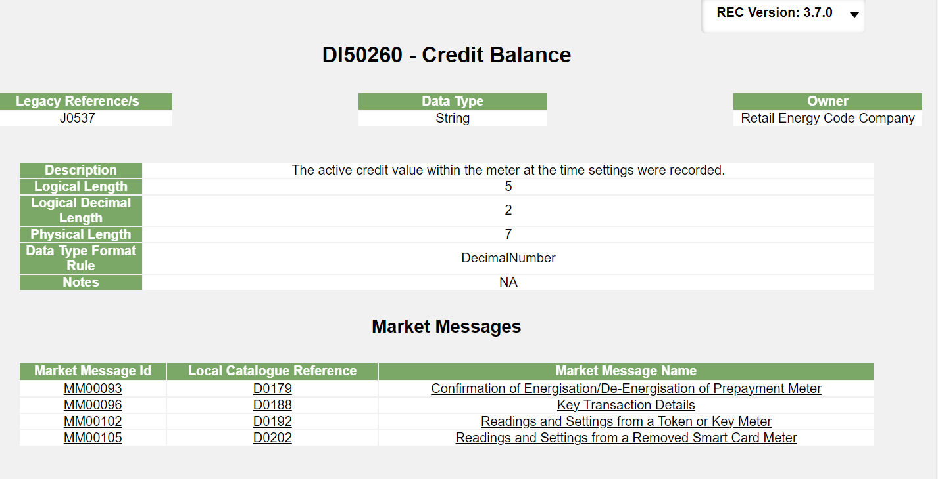

Slide 24
6.2. access to sdep – gt’s
Rig member

Slide 25
6.3. installer skills and competencies for comms hub only exchange activity
Rig member

Slide 26
6.4. PPM Levelisation
Rec change team

Slide 27
R0147 – PREPAYMENT LEVELISATION
Introduce the necessary governance and reconciliation arrangements, to reconcile the impact on Domestic Suppliers of levelling the cost of standing charges to Domestic Consumers paying through Prepayment with those paying by direct debit . This will be known as Payment Method Levelisation (PML) Reconciliation.
Effective from date to be 01 April 2024 (Easter Monday); the implementation date for R0147 is 28 March 2024
  01 April 2024 is the first date that Domestic Suppliers must extract data, for submission by the 15th of the month
  The R0147 Final Change Report has now been published and will be considered by the REC Change Panel on 16 January 2024
  The Authority direction on the licence modifications is due by 23 February 2024. The Authority determination on R0147 is due in the same timeframe and will be led by the licence modification direction.
  What do Domestic Suppliers need to do…

Slide 28
Domestic supplier readiness
A request will be sent out w/c 15 January 2024 for Domestic Suppliers to provide the following:
Confirmation of operational contact details for PML Reconciliation
Confirmation of bank details for payments to be received from RECCo
Confirmation of Sharepoint (reporting) contact details
Declaration from Non-Domestic only Suppliers
An indication on operational readiness for the effective from date of 01 April 2024
This will be sent out by the Code Manager.
Please reach out to your OAM or enquiries@recmanager.co.uk for support if required.

Slide 29
6.5. PROPOSED CHANGES TO THE THEFT Detection incentive scheme
Rig member

Slide 30

Proposed changes to the Theft Detection Incentive Scheme
Code Manager proposing the following changes be made to the Theft Target Methodology (TTM):
While Code Manager has followed the evidence-based approach expected of them, including in particular seeking updated data from parties on the current cost of theft investigation, that data has not been sufficiently available for it to provide an informed view on what the revised Theft Detection Values (TDV) for 2024/25 should be. Absent further intervention, the TDV would continue to be set at previous levels (plus inflation) that have proven to be insufficient incentive for suppliers to undertaken further investigations/increase performance against targets.
Suppliers’ overall performance for each of the past two scheme years has been around 40% of target. This indicates that the incentive scheme isn't offering enough reward to justify the costs of conducting more investigations and uncovering additional confirmed cases of theft. Ofgem has raised concern at this level of performance.
RECCo is therefore aiming to strengthen the incentives, both immediately through the upcoming change to the TTM, and through changes to Schedule 7 of the REC, which would be subject to approval of a REC Change Proposal.
Item | Summary of Changes
Incentive Pots Split | Gas/Electricity Domestic customer segment to be split further by Smart and Non-Smart meter types.
Theft Detection Value | Adjusted for inflation using December 2023 CPI figure published by the Office for National Statistics.
Theft Targets | Addition of Smart and Non-Smart meter type targets within Domestic customer segment, with weighting applied to focus target on traditional metering. Overall target levels maintained to preserve scheme value.
Attribution Methodology | Addition of data used to split pots between Smart/Non-Smart incentive pots. Acknowledgement of potential issue with domestic premise indicator (under investigation).
Notes:
Kirsty

Slide 31
Proposed changes to the Theft Detection Incentive Scheme
Proposed change - via change to TTM:
TDV escalator mechanism
As part of the changes being made to the TTM, we are proposing the introduction of an escalator mechanism to the TDIS, increasing the level of the TDV by [20%] above inflation from 01 April 2024.
    Code Manager was unable to source sufficient data to inform a revised market-based benchmark - anecdotal evidence did suggest that in addition to the prevailing benchmarks being out of date, and too low;
    In the absence of an evidenced-based means of revising the TDV, the results of the scheme may themselves provide a means of discovering an appropriate and effective level of TDV. i.e. incremental increase until there is evidence of a change in supplier behaviour;
    As we remain committed to evidence-based decision wherever practicable, the efficacy of each increment should be assessed before a further one is applied, i.e. increment applies to every second reporting period (every 6 months, rather than 2 yearly).
      Propose that future increments and the timing of them should be subject to determination of the Performance Assurance Board
Notes:
Kirsty

Slide 32
Proposed changes to the Theft Detection Incentive Scheme
Proposed changes – via new REC Change Proposal :
Reporting cycle
Change reporting period from annual to quarterly – beneficial for supplier cash flow but also allows future change to be implemented more quickly, as they need to be tied to start of reporting period;
Considered to be minimal impact on suppliers as confirmed theft reports already submit on a monthly basis
Reasonable endeavours
Scheme previously operated by Gas Transporters prior to TDIS (Gas only, not electricity equivalent) allowing suppliers to make claims to offset cost of investigation against transportation charges;
Scheme largely defunct but still provided for in GT licence
Operating similar scheme under REC (possibly as part of TDIS) could allow suppliers to make exceptional claims for investigations that may otherwise be ruled uneconomic due to level of the TDV, and address flaws in the original scheme
Notes:
Kirsty

Slide 33
Proposed changes to the Theft Detection Incentive Scheme
Next steps
Host a drop-in session to answer any questions – date TBC
Responses to the letter invited 15WD later (w/c 5 FEB).
Following consideration of responses, the Category 3 TTM document will be published by 1 March 2024,
TTM change come into effect 1 April 2024.
Subject to the degree of support for the proposals, also raise the Category 2 Change Proposal(s) by 1 March to:
  changes Schedule 7 to clarify quarterly reporting cycle timetable - target June release;
  develop dual-fuel replacement for the reasonable endeavours scheme.
Notes:
Kirsty

Slide 34
Next meeting:
09 February 2024
Thanks for attending

