Slide 1
REC ISSues group
12 January 2024

Slide 2
1. Introduction and agreement of agenda
Shelley rouse

Slide 3
Agenda For today
 | TITLE | TIME | LEAD
1 | Introductions and Agreement of Agenda | 10:00 | Chair
2 | Data Cleanse Update | 10:05 | REC Performance Assurance Team
2a | Data Cleanse Update Data Cleanse Reporting | 10.15 | REC Performance Assurance Team
3 | R0037 – Prepayment Credit Balance & Debt Transfer Process | 10:25 | REC Change Team
4 | R0109 – Aligning Electricity and Gas Timescale Requirements for Sharing Meter Technical Detail Information | 10:45 | REC Change Team
5 | R0157 – Removal of a Fax as a Code Communication Method | 11:00 | REC Change Team
6 | AOB | 11:15 | All
6.1 | D0189 Flow – Data Item DI50274/J0554 Total Debt | 11:30 | RIG Member
6.2 | Access to SDEP – GT’s | 11:45 | RIG Member
6.3 | Installer Skills and Competencies for Comms Hub Only Exchange Activity | 12:00 | RIG Member
6 | Close | 12:15 | Chair

Slide 4
2. Data cleanse update
REC performance assurance team

Slide 5
2a. Data cleanse reporting
REC performance assurance team

Slide 6
3. R0037 – Prepayment credit balance & debt transfer process
REC change team

Slide 7
R0037 Prepayment Credit Balance & Debt Transfer Processes
R0037 Prepayment Credit Balance and Debt Transfer Processes – current status is with Code Manager relooking at solution development post legal review
Changes to the solution presented last month
  On receipt of message from Gaining Supplier saying customer wants their balance moving over, Losing Supplier sends a flow to the Gaining Supplier confirming if it is possible for the meter to move down this process. Potential reasons why it could not
    Meter currently in Credit Mode
    Meter not communicating
    Debt higher than threshold (would likely also lead to objection)
  If meter is moving down the process, Losing Supplier reads the balance as close to midnight as possible and sends on flow to Gaining Supplier. This is used for invoicing.
OFGEM credit limit discussion - TBC

Slide 8
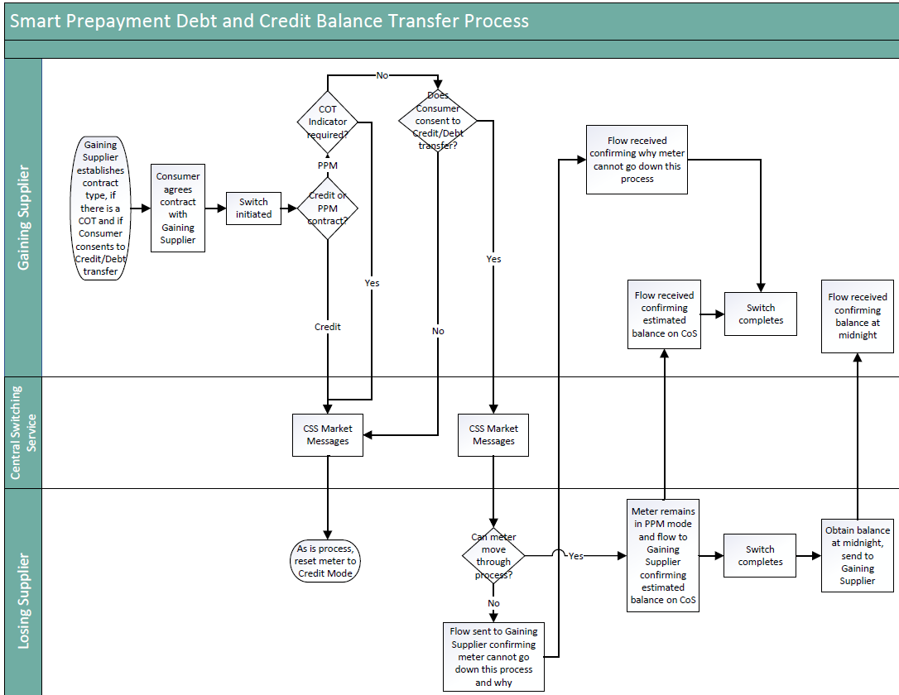

Slide 9
Pass backs
Reasons identified for a “pass back” so far
  CoT before or on CoS date identified after CoS
  Resolution of disputed balance at CoS that impacts debt/credit position
  Customer disputes debt position with Losing Supplier
We intend for the pass back to be able to be full or partial
  For CoT identified after CoS, all credit/debt would be passed back to the Losing Supplier
  For disputed balance at CoS or customer disputing the debt position, a portion of the credit/debt would be passed back to the Losing Supplier as appropriate
We have omitted Erroneous Transfers from a “pass back” on the basis that the same customer should still be in the property using the meter. The credit would not need to be passed back to the Losing Supplier as the right customer was using it, just with the wrong supplier.
  On the meter being returned to the Losing Supplier, it can re-go through this process and the credit/debt at the new CoS transferred back.

Slide 10
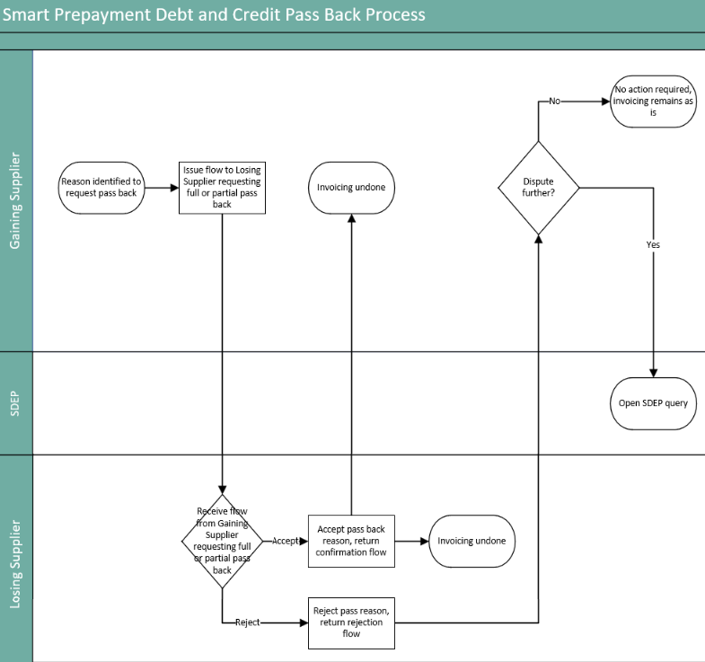
N.B the process can also be initiated by the Losing Supplier, diagram just shows one way for simplicity.

Slide 11
R0037 Prepayment Credit Balance & Debt Transfer Processes
Questions for RIG
Are there any major concerns with the additions to the process?
Are there any other reasons that would require invoicing to be passed back?
Are there any other scenarios to discuss?

Slide 12
4. r0109 – aligning electricity and gas timescale requirements for sharing meter technical detail information
REC Change Team

Slide 13
r0109 – aligning electricity and gas timescale requirements for sharing meter technical detail information
The current timescales for the MEM to send electricity Meter Technical Details to the Supplier via the D0149 and D0150 data flows are 10 Working Days, but the equivalent for gas is 2 Working Days. R0109 seeks to align the requirements to 2 working days for both fuels.
The Code Manager wishes to seek information from industry on the scale of the issue and will circulate an RFI to gain this information.
Does this difference in timings currently cause you operational problems? If yes, please explain.
Are you receiving customer complaints due to the difference in timescales in different fuels? If yes, please provide volumes.
If we were to align these requirements, would you need time to make system changes?
What costs would you incur in making changes to align the requirements?
Do you believe any change to bring the timescales in line across fuels should happen now or wait until MHHS to be implemented? Please give your reasons.
Any other comments you wish to make?
Are there other questions the Code Manger should include within this RFI?

Slide 14
5. R0157 – Removal of a fax as a code communication method
REC Change Team

Slide 15
R0157 – Removal of facsimile as a method of code communication
The Public Switched Telephone Networks (PSTN) is being switched off in December 2025 by all telecom companies and will be replaced with an Internet Protocol (IP) digital network.
UK transition from analogue to digital landlines - GOV.UK (www.gov.uk)
Existing fax machines that are incompatible with new all IP digital networks will become obsolete and no longer capable of meeting Code Communications as prescribed in the REC and all communication methods referencing fax or facsimile will need to be removed.
This change requires a simple solution that is already known. The Code Manager has found all document clause references where an amendment is required. The documents impacted are Metering Operations Schedule, Green Deal Arrangements Schedule, CoMCop and EES Service Definition.
Due to the simple solution already known, and an expectation that the alternative method(s) communication is already in place for REC parties and Market participants, the Code Manager would propose moving straight to PCR and Consultation, without the need for a Party Impact Assessment.
Do you agree with our proposal? We welcome your thoughts and feedback and any questions.

Slide 16
6. AOB
ALL

Slide 17
6.1. D0189 Flow – data item di50274/j0554 total debt
Rig member

Slide 18
What mechanism are parties using to reduce a meter’s debt?
The D0189 has data item J0554 which is the total amount of debt transferred to the customer
This data item currently has to be a positive number
If the meter’s debt is reduced, necessitating a new D0189 should J0554 be the “target” debt amount or the adjustment value?

Slide 19
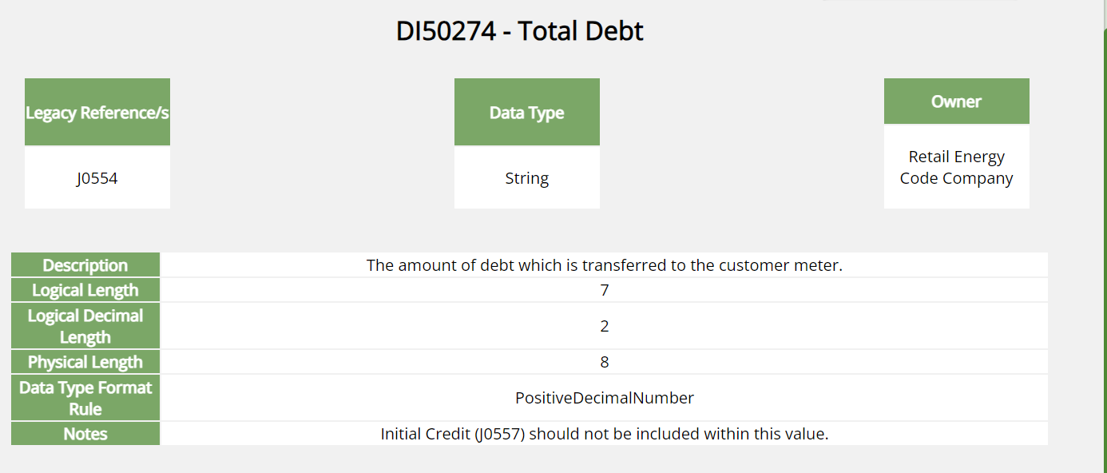
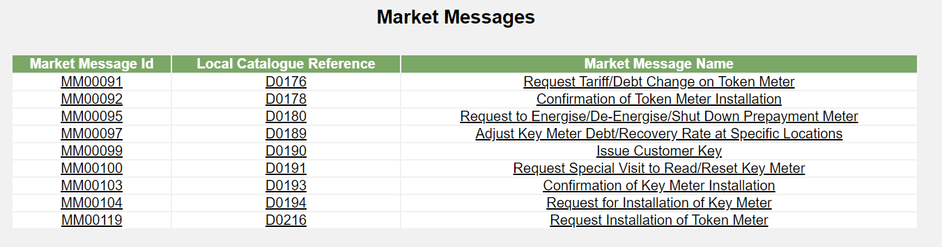

Slide 20
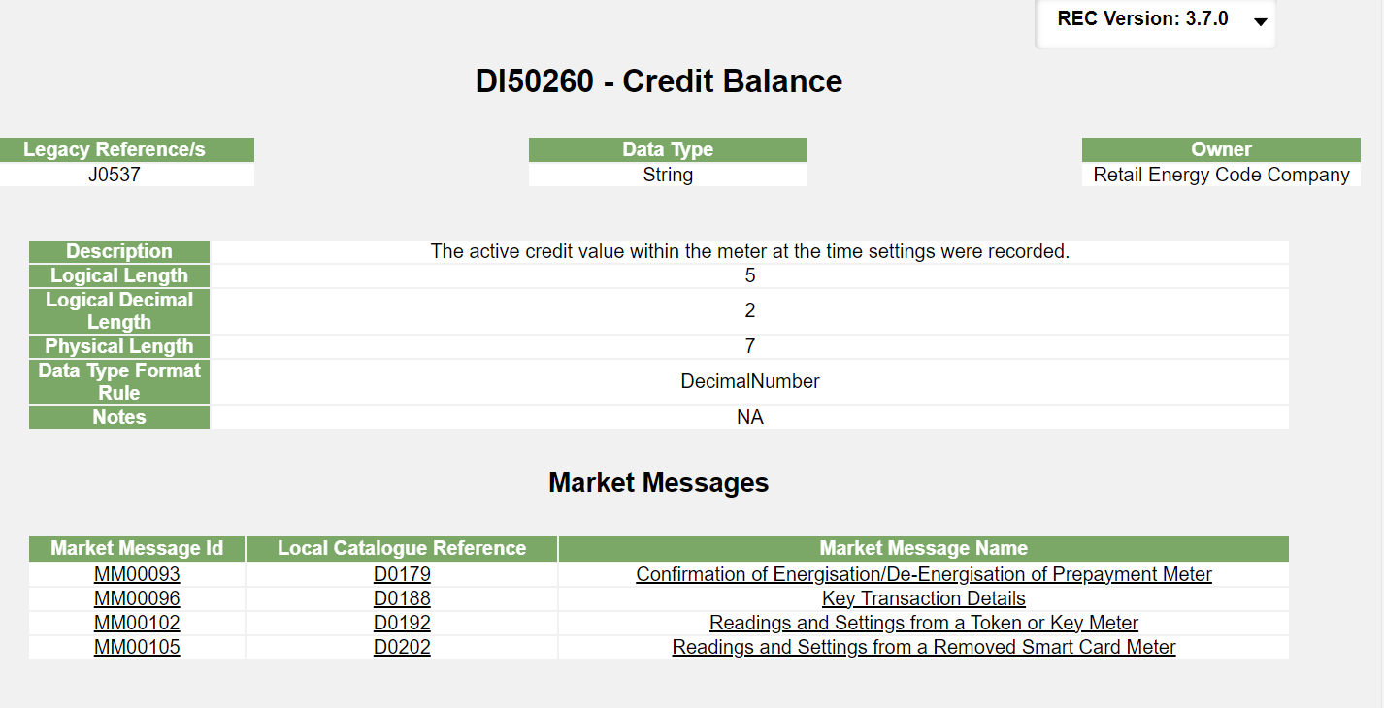

Slide 21
6.2. access to sdep – gt’s
Rig member

Slide 22
6.3. installer skills and competencies for comms hub only exchange activity
Rig member

Slide 23
Next meeting:
09 February 2024
Thanks for attending

