Slide 1
REC ISSues group
09 February 2024

Slide 2
1. Introduction and agreement of agenda
Shelley rouse

Slide 3
Agenda For today
 | TITLE | TIME | LEAD
1 | Introductions and Agreement of Agenda | 10:00 | Chair
2 | Data Cleanse Update | 10:05 | REC Performance Assurance Team
2a | Data Cleanse Sprint 2 Update | 10.15 | REC Performance Assurance Team
3 | Domestic ETs being raised without a Flow | 10:30 | RIG Member
4 | Theft Incentive Scheme Adjustment to Domestic/Non-Domestic Portfolio Data | 10:45 | REC Performance Assurance Team
5 | Maintenance of Qualification | 11:00 | REC Performance Assurance Team
6 | Un-acceded MEMs | 11:15 | REC Performance Assurance Team
7 | Disconnected MPAN Status - Still Secure Active in MPRS | 11:30 | REC Professional Services Team
8 | Access to DI50197/JO427 'Number of Phases' data item following change of use for D0215 after R0017 implementation | 11:45 | RIG Member
9 | JWS Certificate Replacement | 12:00 | Service Provider Representative
10 | AOB | 12:15 | All
11 | Close | 12:30 | Chair

Slide 4
2. Data cleanse update
REC performance assurance team

Slide 5
DATA CLEANSE SPRINT Update
Rec performance assurance team

Slide 6
Data Cleanse Sprint 2 – Proposal
We propose to launch a second 6-month sprint in March 2024, following PAB approval of the selected reports and targets.
We will be raising a change to the data cleanse documentation (Category 3) to create a new Energised Meter Point / No MSN report to be prioritised for sprint 2.
Following feedback from the RIG in January as to whether the originally proposed No Meter MTC reports achieve the intended purpose of assisting the MHHS Programme in clearing data quality issues with the MSN data item in EES.
We will formally communicate the reports and targets via a direct communication to Contract Managers and Alternates.
Report | Proposed Target | Rationale
Invalid Electricity MAP ID | Reduction of pot value to zero | Sprint 1 resulted in a reduction in population of c. 50%. Progress has been linear, and we want to continue to drive down this report until it is cleared. Reported issues with being able to update meter data in CSS in cases where Meter Points were registered to an Invalid MAP ID.
Energised Meter Point / No MSN | Reduction of pot value to zero | Identified as a priority cleanse area by the MHHS programme to improve MTD accuracy ahead of migration.

Slide 7
New Performance Assurance thresholds
Rec performance assurance team

Slide 8
Why there are new thresholds
Over time we are working to improve our monitoring of the market.
We have been consistently monitoring objections since CSS go – live. Its really important for both Suppliers and consumers that these take place when valid, and are not used to block switches inappropriately.
We found it important to differentiate between objections for non-domestic and objections for domestic customers. We have always treated these events differently, but now we have been able to get better data to differentiate between the two.
We therefore split objection measures into different more accurate measures – which therefore need the PAB to set new thresholds.

Slide 9




Threshold setting approaches
The PAB set thresholds to instruct the REC Code Manager when they must look closer at the performance. This doesn’t mean there is necessarily an issue – but it does mean that there needs to be something understood. We take four generic strategies:
An alarm or ceiling, where current market performance is within acceptable bounds but the threshold quickly highlights worsening performance.
This is based on data on current performance levels.
A clear intention to drive performance improvements, usually by setting the threshold so the worst performers today are captured, but not all Parties. ETPAB did this by setting relative measures.
This is based on data on current performance levels.
Irrelevant of where people are performing today it might simply feel unacceptable for underperformance above a certain level. The PAB might set a threshold from the heart, potentially requiring the whole market to improve to meet it.
Thresholds not the right approach. In some areas where any failure is unacceptable, we should not set a threshold.

Slide 10


What are the three thresholds?
Which risk driver? | What is the average Risk Driver Score across the market? | What is the Average Number of Processes | Threshold and Rational | What strategy are the PAB taking?
Risk Driver 8.9- the Supplier objects to a Switch with Change of Occupier (CoO) | 0.08 | 647 | Normalised Risk Driver score is 0.20 or higher, with more than 600 Objections raised in a month Setting the objection rate at 20% over a month allows us to focus on those who are consistently outliers.
Risk Driver 8.10- the A high-percentage of Objections use by a Supplier for Switch Requests related to Domestic Consumers indicates potential inappropriate use | 0.03 | 13,000 | Normalised Risk Driver score is 0.20 or higher, with more than 5000 Objections raised in a month Setting the objection rate at 10% over a month allows us to focus on those who are behaving differently and understanding why.
Risk Driver 8.11- the A high-percentage of Objections use by a Supplier for Switch Requests related to Non-Domestic Consumers indicates potential inappropriate use | 0.30 | 653 | Normalised Risk Driver score is 0.60 or higher, with more than 600 Objections raised in a month This market has many more valid objections. Setting this at a 60% rate is really focusing on organisations that are behaving differently.
In setting these thresholds PAB discussed the differences in the market, particularly the seasonality in non domestic market.
These thresholds will get regularly reviewed based on how the market progresses.
We will also provide an update on this at the next PA webinar, to make sure as many people can understand this approach as possible.

Slide 11
2a. Data cleanse reporting
REC performance assurance team

Slide 12
3. Domestic ET’s being raised without a flow
Rig member

Slide 13
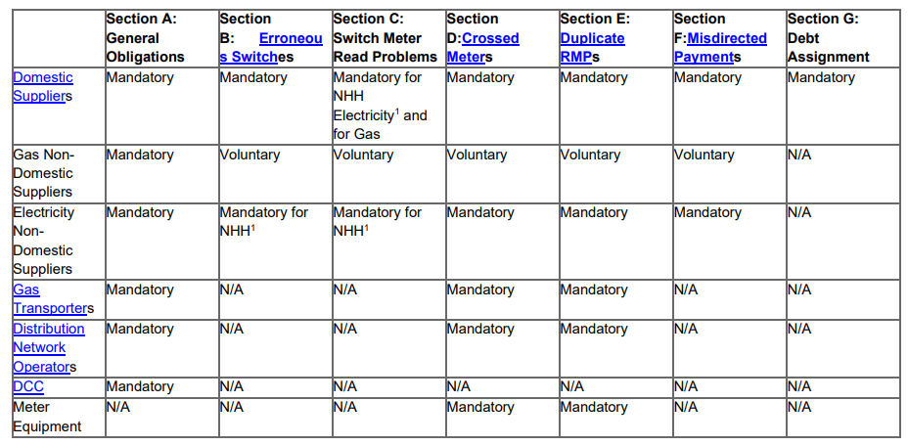
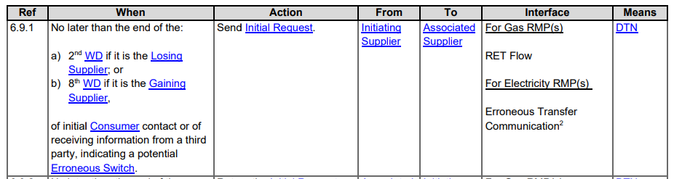
ETs Between Non-Domestic and Domestic Suppliers
Clarity needed?
Issue:
Under the CFSB Schedule 30, Section B “Erroneous Switches” is:
Mandatory for Domestic Suppliers; but
Voluntary for Non-Domestic Gas; and
Mandatory for NHH for Non-Domestic Elec.
We are having issues with a non-domestic supplier not sending flows for domestic gas customers. Impact is we are required to load ETs manually slowing the process for the customer, ultimately leading to customer detriment.
Question:
Is this already a compliance issue; or
Should a change be made to the CFSB schedule so that:
  Non-domestic Gas Suppliers are mandated to use the ETs process; or
  Non-domestic Gas Suppliers are mandated to use the ETs process for domestic customers; or
  “Means” section of 6.9.1 should be changed to “DTN and bilateral messaging”

Slide 14
4. theft incentive scheme adjustment to domestic/non-domestic portfolio data
Rec performance assurance team

Slide 15
Theft incentive scheme context
Context
As per REC Schedule 7 (Theft Reduction) Annex 3 Paragraph 3.5, Theft Targets are required to be calculated using Market Share data using portfolio data that is obtained from CSS, and this requirement is incorporated into the Theft Target Methodology (both for the 2023/24 Reporting Year and the draft TTM for the 2024/25 Reporting Year).
This includes the use of the Domestic Premises Indicator (“DPI”, data item DI90016) to allocate market share between the Domestic and Non-Domestic incentive pots. The DPI was created as part of the Faster Switching programme and the initial values set through that programme, with a request to suppliers to perform data cleanse activity under the programme scope. This included a specific adjustment made for non-domestic only supplier MPID to set all MPxNs to a non-domestic status.
It has come to our attention that there remain some data quality issues with the DPI, in particular arising from the legacy definition of the MPxN designation, that may in some circumstances cause premises that should be classified as domestic per the current data specification to be recorded as non-domestic.
Whilst suppliers are obliged under REC Schedule 23, paragraph 16.1 to update the DPI where they become aware it is incorrect, currently the visibility of this data through the enquiry services is limited, hindering the ability of suppliers to drive data cleanse activities.
We note that the impact of this is not solely on the theft scheme, however that is the focus of this communication.

Slide 16
Theft incentive scheme Impact
Impact
For suppliers with a Domestic/Non-Domestic Supply licence where the DPI is incorrect for a significant number of MPxNs in the portfolio, the theft targets allocated may not be reflective of the actual portfolio supplied and hence may act as a barrier to achieving the allocated target.
This may be most pronounced for suppliers that operate exclusively in the domestic market. Note that this issue does not affect non-domestic only suppliers as under the Theft Schedule and TTM, only non-domestic targets are allocated following changes introduced under REC Change R0091.

Slide 17
Theft incentive scheme actions available
Action Available
Whilst the long-term solution to this issue is to address the underlying data quality issues as noted above, there are barriers to achieving this in the short term.
Following the January 2024 PAB meeting, a derogation has therefore been approved to allow suppliers to notify the Code Manager where the CSS data based on DPI substantially misrepresent the true portfolio position based on the definitions of domestic/non-domestic premises contained in the REC and per the associated supply licence conditions. In such cases, an adjustment will be made by the Code Manager to reallocate meters to the domestic segment for both the finalisation of the 2023/24 Reporting Year and Target Setting for the 2024/25 Reporting Year when performing the relevant calculations.
You have been identified as a supplier with a Domestic/Non-Domestic supply licence and with some meters reported as non-domestic based on the DPI. We have made the MPxN population numbers for both Reporting Years, as reported in the CSS data, available for your organisation(s) on the ‘Theft Targets’ tab of the Performance Assurance Dashboard for your review. Please use the ‘Scheme Year’ filter available to view both the 2023/24 and 2024/25 population numbers.
This issue may be in part driven by export meters, we are in the process of obtaining volume of export meters by MPID for the relevant reporting dates and will share this with suppliers as soon as possible to help you determine if adjustments are required. Note that if you have yet the DPI as domestic for such meters a correction would not be required so we cannot automatically apply an adjustment however we are seeking to make information available that may be helpful, particularly given the short timeframes for this exercise.

Slide 18
Action Available
If you believe that this domestic/non-domestic split does not reflect the actual position of your portfolio please complete and return the attached letter, including the director’s assertion, to performanceassurance@recmanager.co.uk by 16 February
(we appreciate this is a short timescale, however this date required to allow 2024/25 Targets to be set prior to 1 March as per REC requirements). Please note that the Code Manager may require provision of additional supporting information and will directly contact you following your submission if required (this action will not need to be completed by 16 February).
If you do not intend to submit an adjustment form, we should be grateful if you would confirm this by emailing performanceassurance@recmanager.co.uk.
If you have any questions on this, please speak with your OAM or raise a ticket via the REC Service Desk.

Slide 19
5. maintenance of qualification
Rec performance assurance team

Slide 20
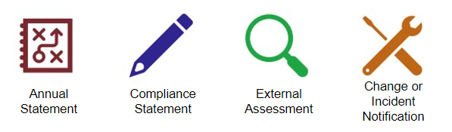
Maintenance of Qualification (MoQ)
Requirements
  All REC Parties and Non-Party REC Service Users are required to complete an annual Maintenance of Qualification (MoQ) submission as per Schedule 9 Qualification and Maintenance Section 11.
  This submission will include an Annual Statement to self-certify their continued qualification under the REC, as well as an Information Security and Data Protection submission.

Slide 21
MoQ 2023 outstanding actions
  A small number of Parties and non-Party REC Service users have not yet completed their 2023 Maintenance of Qualification (MoQ) submission.
  These users have had reminders through the REC Portal and email, and in cases where these Parties are not engaging with the REC Code Manager to complete their overdue 2023 MoQ submission, their access to REC Enquiry Services will be revoked.

Slide 22
Looking Forward: MoQ 2024
  Last month, REC Contract Managers received a notification of their 2024 MoQ deadline and submission requirements, and these requirements will also be shortly uploaded to the REC Portal for their reference.
  Should users encounter any issues with the REC Portal or would like to further discuss roles and access permissions to complete these submissions, please contact enquiries@recmanager.co.uk.
  If users will not be able to complete this requirement by the due date communicated to them, please reach out to enquiries@recmanager.co.uk by 16 February 2024.

Slide 23
6. un-acceded metering equipment managers
REC performance assurance team

Slide 24
Un-acceded Meter Equipment managers
We are seeking feedback from RIG members to discuss the following points. The list below is to support conversations but is not limited.
Are the timelines proposed are appropriate for organisations?
Are there any methods RIG members potentially have to encourage these organisations to compliance under REC.
What information would Suppliers need, if any, to support them appointing a qualified MEM if not already done so.
Are RIG Members aware of any unintended consequences we should be aware of?

Slide 25
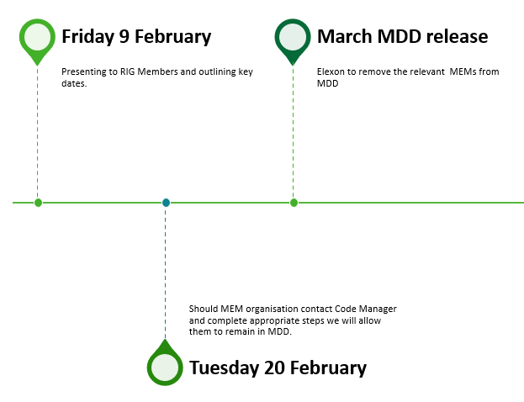
Un-acceded Meter Equipment managers
We have become aware that there are 9 organisations who have a Market Participant ID (MPID), which gives them the ability to act as a MEM but are not yet acceded to the REC and have not become qualified.
We have previously attempted to engage with these Parties in October 2023, however, we and have not been able to get a response.
We are seeking to remove the MEMs, who have not acceded or qualified under the REC, that have an active MPID in Market Domain Data (MDD ).
Following approval from PAB, we are informing RIG members prior to the MEM MPID being end-dated in MDD. This is with the aim to allow REC Parties, specifically Suppliers, who may have the MEMs appointed an opportunity to de-appoint them and appoint a REC-qualified MEM as obligated under the Code.
We will ensure to make the Elexon BSC PAB aware and request Elexon to remove these MEMs from MDD effective from the March MDD release allowing Suppliers sufficient time to take the remedial steps

Slide 26

Un-acceded Meter Equipment managers
The table below highlights the MEMs that have not acceded to the REC since go live. In October 2023, we reached out to all of these Parties who are active in MDD via post issuing them a letter of notice. The Parties can be seen in a list below with comments:
Party Name | MPID | Remove from MDD
Functional Metering Limited | FUML | Yes
Simply Electric Metering Limited | SEML | Yes
Utility Partnership | UPLX | Yes
TMA Data Management | TROJ | Yes
Amey Metering Limited | NORW, UUNL | Yes
Keighley Metering Services Limited | KMSL | Yes,
2 further MEMs were previously acceded to the REC, but subsequently exited from the REC:
Since October 2023, 1 further un-acceded MEM was identified, which was previously end-dated in September 2023 but added to MDD again in November 2023 to allow Suppliers to process de-appointment:
Party Name | MPID | Comments | Remove from MDD
Solace Utilities Ltd | DUNL | In liquidation as per Companies House | Yes
Magnum Utilities Limited | EMSL | Dissolved as per Companies House | Yes
Party Name | MPID | Comments | Remove from MDD
Central Homes & Facilities Management | CHFM | Removed from MDD then re-added, exiting market | Yes

Slide 27
7. Disconnected MPAN Status - Still Secure Active in MPRS
REC performance assurance team

Slide 28

Rig – DNO Queries WITH SUPPLIERS – Disconnected MPAN BUT STILL Secure active
DNO issues identified on their Portfolio
Some DNO’s have identified that they have thousands of MPAN’s which have a status of ‘ Disconnected ‘ but still show as RMP with a status of ‘ Secure Active ‘ on CSS
Cause - Issue seems to be that Suppliers are receiving a D0171 (MM00085) - Notification of Distributor Changes to Metering Point Details flow, from MPAS (Electricity Retail Data Agent), and not then submitting the Registration Deactivation Request to the CSS Provider, which would change the CSS status to ‘ Secure Inactive ‘ in a timely manner
Proposed Next steps from DNO’s
DNO’s using SDEP to raise individual Use Cases on these MPAN’s to Suppliers to update the RMP status to ‘ Secure Inactive ‘
Possible impacts to Suppliers
Using a D0205 (MM00108) – Update Registration Details isn’t possible due to MPAN being set to disconnected

Slide 29
8. Access to DI50197/JO427 'Number of Phases' Data Item Following Change of Use for D0215 after R0017 Implementation
RIG Member

Slide 30
Access to Di50197/jo427 ‘number of phases’ data item following change of use for d0215 after r0017 implementation
Despite R0017 reducing the use cases for the D0170/D0215 flows, E.ON have made the discovery that this particular exchange is the only practical options available for obtaining the J0427/DI50197 (Number of Phases) and J0443/DI50205 (Supply Voltage) data items.
This information is required to ensure the correctly qualified colleague is then able to attend site to conduct meter work.
Consequently, bulk requests for these are still being made, resulting in a continuation of the resource strains which R0017/CP1574 were attempting to minimise.
We are struggling to identify a viable alternative as other flows including this data item do not have appropriate use cases. These requests are being made for NHH sites whereas we believe the solution for R0017 was designed with HH sites.
To what extent are other industry parties coming across this issue?

Slide 31
9. Jws certificate replacement
Chair

Slide 32

MAKING BRITAIN MORE CONNECTED, SO WE CAN ALL LEAD
CSS JWS Certificate Replacement
HELPING TO TRANSFORM BRITAIN’S ENERGY SYSTEM WITH SMART METERING

Slide 33
CSS JWS Certificate Expiry
The CSS JWS Certificate will expire on 03 March 2024
Within the Switching PKI (Public Key Infrastructure) estate there are two types of certificate – TLS and JWS (message signing)
The TLS Certificate is used to establish a ‘secure tunnel’ in which all the data sent between CSS and a CSS User System is encrypted
The JWS Certificate issued to digitally sign each message and validates that the message sender is authenticated and the message integrity
Each CSS User that receives messages from CSS will need to install the updated certificate before 03 March 2024 to ensure messages can still be authenticated – See Further Slide to check dates of availability
DCC will communicate out through the REC Weekly Bulletin and the Feb SOF and liaise with REC if we know a party has not downloaded the new JWS certificate

Slide 34
POAP – JWS Certificate Replacement– February 2023
Week commencing | 08/01/2024 | w/c 15/01/24 | w/c 22/01/24 | w/c 29/01/24 | w/c 05/02/24 | w/c 12/02/24 | w/c 19/02/24 | w/c 26/02/24 | w/c 04/03/24
Key Milestones
Key Activities
Attend SOF to advise of JWS cert Expiry 10/01
Run REC through presentation
18/01
Attend SOF to share Guide 14/02
Landmark request the updated JWS certificate 17/01
REC Code Manager Issue Out Guide via Comms and upload to REC Portal 26/01
REC Code Manager Issue Out Guide via Comms and advise x days left 02/02
REC Code Manager Issue Out Guide via Comms and advise x days left 09/02
REC Code Manager Issue Out Guide via Comms and advise x days left 16/02
Certificate update discussed on CAB with the SDSP’s 17/01
Develop Guide For All Parties
All parties who cannot run multiple certificates to install the cert during the outage window 20/02 – outage 10:00-11:00
New certificate is available to download from the Switching portal 22/01
Today
CSS Production Deployment – Certificate Update 20/02 – outage 10:00-11:00
DCC schedule call with C&C, Electralink, IDCSL, Xoserve and invite REC OAM
REC OAM schedule call with the REC Parties, Stuart & Ed Attend run through pack
All connecting parties download the certificate and apply if they can run multiple certificates & provide confirmation to REC OAM that they have applied the certificate
Parties to monitor to ensure that they are receiving messages from Landmark
All connecting parties who cannot run multiple certs, download the certificate and only download, do not apply. Provide confirmation to REC OAM that they have downloaded the certificate
CSS Outbound messages signed by cert with serial ID 00aa3xxxxxxxxxxxxxxxxxxxxx
CSS Outbound messages signed by NEW cert with
serial ID 00fcdxxxxxxxxxxxxxxxxxxxx. New Cert will not be used until 20/02/24
Key Milestones
Deployments

Slide 35
Key Dates
Landmark will have an outage for outbound Asynchronous messages 20/02/24 between 10:00-11:00, these will be queued, once the outbound function is available again, they will be processed
Parties download the new cert and apply if they can run multiple certs.
LM Request a new JWS Cert
Entrust sign the cert and it is published in ServiceNow
LM and all parties make the cert active during outage window (listed below)
Parties who cannot apply multiple certs, will download the cert in advance and apply it during the outage window
17th January
22nd January
20th February Outage times 10:00-11:00
22nd January – 16th February download the cert
If Landmark need to roll back the cert then every connecting party will need to rollback as well. This will also involve an outage for 1 hour and co-ordination across multiple parties

Slide 36
What happens if I do not apply the certificate
CSS Inbound messages are not impacted, but CSS Async outbound messages (e.g. validation notifications, Gate Closure messages) received by your system will fail authentication and therefore may be rejected by your systems
Key Points
DCC/Landmark cannot install the certificate for you
We cannot tell if you have installed the certificate – Please e-mail your REC OAM, to confirm you have downloaded the cert and applied (if you can run multiple certs, if not please only download the cert)
DCC can tell if you have downloaded the certificate, we will escalate to REC Code Manager if we have not seen a party download the certificate as it gets closer to the date of the new certificate being required.
DCC Change’s view is that the primary option is to forward fix on the day if we run into issues, Rollback will be a last resort due to the complexity of the logistics involved, as every party will need to revert to the original certificate and the change will need to be progressed at a later date before the 03/03/24.
RACI
Activity | A | R | C/I
Create Guidance | DCC | DCC | All
Request new JWS Cert | DCC | LM | All
Publish new JWS Cert | DCC | DCC SP’s | All
Install new JWS Cert | REC | SDSP’s/SU’s/LM | DCC
Assuring Certs are updated | REC | SDSP’s/SU’s | DCC
Post Cert Issues | REC | SDSP/SU’s | DCC/LM
Rollback | DCC | REC | All

Slide 37
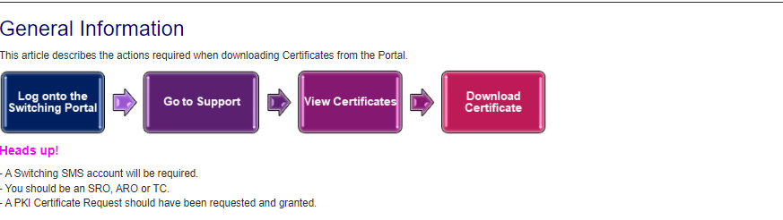
How to download the certificate from the portal – Part 1
This may look slightly different to the instructions below

Slide 38
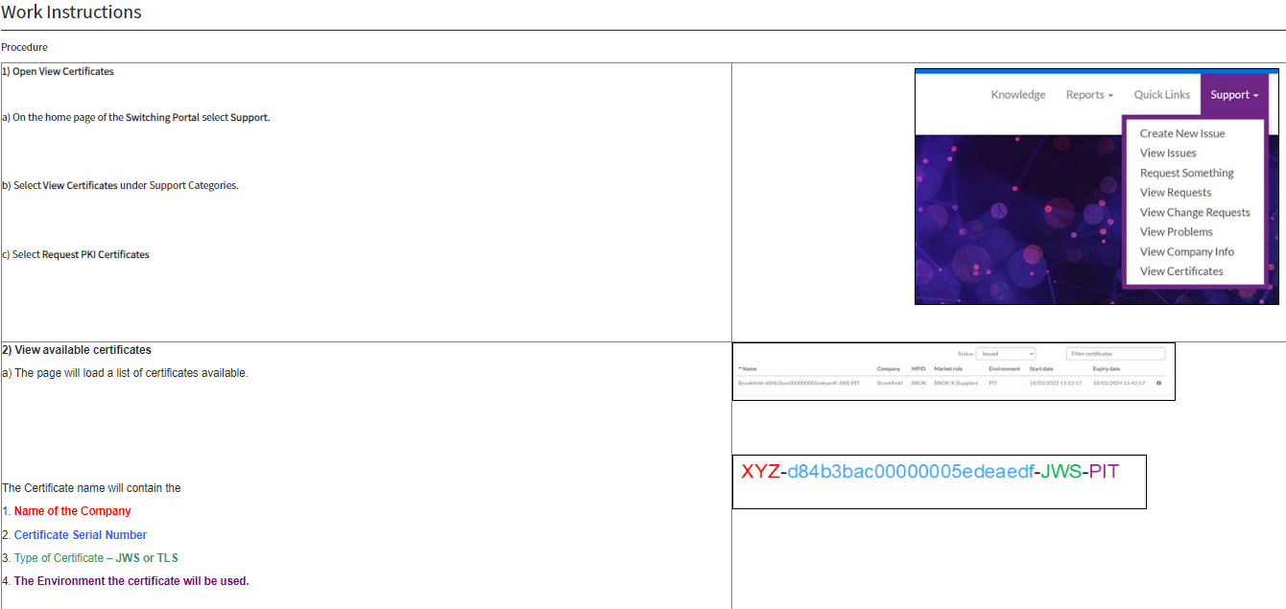
How to download the certificate from the portal – Part 2

Slide 39
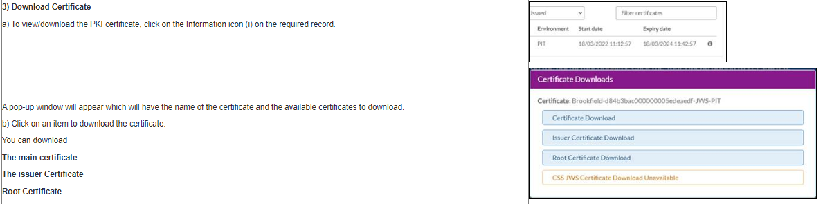
How to download the certificate from the portal – Part 3
This will show as available

Slide 40
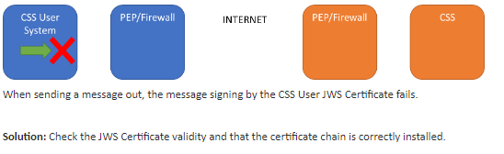
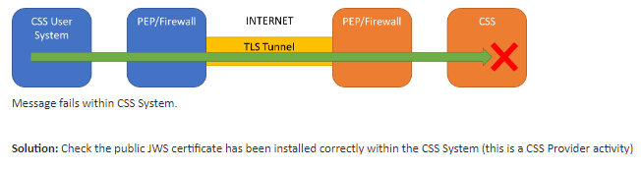
Troubleshooting guide for installing new Certificates
Scenario 1- Parties
Scenario 2 - Landmark

Slide 41
10. AOB
ALL

Slide 42
Rec release updates to the rec portal and change proposal implementation lead times
RIG member

Slide 43
Rec release updates to the rec portal and change proposal implementation lead times
REC Release details:
Our experience has been that (until we proactively intervened to request this) REC Release details have recently not been routinely updated on the REC portal in a timely manner.
Upon request, these details were added within a short turnaround but this has raised concerns regarding visibility of some impending Change Proposal implementation dates for forthcoming releases (we appreciate that proposed implementation dates are published against each Change Proposal and that not all Change Proposals allocated to a future release will have been approved for implementation).
Change Proposal implementation lead times:
Linked to the above, although we acknowledge that REC parties have the opportunity to comment on proposed implementation dates as part of the Consultation process, some proposed implementation dates have relatively short lead times, once the change has been approved.
For urgent or housekeeping–type changes this can be understandable, but with the current unprecedented levels of industry change, these short lead times are particularly challenging for implementation but busy internal teams where systems and/or process changes are needed.
It would be appreciated if the RIG could discuss this in order to understand whether any other REC parties have a similar view, to understand any requirements under REC regarding implementation lead times and whether there is any support that REC can provide to increase implementation lead times.

Slide 44
R0147 – ppm levelisation
RIG member

Slide 45
R0147 – PREPAYMENT LEVELISATION
Introduce the necessary governance and reconciliation arrangements, to reconcile the impact on Domestic Suppliers of levelling the cost of standing charges to Domestic Consumers paying through Prepayment with those paying by direct debit . This will be known as Payment Method Levelisation (PML) Reconciliation.
Effective from date to be 01 April 2024 (Easter Monday); the implementation date for R0147 is 28 March 2024
  01 April 2024 is the first date that Domestic Suppliers must extract data, for submission by the 15th of the month
  The R0147 Final Change Report has now been published and will be considered by the REC Change Panel on 16 January 2024
  The Authority direction on the licence modifications is due by 23 February 2024. The Authority determination on R0147 is due in the same timeframe and will be led by the licence modification direction.
  What do Domestic Suppliers need to do…

Slide 46
Domestic supplier readiness
A request will be sent out w/c 15 January 2024 for Domestic Suppliers to provide the following:
Confirmation of operational contact details for PML Reconciliation
Confirmation of bank details for payments to be received from RECCo
Confirmation of Sharepoint (reporting) contact details
Declaration from Non-Domestic only Suppliers
An indication on operational readiness for the effective from date of 01 April 2024
This will be sent out by the Code Manager.
Please reach out to your OAM or enquiries@recmanager.co.uk for support if required.

Slide 47
Theft Target Methodology 2024/25
RIG member

Slide 48
Theft Target Methodology 2024/25
C3-0061 Theft Target Methodology closed on 5th February 2023
Item​ | Summary of Changes​
Incentive Pots Split​ | Gas/Electricity Domestic customer segment to be split further by Smart and Non-Smart meter types.
Theft Detection Value​ | Adjusted for inflation using December 2023 CPI figure published by the Office for National Statistics with a further 20% escalator mechanism increase applied as outlined in RECCo’s covering letter to the change proposal
Theft Targets​ | Addition of Smart and Non-Smart meter type targets within Domestic customer segment, with weighting applied to focus target on traditional metering.​ Overall target levels maintained to preserve scheme value.​
Attribution Methodology​ | Addition of data used to split pots between Smart/Non-Smart incentive pots.​

Slide 49
Next meeting:
08 March 2024
Thanks for attending

