Slide 1
REC ISSues group
08 March 2024

Slide 2
1. Introduction and agreement of agenda
Shelley rouse

Slide 3
Agenda For today
 | TITLE | TIME | LEAD
1 | Introductions and Agreement of Agenda | 10:00 | Chair
2 | MHHS Update | 10:05 | REC Performance Assurance Team
3 | Data Cleanse Update | 10:20 | REC Performance Assurance Team
4 | Party Assurance Quarterly Update | 10:35 | REC Performance Assurance Team
5 | Erroneous Switch Resolution Process Discussion | 10:50 | REC Professional Services Team
6 | R0147 – Prepayment Levelisation Update | 11:20 | REC Professional Services Team
7 | How does the REC manage RGMA with regards to IGT parties? | 11:35 | RIG Member
8 | CSS/MPRS Alignment Issues | 11:50 | RIG Member
9 | Updating ESME ID | 12:05 | RIG Member
10 | AOB | 12:20 | All
11 | Close | 12:35 | Chair

Slide 4
2. mhhs update
Rec performance assurance team

Slide 5
Market-wide Half hourly settlement update
Code Drafting
  Code Drafting high level overview
  Mop up 2, closing 11 March, Code Topic Mop Up 2 - MHHS Programme
    21 REC artefacts in scope
  Final opportunity to feed into the Code Drafting before it is baselined and submitted for approval
  Code Baseline Matrix

Slide 6
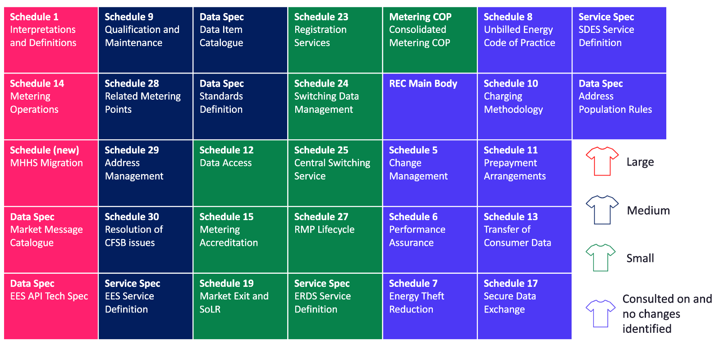
REC MHHS SCR changes – T-shirt sizing

Slide 7
Market-wide Half hourly settlement update
Qualification
  Qualification high level overview, Qualification - MHHS Programme
  What do REC Parties need to do?
  Placing Reliance
  Pre-Qualification Submission
  Qualification Working Group (QWG)

Slide 8
3. Data cleanse update
REC performance assurance team

Slide 9
4. Party assurance quarterly update
Rec performance assurance team

Slide 10
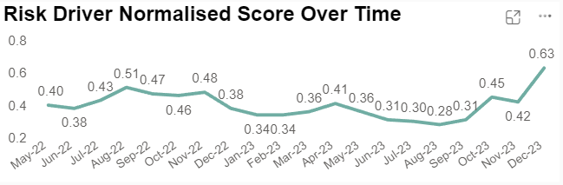
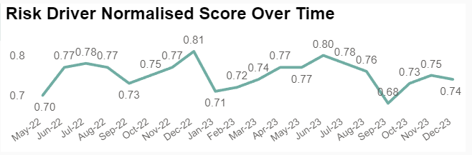
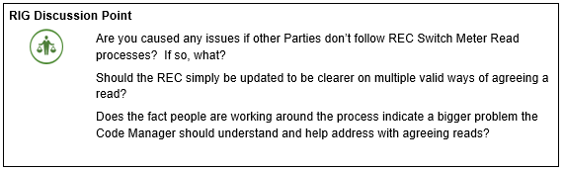
Switch Meter Reads- Retail Risk 5

Slide 11
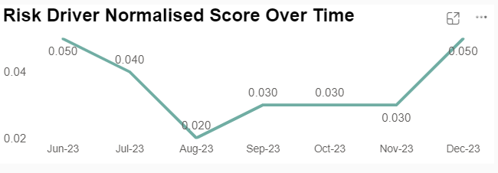

Objections Process- Retail Risk 8 Delayed Switches provides a negative consumer experience of the energy market (outcome measure):
Risk Driver 8.10 – A high-percentage of Objections use by a Supplier for Switch Requests related to Domestic Consumers indicates potential inappropriate use.

Slide 12
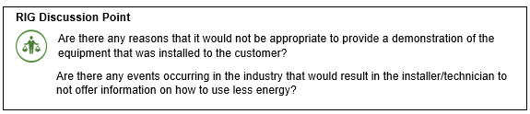
Smart Metering Installation Survey Performance

Slide 13
5. erroneous switch resolution process discussion
Rec professional services team

Slide 14
Background
REC Parties and the Code Manager have been discussing various aspects of the Erroneous Switch Resolution Process as described in Schedule 30. These conversations have been happening since 2023, some at this forum and others offline.
These discussions have brought to light some opportunities for improvement that will benefit Parties and Consumers. The Code Manager would like to take this opportunity to invite Parties to highlight other aspects of the process that may not be working for them.
June 2023 – Derogation from Erroneous Switch Process for Shell Energy Retail Ltd to trial the benefits of extending the timeline for investigations of Erroneous Switches
The Derogation and trial was successful – there is an opportunity to increase the time allowed for ES investigations
The rejected proposal process (6.9.6 / 6.9.7 6.9.8) is not robust and could be reviewed to the benefit of Consumers and Parties
February 2024 – Issue raised to question ES resolution between Non-Domestic and Domestic Suppliers (no ‘paper’ RET process in REC, difficult to get resolutions for Consumers)

Slide 15
Potential areas for consideration
Non Dom Supplier Flows – Cost of DTS to gas only Suppliers?
‘Paper’ RET Process – Should this be in REC? What are the costs of operating this for Domestic Suppliers? Extra SDEP resource?
Should valid and invalid rejection reasons be more prescriptive? Scenarios missing from SPAA/MRA days?
SDEP can be onerous and resource heavy – time for automation and or approved use of BOTs?
Schedule 30 process becomes mandatory under MHHS for HH sites – how does this work with complex metering?
1kw advance – should it return within MHHS 4 month settlement period (after which the incorrect gaining supplier has to foot the bill) – would this incentivise faster fixes? What would this look like in a HH world?
Extend investigation times – more accurate agreements/rejections?
CSS initiated re-registrations upon agreement? Mandate the sending of the registration with the acceptance?
We would invite discussion today, or alternatively comments can be sent to Carl Dennis (carl.dennis@recmanager.co.uk) over the next two weeks. Potential changes will then be presented back to RiG in April.

Slide 16
6. R0147 – Prepayment levelisation update
Rec performance ASSURANCE TEAM

Slide 17
R0147 – PREPAYMENT LEVELISATION update
Licence modifications and R0147 Prepayment Levelisation were approved by the Authority on 23 February 2024
Introduce the necessary governance and reconciliation arrangements, to reconcile the impact on Domestic Suppliers of levelling the cost of standing charges to Domestic Consumers paying through Prepayment with those paying by direct debit . This will be known as Payment Method Levelisation (PML) Reconciliation.
Implementation date is 28 March 2024, with the effective from date of 01 April 2024 (Easter Monday); this is the first date that Domestic Suppliers must extract data, for submission by the 15th of the month.
PML Reconciliation Readiness Checklist for Domestic Suppliers:
Contact and bank details confirmed
Access to reporting Sharepoint
First data extract: midday on 01 April 2024 (Easter Monday)
Data submission: by 17:00 15 April 2024
Sign up to the R0147 Prepayment Levelisation Pre-Release Webinar on 14 March, 13:00-14:30
Please contact your OAM or enquiries@recmanager.co.uk with any questions if need before the webinar.

Slide 18
7. How does the rec manage rgma with regards to igt parties?
Rig member

Slide 19
8. CSS/MPRS alignment issues
Rig member

Slide 20
9. updating esme id
Rig member

Slide 21

Updating esme id
We are currently experiencing 3 issues resulting in the rejection of the D0312 Notification of Meter Information to MPAS.
Scenario 1
Meter A is assigned ESME ID A at the property 10 The Sands.
Meter A (ESME ID A) is then removed and installed in property 12 The Grove.
As the ESME ID pertains to the meter, it is then rejected using rejection reason V - Rejected - ESME ID exists in MPRS.
Not Removed Meter, Associated Import/Export MSID or Related MPAN.
Scenario 2
Meter A is assigned ESME ID A at the property 10 The Sands.
But it should have been installed at 12 The Sands.
Therefore, the meter is removed and installed in the correct property and a default ESME ID is used.
In this scenario, the ESME ID is silently accepted but appears to be using the same ESME ID.

Slide 22
Updating esme id
Scenario 3
When another MOP A uses MOP B's ESME ID incorrectly
MOP B is unable to update MPAS with the correct details, there is no mechanism to identify who is using the ESME ID.
There is no current facility in EES to search by ESME ID.
Similarly, we don't’ believe there is a no way for the MOP to default it which again links to scenario 2 as its being silently accepted and not updating MPAS with the default value

Slide 23
10. AOB
ALL

Slide 24
Next meeting:
12 April 2024
Thanks for attending

