Slide 1
REC ISSues group
12 April 2024

Slide 2
1. Introduction and agreement of agenda
Paul Witton-Dauris

Slide 3
Agenda For today
 | TITLE | TIME | LEAD
1 | Introductions and Agreement of Agenda | 10:00 | Chair
2 | Data Cleanse Update | 10:05 | REC Performance Assurance Team
3 | Data Cleanse Sprint 2 Update | 10:20 | REC Performance Assurance Team
4 | Invalid TopLine Report – Potential supplier registration issue | 10:30 | REC Professional Services Team
5 | Related Meter Point Associations | 10:35 | REC Performance Assurance Team
6 | Gas MEM’s | 10:50 | REC Performance Assurance Team
7 | CSS/MPRS Alignment Issues | 11:00 | REC Professional Services Team
 | Comfort Break | 11:10
8 | Schedule 30 Potential Changes - Erroneous Switch Resolution | 11:20 | REC Professional Services Team
9 | Smart Meter Installation Schedule 16 – Survey Questions | 11:40 | RIG Member
10 | DCC Update | 11:50 | DCC
11 | AOB | 12:30 | All
12 | Close | 12:40 | Chair

Slide 4
2. Data cleanse update
REC performance assurance team

Slide 5
3. Data cleanse sprint 2 update
REC performance assurance team

Slide 6
4. Invalid TopLine Report – Potential supplier registration issue
Rec professional services team

Slide 7
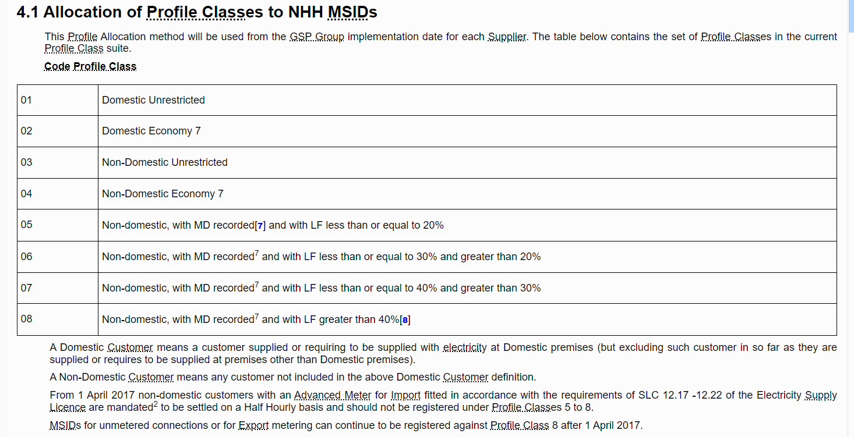
Invalid TopLine Report - Potential supplier registration issue
A Distributor Party has identified a potential issue arising from Supplier first registrations of new MPANs
When the Distributor creates the MPANs they assign the relevant LLFC for Domestic or Non-Domestic
The Supplier then registers the new MPAN and in some instances assigns a Profile Class that does not align with the LLFC
This causes an invalid Topline which then appears on the Distributors report
SDEP Messages are being sent to Suppliers to correct the PCs but these are not answered consistently.
The Code Manager invites discussion on this and would welcome further feedback to guide a course of action.
BSCP516 Profile Class Definition

Slide 8
5. related meter point associations
REC performance assurance team

Slide 9
6. gas mem’s
REC performance assurance team

Slide 10
7. css/mprs misalignment issues
Rec professional services team

Slide 11
Comfort break

Slide 12
8. Schedule 30 potential changes – erroneous switch resolution
REC Professional services team

Slide 13
Erroneous Switch Resolution
Timings (Initiations and responses)
Parties should have 8 Working Days to send the initial request, regardless of them being the gaining or losing Supplier
Parties should have 8 Working Days to respond to the initial request, regardless of them being the gaining or losing Supplier
The Customer Contact Date should not be the trigger for the above timings for the receiving Supplier, it should be the date the Market Message is received
The extra time for the investigation is easily mitigated by Faster Switching
‘Paper’ RET
Parties should be expected to follow the Schedule 30 process, including the use of Market Messages, unless the ES is Commercial to Commercial
or
Parties should be sending CSV files via SDES that are machine readable to enable the recipient to load them to their Gateway
The process would be described in the Schedule

Slide 14
Erroneous Switch Resolution
Rejections
Rejections should be viewed as an end status to the process, Parties should then either negotiate via phone or SDES before agreeing to cancel the ES request or restarting the exchange of Market Messages.
Not having a named Consumer should not be a valid reason for a rejection of an ES request – Parties have deemed supply contracts
The Customer Contact Date should not be the trigger for the above timings for the receiving Supplier, it should be the date the Market Message is received
Reporting Timings (Day count start and duration)
Count start dates should be prescribed. Eg if a Market Message is received during working hours that is day zero, if received outside of working ours then the next period of working hours is day zero
Count durations should specify Working Day to Working Day, reporting should not be Market Message Timestamp to Timestamp

Slide 15
9. smart meter installation schedule 16 – survey questions
Rig member

Slide 16
Smart Meter Installation - Schedule 16 – Survey Questions
The Smart Meter Installation Schedule (SMIS) had been transferred into one document with other regulations, called Consolidation of Metering Code of Practice (CoMCoP). However when this was transferred into CoMCoP, the questions for domestic and micro-business and the methodology around this was not included. According to REC Performance Assurance the questions are still valid and applicable as written.
Therefore please can the questions and other missing information around the survey please be include in the current regulations. Once this has been included, They can look to recommend a change to update them. The Party are raising this following recommendation from REC representatives on the R0152 working group.
Is there an appetite for this ?
Are there any other suggestions / ways of changing we haven’t thought of ?

Slide 17
10. DCC Update
DCC

Slide 18

Today we’ll cover the following:
Switching Performance Leo Brown
Address Management Update Rob Annable
Incident Overview Mark Potts
Problem Overview Shane Clarke/Lorraine Green
Change & Maintenance Update Ed Russell
CSS BCDR Update Ed Russell
AOB

Slide 19
Switching Performance

Slide 20
Month of March
March Gate Closure
Commentary
We have surpassed 26 million switch cumulative requests submitted into CSS with only 37,511 failing validation – Only 5 of these switches were found to have wrongly failed validation, the remaining were due to user behaviour.
March has seen a decrease in switches which is largely due to the slowing of internal migrations. In March 2023 just over 800k switches were submitted.
Gate closure successfully passed SLA 100% of the time in March despite large volumes. We saw 5 days with over a million messages during gate closure.
Gate closure SLA | Message Volume | Average Duration
February | 19,396,166 | 25.93 Min
March | 16,965,809 | 14.38 Min
Cumulative Switch Requests submitted = 26,187,699
Cumulative Active Switches at Gate Closure = 25,528,055
Cumulative Switches Failed CSS Validation = 37,511

Slide 21
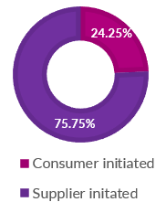
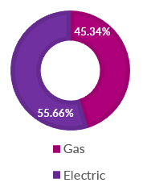
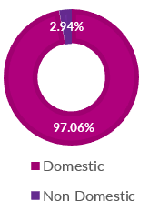
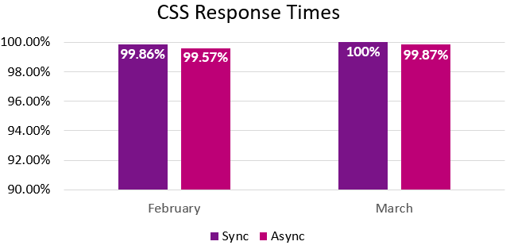
Month of March
March 4.13
Key Highlights
In March, 75.75% of switches were internal migrations rather than consumer-initiated switches. In the month of March there was a combined total of 1.4 million internal migrations through CSS.
A major internal migration activity has come to an end which has accounted for around 2 million switches over the last 3 months. We are expecting to see a decrease in Supplier initiated switches in April.
In March, Async responses fell short of achieving the 100% target due to a single instance where the 3-second Service Level Agreement (SLA) was missed in a single hour with an average of 5.38 seconds. This is however an increase in last months performance.
Sync performance is back at 100% after a drop in performance during February.
Calculations of Async/Sync metrics are being reviewed under R0092.
CSS System Availability for March 24 was 100%
DCC Confidential
21

Slide 22
Address Management Update

Slide 23





Address Management Update
Key Highlights
Guidance document developed and issued to enable Source Data Providers to carry out more detailed analysis on address data
Address Quality Plan (AQP) Compliance report on track to submit to PAB by the end of April – Gives overview of progress vs 2023 AQP
The issue with bulk uploader (for new matches) identified and fix will be implemented during April. We expect to see a large spike in new matches post this.
Working with PAB to align on how industry, PAB and DCC can work together this year to drive further improvements in address matches
Total Unmatched and Matched Addresses
A breakdown of the total address dataset between matched and unmatched records
Customer Engagement
New RMP Quality
New Matches Updated
Centrally
AQP Consultation Update
An indicator of the quality of new address records being supplied to CSS
Volume of new matches updated in CSS directly by DCC and its sub-contractors
Compliance to the REC Obligation to Issue the Address Quality Plan for consultation and publication
The meetings held between DCC and Industry parties to discuss data issues
Meetings held within Quarter to End March 24
AQP Forum | 23 Jan 24
Consultation Period Ends | 31 Jan 24
Supplementary Report Issued to REC PAB | 29 Feb 24
AQP Issued to REC PAB | 29 Feb 24
Submit AQP Compliance Report to PAB | 30 Apr 24
27
Total Meetings
Since
01 April 23
94
Notes:
How do we do this?
By collaborating with source data providers to resolve issues at source with data which cannot be matched to Ordnance Survey
By conducting systematic reviews of unmatched and matched data to ensure the highest quality is sought
By developing an annual plan for the improvement of address data quality

Slide 24
Switching Incidents Overview

Slide 25
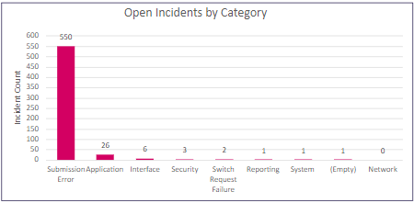
Incident and Service Management Data
Priority 3 and 4 Incidents – Volumes Raised and Trend (Excludes Cancelled, CSS Data Integration Incidents & Poison queue incidents )
Open incidents comparison
As of Close of Play month ending March there were 272 open incidents compared to month ending February where there were 208, (“in progress”, “on hold” , “new” and “resolved” ).
Open Incidents by category
No of new incidents per month and the dominant types
March
598
Commentary by category (Cumulative) :
Inclusive of all open incidents since go live, 56.99% of incidents are categorised as Submission Error – Within this category 46.2% of incidents relate to Error API , Provisional Registration relates to 15.09% of incidents. The rest of the 38.71% is spread out over several issues. Application makes up for 29.04% of the current open stack – the majority of these are failed registration incidents relating to missed messages. The % of Incidents raised from Switch Requests was 0.04% in March To date 96.52% of incidents have been resolved within the overarching Switching Operator SLA - Excluding cancelled incidents 98.01% of incidents now closed have been resolved within their SLA.
February
1074
DCC Confidential
25

Slide 26
Aged Incident Breakdown
March Aged Incidents
February Aged Incidents
Comparison & Commentary
Within the month of March there were 110 incidents in an ‘on hold’ status with energy suppliers This equates to 65% of all open incidents with the oldest incident from 25/08/22 and 73.2% of these have been on hold for more than 30 days. Service desk have formally escalated to REC to assist with this matter due to the lack of progress. We continue to interact with service users via incidents, email & calls to chase for resolution in remaining incidents. Action Required Market Participants to review and resolve/progress their aged Incidents. Review, update and maintain contact/users within the Switching Portal to ensure visibility of Incidents
DCC Confidential
26

Slide 27
Problems Linked to CSS
Major Incidents

Slide 28
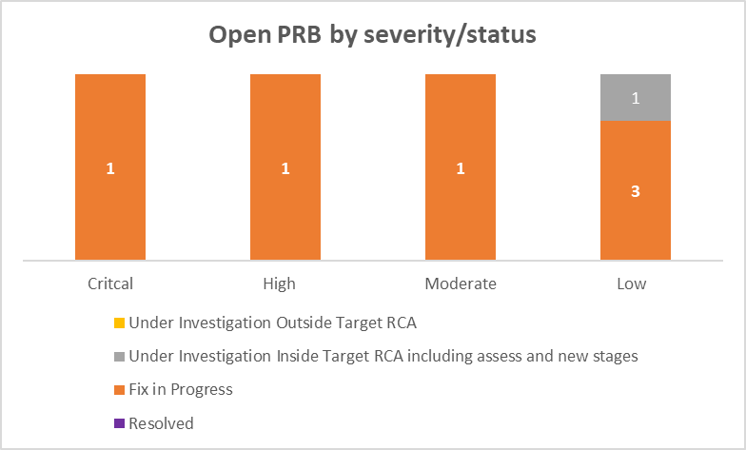
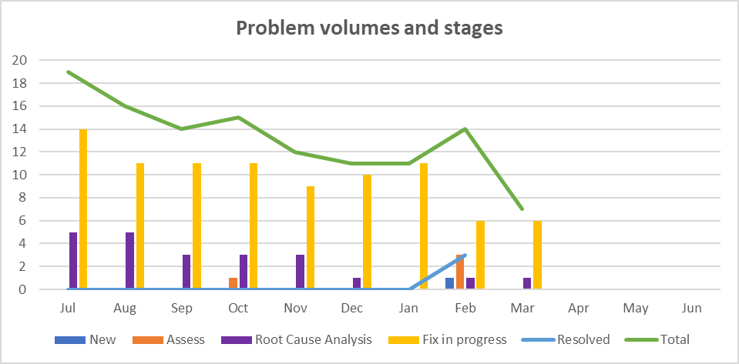
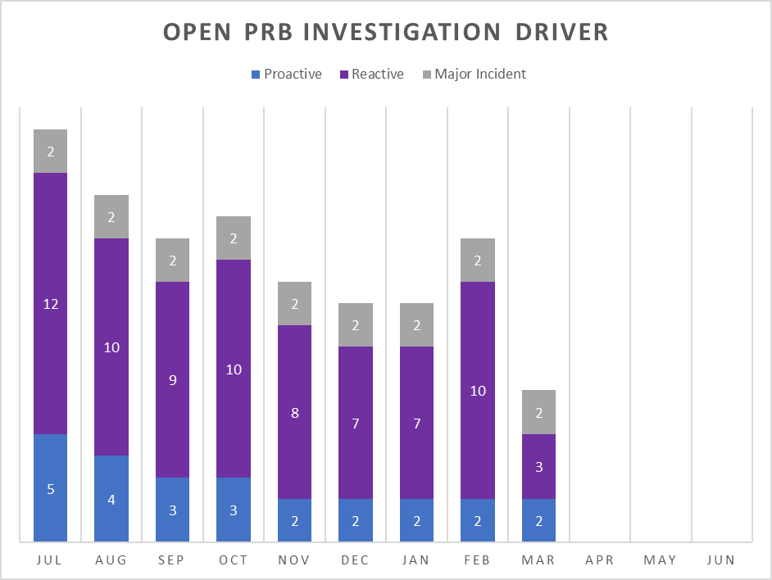
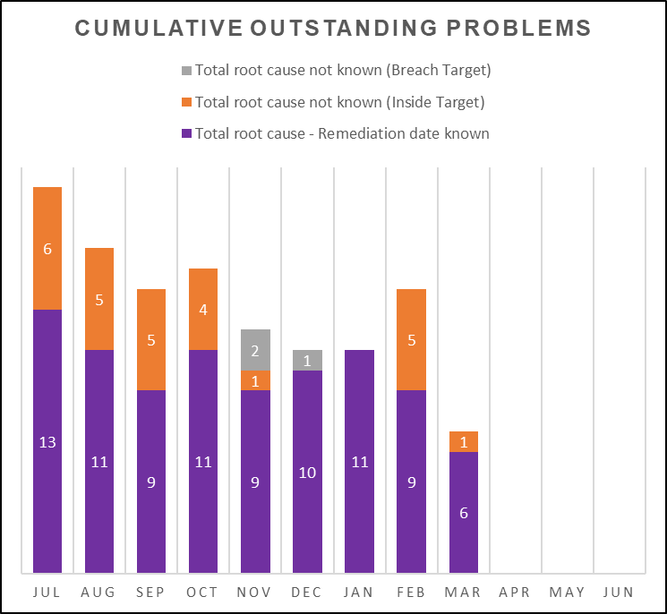
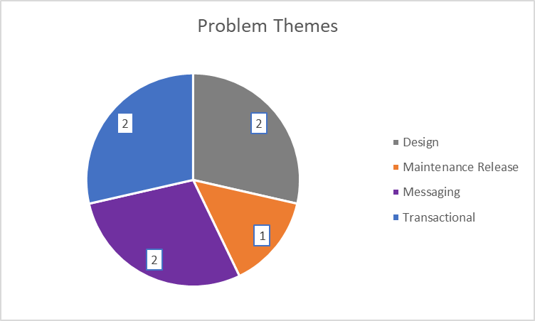
Problems and Remediations
Volume Summary
Total open Problems | 7
Root cause confirmed, fix in progress and resolved | 86%
Ratio Proactive raised V Reactively raised | 29%
Outside DCC control to resolve i.e. not a CSS fault | 0%
Average Age (days) of all open Problem records | 186
Good controls maintained to move investigations forward, Age profile extended this month due to last month’s closure volumes leaving core number of aged problems in profile related to MI progress, themes being design and transactional.
DCC Controlled REC

Slide 29
Problems related to Major Incidents (Full problem details in the Appendix)
Date & Title / Incident & Sev / Problem No | Status | Category (Theme) | Risk of Re-occurrence | Latest Update
22/06/2023 - CSS Inbound message failure for 33 minutes between 12:55 and 13:28/ INC0215199 P2/PRB0040669 | Fix in Progress | People / Skill Based Error / Knowledge | Medium | During Production Integration (PITB) testing of the alerting of the expiry of critical accounts, an unsupported Platform Provider (PP) pipeline task was identified which caused the deployment to error and fail. It has since been established that the recommended authorisation mechanism (Federated Identity) for the deployment of releases into production is incompatible with some elements of the release process (i.e. scripts). This is a known PP bug applicable to their clients globally and will not be resolved in the near future. The alternative deployment method is via the Service Account which previously has been successfully used and is a PP supported feature. The deployment runbooks have been updated and now contain steps to check the account validity/password before deployment starts as mitigation post the observed incident. As the globally identified bug is unlikely to be resolved this year, DCC CTO team have recommended a Risk is generated to allow the closure of this Problem record and are in the process of agreeing the most suitable area that will own and progress this Risk.
06/07/2023- Messages missing from Gate Closure/INC0216074 P1/PRB0040672 | Fix in Progress | Technology/ Environment / Disaster Recovery | Medium | A paper of technical options was provided by the SDSP and subsequently reviewed by the DCC CTO team. A follow up workshop to review/progress/ multiple actions was held on 10th January 2024. Post this activity the DCC CTO team/end to end architect have held internal discussions around which are the optimal improvement proposals to progress with REC Technical Services (RTS)/SDSP via a REC Change Proposal (CP) and which are candidates to be incorporated into the existing REC Change R0096 (Message Regeneration Functionality). Initial proposed inclusions have been presented to RTS (22/03) and SDSP are now reviewing and incorporating feedback from RTS into the change (output is expected w/c 8/04). RTS will then schedule a meeting with industry to present the changes and gather feedback.

Slide 30
Problem Management Continual Service Improvement:
Subject - How to receive updates on Problem Investigations when you have an incident related.
Current – Final state
April 2024 Final status
Once you have been advised that an incident has been related to a problem investigation or has instigated a problem investigation and been provided the PRB reference:
The online portal is the first reference point to check whereby if MPID and Market Role were aligned to the incident the problem will be displayed on the user's online portal.
Alternatively:
The Central Switching Service Service Desk can be contacted:
Email - CSSServiceDesk@smartdcc.co.uk
Phone – 0808 175 4564
Activity undertaken:
Check the status of the problem record to provide either verbal or written update.
Liaise with the CSS Problem Team via email or online chat if the update requires clarification or if there is a query that cannot be answered.
​
At the start of this exercise, it was unclear how visibility of problems could be achieved post go live and there had been limited information concerning portal visibility gathered by DCC Problem Management who are not provided with external portal access.
The exercise enabled DCC Problem Management to clarify portal visibility and understand how this was presented to market participants. An outcome of this process enabled process improvements concerning email incident reporting to be made to ensure incidents reported this way achieved portal visibility if they were aligned to a problem investigation. This final activity was delivered last month and is now being utilised by the Service Centre. ​​
​​
The current final state to the left has been updated to reflect the online portal is now the first place to review problem progress.

Slide 31
Change Overview – May Maintenance

Slide 32
Release Management POAP – Operational Release – May 2024
May 2024 Operational Release |  | 2022
Week commencing | w/c. 04/03/24 | w/c. 11/03/24 | w/c. 18/03/24 | w/c. 25/03/24 | w/c. 01/04/24 | w/c. 08/04/24 | w/c. 15/04/24 | w/c. 22/04/24 | w/c. 29/04/24 | w/c. 06/05/24 | w/c. 13/05/24 | w/c. 20/05/24 | w/c. 27/05/24 | w/c. 03/06/24 | w/c. 10/06/24 | w/c. 17/06/24 | w/c. 24/06/24
Key Milestones
Key Activities
Release Scope Sign off 12/03
PIT Exit gate 16/04
SIT Test Execution Complete 14/05
UIT-A Deployment 29/05
PIT-A Deployment 15/03
CRB For SIT Entry 16/04
SIT Exit Gate 21/05
SIT-B Deployment 30/05
Pre-Prod Deployment 01/07
Commercial Approvals for all impacted parties 12/03
SIT – A deployment 17/04
CAB 22/05
UIT-B Deployment 31/05
Production Deployment – Registration Service 23/05
Solution Design & Development
PIT Test Preparation
Create POAP
PIT Testing
Production and Approval of RITP
SIT Test Preparation
Today
SIT – A deployment 17/04
PIT Assurance
SIT Test Entry Governance
SIT Test Execution (inc. smoke testing)
Production Deployment – Registration Service 23/05
SIT Test Exit Governance
ELS
Update Lower Environments
Key Milestones for the Release
Deployments to Environments

Slide 33
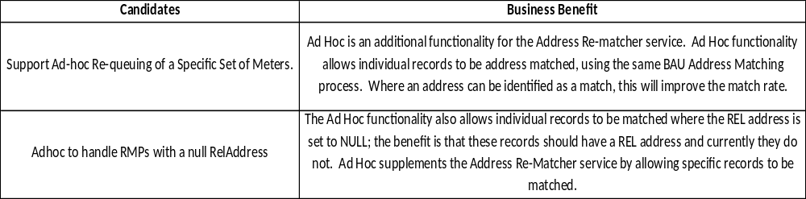
May Release Scope & Benefits

Slide 34

MAKING BRITAIN MORE CONNECTED, SO WE CAN ALL LEAD
CSS TLS/ JWS Certificate Replacement
HELPING TO TRANSFORM BRITAIN’S ENERGY SYSTEM WITH SMART METERING

Slide 35
TLS/JWS Renewal Cycle
The Renewal Cycle is beginning for parties to renew both their TLS and JWS Certificates via the Switching Portal, every two years both certificate types will need to be renewed in the same year but the process on the portal is similar for both.
The relevant contacts ARO/SRO/PKI officer etc will be notified via email 90,60,30, and 1 day prior to the expiry date to provide enough time for planning if needed, you are able to renew early if you choose to do so.
If you think you may not have the access you need for the portal due to inactivity or a password issue please get in contact with the desk who will be happy to help – CSSServiceDesk@smartdcc.co.uk
There are several knowledge articles on the portal to assist with these processes:
KB0010830 - How to Download PKI Certificate from the Portal
KB0010803 - How to Request PKI Certificates
KB0010799 - How to submit a Nominate PKI Officer Request

Slide 36
CSS BCDR Update

Slide 37
Central Switching Service BCDR Exercise Update
Annual BCDR testing is a REC obligation and a contractual requirement for the CSS provider
DCC have made a risk-based recommendation for testing within the Pre-Production environment, starting late April
  REC Technical Services have been consulted and support the recommendation
  REC Performance Assurance Board were briefed in March
  Planning is on track to commence failover activities w/c 29th April 2024
DCC accepts that testing in Pre-Production is not the same as Production
  DCC will ensure that Pre-Production aligns as closely with Production as possible, e.g. data volumes, processing
Benefits of testing Pre-Production are:
  Azure Storage Account geo-replication synchronisation timings and lags can be analysed to better quantify the risk to data on failover
  Recovery procedures for all critical data can be rehearsed and validated ensuring preparedness for future disruptive events
  Testing and exercising can be completed without impacting service
Production BCDR testing will be planned based on Pre-Production testing outcomes

Slide 38
Central Switching Service BCDR Pre-Production Testing Timeline
Pre-Production BCDR Exercise planning timeline, outcomes and communication activities
February 2024
March 2024
April 2024
May 2024
June 2024
  Risk Assessment & Outline Exercise Recommendation to DCC SLT
  REC Technical Services consulted
  Pre-Production Exercise Scope, Objectives and Success Factors agreed
  BCDR Exercise Plan & Approach
  Pre-Production Non-Functional Requirements
  Detailed Schedule of Exercises to be run and associated Runbooks
  Recovery Procedures
  Data copied and restored to Pre-Production (before 28/03/24)
  REC Performance Assurance Board
  Pre-Production environment, tooling and monitoring fully prepared
  Geo-replication timescales estimated (via tests)
  Conduct walkthroughs and rehearsals to validate and update Recovery Procedures
  Briefing to Switching Operator Forum
  REC Weekly Bulletin update
  Conduct Failover(s) w/c 29/04/24
  Monitor replication
  Conduct Failback(s) w/c 07/05/24
  Post-Exercise Review of learnings and outcomes
  BCDR Exercise Report
  Updated Runbooks and data Recovery Procedures
  Future BCDR Exercise Recommendations
  Updates to:
  REC Performance Assurance Board
  Switching Operator Forum
  REC Weekly Bulletin

Slide 39
AOB

Slide 40
THANK YOU
Appendix

Slide 41
2024 Major Incidents - Problem Management Update
Date & Title / Incident & Sev / Problem No | Status | Category (Theme) | Risk of Re-occurrence
22/06/2023 - INC0215199 - CSS Inbound message failure for 33 minutes between 12:55 and 13:28 – PRB0040669 | Fix in progress | People / Skill Based Error / Knowledge | Medium
Root Cause:
Root Cause was related to the June Maintenance Release CHG0031388.​ During the implementation it was identified that the privileged account used to run the Devs Ops pipeline had expired on the day of the release 22nd June 2023. The account had expired after completing UK South (UKS) and when about to start UK West (UKW).​
​A new account was created, however, the engineer deploying the release had restarted the job from the start position (UKS). This resulted in UKS being shut down leaving no traffic to route through. ​
​The error was immediately identified, and UKW was brought back online to restore service and allow traffic to flow. Once UKS deployment was completed the engineer was then able to commence UKW.
Incident was a high severity.
Preventative Steps:
Step now added to runbook for pre-implementation checks on the service principle and ensure that it has not expired and therefore will not have to be created mid-release in future.
Release team will use Teams chat throughout the Release Window, as a touch point on progress/issues with the Service Integrator (SI). Emails will also be sent out at defined checkpoints on the Release Day.
A further step now added to the runbook to confirm the current Primary region before jobs are run.
Proactive and retrospective monitoring gaps to be jointly investigated between DCC and Landmark. This action is being carried forward by DCC under the P1 lessons learned piece to ensure CSS can be queried by Landmark & DCC TOC and show volume and success at each step of the process.
4 eyed principle applied to ensure manual keying errors are not introduced.
Enduring Solution:
Alerting to be created for the expiry of critical accounts. This will ensure expiring accounts are managed in a timely manner and are in a useable state prior to starting a release. Release date under replanning as moved out of scope for March 2024.C
Run books updated to ensure clear instructions to engineers performing change.
For the latest position regarding progression please defer to the slide - Problems related to Major Incidents

Slide 42
2024 Major Incidents - Problem Management Update
Date & Title / Incident & Sev / Problem No | Status | Category (Theme) | Risk of Re-occurrence
06/07/2023/INC0216074 P1/PRB0040672 | Fix in progress | Technology/Environment/Disaster Recovery | Medium
Root Cause:
The underlying cause was due to an issue which had arisen in the Microsoft Azure (Cloud) environment, not within CSS, which meant processing power and other technical resources were prioritized in the recovery of the live traffic incident, which resulted in the CSS P1 incident (future dated switch queue not being replicated correctly during the BCDR event).
Preventative Steps:
Microsoft has confirmed that it has put appropriate monitoring in place to help prevent this issue occurring in future.
Microsoft confirmed that enhanced load balancing monitoring will mitigate for live traffic having priority to replication traffic.
Landmark now have monitoring in place that alerts when replication is 16 minutes out of sync (ie a lag in copying data from one site to another occurs), which allows controls to be put in place in order to prevent this type of issue occurring again.
Additional monitoring for future BCDR tests will be added by both the DCC and Landmark team.
Going forward, Landmark will host a Microsoft engineer on their change bridge to provide assurance on the Azure environment. This practice was deployed on the Maintenance Release on the 16th of August with a successful outcome.
Enduring Solution:
A full Architectural review will be held and will include future-proof failovers with a paper of options being put together by LMK, e.g., backing up data to a third location.
For the latest position regarding progression please defer to the slide - Problems related to Major Incidents

Slide 43
11. AOB
ALL

Slide 44
Next meeting:
10 May 2024
Thanks for attending

