Slide 1
REC ISSues group
10 May 2024

Slide 2
1. Introduction and agreement of agenda
Shelley rouse

Slide 3
Agenda For today
 | TITLE | TIME | LEAD
1 | Introductions and Agreement of Agenda | 10:00 | Chair
2 | Code Roadmap | 10:05 | REC Technical Services Team
3 | Annual Ratings | 10:20 | REC Performance Assurance Team
4 | Data Cleanse Update | 10:35 | REC Performance Assurance Team
5 | RIG Actions – Performance Assurance | 10:50 | REC Performance Assurance Team
6 | R0121 – SDEP Review Improvements – Process Types | 11:05 | REC Professional Services Team
7 | Payment Method Levelisation Single/Multi-Rate Differentiation | 11:20 | REC Professional Services Team
8 | R0105 - Review of ONAGE SLA’s | 11:35 | REC Professional Services Team
9 | D0312 ESME ID Duplication Issue | 11:50 | REC Professional Services Team
10 | Erroneous Switch Change Update | 12:05 | REC Professional Services Team
11 | CSS/MPRS Misalignment Update | 12:20 | REC Professional Services Team
12 | Switching Incentive Regime (SIR) Survey | 12:35 | RECCo
13 | AOB | 12:50 | All
14 | Close | 13:00 | Chair

Slide 4
2. code roadmap
REC technical services team

Slide 5
Code roadmap
Created a roadmap early 2023, as a three-year view of priority areas from across RECCo/REC
Didn’t prove to be as useful as intended
Listened to feedback from users and re-assessed internal need
New format created, now available on Digital Navigator
Approximately fortnightly updates
Feedback to enquiries@recmanager.co.uk

Slide 6
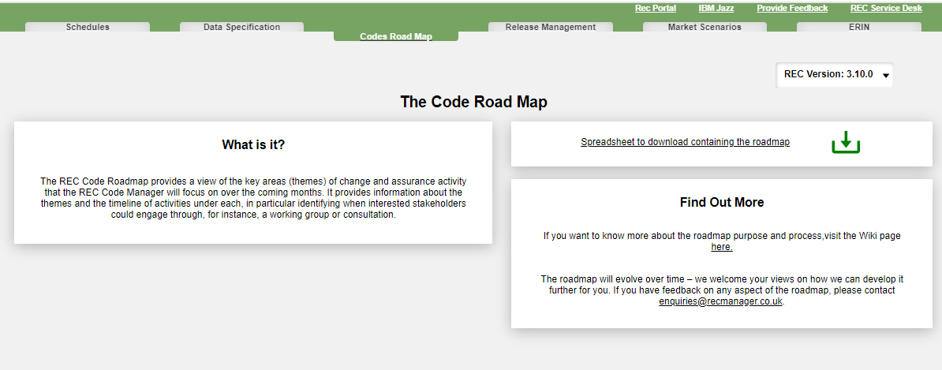
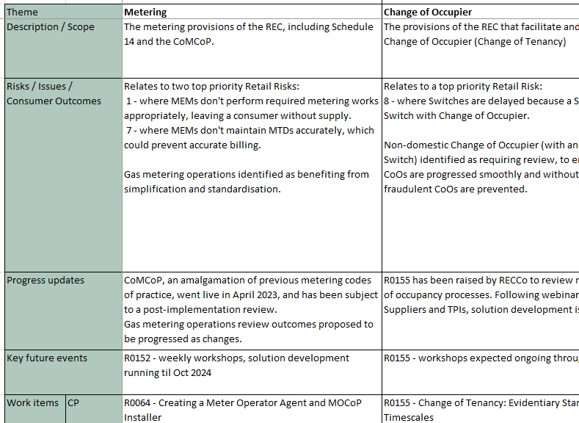
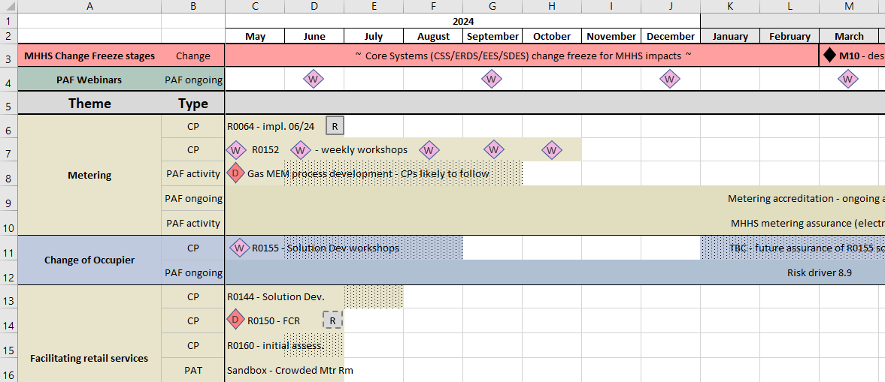
Location and content
Accessible via tab on Digital Navigator
View the list of themes, and a timeline
Shows Change and Performance Assurance activity that could lead to change
Includes points to input or find out more

Slide 7
3. Annual ratings
Rec performance assurance team

Slide 8
Annual Rating
We provided a paper in advance which sets out the rationale for the annual rating criteria we propose. These are summarised below.
Category | Criteria | No Material Weakness | Minor Weakness | Moderate Weakness | Severe Weakness
Performance Data | Action Plan PAT issued |  | 3 | Multiple action plans
 | Management Assertion PAT Issued (except those relating to data cleanse) |  |  | 3
 | Specific Condition PAT Issued |  |  |  | 3
 | Referral to Ofgem |  |  |  | 3
 | Event of Default |  |  |  | 3
Data Cleanse | Management Assertion PAT relating to data cleanse |  | 3
Market Entry and Qualification | Maintenance of Qualification Delay of 1 month or more |  |  | 3
 | CME Condition Breach |  |  | By up to 10% of CME cap | By more than 10% of CME cap
Energy Theft | Energy Theft Detection Scheme target met | 60% + | 40 – 60% | 0 – 40% | 0% and no engagement

Slide 9
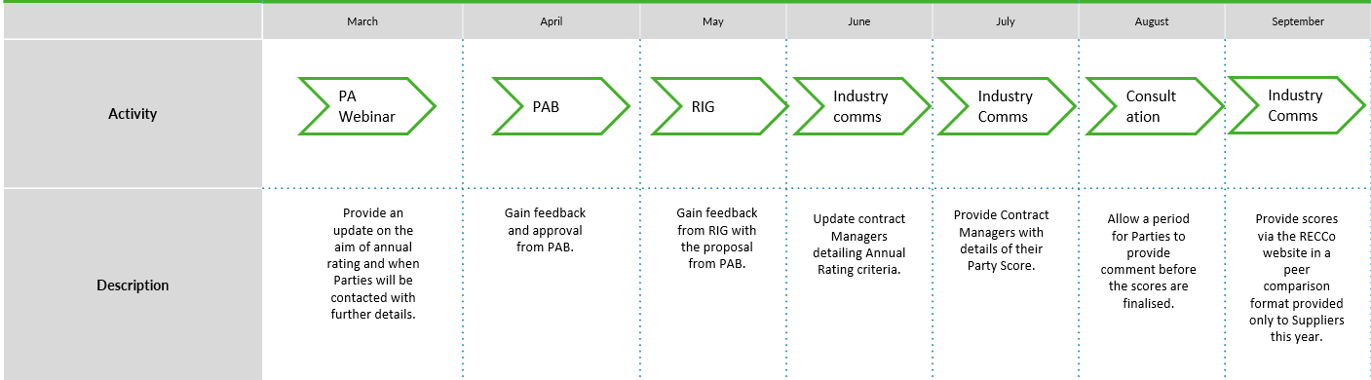
Annual Rating next steps
We wish to discuss these items at RIG, and based on the outcomes of these discussions we will test the criteria with current performance and will also engage with industry following the steps set out below:
We are here.

Slide 10
Questions for rig members
Has the Code Manager missed anything in the criteria that you would suggest including for the Annual Rating? 2. Is there any item you would suggest changing, if so and why? 3. Are there any further steps the Code Manager should take when engaging with industry? If so, please outline what steps should be taken in addition to the next steps.

Slide 11
4. Data cleanse update
REC performance assurance team

Slide 12
5. RIG Actions – Performance assurance
REC performance assurance team

Slide 13
RIG ACTIONS – Performance assurance
ACTION REF. | ACTION | OWNER(S) | UPDATE | STATUS
RECRIG_24_0412_01 | Code Manager to investigate the creation of a data cleanse report showing terminated MPAN’s that meet the Energise Meter Point / no MSN criteria. | REC Performance Assurance Team | An update will be provided at the RIG meeting on 10 May 2024. | Open
RECRIG_24_0412_02 | The Code Manager to investigate the volumes involved in the split supply, related MPAN reports and propose a solution to the issue raised. | REC Performance Assurance Team | An update will be provided at the RIG meeting on 10 May 2024. | Open
RECRIG24_0412_03 | The Code Manager to liaise with a RIG member on the issue of multiple meter points being created as the same, due to the MPRN belonging to the same Gas Transporter but they are not necessarily the same | REC Performance Assurance Team | An update will be provided at the RIG meeting on 10 May 2024. | Open

Slide 14
Energised / No MSN and Terminated
Current report is circa 3600 across 37 Suppliers
Top 4 Suppliers account for 87% of all issues
This will be provided as part of May’s report pack
The data cleanse guidance document will be updated following a Category 3 change
Following the April RIG meeting an action was taken to investigate and develop a new data cleanse report
Description
An Energised Meter Point with no MSN and is terminated
Rationale
The report supports the below logic:
  MSN is not present AND the Energisation Status is set to ‘E’.
  RMP Status is Terminated.
  The meter point is not unmetered.

Slide 15
Discontinuing 3B and 6B
At the April RIG meeting a member raised the challenge involving interacting with customers who are not engaging in scenarios where multiple MPANs have a split Supply and should be brought back together.
The non engagement results in report volumes remaining relatively static and the suggestion was to discontinue these reports.
76% and 68% of MPANs have remained on 3B and 6B reports respectively for 12 months or more
Existing work underway to refine how we categorise data cleanse reports will address this – each report will be classified as per the below table. Work is underway to update this within the relevance Performance Assurance processes, including documenting which classification applies to each report.
There is also an option to define additional exemptions – to be used when reasonable efforts have been taken – RIG member views welcome.
Sprint
Set data cleanse targets, approved by the PAB, for Parties to deliver.
A sprint approach is followed in order to focus effort across the market on prioritised issues.
Track
Provide data cleanse reports to Parties and these should be addressed in line with the published data cleanse guidelines where possible.
These reports may form part of future sprints depending on market activity, performance and priorities.
Unlikely to apply PATs in respect of these reports but if performance dramatically changes, we may engage with relevant Parties to understand more.
Watching brief
Continue to run these reports and share them with Parties but are not actively considering them.
Most commonly used where reasonable efforts to cleanse data have been taken and there is a low residual level of items in these reports.
We do not expect Parties to actively cleanse these but want to be alerted if an event in the market causes a significant resurgence of issues.
If these targets are not met by an individual Party we apply relevant PATs, agreeing the approach with PAB as appropriate.

Slide 16
6. r0121 – sdep review improvements – process types
Rec professional services team

Slide 17
R0121 – sdep review improvements – process types
Following the approval for R0121 for implementation on 23 August 2024, the Code Manager will be updating the SDEP User Guide and drafting guidance to support the efficient and compliant use of the SDEP.
The Code Manager will be requesting user input into the documents and will be circulating a request for feedback in the second half of May. Keep an eye out for communications via the Change Bulletin or change.management@recmanager.co.uk.

Slide 18
7. payment method levelisation Single/Multi-Rate differentiation
Rec professional services team

Slide 19
PAYMENT METHOD LEVELISATION – SINGLE/MULTI RATE DIFFERENTIATION
RECAP
Payment Method Levelisation (PML) Reconciliation (R0147) became effective from 01 April 2024
11 March 2024: Ofgem communicated intention to introduce differentiation between single-rate and multi-rate metering arrangements in the PML Reconciliation calculations.
The extension to single- and multi-rate requires changes to the new Schedule 31 - PML Reconciliation, including a change to data submission requirements.
NEXT STEPS & expected timetable
Working with Ofgem and RECCo to confirm detailed requirements and legal text
REC Change Proposal to be raised in June 2024
Party impact assessment in late July/early August
Consultation in early September
Targeting implementation for the updated Schedule to be effective from January 2025

Slide 20
8. R0105 – Review of ONAGE Sla’s
Rec professional services team

Slide 21
Change overview
Schedule 14 – Metering Operations sets a Service Level Agreement (SLA) of 2WDs for Metering Equipment Managers (MEMs) to respond to the ONAGE Market Message, which is sent from the Supplier to request a change in appointment status.
Lengthy ONAGE SLAs relative to the timescale of the switching process may result in Consumers being left without a MEM during the switch process.
This change seeks to review this SLA in light of Faster Switching and current operational challenges for MEMs.

Slide 22
Current challenges
The proposer has reported that currently it is possible for a site to become MEM-less as a result of the current 2WD SLA.
During a switch, the MEM will receive the ONAGE to alert them of their change in appointment status, and have 2WD to respond.
During this 2WD window, should the Consumer chose to cancel their switch, or switch again, the MEM will receive a 2nd ONAGE before the 1st ONAGE has been processed.
This can present operational challenges to the MEM and may result in the site being without a MEM whilst the series of ONAGEs are processed.

Slide 23
Solution design
The Code Manager is exploring how the SLA can be reviewed:
The SLA will either be lowered, or kept as it currently is.
  If lowered, should it be lowered to 0WD, or 1WD ?
If the SLA is kept at 2WDs, what can be done to support MEMs resolve issues arising from that SLA ?

Slide 24
Question for RIG
Do Parties have a view on whether the SLA should be retained or lowered ?
If we chose to lower the SLA:
  Do MEMs have a view on the operational challenges associated with a reduction in the SLA ?
If we chose to retain the SLA:
  Do Suppliers have a view on how they can adapt their existing processes to accommodate MEMs who may be facing difficulties as a result of the existing SLA ?

Slide 25
9. d0312 ESME ID Duplication Issue
Rec professional services team

Slide 26
D0312 ESME ID Duplication Issue
D0312 ESME ID Duplication Rejections
A number of Parties have raised this issue to the Code Manager
The Code Manager has worked with Parties to review the issue
Parties are receiving rejections when updating new meters to ERDA following their installation and during the Crossed Meter Resolution Process
ERDA appears to not recognise the ESME ID has been removed from the previous RMP and rejects the update
Parties then have to manually send the D0312 again with a Dummy ESME ID to effectively reset the system
They can then send a third D0312 with the original ESME ID to complete the update
The Code Manager is raising this with RTS and the Service Provider for investigation and will provide a further update at the June RIG

Slide 27
10. erroneous switch change update
Rec professional services team

Slide 28
Erroneous Switch Change Update
Timings and Escalation Actions – Progress to CP May 2024 (Aim for Nov 24 or Feb 25 implementation)
Increase initiation and response times to 8 working days
Day count for meeting the SLA starts when the Consumer contacts or when the initial Market Message is received
Remove the requirement to escalate a correct Rejection. If a Market Message has been sent incorrectly Parties should not be measured against not escalating/responding further.
Rejections – Progress to CP or develop guidance document to support Schedule 30 (May/June 2024)
Document to deliver an explanation of valid rejection reasons for the ES request
‘Paper’ RET – Likely to be caught by Code Freeze
Needs system development in SDES and or Supplier systems, no CP at this time, although there may be an opportunity to produce a guidance document on the process
Working Hours and Working Days
Working Hours are defined differently under REC and GSOP – suggest RPA and Parties agree to measure day to day (if PARC data items allow)

Slide 29
New issue – erroneous switch flag on switching flow
Erroneous Switch Flag (6.9.3)
A Party has highlighted that the ES flag is not being used by all Parties to indicate a Switch Request is associated to a confirmed Erroneous Switch
This impacts their ability to use automated objections as part of their loss process for Consumers under contract and or in debt
The Code Manager welcomes discussion of this issue and any insights available from other Parties.

Slide 30
11. css/mprs misalignment update
Rec professional services team

Slide 31
CSS_MPRS Misalignment Update
Issue 1 – Rejections/Withdrawals Close to Gate Closure
REC Technical Services has confirmed a fix forward to prevent future mismatches went live in March 2023
The only example received by the Code Manager had a transfer date in January 2023, so prior to the fix being put in place
The Code Manager is working with DCC to explore the issue further and DCC will develop an initial report intended to show the size of the issue, this will be cross referenced with MPRS data to determine next steps.
Whilst this work is ongoing the Code Manager requests that any such issues identified by Parties are raised to your OAM.
Issue 2 – Related MPANs being split across Suppliers (Secured active/Secured inactive)
In some instances, Related MPANs are being split after Gate Closure
We have limited examples from one Party and would ask Suppliers to come forward with more examples of their own, if they are aware of the issue
In the interim the Code Manager is working with the impacted Party to resolve the issue via the Service Now ticketing process and will provide a further update at the June RIG
https://dccprod.service-now.com/csm

Slide 32
12. switching incentive regime (sir) Survey
Recco

Slide 33
RECCo Switching Incentive Regime Survey
Do you have experience with the Switching arrangements?
We want to hear from you.
Ofgem introduced the Switching Incentive Regime in April 2023, a performance incentive regime for the DCC (Data Communication Company) for its roles in delivering the Switching arrangements to the retail energy market.
RECCo is required to assess the Customer Engagement measure of this regime and users’ satisfaction with the service, and to do this, we require feedback from Retail Energy Code (REC) switching parties.
If you're a REC Party involved in Switching, look out for your invitation to submit your feedback in May.
Any questions please contact: Mollie.DeCamp@retailenergycode.co.uk

Slide 34
13. aob
all

Slide 35
Next meeting:
14 June 2024
Thanks for attending

