Slide 1
REC ISSues group
14 June 2024

Slide 2
1. Introduction and agreement of agenda
Shelley rouse

Slide 3
Agenda For today
 | TITLE | TIME | LEAD
1 | Introductions and Agreement of Agenda | 10:00 | Chair
2 | Actions Log | 10:05 | Chair
3 | Performance Assurance Quarterly Update | 10:20 | REC Performance Assurance Team
4 | Data Cleanse Sprint 2 Mid Review Update | 10:35 | REC Performance Assurance Team
5 | Data Cleanse Update | 10:50 | REC Performance Assurance Team
6 | R0121 – SDEP Review Improvements (1) Process Types | 11:05 | REC Technical Services Team
7 | R0169 – Introduction of Gate Closure Notifications | 11:35 | REC Professional Services Team
8 | Supplier Appointments to Inactive MEMs | 11:50 | REC Professional Services Team
9 | AOB | 12:05 | All
10 | Close | 12:30 | Chair

Slide 4
2. Actions log
Chair

Slide 5
Action log
ACTION REF. | ACTION | OWNER(S) | UPDATE | STATUS
RECRIG_24_0510_13_01 | The Code Manager to investigate the removal of the CSV file format as a file type used on the REC portal. | REC Performance Assurance Team | An update will be provided at the RIG meeting on 14 June 2024. | Open

Slide 6
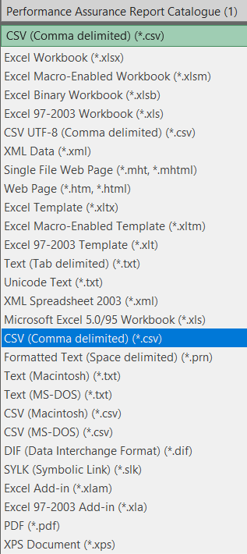
RIG Action: RECRIG_24_0510_13_01
Comma Delimited files
At the May RIG meeting, a member raised the issue they have been facing with uploading .csv files as part of their data submissions. Part of the issue raised was the confusion around the type of .csv file to use and suggestion of using an alternate file like .xlsx (Excel files).
Having considered this issue, we believe the continued use of .csv is beneficial to both Parties and the Code Manager in automating the data ingestion, analysis and interpretation of industry data.
Which filetype to use when using 'save as' in excel.
While there are many types of delimited files that can be created, Parties should only use Comma Delimited (csv extension) or pipe delimited (with txt extension) options when creating files as per the PARC requirements and in line with guidance on the File Validation Wiki page of the REC Portal
Many of the issues we’ve seen that cause files to be rejected are the result of conversion from an Excel file format to a .csv or .txt file. Excel performs a level of autoformatting, which can result in issues such as MPxNs being converted to scientific number format or additional blank columns and/or rows being added.
The best way to avoid this is to avoid using Excel entirely, exporting data directly from your system or database to a .csv or .txt file. However, if that’s not possible, we recommend formatting the MPxN field to numeric format and removing the decimal points before conversion. We also recommend reviewing your file in a text editor (e.g. Notepad or Notepad++) post conversion, to correct any unhelpful autoformatting that has occurred.

Slide 7
3. Performance Assurance quarterly update
Rec performance assurance team

Slide 8
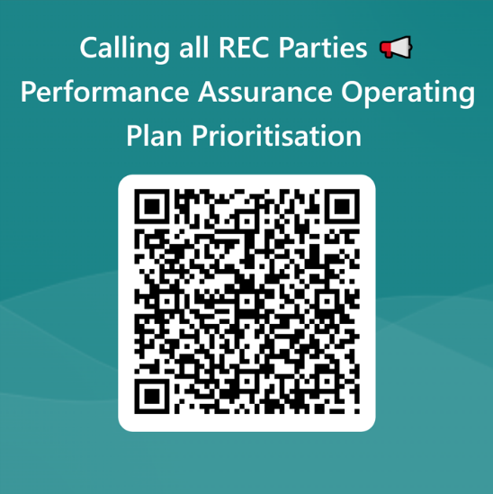
Performance assurance operating Plan
Lastly, thanks to all who joined us and had their say at the Performance Assurance webinar the other week! It was great to hear directly from so many of you where you think we should prioritise and why. If you didn’t manage to attend our Performance Assurance Webinar you can still have your voice heard by filling in the survey
Please complete and return by COP 14 June 2024. If you have any questions, please do reach out to enquiries@recmanger.co.uk and we are happy to help. Thank you in advance for spending the time to complete this form, we really do appreciate it!

Slide 9
4. Data cleanse sprint 2 mid review
REC performance assurance team

Slide 10
Data cleanse sprint next steps
Category | Next Steps
1 | The progress made will be acknowledged and a reminder of the overall timescales provided as a reminder.
2 | We will notify parties of their progress by email and highlight areas where they may not be on track. we will hold an optional 'drop in' session that will be targeted for these parties to provide an opportunity to discuss any blockers and engage with the code manager (note this session will be open to any party). This session will also allow parties to provide feedback and help us understand how we can improve future sprints.
3 | Working with the OAMs we will seek specific information from the party to confirm: is the party aware of the sprint? if they were aware, we would like to understand the reasons for their slow progress? if they were not aware, is there something we can improve in how we communicate to improve their engagement whilst understanding reasons for their low level of engagement? We will also offer these parties the opportunity to join the mid-sprint drop-in session.

Slide 11
5. data cleanse update
REC performance assurance team

Slide 12
6. r0121 – sdep review improvements (1) Process types
Rec technical services team

Slide 13
R0121 brings several new query types into the Secure Data Exchange Portal (SDEP). There are several elements to implementation that parties may or should engage with.
Review of guidance – C3-0083
Setting user permissions
Preparing for implementation
SDEP User Guide has been fully reviewed by C&C and Code Manager
Additional information to be included describing best practice and/or obligated use of all existing and new Process Types
User input sought via consultation on Category 3 change C3-0083
Document live in August with R0121 release [with pre-release version if possible]
One-off exercise with MAUs facilitated in June/July for parties to nominate users and permissions for new Process Types – 7 June to 8 July
Information about best practice and/or obligated use of all new Process Types provided to support identification of individuals
Permissions will be loaded into SDEP for the August R0121 release
Normal method for permissions available now for existing PTs and after August for new PTs
Presentation issued that parties can use in internal training covering general use of SDEP, top tips etc
Information about best practice and/or obligated use of all new Process Types to support amending/creating processes
Normal method for permissions available now for existing PTs
Any questions to enquiries@recmanager.co.uk

Slide 14
introduction
R0121 introducing new Process Types
Review of SDEP User Guide (Category 3 document) alongside R0121
C3-0083 consultation in May – 1 response
Response raised some questions to be discussed

Slide 15
1. Contract Manager General Query
?
We proposed as guidance:
For queries or other secure communications against any processes within the REC arrangements that don’t have a specific Process Type or the relevant Process Type does not have an escalation level (i.e. is a General Query).
Contract Manager General Queries (CMGQ) should not be raised where there is an escalation Process Type available;
Nor should they be raised routinely, rather, where there are exceptional circumstances to avoid excessive numbers of queries obscuring material issues.
If you are raising a CMGQ in relation to another SDEP communication, you must include (clearly indicated) the unique reference of all relevant communications in the message field or an attachment so the recipient can identify all queries.
Escalation PTs, final level, goes to Contract Manager, therefore, it’s a duplication to raise a separate CMGQ – but does it elicit a better response?
Key is to get the queries resolved quickly and efficiently.
If a CMGQ is raised about another unresolved SDEP query, is it preferable to keep both open until resolution, or close the CMGQ once acknowledged?
If there are regular queries that need to be raised, better to have a distinct PT, rather than funnel through Contract Manager?
CMGQs should be used for more material issues?

Slide 16
2. Disputed meter read
?
General Query (Elec) we proposed as guidance:
One general use case, for any query or exchange of consumer data between electricity Suppliers related to Disputed Reads.
Should we specify that the D0300 - Disputed Readings or Missing Readings on Change of Supplier, should have been sent first?
Escalation (Gas) we proposed as guidance:
One general use case, for missed SLAs or incomplete or inaccurate data sent during the processes set out in the interface table for Switch Meter Reading Problems.
One specific use case, if the Switch Meter Reading is not accepted under the UNC.
Need a pointer to the UNC section/document containing the process?
If yes, which is the best reference?

Slide 17
3. Erroneous transfer – general query
?
Gas / Elec - we proposed as guidance:
One general use case for any query or exchange of consumer data between electricity Suppliers related to Erroneous Switches.
One specific use case, for confirmation of resolution of Erroneous Switches involving more than two Suppliers.
Guidance should specify that PT should only be used once ET has been initiated; not as a check if an ET would be accepted / rejected.
Purpose is for additional info or confirmation of complaint.

Slide 18
4. Logical disconnections
?
General Query (Elec) we proposed as guidance:
On specific use case, in Schedule 27 RMP Lifecycle. During termination of an RMP, If the Electricity Supplier believes the Metering Point should not be logically disconnected, a query should be raised with the relevant DNO
SDEP usage is referenced in clause 4.1.8 of Schedule 27 already, where the Electricity Supplier believes the Metering Point should not be disconnected; we added reference to existing PTs PT0042 (logical disconnection) and PT0026 (physical disconnection) to clarify which to use.
Is PT0042 and/or PT0026 also (or instead) used for duplicate RMPs (CFSB Schedule)?
PT0042 and PT0026 have a Supplier to Supplier variant
Any scenarios where Suppliers contact each other about logical / physical disconnections?
E.g. related MPANs or import/export sites?

Slide 19
5. Smart meter comms issues
?
We proposed as guidance:
One specific use case, where more than one electricity Suppliers are responsible for import and/or export for the same Smart Metering System, any of the Suppliers may raise queries about the functioning of communications equipment with the other Supplier(s).
The specific use case is that there is more than one Supplier responsible for a smart meter, and there is an issue with the comms that needs to be discussed.
Is the guidance clear enough?

Slide 20
6. Data error resolution
?
PT0063 MPAS Data Error Resolution
We proposed as guidance:
Three specific use cases, see Schedule 28 Related Metering Points:
A) where resolution of an erroneous Related Metering Point relationship requires communication with the DNO
B) where a DNO identifies that Metering Points have not been related as they should, the DNO shall inform the Registered Supplier including the rationale
C) for Half Hourly Metering Points, where a DNO makes changes which result in the Metering Points needing to be related, the DNO shall inform the Registered Supplier, including the rationale.
PT0064 Supplier Data Error Resolution
We proposed as guidance:
One specific use case, see Schedule 28 Related Metering Points:
A) where resolution of an erroneous Related Metering Point relationship requires communication between Electricity Suppliers.
Schedule 28 requires use of SDEP as per A), B) and C) on the left.
We identified PT0063 and PT0064 as the PTs to use for these scenarios.
Comment made in previous RIG that PT0063 and PT0064 are used by (i)DNOs to flag to Suppliers where PC is wrong and conflicts with the LLFC, and needs changing. Or LLFC needs changing
Is this right?
PTs are about related metering points only or wider?
Please clarify use cases.
Where should they be cited?

Slide 21
7. R0169 – Introduction of Gate closure notifications
Rec professional services team

Slide 22
introduction
Summary
Introduces additional functionality within the Central Switching Service (CSS).
Notifies CSS users when CSS completes processing gate closure messages.
Enables downstream processing for CSS users.
EoGC notification is valuable for parties with post-gate closure obligations but available for all CSS users.
Problem
Gate closure events establish changes of supplier and new registrations.
Initiated at 5pm, CSS sends securedActive and securedInactive messages.
CSS Users (e.g., ERDA, GRDA) must complete onward processing of registration info.
Downstream processing needed to support MHHS program and complete agent appointments (SMDRs).
CSS Users currently must assume gate closure completion to initiate downstream processing.
Introduction

Slide 23
Solution
Creation of a dedicated End-of-Gate-Closure (EoGC) message for two use case as follows:
A party specific notification
A generic broadcast notification
EoGC (PS) Notification
ERDA
2. EoGC (B) Notification
CSS
GRDA
CSS
Any CSS User
DSP
(If subscribed)
Both the EoGC (PS) and EoGC (B) messages will enter the standard retry protocol if delivery fails (short retry and, if still unsuccessful, long retry).
EoGC messages do NOT redefine Gate Closure as per current REC drafting.
Solution

Slide 24
Party Specific Notification
The EoGC (PS) message to each party will include a count of the total number of unique securedActive and securedInactive messages (e.g., per registrationID) sent during the gate closure for that party:
This count will only include the first delivery attempt of each securedActive and securedInactive message
Message retries are not included in the count
The count will exclude the EoGC (PS) message itself
The EoGC (PS) message will be sent to each party as soon as possible following the last message securedActive or securedInactive message to that party.
EoGC (PS) messages are sent (1st attempt) prior to sending of an EoGC(B) broadcast message.
EoGC (PS) Notification
ERDA
CSS
GRDA
DSP
PS Notification

Slide 25
Broadcast Notification
The generic broadcast EoGC(B) message will be optional, where all CSS users will be able to register a webhook for the receipt of this message.
The EoGC(B) message will be sent to all subscribers, notifying that all securedActive and SecuredInactive messages have been sent for the current Gate Closure.
An EoGC(B) subscribed CSS Users will be able to subscribe / un-subscribe from this service at any time.
The message will not contain any volumetric or party-specific information (e.g., message counts).
EoGC (B) Notification
CSS
Any CSS User
B Notification

Slide 26
discussion
Subscribing to the broadcast message is optional for all CSS Users, we have engaged with GRDA, ERDA and DSP to understand the value of the Party-Specific message and now we are looking to understand the following:
  Is there an appetite to subscribe to this message from CSS Users?
  If so, what value does this bring to users?
EoGC (B) Notification
CSS
Any CSS User
B Notification

Slide 27
8. supplier appointments to inactive mems
Rec professional services team

Slide 28

Supplier appointments to inactive mems
In November 2023, it was identified that an MPID (related to a MEM) was closed with appointments still in place.
This issue was resolved but the associated investigation identified further MPIDs that were live but the MEM organisation was no longer operating in the market.
REC Performance Assurance Team worked with those Supplier Parties appointed to the MPIDs and arrange for them to be closed.
REC Schedule 14
  2.2 - Where Energy Suppliers are required to Appoint a Metering Equipment Manager, the Energy Suppliers shall issue Appointment requests for their Metering Equipment Manager(s) within a timescale sufficient to ensure that the Metering Equipment Manager is Appointed by the Supply Effective From Date.
  2.3 - Where Energy Suppliers are required to Appoint a Metering Equipment Manager, they shall ensure that the Metering Equipment Manager is Qualified in accordance with the Qualification and Maintenance Schedule.

Slide 29
Supplier appointments to inactive mems
Activity reported to PAB, who have asked what can be done to prevent this in future.
REC contains processes that consider voluntary withdrawal of MEMs;
  How do Suppliers know that a MEM has exited the market?
  If the REC were able to provide a report to Suppliers on MOP appointments for data cleanse type activities – what frequencies would be most useful?

Slide 30
9. aob
all

Slide 31
Next meeting:
12 July 2024
Thanks for attending

