Slide 1
REC ISSues group
12 July 2024

Slide 2
1. Introduction and agreement of agenda
Shelley rouse

Slide 3
Agenda For today
 | TITLE | TIME | LEAD
1 | Introductions and Agreement of Agenda | 10:00 | Chair
2 | Actions Log | 10:05 | Chair
3 | Gas Unregistered Sites | 10:20 | RECCO
4 | Annual Ratings | 10:35 | REC Performance Assurance Team
5 | Risk Register Update | 10:50 | REC Performance Assurance Team
6 | Data Cleanse Report Configuration | 11:05 | REC Performance Assurance Team
7 | Data Cleanse Sprint 3 Scoping | 11:20 | REC Performance Assurance Team
8 | Data Cleanse Update | 11:35 | REC Performance Assurance Team
9 | Theft Detection Incentive Scheme 23/24 – End of Year Actions | 11:50 | REC Performance Assurance Team
10 | AOB | 12:05 | All
11 | Close | 12:30 | Chair

Slide 4
2. Actions log
Chair

Slide 5
Actions log
ACTION REF. | ACTION | OWNER(S) | UPDATE | STATUS
RECRIG_24_0614_03_01 | The Code Manager to provide an update on the PAOP engagement plan at the next RIG. | REC Performance Assurance Team | An update will be provided at the RIG meeting on 12 July 2024. | Open
RECRIG_24_0614_04_01 | The Code Manager to investigate whether the scenario of a Supplier receiving a rejection when trying to de-energise a meter which is already showing as disconnected is documented under the REC. | REC Performance Assurance Team | An update will be provided at the RIG meeting on 12 July 2024. | Open
RECRIG_24_0614_06_01 | The Code Manager to re-issue the communication to REC Contract Managers, including the template for setting up the SDEP user permissions. | REC Professional Services Team | The communication was re-issued to REC Contract Managers on 14 June. This action will be formally closed at the RIG meeting on 12 July 2024. | Open
RECRIG_24_0614_06_02 | The Code Manager to confirm whether the guidance is proposing the CMGQ not to be used going forward. | REC Technical Services Team | An update will be provided at the RIG meeting on 12 July 2024. | Open

Slide 6
Action : RECRIG_24_0614_04_01
De-energisation of disconnected meter
At the June RIG meeting, a member raised the issue they have been facing with de-energising a disconnected meter. A request was made to where this is referenced to support resolving this issue.
Whilst the code does not directly reference the scenario discussed, Schedule 14 – Metering Operations sections 15.6 and 15.8 describe the process to be followed for de-energisation of either a Half Hourly or Non Half Hourly metering asset.
Discussion points:
Given the ambiguity of the process to follow, how should this issue be resolved?
What previous experience do RIG members have in correcting data for this scenario?
Does further action need to be taken to raise this as an issue for the REC Change Issues Group?

Slide 7
3. gas unregistered sites
recco

Slide 8

Unregistered sites
Issue:
GT informed REC PAB that CDSP data suggests c. 85,000 unregistered gas sites (see next slide)
Contributes to Unidentified Gas (UIG) – cost of gas socialised across all Shippers
  A non-technical loss that may be distorting estimates of gas theft
Customers face the following issues resulting in poor customer journeys and relations with the gas industry
  No contracts with a Supplier / Suppliers unwilling to take on customers
  No meter works (safety issue)
  Likely impact on consumers requiring access to priority services
No clear process for resolution for GT and Suppliers.
Opportunities:
Current review of Schedule 8 (Unbilled Energy CoP) – do industry procedures need to be strengthened to address unregistered/shipper-less sites
R0162 proposes to grant GTs access to SDES – will this facilitate better communication and issue resolution
Remind Suppliers/offer guidance of licence obligation to offer terms to Domestic Consumers
Direct REC PAB oversight of resolution
Questions for RIG:
What currently prevents Suppliers from wanting to take on an unregistered customer?
Should CDSP reporting on unregistered/shipperless sites be submitted to REC PAB to push for resolution (alongside/instead of UNC PAC)?
Are the root cause of shipperless/unregistered sites still those reported in 2011
Do comparable problems exist in electricity or are there lessons to be learnt?
Should existing unregistered/shipper volumes be subject to a targeted data cleansing and resolution exercise?
What role (of any) should the REC play in resolving unregistered/shipperless sites?

Slide 9
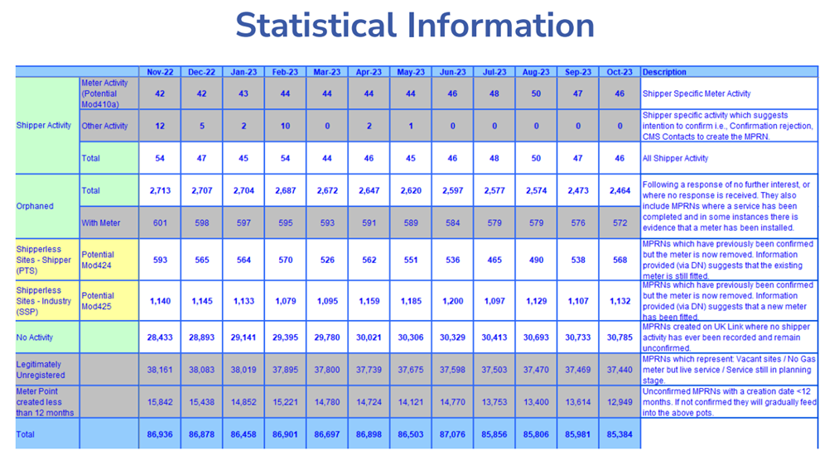
Unregistered sites
Source: Xoserve – Shipperless and Unregistered Workgroup, Nov 2023

Slide 10
4. Annual ratings
Rec performance assurance team

Slide 11
Annual Rating
Next Steps 1
Based on PAB approval, we will engage with the Contract Managers of Energy Suppliers and DNOs via the REC Weekly bulletin to highlight that their Annual Rating score will be available for them to view via their PA Dashboard.
We will allow Parties to provide feedback or ask queries around their Annual Rating score for a month.
The Code Manager will publish the Annual Rating unanonymised based on the communication plan previously approved by PAB.

Slide 12
5. risk register update
REC performance assurance team

Slide 13
Risk Register Update
We would like to discuss:
Are there other risks to the REC objectives that we have not identified?
Do you support the improvements to presentation of the risk register identified within Appendix A?
Are there other measures of performance that we would need to identify to better assess the Performance of the REC?

Slide 14
6. data cleanse report categorisation
REC performance assurance team

Slide 15
Data Cleanse report categorisation
At its June meeting the PAB approved an update to the methodology for Data Cleanse activity and how the Code Manager will track specified reports with different approaches based on the assessment of risk relating to the data items. Any changes to this grouping will be agreed with the PAB. The grouping for Sprint 2 are shown below:
Approach | Description | Reports
Sprint | We set data cleanse targets, approved by the PAB, for Parties to deliver. If these targets are not met by an individual Party we apply relevant PATs, agreeing the approach with PAB as appropriate. A sprint approach is followed in order to focus effort across the market on prioritised issues and to manage the risk of such issues being transferred on switching. | Energised No Meter Invalid Electricity MAP ID
Track | We share these data cleanse reports with Parties, and these should be addressed in line with the published data cleanse guidelines where possible. These reports may form part of future sprints depending on market activity, performance and priorities. We are unlikely to apply PATs in respect of these reports but if performance dramatically changes, we may engage with relevant Parties to understand more. | 3A Unflagged Unrestricted SSC/Active Relationship Flag Report AR3A – All MTC's in Unrelated Range Report AR3C – Unrestricted SSC/Active Relationship Flag Report AR3E – Active Relationship/ Postcode Mismatch Invalid Topline Meter Type Mismatch No Meter MTC Energised, No Meter - Terminated Plot Addresses Smart Meter Type/MTC Mismatch
Watching Brief | We continue to run these reports and share them with Parties but are not actively considering them. This is most commonly used where reasonable efforts to cleanse data have been taken and there is a low residual level of items in these reports, but we want to be alerted if an event in the market causes a significant resurgence of issues. We do not expect Parties to actively cleanse these (and would expect in most cases cleansing has previously been attempted whilst such reports were considered under a sprint) but do expect day to day operational processes to continue. | 3B 4A 5B 6A 6B Report AR3B – Split Supply Report AR3D – Disconnected Metering Points/ Active Relationship

Slide 16
7. data cleanse sprint 3 scoping
Rec Performance Assurance Team

Slide 17
Data Cleanse Sprint 3 - Proposal
We propose to launch a third 6-month sprint in October 2024, following PAB approval of the selected reports and targets.
We will formally communicate the reports and targets in September, at the RIG and via a direct communication to Contract Managers and Alternates. We would like to get input via RIG on potential focus reports:
Report | Proposed Target | Rationale
New MTD items (ESME ID, Meter Location, Number of Register Digits) | TBC depending on initial analysis | Identified as a priority cleanse area by the MHHS programme to improve MTD accuracy ahead of migration.​ Potential to focus on completeness or apply rules to identify potential inconsistencies (e.g. between ESME ID and Meter Type) Subject to alignment with MHHS Programme activities
Invalid Topline (invalid combination due to SSC or PC) | Reduction of pot value to zero | Higher volume report not yet subject to Sprint process Propose focussing on those items that will remain in topline post R0083 Appreciate comments on LLFC given linkage with DUoS Tariff ID
CDSP Metering Parties reconciliation inconsistencies in Model, Manufacturer and MSN | TBC depending on analysis of current reconciliation | Improve MTD accuracy within Gas
Whilst good progress has been made by many suppliers on the Energised no MSN cleanse in sprint 2, further action will be required in sprint 3 if suppliers do not meet target.
A requirement for data cleanse of the Domestic Premise Indicator has been identified, at this time the timeline for obtaining the required data is not confirmed. If possible this will be included in the sprint, but this is subject the data availability in sufficient time for report development.

Slide 18
8. data cleanse update
Rec performance assurance team

Slide 19
9. Energy theft detection incentive scheme 23/24 –end of year actions
Rec performance assurance team

Slide 20
Theft Detection Incentive Scheme 2023/24 End of Year action
The following message was sent to all Contract Managers and Alternates directly this week but is repeated here for visibility.
The confirmed theft figures for Theft Year 2023/24 have been published on the PA Dashboard since 18 June.
The deadline of 18 July is approaching to take action and either:
  Review your confirmed thefts and provide a positive confirmation they are correct by emailing enquiries@recmanager.co.uk
  Review your confirmed thefts and raise a query by emailing enquiries@recmanager.co.uk
There will not be another opportunity to positively confirm or query your confirmed thefts following the deadline.
Following the deadline all confirmed theft figures will be used for Debit/Credit calculations which will be published on the PA Dashboard by 22 August.
Additional information on timelines can be found in the Theft Detection Incentive Scheme (TDIS) Reporting Timeframe.

Slide 21
10. aob
all

Slide 22
10a. r0121 – SDEP review improvements (1) – Process Types
REC technical services team

Slide 23
10b. Terms of reference for the rig
REC professional services team

Slide 24
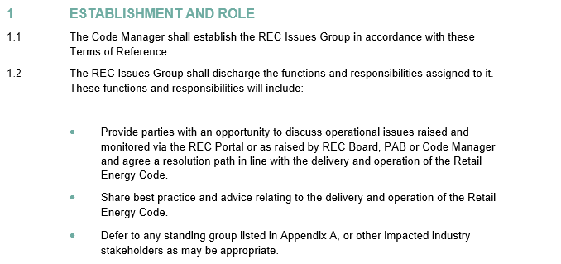

Update to RIG ToR

Slide 25
Next meeting:
09 August 2024
Thanks for attending

